Slide 1
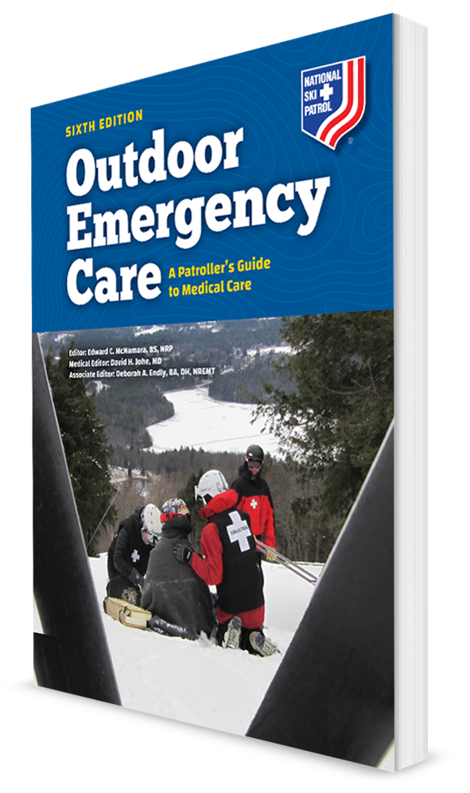
Substance Abuse and Poisoning
CHAPTER 12

Slide 2
The following presentation will utilize two symbols to identify material necessary for an OEC Technician to comprehend:
key term
Meets a Chapter Objective.
This symbol will have the corresponding Objective Number denoted within.
Identifies a Key Term.
The Key Term will be underlined for easy identification.

Slide 3
Objectives
12-1 List and describe the four ways a drug enters and moves through the body.
12-2 List the four routes of absorption.
12-3 List and describe several commonly abused substances.
12-4 List the signs and symptoms associated with commonly abused substances and with common poisonings.
12-5 Describe and demonstrate the proper care of a patient who has abused a substance or been poisoned.
12-6 List and describe two emergency sources for poison-related or chemical-related information.
12-7 Define SLUDGEM and DUMBELS in the context of poisoning.

Slide 4
Key Terms
Absorption
Dermal poison
Designer drug
Ingested poison
Inhaled poison
Injected poison
Opioid
Poison
Substance abuse
Toxicological event
Toxin
Withdrawal

Slide 5
Chapter Overview

Slide 6
Chapter Overview
Depending on the substance involved, an exposure may be accidental or intentional.
The effects can vary greatly.
Can range from being:
Medically therapeutic to
Producing minor distortions in perception and coordination to
Becoming immediately life threatening
One of the chief dangers is their false sense of reality and disturbed behavior and judgment.
Sometimes the effects of the substance can mask or mimic other medical and psychological conditions.

Slide 7
Anatomy and Physiology

Slide 8
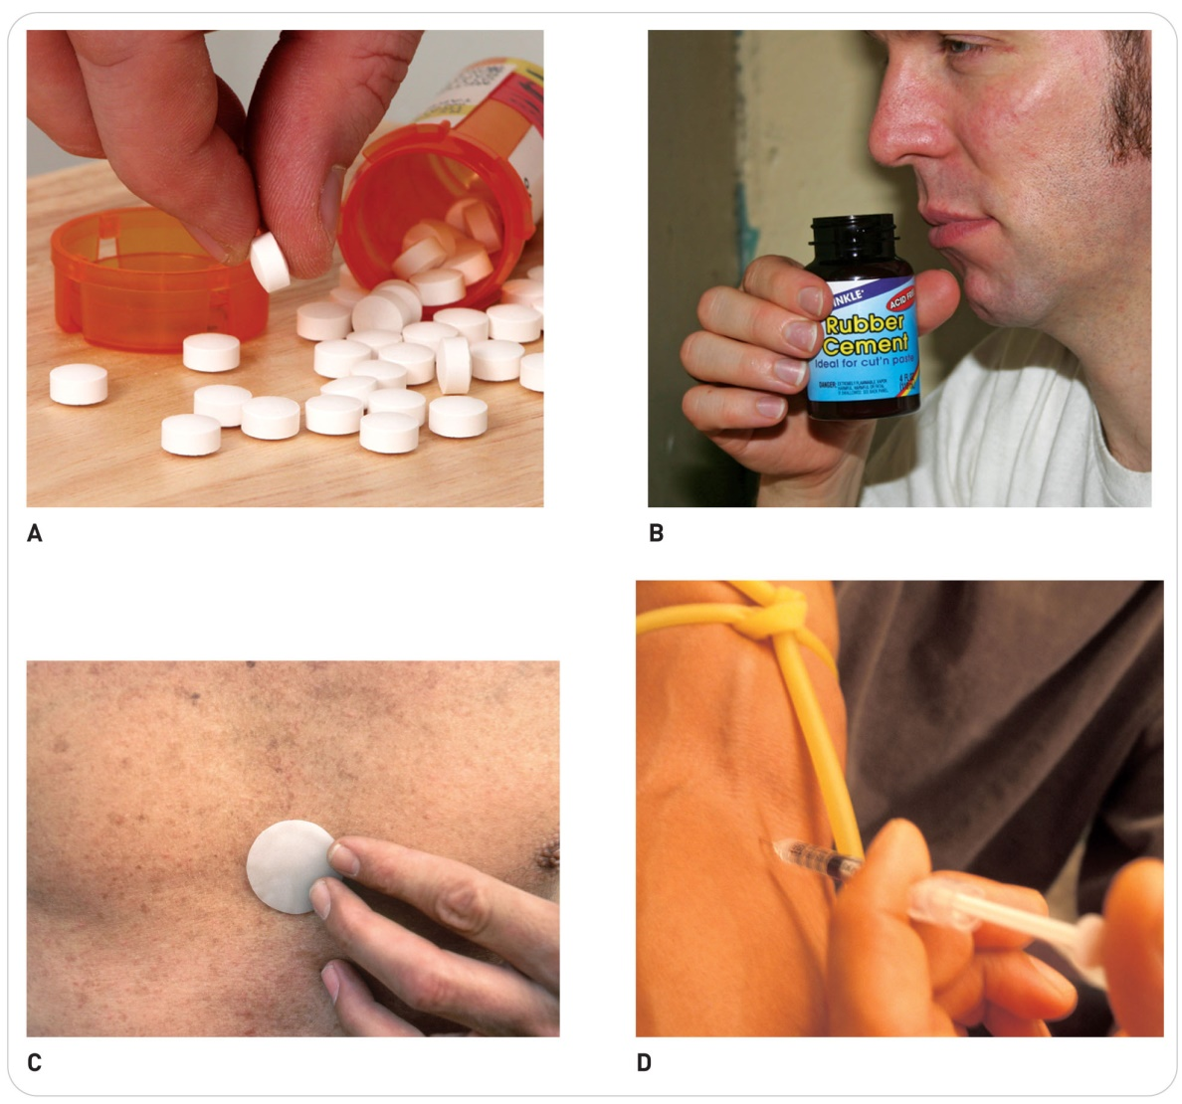
Anatomy and Physiology
12-1
Physiological actions:
Substances enter, affect, and exit the body through four physiological actions:
Absorption
Distribution
Metabolism
Elimination

Slide 9
Anatomy and Physiology: Absorption
12-2
Absorption is the way in which a substance or poison enters the body.
The four routes of absorption are:
Ingestion
Inhalation
Transdermal absorption
Injection
Ingestion
Involves the:
Intake of a substance through the mouth
Absorption through the gastrointestinal tract

Slide 10
Absorption: Ingestion
12-2
Locations of absorption:
Mucous membranes of the mouth
Stomach
Delicate mucosa lining the mouth, esophagus, and stomach may be damaged by contact with the substance.
The substance mixes with the stomach contents, which may slow the rate of absorption.
Little (if any) absorption occurs in the stomach.
Intestines
Most absorption occurs within the small and sometimes the large intestines.
If the stomach is empty, the substance rapidly enters the intestines, which can quicken the rate of absorption.

Slide 11
Absorption: Ingestion
12-2
Substances that are not absorbed are excreted from the body.
Pills and liquids are commonly absorbed following ingestion.
Some medications are extended release.

Slide 12
Absorption: Inhalation
12-2
Inhalation is absorption through the lungs.
Capable of absorbing many substances, including nicotine, carbon monoxide, and other gases
Some substances are highly corrosive.
When inhaled can damage the delicate lung tissue, causing swelling and bleeding
Other inhaled substances can travel through the bloodstream and affect other organs or body systems.
Can cause excess fluid buildup in the lungs, inflammation, or even heart failure
Substances in smoke from marijuana and tobacco and other gaseous substances are absorbed through the lungs.

Slide 13
Absorption: Transdermal
12-2
Transdermal absorption occurs through the skin.
Skin is highly vascular and can absorb a variety of substances.
Prescription medications administered transdermally may be worn as patches that contain scopolamine, nitroglycerin, or opioids, for example.

Slide 14
Absorption: Injection
12-2
Injection involves the use of a hypodermic needle or other sharp object to place a substance into the body’s tissues, including:
Beneath the skin
Into underlying fat or muscle
Directly into the bloodstream
Injectable medications are given this way, or a stinger from a bee or a fang bite from a snake could inject toxic material into the body.

Slide 15
Anatomy and Physiology: Distribution
12-1
Distribution
Once a substance is absorbed, it is transported to the site where it exerts its effects, a process known as distribution.
Depending on the substance, the effects may be:
Isolated to a single organ system OR
Systemic, affecting the entire body
Examples:
An overdose of acetaminophen, for example, may cause an isolated effect on the liver and can result in liver failure.
An overdose of heroin has widespread, systemic effects by depressing the central nervous system, which can lead to respiratory failure, loss of airway, and potentially cardiovascular collapse.

Slide 16
Anatomy and Physiology: Distribution
12-1
Distribution is affected by several factors.
Once the substance is in the bloodstream, it will enter the entire circulatory system quite rapidly.
Certain body systems have barriers that either limit or prevent distribution to them.
Example: the blood–brain barrier
Limits the types and amounts of substances in the blood that can cross into the brain

Slide 17
Anatomy and Physiology: Metabolism
12-1
Metabolism
Metabolism is the process by which the body breaks down a substance.
Primary site of metabolism is the liver.
If the liver is diseased or injured, the time required for metabolism may be prolonged.
Substances not completely broken down initially by liver
Recirculated through the liver, where further breakdown occurs through repeated metabolism
Some benign substances are converted in the body into ones that can harm the body.

Slide 18
Anatomy and Physiology: Elimination
12-1
Elimination
Elimination is a process by which the body purges itself of a substance through the:
Urine
The gastrointestinal tract
The lungs
And/or the skin in sweat
Anything that impairs the proper functioning of these organ systems can reduce the rate of elimination.

Slide 19
Commonly Abused Substances and Poison Related Emergencies

Slide 20
Substance Abuse
12-3
Substance abuse
The intentional misuse of a substance that results in impairment or physical harm
Teenagers and young adults particularly at risk
Exposure at parties and social events often leads to the binge abuse.
Addictive dependence on substances can occur in individuals in ANY age group.

Slide 21
Addiction
12-3
Addiction
A true medical/psychiatric illness
When an individual’s body craves the substance and when the absence of the substance results in some type of physical impairment due to withdrawal
Withdrawal is the physical and mental readjustment that accompanies the discontinued use of an addictive substance.

Slide 22
Substance Abuse and Poison
Drugs that are approved by the US Food and Drug Administration have legitimate medical uses when taken as directed.
These same drugs, however, can have toxic effects if misused or abused.
Overdose may occur when a person takes a larger dose of a drug than is safe.
Line between therapeutic benefit and toxic effect is a narrow one.

Slide 23
Substance Abuse: Poison and Toxin
Poisoning is a significant toxicological event that results in an injury, illness, or death following exposure to a harmful substance.
Poison is a substance that causes harmful effects when introduced into the body.
A toxicological event is when a patient has been exposed to a harmful substance or an incident in which the intentional or unintentional use of a substance or poison endangers public safety and/or results in a medical emergency.
Toxin is a poison that comes from a living organism.
Overdoses and poisonings can be accidental or intentional.
Idiosyncratic reaction is when a substance has an unexpected and harmful effect unique to a specific person.

Slide 24
Chief Categories of Poisons and Substance Abuse

Slide 25
Substance Abuse and Poison-Related Emergencies
Poisons may be absorbed into the body through the same routes as any other substance.
Understanding how a substance becomes poisonous will:
Help you protect yourself and others from harmful exposures
Help you understand the physiological processes that a poisoned patient is experiencing
May encounter:
Ingested poisons, harmful substances that enter the body through the mouth
Inhaled poisons, harmful substances that are absorbed through the lungs
Injected poisons, harmful substances that are injected into a vein or another tissue
Dermal poisons, harmful substances that are absorbed through the skin

Slide 26
Categories: Acids and Bases
12-3
12-4
The chief categories of poisons and substances of abuse:
Acids and bases are substances that are commonly used in the household for a variety of purposes, such as in cleaning solutions.
Can cause direct tissue damage
Especially to the respiratory tract and the delicate mucosa of the mouth and gastrointestinal tract

Slide 27
Categories: Antianxiety Drugs
12-3
12-4
Antianxiety drugs are drugs that help relieve patients of anxious feelings.
Commonly prescribed for people with excessive emotions, panic disorders, or social disorders
Examples of these drugs include:
Diazepam (Valium)
Alprazolam (Xanax)
Lorazepam (Ativan)

Slide 28
Categories: Antidepressants
12-3
12-4
Antidepressants are medicines used to treat depression.
Older antidepressants, known as tricyclics, are particularly toxic to the heart.
Example of a commonly prescribed tricyclic antidepressant is amitriptyline (Elavil).
Some newer antidepressants also are used to treat anxiety and panic.
Although newer drugs may be safer, overdose can lead to:
Heart arrhythmias
Problems with perfusion
Alterations in mental status
Seizures
Examples of newer antidepressants include sertraline (Zoloft) and fluoxetine (Prozac).

Slide 29
Categories: Antipsychotics
12-3
12-4
Antipsychotics (tranquilizers) are used to treat psychoses (i.e., thought disorders).
Overdose can cause:
Low blood pressure
Disruption in the heart’s conduction system, causing an irregular heartbeat
Both overdoses and normal doses can cause dystonic reactions.
Abnormal muscle tone, especially in the neck, and facial movements
Examples of these drugs include haloperidol (Haldol) and chlorpromazine (Thorazine).

Slide 30
Categories: Depressants
12-3
12-4
Depressants are a class of drugs that decrease CNS activity.
Common depressants include alcohol, tranquilizers, opioids, antipsychotics, and antianxiety drugs.
When used in combination, these drugs have increased toxicity and can cause:
Excessive sedation
Respiratory depression
Death

Slide 31
Categories: Designer Drugs
12-3
12-4
Designer drugs (club drugs) are often used by teenagers and young adults.
May impair brain function, causing seizures and coma
When combined with alcohol, can cause profound sedation and amnesia
Overdose can cause nausea and vomiting, respiratory difficulties, seizures, coma, and death.
Some of these substances are made illegally, whereas others are prescription medications.
Examples include:
Ecstasy (MDMA), GHB, flunitrazepam (Rohypnol; a date rape drug), and “bath salts”

Slide 32
Categories: Hallucinogens
12-3
12-4
Hallucinogens are drugs that distort sensory perceptions and impair emotion, judgment, and memory.
Their chief danger lies in the loss of judgment by users.
Uncontrolled agitation and paranoia
Examples of these drugs include:
LSD
PCP
Prescription ketamine (special K)
Peyote, a plant toxin

Slide 33
Categories: Inhalants
12-3
12-4
Inhalants are the chemical vapors from common household products.
Includes cleaning solvents, aerosols, spray paints, commercial adhesives, model glue, and freon
Can produce mind-altering effects like those of alcohol intoxication
Overdose can lead to:
Loss of sensation
Unresponsiveness
Shock
Respiratory distress
Even death
Long-term effects can include permanent brain, lung, or heart damage.

Slide 34
Categories: Nerve Agents
12-3
12-4
Nerve agents constitute a special class of chemicals used in warfare and acts of terrorism.
These substances interrupt nerve impulses in the body, which can lead to profound shock, seizures, respiratory distress, and death.
Poisoning typically occurs through inhalation or transdermal absorption.
Examples of these agents include sarin, soman, tabun, and VX.

Slide 35
Categories: Opioids
12-3
12-4
Opioids are drugs derived from opium or opium-like compounds.
Opioids are medically used to relieve pain; however, they can affect mood and emotion.
Term opioids refers to synthetically designed drugs such as fentanyl.
Term opiates refers to drugs derived naturally from the opium poppy plant such as morphine.
Most medications administered by providers, and increasingly more drugs misused by patients, are opioids.

Slide 36
Categories: Opioids
12-3
12-4
Opioids and opiates affect the CNS:
Causing a surge of euphoria
Then alternating wakefulness and drowsiness with impairment of mental functioning
Overdose can cause significant respiratory depression and death.
Examples of common prescription opioids are morphine, oxycodone, acetaminophen and hydrocodone, hydromorphone, fentanyl, and meperidine.
Heroin is an illegal opiate.

Slide 37
Categories: Organophosphates
12-3
12-4
Organophosphates are chemicals used in insecticides, pesticides, and herbicides.
Commonly found in household and commercial settings
The potential for many individuals to be simultaneously exposed is great.
Poisoning most often occurs through inhalation, transdermal absorption, and ingestion.
Effects of organophosphate poisoning are like those caused by nerve agents.

Slide 38
Categories: Over-the-Counter Medications
12-3
12-4
Over-the-counter medications are not considered dangerous by many people because they are not prescribed by a physician.
Overdose or improper use, however, may have harmful side effects.
Several have become common drugs of abuse by some adolescents.
Cough medicines are most commonly abused by adolescents.
The ingredient used for nasal congestion and cough suppression, when taken in overdose, can cause hallucinations.
Can also cause seizures, arrhythmias, hyperpyrexia, and central nervous system depression

Slide 39
Categories: Prescription Drugs
12-3
12-4
Prescription drugs
Drugs ordered by a licensed physician
Becoming increasingly misused by individuals of all age groups
Almost all prescription medications have potentially harmful effects if they are misused or not taken as directed.
Many have toxic side effects if taken in excess.

Slide 40
Categories: Prescription Drugs
12-3
12-4
For some medications, the therapeutic dose (prescribed) is very close to the lethal dose.
As examples of medications that must be followed or toxic effects can occur:
Dosages for heart and blood pressure medications
Those used to control seizures
Overdose is often accidental.
Can occur when a person shares a medication with a spouse or other family members
Prescription drug overdose is especially common among elderly patients.

Slide 41
Categories: Sedatives
12-3
12-4
Sedatives are drugs that help people relax.
Examples are phenobarbital, zolpidem, eszopiclone, and other sleep medications.
Overdose and poisoning depress the central nervous system.
Leads to decreased levels of responsiveness and depressed respirations

Slide 42
Categories: Stimulants
12-3
12-4
Stimulants are substances that increase CNS activity.
Overdose:
Speeds up vital body functions
Commonly causes excitement and agitation that can lead to erratic and dangerous behavior
Seizures, hypertension, and stroke
Examples of stimulants include methamphetamine, cocaine, and crack.

Slide 43
Commonly Encountered Substances

Slide 44
Commonly Encountered Substances: Acetaminophen
12-3
12-4
Acetaminophen (Tylenol)
Used to treat pain and help reduce fever
Widely used
A common ingredient in numerous combination medications, such as over-the-counter cold medications
Patient may take plain Tylenol in addition to the combination medication.
Thus ingest too much acetaminophen
Overdose of acetaminophen is among the most common poisonings worldwide and can be life threatening.
In toxic amounts, acetaminophen can cause irreversible liver damage.

Slide 45
Commonly Encountered Substances: Alcohol
12-3
12-4
Alcohol
Ethanol, the form of alcohol found in beverages, is the most commonly abused drug in the world.
Mood-altering, central nervous system depressant
A disproportionate number of motor vehicle, aircraft, and recreational injuries are caused by the abuse of this.
Emergencies are relatively common and can be serious, even life threatening.

Slide 46
Commonly Encountered Substances: Alcohol
12-3
12-4
Wide range of effects and affects nearly every body system
Primarily inhibits CNS activity by slowing brain function, sensory input, and motor coordination
Lowers one’s inhibitions, which can lead to behavioral changes
Can depress the respiratory system, slowing both the rate and the depth of respirations
Also a diuretic, possibly causing dehydration
Can lower blood sugar levels
Enhance the effects of certain medications such as insulin and oral diabetes medications

Slide 47
Commonly Encountered Substances: Alcohol
12-3
12-4
Alcohol poisoning:
Too much alcohol causes one to become severely impaired or even unresponsive.
In severe cases, the person loses the gag reflex, aspirates oral secretions or vomit, and stops breathing.
Patients also can develop seizures or hypothermia.
Alcohol withdrawal
Most commonly, this is seen in people who have been drinking large amounts of alcohol over many years and then abruptly stop.
Such sudden cessation can cause a variety of adverse effects, including:
Muscle tremors, hallucinations, seizures, and even death

Slide 48
Commonly Encountered Substances: Aspirin
12-3
12-4
Aspirin (acetylsalicylic acid)
Used to:
Relieve pain and swelling
Reduce fever
A common ingredient in many combination drugs
Before the widespread use of childproof caps, accidental aspirin overdose was relatively common and resulted in numerous deaths.
Overdose is less common today but is still a very dangerous emergency.
Can cause respiratory depression, profound systemic acidosis, and death

Slide 49
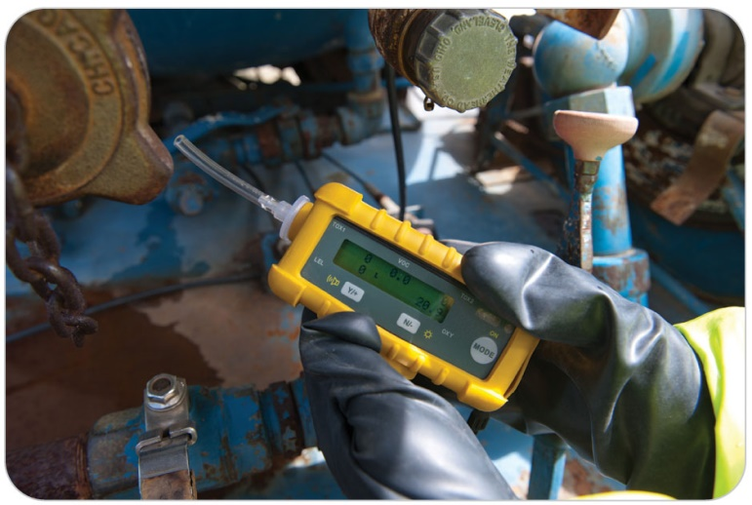
Commonly Encountered Substances: Carbon Monoxide
12-3
12-4
Carbon monoxide
An odorless, colorless, and tasteless gas
A by-product of combustion
Impairs oxygenation of tissues by displacing oxygen molecules on red blood cells
Reduces the amount of oxygen in the blood
Effects of carbon monoxide poisoning range from mild to life threatening.
An extremely common cause of accidental death
In outdoor recreational settings involving:
Stoves
Vehicles
Generators
Fires
Poorly ventilated tents, cabins, campers, and sheds
At high altitudes, the risks are even greater.

Slide 50
Commonly Encountered Substances: Cocaine
12-3
12-4
Cocaine
Commonly referred to as coke, crack, snow, rock, or nose candy
A powerfully addictive drug
Makes the user feel euphoric and energetic
May be inhaled, ingested, injected, or absorbed through the skin or mucosa
Affects the nervous and cardiovascular systems
Constricts peripheral blood vessels and stimulates the CNS
Increases the heart rate, blood pressure, and body temperature
Overtime can cause heart attack, seizure, stroke, and respiratory failure
Sudden death can occur at any time during its use, even upon an individual’s first exposure to it.

Slide 51
Commonly Encountered Substances: Ethylene Glycol
12-3
12-4
Ethylene glycol
Ingestion can cause organ damage, shock, and death.
A component of a variety of household and automotive products

Slide 52
Commonly Encountered Substances: LSD
12-3
12-4
LSD (lysergic acid diethylamide)
Commonly referred to as acid
Effects of this powerful mood-changing drug are unpredictable and vary among individuals
Physical effects include:
Elevated body temperature
Elevated heart rate
Elevated blood pressure
Sleeplessness
Loss of appetite
Large doses can cause delusions and visual hallucinations.

Slide 53
Commonly Encountered Substances: Marijuana
12-3
12-4
Marijuana
Commonly referred to as pot, weed, cannabis, ganja, grass, or Mary Jane
Becoming legalized in a growing number of US states
The active ingredient in marijuana is tetrahydrocannabinol (THC).
Commonly used by individuals both medicinally and recreationally
It is smoked or ingested.
Marijuana distorts perceptions and affects thinking, memory, and learning.

Slide 54
Commonly Encountered Substances: Marijuana
12-3
12-4
Marijuana may be used alongside other drugs, such as alcohol, or mixed directly with other drugs, such as PCP.
Hashish is a form of marijuana that contains a higher concentration of THC.
Commercial “vape” devices contain concentrated THC.
Some vaping products have been found to be harmful to the lungs and may result in death.

Slide 55
Commonly Encountered Substances: Methamphetamine
12-3
12-4
Methamphetamine
Commonly referred to as speed or meth
A powerful stimulant with a high potential for abuse and addiction
The popularity has grown significantly over the past decade.
Methamphetamine produces a heightened state of arousal and physical activity and decreases appetite.
Chronic use can lead to psychotic behavior, hallucinations, and stroke.

Slide 56
Commonly Encountered Substances: Methane
12-3
12-4
Methane
This highly flammable gas displaces oxygen if present in an enclosed space.
In high concentrations, methane can cause profound hypoxia in the body.
Although rare, death can occur.

Slide 57
Commonly Encountered Substances: Opioids
12-3
12-4
Opioids
Addiction to opioids is a national crisis in the United States.
Most who become addicted eventually die.
Fewer than 10% of individuals succeed in stopping this addiction (as reported in 2018).
Opioids include heroin, fentanyl, morphine, codeine, oxycodone, and methadone.
Many people will overdose repeatedly, until death occurs.
Naloxone (Narcan), when given rapidly, will reverse the effects of the overdose initially.

Slide 58
Commonly Encountered Substances: PCP
12-3
12-4
PCP (phencyclidine)
Commonly referred to as angel dust
This veterinary tranquilizer was initially developed for use as an anesthetic in humans.
PCP blocks the perception of pain.
Commonly added to other drugs such as marijuana
Overdose can:
Cause exceptionally violent or suicidal behavior
Increase the user’s risk of serious traumatic injury

Slide 59
Commonly Encountered Substances: Polypharmacy
12-3
12-4
Polypharmacy
Substances are taken in combination.
Can be dangerous because the effects of the combination cannot always be accurately predicted
When the additive effects of polypharmacy produce dangerous effect, the event is known as a multisubstance or polypharmacy overdose.
Common among older patients
Dangerous if they take multiple medications prescribed by different health care providers

Slide 60
Patient Assessment for Substance Abuse and Poisoning

Slide 61
Patient Assessment: Scene Safety
12-5
As for any incident, the very first action is to assess the scene.
Pay careful attention to any potential hazards.
Do not enter the scene if you suspect a hazardous chemical.
Instead, request the assistance of a hazardous materials (hazmat) team.
If illegal drugs are suspected, request law enforcement assistance.

Slide 62
Patient Assessment: Scene Safety
12-5
Especially important if the incident is a toxicological event that could involve public safety or require special handling of toxic chemicals or gases or designer poisons such as those used in terrorism situations
Hazmat teams are specially trained and certified to handle these risks.
Example: an overturned chemical tanker truck or a spill from a chemical storage site
If available, local police often provide crowd control and/or traffic control.

Slide 63
Patient Assessment: Toxicological Event
12-5
When responding to a toxicological event, OEC technicians should take the following actions:
Ensure scene safety.
Practice standard precautions.
Begin the primary assessment and correct any threats to life.
Determine that the incident involves poisoning or substance abuse.
Search the scene for evidence of a substance or poison (e.g., pill bottles, spray cans).
Examine the patient for evidence of exposure to a toxic substance.
Manage and transport the patient.

Slide 64
Patient Assessment: Primary Assessment
Assess the ABCDs carefully and perform frequent reassessments to identify any changes.
Chemical burns involving commercial cleaning agents can damage the oropharynx and can create enough swelling to cause airway obstruction.
Inhalation exposures can cause swelling and inflammation of the respiratory system, resulting in difficulty breathing and hypoxia.
Gases such as carbon monoxide can cause profound hypoxia.
Opioids and depressants can decrease respiratory drive, leading to hypoventilation.
Many poisons have toxic cardiovascular effects that can significantly alter heart rate, heart rhythm, and blood pressure.
Also common are neurologic abnormalities that result in confusion, seizures, and coma.

Slide 65
Patient Assessment: AVPU and Secondary Survey
Carefully assess the patient’s level of responsiveness using the AVPU (alert, verbal, pain, unresponsive) scale.
Depending on the substance involved, the patient’s condition can change quickly.
Next, perform a secondary assessment.
Obtain a complete SAMPLE history, paying close attention to any mention of the use or misuse of any substances or exposure to a poison.
Occasionally, the patient will volunteer this information.
Bystanders should be questioned for this information.

Slide 66
Patient Assessment: Secondary Survey
12-5
Carefully assess the scene for signs that suggest exposure to a harmful substance.
Look for:
Pill bottles
Drug paraphernalia
Suspicious containers or baggies
Alcoholic beverage containers
Cans of spray paint or solvent
Be alert to peculiar odors such as gasoline, glue, or other chemicals.

Slide 67
Patient Assessment: Secondary Survey
12-5
Collect all items, including pill bottles and commercial containers, because they can provide valuable information about the substance(s) involved.
Send these items to the emergency department with the patient.
Try to determine the dosage of exposure and how long ago it happened.
Determine whether the patient has other conditions (or injuries) that could complicate the situation.
Remember not to touch hazardous materials.
Do not contaminate yourself or others with a suspected toxic substance.

Slide 68
Patient Assessment: Physical Examination
Using the DCAPBTLS, look for any signs of a poisonous substance exposure.
Many poisons depress the CNS.
Can include blocking sensations of pain
Patients may be unaware that they sustained any injuries.
Nausea and vomiting are common with exposure to poisons.
Obtain a complete set of vital signs.

Slide 69
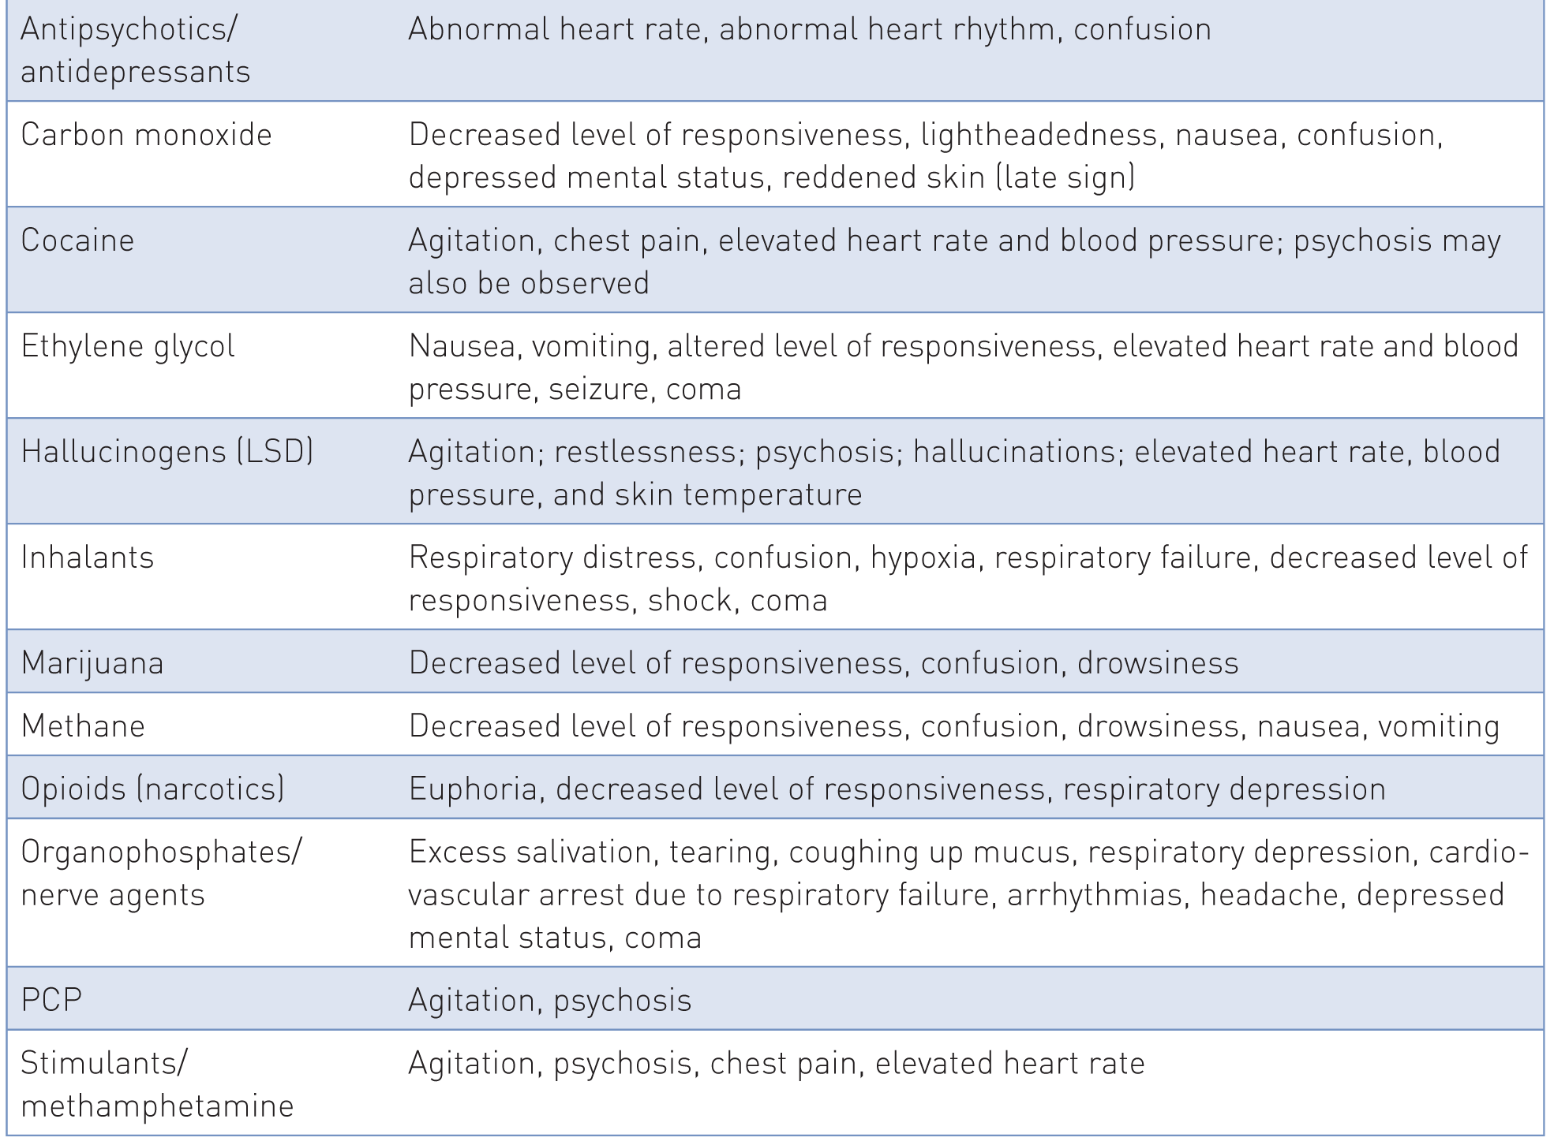
Patient Assessment: Physical Examination
The signs and symptoms of toxic substances are presented in:

Slide 70
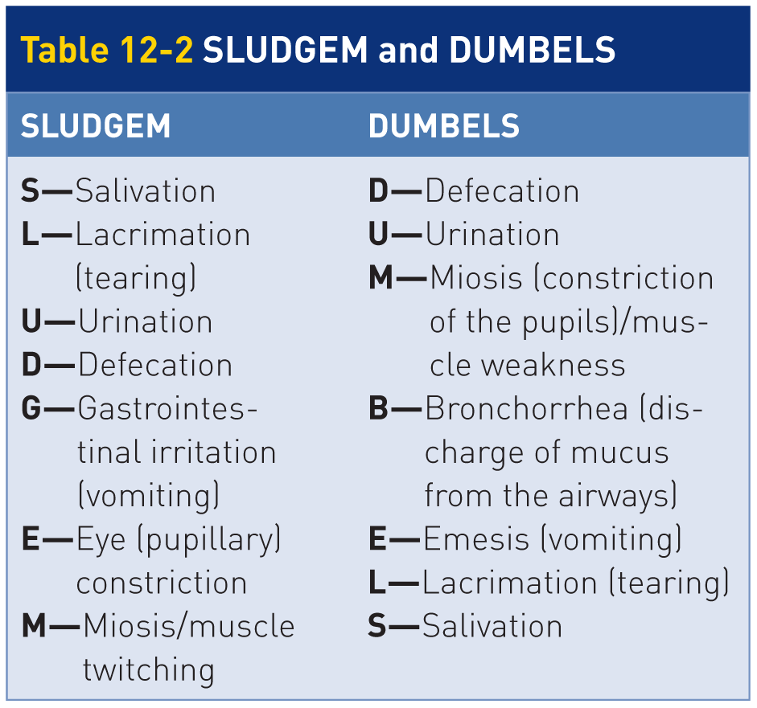
Patient Assessment: Nerve Agent
12-7
To identify organophosphate poisoning or exposure to nerve agents, use the mnemonic SLUDGEM or DUMBELS.

Slide 71
Management of Substance Abuse and Poisoning

Slide 72
Management: Scene Safety
12-5
Personal safety is of paramount importance.
You must ensure that your safety is protected first and that further injury to the patient will not occur.
Especially relevant at scenes involving gaseous poisons and other chemicals
Do not enter the scene until it has been deemed safe by a hazmat team, fire officials, or both.

Slide 73
Management: Scene Safety
12-5
Treatment of a patient affected by a toxicological event is generally supportive in nature.
Requires diligent attention to the patient’s overall appearance, ABCDs, and vital signs
Perform the primary assessment and address any threats to life.
Call early for transport and advanced life support (ALS) if needed.
Patient’s respiratory status should be continually monitored for changes.
Manage airway and breathing problems as necessary.

Slide 74
Management: Poison Control Centers
12-6
Help Is Only a Phone Call Away
Deciding on the best way to care for a patient is not easy.
Especially where transport times may be prolonged and treatment options are quite limited
Contact the American Association of Poison Control Centers.
Coordinates a network of every poison control center in the United States

Slide 75
Management: Poison Control Centers
12-6
Provided you have a radio or cell phone nearby, you may obtain immediate advice from a physician or medical toxicologist.
It can be reached 24 hours a day, 7 days a week.
The phone number 1-800-222-1222.
Can give you up-to-date information about:
A poison
Its treatment
Recommendations concerning the necessity for additional medical care

Slide 76
Management: CHEMTREC
12-6
If you happen upon an accident scene involving the transportation of a toxic chemical, your first call should go to the Chemical Transportation Emergency Center (CHEMTREC).
CHEMTREC is a service of the American Chemistry Council.
Registration of a chemical allows CHEMTREC to perform its emergency response function.
Provide information concerning any of a registrant’s products that may be involved in a transportation accident.
CHEMTREC-registered chemical is tagged with emergency information, including an emergency phone number, 1-800-262-8200, by which important information about the product can be obtained.

Slide 77
Management: Oxygen Therapy
12-5
Only a relatively few toxicological emergencies can be effectively managed in the field.
Most toxicological emergencies require treatment in a definitive-care setting.
Primary treatment for toxic exposures involving the respiratory system:
High-flow oxygen
Keeping the oxygen saturation level at 94% or greater
Oxygen is also essential for patients exposed to any poisons that either stimulate or depress the CNS.

Slide 78
Management: Poisoning
12-5
Beyond ABCD, care for a victim of poisoning follows these steps:
Reduce further exposure.
Reduce absorption.
Rapidly transport to a definitive-care facility.

Slide 79
Management: Reduce Further Exposure
12-5
For ingested poisons:
Dilute the poison by having the patient drink water.
If instructed by your medical director or the local poison center and if there are no contraindications
General contraindications for giving a poisoning patient water by mouth include:
Nausea/vomiting
Depressed level of responsiveness
Having ingested a substance that has the potential to depress level of responsiveness
Inducing vomiting can be quite dangerous and does not significantly reduce absorption.

Slide 80
Management: Reduce Further Exposure
12-5
For dry topical poisons absorbed through the skin:
Brush off the particles.
Rinse away any residue with water.
First, ensure that the poison does not react with water.
For wet poisons:
Thoroughly rinse the affected area with water.
If ocular exposure occurred, immediately irrigate the eyes with copious amounts of sterile water.
Always protect yourself from becoming contaminated.
Wear appropriate Personal Protective Equipment.

Slide 81
Management: Reduce Further Exposure
12-5
For inhaled poisons:
Immediately remove the patient from the source of poisoning.
Treatment:
Maintain the airway.
Administer high-flow oxygen via a nonrebreather mask.
Consider transport with ALS if you observe:
A notable disturbance in coordination or balance
Difficulty breathing
Altered mental status
If the inhaled poison is still present, do not attempt rescue until a hazmat team has removed the source.

Slide 82
Management: Reduce Absorption
12-5
Reduce Absorption
Activated charcoal absorbs and binds many poisons.
It is a relatively safe medication for decreasing absorption.
Most effective if given within 60 minutes following ingestion
May also be beneficial after 60 minutes for extended-release medications or patients that have delayed emptying of the gastrointestinal tract
May be administered ONLY if authorized by a medical advisor or poison control center
Should not be given to any patient with a decreased level of responsiveness

Slide 83
Management: Specific Interventions

Slide 84
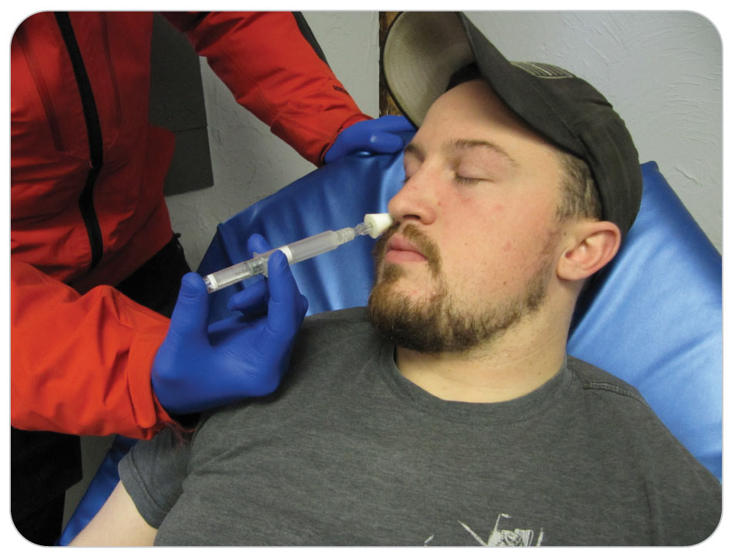
Specific Interventions: Opioids
12-5
Opioid poisoning
If you think the person has taken an opioid either by mouth or injection, give naloxone if trained to use it and management has approved giving it.
Using personal protective equipment
Continue to watch for response to the medication.
Call for an ALS ambulance.
Remember: When you give naloxone, the patient may wake up and react violently to the drug, potentially trying to hurt you.

Slide 85
Specific Interventions: Carbon Monoxide Poisoning
12-5
Carbon monoxide poisoning
Removed patient from the source of the carbon monoxide gas.
Administer 100% oxygen via nonrebreather.
Sometimes hyperbaric oxygen (i.e., oxygen at high pressure) is necessary for severely poisoned patients.

Slide 86
Specific Interventions: Inhalation Poisoning
12-5
Inhalation poisoning
Inhaled poisons, such as dust, fumes, and aerosols, may become deposited in the upper airways.
Damage caused depends on the size of the particles.
Inhaled poisons include natural gas and cyanide.
100% oxygen is the initial treatment of choice.

Slide 87
Specific Interventions: Nerve Agent
12-5
Organophosphate and Nerve Agent Poisoning
If exposed, administering the Mark I or DuoDote antidote kit.
This will be further discussed in Chapter 34.

Slide 88
Case Study

Slide 89
CASE PRESENTATION
You are called to the resort’s cafeteria, where a male in his twenties is passed out on the floor. His friends, who are gathered around him, appear to be intoxicated and say he just passed out. They were drinking heavily on the bus that brought them to the ski area. They made one run and came in to have a few beers. Upon arousal, the patient moans incoherently.
What should you do?

Slide 90
CASE UPDATE
Immediately, you place the patient in the rescue position, on his side, in case he vomits. Going through the ABCDs, you make sure his airway is open and he has a pulse. You note gurgling sounds in his breathing, and he responds to pain, so is P on the AVPU scale. Next you call for help and crowd control. His friends have no information about him medically and keep saying, “He’s just really drunk.”
What should you do now?

Slide 91
CASE OUTCOME
Suspecting acute alcohol intoxication, and possibly other issues from drugs, you call for transport and ALS. Further secondary examination does not reveal any other problems. Security arrives and provides crowd control. You continue to monitor the airway and provide oxygen since the respirations are diminished. You watch for vomiting and have suction ready to prevent aspiration.
EMS arrives and takes the patient to the hospital. Later you find out he had a blood alcohol level of 0.35%, which is very high. He recovers in an intensive care unit and was lucky he did not die.

