Slide 1
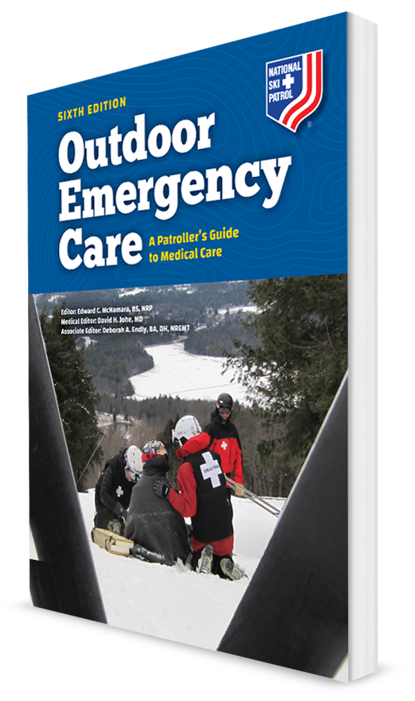
Respiratory Emergencies
CHAPTER 13

Slide 2
The following presentation will utilize two symbols to identify material necessary for an OEC Technician to comprehend:
key term
Meets a Chapter Objective.
This symbol will have the corresponding Objective Number denoted within.
Identifies a Key Term.
The Key Term will be underlined for easy identification.

Slide 3
Objectives
13-1 Describe the physiology of breathing.
13-2 Identify the primary muscle of ventilation.
13-3 List the normal respiratory rate for individuals in the following age groups:
Infant
Child
Adult
13-4 Identify the most common cause of airway obstruction.

Slide 4
Objectives
13-5 List the signs and symptoms of the following respiratory emergencies:
Asthma
COPD
Hyperventilation syndrome
Pulmonary embolism
Pneumothorax
13-6 Describe and demonstrate how to assess a patient who is having difficulty breathing.
13-7 List the signs and symptoms of acute respiratory distress.
13-8 Describe characteristics of abnormal breathing.
13-9 Demonstrate how to assess lung sounds.

Slide 5
Key Terms
Anoxia
Bradypnea
Bronchospasm
Chronic obstructive pulmonary disease (COPD)
Crepitus
Dyspnea
Inhaler
Hyperventilation syndrome
Hypoxia
Pleura
Pleural space
Pneumothorax
Ventilation
Wheezing

Slide 6
Chapter Overview

Slide 7
Chapter Overview
OEC technicians may encounter patients with abnormal breathing.
Problems can range from:
Exercise-induced asthma,
Airway obstruction by a foreign body, to
Severe respiratory distress from pulmonary embolism
Many patients can experience shortness of breath due to such medical conditions as:
Heart attack
Excessive blood loss
Conditions that have caused shock

Slide 8
Chapter Overview
The oxygen supply to our brain cannot be interrupted for more than 4 minutes without severe and possibly even irreversible consequences.
OEC technicians do not diagnose breathing problems, but they can:
Perform a rapid, thorough respiratory assessment
Identify potential threats to life
Initiate life-stabilizing therapy that includes oxygen delivery and transport to a higher level of care

Slide 9
Chapter Overview
This chapter begins by reviewing the major anatomical structures of the lower airway and the mechanics of breathing.
Discusses the most common types of respiratory emergencies that you will likely encounter
Signs and symptoms associated with each emergency
Their treatments

Slide 10
Anatomy and Physiology

Slide 11
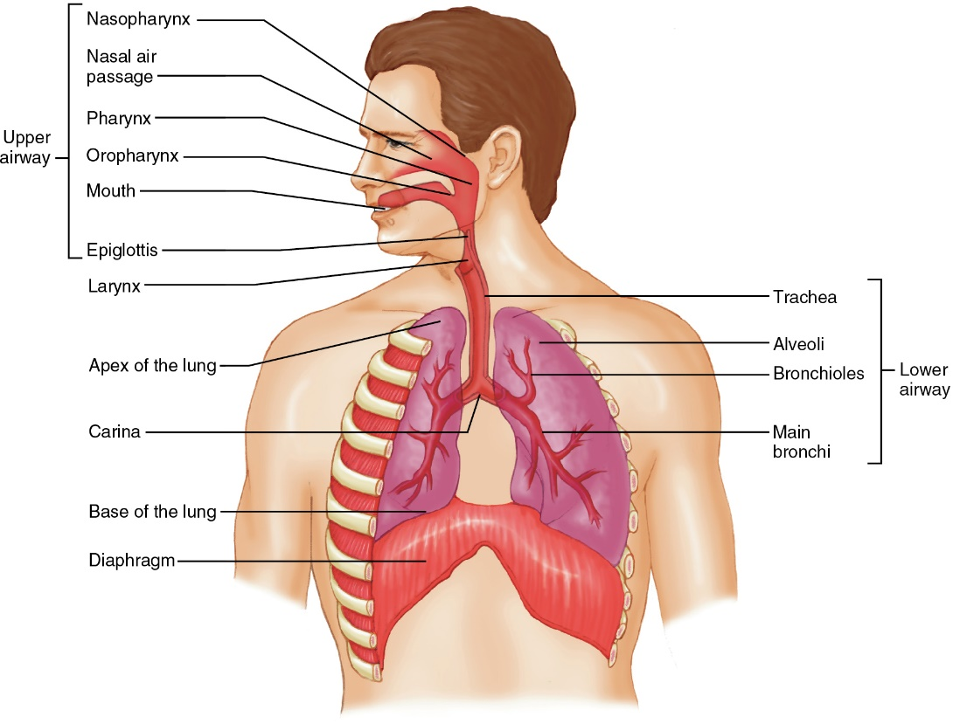
Anatomy and Physiology
13-1
13-2
Ventilation: the mechanical and physiological mechanisms by which the lungs take in oxygen from the air and expel carbon dioxide
The airway begins at the mouth and nose and terminates in the lung tissue.
The airway is divided at the epiglottis into two parts: the upper airway and the lower airway.
Diaphragm and chest wall muscles mechanically expand the chest cavity.
Sucking outside air through the airway branches into the lung’s many alveoli.

Slide 12
Anatomy and Physiology: Gas Exchange
13-1
Air consists of:
78% nitrogen
21% oxygen
1% other gases
Gas exchange at the alveolar level is driven by:
Relatively high oxygen concentration in air
The very low concentration of carbon dioxide
A process called diffusion

Slide 13
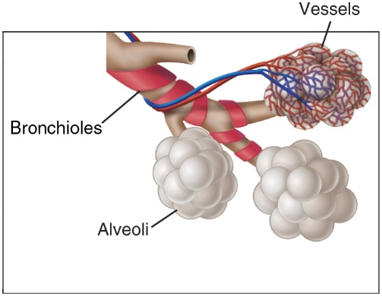
Anatomy and Physiology: Gas Exchange
13-1
13-1
Tiny air sacs called alveoli are the functional units of the pulmonary system.
Sites of gas exchange
Organized into grape-like clusters
Approximately 700 million alveoli in the lungs
Thin membrane separates each alveolus from individual red blood cells traveling through microscopic capillaries.

Slide 14
Anatomy and Physiology: Gas Exchange
13-1
By diffusion via the lung capillaries of the alveoli:
Oxygen moves into the blood.
Carbon dioxide diffuses out of the blood into the air that is exhaled.
Once oxygen reaches the blood, it binds to hemoglobin in red blood cells.
Then carried throughout the body in the bloodstream
Carbonic acid, which is dissolved in the blood, is released from the capillaries as carbon dioxide, which is exhaled.

Slide 15
Anatomy and Physiology: Respiration
13-1
Respiratory rate and depth are controlled by the amount of acidity in the blood.
More acid in the blood = a lower “pH”
Carbon dioxide (a waste product from all our cells) combines with water in the blood to make carbonic acid, which lowers the pH of the blood.

Slide 16
Anatomy and Physiology: Respiration
13-1
Excessive carbon dioxide in the blood is detected by sensors located in the carotid arteries in the neck and in the aorta.
Thus, HIGH carbonic acid causes a lower pH.
Signal the brain to automatically INCREASE the rate and depth of breathing
Increased respiratory rate blows off excess carbon dioxide, raising the pH.

Slide 17
Anatomy and Physiology: Respiration
13-1
Amount of carbon dioxide dissolved in the blood that controls breathing
Not the amount of oxygen in the blood
Any disruption causing increased carbon dioxide in the blood causes difficult or labored breathing, accompanied by feeling short of breath (dyspnea).

Slide 18
Anatomy and Physiology: Respiration
13-1
The two phases of the respiratory cycle are inhalation and exhalation.
During inhalation:
Air is actively sucked in through the airways and into the lungs.
Due to the contraction of the diaphragm and of intercostal muscles located between the ribs
During exhalation:
Relaxation of these muscles allows the chest cavity to passively decrease in size.
Pushes the gas in the lungs out through the airways and into the outside environment

Slide 19
Anatomy and Physiology: Breathing
13-3
Breathing
Prehospital responders describe breathing using four terms: Rate, Rhythm, Quality, and Depth.
Rate
How fast a person is breathing, usually in breaths per minute
Normal Respiratory Rates per minute
Infant 20-60
Child 15-30
Adult 12-20

Slide 20
Anatomy and Physiology: Breathing
13-1
Rhythm
Time between each breath and the length of time of each breath
Breaths should be equal in duration.
The time between each breath should be equal.
During exercise, the rhythm remains the same, but the rate goes up.
Quality
Should produce very little external sound
Should be inconspicuous except during exercise
Depth
Volume of air taken in for each breath
When more oxygen is needed, the chest will expand more on inhalation.

Slide 21
Common Respiratory Emergencies

Slide 22
Common Respiratory Emergencies: Choking
13-4
13-5
Obstruction/Choking
Airway patency must always be maintained for effective gas exchange to occur.
Tongue is the most common cause of airway obstruction.
In a patient that is lying down, the relaxed tongue can fall across the posterior pharynx and block the upper airway.

Slide 23
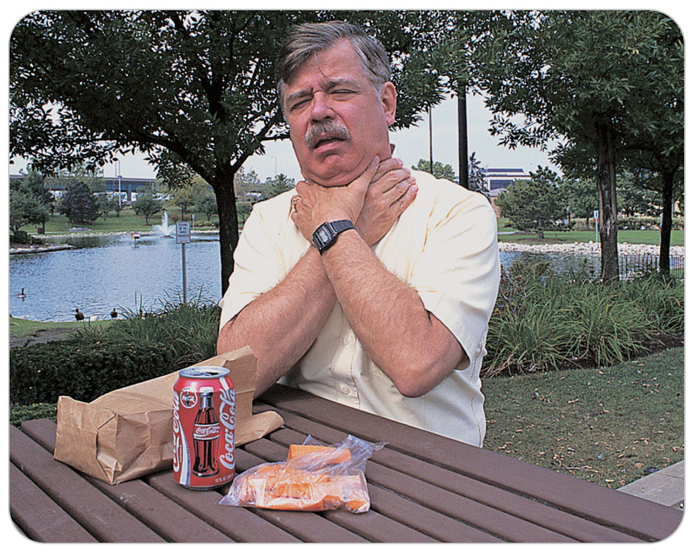
Common Respiratory Emergencies: Choking
13-4
13-5
Foreign bodies that get past the epiglottis may become lodged in the trachea, a bronchus, or one of the lower airways.
Results in a foreign body obstruction
OEC technicians can remove obstructions from the airway by using the:
Finger sweep
Suction
Gravity and positioning
Abdominal thrusts

Slide 24
Common Respiratory Emergencies: Asthma
13-5
Asthma
Asthma is a respiratory disease characterized by sudden, recurrent lower airway (bronchioles) constriction and increased mucus production.
An acute asthma attack can be reversed by treatment.
Can be life threatening
Accounts for nearly 2 million visits to the emergency department each year
Chronically untreated: permanent lung damage can occur

Slide 25
Common Respiratory Emergencies: Asthma
13-5
The exact cause of asthma is not known.
Researchers believe genetics and environmental triggers such as pollen, mold, allergens, or cold air can stimulate an intense reaction, resulting in acute bronchospasm, inflammation, and mucus accumulation.
Bronchospasm: the involuntary contraction of the bronchioles

Slide 26
Common Respiratory Emergencies: Asthma
13-5
Strenuous physical activity also has been implicated as the cause of another, atypical variety of asthma.
A condition known as exercise-induced asthma
Status asthmaticus involves a severe asthmatic attack that does not respond to inhaled medications.
Requires the immediate dispatch of ALS and transport to the nearest hospital

Slide 27
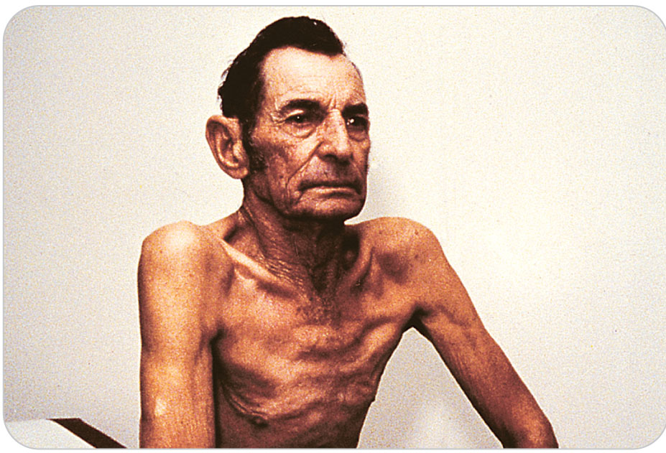
Common Respiratory Emergencies: COPD
13-5
Chronic Obstructive Pulmonary Disease
Chronic obstructive pulmonary disease (COPD) is a chronic inflammatory lung disease.
Causes obstructed airflow by constricting the bronchi (the tubes) that carry air into and out of the lungs
Symptoms include:
Breathing difficulty
Cough
Mucus (sputum) production
Wheezing

Slide 28
Common Respiratory Emergencies: COPD
13-5
Most often caused by long-term cigarette smoking
Also caused by certain diseases or by prolonged exposure to dust, chemicals, pollution, and other environmental irritants
The third leading cause of death in the United States
Many are undiagnosed.
People with COPD are at increased risk of developing heart disease, lung cancer, and a variety of other conditions.
COPD cannot be cured but can be treated by improving oxygenation.

Slide 29
Common Respiratory Emergencies: COPD
13-5
Two forms of COPD:
Chronic bronchitis
Chronic emphysema
Both develop gradually.
Both result in permanent lung damage and hypoxia (decreased amount of oxygen reaching the tissues).
Some people can have both conditions, simultaneously.

Slide 30
Common Respiratory Emergencies: Chronic Bronchitis
13-5
Chronic bronchitis is a persistent inflammation of the bronchial tubes.
Results in:
Increased mucus production
Thickening of the bronchial walls
Narrowing of the airway passages
A cough
The cough occurs every day with sputum production.
Must last for at least 3 months, for 2 years in a row
May be worse in the morning when awakening

Slide 31
Common Respiratory Emergencies: Chronic Emphysema
13-5
Chronic emphysema is a condition where patients are unable to exhale adequate amounts of air.
Air is trapped in the lungs because of destruction of the tiny alveolar sacs where oxygen is absorbed.
Results in the blood not being able to receive oxygen as well

Slide 32
Common Respiratory Emergencies: Hyperventilation Syndrome
13-5
Hyperventilation Syndrome
Hyperventilation syndrome (HVS) results in abnormally low levels of carbon dioxide in the blood.
A relatively common disorder
Caused by excessive deep breathing, or hyperventilation
The body’s response to some physiological insult such as uncontrolled diabetes
May also be caused by psychological factors
Often preceded by anxiety or a panic attack
Usually benign

Slide 33
Common Respiratory Emergencies: Hyperventilation Syndrome
13-5
Can mimic other forms of deep breathing that have a more serious origin
Such as heart attack, a diabetic emergency, or a head injury
Most severe form can cause:
Peripheral tingling
Spasms in the hands and feet
Chest tightness
Tachycardia
Temporary loss of responsiveness
Known to cause seizures in patients who have seizure disorders

Slide 34
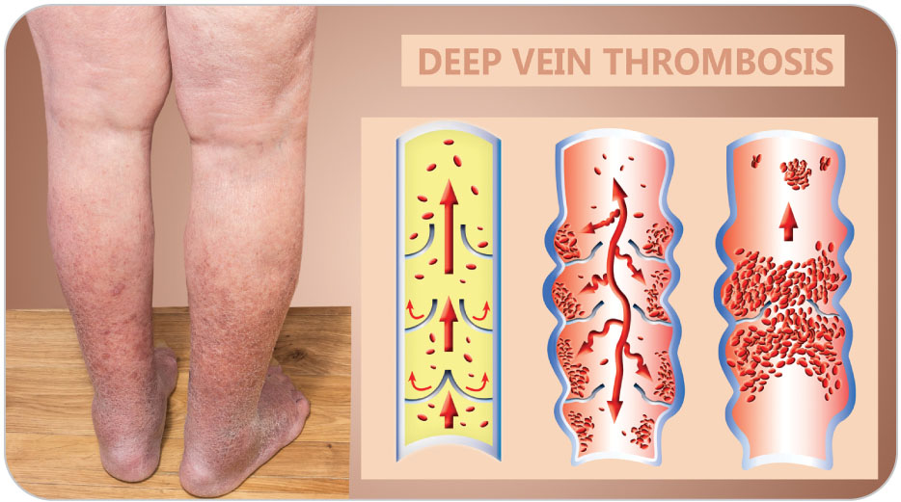
Common Respiratory Emergencies: Pulmonary Embolism
13-5
Pulmonary Embolism
A pulmonary embolism is a condition where a blood clot becomes stuck in and blocks a pulmonary artery.
Pulmonary artery is an artery that goes from the heart to the lung, where oxygen enters the blood.
Blood clot travels from a distant location, usually a vein in the legs or pelvis.
Called a thrombus

Slide 35
Common Respiratory Emergencies: Pulmonary Embolism
13-5
The clot breaks loose, travels as an embolism through the right side of the heart, and lodges in the pulmonary artery.
Resulting blockage disrupts the flow of blood through the lungs and back to the heart.
Prevents gas exchange in the lungs
Pulmonary embolism is rapidly fatal if it occurs in a large pulmonary artery and is not treated immediately.

Slide 36
Common Respiratory Emergencies: Pulmonary Embolism
13-5
Blood clots often arise in the deep veins of either the lower legs or pelvis.
Can break off and travel through the venous system through the right side of the heart and into the pulmonary circulation
In the legs, the condition is characterized by a swollen, tender calf caused by clots in the leg.
Called deep vein thrombosis (DVT)

Slide 37
Common Respiratory Emergencies: Pulmonary Embolism
13-5
Causes of DVT are numerous and include:
Prolonged sitting or immobilization
Fracture of a long bone
Recent surgery
Heart disease
Pregnancy
Certain inherited predispositions
A person who has had DVT previously is at an increased risk of a recurrence, especially if not taking medication to prevent recurrence.

Slide 38
Common Respiratory Emergencies: Pulmonary Embolism
13-5
Most cases of pulmonary embolism (PE) affect only small portions of the lung.
Large blockages can obstruct blood flow to the entire lung, causing severe hypoxia or even anoxia with shock, and even death.
Hypoxia is a decreased amount of oxygen reaching the tissue.
Anoxia is a condition characterized by the lack of an oxygen supply.

Slide 39
Common Respiratory Emergencies: Pulmonary Embolism
13-5
The most lethal type of PE is a “saddle embolus.”
Occludes the lung’s arterial circulation at the junction between the right and left pulmonary arteries, stopping blood flow into both of the lungs
Death from this form of PE can occur within minutes from acute right-sided heart strain, shock, and cardiac arrest.

Slide 40
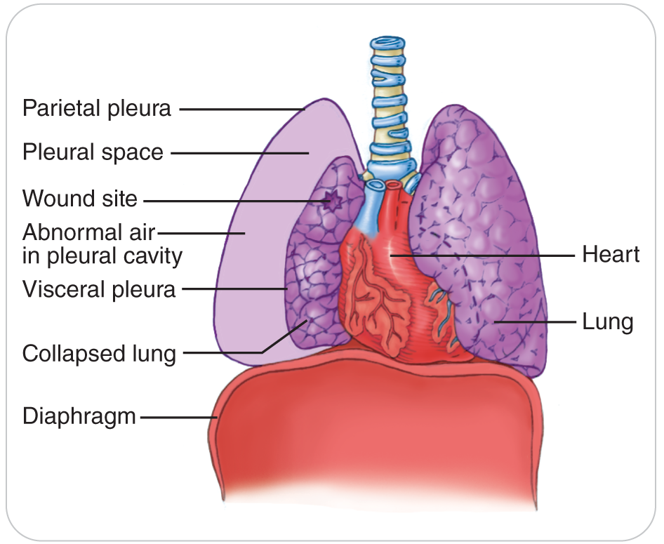
Common Respiratory Emergencies: Pneumothorax
13-5
Pneumothorax
An accumulation of air between the lung and inner chest wall (pleural space)
Pleural space is the potential space that lies within the pleura, covering the outside of the lungs and the inside of the chest wall.
The thin transparent membrane covering the outside of the lungs and the inside of the outside of the chest wall is known as the pleura.

Slide 41
Common Respiratory Emergencies: Pneumothorax
13-5
The most common cause of this condition is traumatic injury to the chest wall, ribs, or lung itself.
Results in the escape of air from the lung into the pleural space
Less common cause:
Chronic emphysema or severe acute asthma can cause alveoli to rupture spontaneously.
Results in the escape of air from the lung into the pleural space

Slide 42
Common Respiratory Emergencies: Pneumothorax
13-5
Depending on the size of the hole in the lining of the lung and subsequent air leakage:
Problem may resolve spontaneously
May cause profound hypoxia or shock requiring emergent hospital care
If there is blood instead of air in the pleural space, it is called a hemothorax.

Slide 43
Common Respiratory Emergencies: Coronavirus (COVID-19)
13-5
In 2020, COVID-19 was a global pandemic.
Highly contagious, spread by airborne transmission
Symptoms: fever, cough, and shortness of breath
Elderly and those with compromised immune systems affected most severely
Evidence that infectious disease can devastate mankind
Ever-vigilant use of proper precautions necessary with someone who has an infectious, airborne disease

Slide 44
Patient Assessment for Respiratory Emergencies

Slide 45
Patient Assessment: Primary Assessment
13-6
First do a scene size-up and ensure that the area is safe.
As you approach patient, note whether any signs of acute respiratory distress are apparent, or whether patient’s breathing is absent or noisy.
Control severe bleeding.
Conduct a primary patient assessment of the ABCDs.
Correct any life-threatening conditions.
Include opening and clearing the airway using adjuncts.
If patient has severe respiratory compromise, immediately call for ALS assistance.
Assess patient’s circulation and level of responsiveness using AVPU.

Slide 46
Patient Assessment: General Appearance
13-6
Note patient’s overall appearance and any revealing signs.
Does patient appear ill at ease, restless, agitated, or confused?
Does patient seem thin or obese?
Chronic bronchitis:
Generally overweight
Have a productive cough
Appear slightly cyanotic
Use their accessory muscles to breathe

Slide 47
Patient Assessment: General Appearance
13-6
Chronic emphysema:
Usually quite thin
Have a barrel-shaped chest due to the trapping of air
Breathe through pursed lips
They seldom have a productive cough.
Asthma:
Generally appear very anxious
Have rapid shallow breathing
May have audible wheezing
A high-pitched respiratory sound caused by a narrowing of the tubular airways

Slide 48
Patient Assessment
13-6
Pulmonary embolism:
Cyanotic
Panicked due to hunger for air
Have rapid, deep respirations
May even be unresponsive, depending on the severity and resulting shock
Hyperventilation syndrome:
May appear panicked
Exhibit rapid, deep respirations
Color, however, is usually normal.

Slide 49
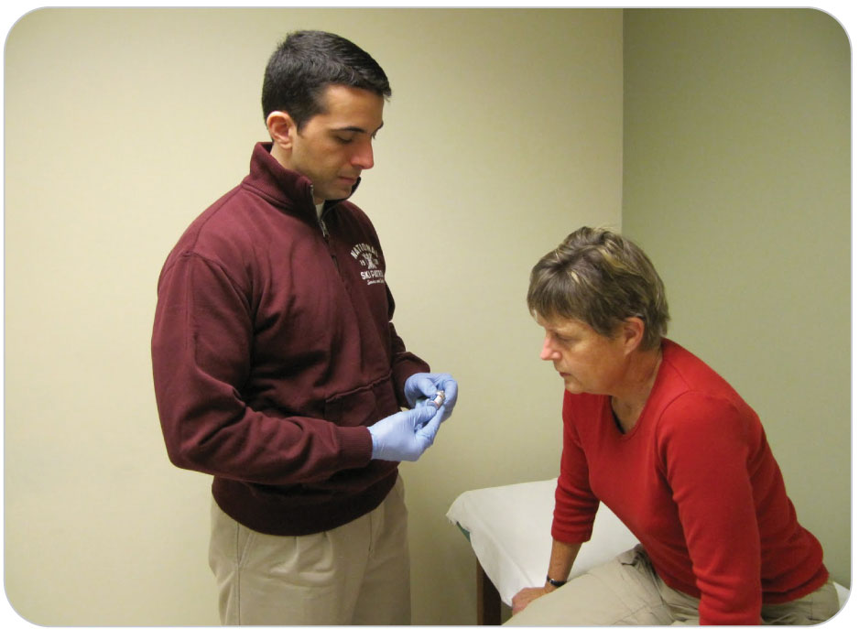
Patient Assessment
13-6
13-7
The hallmark of any respiratory-related emergency is dyspnea.
Learn to recognize the signs and symptoms of acute respiratory distress.
Provide valuable clues about the severity of patient’s condition and underlying hypoxia

Slide 50
Patient Assessment: Acute Respiratory Distress
13-6
13-7
Signs of acute respiratory distress, which often precede complete respiratory failure, include the following:
Choking or gagging
Inability to speak
Open-mouthed breathing
Panting, gasping
Breathing through pursed lips

Slide 51
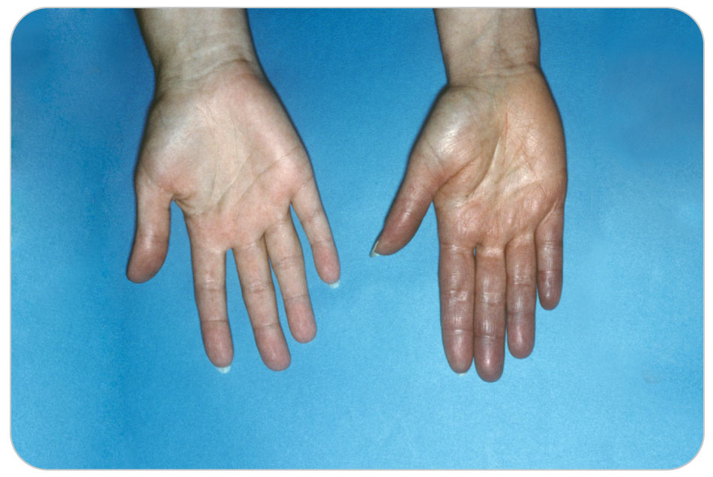
Patient Assessment: Acute Respiratory Distress
13-6
13-7
Tachypnea (greater than 30 rpm breaths per minute in adults)
Bradypnea (fewer than 10 rpm in adults)
Cyanosis
Nasal flaring
Sitting in an upright or tripod position
Changes in level of responsiveness

Slide 52
Patient Assessment: Tripod Position
13-6
Patients who are having problems breathing often assume a “tripod” position:
They sit upright while leaning forward with their hands near or gripping their thighs or knees.
Elbows may be out from the body.
Position lets gravity pull the chest wall outward and downward, which allows the lungs to expand more fully.
In severe cases, involuntary use of the accessory respiratory muscles will be evident, further aiding patient’s efforts to breathe.
Nostrils of the nose will flare.
Shoulders will elevate on inspiration.
Chest cavity will expand maximally.

Slide 53
Patient Assessment: Abdominal Breathing
13-6
Patients who are having trouble breathing, especially children, may exhibit abdominal breathing:
The abdominal muscles forcefully expand the abdomen outward upon inspiration.
Lowers the diaphragm and allows more air to enter the lungs
They also may exhibit expiratory grunting.
The abdominal muscles force air out of the lungs at the end of each exhalation.

Slide 54
Patient Assessment: Medical History
13-6
Next obtain a medical history using SAMPLE.
Ask if anything makes the symptoms better or worse.
Be sure to ask about any medications patient may be using, including over-the-counter drugs, herbs, and supplements.
If you do not know what the medication is for, ask patient.
Find out if patient uses an inhaler.
If so, whether it is available

Slide 55
Patient Assessment
13-6
Identify any associated symptoms:
Productive cough
Fever
Chest pain
Swelling of the lower extremities
Ask about past medical problems such as:
Blood clots
Any underlying lung disease (e.g., COPD, asthma)

Slide 56
Patient Assessment
13-6
If patient’s history includes a respiratory ailment:
Ask how the current problem compares to previous episodes.
Ask if he/she could walk a short distance without becoming short of breath.
Ability to ambulate or walk suggests that the underlying condition may be relatively minor.
Shortness of breath while at rest or when walking only a short distance indicates a potentially serious condition.

Slide 57
Patient Assessment: Secondary Assessment
13-6
Perform a secondary patient assessment, which includes a physical assessment and a check of the vital signs.
Although patient has difficulty breathing, ask if something else is wrong.
Any chest pain?
If dyspnea is relatively mild, patient will provide this information with minimal effort and may even offer other unsolicited information, such as:
History of the problem
Duration of symptoms
Previous attempts at treatment

Slide 58
Patient Assessment: Secondary Assessment
13-6
Note whether the person can speak in complete sentences, or whether responses are broken into short groups of words.
Severe dyspnea often limits patient to one- or two-word answers.
Frame your questions so that they may be answered with just a few words.
Or as yes-or-no questions
Do not ask open-ended questions.
Patient may not be able to answer due to a hunger for air.

Slide 59
Patient Assessment: Physical Exam
13-6
Observe skin color for pallor or cyanosis.
Look closely at the inside of patient’s eyelids, around the lips, and at the fingernail beds.
Complete the rest of the physical examination in the usual fashion.
For the chest exam, carefully palpate the skin of patient’s chest for the presence of any “crackling” or “Rice Krispies feeling” beneath the skin.
Emphysema or crepitus often due to a pneumothorax
Indicates that air or gas is present beneath the skin.
Other potential causes include penetrating trauma and severe skin and tissue infections.

Slide 60
Patient Assessment: Vitals
13-6
Obtain a complete set of vital signs.
Respirations including the rate, rhythm, depth, and quality
Do not guess the respiratory rate.
Count the breaths for 30 seconds and multiply the count by 2 to determine the number of breaths per minute.

Slide 61
Patient Assessment: Vitals
13-6
Vital signs change over time:
Repeat the vital signs frequently (every 5 minutes) in patients exhibiting signs of acute respiratory distress.
Several sets of vital signs usually provide more information than a single, isolated measurement.
Can serve as a marker for change, both favorable as well as unfavorable

Slide 62
Patient Assessment: Vitals
13-6
Respiratory rate:
Ominous: Less than 8 per minute or greater than 30 per minute in an adult
Signify impending respiratory failure
Remember that a normal respiratory rate for an adult is 12 to 20 per minute.

Slide 63
Patient Assessment: Tachypnea and Hyperventilation
13-6
Tachypnea and hyperventilation causes range from psychogenic in nature to a potentially lethal pulmonary embolism.
A patient can maintain a rapid respiratory rate for only a short period of time.
Psychogenic (e.g., hyperventilation) will eventually resolve.
Compensatory mechanisms will eventually be lost, and sudden respiratory failure will then result, especially in children.

Slide 64
Patient Assessment: Hyperventilating
13-6
Hyperventilating:
Tingling or a “pins and needles” sensation around the lips, hands, or feet, a condition known as paresthesia
Not being able to open their hands due to excessive muscle cramping
Hands and fingers may appear contorted.
Although alarming, these findings are benign.
Will disappear once patient’s respiratory rate slows
Often seen in very anxious patients

Slide 65
Patient Assessment: Breath Sounds
13-8
13-9
Breath Sounds
Listening with a stethoscope:
Normal breath sounds are regular, relatively quiet (like a sigh), and equal for the two lungs.
Abnormal breath sounds are diminished or absent, noisy (wheezes, crackles, gurgles), or unequal between the two lungs.
It is beyond the scope of knowledge for OEC technicians to fully learn breath sounds.
Assess whether air is moving in and out of the lungs.
Determine whether patient is sufficiently oxygenated.
By assessing patient’s level of responsiveness, respiration quality and quantity, capillary refill, and skin color

Slide 66
Patient Assessment: Using a Stethoscope
13-9
If you listen with a stethoscope, always tell patient that you are going to listen to the lungs.
Place patient in an upright position, preferably seated.
The exception to this is when spinal injury is suspected, in which case patient should remain in a neutral, supine position.

Slide 67
Patient Assessment: Using a Stethoscope
13-9
Avoid startling patient with a cold stethoscope.
Warm it before use by vigorously rubbing it in a circular pattern on the palm of your hand.
Place the stethoscope firmly against patient’s bare skin, not against clothing, as breath sounds may be subtle.
Instruct patient to breathe normally.
If unable to hear patient breathe, ask patient to breathe through an open mouth or to breathe deeply.

Slide 68
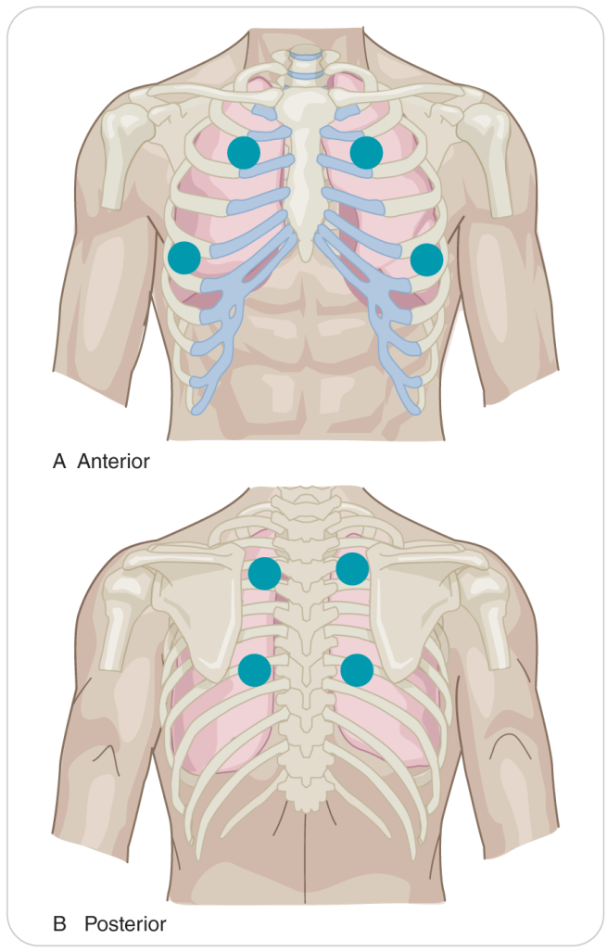
Patient Assessment: Using a Stethoscope
13-9
Using the large diaphragm of the stethoscope, listen at each location for approximately 15 seconds.
Avoid unnecessary movement or talking.
Do not allow the stethoscope tubing to rub against patient’s clothing or to bump into anything.
Resulting noise can make your assessment more difficult.
Listen with a stethoscope over the upper and lower chest in both the front and back of patient.

Slide 69
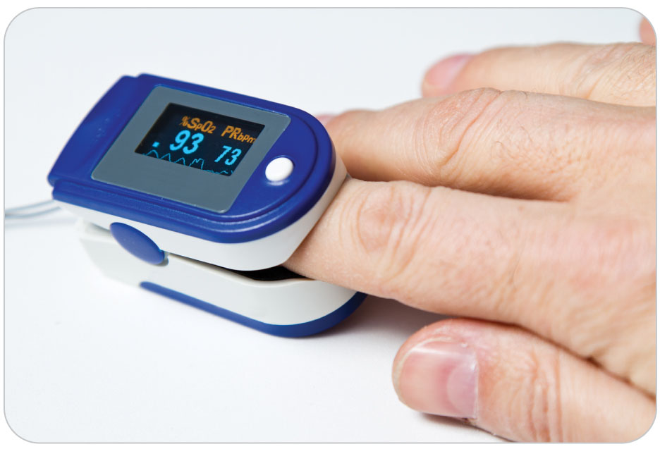
Patient Assessment: Pulse Oximetry
13-6
If you have a pulse oximeter and local protocol allows its use, assess patient’s blood oxygen concentration.
Patient’s oxygen saturation should be greater than or equal to 94%.
At high altitude, the oxygen saturation may normally be slightly less than 94%.
Any value below this should be given oxygen.
Pulse oximetry is a useful tool for assessing oxygenation trends over time.

Slide 70
Patient Assessment: Pulse Oximetry
13-6
The degree of dyspnea perceived by patient may not correlate with the pulse oximeter readings.
Pulse Oximetry helps decide when to increase oxygen therapy or when to expedite patient’s transfer to a higher level of medical care.
If a patient with a pulse oximetry reading of 94% is cyanotic, breathing fast, and looks ill, trust your own observations and provide oxygen.
Treat according to what patient shows you.
Pulse oximeter may not be giving a true reading.

Slide 71
Management of Respiratory Emergencies

Slide 72
Management of Respiratory Emergencies
13-10
The treatment of a respiratory emergency centers on improving patient’s overall oxygenation.
Treatment begins by ensuring that the airway is open and clear.
Assess and monitor the pulse and treat for shock if found.

Slide 73
Management: Choking
13-10
If patient is choking, determine whether patient can speak.
Can speak:
Allow patient to clear the airway on his or her own.
Cannot speak:
You must intervene quickly, or patient will soon die.
To clear the airway of a patient who is choking, follow the current guidelines for performing abdominal thrusts.
American Heart Association or American Red Cross guidelines
Regardless if responsive or unresponsive

Slide 74
Management: Acute Respiratory Distress
13-10
If patient is responsive and there is no indication of head or spine injury, allow patient to assume a position of comfort that maximizes respiratory function.
For most, this will be upright or a “tripod” position
Keeps the abdominal contents from pushing upward on the diaphragm
Maximizes the actions of the accessory muscles of respiration
Do NOT place patient in a supine position.
Doing so will compromise patient’s breathing efforts
May even precipitate respiratory failure
Unless signs of shock are present

Slide 75
Management: Acute Respiratory Distress
13-10
Trouble breathing and NO shock:
Load a patient into a ski toboggan with patient’s head UPHILL.
Elevate the chest and head slightly using an aid or equipment bag or a blanket.
A patient on a backboard may need the head of the board to be raised slightly.
Always administer supplemental oxygen for patients with a respiratory illness.
Anyone with obvious respiratory distress should be placed on a nonrebreather mask initially at 15 LPM.
Lower the flow until the reservoir bag remains half full for every breath.

Slide 76
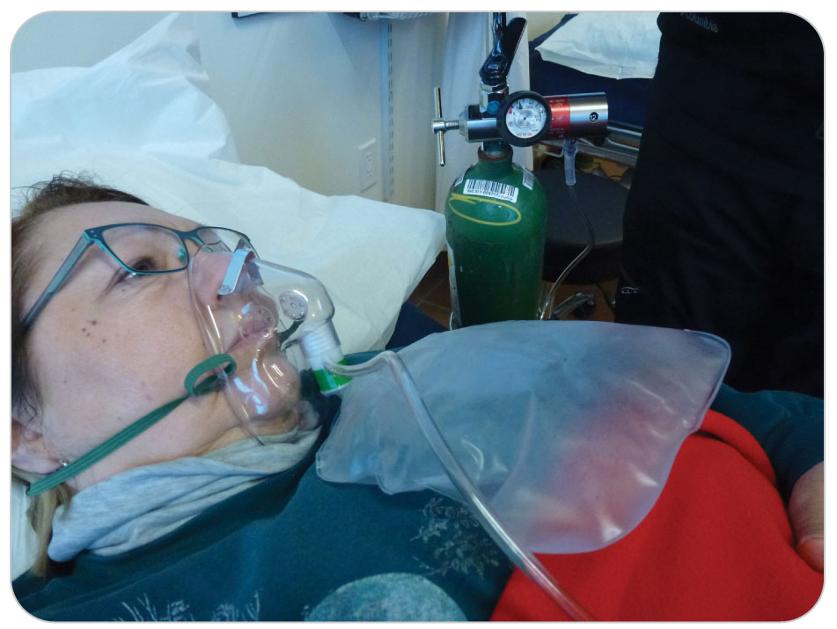
Management: Acute Respiratory Distress
13-10
High-flow oxygen administration through a properly fitting facemask can dramatically improve oxygen delivery to the tissues.
Very mild shortness of breath and can speak in complete sentences, and the rate, rhythm, depth, and quality of respirations are normal:
A nasal cannula at 2 to 6 LPM may be used.

Slide 77
Management of Respiratory Emergencies
13-10
Most of the time:
High-flow oxygen by nonrebreather mask in field
When in the aid room, if pulse oximetry is used, adjust oxygen delivery to achieve an oxygen saturation level of 94% or greater.
As a rule, start oxygen delivery high and gradually reduce it as necessary.
“Start high and titrate low”
If needed, assist patient’s ventilations using a bag-valve mask connected to oxygen.

Slide 78
Management: Refusal of Face Mask
13-10
Refusal of face mask:
Especially a child
Possibly from claustrophobia
Always encourage such patients to keep the face mask on.
If they refuse, hold the face mask as close to the face as possible.
Or use a nasal cannula at 6 LPM. This is better than not providing oxygen.

Slide 79
Management: Using an Inhaler
13-10
Using an Inhaler
Patients may carry a metered-dose inhaler, or “puffer,” with them.
A metered-dose inhaler, or MDI, is a small pressurized canister containing a powerful medication that:
Dilates the bronchioles
Opens the airways
Allows the patient to breathe more easily
A typical metered-dose inhaler consists of a medication canister, a plastic housing/mouthpiece, and a spacer.
Contains respiratory medicine and is used to improve breathing

Slide 80
Management: Using an Inhaler
13-10
13-11
If your local protocol allows it, you may assist patients having an asthma attack to use their own inhalers.
Do not use someone else’s inhaler.
Make sure the inhaler’s expiration date has not passed.

Slide 81
Case Study

Slide 82
CASE PRESENTATION
A middle-aged man walks into the patrol medical room, saying “I can’t breathe.” You immediately have the man sit and begin your assessment. During your questioning, you find he is a smoker and 3 weeks ago had “minor knee surgery on his right leg.” He said this is his first time out skiing since surgery. He is breathing at 28 breaths per minute and appears in distress. He has mild chest pain and cannot talk in complete sentences. His right calf is swollen and tender.
What should you do?

Slide 83
CASE UPDATE
You place a pulse oximeter on his finger, which shows a pulse of 120 beats per minute and oxygen saturation of 85%. He becomes more anxious, and his respiratory rate is now 28 breaths per minute. Since he has chest pain and a low oxygen saturation with obvious respiratory distress, you place him on high-flow oxygen with a nonrebreather mask and have another patroller immediately call for transport with ALS. Your SAMPLE history only reveals recent knee surgery. While waiting for transport, you consider the possibilities of myocardial infarction, pulmonary embolus from blood clot (DVT) that came from the swollen calf, or other causes of acute breathing problems with chest pain. No matter what the medical problem is, transport is urgently needed.
How do you give a report to the prehospital ambulance personnel when they arrive?

Slide 84
CASE OUTCOME
Using a pulse oximeter, patient’s oxygen saturation is titrated and kept at greater than or equal to 94%. You continue to take vital signs every 5 minutes, allowing patient to continue to sit up. Ambulance personnel arrive. You explain patient has had significant dyspnea and chest pain. He has been on oxygen with an oxygen saturation at 94%. You show the vital signs log, indicating elevated respirations and tachycardia. You explain the man had a knee arthroscopy 2 weeks ago.
Showing the swollen, painful calf to the paramedic, you both consider the possibility of a pulmonary embolus. Following rapid transport to a local hospital, further tests are completed, showing a blood clot in the man’s lung. He is given medication to dissolve the clot, recovers, and comes back 3 weeks later to thank you.

Slide 85
OEC Skill Activities

Slide 86
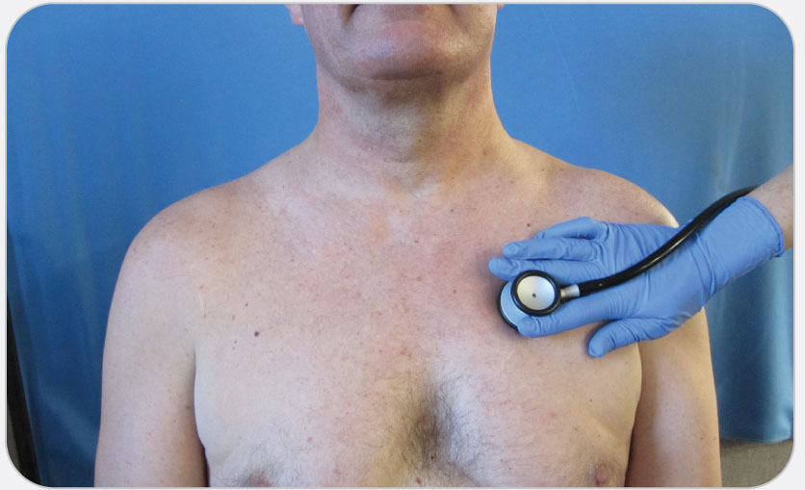
OEC Skill 13-1: Auscultation of Lung Sounds (8 Locations)
1. To listen to the left upper lung lobes anterior: place your stethoscope on the left side of the anterior chest 1.5 inches below the middle of the clavicle (midclavicular) (shown in Photo 1).
To listen to the right upper lung lobes anterior: place your stethoscope on the right side of the anterior chest 1.5 inches below the middle of the clavicle (midclavicular). Compare the results (Position 1 and 2).

Slide 87
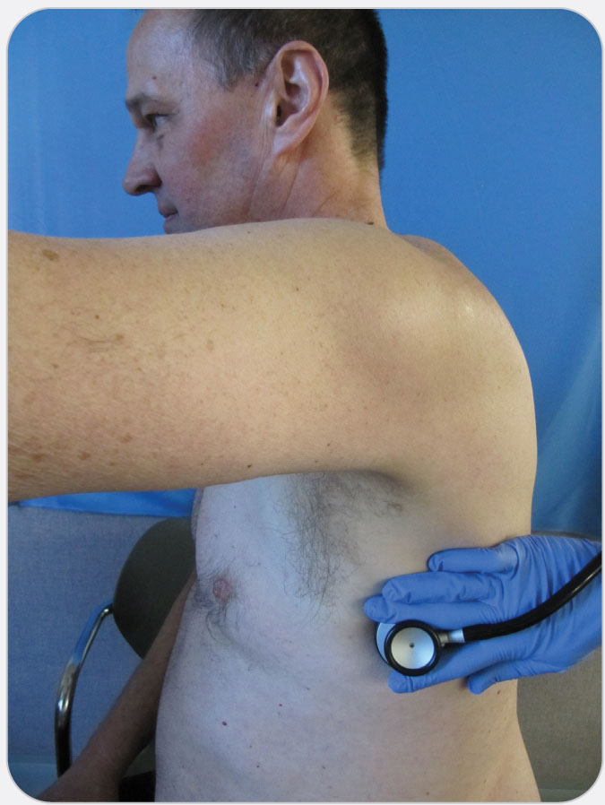
OEC Skill 13-1: Auscultation of Lung Sounds (8 Locations)
2. To listen to the left lower lung lobe anterior: place your stethoscope on the left midaxillary line between the 6th and 7th rib and under the armpit (shown in Photo 2).
To listen to the right lower lung lobe anterior: place your stethoscope on the right midaxillary line between the 6th and 7th rib and under the armpit. Compare the results (Position 3 and 4).

Slide 88
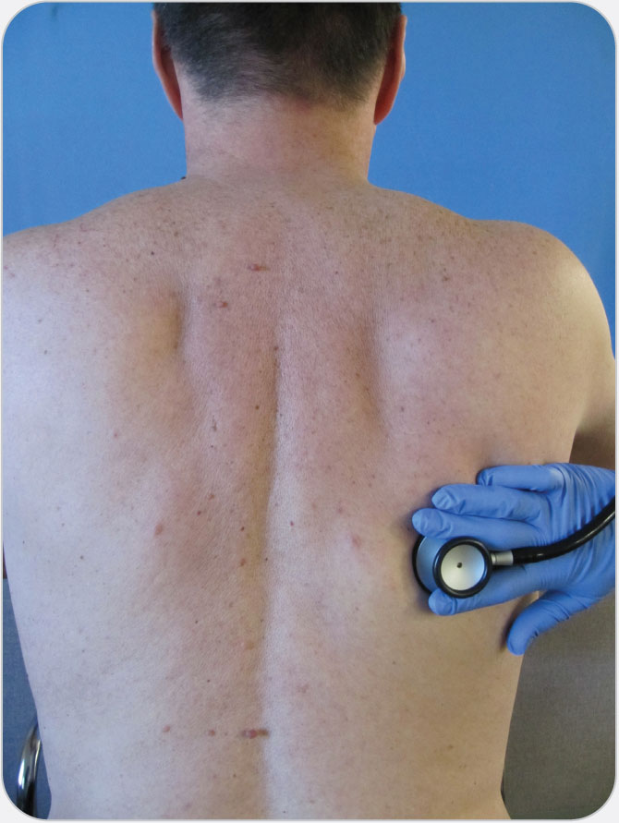
OEC Skill 13-1: Auscultation of Lung Sounds (8 Locations)
3. To listen to the left upper lung lobe posterior: place your stethoscope on patient’s left upper back between the top of the scapula and the spine, approximately 2 inches below the neck.
To listen to the right upper lung lobe posterior: place your stethoscope on patient’s right upper back between the top of the scapula and the spine, approximately 2 inches below the neck. Compare the results (Position 5 & 6).

Slide 89
OEC Skill 13-1: Auscultation of Lung Sounds (8 Locations)
3. (cont’d)
To listen to the left lower lung lobe posterior: place your stethoscope on patient’s left lower back below the scapula and between the scapula and spine.
To listen to the right lower lung lobe posterior: place your stethoscope on patient’s right lower back below the scapula and between the scapula and spine (shown in Photo 3). Compare the results (Position 7 & 8).

Slide 90
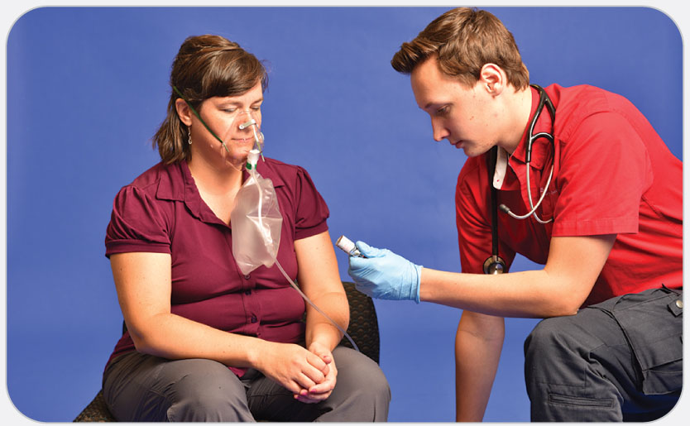
OEC Skill 13-2: Assisting a Patient with a Metered-Dose Inhaler
1. Check to make sure you have the correct medication for the correct patient. Check the expiration date. Ensure inhaler is at room temperature or warmer.

Slide 91
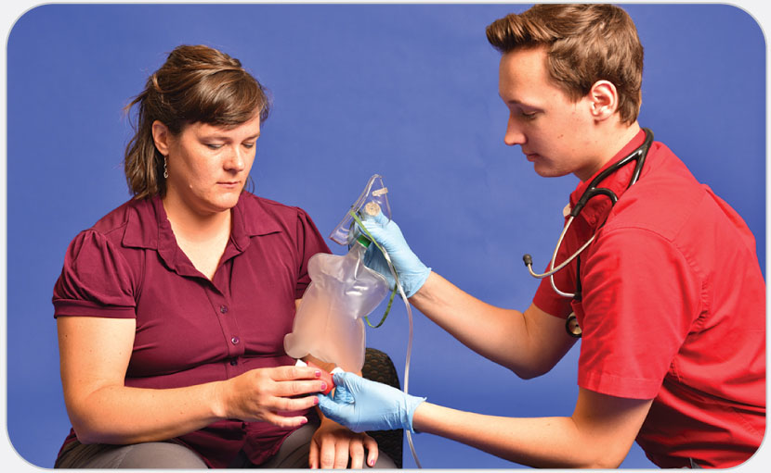
OEC Skill 13-2: Assisting a Patient with a Metered-Dose Inhaler
2. Remove the oxygen mask. Hand the inhaler to patient. Instruct patient to hold the MDI upright and place their lips around the MDI tube, maintaining a good lip seal.

Slide 92
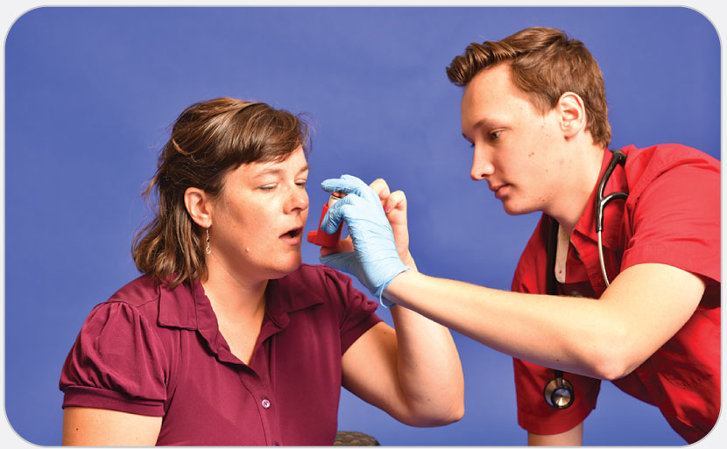
OEC Skill 13-2: Assisting a Patient with a Metered-Dose Inhaler
3. Instruct patient to press the inhaler (assist if necessary) and inhale one puff. Instruct patient to hold their breath for at least 10 seconds.

Slide 93
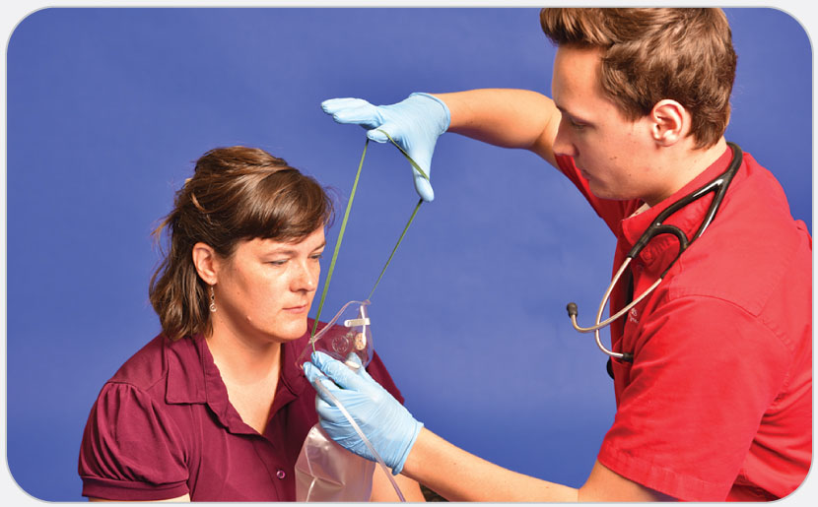
OEC Skill 13-2: Assisting a Patient with a Metered-Dose Inhaler
4. Reapply oxygen. After 1 to 2 minutes, have patient repeat the dose, if order or protocol allows.

