Slide 1
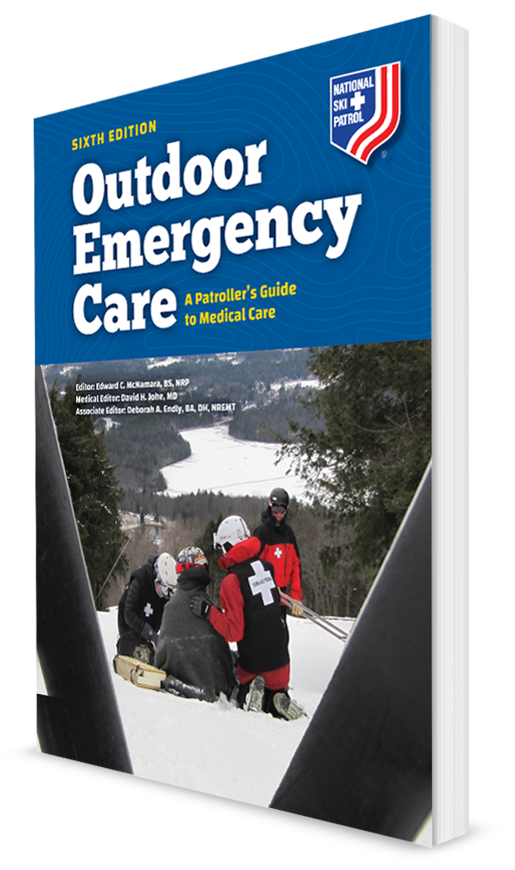
Cardiovascular Emergencies
CHAPTER 15

Slide 2
The following presentation will utilize two symbols to identify material necessary for an OEC Technician to comprehend:
key term
Meets a Chapter Objective.
This symbol will have the corresponding Objective Number denoted within.
Identifies a Key Term.
The Key Term will be underlined for easy identification.

Slide 3
Objectives
15-1 List the arrhythmias associated with sudden cardiac death.
15-2 Demonstrate how to assess and treat a patient with a cardiovascular emergency.
15-3 Describe what you should ask a patient who takes a heart medication.
15-4 Explain what an anticoagulant (“blood thinner”) is.

Slide 4
Objectives
15-5 List the signs and symptoms for each of the following cardiovascular disorders:
Acute myocardial infarction
Congestive heart failure
Aortic aneurysm
Pericardial tamponade
15-6 Give the indications and contraindications of aspirin and nitroglycerin therapy.
15-7 Describe and demonstrate assisting a patient in taking nitroglycerin and/or aspirin.

Slide 5
Key Terms
Acute myocardial infarction (AMI)
Angina pectoris
Aorta
Aortic aneurysms
Arrhythmia
Asystole
Atherosclerosis
Automated external defibrillator (AED)
Automatic implantable cardioverter defibrillator (AICD)
Cardiopulmonary resuscitation (CPR)
Congestive heart failure (CHF)
Coronary arteries
Coronary artery disease
Defibrillation
Hypertension

Slide 6
Key Terms
Hypotension
Ischemia
Myocardium
Pericarditis
Pulmonary edema
Sudden cardiac arrest (SCA)
Ventricular assist device (VAD)
Ventricular fibrillation (VF)
Ventricular tachycardia (VT)

Slide 7
Chapter Overview

Slide 8
Chapter Overview
Cardiovascular disease is the leading cause of death in the United States.
Includes pathologic conditions of both the heart and blood vessels.
Also, deep vein thrombosis and pulmonary embolism, where a blood clot in a vein travels to the lung
Many cardiac emergencies occur outside the hospital setting.
Can be immediately life threatening
Important to:
Identify the signs and symptoms of these emergencies quickly
Render appropriate care quickly
Transport with advanced life support (ALS) assistance

Slide 9
Anatomy and Physiology

Slide 10
Anatomy and Physiology
The cardiovascular system consists of three major components: the heart, blood vessels, and blood.
Responsible for providing oxygen and nutrients
Carrying waste products in the blood
Takes carbon dioxide to the lungs
Other waste products to the kidneys, so these waste products can be excreted

Slide 11
Anatomy and Physiology
Blood is pumped by the left side of the heart through the arteries starting with the largest artery, the aorta, to all parts of the body.
Arteries continue to divide into progressively smaller arteries and arterioles.
The capillaries allow nutrients and oxygen in the blood to diffuse into the tissues, and waste products to diffuse out of the tissues into the bloodstream and to the kidneys for excretion.
The capillaries then serve as the bridge between arterioles and venules.

Slide 12
Anatomy and Physiology: The Heart
The Heart
A thick organ located behind and just to the left of the sternum
Approximately the size of a closed fist
Enclosed within a tough, fibrous pericardial sac
Contains a small amount of pericardial fluid that allows friction-free movement of the heart within the sac

Slide 13
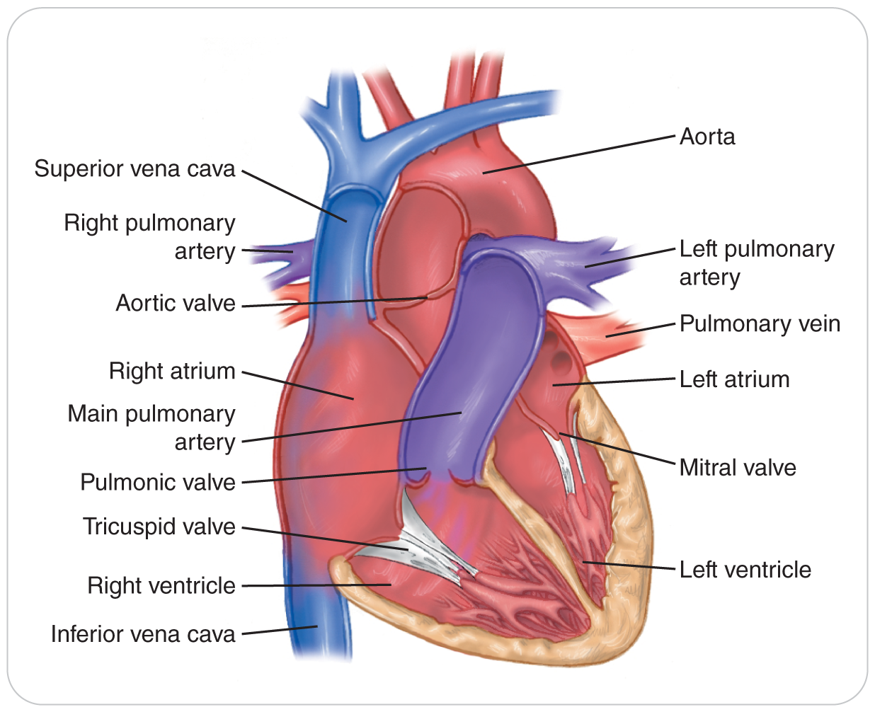
Anatomy and Physiology: The Heart
The heart is a muscular organ with four 4 compartments or “chambers.”
Divided into right and left sides, with two chambers on each side
Each side has an upper chamber called the atrium.
Serves as a primer pump for the lower, larger, and more powerful chambers called the ventricle

Slide 14
Anatomy and Physiology: The Heart
The right side accepts deoxygenated blood FROM the body.
Pumps it to the lungs to remove carbon dioxide and to receive fresh oxygen
Oxygenated blood then moves from the lungs to the left heart.
The heart then pumps the oxygenated blood to the brain, muscles, and other organs.

Slide 15
Anatomy and Physiology: The Heart
Cardiac muscle is called myocardium.
Heart’s pumping function is coordinated through the cardiac conduction system.
An electrical pathway that has a pacemaker function located in the atrium that initiates an automatic electrical impulse
Impulse stimulates the myocardium to contract in an organized and efficient manner.
Electrical system creates the regular “beat” of the heart.
Efficiency of the pump depends on four valves.
Situated between each of the chambers and the major blood vessels
The opening and closing of which allows for only forward flow of the blood

Slide 16
Anatomy and Physiology: Blood Vessels
Blood Vessels
There are different types of blood vessels that serve different purposes.
Arteries and arterioles carry blood away from the heart.
Veins and venules bring blood back to the heart.
Capillaries connect the arteries to the veins.

Slide 17
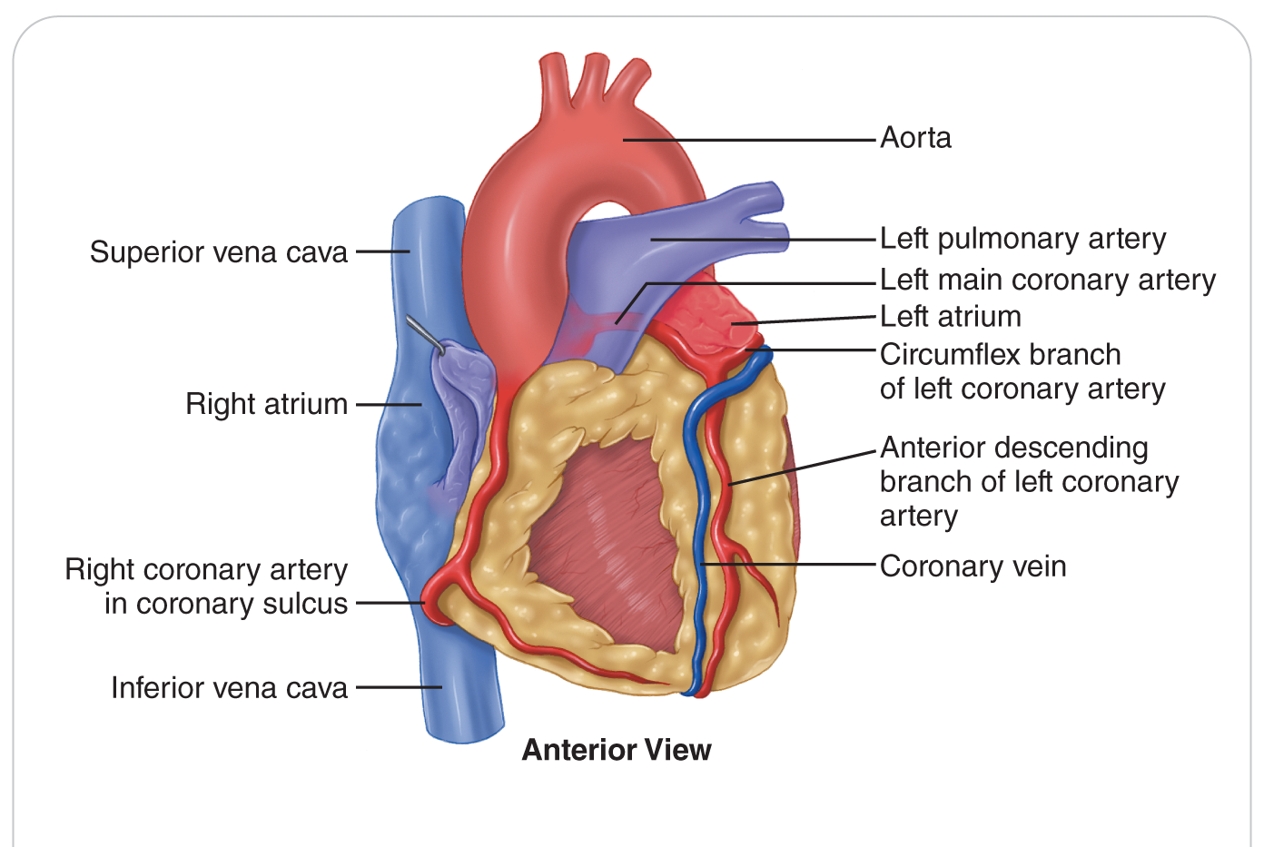
Anatomy and Physiology: Major Arteries
Aorta: the largest artery in the body, carries blood out of the left side of the heart to smaller arteries that travel through the entire body
Coronary arteries: carry oxygen-rich blood to the heart muscle, leave the aorta just above the heart

Slide 18
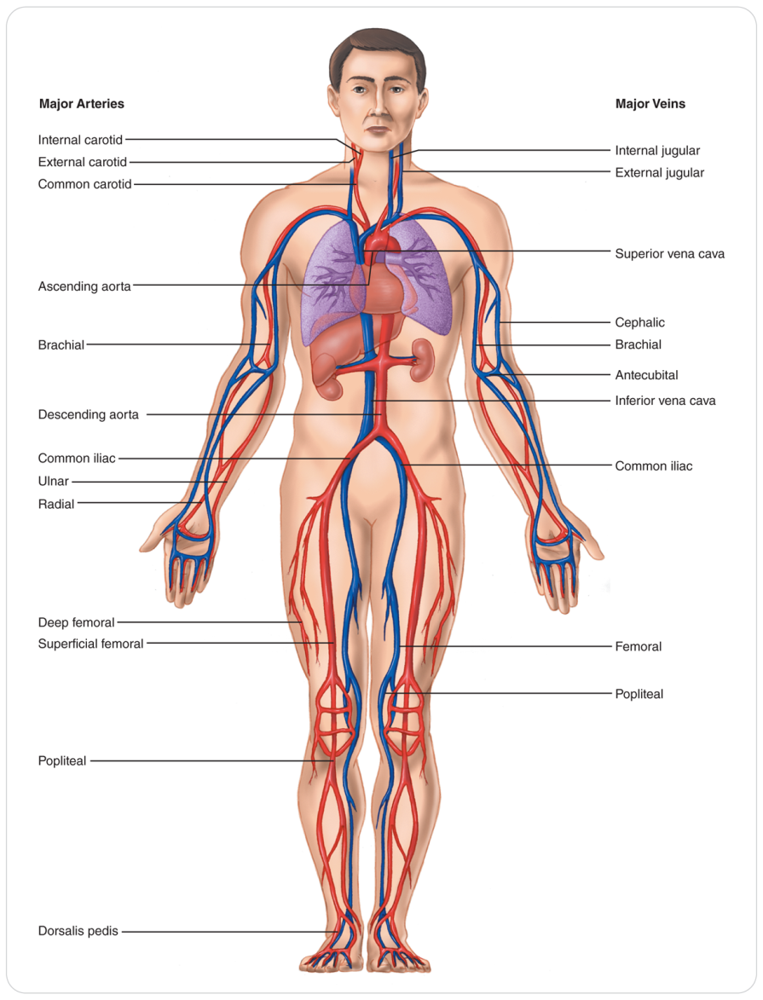
Anatomy and Physiology: Major Arteries
Carotid arteries:
In the neck
Supply blood to the brain
Subclavian arteries:
Under the clavicles
Supply the arms through the brachial, radial, and ulnar branches
Abdominal aorta:
Supplies blood to the internal organs
Then the pelvis and legs through the iliac and femoral arteries

Slide 19
Anatomy and Physiology: Major Arteries
Femoral arteries:
In the legs
Divide into the tibial and peroneal arteries
Dorsalis Pedis artery:
On top of the foot
Several of these arteries are just under the skin.
Where you can take a pulse

Slide 20
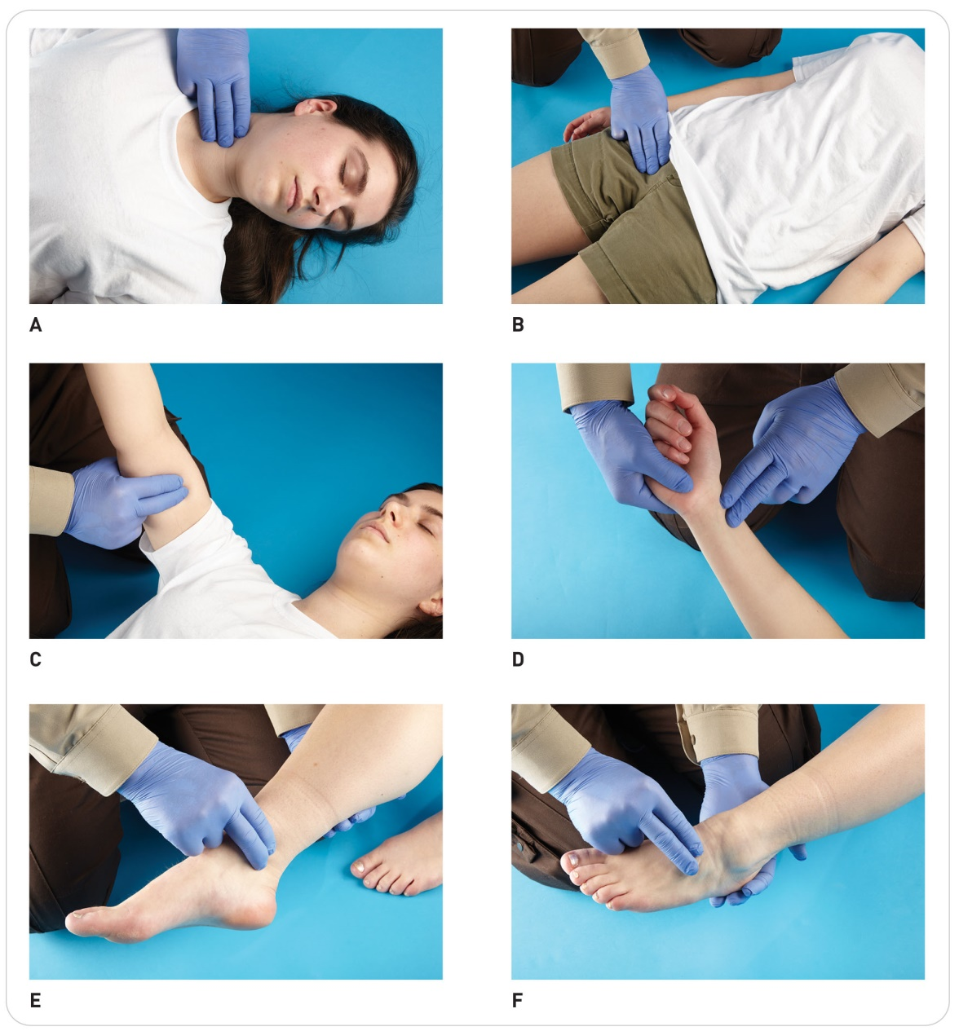
Anatomy and Physiology: Major Arteries and Pulses

Slide 21
Anatomy and Physiology: Veins
Veins transport oxygen-depleted blood back to the right side of the heart.
Venules are the smallest component of the venous circulation.
Drain into progressively larger venules and veins
The two major veins:
The superior and inferior venae cava, which drain into the right side of the heart.

Slide 22
Anatomy and Physiology: Veins
Blood from the body drains to the:
Superior Vena Cava:
Venous blood from the head, arms, and chest
Inferior Vena Cava:
Blood from the legs and abdomen
Blood then goes through the right side of the heart.
Then to the lungs where carbon dioxide is excreted, and oxygen is taken in
Blood goes back to the left side of the heart.
Then the cycle is repeated.

Slide 23
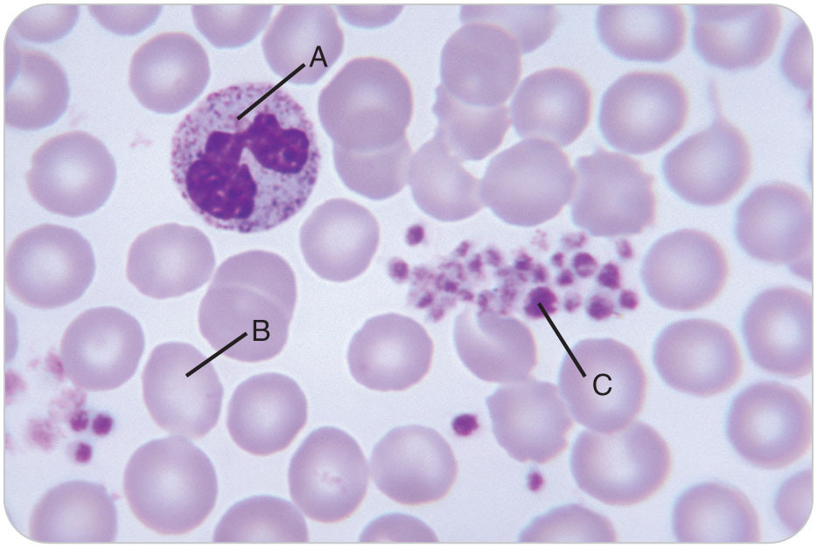
Anatomy and Physiology: The Blood
The Blood
There are four main components of blood:
White blood cells
Red blood cells
Platelets
Plasma

Slide 24
Anatomy and Physiology: The Blood
Red blood cells:
Carry oxygen to the body’s cells
Assist in removing carbon dioxide
White blood cells:
Part of the body’s immune system
Helping the body defend itself against infection
Platelets:
The component of blood (along with specialized proteins from the liver in the plasma) that forms blood clots to stop bleeding

Slide 25
Cardiovascular Emergencies

Slide 26
Cardiovascular Emergencies
15-2
15-5
Most causes of cardiovascular system failure can be traced to cardiovascular disease.
A generic term that describes several diseases that affect the heart and blood vessels
Can cause a host of problems, including:
High blood pressure
Congestive heart failure
Acute myocardial infarction
Stroke

Slide 27
Cardiovascular Emergencies
15-2
15-5
15-5
“Heart attack”
Known as an acute myocardial infarction
More common in individuals 40 to 70 years of age
Can occur as early as one’s twenties
Remains a significant problem in the elderly
A feared complication is triggering a lethal arrhythmia leading to sudden cardiac arrest.
The heart cannot pump blood

Slide 28
Cardiovascular Emergencies
15-2
15-5
15-5
Most causes of cardiovascular disease are attributed to coronary artery disease.
Coronary artery disease is the narrowing of the coronary arteries, which supply blood and oxygen to the muscle of the heart.
Atherosclerosis is when cholesterol and lipid plaques form within the walls of arteries.

Slide 29
Cardiovascular Emergencies: Congestive Heart Failure
15-2
15-5
15-5
Congestive Heart Failure
The heart cannot adequately pump blood to body tissues.
Blood backs up into the major blood vessels that leads to the heart and certain organs.
Called congestive heart failure (CHF)
One or both sides of the heart can fail.

Slide 30
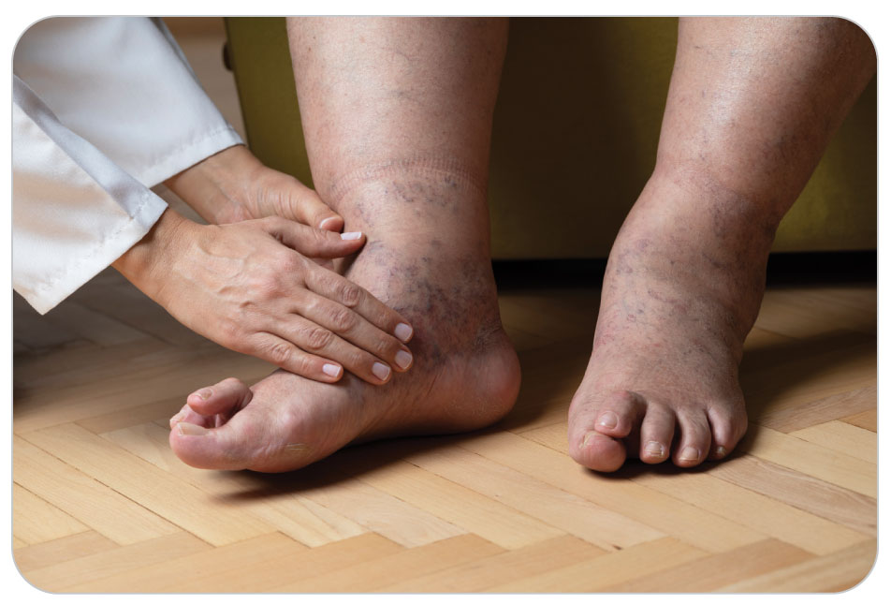
Cardiovascular Emergencies: Congestive Heart Failure
15-2
15-5
15-5
Right-sided CHF results in the backup of blood in the venous system.
The body’s blood return circuit
Causes leakage of the fluid part of the blood into the extremities, commonly the legs, ankles, and feet
Resulting swelling is known as pedal edema.

Slide 31
Cardiovascular Emergencies: Congestive Heart Failure
15-2
15-5
15-5
Left-sided CHF causes blood to backup in the lungs resulting in:
Shortness of breath
Fluid in the lungs known as pulmonary edema
Causes difficulty breathing

Slide 32
Cardiovascular Emergencies: Pulmonary Edema
Pulmonary edema
Pulmonary edema is an accumulation of fluid in the lungs.
Cause may be due either to:
The heart failing
Other non-heart-related causes
Common cause: heart damage from an AMI
Other conditions include: untreated hypertension, heart valve disease, direct trauma to the lung tissue, and certain drugs (heroin)

Slide 33
Cardiovascular Emergencies: Pulmonary Edema
Results from the inability of the left ventricle to pump blood effectively to the body
Blood backs up into the lungs.
Causes an increase in fluid pressure within the pulmonary capillaries
Fluid seeps into the alveoli.
Prevents proper exchange of oxygen and carbon dioxide
Leads to moderate-to-severe hypoxemia (low oxygen in the blood) with associated respiratory distress

Slide 34
Cardiovascular Emergencies: Pulmonary Edema
Respiratory centers within the brain signal the body to breathe faster.
The lungs become more damaged.
Red blood cells leak into the alveoli.
Lead to frothy, blood-tinged fluid to be coughed up
Eventually patient develops cardiogenic shock from profound hypoxia.
Another cause of pulmonary edema is altitude illness.

Slide 35
Cardiovascular Emergencies: Angina Pectoris
15-2
15-5
15-5
Angina Pectoris
Angina pectoris is chest pain or discomfort caused by ischemia (lack of oxygen) of the myocardium (heart muscle).
Simply referred to as angina
Heart muscle is not getting enough oxygen.
Typically manifested as chest discomfort
When the stressor is eliminated, the pain usually subsides.

Slide 36
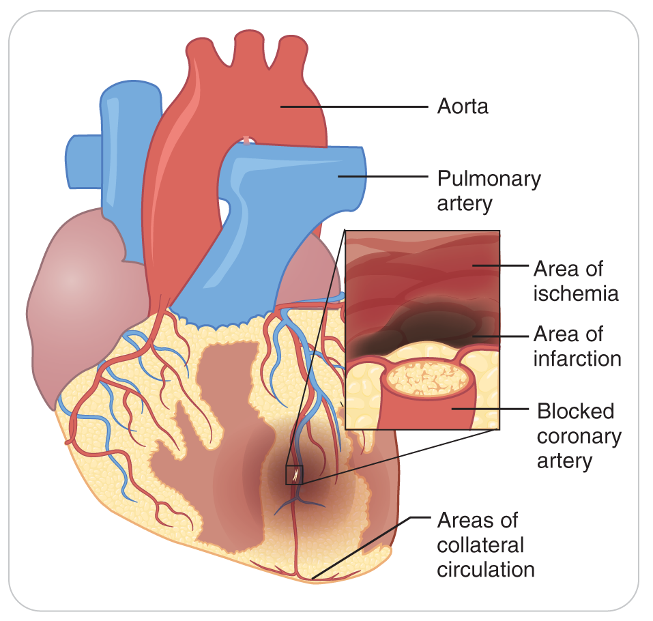
Cardiovascular Emergencies: Myocardial Infarction
15-2
15-5
15-5
Myocardial Infarction
A myocardial infarction is a blockage in one or more of the coronary arteries.
Results in ischemic death of heart muscle that is supplied by the blocked artery(s)
Also known as acute myocardial infarction (AMI)

Slide 37
Cardiovascular Emergencies: Myocardial Infarction
15-2
15-5
15-5
A blood clot is the most common source of the blockage.
Represents approximately 90% of all myocardial infarction cases
A small atherosclerotic plaque in the coronary artery has ruptured or dislodged.
A blood clot forms to repair the rupture.
The coronary artery can become completely blocked.
Preventing blood flow past the blockage
Another cause is the gradual growth of plaques in coronary vessels until they completely prevent blood flow through the vessels.

Slide 38
Cardiovascular Emergencies: Myocardial Infarction
15-2
15-5
15-5
The heart tissue supplied by an obstructed coronary artery becomes oxygen starved.
The tissue begins to die.
This area of dead heart muscle is referred to as an infarct.
If enough heart muscle is damaged, the heart cannot pump effectively.
Leads to a host of other life-threatening problems, including:
Cardiac arrhythmias
CHF
Cardiogenic shock
Death

Slide 39
Cardiovascular Emergencies: Cardiac Arrhythmias
15-1
Built into the heart is a pathway with a coordinated electrical signal.
Makes the heart beat in a normal rhythm
Any abnormality can lead to an irregular heart beat or heart rhythm.
Known as an arrhythmia
Can compromise normal heart function
Arrhythmias can be caused by:
A blockage of the electrical pathway through the heart muscle
An abnormal electrical signal somewhere in the heart muscle

Slide 40
Cardiovascular Emergencies: Cardiac Arrhythmias
15-1
Sudden life-threatening arrhythmias may be caused by ischemia (lack of oxygen) of the heart muscle.
The effects of cardiac arrhythmias are:
Slow the heart rate to below 60 beats per minute (bradycardia)
Speed it up to above 100 beats per minute (tachycardia)
Alter the regularity of the rhythm
Stop the heart, resulting in sudden cardiac arrest
Many arrhythmias affect the ability of the heart to pump blood.
Cause a severe drop in blood pressure
Leads to cardiogenic shock

Slide 41
Cardiovascular Emergencies: Cardiac Arrhythmias
15-1
Not all arrhythmias cause immediate life-threatening problems.
Some chronic arrhythmias are relatively benign.
Still indicate a problem with the heart’s electrical system
Chronic cardiac arrhythmias can cause blood to stagnate and clot within the heart.
Such clots can break free.
Travel to the brain or elsewhere in the body
May block blood flow

Slide 42
Cardiovascular Emergencies: Cardiac Arrhythmias
15-1
15-4
People who have certain chronic arrhythmias are put on medications that prevent the blood from clotting.
Some patients take prescribed “blood thinning” medications.
These medications are called anticoagulants.
Slow the normal clotting process for patients with certain medical conditions
Heart arrhythmia
History of a blood clot in the leg, lung, heart, or brain
Bleeding is more difficult to control in these patients.

Slide 43
Cardiovascular Emergencies: Cardiac Arrhythmias
15-1
15-4
Common “blood thinners” include:
Aspirin
Warfarin (Coumadin)
Dabigatran (Pradaxa)
Clopidogrel (Plavix)

Slide 44
Cardiovascular Emergencies: Cardiogenic Shock
15-2
Cardiogenic Shock
Enough heart muscle is suddenly and severely damaged.
The heart can no longer pump.
Cardiogenic shock is a condition in which the heart can not adequately pump blood.

Slide 45
Cardiovascular Emergencies: Sudden Cardiac Arrest
15-1
Sudden Cardiac Arrest
Sudden cardiac arrest (SCA) is the abrupt cessation of effective pumping of blood from the heart into the coronary arteries, the brain, and other vital organs.
Caused by arrhythmias:
Ventricular fibrillation (VF)
Chaotic
Ineffective contractions of the ventricles
Leads to cardiac arrest

Slide 46
Cardiovascular Emergencies: Sudden Cardiac Arrest
15-1
Caused by arrhythmias (cont’d):
Ventricular tachycardia (VT)
A rapid regular contraction of the ventricles
Leads to ineffective blood flow to the body tissues
Eventually leading to cardiac arrest
Asystole is an abrupt cessation of all cardiac electrical activity.
Without cardiopulmonary resuscitation (CPR) and the use of an automated external defibrillator (AED), nearly all sudden cardiac arrest (SCA) will die.
An automated external defibrillator (AED) is a medical device:
Used to deliver an electrical shock
To restore an effective heart rhythm

Slide 47
Cardiovascular Emergencies: Pericarditis
15-2
15-5
Pericarditis
Pericarditis is an inflammation of the pericardial sac that surrounds the heart.
Among the numerous causes of pericarditis are:
Myocardial infarction
Bacterial and viral infections
Trauma
The inflammation can cause the pericardium to rub against the heart.
Results in severe pain
Especially upon deep inhalation or coughing

Slide 48
Cardiovascular Emergencies: Pericarditis
15-2
15-5
15-5
Pericardial Tamponade
Excess fluid may build up within pericardial sac.
Applies external pressure to the heart
Prevents adequate filling of the heart with blood
Restricts the heart’s ability to pump effectively
Pericardial Tamponade from trauma usually occurs suddenly.
While pericarditis develops slowly
Rapidly leading to death without treatment at a hospital

Slide 49
Cardiovascular Emergencies: Aortic Aneurysm
15-2
15-5
15-5
Aortic Aneurysm
An aneurysm is a localized dilation in a blood vessel.
Like a “bubble” that forms on an overinflated bicycle inner tube
Causes are:
Congenital (born with the condition) OR
From the degenerative weakening of the vessel wall over time, caused by:
Atherosclerosis, hypertension, and smoking

Slide 50
Cardiovascular Emergencies: Aortic Aneurysm
15-2
15-5
15-5
Aortic aneurysm is an aneurysm that occurs anywhere along the length of the aorta.
Potentially deadly in the abdomen or in the chest
Nearly all patients will bleed to death within minutes.

Slide 51
Cardiovascular Emergencies: Aortic Dissection
15-2
15-5
15-5
Aortic dissection is a condition in which the inner wall tears away from the outer wall.
Due to the high pressure within the aorta
The tear grows and can penetrate the other layers of the vessel.
Weakens the vessel wall
Makes it susceptible to rupture
Should rupture occur, life-threatening internal bleeding ensues.

Slide 52
Cardiovascular Emergencies: Aortic Dissection
15-2
15-5
Thoracic aortic dissection:
A severe tearing sensation between the shoulder blades
Symptoms may be confused with an AMI.
Abrupt stop causing trauma to the chest:
Can cause tearing of the thoracic aorta with aortic dissection
Followed by rupture and rapid death
Example: when a skier hits a tree at a fast speed

Slide 53
Patient Assessment of Cardiovascular Emergencies

Slide 54
Patient Assessment: Primary Assessment
15-2
Ensure that the scene is safe.
Perform a primary patient assessment.
Address any problem related to ABCDs.
Cardiac arrest will be:
Unresponsive
Apneic
Pulseless
Immediately begin CPR.
Call for an AED and ALS.
Do not delay transport, except to use an AED.

Slide 55
Patient Assessment: Secondary Assessment
15-2
For a secondary assessment:
Pay close attention to:
Any complaints of chest pain
Any cardiac medications such as nitroglycerin or aspirin
If took nitroglycerin, ask if the symptoms:
Went away
Diminished
Stayed the same
Cardiovascular emergency patients may have difficulty communicating.
Gather historical information from a relative or friend.

Slide 56
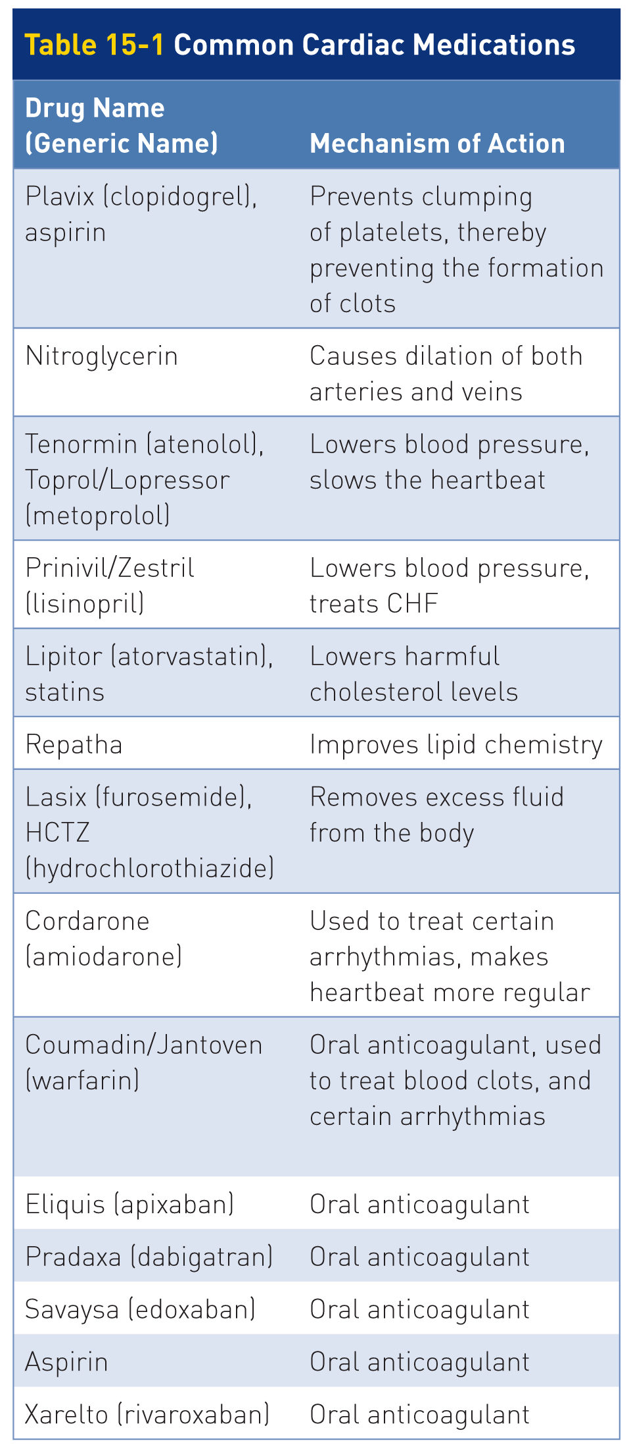
Patient Assessment of Cardiovascular Emergencies
15-2
15-3
If a patient tells you they take a “heart” medication, ask:
What?
Why they take it?
Ask a family member if needed.

Slide 57
Patient Assessment: OPQRST
15-2
If patient complains of chest discomfort or pain, use OPQRST mnemonic.
Cardiac chest pain is usually described as:
“Heavy”
“Crushing”
“Tight”
Less commonly described as:
“Sharp”
May indicate that the pain increases during inspiration
May locate the pain in the chest wall or over the stomach

Slide 58
Patient Assessment
15-2
Ask patients if the pain is only in the chest or radiates into the jaw, abdomen, back, or down the arm.
Referred pain can indicate a myocardial infarction.
Patients with a pulmonary embolism can have significant chest pain.
As an OEC technician, you will not be able to determine if a patient is having an AMI or a pulmonary embolus; both are emergencies.

Slide 59
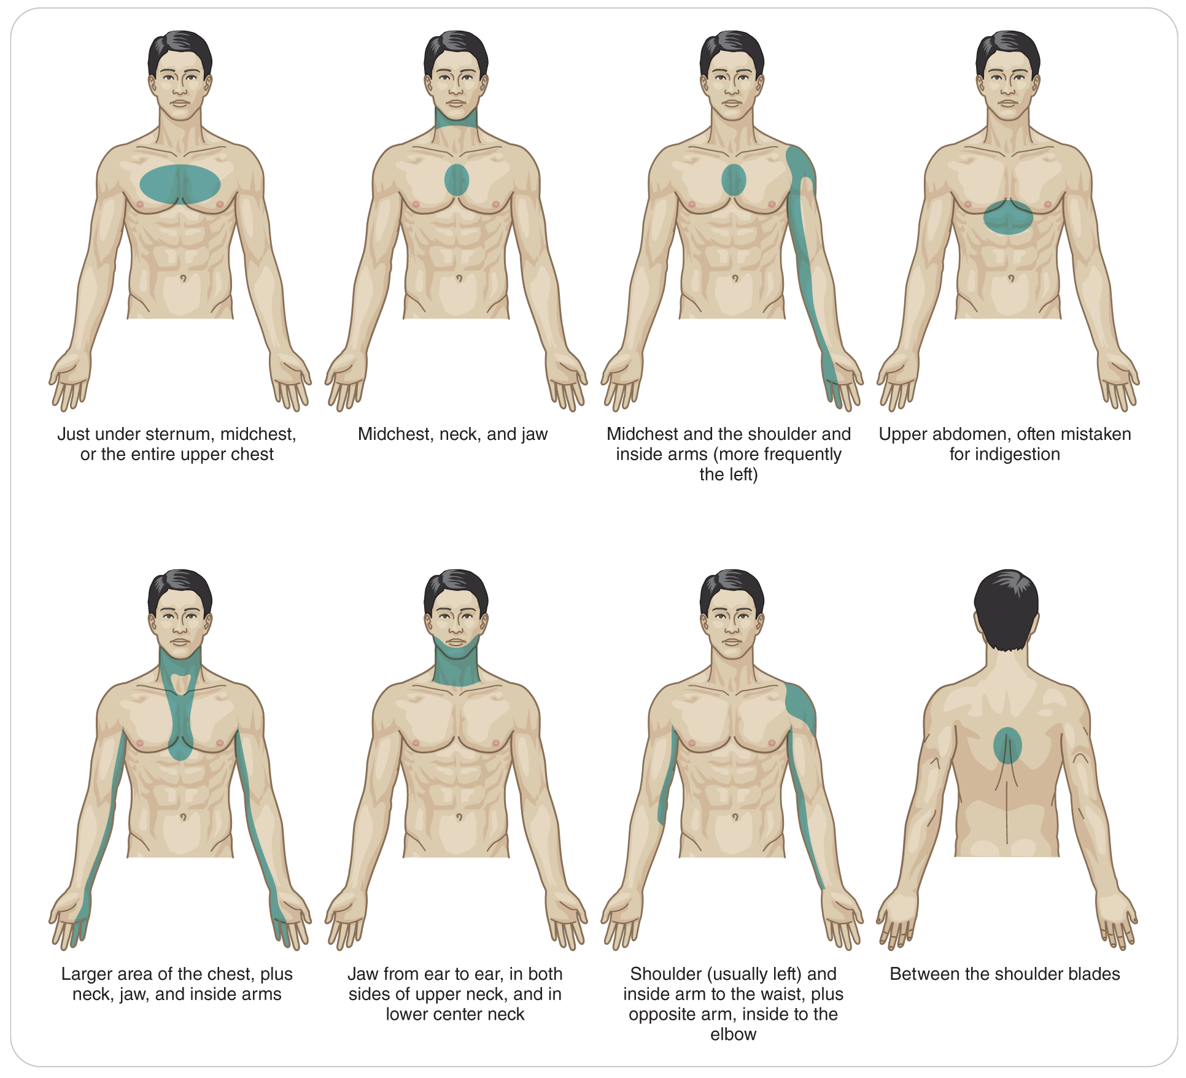
Patient Assessment
15-2

Slide 60
Patient Assessment
15-2
Patients with an aortic dissection often describe the pain as “tearing.”
The pain can be abdominal or acute severe back pain.
Depending on the site of the dissection
Ask patients whether the pain or other symptoms improve with rest or remain constant.
Ask about a patient’s medical history, including potential risk factors for cardiovascular disease.
Do not be afraid to ask about the use of street drugs.
Use of some increase the risk for AMI.
Cocaine and methamphetamine

Slide 61
Patient Assessment: Physical Exam
15-2
Next, perform a physical exam and assess vital signs:
Patients with cardiac emergencies are usually short of breath.
Check pulses, capillary refill, and level of responsiveness.
Evidence of tissue perfusion
Assess the skin for color, temperature, and profuse sweating.
Profuse sweating, or diaphoresis, is caused by ischemia during an AMI.
When outside the aid room, take a radial pulse.
If present, the systolic blood pressure is at least 80.
In the aid room, take a blood pressure with the equipment available.

Slide 62
Patient Assessment: Vitals
15-2
Reassess patient and the vital signs at regular intervals:
Every 5 minutes if patient is unstable
Every 15 minutes if patient is stable
Record the vital signs and compare the results to previous findings.
Vital signs that are deteriorating indicate that a patient has a serious medical problem.

Slide 63
Patient Assessment
15-2
You should never delay transport for a patient you think is having a cardiovascular emergency.
Call for transport early.
As soon as transport arrives, interrupt your assessment and ship patient.
Unless you have a specific treatment that will benefit patient on scene
Such as an AED

Slide 64
Patient Assessment: Hypertension
15-2
Hypertension
Symptoms and signs of hypertension generally do not become apparent until blood pressure reaches high levels.
This pressure varies from person to person.
Headache
Vision disturbances
Seizures
Nausea and/or vomiting
Facial flushing
Bounding pulse
Dangerous levels of hypertension typically complain of chest pain, shortness of breath, and/or confusion.
Transport with ALS is indicated.

Slide 65
Patient Assessment: Angina and Myocardial Infarction
15-2
Angina and Myocardial Infarction
Both lack enough delivery of oxygen to the heart muscle.
Present with same signs and symptoms
Pain:
Patient may describe in a vague way:
Such as severe “heartburn”
Only in the chest
Or may radiate into the jaw, arm, or back

Slide 66
Patient Assessment: Angina and Myocardial Infarction
15-2
Other symptoms include:
Anxiety
Dizziness
Nausea
Diaphoresis
Feelings of impending doom or death
Women may also have an atypical presentation, such as a painless myocardial infarction, more than men.

Slide 67
Patient Assessment: Silent Myocardial Infarction
15-2
Heart Attack Without Chest Pain
A “silent myocardial infarction” refers to a condition in which a patient is having AMI without chest pain.
Up to a third have no chest pain.
More common in women, diabetics, and the elderly
Will still have some symptoms. Two most common are:
Shortness of breath
Fatigue
Other complaints include upper back pain, abdominal pain, and nausea.
Some people do not seek care for a silent AMI.
But will show up on an EKG later

Slide 68
Patient Assessment: Cardiogenic Shock
15-2
Cardiogenic Shock
Patients who are in cardiogenic shock appear deathly ill and exhibit signs of shock, including:
Pale skin
Diaphoresis
Anxiety
Respiratory distress

Slide 69
Patient Assessment: Cardiogenic Shock
15-2
If the cause of the shock is:
AMI
Tachycardic
Hypotensive
Abnormal heart rhythm
Bradycardic or Tachycardic
Hypotensive

Slide 70
Patient Assessment: Congestive Heart Failure
15-2
Congestive Heart Failure
Wide range of signs and symptoms
Depends on which side of the heart is affected
Right-sided CHF causes:
Edema in the lower extremities
Swollen ankles that may or may not be painful to the touch
With time can become severe and may progress up the leg
Pressing the swollen area gently with a finger may leave an indentation.
Known as “pitting edema,” a common finding
The more pronounced the swelling, the more severe the effects of heart failure.

Slide 71
Patient Assessment: Congestive Heart Failure
15-2
Left-sided CHF causes:
Blood to back up into the lungs
Symptoms:
Shortness of breath
Mild
Profound dyspnea
With audible “bubbling” sounds
With gasping breaths due to fluid in the lungs
Patients can have both right-sided and left-sided CHF at the same time.

Slide 72
Patient Assessment: Pericardial Tamponade
15-2
Pericardial tamponade
Patients with pericardial tamponade appear gravely ill.
Signs and symptoms:
Short of breath
Appear anxious or restless
Pale, cool, diaphoretic skin
Hypotension, abnormally low blood pressure
Chest pain
Tachycardia
Hallmark signs are:
Hypotension
Distended neck veins

Slide 73
Patient Assessment: Pericardial Tamponade
15-2
Pulse pressure narrows:
The systolic and diastolic blood pressure numbers get closer.
Systolic pressure is lower.
The left ventricle cannot force as much blood out when the heart contracts.
The fluid in the pericardium limits the filling capacity of the left ventricle.
Diastolic pressure gets higher.
The external pressure on the heart when it relaxes
Patients with gradual onset pericardial tamponade may initially present with fatigue and tachycardia only.

Slide 74
Patient Assessment: Aortic Aneurysm
15-2
Thoracic Aortic Dissection
Commonly complains of severe chest pain and occasionally back pain
Pain described as tearing, ripping, or stabbing
The pain frequently radiates to the back between the shoulders.
Unless the dissection has ruptured, patient may be hypertensive.
Rupture of the thoracic aorta can occur when a person hits a fixed object with his or her chest when moving rapidly.

Slide 75
Patient Assessment: Aortic Aneurysm
15-2
Abdominal Aortic Aneurysms
Present in an older age group
Abdominal pain radiating to the groin or back pain
Decreased pulses in the groin or legs
If you suspect, abdominal exam should not be performed.
If the aneurysm ruptures, patient goes into profound shock.
Hypotension
Diaphoresis
At great risk for dying

Slide 76
Patient Assessment: Pulmonary Embolism
15-2
Pulmonary Embolism (Thromboembolism)
The hallmarks of pulmonary embolism are:
A sudden onset of chest pain
Shortness of breath
Rapid breathing
Tachycardia
The pain is often described as “sharp” and increases with deep breaths.
Patient also may be cyanotic.
Pulse Oximeter: may be hypoxic if they do not compensate by breathing fast

Slide 77
Patient Assessment: Pulmonary Embolism
15-2
For patients you suspect have pulmonary embolism, look for the presence of deep vein thrombosis (DVT).
Signs and symptoms of DVT:
Affect only one leg
Severe pain
Tenderness to touch
Swelling, usually in the calf
The most dangerous DVTs form in the larger pelvic veins.
Often asymptomatic until they break loose causing a pulmonary embolism
While finding a DVT will not affect your acute management, it can help support the diagnosis.

Slide 78
Management of Cardiovascular Emergencies

Slide 79
Management: Overview
15-2
Time is of the essence.
The more time that passes without medical intervention:
The greater the extent of the myocardial infarction
The greater the heart damage
The more likely this situation will proceed to Sudden Cardiac Arrest (SCA)
SCA occurs most often within the first hour of Acute Myocardial Infarction.
Transport with ALS assistance should be requested immediately.
Call for oxygen and an AED as soon as possible.
If patient becomes hypoxic, or cyanotic, use the oxygen.

Slide 80
Management: ABCDs
15-2
Initial care: ABCDs.
Severe difficulty breathing?
Make sure the airway is open.
Assist patient’s breathing efforts.
Provide high-flow oxygen with a nonrebreather mask.
When inside, regulate with a pulse oximeter.
Oxygen saturation equal to or greater than 94%
Patient diaphoretic and cyanotic?
Use oxygen immediately.

Slide 81
Management: Cardiac Arrest
15-2
Cardiac Arrest
Rapid primary patient assessment necessary
Correction of threats to life:
CPR
Use of an AED
Rapid transport using ALS
If rapidly available, oxygen can be provided.
If unresponsive, pulseless, and apneic:
Recognize the primary problem is lack of circulation.
Immediately begin CPR.
Should be assessed following a CAB approach.

Slide 82
Management: Cardiac Arrest
15-2
Using CAB assesses circulation first.
Unresponsive patient?
Immediately check for a pulse.
No pulse?
Begin chest compressions.
Need to open the airway and simultaneously check for breathing.
Absent pulse and no breathing?
Begin basic life support (BLS) measures immediately.

Slide 83
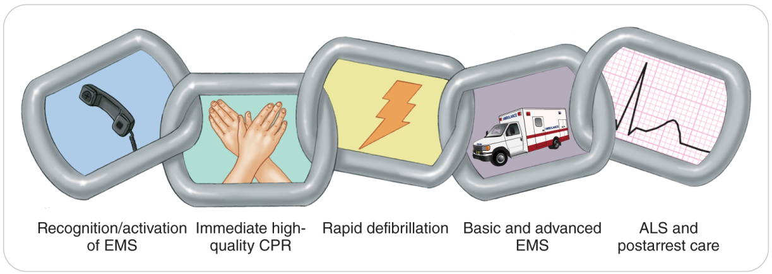
Management: Chain of Survival
15-2
The five links in the adult out-of-hospital chain of survival are:
Recognition of early warning signs and immediate activation of the emergency medical services
Immediate CPR with an emphasis on high-quality chest compressions
Rapid defibrillation
Basic and advanced emergency medical services
Advanced life support and post-arrest care

Slide 84
Management: First Link in the Chain of Survival
15-2
Recognition of Early Warning Signs and Immediate Activation of the Emergency Medical Services
First link in the chain of survival
Focuses on recognizing the signs and symptoms of Sudden Cardiac Arrest
Trained ALS medical personnel are needed rapidly.
Specialized equipment and medications
Delays decrease patient’s chances of survival.

Slide 85
Management: CPR Requirements for OEC Technicians
15-2
Approved programs that teach CPR:
Follow the lead of the American Heart Association, Emergency Cardiac Care standards.
Mandatory for all OEC technicians to maintain current certification in the CPR and AED methods.
Must demonstrate CPR skills annually to a CPR Instructor

Slide 86
Management: Second Link in Chain of Survival
15-2
Immediate CPR with Emphasis on High-Quality Chest Compressions
Survival rates fall drastically when CPR is delayed.
CPR must be initiated as quickly as possible to anyone needing it.
Goal is to pump remaining oxygenated blood from the heart to other vital organs.
The most critical step in the performance of CPR is the effective use of chest compressions, minimizing any interruption of compressions.
The current philosophy in CPR care is “Push hard, push fast.”
At least 100 times a minute
Allow time for full recoil of the chest to occur.

Slide 87
Management: Second Link in Chain of Survival
15-2
Once begun, CPR should not be stopped unless:
Patient improves
Return of Spontaneous Circulation (ROSC)
An AED has been attached to patient and is ready to be used
Do not stop compressions until the AED is attached, powered on, and ready to analyze.
Rescuers are too tired to continue
Care has been transferred to another health care provider of equal or higher competency
Patient is declared dead

Slide 88
Management: Third Link in Chain of Survival
15-2
Rapid Defibrillation
The third link in the chain of survival is to correct life-threatening arrhythmias as soon as possible.
VF and VT
While CPR is important to maintain circulation to vital organs, the key is to reestablish cardiac circulation.
Done by defibrillation, using a defibrillator
Device used in the field for defibrillation by BLS providers is called an automated external defibrillator (AED).
Delivers an electric shock (defibrillation) to convert VT or VF to an effective heartbeat.

Slide 89
Management: Third Link in Chain of Survival
15-2
When an AED delivers a shock:
Temporarily stops the heart’s electrical activity
Allows the heart’s internal pacemaker cells to reset
If the heart is capable, it will resume directing the heartbeat in an organized fashion.
In the US, when an AED is used during out of hospital care, survival is greatly improved.

Slide 90
Management: Third Link in Chain of Survival
15-2
An AED must be applied quickly.
Its effectiveness decreases very rapidly over several minutes.
After 10 minutes of pulseless cardiac arrest due to VT or VF without CPR, the heart is nearly completely nonresponsive to electrical stimulation.
CPR can expand the window of time for which defibrillation may be effective.

Slide 91
Management: Third Link in Chain of Survival
15-2
When two trained rescuers are on scene:
One person: CPR should be performed
Second rescuer: finds an AED
If CPR is in progress and an AED is available:
Continue CPR while the pads are applied and the AED is turned on.
Stop CPR only when the machine is ready to analyze and directs everyone to stand back and not touch patient.
Recent studies indicate that an AED may be safely used on cardiac-arrest patients of any age.

Slide 92
Management: Fourth Link in Chain of Survival
15-2
Basic and Advanced Emergency Medical Services
The fourth link is basic and advanced emergency medical services.
Provide valuable interventions and lifesaving medications for cardiac arrest patients
Calling for ALS early is important so advanced interventions can be given to patient.

Slide 93
Management: Fifth Link in Chain of Survival
15-2
Advanced Life Support and Post-Arrest Care
The final link provides:
Advanced life support
Transport
Care at a critical care facility
Definitive care at a hospital is part of the last link in the chain of survival.
The survival rate from an AMI is better, provided the chain of survival is maintained.

Slide 94
Management: Post-Arrest Care
15-2
Once at the hospital, restore effective circulation to the heart with:
Thrombolytic therapy
Medications are injected to dissolve any blood clots or thrombi that may be occluding the coronary arteries.
Commonly referred to as “clot busters”
Angioplasty
Surgical technique
A small balloon is inserted into a blocked coronary artery at the site of occlusion.
The balloon is inflated, thereby restoring effective circulation.

Slide 95
Management: Post-Arrest Care
15-2
Cardiac stent
Surgical
Small wire-mesh tube inserted into a formerly blocked coronary artery to keep the vessel open and to prevent its reocclusion
Stents are commonly inserted during a heart catherization.
Coronary artery bypass grafting
Taking a vein from patient’s leg, arm, or chest
Inserting it in such a way that it bypasses a blocked coronary artery

Slide 96
Management: Post-Arrest Care
15-2
Ventricular Assist Device
The ventricular assist device (VAD) is implanted in the chest, with a battery pack outside the chest.
A pump that helps the failing heart with poor muscle
Connected to the left ventricle (LVAD), assists pumping blood into the aorta
Connected to the right ventricle (RVAD), assists pumping blood into the pulmonary arteries
Not an artificial heart but assists patient’s heart

Slide 97
Management: Post-Arrest Care
15-2
Patients with a VAD need special care.
Patient will not have a pulse.
The artificial pump’s flow is continuous.
Not intermittent like with a normal heart
A blood pressure will be hard to obtain since there is no pulse pressure.
Most of these patients are on blood thinning medications.
A pulse oximeter does not read accurately in these patients.
Patient may be in VT or VF and be talking to you as the pump is keeping blood flowing.

Slide 98
Management: Post-Arrest Care
15-2
Automatic implantable cardioverter defibrillator (AICD)
Device detects life threatening arrhythmais
Can supply a shock to the heart that restores a normal heart beat
When you have a patient with one of these devices, help is needed.
Ask patient’s family
There is usually an emergency number to call for immediate help.
If not, call 9-1-1 immediately.
Routine CPR with defibrillation can be done.
Controversial if chest compressions can be done without damaging the device

Slide 99
Management: Cardiovascular Patients
15-2
Cardiovascular Patients Who Are Not in Cardiac Arrest
Responsive patients with a suspected cardiovascular emergency may go into cardiac arrest at any time.
Call immediately for assistance, oxygen, AED, and transport with ALS.
Attempt to keep patients calm.
Doing so will help reduce both anxiety and stress on the heart

Slide 100
Management: Cardiovascular Patients
15-2
Place patient into a position of comfort.
Chest pain: usually sitting up
Hypotensive patients: a supine position and keep them warm
CHF or pulmonary edema: seated upright because this helps breathing
Allow legs to be in a dependent position to allow excess fluid to pool in the lower extremities.
Can also permit patient to breathe more easily

Slide 101
Management: Oxygen Therapy
15-2
Oxygen Therapy
Important to maintain normal blood oxygen levels
Prehospital environment:
Difficult to measure blood oxygen levels
When clinically indicated with hypoxemia or cyanosis, oxygen therapy should be initiated.
Administer high-flow oxygen at 15 LPM via a nonrebreather mask.
Inside:
Use a pulse oximeter to titrate the oxygen flow.
Oxygen saturation greater than or equal to 94% and 99%

Slide 102
Management: Oxygen Therapy
15-2
If claustrophobic when an oxygen mask is used:
Calm patient.
Avoid worsening their anxiety and increasing oxygen demands on the heart.
Consider using a nasal cannula.
Administer oxygen at 4 to 6 LPM.
Better than no oxygen
The use of a mask is preferred.

Slide 103
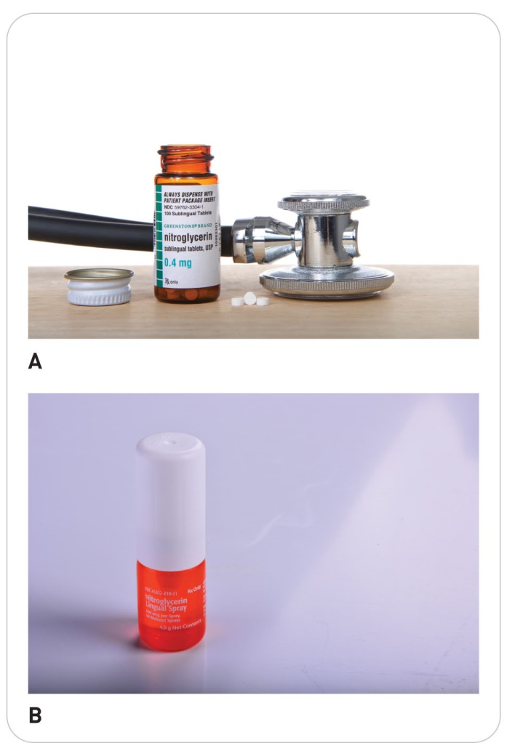
Management: Nitroglycerin
15-7
Nitroglycerin
Some patients with angina pectoris may carry their own nitroglycerin.
A medication used to relieve chest pain
This drug may be used only by patient for whom it has been prescribed.
You may need to assist patient in taking this medicine.
If permitted by area, state, or provincial protocols
Should call for transport and ALS

Slide 104
Management: Nitroglycerin
15-6
Nitroglycerin should be given only to a patient who:
Has chest pain
Is awake
Is responsive
Contraindications:
Expired
Not prescribed for that patient
Systolic blood pressure is less than 100 mm Hg
Three doses of nitroglycerin already for this episode of chest pain
Used a medication for erectile dysfunction (e.g., Viagra, Levitra, Cialis) within the past 24 hours
Chest pain is due to trauma (is not cardiac in origin)

Slide 105
Management: Nitroglycerin
15-7
Steps to assist patients in taking their own nitroglycerin tablets:
Check systolic BP to ensure it is over 100 mm Hg.
Check medication is prescribed for this patient and not expired.
Put on your disposable gloves.
Remove one tablet from the bottle.
Place the tablet in patient’s hand.
Instruct patient to place the medication under the tongue. Allow it to dissolve completely.
Do not chew or swallow the tablet.
If necessary, assist patient by putting the medication in place once patient has lifted the tongue.

Slide 106
Management: Nitroglycerin
15-7
If patient is still experiencing chest pain:
Assist patient in taking two more doses of nitroglycerin.
A total of three doses
At 5-minute intervals
This total of three doses includes any taken immediately before your arrival.
Recheck patient’s blood pressure after each dose.
If systolic pressure is less than 100 mm Hg, do not give more nitroglycerin.

Slide 107
Management: Nitroglycerin
15-7
After:
Reassure patient of commonly occurring symptoms with Nitroglycerin.
May have a burning sensation beneath the tongue
May get a headache
Document in your notes the date, time, and dosage at which the drug was administered.
Reassess frequently and recheck the vital signs at regular intervals.

Slide 108
Management: Aspirin
15-6
15-7
Aspirin
Assist a person who is having a myocardial infarction (heart attack) chew and swallow Aspirin as soon as symptoms appear.
An adult (325 mg) OR
Four pediatric (81 mg)
Most myocardial infarctions are caused by a blood clot in a coronary artery.
Clot consists of platelets.
Aspirin prevents platelets from sticking together.

Slide 109
Management: Aspirin
15-6
Contraindications:
Do not give to anyone who is either allergic to or sensitive to aspirin or wintergreen
Give only to patients who are fully responsive and can swallow.

Slide 110
Management: Aspirin
15-7
To assist a patient in taking aspirin, follow these steps:
Confirm that patient is not allergic.
Confirm there is no obvious GI bleeding.
No vomiting of blood or blood in stool
Select the proper dosage of aspirin.
One adult buffered aspirin (325 mg per tablet) or four chewable baby aspirins (81 mg)
Baby aspirin are preferred and easier for a patient to chew and swallow.
Check the expiration date of the aspirin.
Instruct patient to chew the aspirin before swallowing it.
A sip of water may help get the aspirin into the stomach.

Slide 111
Management: Aspirin
15-7
Document the date, time, and dosage administered.
Reassess patient frequently, including the vital signs.
Whenever possible, minimize patient’s physical exertion.
Exertion increases the oxygen demand on the heart.

Slide 112
Management: High Mortality Conditions
15-2
High mortality rates if lifesaving interventions are not rendered quickly:
Aortic aneurysm
Aortic dissection
Pulmonary embolism
Pericardial tamponade
Unfortunately, the field care for these threats to life is limited.
Treat for shock
Provide oxygen
Provide rapid transport with ALS to a definitive-care facility.

Slide 113
Management: Cardiovascular Patients
15-2
Cardiovascular Patients Who Are Not in Cardiac Arrest
Responsive patients with a suspected cardiovascular emergency may go into cardiac arrest at any time.
Call immediately for assistance, oxygen, AED, and transport with ALS.
Attempt to keep patients calm because doing so will help reduce both anxiety and stress on the heart.
Place patient into a position of comfort.
For patients with chest pain, this is usually sitting up.

Slide 114
Case Study

Slide 115
CASE PRESENTATION
You are called to assist a 65-year-old man who is complaining of chest pain. Upon arrival, you find patient sitting on a log. He appears to be in considerable distress. Patient tells you that he was hiking on snowshoes when he suddenly experienced a “crushing pain” in his chest that radiated down his left arm. He has a history of “heart problems” but has never experienced pain this bad before. He also complains of feeling weak and slightly nauseated. He is pale and is sweating profusely.
What should be your first step in providing care?

Slide 116
CASE UPDATE
After ensuring that the scene is safe, you call for transport with ALS assistance and begin your assessment. You note a pulse of 128 beats per minute, respirations of 28 breaths per minute and shallow, and blood pressure of 164/94. The physical exam reveals an overweight man who is short of breath and appears to be very anxious. He is pale and diaphoretic. He describes the chest pain as a “9” on a scale of 1 to 10. Upon further questioning, you discover that he has a history of angina pectoris, but according to him, “This is the worst it’s ever felt.” He also says, “I feel like I’m going to die!”
What should you do?

Slide 117
CASE OUTCOME
You administer oxygen by nonrebreather mask at 15 LPM. The man is more comfortable sitting. Soon after ALS personnel arrive, you assist them in transporting patient to an ambulance waiting at the trailhead. Later, you learn that patient had a myocardial infarction. He underwent a cardiac catherization placing a stent into the blocked coronary artery and is expected to make a complete recovery.

Slide 118
OEC Skill Activities

Slide 119
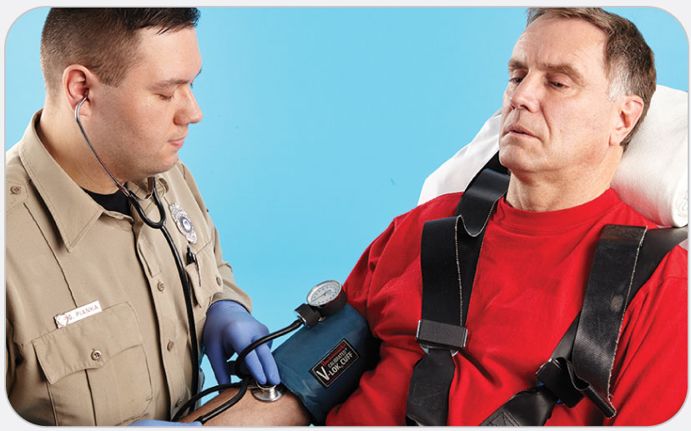
OEC Skill 15-1: Administering Nitroglycerin
1. Check systolic blood pressure to ensure it is over 100 mm Hg.

Slide 120
OEC Skill 15-1: Administering Nitroglycerin
2. Check the medication to ensure it is prescribed for patient and that it has not expired. Do NOT shake the metered-dose spray.

Slide 121
OEC Skill 15-1: Administering Nitroglycerin
3. Instruct patient to lift the tongue.

Slide 122
OEC Skill 15-1: Administering Nitroglycerin
4. Apply one spray beneath patient’s tongue.

