Slide 1
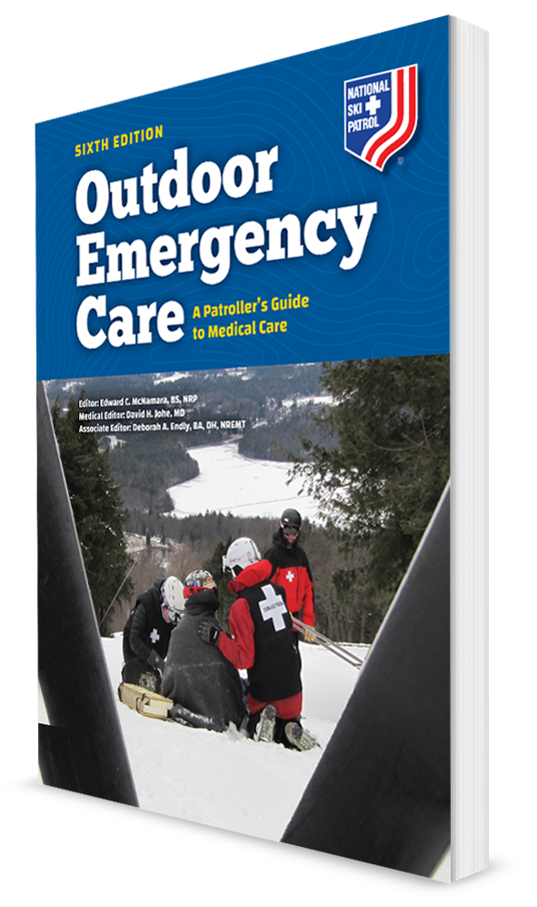
Principles of Trauma
CHAPTER 18

Slide 2
The following presentation will utilize two symbols to identify material necessary for an OEC Technician to comprehend:
key term
Meets a Chapter Objective.
This symbol will have the corresponding Objective Number denoted within.
Identifies a Key Term.
The Key Term will be underlined for easy identification.

Slide 3
Objectives
18-1 Define mechanism of injury.
18-2 Describe the five mechanisms of injury.
18-3 Describe why specific patients should be sent to a trauma center versus a community hospital.
18-4 Describe and demonstrate the management of a trauma patient.

Slide 4
Key Terms
Golden hour
Injury pattern
Kinetic energy
Trauma
Trauma center

Slide 5
Chapter Overview

Slide 6
Chapter Overview
Trauma is a physical injury caused by an external force.
Trauma is the leading cause of death in the United States for individuals up to the age of 45 years.
Fourth leading cause of death overall for all ages
Sixth leading cause of death worldwide
Fifth leading cause of significant disability worldwide
Trauma is the most common emergency that OEC technicians will encounter.
It is essential that OEC Technicians have a firm understanding of the causes and basic management of trauma or physical injury caused by an external source.

Slide 7
Mechanisms of Injury

Slide 8
Kinetic Energy and Injury Pattern
18-1
Kinetic Energy is the energy of a moving object.
The speed of the individual is the important factor, not the size or weight.
The Mechanism of Injury (MOI) is the type of force that acts on the body to cause injury or the method of trauma causing an injury.
An injury pattern is a set of problems associated with a specific source of trauma.
Stopping Distance is the amount of space necessary for kinetic energy to dissipate during an impact.
The distribution and severity of injury is vastly different because of the flexibility of the object.

Slide 9
Different Types of MOIs
18-2
OEC technicians should be familiar with the following five major MOIs:
Impact/blunt injury
Penetrating injury
Rotational injury
Crush injury
Blast injury

Slide 10
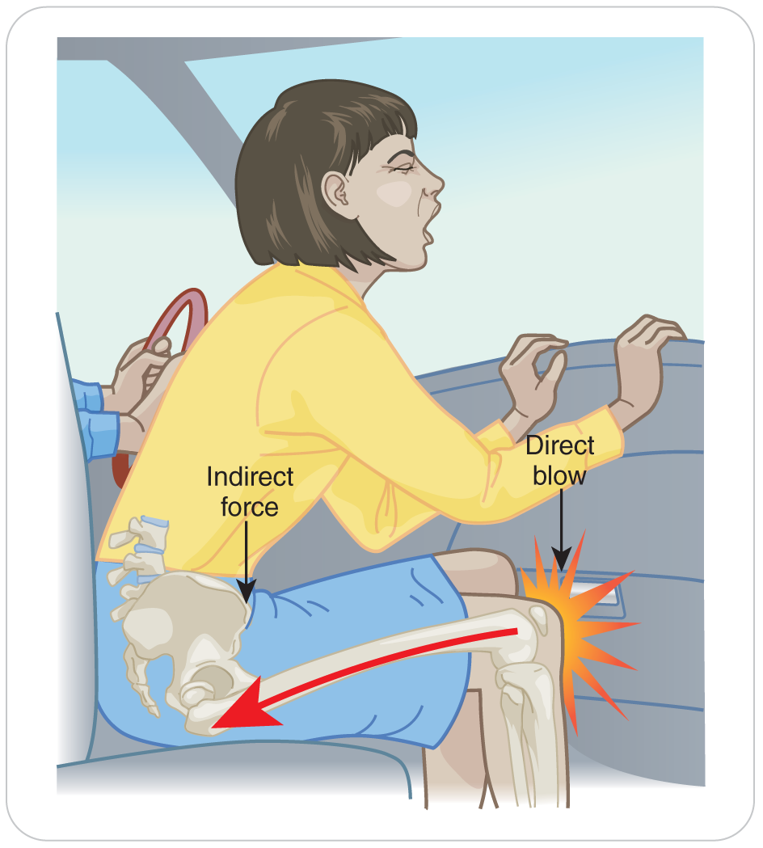
Impact/Blunt Injury
18-2
Severity of bodily injury from blunt trauma is directly related to three factors:
Amount of kinetic energy absorbed
Direction the energy travels through the body
Density of the body structures impacted

Slide 11
Impact/Blunt Injury (Cont’d)
18-2
An impact/blunt, or “closed,” injury is one in which kinetic energy is transmitted through, but does NOT break, the skin.
Transmitted to underlying structures, resulting in injuries such as:
Bruised tissues
Internal bleeding
Broken bones
Organ damage
Impact/blunt injuries are commonly seen in falls, ski slope collisions, snowmobile accidents, and as a result of physical assault.

Slide 12
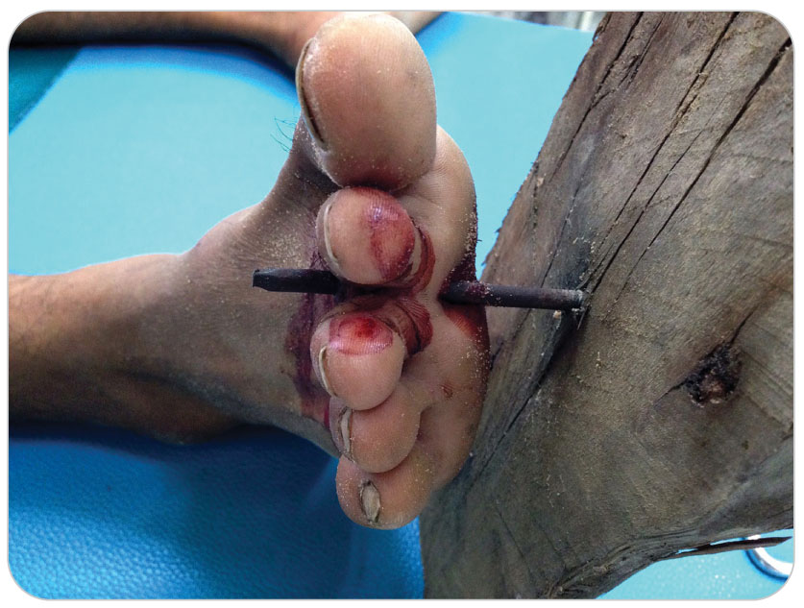
Penetrating Injury
18-2
An “open” injury, one that breaks the skin and damages underlying structures
Smaller surface of the skin is affected when an object in motion strikes the body and pierces the skin.
Can also occur when the body impales itself upon an object such as a tree branch, a ski pole, or an ice axe
Penetrating injuries are divided into two categories: High and Low Velocity Wounds.

Slide 13
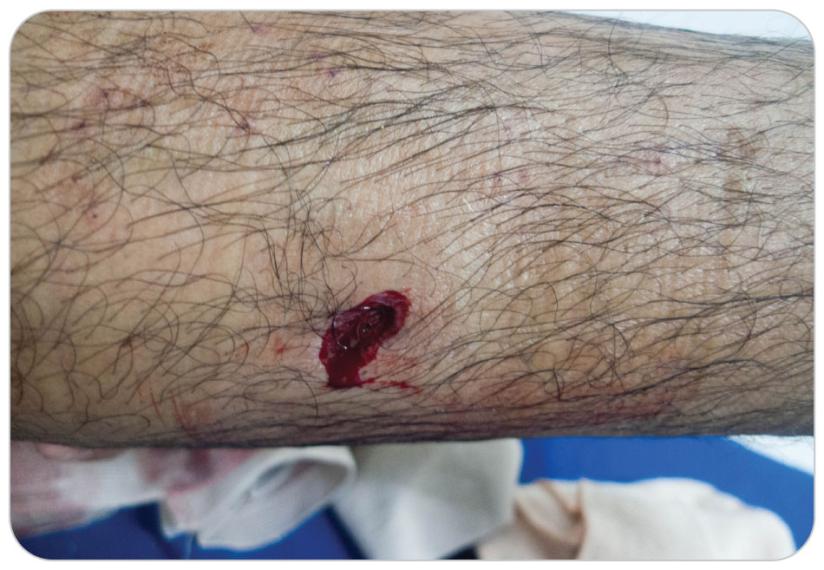
Penetrating Injuries: High-Velocity Wounds
18-2
High-velocity wounds occur when an object is moving faster than 2,000 feet/second.
These injuries are usually caused by bullets from high-powered hunting rifles and military weapons.
High-velocity wounds cause extensive tissue destruction that spreads out and away from the path of the projectile.

Slide 14
Penetrating Injuries: Low-Velocity Wounds
18-2
Low-velocity wounds occur when an object is moving slower than 2,000 feet/second.
Gunshot wounds from handguns and stab wounds are examples of low velocity wounds.
Tissue destruction is limited to the actual path of the moving object.

Slide 15
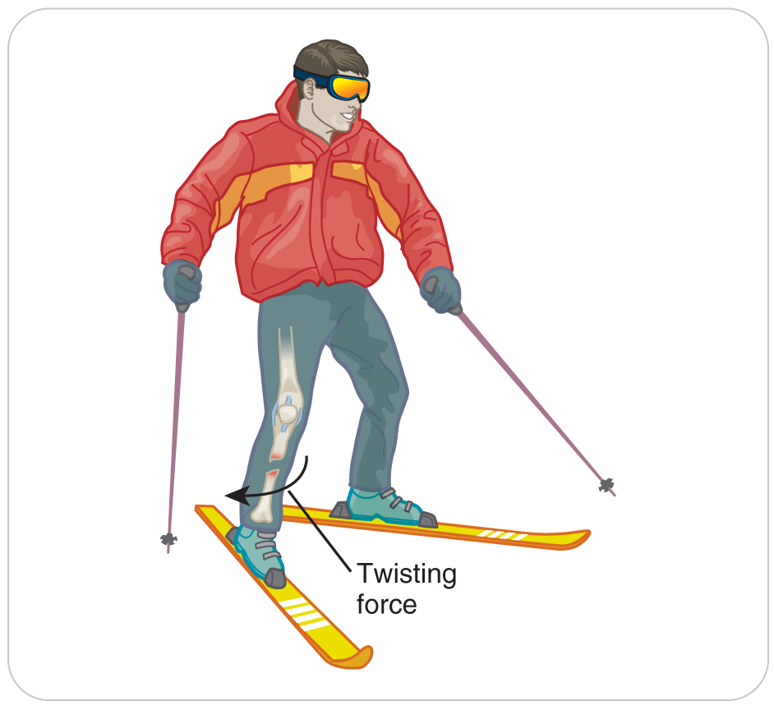
Rotational Injury
18-2
Occur when energy is transmitted to the body in a twisting direction
Twisted through an abnormal range of motion
Primary factor in a rotational injury is the direction the energy is traveling through the body.
Examples include:
Turning an ankle while hiking
Dislocating a shoulder after catching a ski pole on a tree branch
Twisting the lower leg and causing a spiral tibia fracture

Slide 16
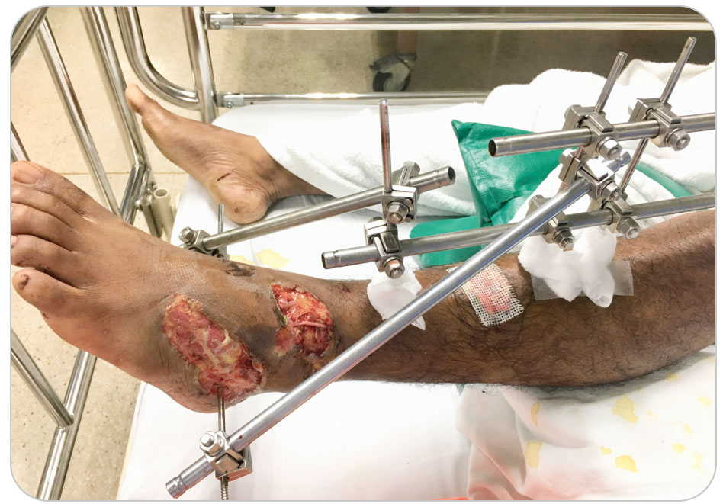
Crush Injury
18-2
A crush or compression injury occurs when a body part is caught between two or more hard objects and is subjected to significant compressive force or pressure.
Can produce devastating wounds that include penetrating trauma, blunt trauma, or both
Common in river sports, backcountry skiing, and mountaineering
Avalanche victims can also suffer from crush injuries from heavy packed snow.

Slide 17
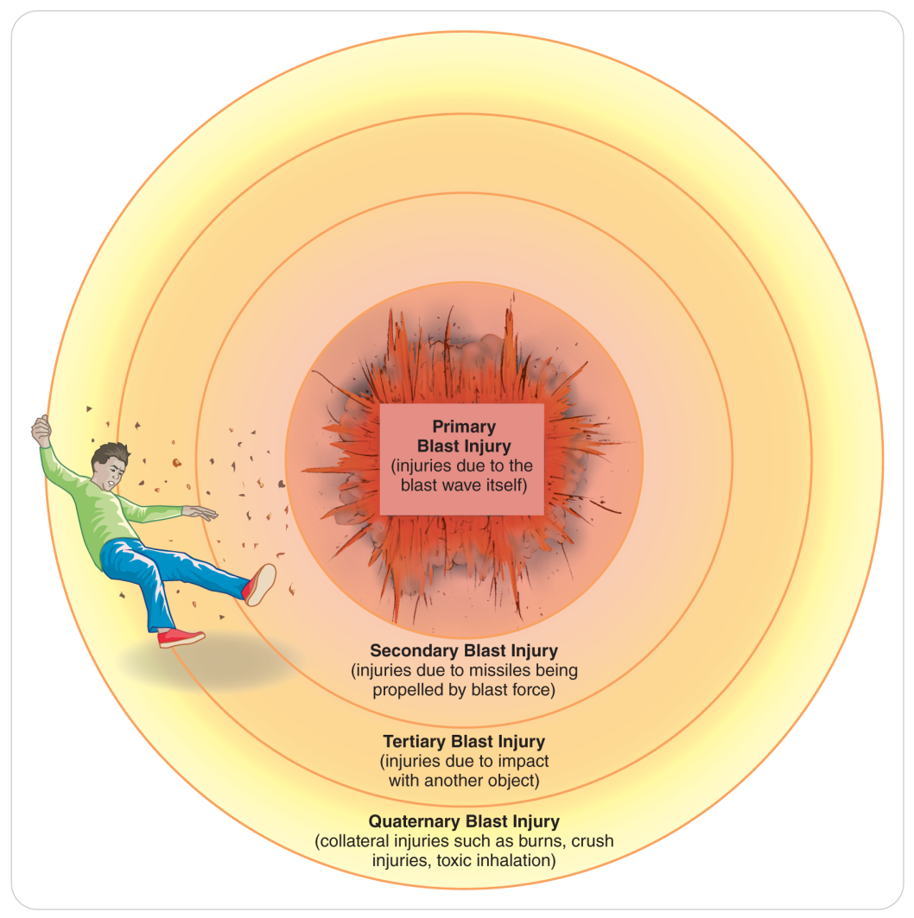
Blast Injury
18-2
Blast injuries are caused by an explosive force and are divided into four categories: primary, secondary, tertiary, and miscellaneous (or quaternary) injuries.

Slide 18
Blast Injury: Primary and Secondary
18-2
Primary blast injuries are due to a massive pressure wave that strikes the body following the rapid release and expansion of gases.
Solid and water-dense tissues (such as the liver or urinary bladder) are minimally affected, whereas air-dense tissues (such as the lungs, ears, or intestines) can be contused or ruptured.
Secondary blast injuries are caused by airborne objects that strike the body.

Slide 19
Blast Injury: Tertiary and Quaternary
18-2
Tertiary blast injuries occur when the body is forcibly thrown and strikes other objects such as a wall or the ground.
Usually seen only in high-energy explosions
Miscellaneous, or quaternary, injuries are caused by other blast-related factors such as exposure to steam or burning materials, inhalation of toxins, or impact by debris from a collapsing building.
When aggravated by a blast, illnesses including asthma, angina, hypertension, and anxiety are also considered quaternary injuries.

Slide 20
Blast Injury
18-2
Blast injuries are more commonly associated with an industrial accident or a military/terrorist event, but they could be encountered in kitchens or backcountry environments.
Examples include a camp stove explosion, a mountain lodge kitchen stove blast, or an accidental explosion during avalanche control measures
“Blast Pattern Triad”
Reflex response during the initial stage of blast Injuries consists of:
Apnea (“wind knocked out”)
Bradycardia (slow heart rate)
Hypotension (low blood pressure)
Usually return to pre-blast values within a relatively short time unless other significant injuries are present

Slide 21
Trauma Centers

Slide 22
Trauma Centers
18-3
OEC technicians need to be able to decide if a patient needs to be rapidly transferred to a trauma center.
Most minor injuries you will encounter can be seen in local or community outpatient hospital setting.
Some larger ski resorts in the United States now have medical clinics staffed by x-ray technicians, lab technicians, doctors, and other health care providers.
These facilities can handle most of the area’s patients.
Transportation to a trauma center using ALS, if available, is needed for major injuries.

Slide 23
Trauma Centers
18-3
OEC technicians such as ski patrollers, climbing and rafting guides, and bicycle patrollers need to know the location of the nearest trauma center.
If available, air transport may hasten the transport time to these specialized centers.
With the help of the local EMS system, develop a local protocol regarding air transport.

Slide 24
Trauma Centers
18-3
A national system of designated accredited trauma centers has been established in the United States to provide specialized care to multisystem trauma patients.
Equipped to provide care to trauma patients at any time and are specifically designed to manage patients whose injuries involve two or more body systems, a condition known as multisystem trauma
Example: a patient with a possible fractured femur and internal abdominal injuries
Definitive care at these centers is coordinated by a trauma surgeon.
Then calling on specialists when needed

Slide 25
Patient Assessment

Slide 26
Patient Assessment
In addition to standard SAMPLE history, obtain trauma-specific information.
Look at the forces involved.
In unwitnessed trauma patients, assessment of many suspected injuries may be based only on a good understanding of how the trauma occurred.
Based on the MOI, a thorough evalution of a body part suspected to be injured is important.
When there is a multiple trauma, a full hands-on head-to-toe secondary physical assessment may find additional injuries that were overshadowed by another more painful injury.
Monitor and reassesses the patient frequently by taking vital signs every 5 minutes for critical patients and every 15 minutes for non-critical patients.

Slide 27
Management

Slide 28
Management
18-4
As for any patient, the first step in managing a person who has been injured is to mitigate any hazards that may be present.
Correct any immediate threats to life (ABCD).
Control excessive bleeding.
If the patient is unresponsive, it is important to open the airway, simultaneously assess breathing, and make sure there is a carotid pulse.
Feel for 10 seconds.
If not breathing and no pulse, immediately begin CPR.
If indicated, stabilize the patient’s spine by applying manual stabilization to the head and neck.
Must be maintained until replaced with mechanical stabilization

Slide 29
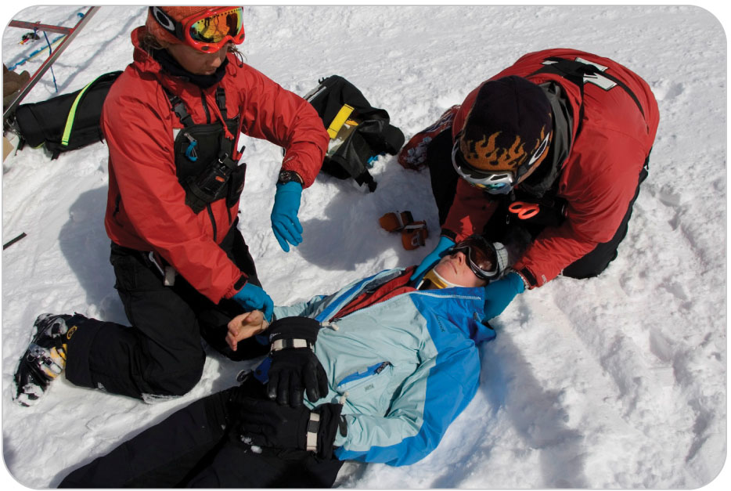
Management: “Load-And-Go”
18-4
Critical multisystem trauma patients may need a “load-and-go” approach.
Manage ABCDs.
Control bleeding.
Stabilize the spine if needed.
Load the patient into the toboggan or onto the litter.
Transport with as little delay as possible.

Slide 30
Management: Supplemental Oxygen
18-4
If oxygen is immediately available, administer oxygen at 12 to 15 liters per minute by nonrebreather mask.
Titrate oxygen with a pulse oximeter, if available.
Keep the oxygen saturation between 94 and 99%.
If a patient needs rapid transport for life threats you cannot correct, do not wait for oxygen to arrive on scene; transport and provide oxygen when available.
Monitor for shock and treat accordingly.
Keep them warm because hypothermia can hasten the effects of shock.

Slide 31
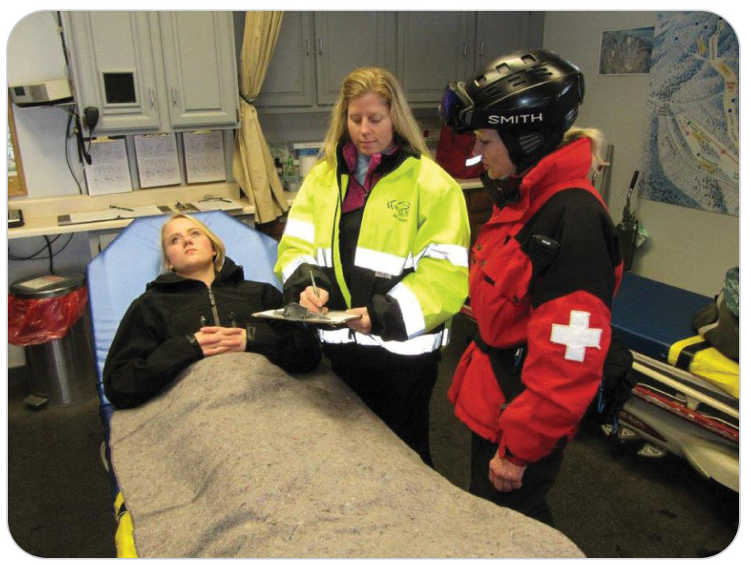
Management
18-4
For patients who are stable and do not require load-and-go transport, turn your attention to any less critical injuries or problems that may exist, such as stabilizing long-bone fractures by applying splints.
Prepare patients for transport to a medical care facility or, when appropriate, to a trauma center.
Mode of transportation largely depends on your findings during the assessment.

Slide 32
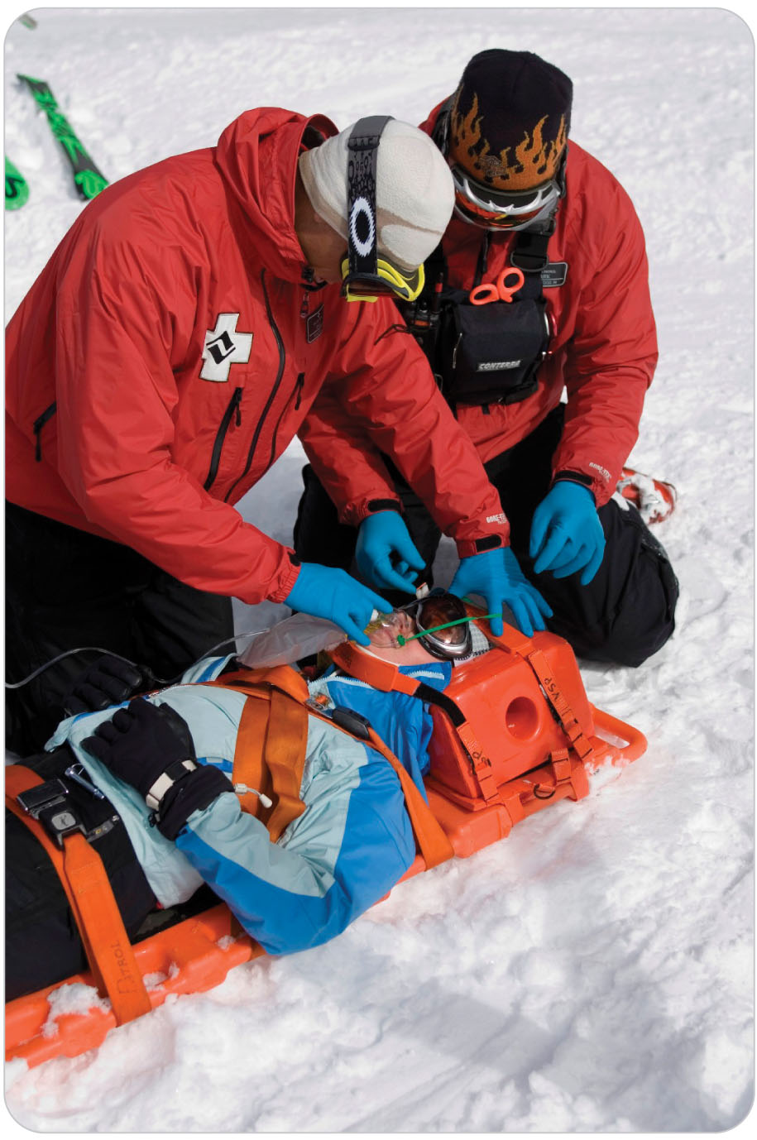
Management
18-4
Protect trauma patients who need spinal motion restriction from the elements and secure them either to a long backboard or in a basket-style litter.
Base your additional treatment decisions on reassessment findings.
Document your assessment findings and the treatments you provided on a patient care report.
If local protocol allows, send a copy with the patient to the hospital.

Slide 33
Management: Golden Hour
18-4
The first hour, known as the Golden Hour, following a life-threatening injury
A crucial period during which survival rates may be improved if critical injuries are identified and properly managed
In backcountry settings, immediate evacuation to a specialized definitive-care facility, known as a trauma center, becomes important.

Slide 34
Case Study

Slide 35
CASE PRESENTATION
A bicyclist is racing on a course at a ski area in the summer. At a high rate of speed, he loses control and hits a tree. Upon your arrival on scene, you find the patient lying up against the tree, which has some bark missing. He is complaining of pain in his groin and chest. Bystanders state the fall was “nasty” and that the crash “was very bad.” The patient is short of breath and says, “I think I’ll be all right.” The handlebars are bent.
What should you do?

Slide 36
CASE UPDATE
You are concerned that the patient’s MOI—slamming into the handlebars and then a tree at a high rate of speed—may have caused internal injuries. After making the scene safe, you check for life-threatening bleeding and assess the ABCDs. The patient talks to you in short sentences. You complete your primary patient assessment and radio for extra help and equipment.
The patient’s initial pulse was 92 beats per minute and respirations were 18 breaths per minute; they are now 140 beats per minute and 26 breaths per minute. You suspect that the deterioration in condition is due to internal injuries caused by blunt trauma. You notify the dispatcher to activate EMS and request air transport. The pain in the patient’s anterior pelvic area and chest is significant.
What should you do now?

Slide 37
CASE OUTCOME
As other patrollers arrive with oxygen and equipment, you inform them that you believe the patient is suffering from blunt trauma and has a high potential for serious internal injury. Given the MOI, the patient’s deteriorating state, and your assessment findings, you suspect a fractured pelvis with internal bleeding, and an internal chest injury.
Recognizing that this is a load-and-go situation, you place the patient on high-flow oxygen by nonrebreather mask and prepare to evacuate him from the slopes as expeditiously as possible.

Slide 38
CASE OUTCOME
The patrollers use a pelvic binder to stabilize the pelvis and use spinal motion restriction with a long backboard. By radio, you notify the base clinic of your impending arrival. After delivering the patient, an ALS provider starts an IV. Soon after, a helicopter crew arrives and begins administering blood to the patient. They transport him past the local community hospital, which is only a few miles away, in favor of a Level II trauma center just a few air miles farther.
Later that day, the clinic physician joins you during a break in the patroller hut. He tells you that he received a call from a trauma surgeon congratulating him and his staff on the rapid and comprehensive field care of the patient, who broke his pelvis in four places and had a collapsed lung. The patient is now stable and expected to make a full recovery.

