Slide 1
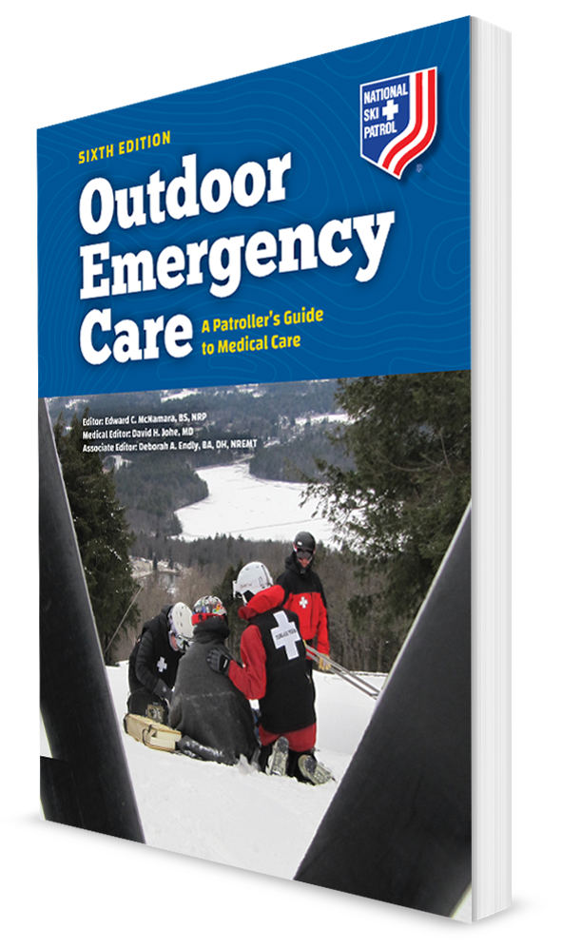
Introduction to Outdoor Emergency Care
CHAPTER 1

Slide 2

The following presentation will utilize two symbols to identify material necessary for an OEC Technician to comprehend:
key term
Meets a Chapter Objective.
This symbol will have the corresponding Objective Number denoted within.
Identifies a Key Term.
The Key Term will be underlined for easy identification.

Slide 3
Objectives
  1-1 Describe the evolution and purpose of the National Ski Patrol’s OEC program.
  1-2 Identify the founder of the National Ski Patrol.
  1-3 Describe the OEC certification and recertification processes.
  1-4 Describe the impact of Good Samaritan laws on volunteer rescuers.
  1-5 Contrast the standard of training and standard of care.

Slide 4
Objectives
  1-6 Define the following legal terms:
    Abandonment
    Duty to act
    Negligence
    Breach of duty
  1-7 Describe the following concepts related to consent:
    Informed consent
    Expressed consent
    Implied consent
    Minor consent
Consent
Assault
Battery

Slide 5
Key Terms
Abandonment
Assault
Battery
Breach of duty
Charles Minot “Minnie” Dole
Consent
Doctrine of public reliance
Duty to act
Ethics
Expressed content
Good Samaritan laws
Gross negligence
Health Insurance Portability and Accountability Act (HIPAA)
Implied consent
Informed consent

Slide 6
Key Terms
Minor consent
National Medical Advisor
National Medical Committee
National OEC Program Committee
National OEC Program Director
National OEC Refresher Committee
National Ski Patrol System, Inc. (NSP)
Negligence
Outdoor Emergency Care (OEC)
Prehospital care
Refresher
Standard of care
Standard of training
Winter Emergency Care

Slide 7
Chapter Overview

Slide 8
Chapter Overview
For over 80 years, the National Ski Patrol (NSP) has trained people who have successfully cared for thousands of injured snow sports enthusiasts.
Now NSP has a presence at a variety of four-season outdoor activities available at:
  Ski areas
  Bike parks
  Other land management areas
Today, patroller’s level of training is that of a National Highway Traffic Safety Administration (NHTSA) Emergency Medical Responder.

Slide 9

Chapter Overview
Mid-1980s:
  Created by Dr. Warren Bowman
  The first medical text exclusively developed for Ski Patrollers
  Called Winter Emergency Care
Today, the program has expanded to a four-season text.
  Called Outdoor Emergency Care
  Learn how to function with minimal equipment in any environment while assessing and caring for the sick and injured
  Covers the niche of prehospital care

Slide 10
NSP: The History and Evolution

Slide 11
The Founder of the National Ski Patrol
1-2
Charles Minot “Minnie” Dole
Charles Minot “Minnie” Dole, experienced the need for emergency care and rescue services during a personal skiing mishap at Stowe, Vermont.
  Took a serious fall, resulting in a nasty angled fracture of ankle
Two months later, the fatal accident of Minnie’s friend, Frank Edson, planted the seed for what would become the National Ski Patrol.
National Ski Patrol © NSP.

Slide 12
The Conception of the National Ski Patrol’s Training
In 1938, National Ski Association (NSA) asked Dole to organize the setup of patrols on a national basis.
  Marked the birth of National Ski Patrol System, Inc. (NSP)
In the 1939, the first text developed was in affiliation with the American Red Cross.
  “Ski Safety and First Aid” by an American Red Cross officer, L. M. Thompson, NSP’s first National Medical Advisor
Around the same time, during World War II, Minnie Dole convinced the Army of the value of winter warfare troops.
  10th Mountain Division was born.
  Many 10th Mountain Division veterans returned home to become the leaders in the growing US ski industry following the war’s end in 1945.

Slide 13
The Birth of the Outdoor Emergency Care
1-1
In 1980, Congress granted the NSP with a federal charter.
  Patrollers required additional prehospital medical care training to care for patients during cold weather and at high altitude.
By 1985, Dr. Warren Bowman created an emergency responder textbook exclusively for ski patrollers, titled Winter Emergency Care.
Three years later, this textbook was revised and renamed Outdoor Emergency Care.
  The new text was expanded to include information about a variety of illnesses and injuries in outdoor enthusiasts regardless of season.

Slide 14
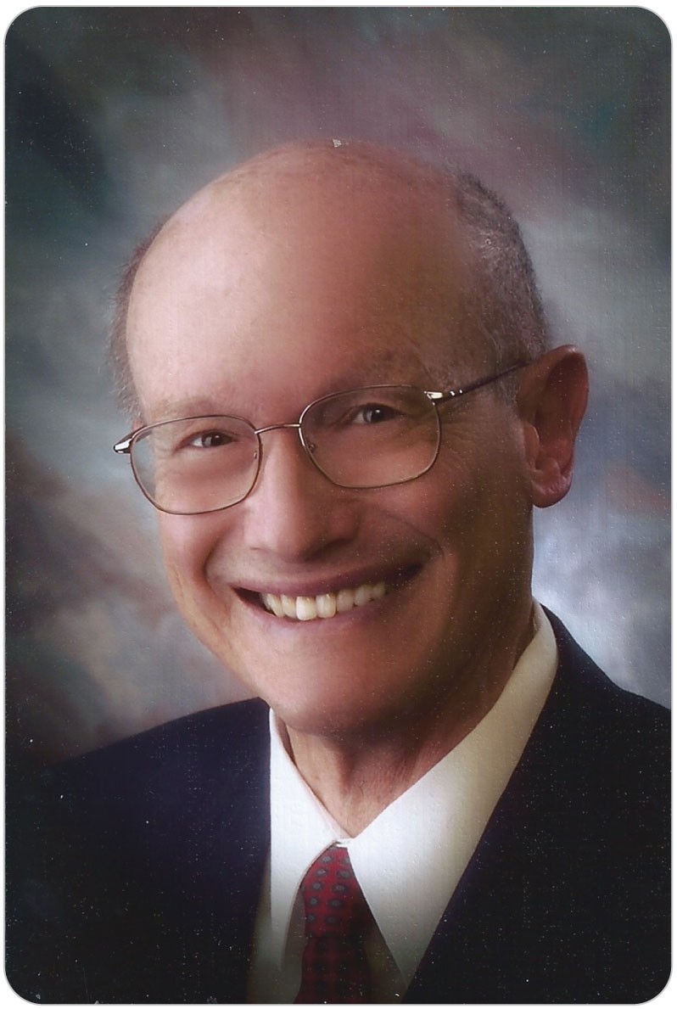
The Birth of OEC
1-1
Dr. Warren Bowman
  The father of Outdoor Emergency Care
Courtesy of Dorothy Bowman.

Slide 15
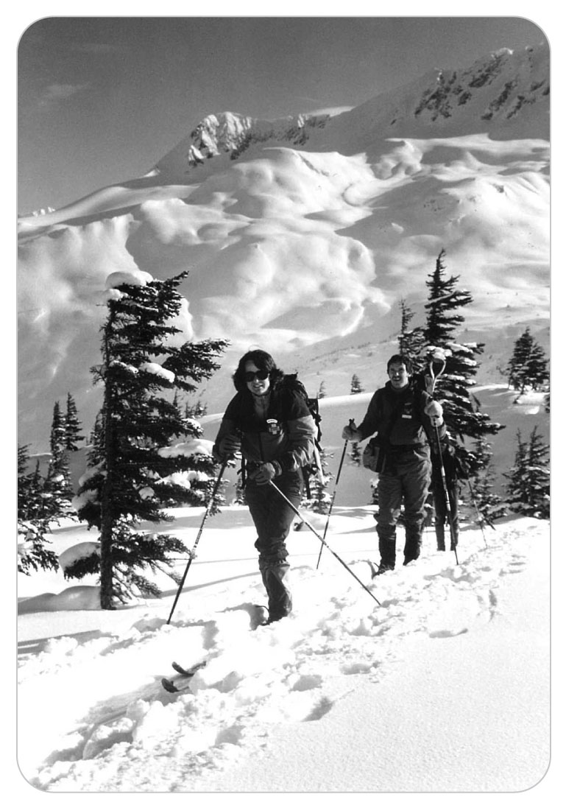
OEC Today
1-1
NSP Training Over 80 Years
Prehospital emergency medical care is ever changing.
  OEC curriculum improved to meet needs of patrollers and outdoor emergency medical care responders
  Primary curricula taught to ski and bicycle patrollers
  Used by other prehospital medical responders
© National Ski Patrol.

Slide 16
OEC 6th Edition
1-1
The Sixth Edition of Outdoor Emergency Care was written following the principle of Evidence-Based Medicine, unlike many older emergency medical publications based on anecdotal information.
Present OEC curriculum contains the knowledge and skills identified in the NHTSA curriculum for emergency medical responder training, plus additional information and training for patrollers.

Slide 17
Training: The Focus of the OEC Program

Slide 18
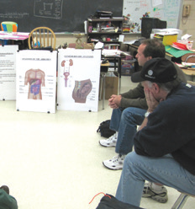
Outdoor Emergency Care Course
OEC Class
As an OEC technician, you must master:
  Anatomy and physiology
  Patient assessment process
  Documentation
  Medical interventions
Mastered through repeated practice, training in evaluation, intervention, and continued care for critical patients
© Edward McNamara.

Slide 19
OEC Certification Requirements
1-3
The OEC program is developed and improved by the NSP, in conjunction with:
  The National OEC Program Committee
    A committee composed of all Division OEC Supervisors and the National Medical Advisor
    Chaired by the National OEC Program Director
  The National Education Committee
  The National Medical Committee
    A group of physicians that include Division Medical Advisors, the National Medical Advisor, and other physicians at large

Slide 20
OEC Certification Requirements
1-3
To receive an OEC certificate of completion, OEC candidates must successfully complete the OEC course, which culminates with a nationally standardized assessment that consists of two parts:
  Written exam
  Practical exam
One may complete the course without having the ability to ski, snowboard, or ride a bicycle.
  An On-the-Hill OEC technician is required to:
    Demonstrate a level of skiing and toboggan handling proficiency to care for and transport an injured skier at a ski area
    Meet their special requirements for transportation
    Perform other duties as required by the area

Slide 21
Recertification Requirements
1-3
Each year, NSP develops a continuing education program for patrollers to remain current.
  Developed by the National OEC Refresher Committee
  Enables OEC technicians to “refresh” their knowledge and skills
  One third of the OEC curriculum/content is covered each year.
  Referred to as a “Refresher” course
  Primarily a hands-on course

Slide 22
Recertification Requirements
1-3
Active NSP members must ALSO:
  Complete a professional level CPR/AED course every other year AND demonstrate the skill portion of the CPR curriculum annually, regardless of how long the CPR certificate is valid for
  Take and pass the ICS 100: Basics of ICS course given by the National Incident Management System once

Slide 23
Ethical and Legal Issues

Slide 24
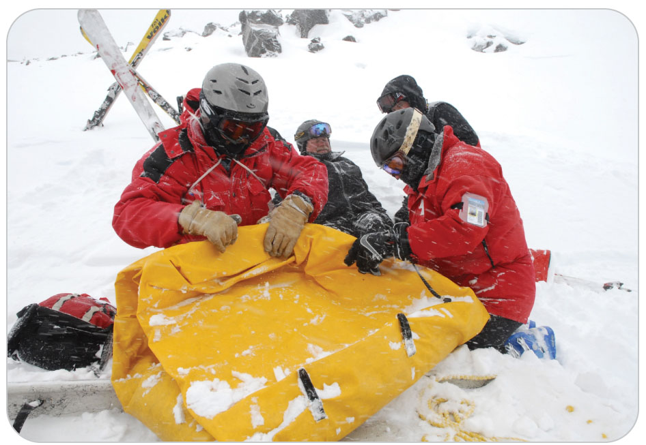
Ethical and Legal Issues
Throughout the history of the NSP, ski patrollers have developed a good image with the skiing public, which is a significant protection for patrollers from legal implications.
Just as patrollers must manage a patient’s medical care, all must also know how manage the legal aspects of rendering emergency care:
  Understand how to reduce legal risk arising out of an accident situation is an important part of patrolling.

Slide 25
Ethical Issues Facing OEC Technicians
As an OEC technician, hold yourself to a high ethical standard.
  Ethics is the science of morality or behavior that defines what is “good” or “right.”
  NSP patrollers and OEC technicians have always maintained a high standard of ethical conduct with the public.

Slide 26
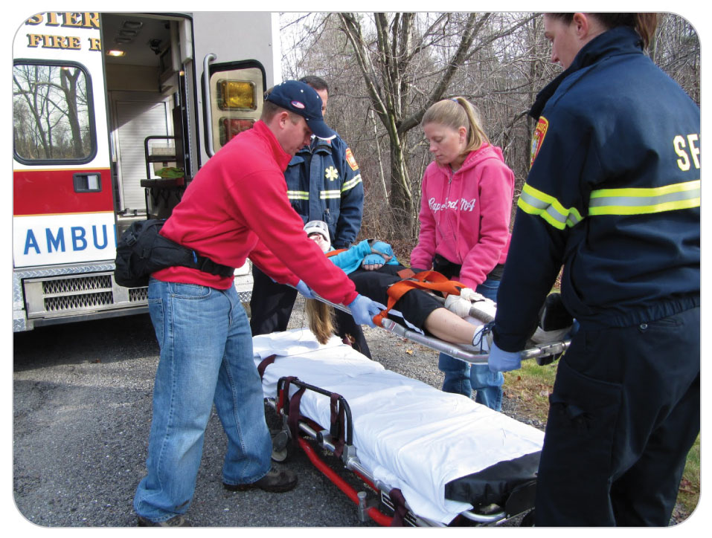
Ethical Issues Facing OEC Technicians
NSP patrollers and OEC technicians have always maintained a high standard of ethical conduct with the public.
Maintaining high ethics and the public’s respect for OEC technicians is one of the duties and privileges of the job.

Slide 27
Good Samaritan Law
1-4
Public has long viewed OEC technicians as “Good Samaritans.”
  People who help other people but expect nothing in return
Good Samaritan laws are designed to encourage volunteers to provide first-aid care without the worry of being sued for negligence.
  Reflect the good work that voluntary rescuers provide the public

Slide 28
Good Samaritan Law
1-4
Still important for OEC technicians to make sure that the ski area or resort has adequate insurance protection.
  Whether they work or volunteer
Also, that they have adequate personal insurance
  Good Samaritan Laws are not legislated in all states.
  Area management can inform you what impact the laws may have on you as an OEC technician in your state.
Does NOT protect from gross negligence
  Defined as an intentional failure to perform a manifest duty in reckless disregard of the consequences as affecting the life or property of another

Slide 29
Duty to Act
1-6
Whether on duty or off, a uniformed OEC technician or other rescuer may have a legal obligation to render first-aid care to an injured person in need of such care due to the Doctrine of Public Reliance.
  The legal issue as to whether an OEC technician is required when NOT on duty is primarily governed by individual state or provincial laws.
  Understanding the relevant laws and codes concerning this legal point are important for an OEC technician’s own legal protection.
OEC technicians have both a moral duty and a legal duty to act.
The exception to this rule is when performing such are may place the safety of a rescuer or others at risk.

Slide 30
Abandonment
1-6
An OEC technician who inappropriately terminates first-aid care once begun could be liable under the legal doctrine of abandonment.
Examples of abandonment include:
  Initiating care on an injured child and then leaving the child alone while you handle another accident
  Leaving a patient who is awaiting ambulance transport alone in the aid room while the patient goes into shock
Exceptions are when providing such care could threaten a rescuer’s own safety or when competent patients have informed a rescuer that they no longer want first-aid care.

Slide 31
Negligence
1-6
Negligence can occur when an OEC technician harms an individual by not performing up to the technician’s standard of training.
  Failure to provide care within the standard of training that a reasonable and prudent OEC technician is expected to provide under the circumstances can also be negligence.
  Patroller must meet the standard of training when performing first-aid activities in order to avoid legal negligence.

Slide 32
Breach of Duty
1-6
Once a duty to act is established, you are legally required to render appropriate care after you approach a patient.
  This failure to perform a promised act or obligation of due care is considered a Breach of Duty.

Slide 33
Negligence and Breach of Duty: Documentation
Documentation
Important to document evidence of any contributory negligence by the patient involved in an accident. In this situation, the patient actually contributes to his or her own harm.
  Might identify the legal concept of contributory negligence
In addressing either of these two legal principles, OEC technicians should fully document the circumstances surrounding the accident and any care rendered.

Slide 34
Assumption of Risk
Doctrine of the Assumption of Risk
  A legal principle that protects patrollers
  When skiers or snowboarders choose to participate, they assume that the sport has inherent risks.
It is important to record details of such accidents with great attention to “how” accident was caused.
  If a skier or snowboarder does not follow proper procedures or follow directions properly, make sure such information is documented on accident forms.
  The same principle also applies to accidents that involve equipment such as snowmobiles.
    Collisions with such objects should be carefully documented.

Slide 35
Preparing Documentation
Filling out a report
As part of your OEC training, you will learn to document what occurred at the accident scene.
  Might be the only reliable source of information for reconstructing in court what happened
  Vital part of your training and a critical part of the risk management of an accident scene
© Edward McNamara.

Slide 36
Standard of Training vs. Care

Slide 37
Scope of Training
1-5
OEC technicians are trained in several doctrines: the NSP Outdoor Emergency Care curriculum, the local protocols for emergency care required in their areas, and the requirements of the state laws and regulations that govern first-aid care.
Scope of training may be different for different members of a medical response team.
  It is important for members of the medical response team to understand their roles and the limitations that are placed on them pursuant to their level of training.

Slide 38
Standard of Training Versus Standard of Care
1-5
Standard of Training:
  You are trained in the NSP’s Outdoor Emergency Care curriculum.
    Set forth in the OEC Course, using this text as a reference.
  Understanding the limits of the standard of training is important in reducing your legal risk as an OEC technician.
Standard of Care:
  A level of care an OEC technician must render based on OEC training, local medical protocols, and the requirements of a state’s EMS system
  Patrollers MUST be familiar with the local first-aid protocols established by the ski area or land management area in which they serve.

Slide 39
Joint Statement of Understanding
When you work as an OEC technician at a ski area, you should be aware that you are patrolling as an “agent” of the ski area, NOT on behalf of the NSP.
NSP only provides educational training to OEC technicians in the classroom and on the slopes.
NSP does NOT control the patrol activities of patrollers while they are patrolling at their respective ski areas.
Ski area bears legal responsibility for patrolling activities that fall within scope of duties of OEC technicians.

Slide 40
Patient’s Consents

Slide 41
Informed Consent
1-6
1-7
Before providing first-aid care, OEC technicians should obtain permission from the patient for that care, also known as consent.
To give informed consent, the injured person must understand what actions the responder plans to take and agree to them.

Slide 42
Expressed Consent
1-7
If the patient is competent and says yes to your care, then you have obtained expressed consent.
The concept of expressed consent can become complex at an accident scene.
  Can involve both expressed consent to assess and refusal of care to perform first aide and/or transport

Slide 43
Implied Consent
1-7
Another type of consent is implied consent, which means the patient is not capable of providing expressed consent but would request first-aid care if he or she could.
Examples:
  The injured skier is delusional or unresponsive
© Edward McNamara.

Slide 44
Minor Consent
1-7
Minor Consent
  Some states have determined that minors do not have the judgment necessary to provide expressed consent.
  If a parent or legal guardian is not available, implied consent typically allows OEC technicians to conduct first aid and provide transportation.
  Group Leaders or Chaperones:
    Written consent-to-treatment forms or
    Obtain expressed consent after ascertaining their authority

Slide 45
Refusal
Refusal
Allowing an injured skier the opportunity to refuse first aid is important.
  Offer to provide first-aid assistance.
  Denial should be documented.
    Remember the Doctrine of Abandonment.
  Document the refusal in writing, signed by the injured skier and, if possible, witnessed by another OEC technician.
© Edward McNamara.

Slide 46
Additional Legal Concepts

Slide 47
Assault and Battery
1-6
OEC technicians who continue to provide care after receiving a competent refusal of such first aid are placing themselves at legal risk of being accused of assault and battery.
Touching someone who does not desire to be touched is known as battery.
Placing a person in a position in which he reasonably fears that battery will occur is known as assault.

Slide 48
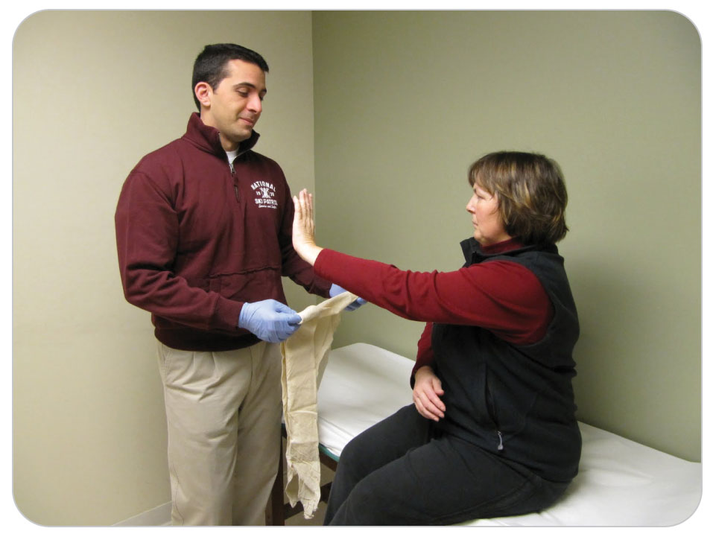
Assault and Battery
The use of physical force is very rarely justified.
If a skier threatens you with the use of force, back away and call for more patrollers and area security staff.
OEC technicians are trained to avoid scenarios in which they could be accused of assault or battery.

Slide 49
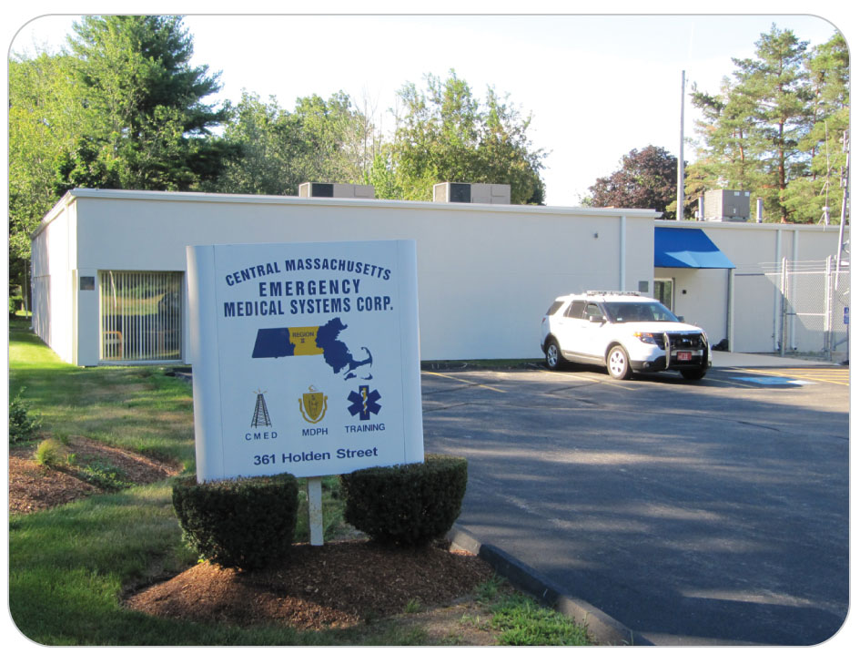
EMS System Regulations
Each state has its own emergency medical services (EMS) system.
  Different states prohibit the use of different types of medical procedures.
  NSP has not designed the information in Outdoor Emergency Care, Sixth Edition for any particular state.
  It is important to understand the level of care to patients based on their particular state’s or province’s EMS laws, rules, and regulations.
Central Massachusetts Emergency Medical System Corp., © Edward McNamara.

Slide 50
Patroller and EMS: Transition of Patient Care
The transition of care to a higher-level medical provider begins with a concise report that includes:
  What the patient’s problem is
  What treatment you have provided
  What your concerns are
The transition of care concludes with the patient being transported to a more definitive care.
© Edward McNamara.

Slide 51
Privacy Laws
General trend of current laws is to keep medical information about injured persons private.
  Health Insurance Portability and Accountability Act (HIPAA) was passed by US Congress in 1996 to protect the privacy of an individual’s medical information.
HIPAA likely does not apply to volunteer patrolling activities.
  Patrollers do not receive direct compensation for the medical services they render to injured skiers.
  However, some paid patrols might be subject to HIPAA requirements.
This exemption for many volunteers does not eliminate the need to keep private the medical information obtained from an injured skier.

Slide 52
Case Study

Slide 53
CASE PRESENTATION
A call comes in for a motor vehicle accident in the parking lot of a resort where a mountain bike race is occurring. One of the racers had just unloaded his bike. As he was riding to the starting area, a car hit him and left the scene. Upon your arrival, you find a 16-year-old boy lying on the ground holding his shoulder. He is tangled in his bicycle. Quite angry and yelling, he also is bleeding from his forehead. A small crowd has gathered.
What should you do?

Slide 54
CASE UPDATE
You immediately assess the situation and make sure the scene is safe by instructing bystanders to stop any traffic. The injured teen is still yelling, so you calm him down. You stop the bleeding on his forehead. Following your initial assessment, having found no evidence of head or spinal injury, you call for help and EMS transport on the radio and ask a responsible bystander to keep the crowd back. One bystander says he got the license plate number of the car, so you ask him to stay. Another OEC technician arrives, and you instruct him to splint the boy’s shoulder. Area management and the police are called.
What should you do?

Slide 55
CASE OUTCOME
Another OEC technician arrives, and you instruct him to find the boy’s parents. You care for the boy, rendering first aid until the ambulance arrives. Management arrives, as do the police, and you direct them to the witness so that his statement may be obtained. The boy’s parents are found in their condominium and come to the scene. You explain to them what happened. While the mother accompanies her son to the hospital, you go back to the aid room and complete your paperwork. The next day, the mother calls the patrol room to tell you her son dislocated his shoulder, had it reduced, and will be all right. Management informs you that the police found the driver who hit the boy.

