Slide 1
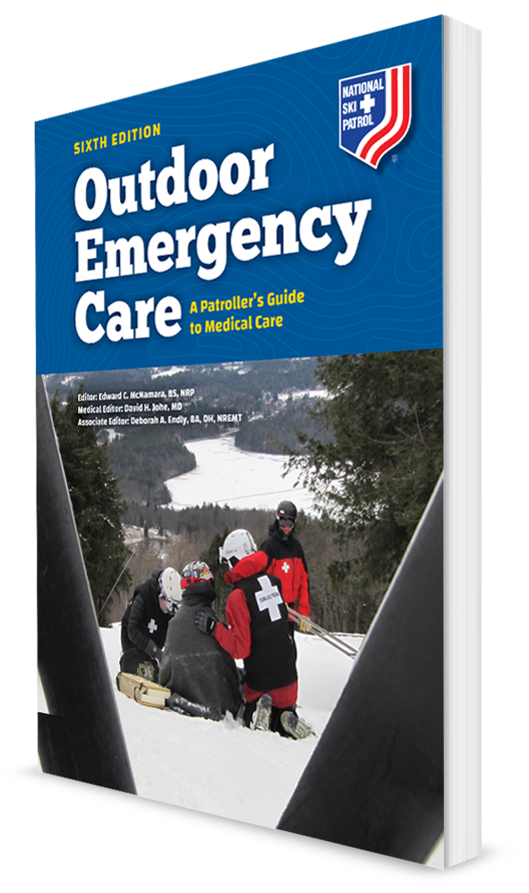
Spine, Brain, and Nervous System Injuries
CHAPTER 21

Slide 2
The following presentation will utilize two symbols to identify material necessary for an OEC Technician to comprehend:
key term
Meets a Chapter Objective.
This symbol will have the corresponding Objective Number denoted within.
Identifies a Key Term.
The Key Term will be underlined for easy identification.

Slide 3
Objectives
21-1 Identify and define the two major anatomic components of the central nervous system.
21-2 Define traumatic brain injury.
21-3 Describe traumatic injuries involving the spine.
21-4 Describe the signs and symptoms of spinal injuries.
21-5 Describe how to properly assess a patient with a suspected brain and spinal cord injury.
21-6 List the signs and symptoms of traumatic brain injury.

Slide 4
Objectives
21-7 Demonstrate how to properly care for a patient with a brain and spinal cord injury.
21-8 Demonstrate how to maintain proper spinal alignment while placing a patient onto a long backboard from the following positions:
Supine
Sitting
21-9 Explain and demonstrate how to perform neutral head alignment.
21-10 Demonstrate how to size and apply a cervical collar.

Slide 5
Objectives
21-11 Demonstrate how to perform an axial drag.
21-12 Demonstrate how to secure a patient to a long backboard.
21-13 Demonstrate how to place a patient on a full-body vacuum mattress.
21-14 Describe and demonstrate how to remove a helmet.
21-15 Explain and demonstrate the principle of “jams and pretzels.”

Slide 6
Key Terms
Antegrade amnesia
Axon
Cerebral contusion
Concussion
Coup-contrecoup brain injury
Cranium (skull)
Epidural hematoma
Intracerebral hematoma
Intracranial pressure
Jams and pretzels
Lucid interval
Retrograde amnesia
Stabilized extrication
Subdural hematoma
Traumatic brain injury

Slide 7
Chapter Overview

Slide 8
Chapter Overview
Outdoor sports carry inherent risks for injuries, including serious injuries involving the brain, neck, or spine that range from relatively minor to immediately life threatening.
Proper prehospital care of nervous system injuries by an OEC technician can reduce the possibility of permanent disability or death.
CNS injuries are among the most serious that OEC technicians encounter.
CNS trauma is associated with high mortality and morbidity rates, significant economic consequences, and serious effects on patient’s quality of life.
One of the most severe forms of CNS trauma is traumatic brain injury, a leading cause of traumatic death in individuals under age 45.

Slide 9
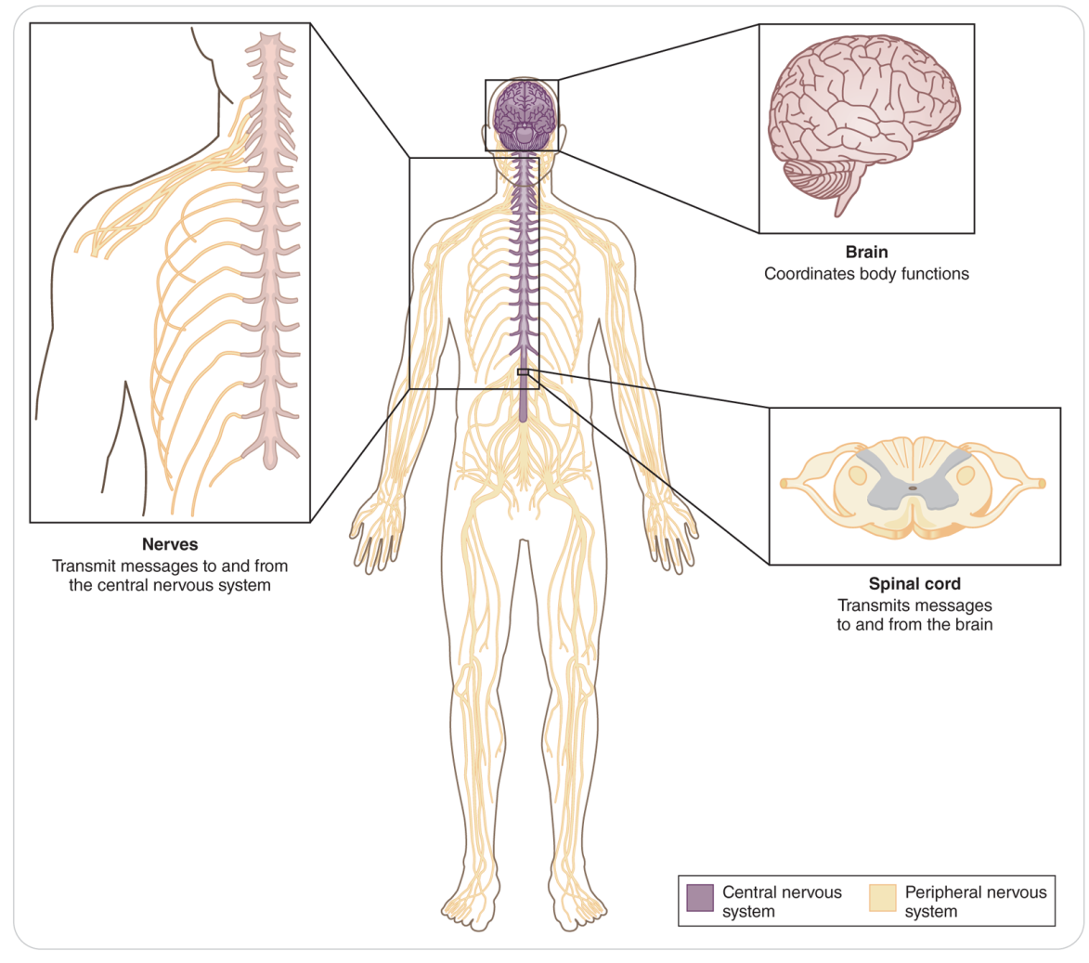
Chapter Overview
It is important for OEC technicians to understand the mechanisms responsible for traumatic CNS injuries and be able to quickly recognize the signs and symptoms of specific CNS injuries.
Must be able to safely manage patients with traumatic head and spine injuries and minimize additional injury
Can help to reduce the morbidity and mortality associated with this devastating form of trauma

Slide 10
Anatomy and Physiology

Slide 11
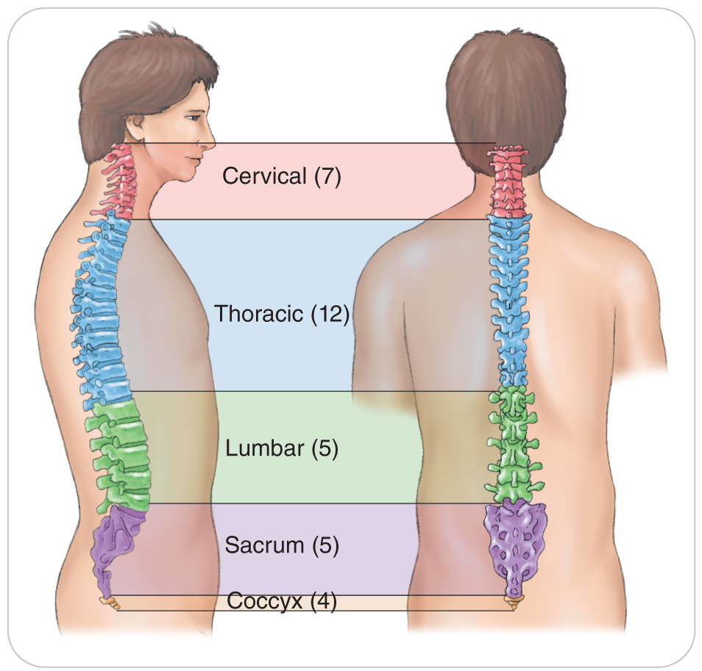
Anatomy and Physiology
The axial skeleton consists of:
Skull (cranium)
33 vertebrae in the spine
The spinal column consists of the cervical, thoracic, lumbar, sacral, and coccyx sections.

Slide 12
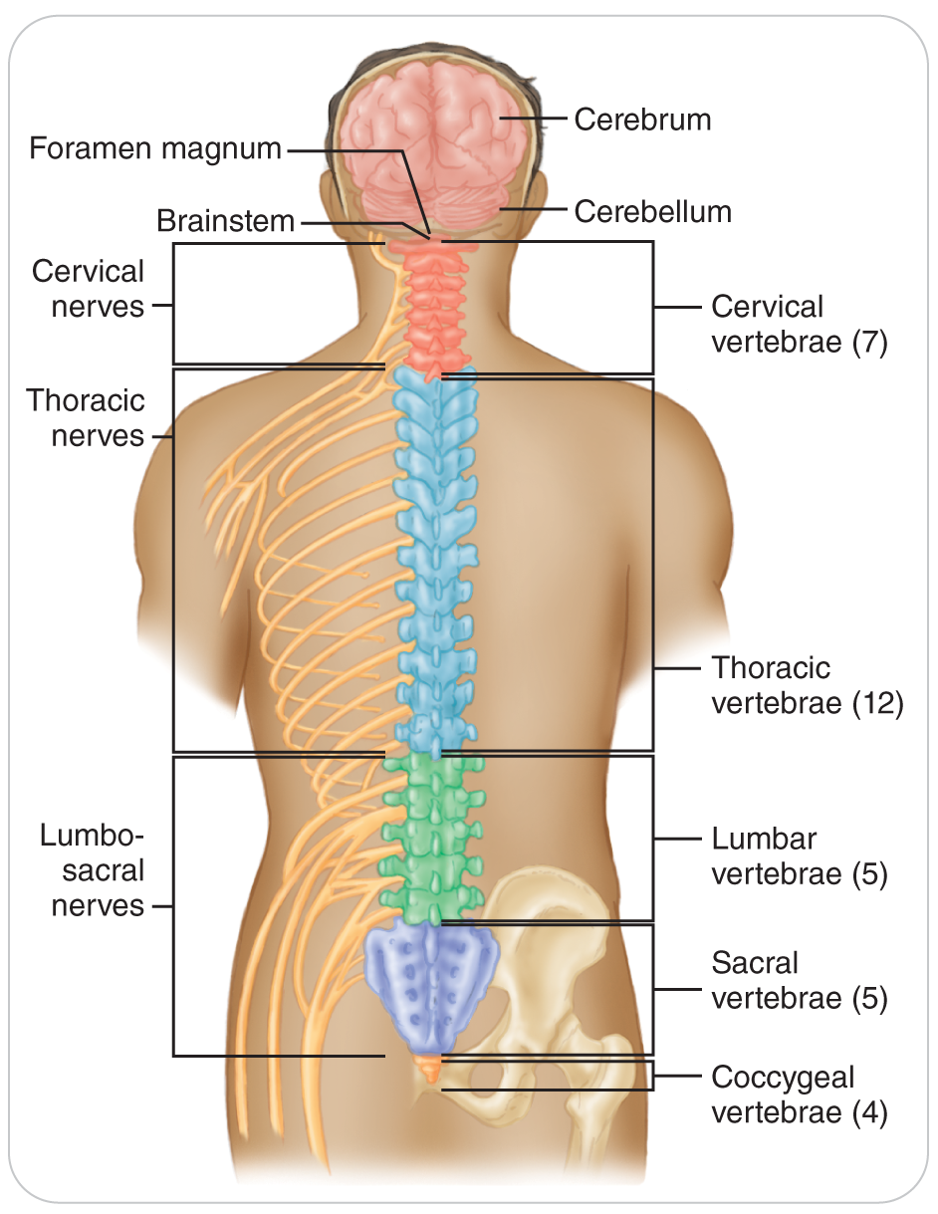
Anatomy and Physiology
Central Nerves System has two major components:
The brain is the central computer for the body.
The spinal cord is the pathway from the brain to the rest of the body.
Peripheral Nerves System
The nerves that connect the rest of the body to the spinal cord

Slide 13
Common Injuries

Slide 14
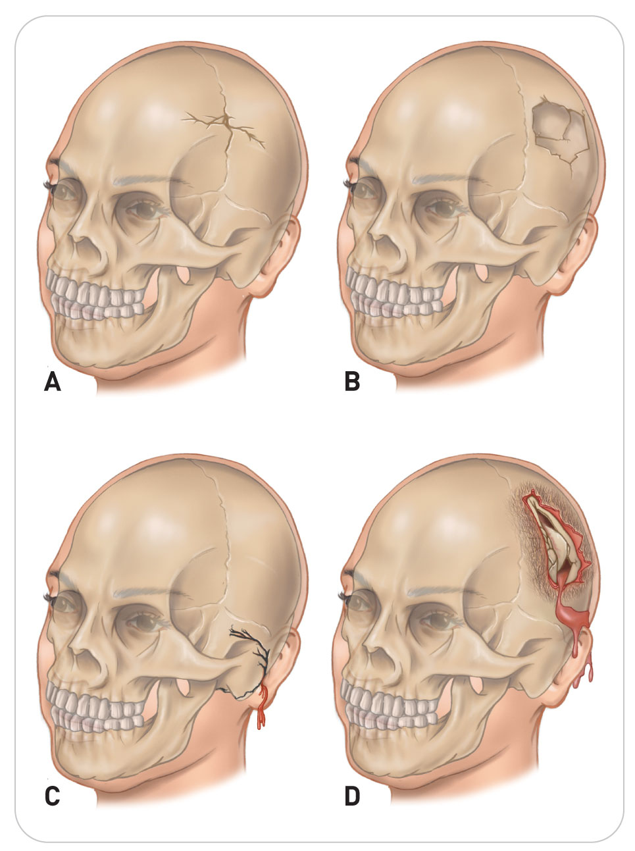
Head Soft-Tissue Injuries
Injuries to the brain and spinal cord can be divided into:
Closed CNS Injuries: the integrity of the skull and spinal column is not compromised to the outside environment.
Open CNS Injuries: the brain or spinal cord is directly exposed to the environment or in which Cerebral-Spinal Fluid (CSF) is leaking from a wound or a cavity such as the nose or ears.

Slide 15
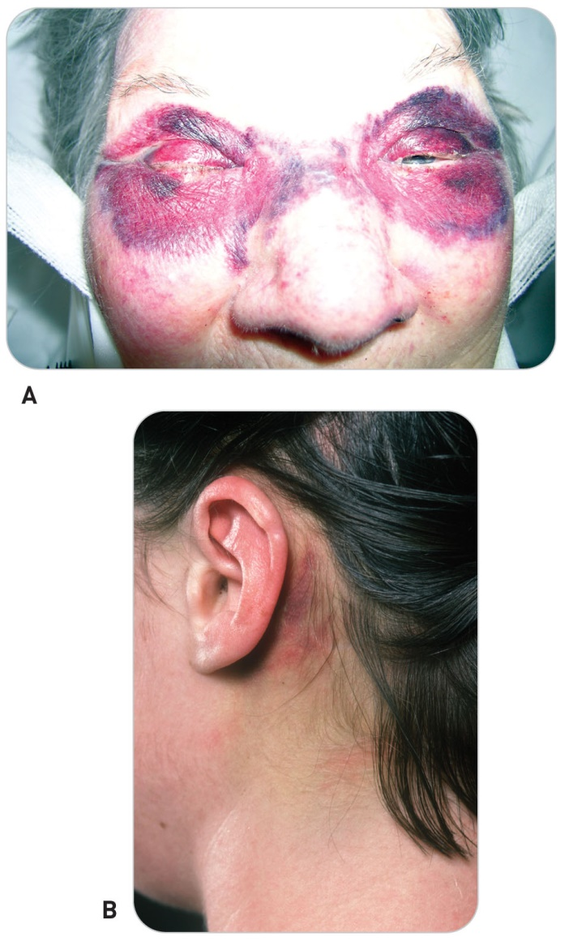
Head Soft-Tissue Injuries
Skull Fractures can present with:
A “soft spot” or depression overlying the fracture with contusion and tenderness to the scalp
CSF leaking out of the cranial vault and into the ear canals, nasal passageways, or mouth
Ecchymosis (bruising) that develops below the eyes (Raccoon Eyes) or behind one ear (Battle Sign) several hours later
Brain tissue exposed to the environment

Slide 16
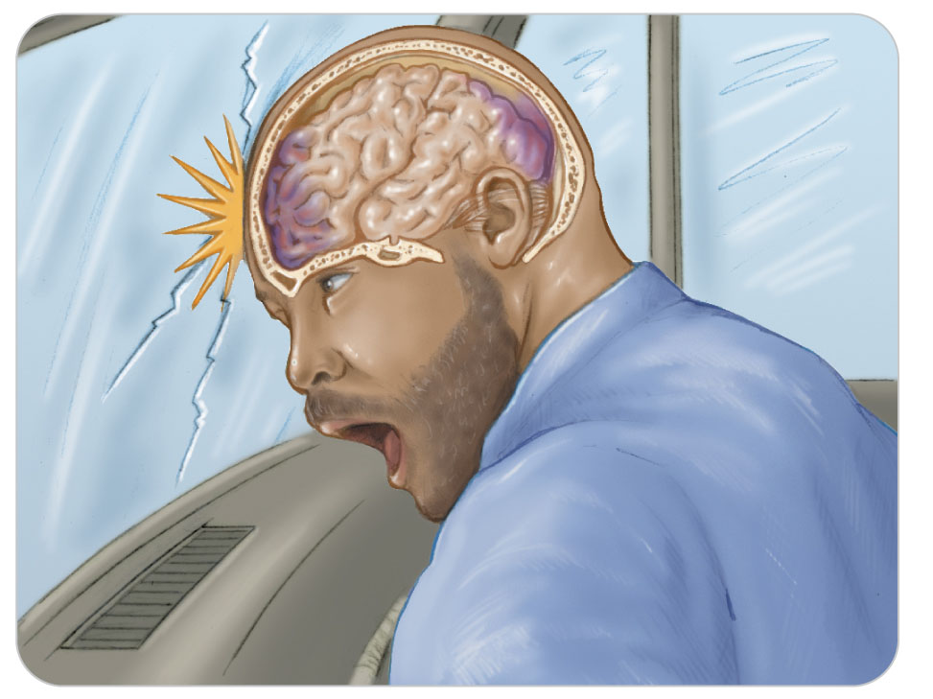
Brain Injuries: Coup-Contrecoup Brain Injury
Coup-Contrecoup Brain Injury is caused by a rapid deceleration of the head.
On impact, the brain keeps moving forward and strikes the inside of the skull (coup), damaging the brain.
The contrecoup portion of the injury occurs when the head stops and the brain rebounds in the other direction and strikes the inside of the skull on the opposite side.
Swelling and bleeding from the events will create intracranial pressure, pressure within the skull.

Slide 17
Brain Injuries: Traumatic Brain Injury (TBI)
21-2
Traumatic brain injury (TBI):
A mechanical injury to the brain that results in short-term and/or long-term neurologic deficit
Types of TBI:
Concussion
Cerebral Contusion
Cerebral Hematoma:
Epidural Hematoma
Subdural Hematoma
Intracranial Hematoma
Diffuse Axonal Injury

Slide 18
Signs and Symptoms of Traumatic Brain Injuries
21-6

Slide 19
Concussion
A concussion is a TBI caused by temporary disruption of coordinated brain function caused by trauma.
Mild: NO Loss of Responsiveness (LOR) but may include confusion, dizziness, nausea, vomiting, headache, and visual and auditory disturbances
Moderate: LOR that lasts less than 5 minutes and more pronounced disruption of brain function
Severe: LOR that is greater than 5 minutes and significant disruption of brain function
Many patients who suffer a concussion exhibit some measurable memory loss, known as amnesia.
The severity depends on the extent of the concussion.

Slide 20
Amnesia
Retrograde amnesia is characterized by no recollection of the events prior to the injury including the injury itself.
Antegrade amnesia is characterized by no recollection of events occurring after the injury.
Perseveration
Patients with amnesia often have a distinctive speech pattern.
“What happened?” or “What happened?” or “Where am I?”
Indicative of the confusion experienced and of antegrade amnesia
If antegrade amnesia lasts longer than retrograde amnesia, prognosis is worse.
Recovery can take months or even years.

Slide 21
Cerebral Contusion
A cerebral contusion is a bruise involving the brain.
Rupture of small, superficial blood vessels
Affects localized areas of the brain
Presents with identical signs and symptoms to a concussion but is more serious

Slide 22
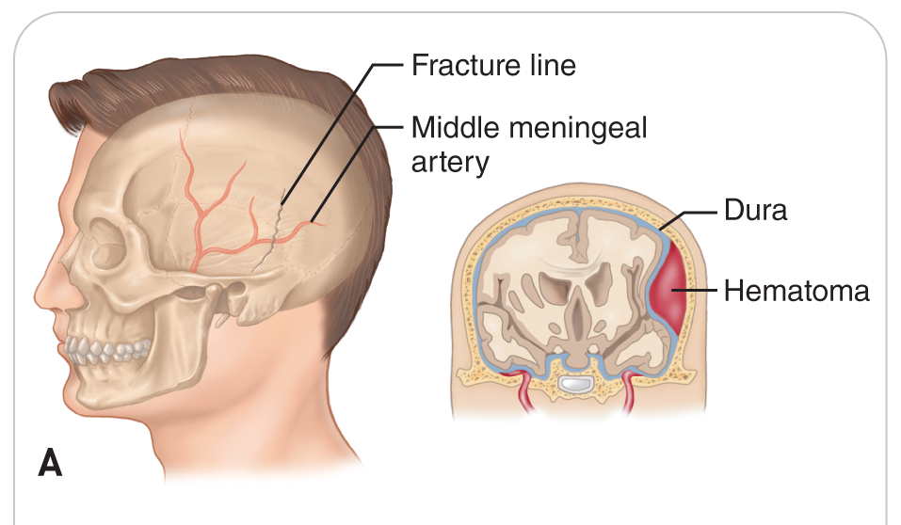
Epidermal Hematoma
An epidermal hematoma is a TBI that results in arterial bleeding between the skull and the dura mater.
Generally a result of blunt trauma that causes a skull fracture
Onset of signs and symptoms is rapid.
Initially unresponsive
Followed by a “lucid interval”
Then becomes increasingly less responsive, until unresponsive
Deadly without rapid surgical treatment

Slide 23
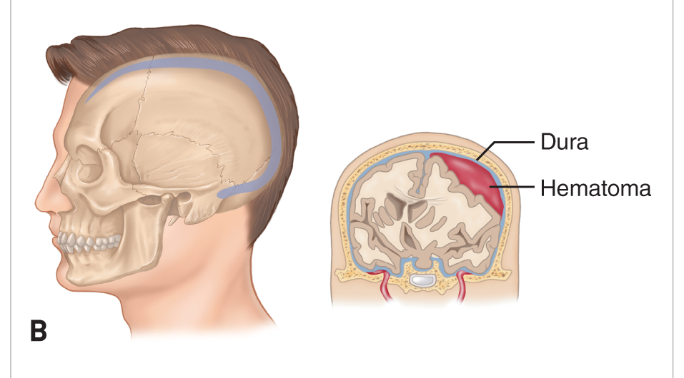
Subdural Hematoma
A subdural hematoma is a collection of venous blood between the dura mater and the brain.
Often caused by rapid deceleration injuries
Similar symptoms to an Epidermal Hematoma but progresses more slowly
Onset of symptoms: hours, days, or even weeks after insult

Slide 24
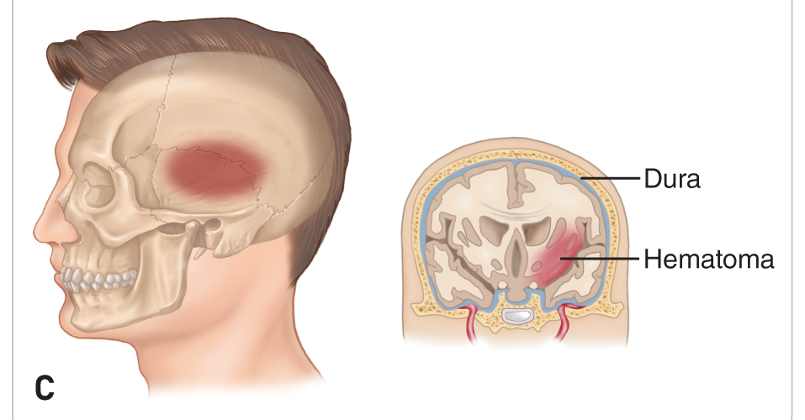
Intracerebral Hematoma
An intracerebral hematoma occurs when a blood vessel inside brain tissue ruptures, forming a hematoma inside the brain.
Can occur spontaneously or from trauma
Can be life threatening because of a rapid rise in intracranial pressure
Prognosis is very poor for those on anticoagulants.

Slide 25
Diffuse Axonal Injury
An axon is the long, slender projection of a neuron that send electrical signals away.
Diffuse Axonal Injury is a devastating TBI resulting in widespread brain injury.
Caused by high-velocity rotational/deceleration mechanisms
Ex: high speed ski, snowmobile, and bicycle crashes
Patients may be unresponsive at the time of injury or become unresponsive later.

Slide 26
Spine Injuries: Fractures
21-3
Fractures of the vertebrae may occur from blunt, penetrating, compression, twisting, or distraction forces.
Hyperflexion, hyperextension, and rotational injuries
Cervical and lumbar regions
Blunt and compression trauma
Thoracic vertebrae
Sacral and coccygeal vertebrae

Slide 27
Cervical Spine Fractures
21-3
21-4
Fractures of the cervical spine causing damage to the spinal cord can result in paralysis of the arms and legs and loss of sensation below the level of the injury.
“C3, C4, C5, keep the diaphragm alive.”
Fractures of the cervical spine that damage the spinal cord at the level of C3 through C5 can decrease signals to the phrenic nerves, resulting in a patient who is unable to breathe on his or her own.
Without rapid intervention, patients die.

Slide 28
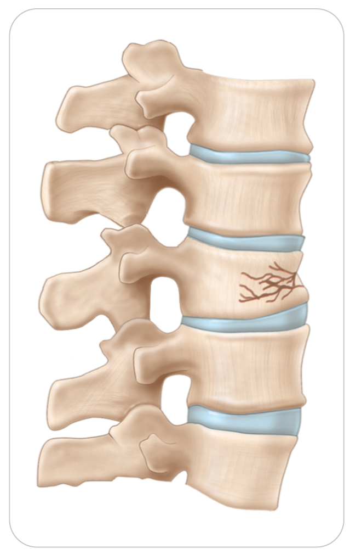
Thoracic Spine Fractures
21-3
Vertebrae of the thoracic spine are protected from rotational injuries by the rib cage.
Compression of a thoracic vertebra can occur from a fall or axial loading (force that is applied from one end of the spine to another).
Upper thoracic spine fractures are less common than other vertebrae.

Slide 29
Other Spinal Fractures
21-3
Most common fractures of the spine occur in the lower-thoracic and lumbar areas, or at the junction of the two.
Men experience fractures four times more often than do women.
Injuries involving the lumbar vertebrae are due to twisting forces and sudden axial loading, which can violently compress the vertebrae.
Can also result from deceleration forces, as when deceleration flexes the lumbar spine in an individual restrained by a seatbelt
Injury of the sacral vertebrae is rare.
Fracture of the coccyx is common.
Occurs when a person falls on the buttocks

Slide 30
Neurologic Injuries of the Spinal Cord
21-3
May result from direct or indirect injuries to the spinal cord
Direct, or primary, injury to the spinal cord can be caused by:
A broken or displaced vertebra putting pressure on the cord
A laceration of cord nerve fibers by sharp bone ends
Indirect injury is caused by:
Pressure from a hematoma inside the bony spinal canal, which puts pressure on the spinal cord
Traumatic swelling of the spinal cord, resulting in loss of blood supply to the cord called neural ischemia

Slide 31
Neurogenic Shock
21-3
21-4
Form of shock that is caused by disruption of the Autonomic Nervous System
Peripheral blood vessels dilate, trapping blood in the capillary beds, which causes a precipitous drop in blood pressure.
The most common cause is spinal cord injury.
Condition is characterized by bradycardia (slow heart rate) and often a normal respiratory rate.
Potentially life-threatening complication of spine trauma that must be considered
Consider other causes of shock, especially hypovolemic shock, before attributing shock to neurogenic causes.

Slide 32
Patient Assessment

Slide 33
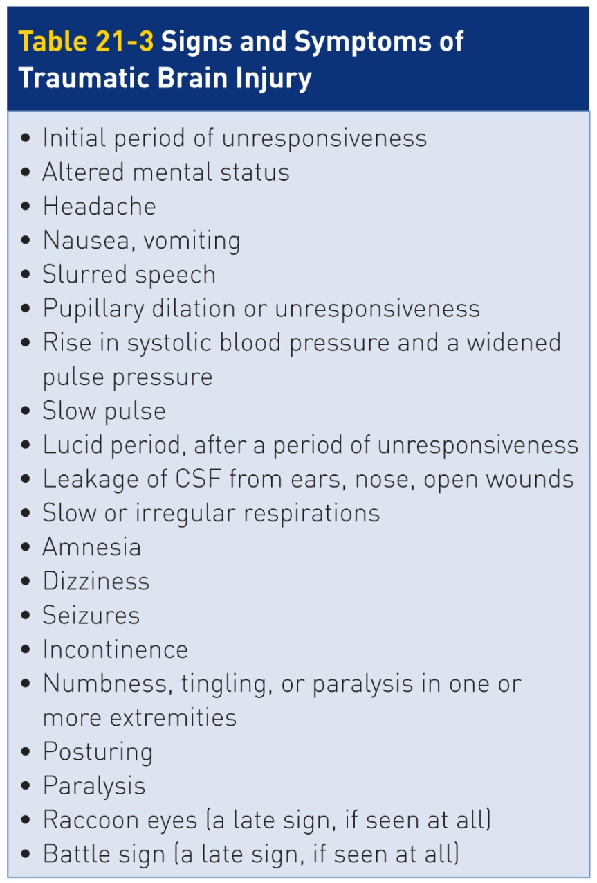
Patient Assessment: Evaluating for the TBI
21-6

Slide 34
Patient Assessment: Evaluating for the TBI
Conditions that have signs and symptoms that are similar to TBIs:
Stroke
Low blood sugar
Low blood pressure
Drug or alcohol ingestion
Consider other possibilities before concluding the problem is a TBI.

Slide 35
Patient Assessment: Spinal Motion Restriction
Previously, many patients with neck or back pain were automatically strapped on a long backboard.
Referred to as “spinal immobilization”
Many studies have shown this is not needed unless specific criteria are met.
Now many fewer patients need spine “protection” in the prehospital setting.
Now referred to as “Spinal Motion Restriction” or SMR

Slide 36
Patient Assessment: Evaluating the Spine
21-5
In unresponsive or altered mental status patients:
If you suspect a spine injury in a trauma situation, Spinal Motion Restriction (SMR) is maintained during the assessment and treatment.
When CPR is necessary:
If alone, begin one-person CPR as this takes priority
If two OEC technicians:
One provide spinal motion restriction
Other performs patient assessment or CPR if needed

Slide 37
Patient Assessment: Evaluating the Spine
21-5
Conscious and alert patients:
Often can be directed to simply limit movement of the spine, allowing the OEC technician to complete an assessment and begin treatment

Slide 38
Patient Assessment: Decision to Remove a Helmet
21-5
The assessment of a patient with a suspected brain or spinal cord injury should include an exam of the skull, spine, and nervous system.
The first decision is whether or not to remove the helmet.
It is recommended that you remove a helmet only if:
Patient does not have a patent airway, is not breathing adequately, and the helmet prevents you from managing these problems
Helmet is too big or allows patient’s head to move
Helmet prevents you from properly placing a cervical collar
Patient is in cardiac arrest
Helmet is broken

Slide 39
Patient Assessment: Inspection and Palpation
21-5
Assessment starts by palpating:
The head (skull) assuming you remove the helmet
For pain and abnormalities such as a depression in the skull
Each spinous process in the midline of the spinal column from the top of the posterior neck to the top of the sacrum
Misalignment or a step-off in the spinous processes of the spine
Look and feel for any evidence of trauma using DCAP-BTLS:
Deformity, Contusions, Abrasions/Avulsions, Punctures/Penetrations, Burns/Bleeding/Bruises, Tenderness, Lacerations, Swelling

Slide 40
Patient Assessment: Neurologic Evalution
21-5
Neurologic evaluation includes:
Assessing responsiveness
Looking for spinal fluid leakage
Motor or muscle strength
Sensation
Function of the eyes

Slide 41
Patient Assessment: Assess Responsiveness
21-5
Use the AVPU scale to determine Level of Responsiveness.
Patients with a neurologic injury may appear:
Normal
Confused
Agitated
Combative
Comatose
Assessment must be repeated at least every 5 minutes because it can change rapidly.

Slide 42
Patient Assessment: Spinal Fluid Leakage
21-5
Examine the ears and nose for leakage of CSF, an indicator of a skull fracture.
All skull fractures suggest a high-impact MOI.
Almost always occur in combination with TBI
By itself, CSF appears clear and colorless and may be mistaken for sweat, rain, or melted snow.
In the setting of neurologic trauma, CSF will likely be mixed with blood and may leak from the ear canals, nostrils, or mouth.

Slide 43
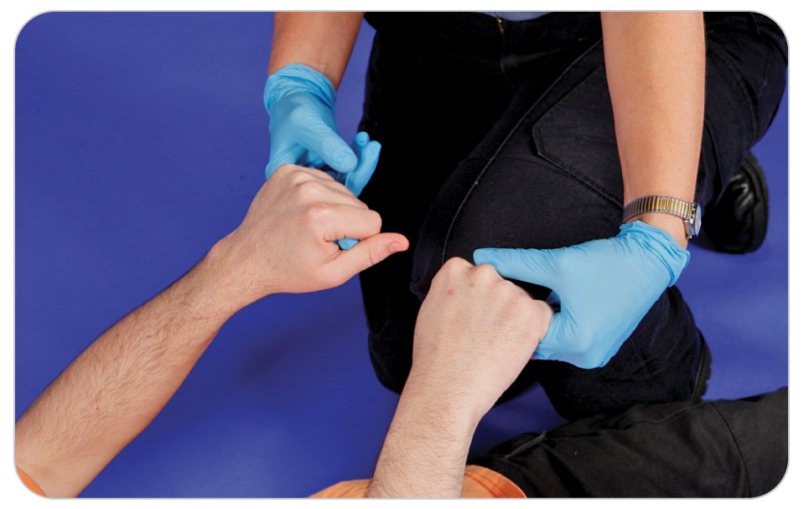
Patient Assessment: Motor and Muscle Strength
21-5
Damage to the spinal cord:
In the neck causes neurologic compromise to all four extremities
In the thoracic or lumbar region causes neurologic problems in just the legs
Motor testing of nerves that come out of the spinal cord involves manually testing arm and leg muscle groups.
In responsive patients, ask them to squeeze your index and long fingers, checking to see if strength is equal.

Slide 44
Patient Assessment: Sensation
21-5
Touch the fingers of both patient’s hands, asking the person if they can feel it.

Slide 45
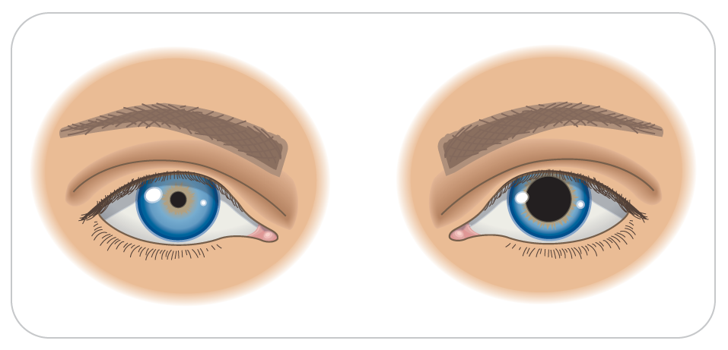
Patient Assessment: Function of the Eyes
21-5
Examine the eyes by performing a pupillary exam and an evaluation of extraocular movement.
Pay close attention to any abnormal findings such as pupils that are unequal, dilated, or unresponsive to light.
Make sure patient can follow your finger with both eyes in all directions.

Slide 46
Patient Assessment: SAMPLE and Vitals
21-5
Obtain a SAMPLE history and take a complete set of vital signs.
Attempt to determine the forces involved and whether patient was rendered unresponsive, even if only momentarily.
Ask if patient has diabetes or a history of seizures, or if used any mind-altering substances, including alcohol, legal and/or illicit drugs.
Can also alter neurologic findings
May need to care for patient for both a medical problem and the neurologic trauma

Slide 47
Patient Assessment: Secondary Assessment
21-5
Complete a head-to-toe exam noting any non-neurologic injuries, especially fractures of the scapula and posterior ribs.
Patients with a suspected scapula or posterior rib fractures have a higher incidence of spinal injury.
Many spinal injuries are not isolated, with extremity, chest, or abdominal injuries frequently present as well.

Slide 48
Patient Assessment: Reassessment
21-5
Every 5 minutes after the completion of the Secondary Assessment, reassess the vital signs and carefully evaluate each value.
TBI with increased intracranial pressure is associated with the following changes in vital signs:
Increased Systolic Blood Pressure
Decreased Diastolic Blood Pressure
Tachypnea (Fast Respiration Rate)
Bradycardia (Slow Heart Rate)

Slide 49
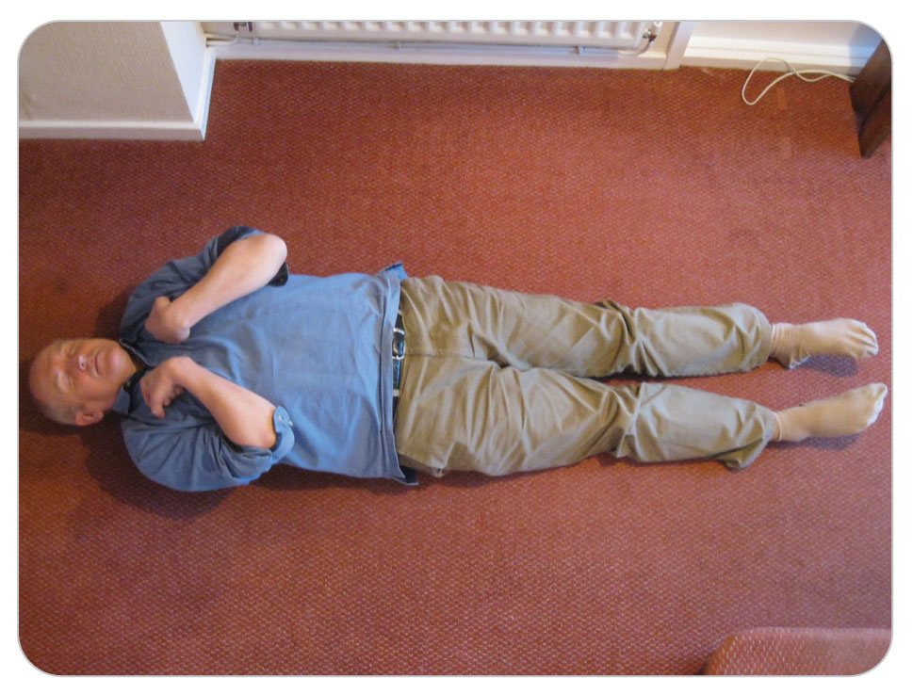
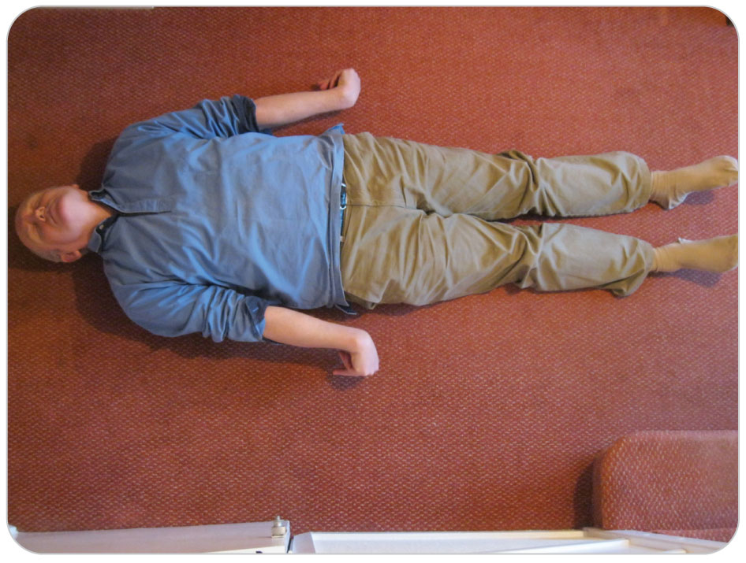
Patient Assessment: Posturing
Posturing is an abnormal neurologic finding that indicates a serious CNS injury.
Decorticate
Decerebrate

Slide 50
Spinal Motion Restriction

Slide 51
Spinal Motion Restriction
21-7
All transfers should be done with careful attention to limiting spinal motion.
May include the use of:
Stretcher or Gurney
Whole Body Vacuum Splint
Backboard
When using Spinal Motion Restriction, a cervical collar is REQUIRED.
The spine should be further protected against movement with padding/bracing to fill voids and strapping to limit movement laterally and axially.

Slide 52
Risk of No Precautions
When a patient with a spinal trauma is moved without such precautions, damage to the spinal cord can occur.
Unstable vertebrae or vertebral bone fragments may:
Intrude into the spinal canal
Put direct pressure on the spinal cord

Slide 53
Spinal Motion Restriction Algorithm
21-5
The decision to institute Spinal Motion Restriction involves three elements:
Determine the Mechanism of Injury.
Consider the Potential for Spine Injury based on the MOI.
Reliability of Assessment
Consider the Level Of Responsiveness of the patient and its effect on the credibility of the exam.
Exam Findings
Assess and determine if the Physical Findings support a possible Spinal Injury.
An Algorithm was developed by NSP to guide OEC Technicians through this decision process.

Slide 54
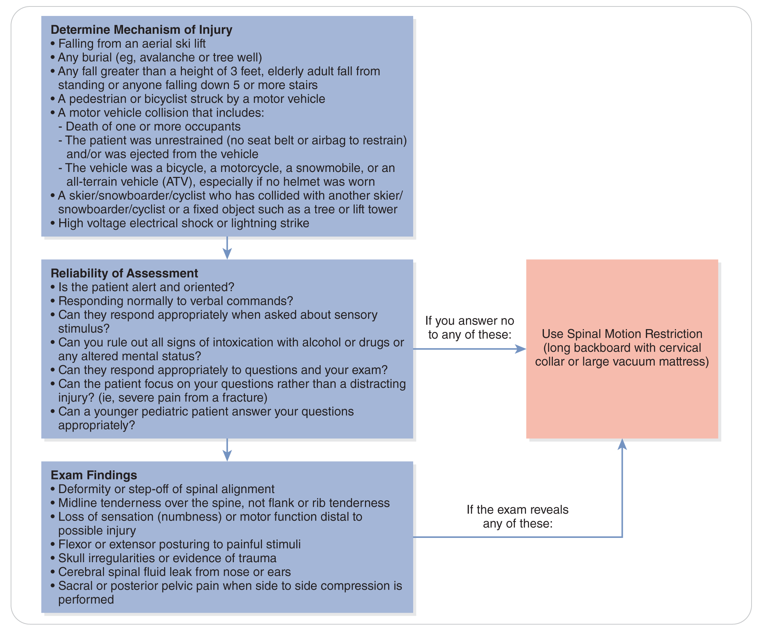
Spinal Motion Restriction Algorithm
21-5

Slide 55
REQUIRED Spinal Motion Restriction
21-5
Potential (MOI) for spine injury, normal mental status, exam finding associated with spinal injury
Potential (MOI) for spine injury, altered mental status (such that the exam is not reliable)
Any positive physical finding on the exam
Potential (MOI) for spine injury with a distracting injury (that makes exam impossible)
Any unresponsive patient involved in an unwitnessed trauma accident

Slide 56
Positive Physical Findings
21-5
Deformity or step-off of spinal alignment
Midline tenderness over the spine (not flank or rib tenderness)
Loss of sensation (numbness) or motor function distal to injury
Flexor or extensor posturing to pain stimulus
Skull irregularities or evidence of trauma
Cerebral spinal fluid leak from nose or ears
Sacral or posterior pelvic pain when side-to-side pressure applied

Slide 57
Spinal Motion Restriction is NOT Indicated
Spinal Motion Restriction is NOT needed for:
Low energy injuries even with minor injuries
“Just in case” there is an injury (low level probability)
A headache, a brief loss of consciousness (a few seconds) or concussion in a now otherwise alert and oriented patient
Patients who are up and walking at the scene without physical findings or symptoms
Isolated penetrating trauma without spinal or neurologic deficit

Slide 58
Cannot Obtain Adequate Exam
If you suspect a spinal injury and cannot obtain an adequate exam in the field and it is more important to get the patient inside as quickly as possible, use Spinal Motion Restriction during transport.
Once indoors and able to perform an adequate exam, if Spinal Motion Restriction is NOT indicated, the materials used to restrict motion can be removed.
This is NOT considered “Clearing the Spine” but delaying your evaluation with restrictions.
When in doubt, continue SMR until a higher-level EMS person evaluates the patient.

Slide 59
Management

Slide 60
Management
21-7
The goals of emergency management of traumatic brain and spinal cord injuries are to:
Fully assess patient
Adequately maintain patient’s vital signs
Avoid secondary injury while transporting patient

Slide 61
Management: Brain Injuries
21-7
Serious brain injuries are potentially life threatening and require rapid transport to a definitive medical facility.
OEC technicians are NOT expected to be able to differentiate between different types of serious brain injuries.
Must be able to identify patients with signs and symptoms of significant brain injuries and arrange appropriate transport to a trauma center capable of managing such injuries
When in doubt, EMS transport is best.

Slide 62
Management: Steps for Serious Head or Spine Injuries
21-7
1) ABCDs of Head and Spine Injuries
Care of patients with serious head or spine injuries consists of the following steps:
Correct any threats to life (ABCDs) that may be present while protecting the spine, especially the cervical spine.
Perform CPR, if necessary.
Control severe external bleeding and maintain blood flow to body tissues.
Establish and maintain an adequate airway using the jaw thrust maneuver.
If patient is unresponsive and has no gag reflex, insert an oropharyngeal airway or nasopharyngeal airway.
Suction to keep the airway clear as needed.

Slide 63
Management: Steps for Serious Head or Spine Injuries
21-7
2) Supplemental Oxygen
Provide supplemental oxygen when needed.
If breathing:
Administer oxygen via nonrebreather mask at 15 LPM.
Then titrate to keep the nonrebreather mask half full.
If not breathing (or is breathing less than eight breaths per minute):
Ventilate patient using a bag-valve mask.
Watch each breath so the chest rises normally.
Use supplemental oxygen at a normal respiratory rate.

Slide 64
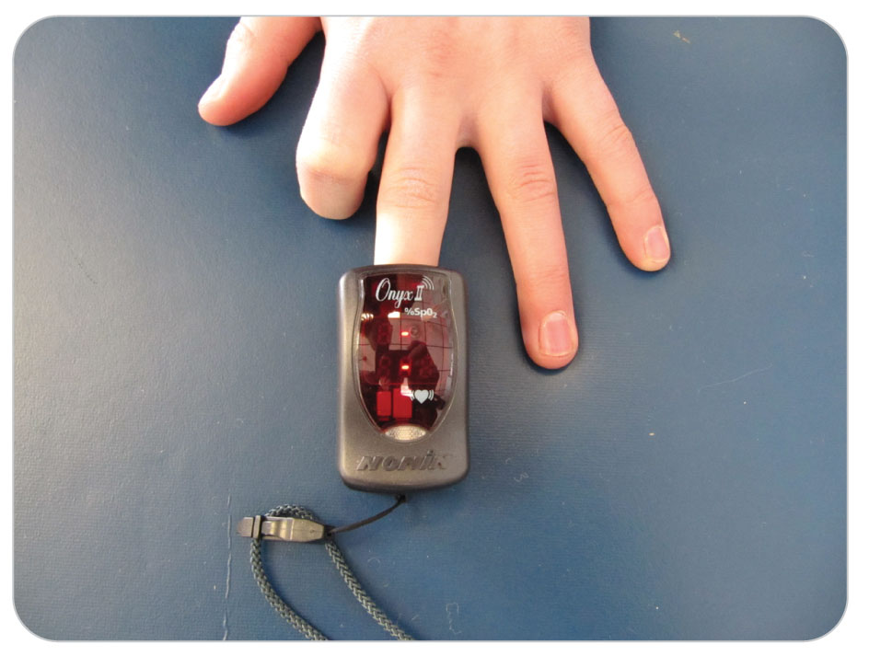
Management: Steps for Serious Head or Spine Injuries
21-7
2) Supplemental Oxygen (Cont’d)
Use a pulse oximeter, keeping the oxygen saturation between 94 and 99%.
Hyperventilation (oxygen saturation of 100%) with oxygen of a patient with a TBI is not recommended.
Hyperventilation can in fact be detrimental to patient.

Slide 65
Management: Steps for Serious Head or Spine Injuries
21-7
3) Spinal Protection:
Protect the spine until assessment for spinal motion restriction has been completed.
Use manual stabilization of the cervical spine.
If Spinal Motion Restriction (SMR) is needed, apply a collar, padding and back board, or vacuum mattress.

Slide 66
Management: Steps for Serious Head or Spine Injuries
21-7
If time permits, treat other minor injuries.
In severe brain or spinal injuries, transport as soon as possible.
If CSF is leaking from the ears or nose, do not attempt to stop the flow.
Transport patient with the head uphill to prevent worsening of an intracranial head injury.
Continually monitor patient.
Check patient’s Level of Responsiveness and other vital signs every 5 minutes and record any changes later in the PCR.
Transport patient to a definitive-care facility as soon as possible.

Slide 67
Management: Manual Stabilization of the Neck
21-7
Initially manually stabilize the neck and spine of any patient with a significant mechanism for potential head or spinal cord injury.
If findings do not indicate the need for spinal motion restriction after a quality spine and neurologic evaluation, manual stabilization can be discontinued.
Put a cervical collar in place if findings indicate the need for spinal motion restriction.

Slide 68
Management: Cervical Collar
21-7
Manual in-line stabilization of the head and cervical spine is the first step in properly restricting motion in a patient with a spine injury.
Rigid cervical collars
Known as C-Collars or Extrication Collars
Provide support for the head and cervical spine during transport
They provide ONLY partial restriction.
ALWAYS use these devices in conjunction with a long backboard.
Whole body vacuum mattress when applied correctly does not require a cervical collar.

Slide 69
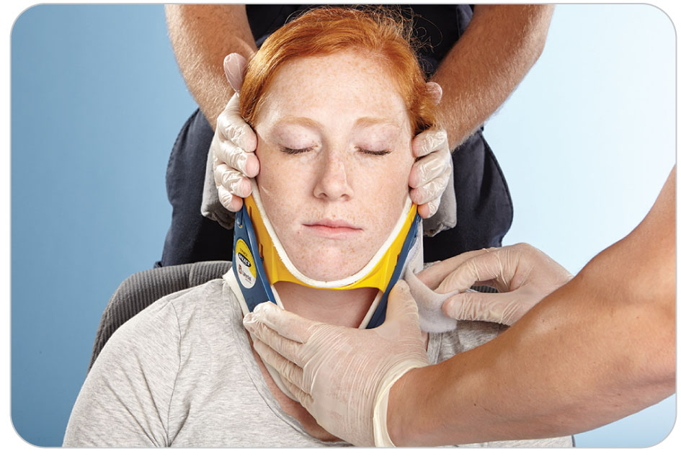
Management: Sizing a Cervical Collar
21-10
To be effective, a cervical collar must be properly sized to patient.
Should rest on the shoulder
Provide firm support:
Under the chin
Along both sides of the mandible
At the occiput on the back of the head
Should not obstruct the airway
Always follow the manufacturer’s directions.

Slide 70
Management: Sizing a Cervical Collar
21-10
A properly sized cervical collar will:
Restrict motion of the head and cervical spine in neutral alignment
Not hyperextend the neck
The chin will rest flush with the edge of the chin cup.
Do not hyperextend or flex the neck.

Slide 71
Management: Improper Cervical Collar
21-7
An improperly sized or applied cervical collar can:
Compromise airway patency
Compromise cervical spine stability
Cause further injury
If the appropriate size is not available, or if the cervical collar cannot be applied appropriately for any reason, DO NOT use it.

Slide 72
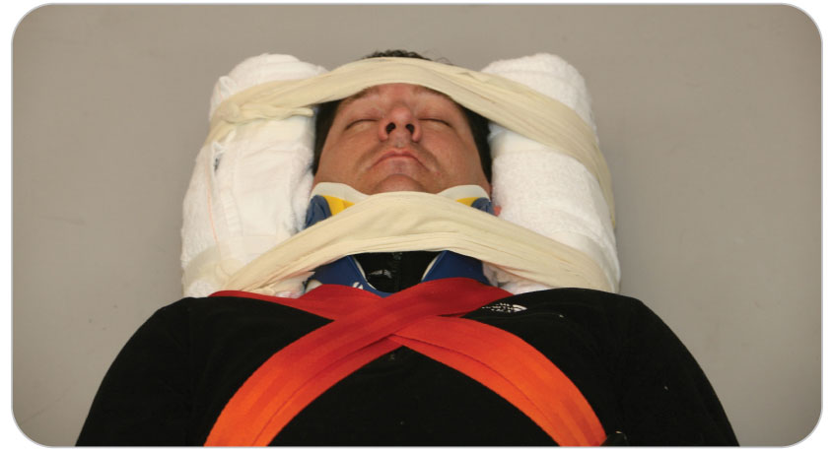
Management: Alternative to a Cervical Collar
21-7
Instead of a Cervical Collar, use:
A commercial head block
A tightly rolled towel against each side of the head as a head block
A horseshoe-shaped blanket over the top of the head, and then secure patient’s head to the long backboard using cravats

Slide 73
Management: The Supine Patient
21-7
21-8
Supine Patient
When logrolled, the procedure must be carefully executed to prevent any twisting or excessive bending of the spine.
Logroll should be performed using at least four rescuers.
Prior to beginning the logroll, make sure a cervical collar has been applied.
Review the skill “To Logroll a Supine Patient onto a Long Backboard,” OEC Skill 5-7.

Slide 74
Management: Axial Drag
21-7
21-8
21-11
As the rescuers continue to hold patient, Rescuer 1 checks to make sure patient is properly centered on the long backboard.
If patient is not centered on the long backboard, patient must be centered by performing an axial drag.
Drag is a method of pulling a patient on the ground to another location.
Axial drag is used to center a patient on a backboard.
Procedure may be repeated as necessary until patient is properly positioned on the long backboard.

Slide 75
Management: Axial Drag
21-7
21-8
21-11
Alternative to a logroll onto a long board:
Place the long backboard with about a foot and a half of it extending above patient’s head.
Then do an axial drag to center patient.

Slide 76
Management: Securing a Patient onto a Long Backboard
Once properly positioned on the long backboard, patient is secured using straps, cravats, tape, or a commercial device.
Because a child’s head is larger in relation to its body than an adult, pad beneath a child’s shoulders to lift the thorax.
Allows the head and neck to assume a neutral position

Slide 77
Management: The Sitting Patient
21-7
21-8
Not every spine injury patient you encounter will be lying down.
Some will be wedged against a rock or tree, sitting in an automobile, or will sit down following their accident.

Slide 78
Management: The Sitting Patient
21-7
21-8
Patients who can move on their own volition and who are reliable, should be allowed to lay themselves onto a stretcher, toboggan, or vacuum mattress.
Stabilize the head by placing a cervical collar prior to having patient move.
Manually stabilize the head and cervical spine and apply a cervical collar.
Patient must be moved carefully to ensure axial alignment when moving from a sitting to a supine position.
At that point, move patient to a long backboard.

Slide 79
Management: The Standing Patient
If the patient is standing and meets the requirement of Spinal Motion Restriction:
Apply a cervical collar.
Assist the patient in lying down on the backboard.
Complete Spinal Motion Restriction (SMR) and transport.

Slide 80
Management: Placing a Patient on a Vacuum Mattress
Load a patient on a Vacuum Mattress using the same method as for a long backboard.
With axial drags, center the patient on the mat.
No straps are needed.
The mat forms a rigid construct around the patient and provides Spinal Motion Restriction (SMR).
When applied correctly does NOT require a cervical collar

Slide 81
Management: Helmet Use
As a result of effective injury prevention efforts, most outdoor enthusiasts now wear helmets while participating in their chosen sports.
In 2019, 85% of skiers/snowboarders wore a helmet.
National Medical Committee of the National Ski Patrol recommends that anyone who participates in a snow sport wear a helmet to reduce the severity of injuries to the head.
Wearing a helmet does not appear to increase the risk of neck or cervical spine injuries in adults.

Slide 82
Management: Decision to Remove a Helmet
21-7
21-14
Even though the presence of a helmet can complicate the management of patient, you may not need to remove the helmet to care for patient.
Leave Helmet ON if:
Helmet fits properly
Does not obstruct the airway
Does not interfere with assessment and management of the airway
Can be incorporated into proper spinal motion restriction of the spine
If patient is sitting or standing AND it is necessary to remove the helmet, you may allow patient to remove their own helmet if they are willing and able while you are stabilizing the head.

Slide 83
Management: Decision to Remove a Helmet
21-7
21-14
It is recommended that you REMOVE a helmet only if:
Patient does not have a patent airway, is not breathing adequately, and the helmet prevents you from managing these problems
Helmet is too big or otherwise allows patient’s head to move while it is left in place
Helmet prevents you from properly placing a cervical collar due to its size or shape
Patient is in cardiac arrest
Helmet is broken and thus does not allow proper head and neck immobilization or visualization of injuries

Slide 84
Management: Jams and Pretzels
21-7
21-15
Patients who incur serious injuries in the field often are found in a contorted position with severely angulated limbs.
To effectively immobilize and transport these patients, it is necessary to:
Move them into an anatomically correct supine position
Package with Spinal Motion Restriction (SMR)
A process referred to as “Jams and Pretzels”

Slide 85
Management: Jams and Pretzels
21-7
21-15
Always remember to apply a cervical collar PRIOR to moving a patient or performing “Jams and Pretzels” when Spinal Motion Restriction is necessary.

Slide 86
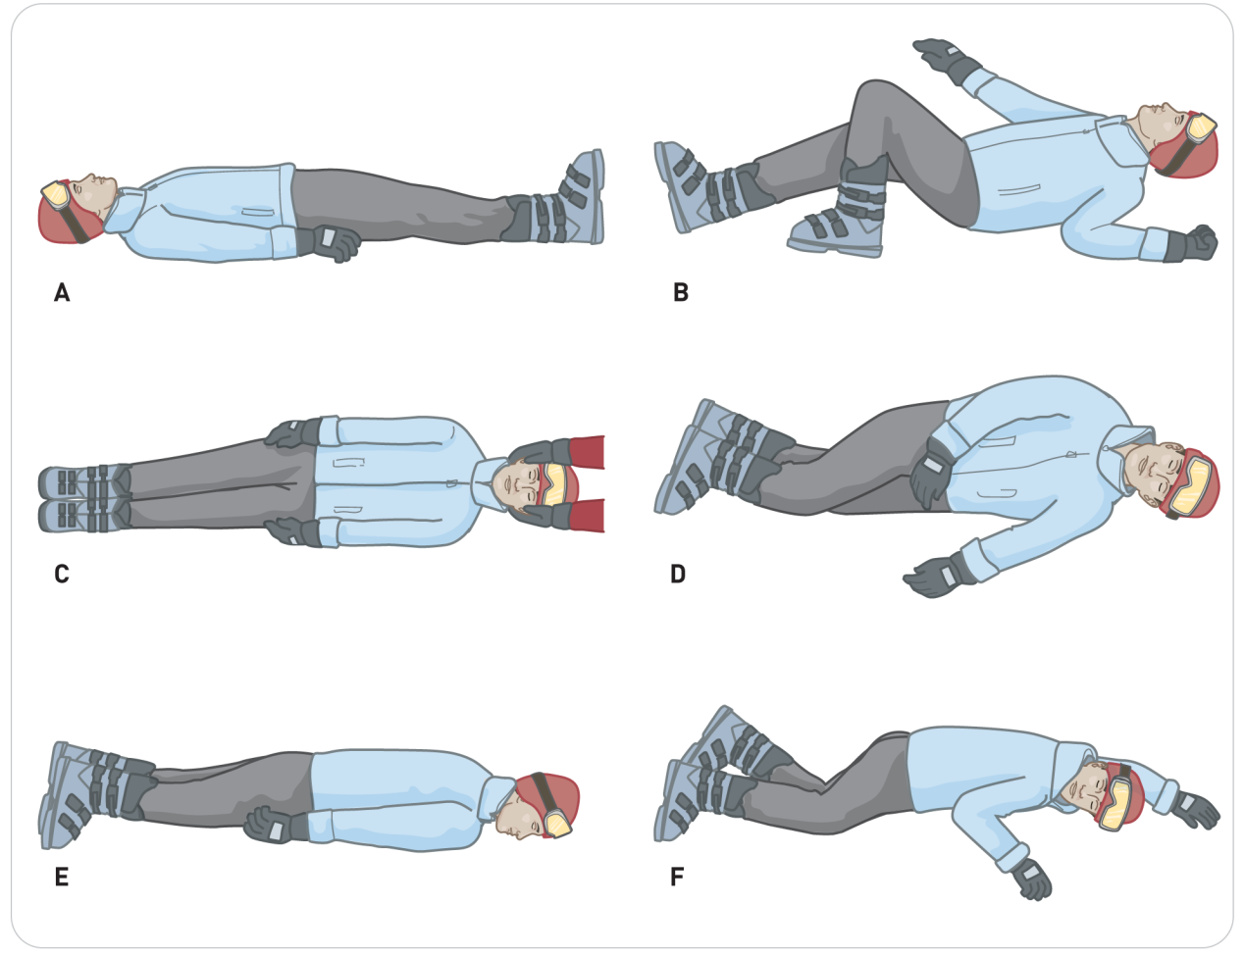
Management: Jams and Pretzels
21-15
Rescuers encounter injured patients in one of six basic anatomic positions.
Positions were popularized by Warren Bowman, MD.
First introduced to the NSP in Outdoor Emergency Care, Third Edition

Slide 87
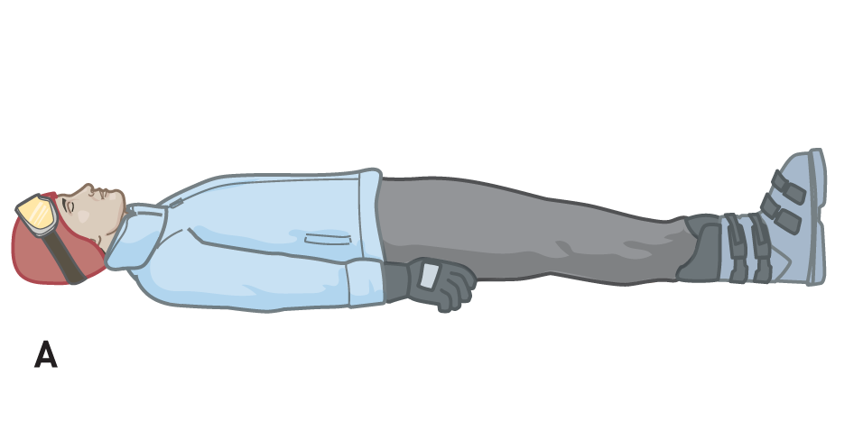
Management: Jams and Pretzels
21-15
Position 1:
Patients are:
Supine
In a neutral anatomic position with the back straight and the eyes facing forward
The extremities are straight, with the palms against the thighs.
Ideally, patients should be aligned in THIS position before transfer to a long backboard.

Slide 88
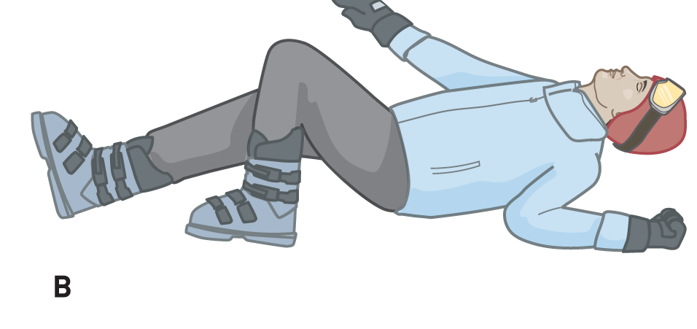
Management: Jams and Pretzels
21-15
Position 1a:
Patients are:
Supine
Head, neck, back, and/or extremities are rotated, bent, or in some position other than an anatomically correct position.

Slide 89
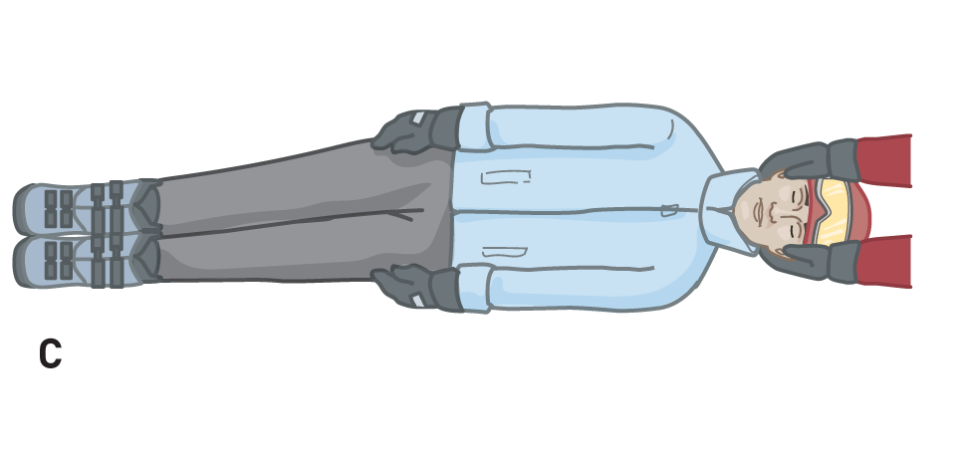
Management: Jams and Pretzels
21-15
Position 2:
Patients are:
On their side
In a neutral anatomic position with:
The back straight
The eyes facing forward
The extremities straight
The palms against the sides of the thighs
Patients in this position should be rolled in one direction to Position 1 by using a logroll.

Slide 90
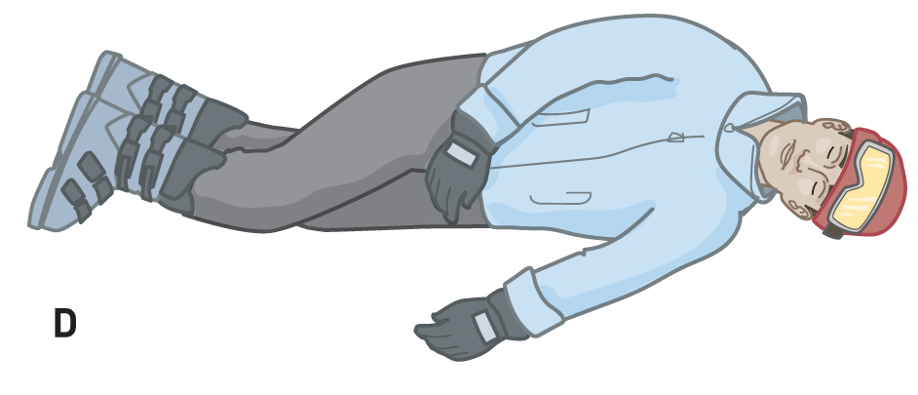
Management: Jams and Pretzels
21-15
Position 2a:
Patients are:
On their side
The head, neck, back, and extremities in any position except a normal anatomic position

Slide 91
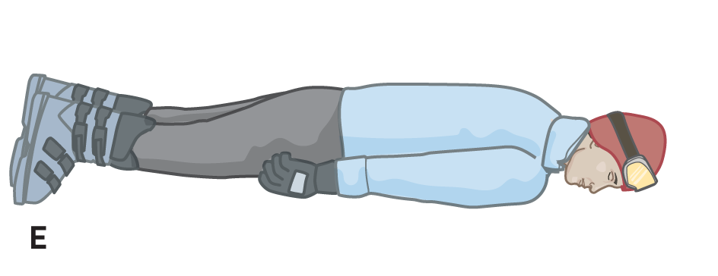
Management: Jams and Pretzels
21-15
Position 3:
Patients are:
Prone
In a neutral anatomic position, except that the head is usually turned to the side

Slide 92
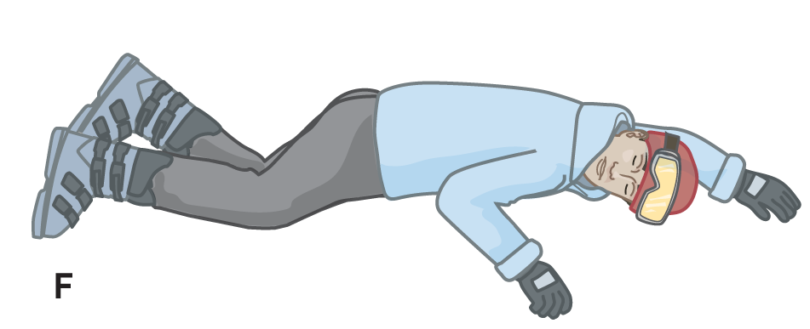
Management: Jams and Pretzels
21-15
Position 3a:
Patients are:
Prone
The head, neck, back, and extremities in any position except a neutral anatomic position

Slide 93
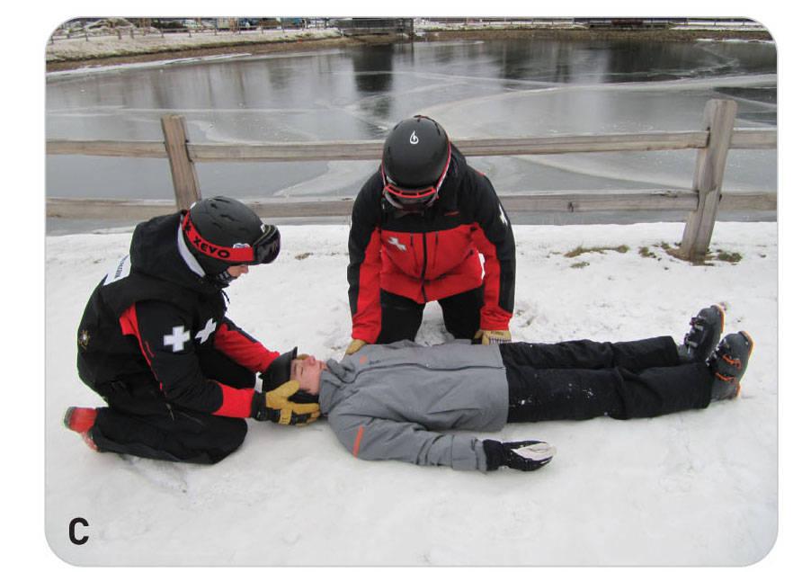
Management: Jams and Pretzels
21-15
GOAL = Position 1
The goal is to move the person, especially one with a suspected spinal injury, into Position 1, either on the ground or on a backboard, without causing any damage to the spinal cord or further neurologic injury.
When a patient lies supine in the anatomic position, the back of the person’s head (occiput), shoulders, buttocks, calves, and heels are all in the same line.

Slide 94
Management: Body’s Reference Points
21-15
Three important POSTERIOR reference points are:
Head
Shoulders
Hips
Three important ANTERIOR reference points are:
Nose
Naval
Toes

Slide 95
Management: Stabilized Extrication
21-15
The process of placing a patient into anatomic alignment is termed Stabilized Extrication.
The goal of stabilized extrication is to align patient such that the three posterior reference points remain aligned in both the vertical and horizontal planes.
The key to performing stabilized extrication, then, is to keep these three reference points both aligned and in the same plane while patient is being moved.
When this is accomplished, the spine will be stabilized and little or no motion will occur in the spinal segments.
When properly positioned, the three anterior points should also form a straight line.

Slide 96
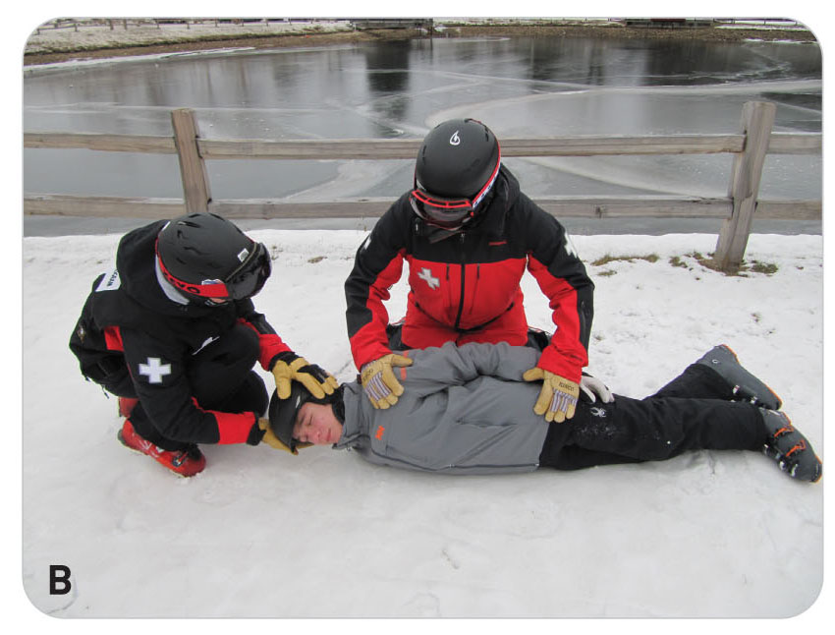
Management: Stabilized Extrication
21-15
All movements should be coordinated by a lead OEC technician.
Rescuers should move patient smoothly, without hesitation, and in unison following the leader’s directions.
Manually stabilize the three posterior reference points at all times.

Slide 97
Management: Stabilized Extrication
21-15
Move patient axially (by sliding) or vertically (by lifting and/or lowering), but never move patient sideways.
Move by increments of 6 to 12 inches.
Should be started and stopped at the leader’s command
When patient’s limbs, head, or neck need to be straightened:
Move only one joint at a time in only one plane at a time while manually stabilizing the three posterior reference points.

Slide 98
Management: Stabilized Extrication
21-15
Align all body parts into Position 1, 2, or 3 as early as possible, unless major pain or resistance occurs.
Begin with the head and neck so that the airway can be protected.
Perform all maneuvers with confidence but not in a hurried manner.
Try to keep the number of positions selected at a minimum.
Generally try to progress from a higher numbered position to a lower numbered position.

Slide 99
Case Study

Slide 100
CASE PRESENTATION
You are dispatched to an accident where a skier has collided with a large tree. Upon your arrival, you find an unresponsive male skier, approximately 30 years old, lying on his back. After the scene is made safe, you prioritize by caring for life-threatening problems. There is no excessive bleeding. Next, you recognize the need for airway management. Using techniques to minimize injury to the spine (spinal motion restriction), you immediately open the airway with the jaw-thrust maneuver and simultaneously check for breathing and a carotid pulse. You find patient is breathing and has a pulse. You immediately place an oropharyngeal airway. The individual is wearing a helmet that is cracked in two places. Blood and a clear fluid are leaking from patient’s nose and ears. The ski tracks indicate that patient went straight into the tree.
What should you do?

Slide 101
CASE UPDATE
Since patient is unresponsive, you immediately call for assistance. You instruct rescuers to bring a long backboard, a cervical collar, oxygen, and a trauma pack. You also request a toboggan and advanced life support. The supine patient’s pulse is 62 beats per minute and regular. As you await help, you continue to maintain spinal motion restriction. At the same time, you begin to visually assess patient’s injuries. He has contusions on his right facial cheek and his forehead. Soon, several other OEC technicians arrive on scene.
What should you do now?

Slide 102
CASE OUTCOME
You instruct one OEC technician to take over manual in-line stabilization of patient’s cervical spine. You instruct another to place patient on high-flow oxygen. You palpate the entire body and find no other injuries. You place a cervical collar on patient, and with the assistance of other patrollers, carefully logroll patient onto a long backboard for transport off the mountain. His vital signs remain stable. You provide spinal motion restriction with strapping, securing patient’s head to the long backboard last. You load him into a toboggan with his head uphill, and quickly transport him to a nearby landing zone, where his care is transferred to a helicopter’s medical crew after giving them a brief but pertinent handoff report. Patient is then flown to the nearest trauma center.

Slide 103
CASE OUTCOME
During your monthly patrol meeting later that week, you learn that patient had a linear skull fracture with an epidural hematoma, a fractured vertebra at C6, and neurogenic shock.
Although patient’s condition is serious, he appears to be making progress and reportedly has a good chance of returning to a normal life. The neurosurgeon was very impressed with the care patient received in the field and commends you and your team for recognizing the severity of the brain injury, protecting patient’s spine, and getting him to the hospital rapidly.

Slide 104
OEC Skill Activities

Slide 105
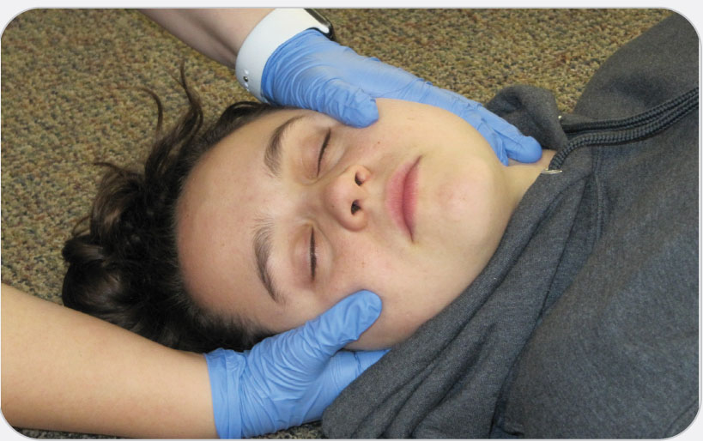
OEC Skill 21-1: Performing Neutral Head Alignment
1. Kneel next to patient’s head, either to the side or at the top of the head. Place your hands on either side of patient’s head, with the palms adjacent to the ears and the fingers supporting the jaw and the back of the head.

Slide 106
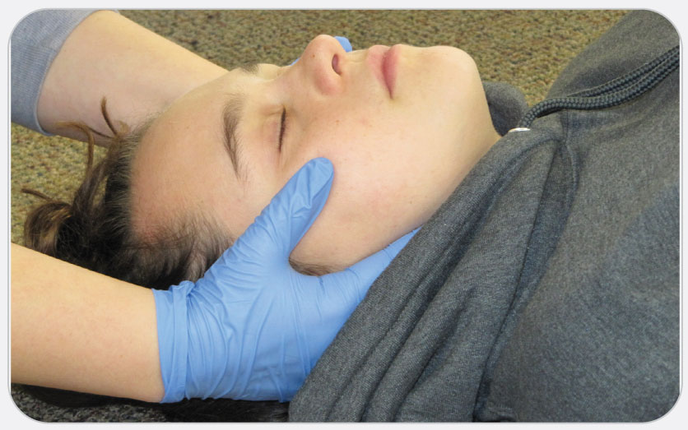
OEC Skill 21-1: Performing Neutral Head Alignment
2. Gently move the head so that patient’s eyes are looking forward and patient’s nose and chin are aligned with the sternum. Never force the head into alignment. If patient has muscle spasms in the neck or if your movement causes increased pain in the neck or numbness, tingling, or weakness in the extremities; or if alignment compromises airway or breathing, stop what you are doing and stabilize patient in the position found. Continue to manually support the head while your partner applies a cervical collar around the neck. If the head cannot be moved into alignment, you may have to stabilize the head using a blanket roll. Do not allow patient to move.

Slide 107
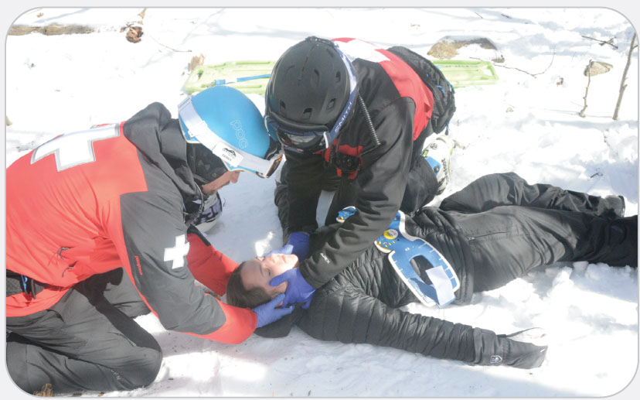
OEC Skill 21-2: Sizing and Applying a Cervical Collar
1. Maintain or establish manual stabilization of the head and cervical spine.

Slide 108
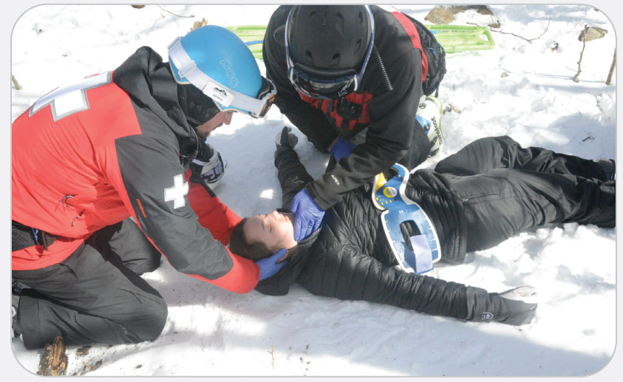
OEC Skill 21-2: Sizing and Applying a Cervical Collar
2. Measure patient and the cervical collar. Be sure to follow the manufacturer’s specifications for sizing for each of the different collar types.

Slide 109
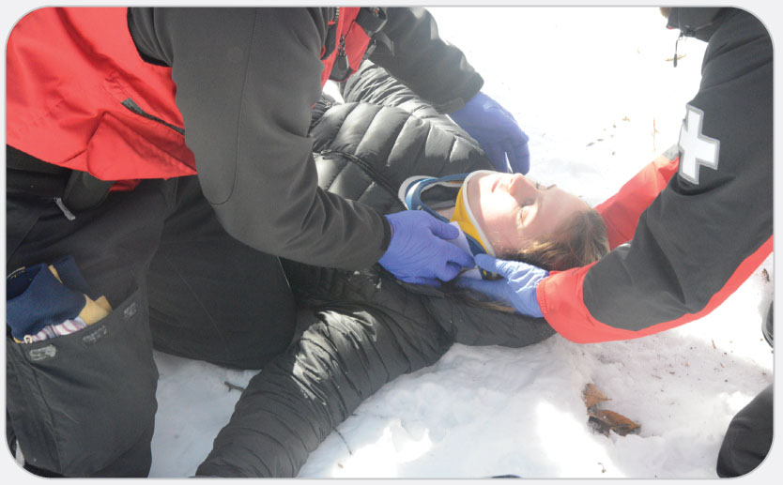
OEC Skill 21-2: Sizing and Applying a Cervical Collar
3. Apply the cervical collar.
Open patient’s coat or shirt.
Move any bulky clothing out of the way. Do not put the collar on over clothing.
Slide the posterior neck portion of the collar behind patient’s neck.
Swing the chin portion of the collar up over patient’s chest until it cups the chin.
Secure the cervical collar using the Velcro closure and ensure a proper fit.

Slide 110
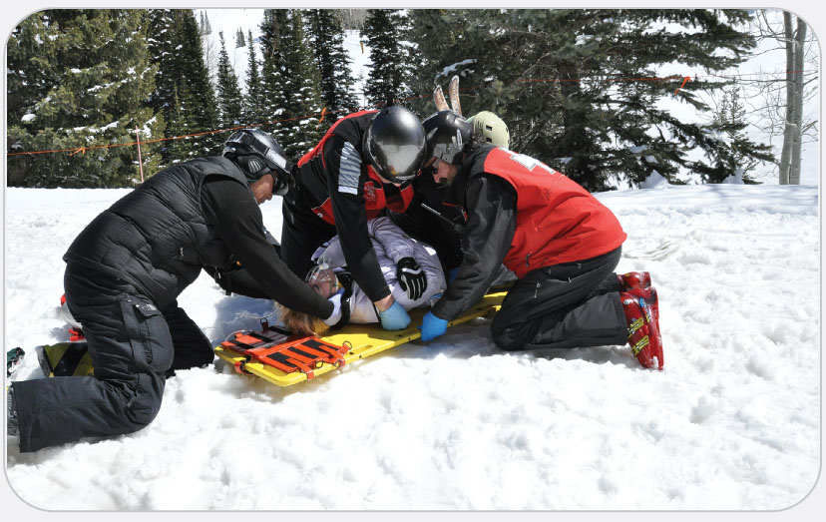
OEC Skill 21-3: Performing the Axial Drag
1. Rescuer 1 instructs Rescuers 2, 3, and 4 to slide patient toward the foot of the backboard (toward the rescuers) on the count of three. Rescuers’ hands should be at the hip area pulling patient down to the foot of the board.

Slide 111
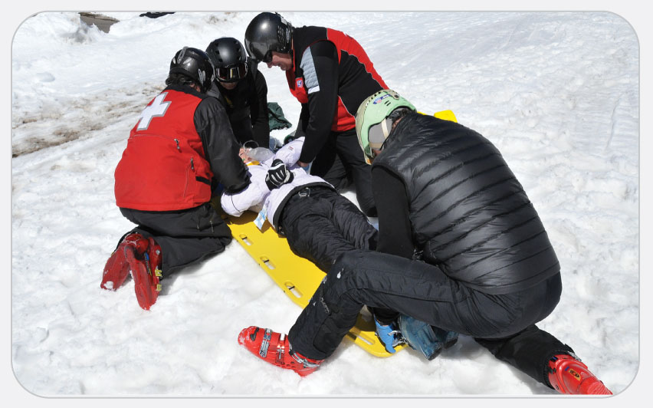
OEC Skill 21-3: Performing the Axial Drag
2. Rescuer 1 instructs rescuers to slide patient into the proper position on the count of three. Pull patient up toward the head of the long backboard with rescuers’ hands under the armpits on each side and moving simultaneously.

Slide 112
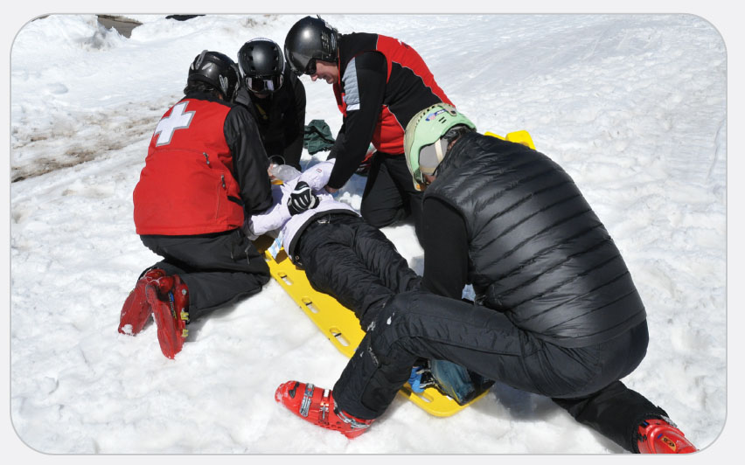
OEC Skill 21-3: Performing the Axial Drag
3. Repeat Step 2 until patient is positioned on the board correctly.

Slide 113
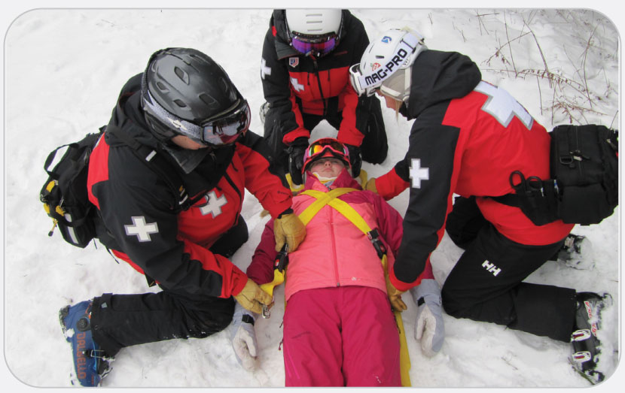
OEC Skill 21-4: Securing patient onto a Long Backboard
1. Secure the torso first. Cross the straps from over the shoulder to just above the opposite hip and tighten smoothly as patient takes a deep breath. Do not tug or overtighten. (An appropriately tight strap should allow you to fit one finger between the strap and patient and should never compromise patient’s ability to breathe.) If you are using a commercial device, follow the manufacturer’s directions. Pad any voids using towels, blankets, or clothing to prevent movement or twisting of the spine and to improve patient’s comfort. There is usually a void under the knees that needs padding.

Slide 114
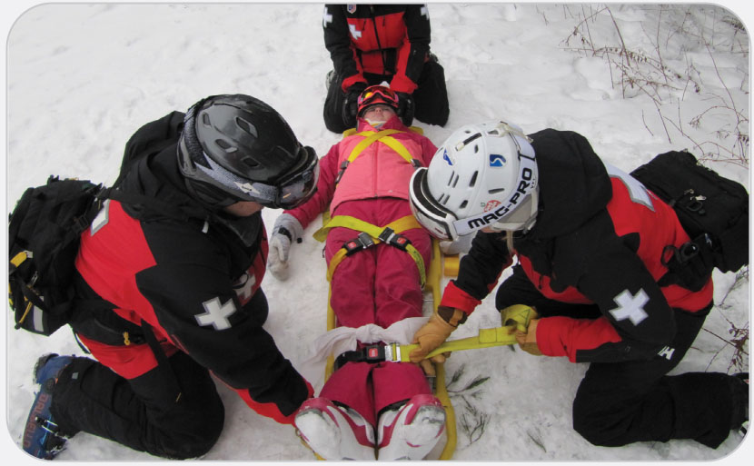
OEC Skill 21-4: Securing patient onto a Long Backboard
2. Secure the pelvis and the extremities next. Beginning where the torso straps end to prevent gaps, cross the pelvis straps from above the iliac crests (patient’s hips) to just below the level of the greater trochanter of each femur (the upper thigh). This ensures that the entire weight of the pelvis is contained within the straps and is properly immobilized. (Alternatively, a single strap can be placed across the pelvis at the level of the pubis bone.) An additional strap should be placed across the mid-thighs between the end of the pelvis straps and the knees. Place another strap across the lower legs. If patient has a possible pelvis or hip fracture or an abdominal injury, you may need to place the straps just above or below the injury, but never place them tightly across the abdomen.

Slide 115
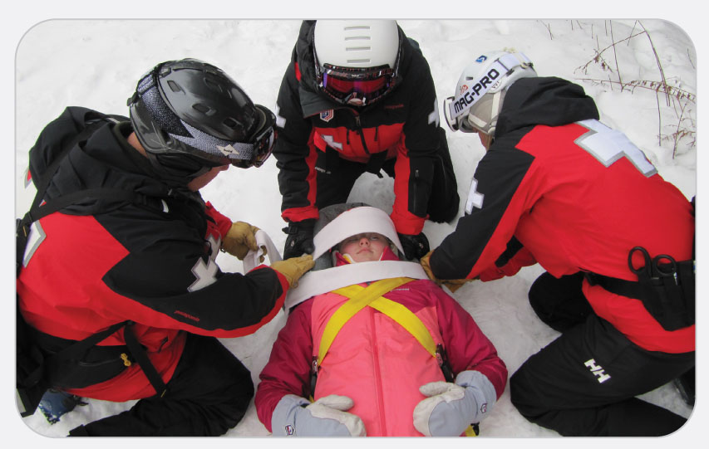
OEC Skill 21-4: Securing patient onto a Long Backboard
3. Secure the head last. If you are using a commercial head immobilization device (head blocks), follow the manufacturer’s directions. If you are using towels rolls:
Roll two standard towels and securely tape each roll.
Place one towel on each side of patient’s head.
Secure the head by placing a large piece of tape or a cravat over patient’s forehead. Be sure not to cover the eyelids. Place a second piece of tape over the C-collar just below the chin.
An alternative method is to place a rolled-up (horse-collar shaped) blanket around patient’s head and secure it at the chin and forehead.
If you have determined that the helmet should remain on patient, use commercial head blocks or towels, and strap the helmet to the board.

Slide 116
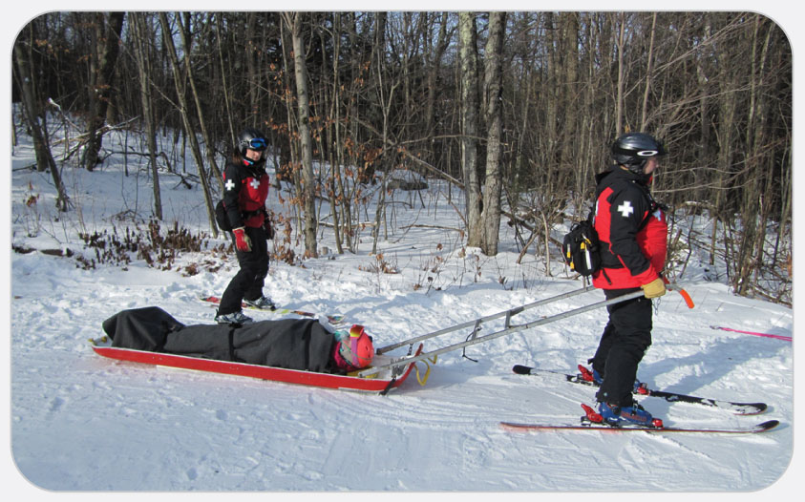
OEC Skill 21-4: Securing patient onto a Long Backboard
4. Reassess patient’s airway and breathing. Also reassess distal circulation, sensation, and movement in each extremity. Document these CMS findings on the PCR. Monitor patient throughout transport. Given that vomiting is common with TBI, have suction available and be prepared to roll patients who have undergone spinal motion restriction onto their sides while they remain strapped to the board.

Slide 117
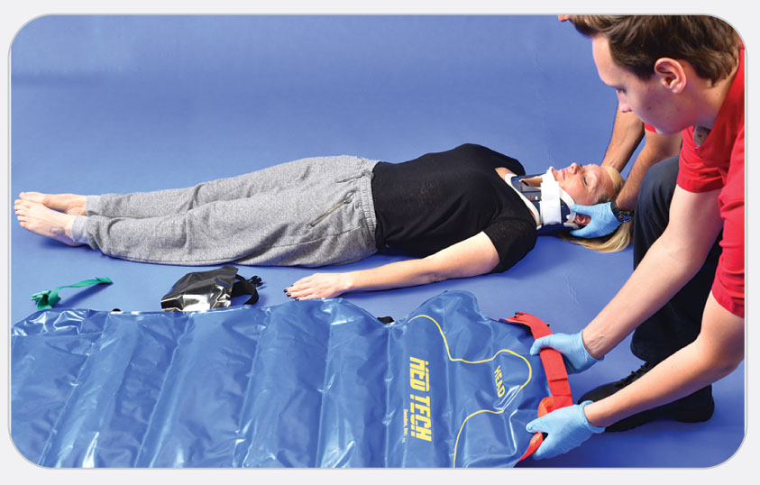
OEC Skill 21-5: Placing a Patient on a Full-Body Vacuum Mattress
1. Place the mattress on a flat surface near patient, with the head end of the mattress at patient’s head.

Slide 118
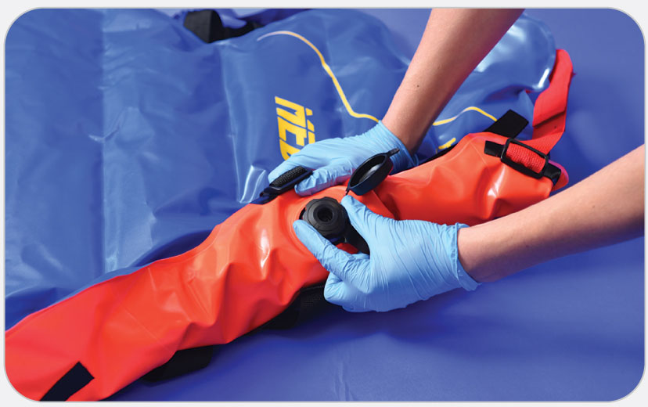
OEC Skill 21-5: Placing a Patient on a Full-Body Vacuum Mattress
2. Allow air to enter the mattress. Keep the valve stem open until the mattress is soft and pliable.

Slide 119
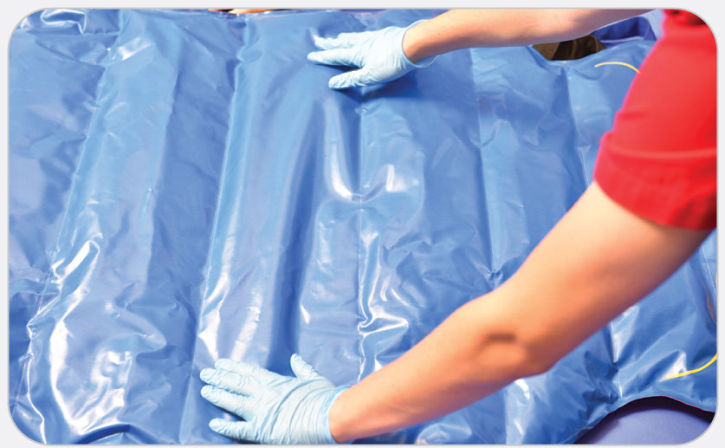
OEC Skill 21-5: Placing a Patient on a Full-Body Vacuum Mattress
3. Smooth the mattress so it is flat and level.

Slide 120
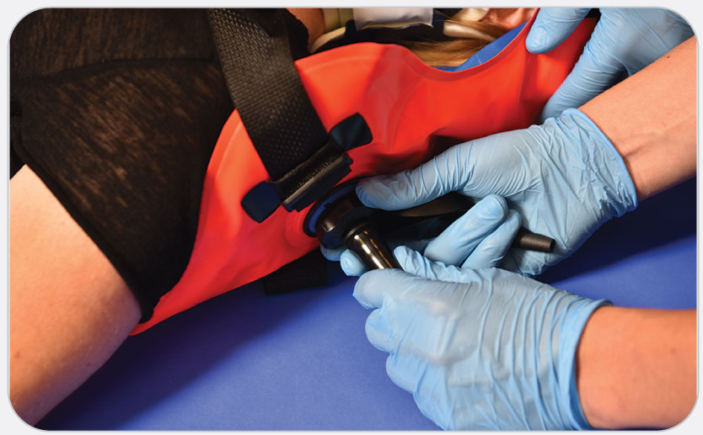
OEC Skill 21-5: Placing a Patient on a Full-Body Vacuum Mattress
4. Connect the pump to the mattress.

Slide 121
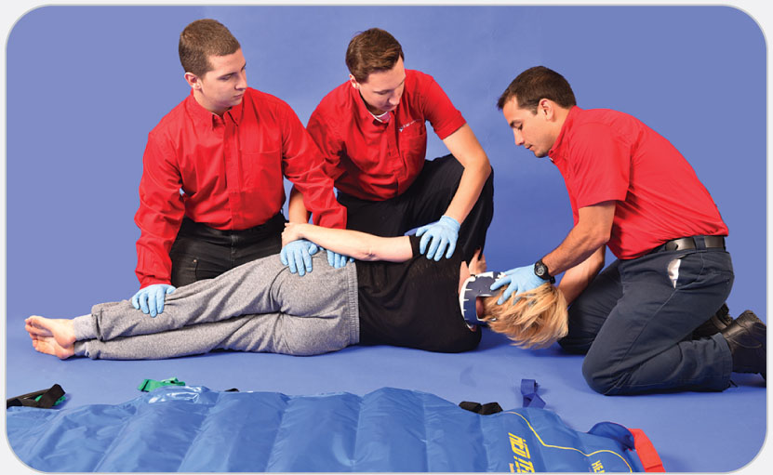
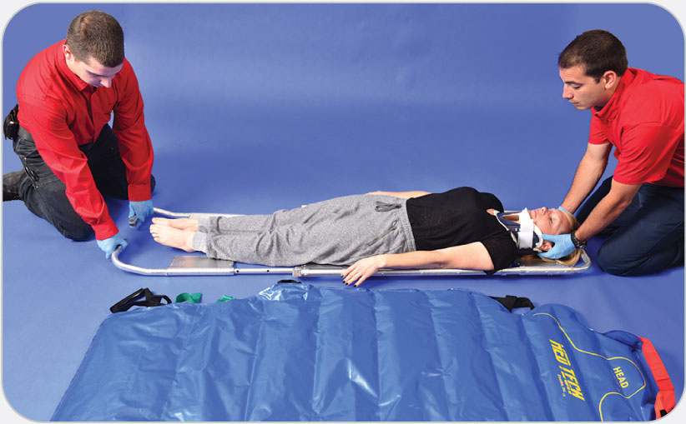
OEC Skill 21-5: Placing a Patient on a Full-Body Vacuum Mattress
5. Determine which method you will use to move patient onto the mattress. If you use the logroll, evacuate the mattress until it is partially rigid (this step is not needed if you are using the scoop stretcher method). The surface should be smooth, and the beads should be spread out as evenly as possible. If using a scoop stretcher, you do not need to partially evacuate the mattress at this stage.

Slide 122
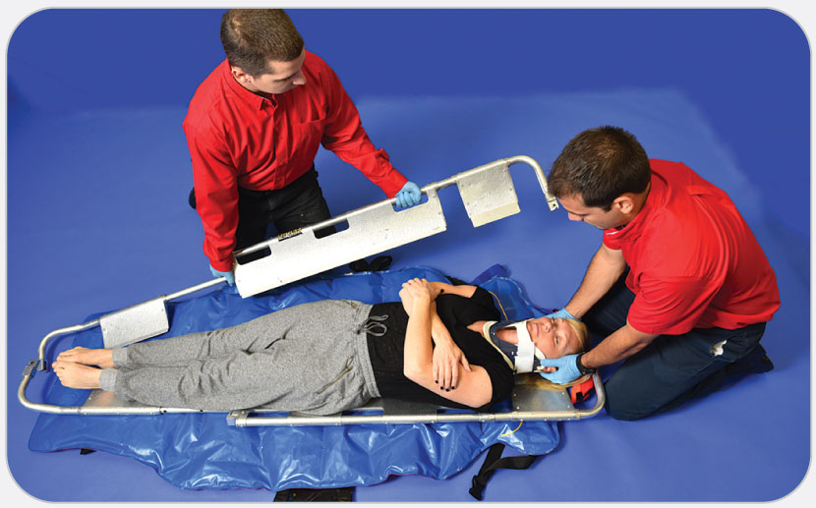
OEC Skill 21-5: Placing a Patient on a Full-Body Vacuum Mattress
6. Move patient onto the vacuum mattress using the method you determined during the previous step. Maintain spinal alignment.

Slide 123
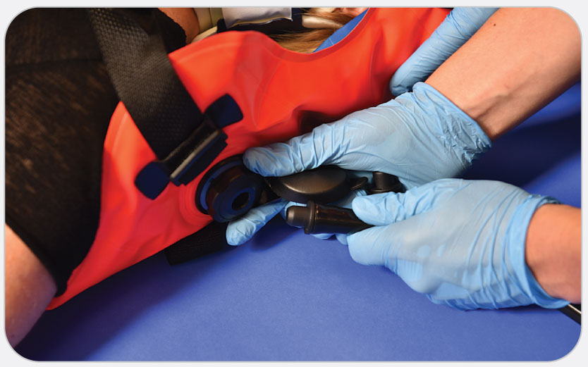
OEC Skill 21-5: Placing a Patient on a Full-Body Vacuum Mattress
7. If the vacuum mattress is partially rigid, open the valve to allow air to enter. Keep the valve open until the mattress is pliable.

Slide 124
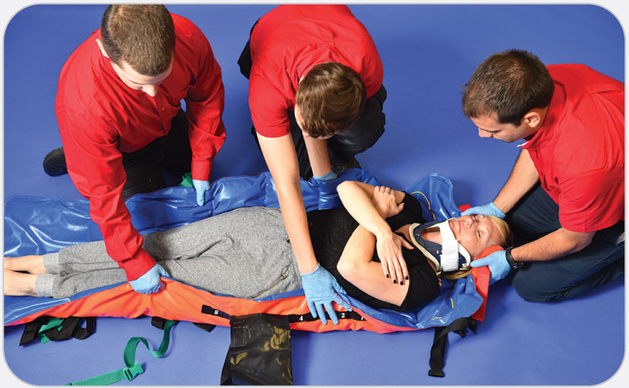
OEC Skill 21-5: Placing a Patient on a Full-Body Vacuum Mattress
8. Conform the mattress to each side of patient’s head close to the shoulders, but not the top of the head. Continue to hold these “head blocks” that you have formed and have a second person hold up the sides of the mattress to patient’s hips until the mattress is evacuated of air completely. Always form the mattress to meet the needs of patient.

Slide 125
OEC Skill 21-5: Placing a Patient on a Full-Body Vacuum Mattress
9. Secure patient’s chest, hips, and legs in the mattress.

Slide 126
OEC Skill 21-5: Placing a Patient on a Full-Body Vacuum Mattress
10. Secure patient’s head with medical tape. Pad any voids at the top of the shoulders.

Slide 127
OEC Skill 21-5: Placing a Patient on a Full-Body Vacuum Mattress
11. Ensure patient is as comfortable as possible, then evacuate the remaining air to achieve immobilization.

Slide 128
OEC Skill 21-5: Placing a Patient on a Full-Body Vacuum Mattress
12. Disconnect the vacuum pump and ensure that the valve is closed or secured so the mattress is not accidently deflated.

Slide 129
OEC Skill 21-5: Placing a Patient on a Full-Body Vacuum Mattress
13. Reassess and adjust the straps around the chest, hips, and legs.

Slide 130
OEC Skill 21-5: Placing a Patient on a Full-Body Vacuum Mattress
14. Check patient’s neurovascular status and recheck all straps prior to lifting or moving patient.

Slide 131
OEC Skill 21-6: Removing a Helmet from a Patient
1. Align patient axially. Rescuer 1: manually stabilize the head and cervical spine by placing one hand on either side of the helmet.

Slide 132
OEC Skill 21-6: Removing a Helmet from a Patient
2. Rescuer 2: carefully open the face shield and/or remove goggles (if present). Unfasten the chin strap and place one hand at the occiput and the other at the chin. If blood is suspected, use standard precautions. As an alternative method, Rescuer 2 places one hand along either side of patient’s head sliding your hands inside the helmet, so that the fingers are in position to support each side of the face up over the ears. Either method is acceptable.

Slide 133
OEC Skill 21-6: Removing a Helmet from a Patient
3. Remove the helmet.
Rescuer 1 grasps the helmet straps or sides of the helmet and pulls them apart, spreading the helmet, then pulls the helmet axially away from patient’s head, providing forward rotation of the helmet to ease passage of the chin guard (plastic device that protects the mouth and chin area on some types of ski and other sports helmets) off the face.
Rescuer 2 slides the fingers up to the occiput and chin (or on both sides of the head over the ears), ensuring that patient’s head and cervical spine remain immobilized. Continue to stabilize the head until a cervical collar is applied.

