Slide 1
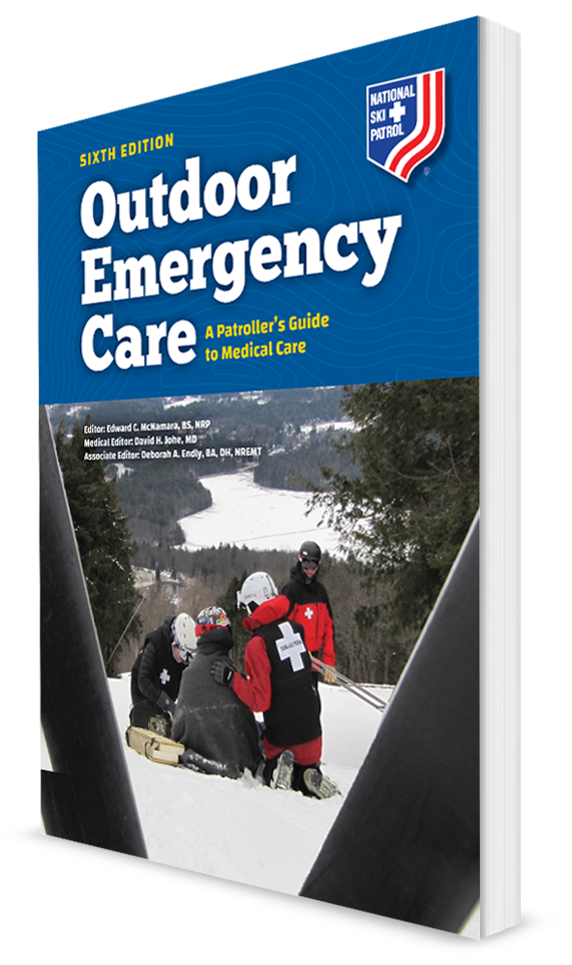
Face, Eye, and Neck Injuries
CHAPTER 22
BJ

Slide 2
The following presentation will utilize two symbols to identify material necessary for an OEC Technician to comprehend:
key term
Meets a Chapter Objective.
This symbol will have the corresponding Objective Number denoted within.
Identifies a Key Term.
The Key Term will be underlined for easy identification.

Slide 3
Objectives
22-1 Describe the function of the eye.
22-2 Describe the assessment and management of ear injuries.
22-3 Describe and demonstrate the management of a patient with a penetrating injury to the eyeball.
22-4 Identify the important structures of the anterior neck.

Slide 4
Objectives
22-5 List the signs and symptoms of traumatic injury emergencies of the neck and upper airway.
22-6 Describe the function of the lacrimal glands.
22-7 Describe the management of a dental injury.
22-8 List the signs and symptoms of emergent injuries to the face, eyes, and neck.
22-9 Describe and demonstrate how to assess face, eye, and neck injuries.
22-10 Describe and demonstrate the proper care of a face, eye, or anterior neck injury.

Slide 5
Key Terms
Anisocoria
Blowout fracture
Cornea
Epistaxis
External auditory canal
Hyphema
Lacrimal glands
Mandible
Maxillae
Orbit
Retinal detachment
Sternocleidomastoid muscles
Subcutaneous emphysema

Slide 6
Chapter Overview

Slide 7
Chapter Overview
In individuals participating in outdoor recreational activities, the face and neck are typically exposed and thus are especially susceptible to direct trauma.
Injuries to the face and neck can cause long-term disfigurement or be life threatening.
Soft tissues of the upper airway can easily be affected, requiring immediate attention.
Traumatic injuries involving the face or neck may bleed profusely due to the generous blood supply in these areas of the body.

Slide 8
Chapter Overview
Serious injuries from blunt or penetrating trauma and environmental exposure can affect hearing, vision, and smell.
Pain can be severe due to the abundance of nerves, especially in injuries involving the eyes.
Facial and neck emergencies often result from mechanisms of injury that should alert OEC technicians to the possibility of coexisting injuries such as closed head and cervical-spine injuries.

Slide 9
Anatomy and Physiology

Slide 10
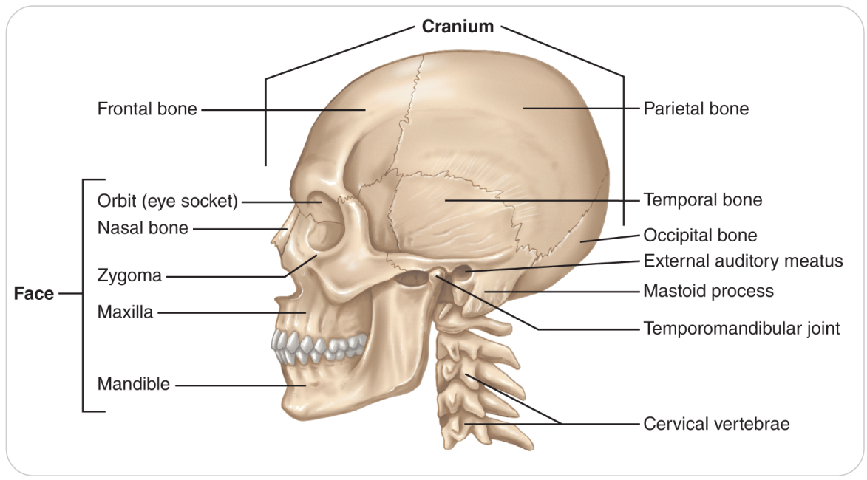
Face Structures
The face consists of 14 bones.
Their functions are to provide protection to underlying structures.
The maxillae are the bones of the midface that form the upper jaw.
Mandible is the jawbone, which is the only moveable bone on the face.

Slide 11
Visual System
22-1
22-6
The sense we call vision begins when light enters the globe-shaped eyeball.
The eye captures light images that are then sent to the brain via the optic nerves.
The eye is relatively well protected within a bony socket formed by the skull and facial bones.
Orbit protects much of the fluid-filled eyeball.
Orbit simultaneously anchors the muscles that go to the external surface of the eyeball and control eye movement.
Front of the eyeball is relatively unprotected and therefore susceptible to injury.
Six small muscles, known as extraocular muscles, attach to each eye and enable the two eyes to move in various directions at the same time.
Muscles are controlled by nerves that come directly from the brain.

Slide 12
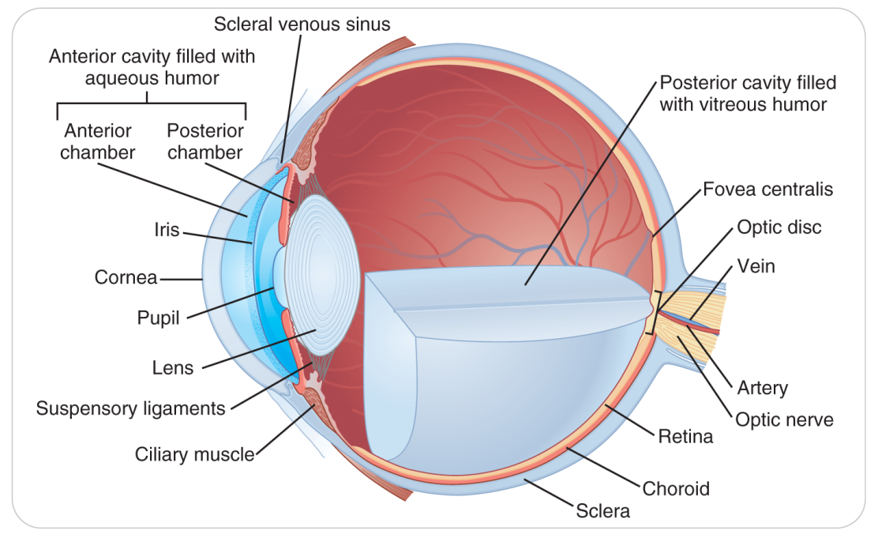
Visual System: External Eye
22-1
22-6
External part of the eye and the inner lining of the eyelids consist of a thin clear membrane known as the conjunctiva, which contains small blood vessels.
Located directly behind the conjunctiva in the front of the globe is the cornea, which is surrounded by the sclera.
The round, transparent cornea bends or refracts light as it enters the eye.

Slide 13
Visual System: Iris and Pupil
22-1
22-6
The iris works like a camera shutter to adjust the amount of light entering the eye.
Pigment in the iris accounts for the color of the eye.
In the center of the iris is the pupil, visible as a black circle.
Constriction of the iris narrows the pupil and allows less light to pass through the lens of the eye, whereas dilation of the iris widens the pupil and allows more light to enter the eye.

Slide 14
Visual System: Pupil Response
22-1
22-6
Under normal conditions, the pupil very quickly becomes smaller in response to bright light.
Called the direct response
If you shine a light into only one eye, the other eye’s pupil will also constrict if the visual system is functioning properly.
Called indirect response

Slide 15
Visual System: Anisocoria
22-1
22-6
Under normal conditions, both pupils should be approximately equal in size.
Unequal pupil size is a condition known as Anisocoria.
May be caused:
Directly due to an insult to the eye
Indirectly due to a problem in the brain
In a small percentage of the population, approximately 20%, the pupils are normally unequal in size.

Slide 16
Visual Systems: Lens and Retina
22-1
22-6
Depending on the distance an object is from the eye, small muscles within the eye change the shape of the lens so that light is focused on the back of the eye.
Light entering the eye then strikes the retina, a sheet of light-sensitive nerve endings located in the back of the inside of the eye.
Nerve endings transmit signals through the optic nerves to the brain, which then formats the information as a visual image.
Sensation of depth perception is created because the brain receives slightly different signals from each eye when looking at a given object, especially close objects.

Slide 17
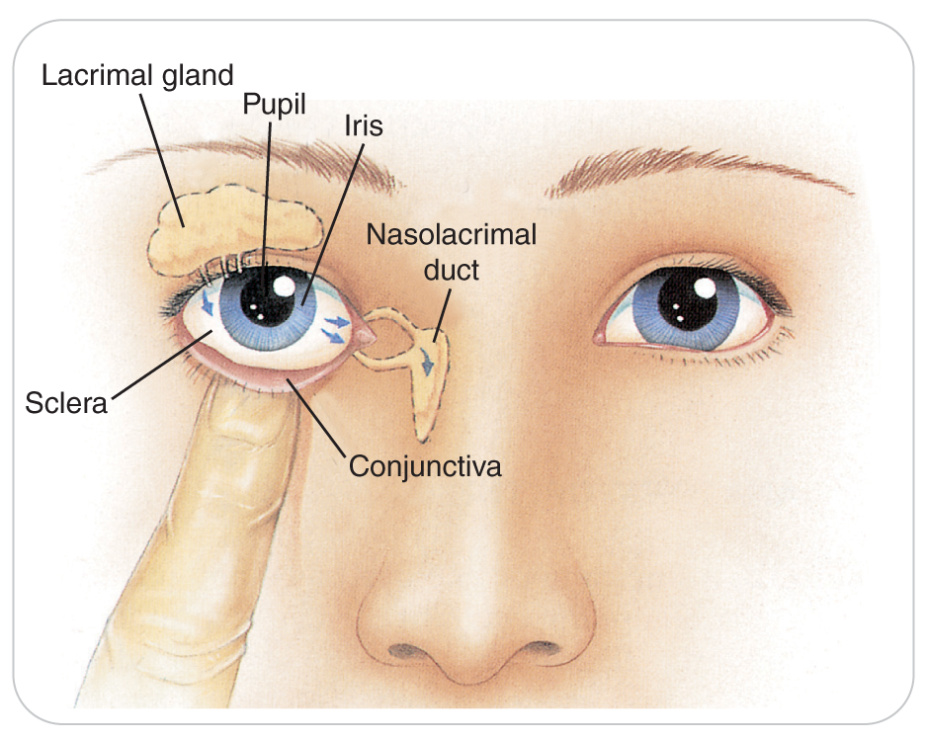
Visual Systems: Lacrimal Glands
22-1
22-6
Tear glands, also called lacrimal glands, are positioned above each eye and provide constant irrigation in the form of tears.
Tears and blinking flush away surface debris and clean the exposed surface of the eye.
Tears drain toward the inner side of each eye and into the lacrimal (tear) ducts.

Slide 18
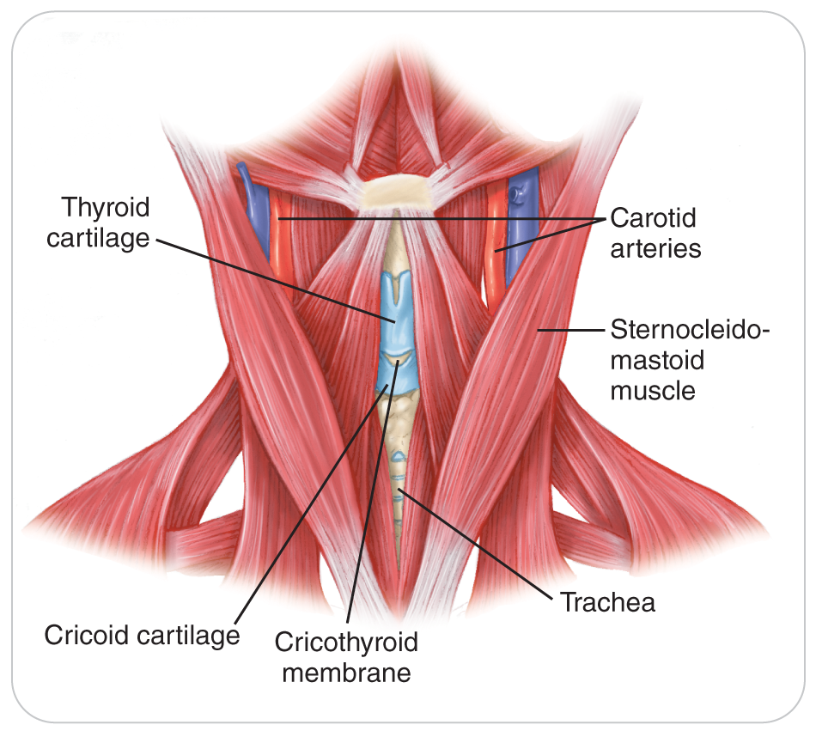
Neck Anatomy
22-4
The anterior part of the neck contains several unprotected vital structures:
The carotid arteries
Jugular veins
Esophagus
Trachea
Thyroid gland
Trauma to these structures can result in significant bleeding, swelling, and closure of the airway.

Slide 19
Neck Anatomy
22-4
In the midline of the anterior neck, palpable just beneath the skin, is the thyroid cartilage of the larynx.
Cartilage is more prominent in men than it is in women or children.
Approximately 1 to 2 cm on either side of the larynx are the large carotid arteries, which supply blood to the neck and head.
Below the larynx (voice box) is the trachea (windpipe).
The esophagus is situated directly behind the trachea.
The sternocleidomastoid muscles are powerful muscles at the sides of the neck that facilitate turning of the head.

Slide 20
Face, Eye, and Neck Injuries

Slide 21
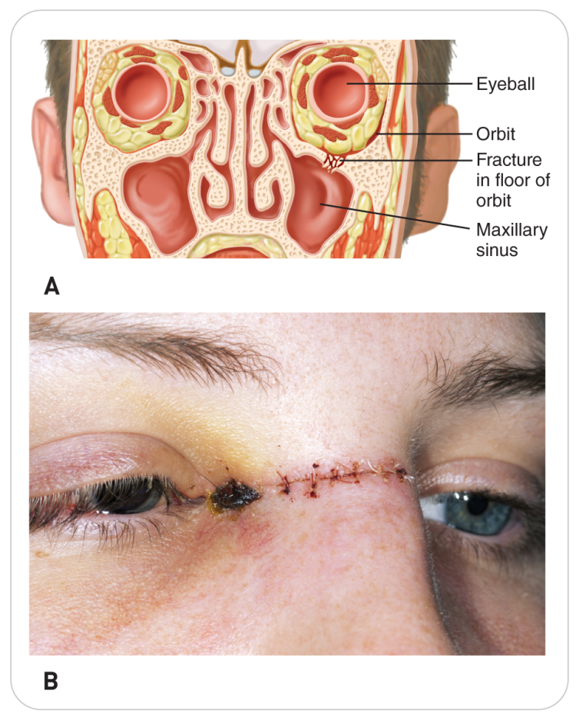
Face, Eye, and Neck Injuries: Face
The face is susceptible to environmental injures as well as trauma.
Bleeding can be severe.
Due to vascular nature of the face
Nerve damage can occur.
Due to close proximity to major nerves
Facial injuries can result in other underlying trauma or system injuries.
Example: an airway obstruction might result from a blunt or penetrating trauma.
A fracture that involves the bony structure of the eye or a blowout fracture may injure the eye as well as the muscles around the socket.

Slide 22
Face, Eye, and Neck Injuries: Nose
Direct trauma to nose may result in:
Fracture of nasal bone
Damage to cartilage at the tip of the nose
Trauma to the nose may result in epistaxis, or nosebleed, which can result in an airway compromise.

Slide 23
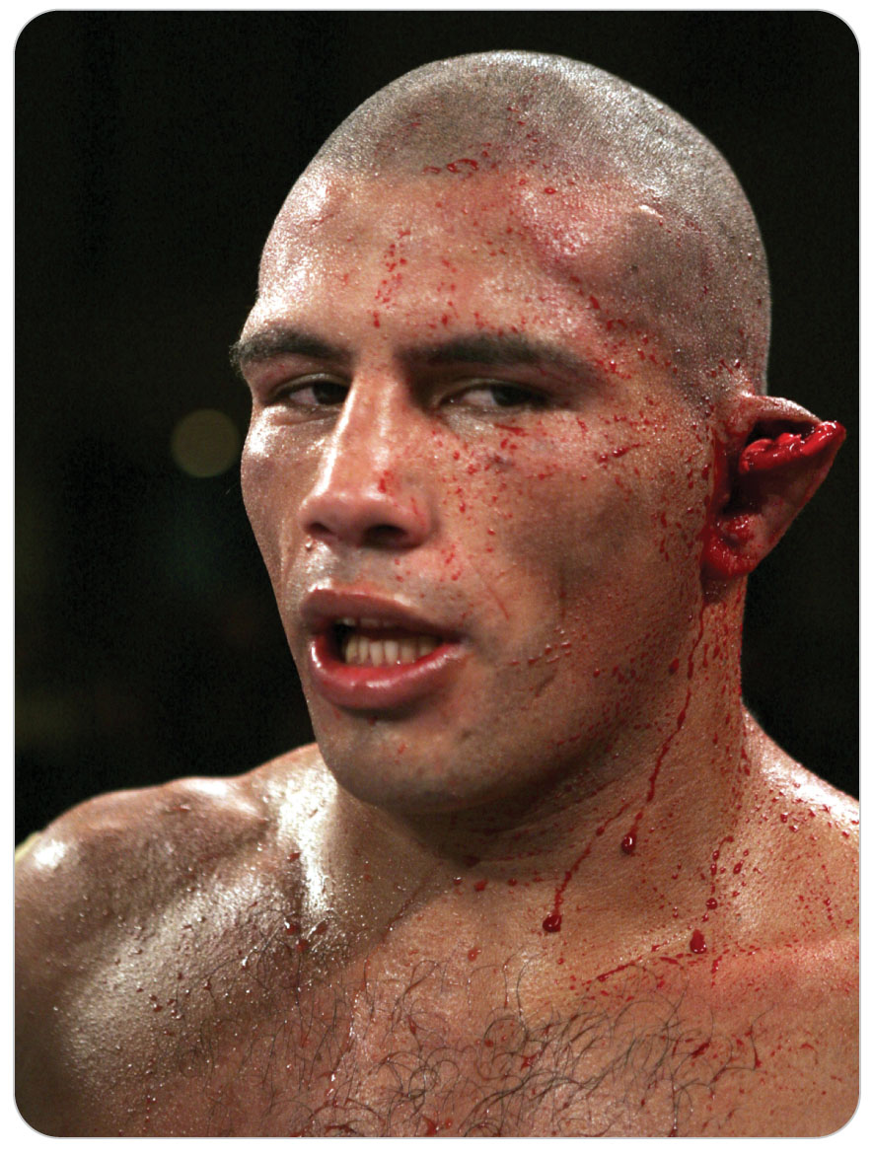
Face, Eye, and Neck Injuries: Ear
The external ear canal makes it susceptible to lacerations and contusions.
Foreign bodies could be lodged in the external auditory canal resulting in a painful and anxiety-provoking situation.

Slide 24
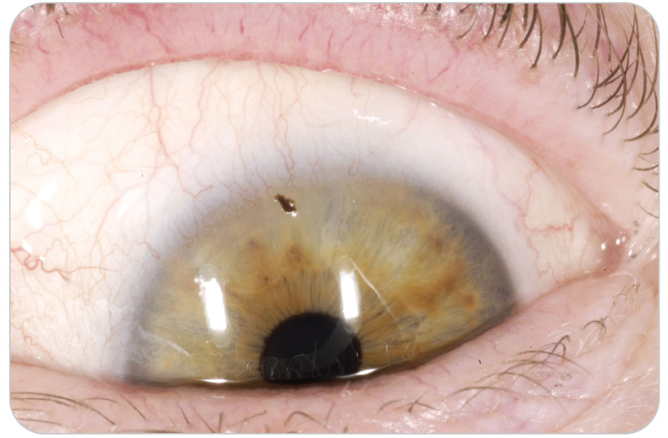
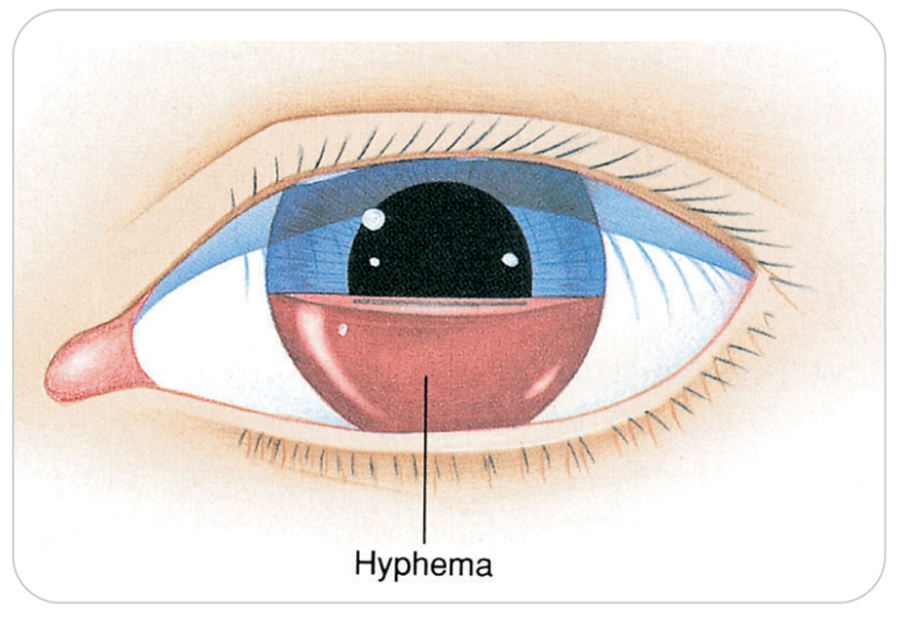
Face, Eye, and Neck Injuries: Eye
Eyes are vulnerable to abrasive and penetrating injuries, including impaled objects.
Globe ruptures are leading trauma-related cause of blindness.
Conditions in which the integrity of the eyeball has been compromised.
Trauma to the eye can lead to an accumulation of blood in the aqueous fluid of the eye, resulting in hyphema.
This is a very serious problem.

Slide 25
Patient Assessment

Slide 26
Patient Assessment: Primary Assessment
22-5
22-9
The rich vascular supply to the head and neck can result in profuse bleeding.
Always use personal protective equipment (PPE).
Disability from trauma to the brain or cervical spinal cord is likely.
In a patient who has a significant head injury, the chances of having a significant injury to the cervical spine are greater than 10%.
After the initial primary assessment, OEC technicians should continually monitor the ABCDs.
Over time, the airway may become obstructed, bleeding can recur, or patient’s mental status or neurologic function may change.

Slide 27
Patient Assessment: Primary Assessment
22-5
22-9
Obtain a complete set of vital signs.
If initial primary assessment is unremarkable, begin a secondary assessment:
SAMPLE
OPQRST
Physical examination already began with any observations made during the primary assessment.
Continue the assessment by looking at the entire scalp and the face and neck for lacerations, abrasions, punctures, or other injuries.
Look for facial asymmetry, such as a depressed cheekbone from a fracture.

Slide 28
Patient Assessment: Eye
22-9
Patients may be reluctant to open a severely injured eye.
Gently attempt to open a swollen eyelid.
Never forcibly open an injured eye.
If patient can open the eyes, begin the ocular exam by asking patients if they can see normally and if they can see normally with each eye.
Hold up two fingers and ask how many they see.
Ask if there is double vision.

Slide 29
Patient Assessment: Eye
22-9
Look at each eye.
Does each pupil appear round?
Or irregular?
Patients who have had previous lens replacement surgery or cataract surgery may have irregularly shaped pupils.
Be sure to ask about past eye surgery.
Do they wear contacts or have a glass eye?
Examine injured or painful eyes for the presence of foreign bodies, blood, or clear fluid that is leaking from the eye.

Slide 30
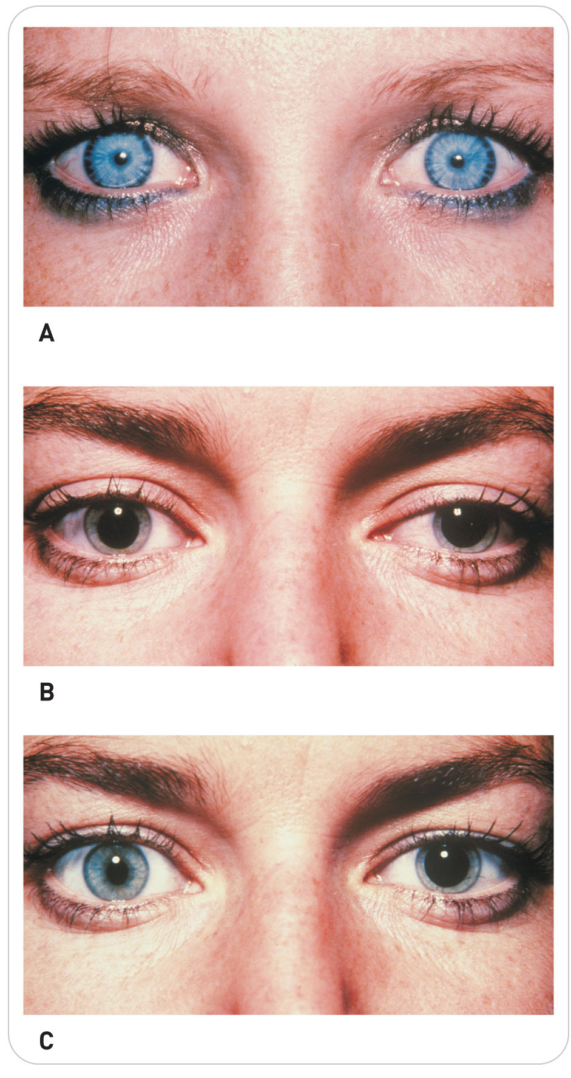
Patient Assessment: Eye
22-9
If only one eye is injured:
Start the assessment by examining the other eye.
Note its reaction to light.
Then assess the injured eye by comparing it to the uninjured eye.
Assess pupillary reaction and extraocular motion.
Remember that some patients may have different findings in each eye normally.
Anisocoria (different-sized pupils) or different-colored irises of the eyes can be normal.

Slide 31
Patient Assessment: Midface and Nose
22-8
22-9
Inspection: Examine the nose for bleeding, deformity, pain, or obstruction.
Assess the cheeks for pain and deformity by looking at them and gently pressing on them.
One or both cheeks could be deformed or depressed.
Palpation: Gently press on the bones between the nose and upper lip (maxillae).

Slide 32
Patient Assessment: Mouth
22-7
22-9
Ask the person to bite down.
Ask if this feels normal.
If offset, patient will either not be able to bite or will say that the teeth do not close correctly.
Examine the lips and the inside of the mouth for bleeding.
Check for loose or missing teeth and lacerations of the tongue.
Assess the clarity of the voice and see if patient is swallowing normally.
Difficulty or pain upon speaking or swallowing is a cause for concern.
May indicate impending airway compromise

Slide 33
Patient Assessment: Ear
22-8
22-9
Look at each ear for obvious evidence of trauma.
If bleeding is present, try to determine whether the source is the external part of the ear, the ear canal, or a nearby site from which blood has flowed into the ear.
Look for pink or clear fluid coming out of the ear.
It may be cerebrospinal fluid leaking from a basal skull fracture.
Look for swelling or ecchymosis over the bony prominence of the mastoid process behind each ear.
Bruising to this area hours after head trauma
May indicate local trauma to the mastoid process or a serious fracture of the base of the skull
Known as the Battle Sign

Slide 34
Patient Assessment: Ear
22-8
22-9
Examine the external canal of the ear for a foreign body.
Assess patient’s hearing by talking normally directly into each ear.
Use the same pitch and amplitude for each ear.
Ask if your voice has the same quality and loudness in both ears.
May have preexisting deafness
Hearing aids: Leave in place unless caring for an injury to the ear that requires assessment and treatment.

Slide 35
Patient Assessment: Neck
22-5
22-8
22-9
The primary assessment using ABCD is important with potential neck injuries.
Airway is open?
Major bleeding is controlled?
Provide inline manual stabilization of the head and neck for any face, eye, or neck injury, until an exam is done showing no evidence of spine or spinal cord injury.
Assess CMS in all extremities.
If spinal injury is apparent, use spinal motion restriction.

Slide 36
Patient Assessment: Neck
22-5
22-8
22-9
Listen to patient breathe and talk, noting any changes in voice quality, hoarseness, or audible breath sounds.
Ask patient to swallow, and observe the results.
When assessing the mouth:
Difficulty or pain upon speaking or swallowing may indicate impending airway compromise.

Slide 37
Patient Assessment: Neck
22-5
22-8
22-9
Look at and palpate the anterior and posterior aspects of the neck.
Major bleeding from a laceration usually means a large carotid artery or jugular vein has been damaged.
Carotid bleeding will spurt.
Jugular venous bleeding flows freely.
If no external bleeding is seen, look for symmetry between the two sides of the neck.
Internal bleeding from a major blood vessel will cause a hematoma or palpable mass and could obstruct the airway.

Slide 38
Patient Assessment: Neck
22-5
22-8
22-9
Assess midline structures:
Shifted?
Is there swelling or bruising?
Look for air-filled bubbles that are palpable underneath the skin in the upper chest area and neck, called subcutaneous emphysema.
Bubbles may sound like Rice Krispies cereal.
Indicates an injury to an airway structure
Gently palpate the larynx and trachea for stability.
Reassess patient frequently, looking for airway compromise that occurs over time.

Slide 39
Management

Slide 40
Management: Face and Neck
22-9
Following the management of any safety issues, the primary assessment will include assessment of face and neck injuries.
Control excessive bleeding of the face, neck, and scalp.
Problems that affect the ABCDs (neurologic deficit) take precedence over secondary management concerns.
If the airway is compromised, use the jaw-thrust maneuver to protect the cervical spine.
Not the head tilt–chin lift method
Suction patient’s mouth and nose as needed to keep the airway patent.

Slide 41
Management: Face and Neck
22-9
The face, mouth, and neck are highly vascular.
Bleeding can be significant; it is always essential that standard precautions be observed.
External bleeding usually can be managed with direct pressure.
Never use a tourniquet.

Slide 42
Management: Face and Neck
22-9
If significant face or neck trauma is present and there are findings indicating the need for spinal motion restriction, restrict the motion of patient’s spine.
If spinal injury is not suspected and bleeding of the face is present, lean patient forward or place patient on his or her side to prevent blood from draining into the airway and from being swallowed.
Be prepared to suction the airway if necessary.

Slide 43
Management: Face and Neck
22-9
High-flow oxygen
If a pulse oximeter is available, keep oxygen saturation between 94 and 99%.
Should be provided to patients:
With airway or breathing compromise
When there is significant external bleeding
Reevaluation is needed frequently, especially during toboggan transports because these injuries can rapidly progress to life-threatening situations.
ALS personnel should be notified to assist when appropriate.

Slide 44
Management: Facial Injuries
22-5
22-10
The primary goal when managing a patient with a facial fracture is to keep the airway open and clear.
Patients often need aggressive airway management, including:
Appropriate positioning
Suctioning
Oxygen
Occasionally ventilatory support

Slide 45
Management: Facial Injuries
22-5
22-10
Assess the airway, and if you can easily place an airway device (oropharyngeal airway), this is usually best.
If the mouth or nasal area is severely injured or crushed, it may be difficult to insert an airway device.
Never force an airway device in the patient.
If there are nasal injuries, a nasal airway device (nasopharyngeal airway) will not work.

Slide 46
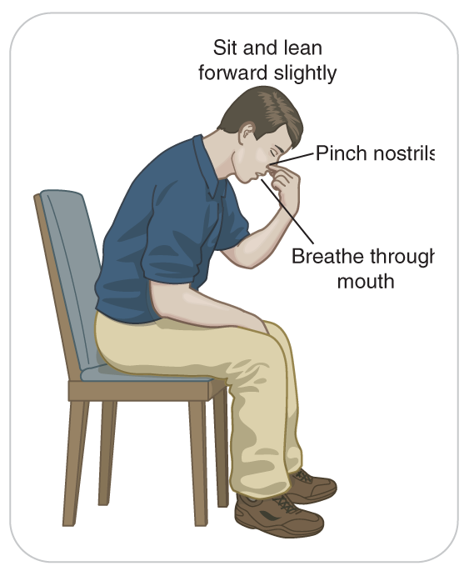
Management: Epistaxis
22-5
22-10
Direct pressure is the best way to control epistaxis (nosebleed) whether it is mild or severe.
The nares (nostrils) should be pressed together just below the bony prominence of the nose.
Hold pressure up to 15 minutes before evaluating ongoing bleeding.
Lean patient forward to allow blood and other secretions to drain out of the nose and mouth.

Slide 47
Management: Epistaxis
22-5
22-10
Most common mistakes in the management of epistaxis are:
Removing the pressure too soon
Having patient lean the head backwards
If unable to control the bleeding with direct pressure, place a cloth or bandage-wrapped ice pack on the bridge of the nose.

Slide 48
Management: Mouth Injuries
22-5
22-10
The focus of care is ensuring a patent airway.
Tongue lacerations are controlled with direct pressure.
Remove any broken teeth that may be present.
If a tooth is displaced but still in its socket and is at risk of falling out, causing airway obstruction, leave it in place and monitor the airway, if possible.

Slide 49
Management: Avulsed Tooth
22-5
22-10
Pick up any tooth that has been completely knocked out of its socket (an avulsed tooth) by its crown (part that is exposed normally).
Avoid touching the root (the part that was below the gum).
Do not wash or scrub an avulsed tooth.
If sterile saline or tepid tap water is available, rinse the tooth gently.
If patient is alert and has no airway problems, place the tooth back in the socket correctly or have patient keep the tooth against the inside of the cheek.
Remind patient to not swallow the tooth.

Slide 50
Management: Avulsed Tooth
22-5
22-10
If a patient cannot safely keep an avulsed tooth in the socket or against the cheek, it should be preserved using other means.
Ideally, the tooth should be placed in Hanks’ solution.
If this product is not available, place the tooth in either milk or sterile saline in a sterile or clean container.
Doing so will allow reimplantation for up to 6 hours.
Some patrols may have kits for avulsed teeth.

Slide 51
Management: Ear Injuries
22-5
22-10
Ear Lacerations/Avulsion:
Bleeding from a lacerated external ear and ear avulsions are controlled using direct pressure, a dressing, and a bandage.
Outer ear injuries require dressing and bulky support between the outer ear and the scalp.
If the external ear is completely amputated, preserve the part.
Any patient with a severe external ear injury should be transported to a physician for cosmetic repair.

Slide 52
Management: Ear Injuries
22-5
22-10
Foreign Body
Manipulation of a foreign body stuck in the external auditory canal can cause injury to the tympanic membrane.
When faced with this situation, turn patient onto his or her side with the affected ear down to see if the object will fall out on its own.
If it does not, patient should be evaluated in a medical facility for removal and follow-up treatment.

Slide 53
Management: Ear Injuries
22-5
22-10
Ear Drum Rupture
Tympanic membrane rupture, whether from trauma, diving, or infection, does not require an occlusive or pressure dressing.
Allow secretions to drain by having patient tilt the head toward the affected side.
If there are no other injuries, patient may be transported in this position to a medical facility for further treatment.

Slide 54
Management: Ear Injuries
22-5
22-10
Inner-Ear Balance Problems
Part of the inner-ear system controls balance.
Symptoms of inner-ear balance problems are usually associated with chronic illness but may be caused by more serious problems such as a recent stroke.
For this reason, any patient who reports dizziness, sudden balance problems, or a rapid onset of severe nausea should be evaluated by a physician.

Slide 55
Management: Eye Injuries
22-3
22-10
Because eye injuries can result in blindness, any patient with an eye injury should be transported for physician evaluation.
Obvious penetrating injuries, massive orbital trauma, and suspected globe rupture require emergent referral to an eye specialist.
Soft-tissue injuries around the eye should be managed with the utmost care to avoid applying pressure to the eyeball.

Slide 56
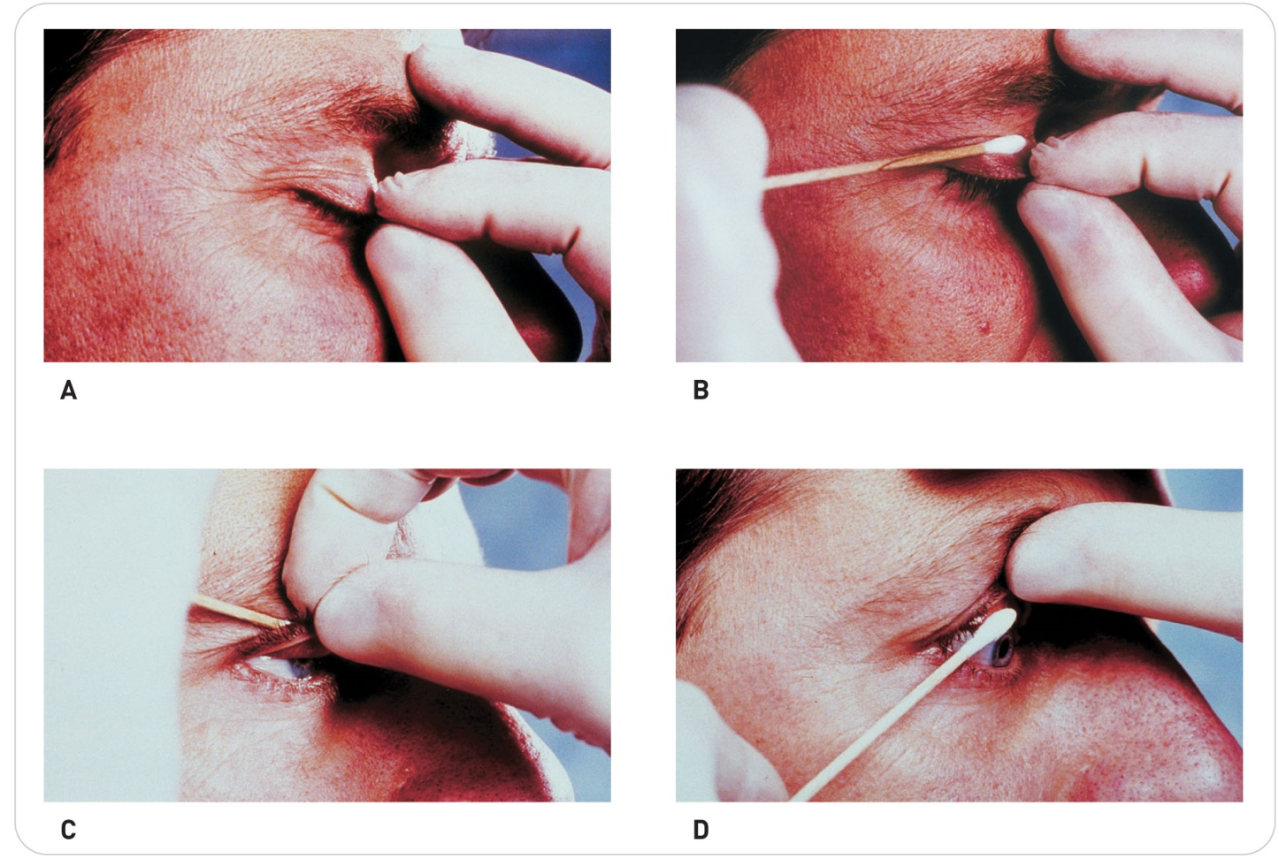
Management: Eye Injuries
22-3
22-10
Foreign Bodies
Small foreign bodies on the surface of the eye are a common problem.
If patient allows, carefully retract the upper and lower eyelids to examine for the presence of a superficial foreign body.
The foreign particle could be present on the underside of the lid or on the globe.
To examine the inside surface of the upper eyelid, pull the lid forward and up over a cotton swab.

Slide 57
Management: Eye Injuries
22-3
22-10
Foreign Bodies
Inflammation—reddening of the conjunctiva, known as conjunctivitis—may be readily apparent.
Pain may be aggravated by bright light.
Send patient for definitive care at a health care facility.

Slide 58
Management: Eye Injuries
22-3
22-10
Impaled Object
Objects that have adhered to the conjunctiva may penetrate the surface of the eyeball.
Especially when the injury involves metalwork, such as filing or hammering.
Injuries require urgent consultation with an ophthalmologist.
Larger foreign bodies impaled in the eye require eye stabilization prior to transport.
Use a circular or ring dressing or cup to protect the eye and use a gauze bandage to stabilize the impaled object.

Slide 59
Management: Eyelid and Eyeball Lacerations
22-3
22-10
Eyelid Lacerations
Bleed may be profuse due to the blood supply to this part of the face.
Commonly controlled with gentle direct pressure.
Eyeball Lacerations
Because the eyeball itself also may be injured, do not apply pressure to the eye’s globe.
The eye or globe should never be manipulated.
If the eyeball is out of the socket and still connected to the body, it should be covered with a moistened, sterile dressing to prevent drying.
Fully detached eyeballs cannot be re-implanted.
Do not attempt to put the eyeball back in the socket.

Slide 60
Management: Eye Injury
22-3
22-10
When one eye is injured, cover both eyes to decrease synchronous movement of the injured eye when the uninjured eye moves.
This is especially important in penetrating injuries.
Bandaging both eyes will make patient unable to see at all, which can be extremely frightening to some people.
Stay with such patients and talk to them, guide them, and reassure them.

Slide 61
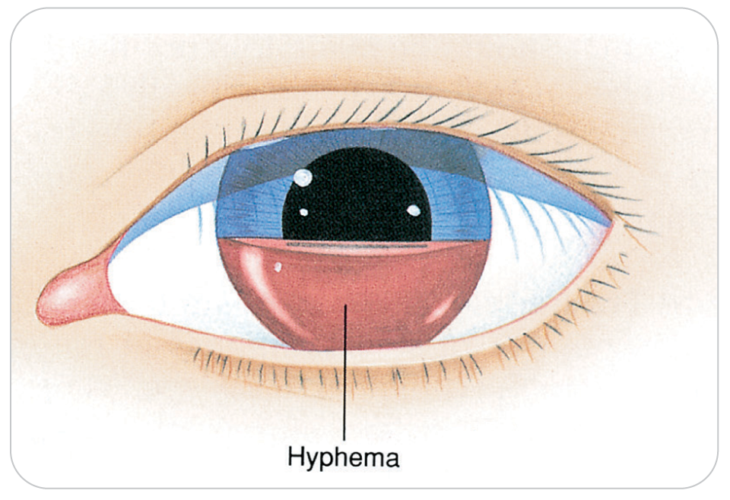
Management: Hyphema
22-10
Direct trauma to the eye or surrounding soft tissue can cause bleeding within the eye.
If the bleeding fills the anterior chamber of the eye, the result is a hyphema.
Patients with a hyphema should be transported with the head of the bed elevated 30 degrees if possible.

Slide 62
Management: Retinal Detachment
22-10
Any blunt trauma to the eye may also cause retinal detachment.
Symptoms: seeing specks, flashing lights or “floaters” in the visual field, or decreased vision in that eye
Patients reporting any of these symptoms require emergent evaluation by an ophthalmologist.

Slide 63
Management: Burns to the Eyes
22-10
Exposure to chemicals, heat, and UV or intense light can burn the surface of the eye.
Such exposure often injures both eyes.
Quick assessment and treatment of these injuries may allow OEC technicians to prevent further damage to the eyes.

Slide 64
Management: Chemical Burns to the Eye
22-10
Exposure to any chemical strong enough to irritate the eyes is an emergency.
To minimize the injury, immediately gently open the eye and gently irrigate the eye with tepid sterile saline solution (or tepid tap water if saline is not available).
Do not use cold or hot water.
Medical irrigation faucets may be available in commercial or industrial settings.

Slide 65
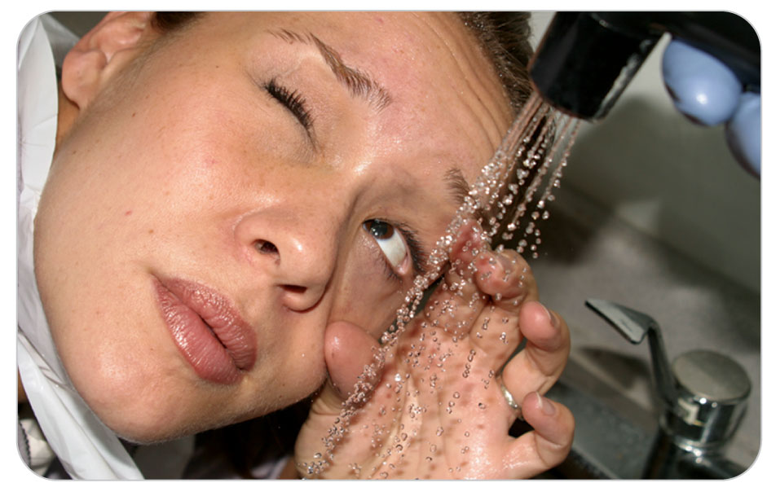
Management: Chemical Burns to the Eye
22-10
In the absence of specialized equipment in outdoor environments, directly irrigate the eye with saline or clean water from a bag or bottle by pouring into the medial corner of the eye, letting fluid run across the eye to the outside.
If available, a gently running shower or faucet also may work.
Regardless of the flushing technique used, take care not to contaminate the unaffected eye.
Put a shield up across the bridge of the nose to prevent the fluid from getting into the good eye.

Slide 66
Management: Chemical Burns to the Eye
22-10
To be effective, irrigation requires the use of copious fluids.
Irrigate the affected eye for at least 5 minutes.
If burn was caused by a strong chemical, irrigate the eye for 20 to 30 minutes.
If pain persists, continue the irrigation.
May be difficult for patients to keep their eyelid(s) open during irrigation, so they may require your assistance.

Slide 67
Management: Chemical Burns to the Eye
22-10
Damage from strong acids or strong bases can continue even after copious irrigation.
Patients with such injuries should be transferred with ALS for emergency care.
Assume that if patient still has pain, then damage from the chemical remains ongoing.
May be able to reduce damage to the eye by continuing irrigation during transport

Slide 68
Management: Chemical Burns to the Eye
22-10
Be sure to note the chemical(s) involved using the material safety data sheet, which can often be provided by patient’s employer in an industrial accident, and include that information in your handoff report to subsequent rescuers or care providers.
In case of a chemical burn, any contact lenses should be removed prior to irrigating.
Patients who require eye irrigation will naturally want to keep their eyes closed, especially if experiencing pain.
Use PPE to keep the chemical off you, and if needed, use gauze to help keep the slippery eyelids open.

Slide 69
Management: Steps of Irrigation
22-10
To irrigate the eyes, follow these steps:
Attach irrigation solution to intravenous tubing.
If intravenous solution is not available, use tepid tap water.
Place the water in a clean plastic bag and poke a small hole in the corner or pour slowly from a medicine bottle.
Gently hold patient’s eye open.
Direct the solution into the affected eye so that it flows from the medial (nasal) side of the eye to the lateral (cheek) side of the eye.

Slide 70
Management: Thermal Burns
22-10
When the eyelids or the surface of the eye is burned by the heat of a thermal accident, take immediate action to stop the burning.
Cover both eyes with a moist sterile dressing and immediately transport patient for definitive care.
Specialist care and follow-up are required.
Airway could also have burns when the eyes have been burned.

Slide 71
Management: Ultraviolet Light Burns
22-10
Different sources of light burn different parts of the eye.
Light from welders, UV light, snow blindness, and “black lights” can injure the eye.
Patient may or may not have pain associated with the injury.
Treat superficial burns to the cornea by applying a moist sterile dressing and an eye shield, and transport patient for evaluation by a specialist as soon as possible.
If you suspect a light injury as the cause of a loss of vision in the absence of pain, manage the injury as a retinal burn, which requires evaluation by a specialist.

Slide 72
Management: Contact Lenses
22-10
When evaluating patients for an eye injury, always ask them if they wear contact lenses.
If patient can remove their contact lenses by themselves, ask them to do so.
Attempt to remove a contact lens ONLY when a patient has suffered a chemical burn to the eye, when irrigating the eye, or when assisting someone who has requested your assistance in the removal of a lens.
In other situations, the manipulation required to remove the lens may cause further damage to the eye.
In a severely injured eye, do not attempt to remove contact lens.
If patient wore contact lenses during your eye exam, relay this information to the EMS provider.

Slide 73
Management: Artificial Eyes
22-10
It may be difficult to distinguish a patient’s prosthetic eye from a natural eye.
Ask patient if the eye is a prosthesis.
Patient may have some ability to move the prosthetic eye using extraocular muscles, making any visible difference between the two eyes very subtle.
Prosthetic eye will not have any pupillary response.
If eye is out of the socket, protect it, as prosthetic eyes are expensive.

Slide 74
Management: Neck Injuries
22-10
Injuries to the anterior neck can be life threatening, may be associated with cervical-spinal injuries, and should be considered an emergency by OEC technicians.
Manage the ABCDs and the spine accordingly.
Keep patients with anterior neck bleeding lying down to help reduce the chances of air embolism.
If patient sits up, air can enter a large vessel in the neck.

Slide 75
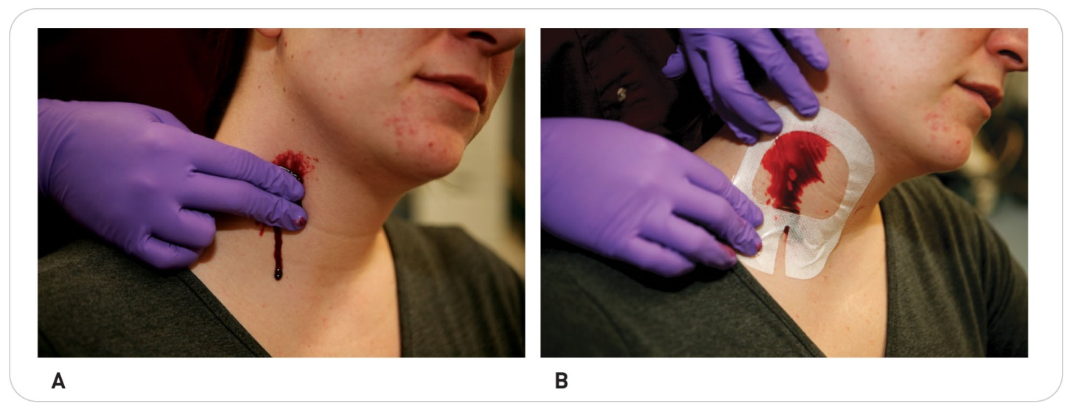
Management: Neck Injuries
22-10
Open neck injuries with severe bleeding usually can be controlled using the combination of:
An occlusive dressing
and then
Sterile dressings and direct pressure

Slide 76
Management: Neck Injuries
22-10
Be careful not to apply direct pressure to both sides of the neck simultaneously.
Doing so can reduce blood flow through the carotid arteries to the brain.
Do not wrap bandages around the neck because doing so can compromise both the airway and circulation.
Place an occlusive dressing over the wound.
Then secure a pressure dressing over the wound by wrapping roller gauze in a figure-eight pattern around the neck and around the arm and armpit of the opposite shoulder.

Slide 77
Management: Neck Injuries
22-10
Immobilize impaled objects in place unless they compromise the airway.
Blunt trauma to the anterior neck can be more difficult to manage than penetrating neck trauma because structural damage may completely occlude the airway.
Aggressively manage the airway.
Summon ALS assistance.
Urgently transport patient to the nearest medical facility.

Slide 78
Case Study

Slide 79
CASE PRESENTATION
You are checking boundary and trail closures when you see a snowboarder lying in the snow several feet beyond a yellow closure rope. As you approach, you notice that the rider’s track goes underneath the closure rope. The rider is lying on his back, holding his face with both hands. He appears to be in considerable distress.
What should you do?

Slide 80
CASE UPDATE
Evaluating the scene as you approach the injured snowboarder, you look for fixed objects other than the closure rope that patient may have hit. Evaluating the likely mechanism of injury, you suspect that the snowboarder could have serious neck trauma. Upon examination, you notice that patient is clearly anxious and is having difficulty breathing. His respiration rate is 24 per minute with shallow inspirations, and as he tries to respond to your questions, he can speak only in a hoarse whisper. You note as well that the snowboarder cannot swallow his saliva and is drooling blood from his mouth. His pulse is 100 beats per minute.

Slide 81
CASE UPDATE
His jaw is crooked, and his pupils appear equal. No trauma is apparent around his ears or scalp. When you examine patient’s neck, you notice a dark red abrasion and underlying swelling on the right anterior portion of his neck. Palpation of the posterior neck reveals no tenderness or deformities, and there are no distal extremity neurological deficits. The jaw is swollen. You call for assistance.
What should you do?

Slide 82
CASE OUTCOME
As you wait for backup to arrive at the scene of the accident, you reassure the snowboarder, making sure the ABCDs remain stable. Upon the arrival of additional patrollers and equipment, you apply high-flow oxygen. Patient maintains A on the AVPU scale. You give clear instructions to your partners regarding your assessment of anterior neck soft-tissue trauma and a possible fractured jaw. Rapid transport to the emergency department is needed. During the brief transport, you reassess patient’s condition several times.

Slide 83
CASE OUTCOME
You give the ALS provider your handoff report, which includes your concern for possible compromise of patient’s airway. The ALS provider gives medications so he can intubate patient, as he is concerned that the airway could become obstructed. Following transport to the hospital, vascular studies show that patient did not injure his carotid arteries, his jugular veins, or his cervical spine. His airway problem resolved over the first 24 hours of his 2-day hospital stay. He had surgery to repair a fractured jaw. One month later, the snowboarder stops at the patrol hut to thank you for the quality of care he received from you.

Slide 84
OEC Skill Activities

Slide 85
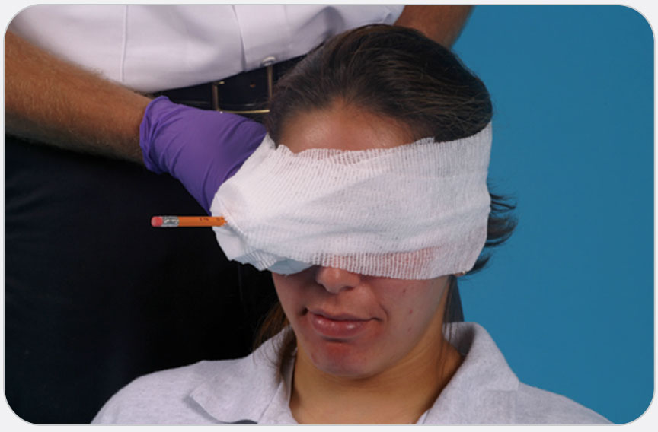
OEC Skill 22-1: Stabilizing an Impaled Object in the Eye
1. When an object has penetrated an eye, do not remove the object. Place padding around the eye, using a roll of gauze or cravat to create a “doughnut.” An alternative is to place a paper cup over the eye.

Slide 86
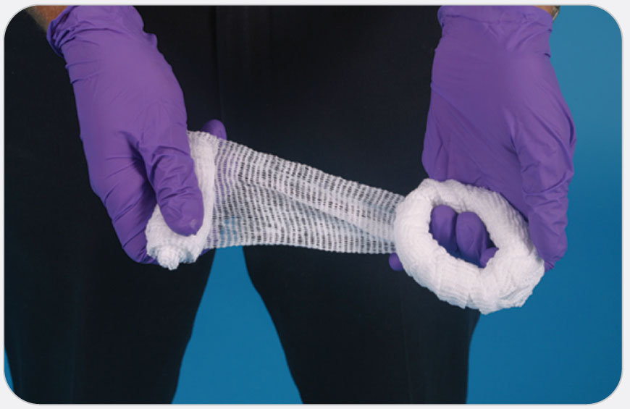
OEC Skill 22-1: Stabilizing an Impaled Object in the Eye
2. Use a roller bandage to secure the doughnut or cup in place.

