Slide 1
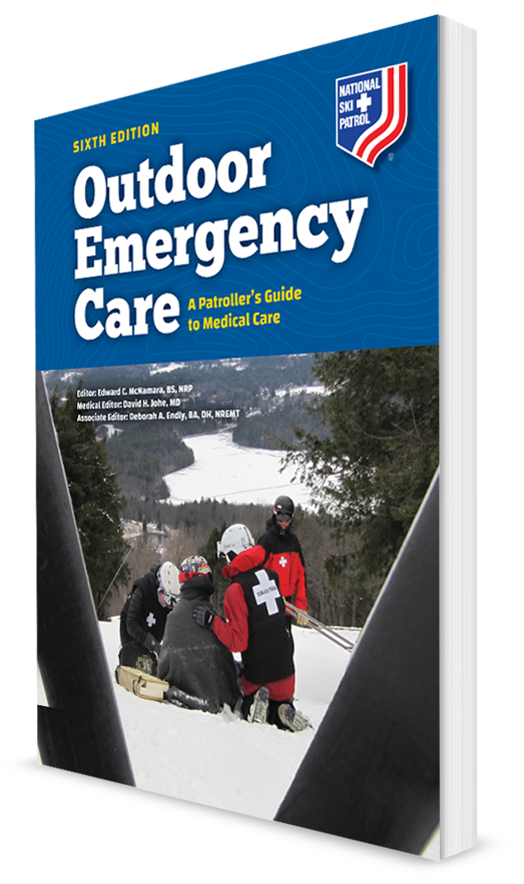
Abdominal and Pelvic Trauma
CHAPTER 24

Slide 2
The following presentation will utilize two symbols to identify material necessary for an OEC Technician to comprehend:
key term
Meets a Chapter Objective.
This symbol will have the corresponding Objective Number denoted within.
Identifies a Key Term.
The Key Term will be underlined for easy identification.

Slide 3
Objectives
24-1 Identify and locate the major anatomic structures within the abdominal and pelvic cavities.
24-2 List and describe at least six abdominal and pelvic injuries.
24-3 Describe and demonstrate how to assess a patient with abdominal or pelvic trauma.
24-4 Describe and demonstrate how to manage a patient with abdominal or pelvic trauma.
24-5 Describe and demonstrate how to manage an abdominal evisceration.
24-6 Describe and demonstrate how to manage an impaled object in the abdomen.

Slide 4
Key Terms
Abdominal evisceration
Straddle injury
Symphysis pubis

Slide 5
Chapter Overview

Slide 6
Chapter Overview
Assessing and treating trauma of the abdominal and pelvic cavities adds another dimension to your skills.
Organs in the abdominal cavity are less well protected than those in the chest.
Structures within the pelvis, although better protected, can still be injured.
Both cavities are served by a vast network of blood vessels.
The goal is to identify a potentially serious emergency, render emergent care, and quickly move patient toward definitive treatment.

Slide 7
Anatomy and Physiology

Slide 8
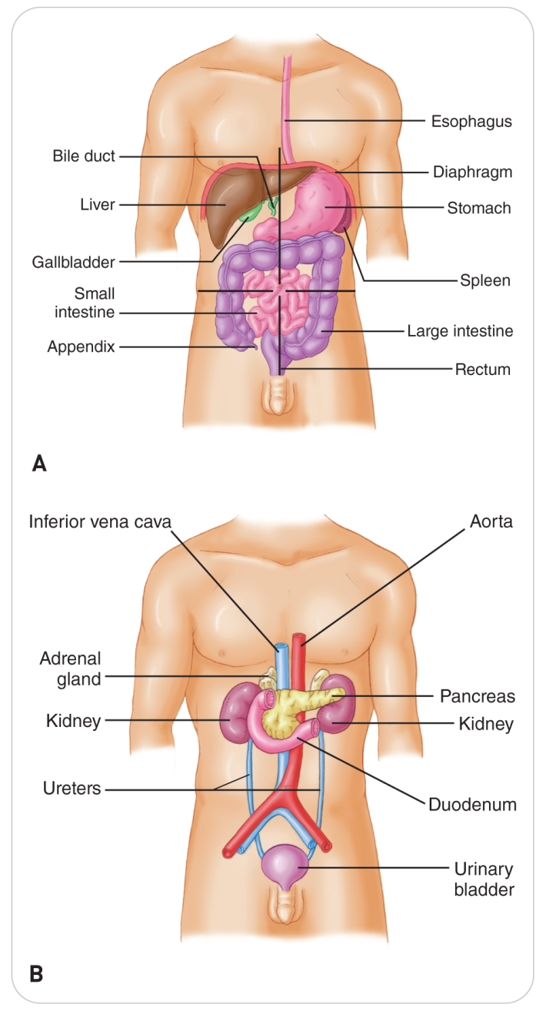
The Abdominal Cavity
24-1
The abdomen and pelvis constitute the largest cavity in the human body.
The abdominal cavity is separated from the thoracic cavity by the diaphragm, the muscle that contracts to expand the lungs.
The inferior margin of the abdomen is the pelvic brim, which is an imaginary plane formed by the top of the pelvic bones.

Slide 9
The Pelvic Cavity and Retroperitoneal Space
24-1
The Pelvic cavity is encased by the pelvic bones.
Pelvic organs are relatively protected from trauma by these bones--the ilium, the ischium, and the pubis.
Not the case with the abdominal organs
Just posterior (behind) the abdominal cavity are the kidneys and abdominal aorta in the retroperitoneal space.
Some of the organs in or just behind the abdominal cavity are involved with processing blood (increasing the risk of internal bleeding):
Kidneys
Liver
Spleen
Aorta and companion inferior vena cava

Slide 10
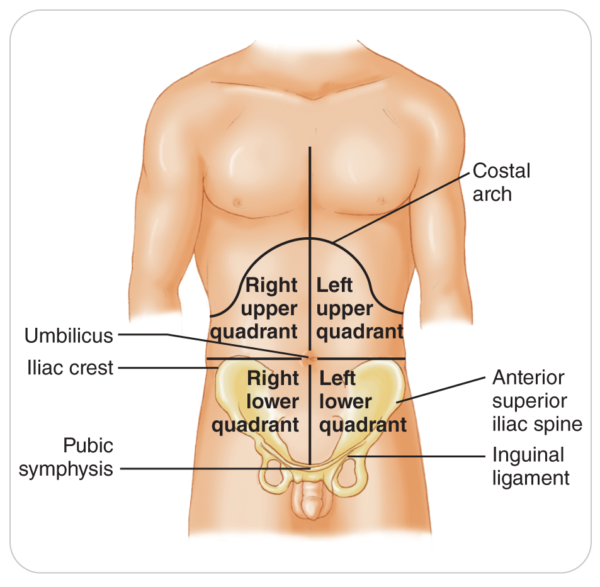
Four Quadrants of the Abdomen
24-1
The abdomen is divided into four quadrants.
Right upper quadrant trauma should make you consider liver injury.
Left upper quadrant trauma should heighten your suspicion for spleen injury.
Trauma to the midline of the upper abdomen should cause concerns for injury to the aorta, bowel, pancreas, spleen, or liver.

Slide 11
Common Abdominal and
Pelvic Injuries

Slide 12
Common Abdominal and Pelvic Injuries
The mechanism of injury can provide valuable information for identifying the nature of a patient’s problems.
Blunt trauma tends to cause injury to solid organs, whereas penetrating trauma may affect solid or hollow organs.
It is more common to find solid organ injuries than hollow organ injuries.
Trauma can injure more than one structure or organ in the abdominal and pelvic cavities.

Slide 13
Abdominal Wall Contusion
24-2
Any trauma to the abdominal wall can cause bruising of the skin and superficial abdominal muscles.

Slide 14
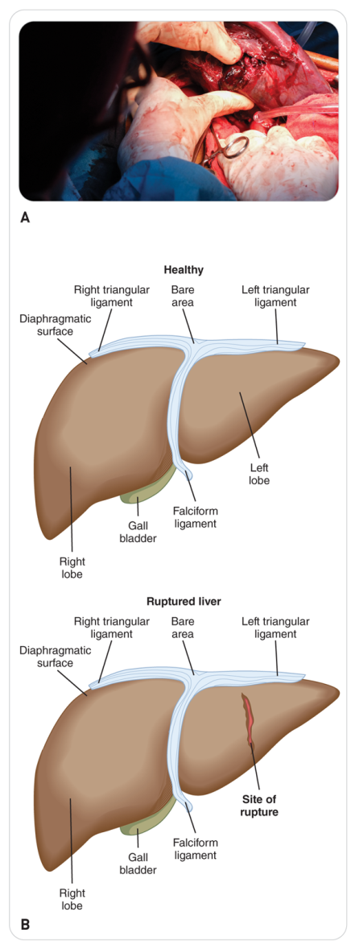
Liver Injuries
24-2
Largest solid organ in the abdomen, and injuries to it are not uncommon
Even though most of the liver is protected by the rib cage, it is vulnerable to both blunt and penetrating trauma.
Liver’s fibrous tissue and tough surrounding capsule enable it to withstand some trauma.
However, it is a highly vascular organ; injuries to it frequently cause internal bleeding.

Slide 15
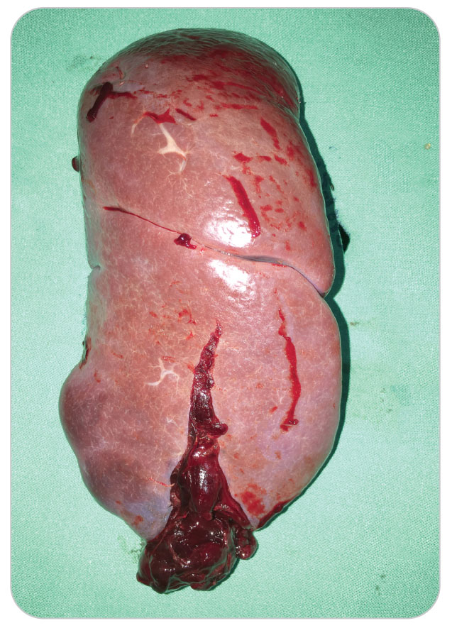
Spleen Injuries
24-2
In the left upper quadrant and flank
Partially protected by the lower rib cage
A highly vascular and fragile organ
Most injuries from blunt trauma
Can also be injured from:
Penetrating trauma
A fractured rib of the lower left rib cage
Internal bleeding can be severe.

Slide 16
Vascular Injuries
24-2
The abdomen and pelvis contain numerous arteries and veins, both large and small.
Among the larger vessels are the abdominal aorta, inferior vena cava, hepatic vessels, renal vessels, and iliac arteries and veins.
Rapid deceleration that results when the body hits a fixed object is the most common cause of vascular injury.
Penetrating trauma can also damage blood vessels.
Bleeding can be severe and immediately life threatening.

Slide 17
Diaphragm Tear/Rupture
24-2
Diaphragm is vulnerable to both blunt and penetrating trauma:
Severe blunt abdominal trauma can cause increased intra-abdominal pressure.
Most common injury is a diaphragmatic hernia.
Penetrating objects can directly cause holes in the diaphragm.
Tears or holes in the diaphragm allow structures within the abdominal cavity, mainly the intestines, to migrate into the thoracic cavity.
An injury to the diaphragm or the presence of abdominal organs in the chest cavity can compromise patient’s breathing.

Slide 18
Intestinal Tear/Rupture
24-2
Some portion of the large intestine or the small intestine is in every quadrant of the abdomen.
Many intestinal injuries are due to penetrating trauma, which can cause undigested food and fecal matter to leak into the abdominal cavity, resulting in severe pain, inflammation, and infection.
Significant bleeding can also occur if a vessel in the intestinal wall is damaged.
Blunt injuries to the intestines can also be concerning and sometimes have a more delayed presentation.

Slide 19
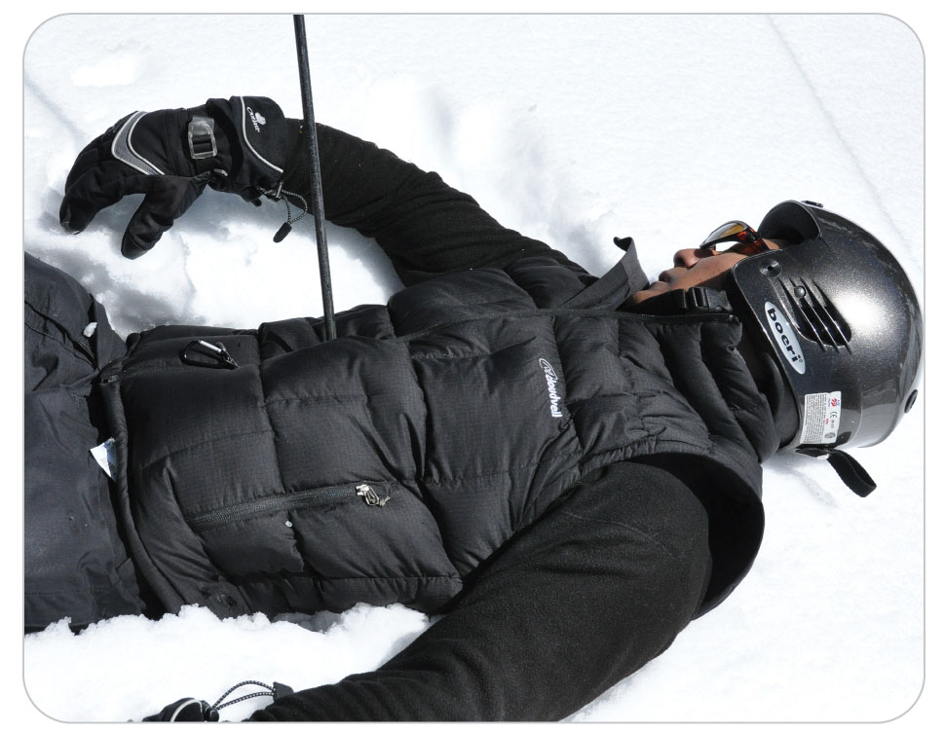
Impaled Objects
24-2
Impaled object can result in a variety of life-threatening injuries.
Objects such as ski poles, tree branches, fence posts, knives, or pipes are common impaled objects.
Many impaled objects in the abdomen or pelvis miss important organs or blood vessels, allowing patient to do quite well with timely definitive care.
Major complications are bleeding and infection.

Slide 20
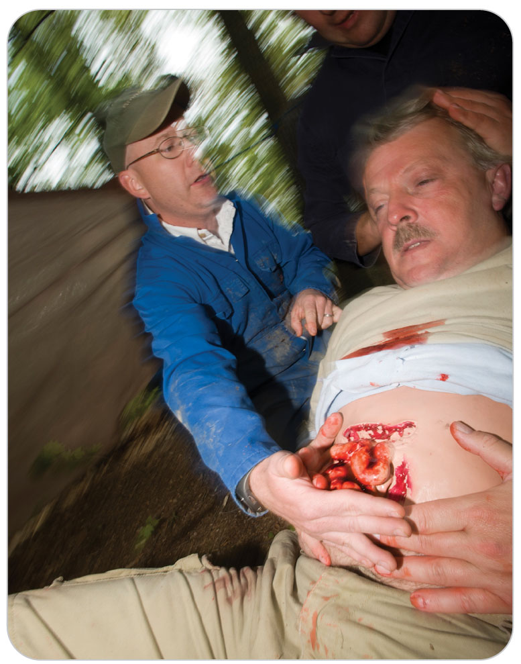
Abdominal Evisceration
24-2
An abdominal evisceration occurs when a tear in the abdominal wall and peritoneum exposes the intestines and/or other organs to the external environment.
Uncommon injury
Results in severe bleeding, rapid heat loss, and the risk of infection

Slide 21
Pelvic Fractures
24-2
Pelvic bones are some of the sturdiest bones in the body.
Still not immune to blunt or penetrating injury
Fractures require great force and should be suspected in high-speed collisions, falls, motor vehicle crashes, pedestrian-vehicle collisions, pelvic gunshot wounds, or any other type of direct or blunt trauma.
May also result in injuries to internal structures such as the urinary bladder and blood vessels
Most significant complication of a pelvic fracture is acute internal bleeding.
Because the pelvis is a ring, it is likely to fracture in more than one location.

Slide 22
Lower Urinary Tract Injuries
24-2
The urinary bladder is located behind and is protected by the symphysis pubis.
If the symphysis fractures, bone fragments can lacerate the bladder.
Most commonly this occurs from direct blunt trauma to the symphysis.
Falls and straddle injuries are common sources of this type of trauma.
Can cause the bladder to rupture, which is much more likely to occur when the bladder is full
Pressure of a seat belt at the end of a rapid deceleration also can rupture a full or distended bladder.
The urethra can be torn from the bladder.
Can result in internal bleeding or in urine leaking into the pelvic cavity

Slide 23
Genital Injuries
24-2
Generally not life threatening but can be a challenge for both patient and the rescuer
In outdoor settings, most caused by a straddle injury, which occurs when patient’s groin strikes an object such as a ski pole, a rail, or the top bar of a bicycle.
Females:
Limited to external structures because the uterus and ovaries are well protected within the bony pelvis.
The labia are very vascular, and external injuries to them can cause profuse bleeding.
Males:
Often more serious, can be very painful, and can result in long-term complications.
External genitals can receive blunt or sharp trauma.
Blunt trauma to the testicles can result in a hematoma in the scrotum.
Lacerations can occur to the penis or scrotum and are seen most commonly when the genitals are caught in a zipper.

Slide 24
Patient Assessment of the Abdomen and Pelvis

Slide 25
Patient Assessment of the Abdomen and Pelvis
24-3
Abdominal and pelvic injuries are often difficult to assess because the initial presentation can be relatively benign and then patient’s condition can deteriorate.
The assessment process:
Emphasis is on recognizing that an abdominal or pelvic injury exists rather than identifying exactly what organs have been injured.

Slide 26
Patient Assessment: Primary Survey
24-3
Begin by ensuring that the scene is safe.
Look for excessive external bleeding and assess patient’s ABCDs.
SAMPLE
Ask patients whether they have consumed alcohol or ingested any drugs.
These can mask symptoms of abdominal and pelvic trauma.
Ask the patient about any falls or collisions over the past few days, because some injuries may have gone unrecognized for several days.

Slide 27
Patient Assessment: Signs and Symptoms
24-3
As you perform the physical exam, note the presence of the following signs and symptoms that are consistent with an abdominal or pelvic injury:
Pain
Tenderness
Visible external wounds
Abdominal distention
Abdominal rigidity
Unexplained shock

Slide 28
Patient Assessment: Pain
24-3
If in pain, ask where located and assess its nature.
OPQRST mnemonic
Have patient point with one finger where it hurts the most.
Location of pain is helpful to determine which organs might have incurred injury.
Early pain is often experienced where the initial impact occurred.
Later becomes more generalized if blood, bile, or intestinal contents have leaked into the abdominal cavity and caused peritonitis
Serious internal bleeding is not always obvious.

Slide 29
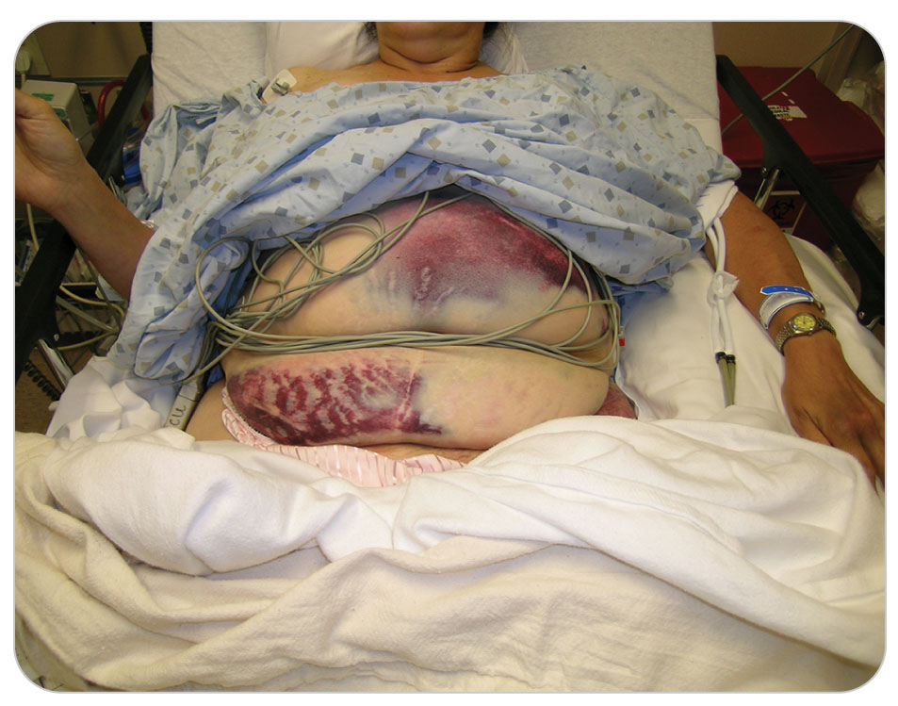
Patient Assessment: Inspection
24-3
Inspect the abdomen for abdominal distention.
Enlarging over time can be an indication of severe intra-abdominal bleeding.
May detect a large band of bruising across the lower abdomen, an area of discoloration known as the “seat belt sign.”
May take several hours to appear
More commonly associated with rapid deceleration
Also may be encountered if the abdomen strikes a fixed object

Slide 30
Patient Assessment: Inspection
24-3
Inspect both flank areas for discoloration.
DCAP-BTLS assessment
Deformity
Contusions
Abrasions/Avulsions
Punctures/Penetrations
Burns/Bleeding/Bruises
Tenderness
Lacerations
Swelling

Slide 31
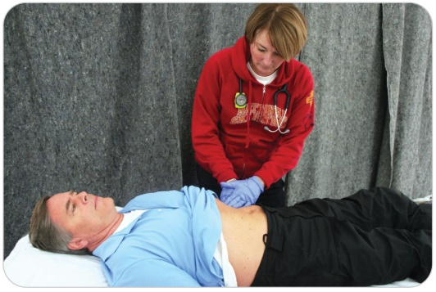
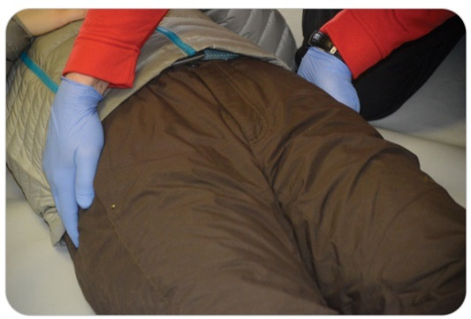
Patient Assessment: Palpation
24-3
Palpate the lower rib cage.
Rib tenderness and crepitus are signs of rib fracture.
Organs beneath a broken rib may be injured as well.
Palpate all four quadrants of the abdomen.
Carefully palpate the abdomen.
Assess the integrity of the pelvis.
Place your palms on the iliac crest on each side and apply gentle but firm inward (medial) pressure.
Bone crepitus, increased pain, or tenderness suggests a potential pelvic fracture.
Palpate pubic bones gently.

Slide 32
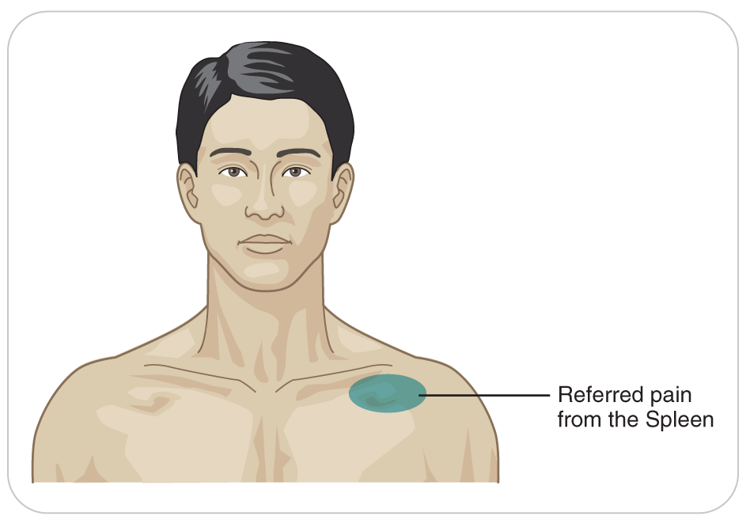
Patient Assessment: Referred Pain
24-3
When the spleen or liver is injured and bleeding from the organ irritates the underside of the diaphragm, pain can be referred to the shoulder on the same side as the injured organ.
A finding known as the Kehr sign
Left shoulder pain (in the absence of an actual shoulder injury) may indicate a ruptured spleen.
Right shoulder pain may indicate a lacerated liver.

Slide 33
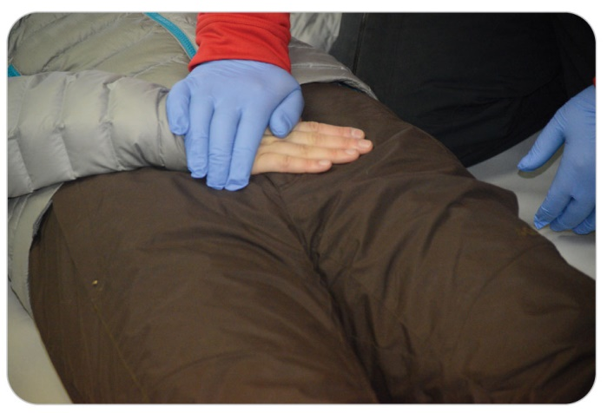
Patient Assessment: Special Considerations
24-3
Assess the front of the pelvis by placing patient’s hand on the pubic bone and then gently pushing on patient’s hand.
Only one rescuer should examine a patient for pelvic fracture.
If the pelvis is fractured, multiple examinations may lead to potentially life-threatening bleeding by disturbing the blood clot that has formed at the fracture site.

Slide 34
Patient Assessment: Genital Injuries
24-3
Genital injuries can be very painful and may be associated with pelvic fracture.
When indicated, inspect the area for bleeding, discoloration, or soft-tissue injury.
Discretion on the part of rescuers
Performed by one OEC technician with a second in attendance that is the same gender as patient
If patient is a child, ideally a parent or guardian should be present throughout the examination.
Do not delay an examination of a potentially life-threatening injury.

Slide 35
Patient Assessment: Monitoring for Shock
24-3
The abdomen and pelvis are filled with numerous blood vessels.
Several liters of blood can accumulate in these cavities.
A rising pulse rate, a falling systolic blood pressure, and a decreasing level of responsiveness are ominous signs that must not be overlooked.
Any injury in the abdominal and pelvic cavities has potential for serious blood loss, especially:
Left upper quadrant injuries (splenic injuries are especially prone to bleeding)
Pelvic fractures

Slide 36
Patient Assessment: Monitoring for Shock
24-3
Follow-up exams and serial sets of vital signs cannot be overemphasized.
Initiate management for shock if a patient with minimal symptoms develops:
Abdominal distention
Pain upon examination
An elevated pulse rate
Decreasing blood pressure
Transfer to definitive care.

Slide 37
Management of Abdominal and Pelvic Trauma

Slide 38
Management: ABCDs
24-4
After ensuring that the scene is safe and putting on PPE, focus on ABCD-related problems.
B: If patient is having trouble breathing, place patient on high-flow oxygen by nonrebreather mask to maintain oxygen saturation between 94 and 99%.
May need to assist with ventilations
Consider a potential ruptured diaphragm.
C: Open wounds should be dressed and bandaged.
D: Place a small amount of padding under patient’s knees while maintaining spinal alignment and protect the cervical spine if spinal motion restriction is needed.

Slide 39
Management
24-4
Once life threats have been addressed, place patient into a position of comfort.
Typically is supine with the knees slightly flexed, reducing strain on the abdominal muscles
Activate EMS for transport to definitive care as soon as a serious injury or threat to life is identified.

Slide 40
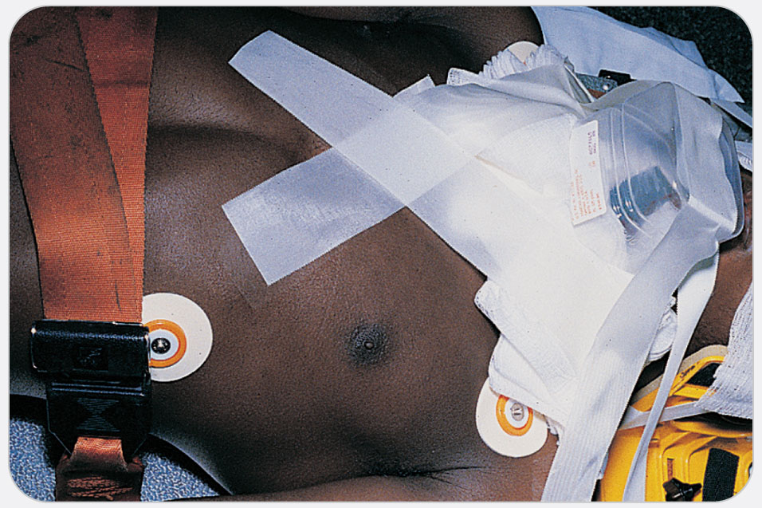
Management: Impaled Objects
24-6
Impaled objects should be secured in place.
Expose the wound, manually stabilize the object, and control bleeding.
Further stabilize the object with a bulky dressing.
If the length of an impaled object compromises transport or rescue operations, you may need to cut the object to allow for transport.
Keep the impaled object stationary when shortening it, as movement could cause additional internal injury.

Slide 41
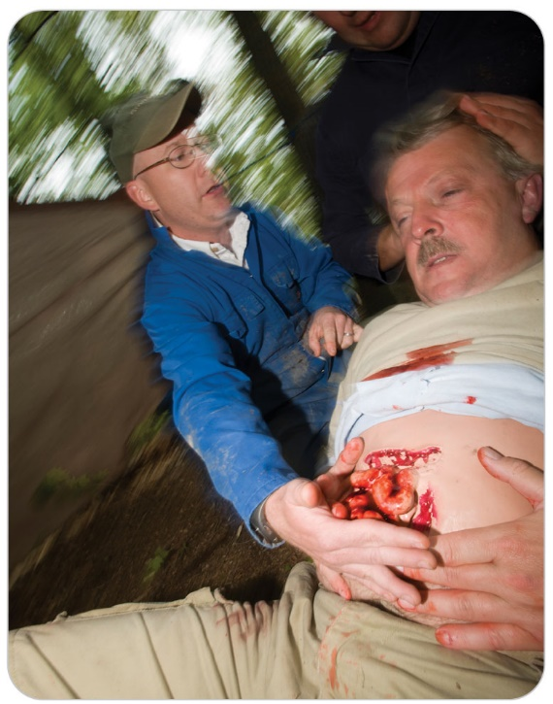
Management: Abdominal Evisceration
24-5
It is acceptable to put abdominal contents back into a large wound so the organs do not dry out and the blood vessels are not stretched.
This is more beneficial than leaving the organs out.
If possible, clean off any gross contamination first.
If there is a small hole, leave the contents out.
Do not force the contents back in.
If the transport time to definitive care is short, you may consider leaving the contents out.
Cover the area with a sterile dressing moistened with sterile water or saline solution, if available.

Slide 42
Management: Abdominal Evisceration
24-5
If you do not have access to sterile fluids, then keep the area moist with water that is clean enough to drink.
Do not use pond or stream water, which could have bacterial contamination.
Do not allow the eviscerated abdominal contents to dry out.
In the event you are in an area where clean water is not available, use a dry sterile dressing.
Keep patient warm because evisceration can cause rapid, significant heat loss.

Slide 43
Management: Fractured Pelvis
24-7
Apply a pelvic binder for a fractured pelvis, which will slow down the internal bleeding.
Move any patient with a possible pelvic fracture as little as possible.
More movement means more internal bleeding.
Commercial binders are better than a “homemade” sheet binder, but if only a sheet is available, use a sheet.
Studies published in 2019 show the commercial SAM pelvic binder may be superior.

Slide 44
Management: Fractured Pelvis
24-7
Before or after applying a pelvic binder, it is best to not logroll a patient with a suspected pelvic fracture.
Logrolling not only is very painful for these patients but also can cause more bleeding, with resulting hypovolemic shock.
It is best to use a carefully performed bridge lift for a broken pelvis.
Do not delay transport if additional trained personnel are not available.
If responsible bystanders are present, they may be able to help you perform a bridge lift.

Slide 45
Management: Shock
24-4
Shock is common in abdominal and pelvic trauma and is treated in the usual manner.
Patients who are in shock should not be given anything by mouth.
ALS should be requested if available.
Patients should be rapidly transported to a definitive-care facility.
Overall management for abdominal injuries includes early recognition, specific care for the injury, treatment for shock, and rapid transport to a trauma center.

Slide 46
Case Study

Slide 47
CASE PRESENTATION
On an intermediate ski trail, you see a young woman go off the edge of the slope. You note that she is trying to stop by sticking her poles into the snow ahead of her. Suddenly, the tip of a pole catches in the snow and the handle jams into her abdomen. She immediately falls to the ground. When you reach her, she is lying on the snow, gasping for air, and clutching her abdomen.
What is your first step in assessment?

Slide 48
CASE PRESENTATION
You ask patient if she is OK, and she replies, “No, help me.” You confirm that patient’s ABCDs are intact and that she does not have any serious external bleeding, spine pain or neurologic deficit. During your secondary assessment, patient complains of severe pain in her “stomach.” Examination of the abdomen reveals tenderness to palpation in the left upper quadrant. Patient’s radial pulse is 124 beats per minute, and her respirations are 20 breaths per minute. She says that she has no medical problems, is not taking any medications, has no allergies to medications, and last ate at breakfast approximately 3 hours ago. She denies any possibility that she could be pregnant. After 5 minutes, she appears to be breathing more easily but states that her “stomach really hurts.” Pulse is now 108 beats per minute, and respirations are 16 breaths per minute.
What is your care and transport plan?

Slide 49
CASE OUTCOME
Other patrollers arrive. You administer oxygen to patient on scene using a high-flow nonrebreather mask. Because she has significant left upper quadrant abdominal pain, you radio for ALS transport. The woman is transported in a toboggan in a head-uphill position because of breathing difficulties. In the first-aid room, patient says, “I don’t feel good.” Further assessment reveals more generalized abdominal tenderness, and she tenses when you palpate her abdomen. There is no abdominal distention, but she is very nauseated. Her pulse is now 132 beats per minute, and blood pressure is 98/50 mm Hg. Keeping patient supine, you add blankets, allow her to bend her knees, and help load her into an ambulance. You later find out patient was admitted for an injury to her spleen. Following surgery to remove a badly ruptured spleen, she returns to thank you for saving her life.

Slide 50
OEC Skill Activities

Slide 51
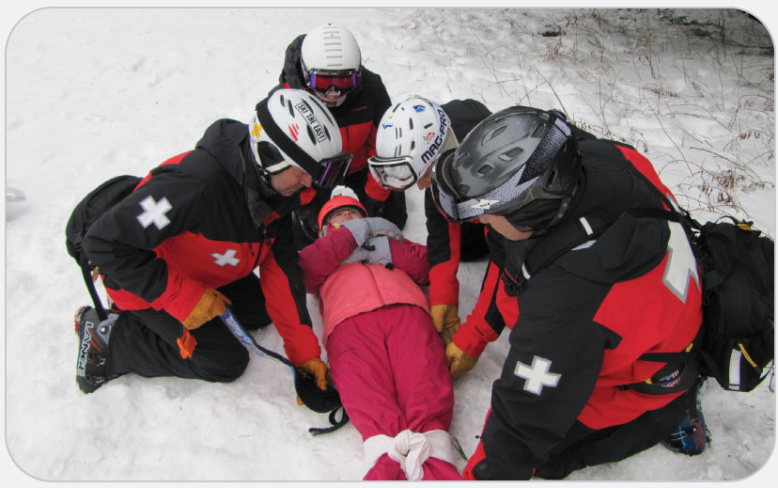
OEC Skill 24-1: Stabilizing the Pelvis
1. Prepare the commercial pelvic binder or folded sheet and place it beside the patient on the backboard, or stretcher, that is being used as a litter. Place it where the supine patient’s pelvis will be. If possible, dig out the snow or material under the pelvis and slide the device under the patient and apply.

Slide 52
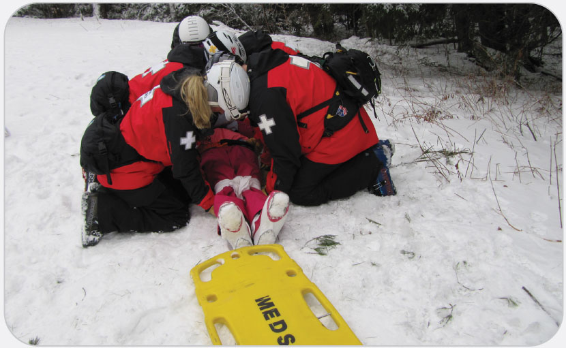
OEC Skill 24-1: Stabilizing the Pelvis
2. Perform a bridge lift. Place the patient on top of the sheet or the commercial binder so it is 1 to 2 inches below the iliac crests. Logroll only if absolutely necessary since doing so can cause more internal bleeding.

Slide 53
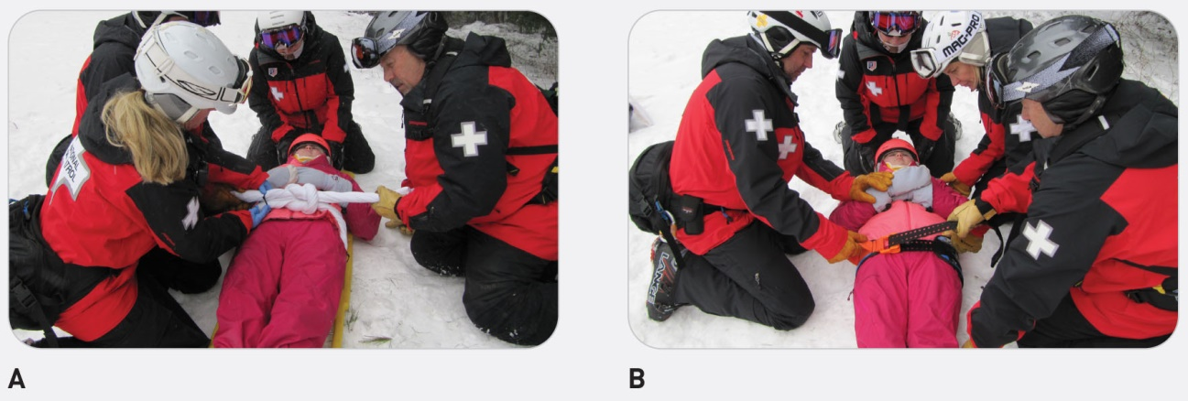
OEC Skill 24-1: Stabilizing the Pelvis
3. Fasten the binder:
a. If using a sheet, draw the two ends of the sheet together over the symphysis pubis, compressing the hips (greater trochanters) together. Then tie the sheet ends together snugly using an overhand knot. Plastic ties are in some cases better than using an overhand knot if available.
b. If using a commercial binder, pull the two ends together snugly in a similar way and Velcro or belt the binder per the manufacturer’s directions.

Slide 54
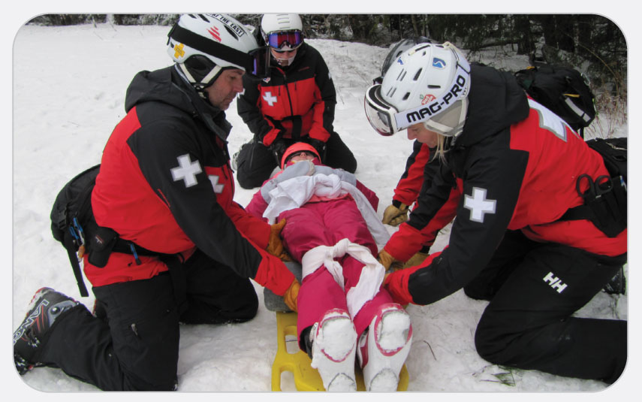
OEC Skill 24-1: Stabilizing the Pelvis
4. Lift the knees approximately 6 to 8 inches or to a position of comfort and place a blanket or other padded material under the knees prior to strapping the patient down

Slide 55
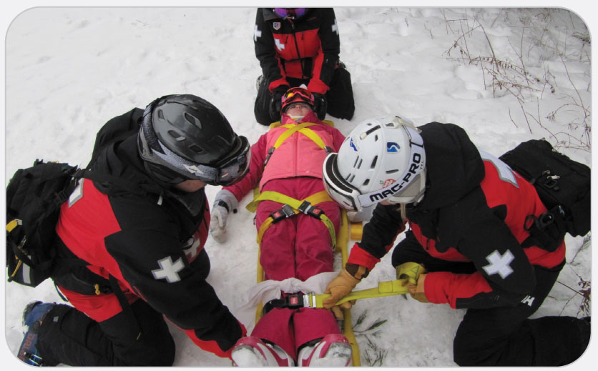
OEC Skill 24-1: Stabilizing the Pelvis
5. Finish securing the patient to the backboard or stretcher.

Slide 56
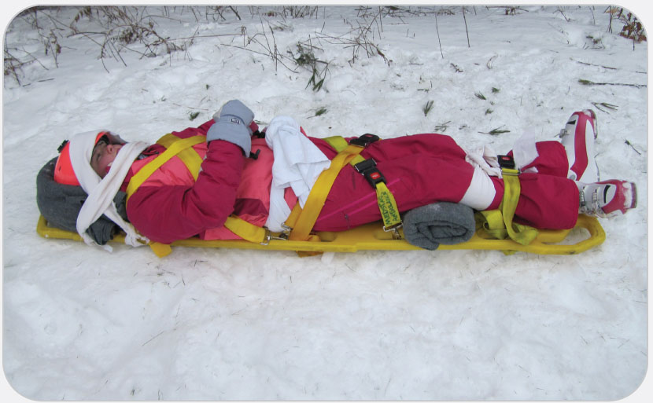
OEC Skill 24-1: Stabilizing the Pelvis
6. Because this is a distracting injury, apply a collar and head blocks and use spinal motion restriction (with the padding under the knees).

Slide 57
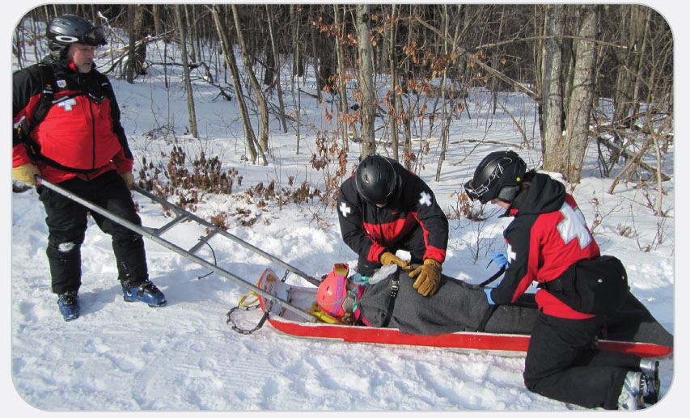
OEC Skill 24-1: Stabilizing the Pelvis
7. Lift the patient carefully into the toboggan or transport device outside. Again, a bridge lift is best.

