Slide 1
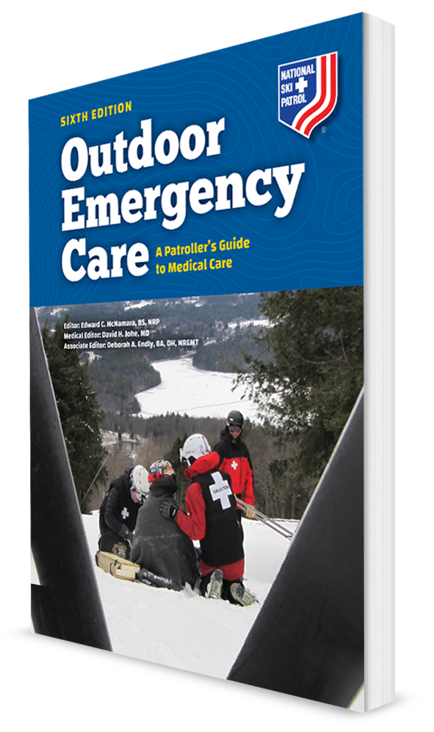
Cold-Related Emergencies
CHAPTER 25

Slide 2
The following presentation will utilize two symbols to identify material necessary for an OEC Technician to comprehend:
key term
Meets a Chapter Objective.
This symbol will have the corresponding Objective Number denoted within.
Identifies a Key Term.
The Key Term will be underlined for easy identification.

Slide 3
Objectives
25-1 Explain the wind chill index and how it applies to temperature.
25-2 List the signs and symptoms of frostnip and frostbite.
25-3 Explain the two types of hypothermia.
25-4 Define afterdrop.
25-5 Describe the assessment of a patient with cold injuries.
25-6 Describe the four categories of cold exposure.
25-7 Demonstrate the management of a patient with cold injuries.
25-8 Describe and demonstrate the emergency care of an avalanche victim.

Slide 4
Key Terms
Afterdrop
Frostbite
Frostnip
Hypothermia
Thermoregulation
Wind chill

Slide 5
Overview

Slide 6
Chapter Overview
Cold temperatures, in combination with inadequate preparation including necessary clothing, food, and shelter can overwhelm the body’s mechanisms for regulating temperature.
A variety of medical emergencies can result from exposure to cold, particularly during recreational activities in wilderness and high-altitude environments.
These emergencies include localized injuries (e.g., frostbite) and systemic illnesses (e.g., hypothermia and related problems).

Slide 7
Anatomy and Physiology

Slide 8
Thermoregulation
When the body’s core (internal) temperature decreases, sensors located throughout the body send signals to the brain.
In response, the brain sends messages to various body systems that reduce heat loss, generate heat (energy) production, or both.
Reduce heat loss
Constricting peripheral blood vessels
Halt sweat production, allowing skin to dry
Generate heat
Shivering
The process of maintaining normal body temperature is called thermoregulation.

Slide 9
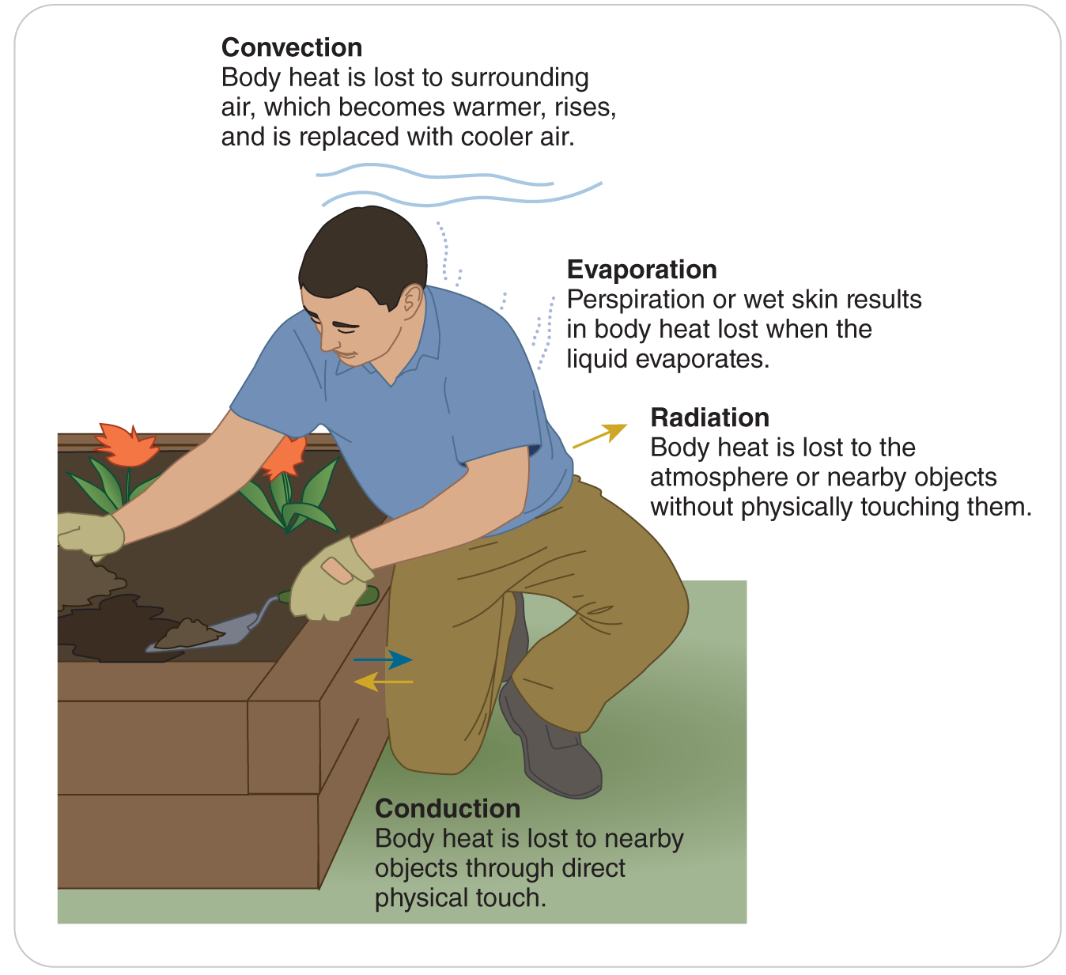
Cold Injury
25-1
Wind can make one more susceptible to cold weather injury.
As the wind speed increases, the “relative” temperature can become much worse.
Wind chill is the apparent temperature felt on exposed skin.
It is a reading of the air temperature and wind speed.

Slide 10
Wind Chill Index

Slide 11
Common Emergencies

Slide 12
Cold-Related Emergencies
25-1
There are several common cold-related injuries that OEC technicians need to understand.
These include:
Frostnip
Frostbite
Primary and secondary hypothermia

Slide 13
Frostnip
25-2
Frostnip is a relatively minor, local cold injury.
Results from local vasoconstriction of blood vessels in response to cold
Does not involve freezing or permanent damage of the tissues.
Areas prone to local cold injury such as frostnip include:
Ears
Tip of the nose
Fingers
Toes

Slide 14
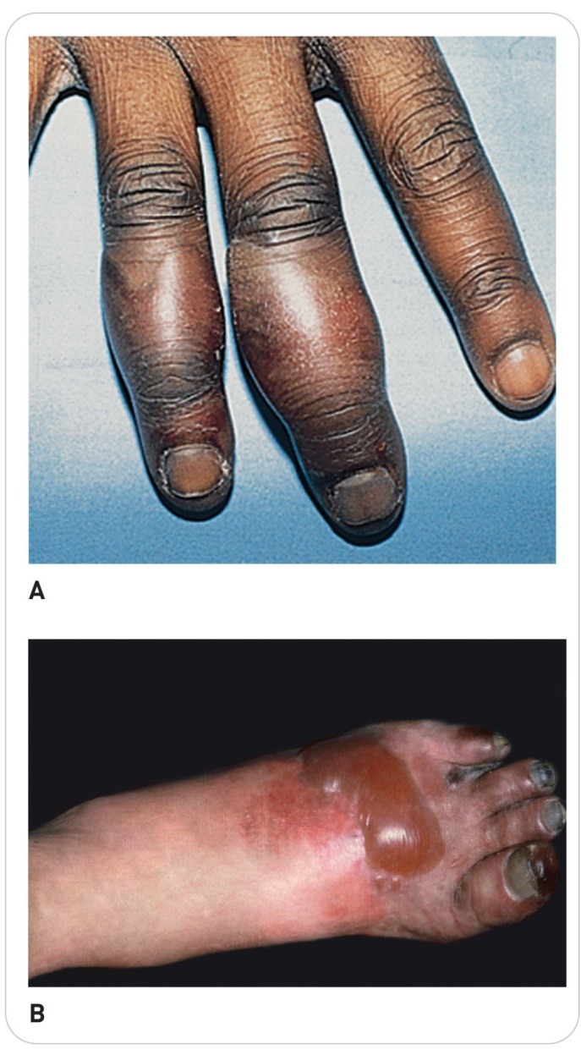
Frostbite
25-2
Frostbite is the actual freezing of body tissue.
Injury most commonly affects the:
Fingers
Toes
Nose
Ears
Cheeks
The male genitalia
May extend to deep tissues and even bones in severe cases.
Severity:
Is not always related to absolute temperature
Is determined by the extent and duration of the freezing of the tissues

Slide 15
Frostbite: Mechanisms of Tissue Injury
25-2
Tissue injury from frostbite is produced in two ways.
Actual freezing of the tissue forms ice crystals from within and between cells, extracting water from them.
Leads to dehydration and chemical imbalances in the cells and damages proteins.

Slide 16
Frostbite: Mechanisms of Tissue Injury
25-2
Loss of blood supply to cells as capillaries and other small blood vessels are damaged.
Damage to surviving capillaries and veins results in leakage of the liquid part of the blood (serum) out into the tissue.
This causes sludging or thickening of the blood, making it semisolid.
Blood eventually clots and form blockages.
Lack of blood supply causes tissue death.
This is the more significant mechanism of tissue injury.

Slide 17
Frostbite
25-2
The earlier the freezing is discovered and reversed, the less severe the overall injury will be.
The extent of damage caused by frostnip or frostbite is determined by how deeply the cold injury penetrates the skin and underlying structures.

Slide 18
Frostnip and Frostbite Classifications
25-2
The conditions are categorized as follows:
Superficial (frostnip)
Affects the first or top layer of skin
No permanent damage to the tissues results.
Partial thickness (frostbite)
Affects the upper layers of skin
Minor damage to the tissues results.
Full thickness (frostbite)
Affects all the layers of skin plus muscle and may even affect bone

Slide 19
Hypothermia
25-3
Hypothermia is an abnormally low body temperature.
Clinically defined as a body temperature below 35°C (95°F) according to the American Heart Association (AHA)
Occurs when heat loss exceeds metabolic heat production and heat conservation
Can occur at temperatures well above freezing, especially when a person is in contact with flowing cold water or wind

Slide 20
Hypothermia
25-3
Mild Hypothermia:
Metabolism initially increases, causing shivering, which serves to warm the body.
Moderate to Severe Hypothermia:
As core temperature drops further, body systems slow, causing:
Clumsiness
Stumbling
Mental confusion
Removal of clothing
Eventually unresponsiveness
Patient is often unaware of what is happening, further exacerbating the seriousness of the condition.
Hypothermia is commonly divided into two types: primary hypothermia and secondary hypothermia.

Slide 21
Primary Hypothermia
25-3
There are two types of primary hypothermia: immersion and non-immersion.
Immersion:
In cold-water immersion, body core cooling rates are fast, but hypothermia does not occur as quickly as might be thought.
It takes more than 30 minutes for individuals to become hypothermic after falling into very cold water while wearing winter clothing, if the person is wearing a personal flotation device or can somehow hold his or her head above the water.
The problem is that without a life jacket, the person must tread water, but muscle function in the arms and legs will be lost after 10 to 15 minutes, and drowning can occur.

Slide 22
Primary Hypothermia
25-3
Non-Immersion:
Also known as accidental hypothermia
Occurs more slowly but may be accelerated by wind, rain, or snow if the person lacks adequate insulation
Does not involve immersion in water

Slide 23
Secondary Hypothermia
25-3
Secondary hypothermia occurs with systemic disorders and is frequently associated with traumatized or critically ill patients.
Injury or illness is the primary problem, and hypothermia is an associated secondary problem.
Can be severe and even life threatening

Slide 24
Afterdrop
25-4
Afterdrop is defined as a continued drop in core body temperature after removal from exposure to the cold.
Occurs for a limited time, even after warming measures are initiated
Thought to be caused by the return of cold blood from the extremities to the heart, resulting in a further drop in core body temperature
In severe cases, afterdrop can result in shock and cardiac arrest.

Slide 25
Patient Assessment

Slide 26
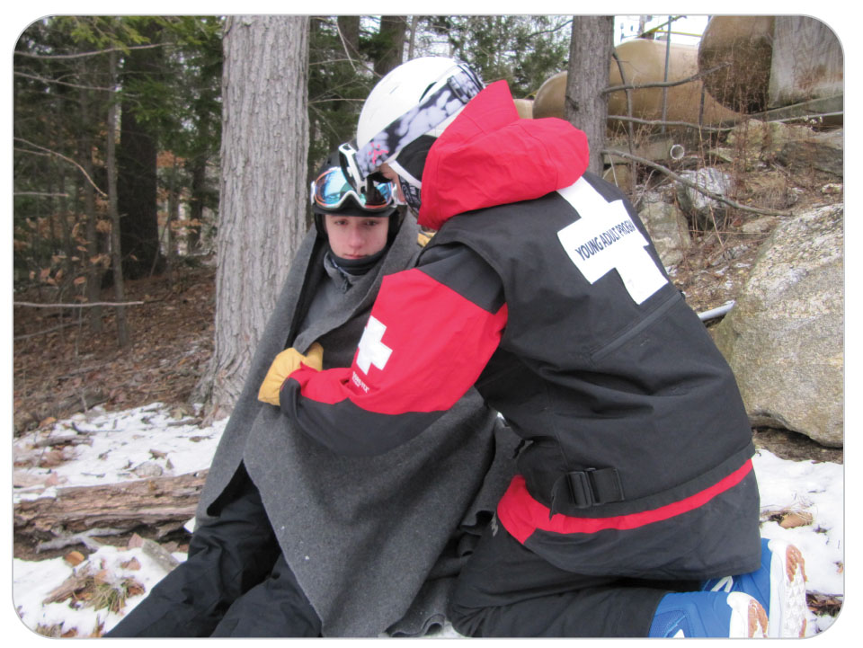
Patient Assessment: Scene Safety
25-5
First and foremost, rescuers must not become patients.
This can jeopardize the safety of everyone on scene.
In the past, some OEC technicians have placed their jackets or clothing on a cold patient.
It is better to rapidly transfer patient to a warm environment.
The OEC technician should be prepared by having a blanket available for patient.
Most ski patrols pack blankets in the rescue pack in a toboggan.

Slide 27
Patient Assessment
25-4
Once the scene is considered safe, control excessive bleeding and assess patient’s ABCDs just as you would any patient.
Many will have an injury that caused them to be caught out in the cold, resulting in hypothermia as a secondary problem.
Once primary assessment is complete, perform a secondary assessment.
Examine patient fully using the DCAP-BTLS.
Obtain a complete SAMPLE history.
Excessive exposure of the body surface while performing a physical examination promotes further heat loss.
Make every effort to limit the surface area exposed.
Look for signs of cold injury, such as frostbite.
Rapid thorough assessment of patient is warranted.

Slide 28
Patient Assessment: Frostnip
25-5
When frostnip occurs, an individual’s skin appears cool and pale.
While frostnip can be a painful injury, tissues remain intact.
Skin is still pliable.

Slide 29
Patient Assessment: Frostbite
25-5
The earliest symptom of frostbite is pain at the involved site, although this is variable.
Pain is followed by numbness without pain because as the tissue freezes, sensation and pain stop.
Easing of pain is often mistaken for improvement of the condition.

Slide 30
Patient Assessment: Frostbite
25-5
Frostbite should be suspected if a painfully cold body part suddenly stops hurting but is not getting warmer.
Affected part may initially feel soft but over time may become firm or woody to the touch.
Affected area is initially gray or waxy and then turns pale or red, depending on severity.
If the area involved is the head or face, someone other than patient may be the first to notice it.

Slide 31
Frostnip and Frostbite: Signs and Symptoms
25-5

Slide 32
Categories of Cold Exposure

Slide 33
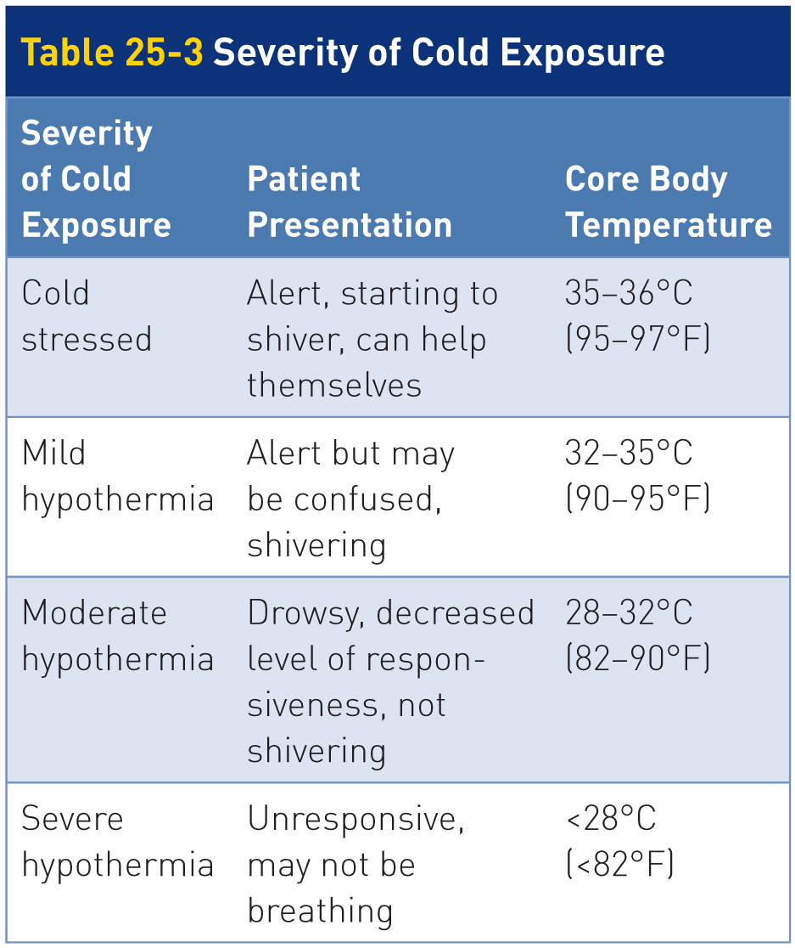
Categories of Cold Exposure
25-6
Cold patients are divided into four categories that are defined by core body temperature ranges.
In the field, measurement of core temperature can be difficult or impossible.
Table 25-3 presents a system for estimating core body temperature and the severity of hypothermia based on patient’s presentation.

Slide 34
Cold Stressed: 95°F to 97°F
25-6
Cold Stressed
A person is considered cold stressed when the body temperature is below 36°C (97°F) but above 35°C (95°F).
When this occurs, heat is lost by the body, which in turn starts to compensate.
Shivering usually begins when someone is cold stressed.

Slide 35
Mild Hypothermia: 90°F to 95°F
25-6
Generally, mild hypothermia first manifests as shivering, which can be vigorous.
Shivering is an important mechanism that significantly increases muscle activity and heat production.
Initially starts when the body’s core temperature falls below approximately 35°C (95°F).
Unless other factors are present, shivering should enable patient to overcome heat loss and elevate core temperature.
Most patients with mild hypothermia can warm themselves through shivering alone.
Still require protection from further heat loss.

Slide 36
Mild Hypothermia: 90°F to 95°F
25-6
If core temperature continues to fall, uncontrollable shivering is observed until the core temperature reaches approximately 32°C (90°F).
There are exceptions to this including exhausted patients who are unable to shiver and some cases of chronic exposure (several hours) in which exhaustion occurs and shivering stops.
Such patients generally remain responsive, although they may be confused and exhibit both a loss of judgment and decreased fine motor coordination.

Slide 37
Moderate Hypothermia: 82°F to 90°F
25-6
The transition to moderate hypothermia (28–32°C, or 82–90°F) is characterized by cessation of shivering (usually at a core temperature of about 32°C or 90°F).
A progressive slowing of metabolism also occurs, as evidenced by a slow pulse and/or slow respirations.
As the heart rate falls and peripheral vasoconstriction relaxes, hypotension results. In other words, the heart beats more slowly and the blood vessels in the arms and legs relax, allowing more blood into the extremities and causing blood pressure to fall.
The level of responsiveness continues to decrease from slurred speech and a staggering gait to unresponsiveness.
The surface temperature of the skin gets much colder.

Slide 38
Severe Hypothermia: Below 82°F
25-6
As core temperature falls below 28°C (82°F), the heart is at risk of ventricular fibrillation, either spontaneously or in response to mechanical stimulation.
For this reason, it is imperative to handle hypothermic patients gently and with great care.
In severe hypothermia, mental status is severely depressed, resulting in coma.
At core body temperatures nearing 25°C (77°F), patient may appear clinically dead.
Examination may reveal an unresponsive and comatose patient.
Patient may be rigid, without palpable pulses or discernable respirations.

Slide 39
Severe Hypothermia: Below 82°F
25-6
The torso is cold to the touch.
Pupillary eye reflexes and deep tendon reflexes are diminished or absent.
Although apparently dead, patient cannot be presumed dead unless those conditions persist after warming or obvious signs of fatal trauma are present.
Suppression of energy-dependent processes markedly diminishes oxygen and metabolic demands.
As cells become cold, they do not require as much oxygen and glucose.
Decreased requirements explain the successful resuscitation of some hypothermic victims despite the appearance of death.

Slide 40
Management

Slide 41
Management: Cold-Related Emergencies
25-7
The general principles of OEC treatment apply to all cases of cold injury, regardless of cause or severity.
As with any situation, rescuer safety is the top priority and is ensured by mitigating any hazards (scene safety) that may be present.
Then correct any severe bleeding and any ABCD-related problems first.

Slide 42
Management: Cold Stress and Hypothermia
25-7
Preventing Further Heat Loss and Warming patient
In winter weather, prevention of heat loss is important for the care of all patients.
In the field, use insulating pads beneath patient as a base; then add blankets while maintaining adequate exposure of patient’s airway and spine.
This procedure will minimize convective and conductive heat loss while allowing for airway-related interventions, as needed.
Place an insulating hat on patient’s head to decrease radiant heat loss.
After caring for an injury, replace any clothing that was opened for the exam.
A vapor barrier can be added to eliminate evaporative heat loss and to protect insulation from getting wet.

Slide 43
Management: Cold Stress and Hypothermia
25-7
Move any injured or ill patient to a shelter and out of the wind.
A heated building is best.
In the backcountry, if the only heat available is from a fire, make sure adequate ventilation of the smoke and carbon monoxide occurs.
Replace patient’s wet or cold clothing with dry insulating clothing.
If shelter is not immediately available, protect patient from the chilling effects of wind exposure and insulate patient from the ground or other cold-conducting surfaces.

Slide 44
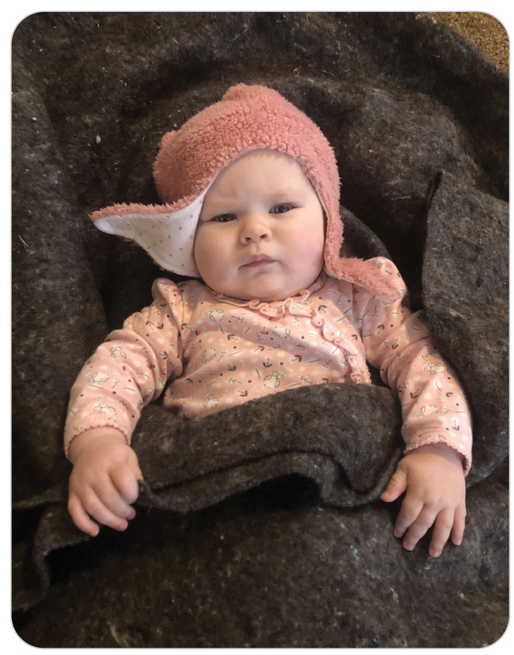
Management: Passive Rewarming
25-7
Once heat loss has been minimized, attention may be turned toward warming patient.
Warming methods are of two types: passive and active.
Passive warming relies on retention of patient’s internal body heat, such as covering with a blanket.
Shivering is the primary passive warming mechanism for patients in the field.
Often all that is needed to warm patients who are mildly hypothermic

Slide 45
Management: Active Rewarming
25-7
Involves the application of heat
May be separated into external and internal modalities
External: The application of hot packs or hot water bottles to major superficial arterial sites, the periphery, and the trunk
Does not provide enough heat to warm moderately or severely hypothermic patients who are not shivering
Inside aid rooms, electric blankets provide a good method for rewarming patients.
Simple radio call to the aid room asking to have an electric blanket turned on prior to transport can prove incredibly beneficial.

Slide 46
Management: Active Rewarming
25-7
Internal:
Upon arrival, offer warm beverages (provided there is not a reason to restrict oral intake).
Warm, high-energy, nonalcoholic drinks and high-energy foods containing sugar are helpful, providing that the patient is:
Responsive
Can hold an object in their hand
Can swallow without choking
Provides fuel to the body that enables the muscles to continue to shiver, which generates additional heat

Slide 47
Management: Moderate to Severe Hypothermia
25-7
In moderate to severe hypothermic patients:
Aggressive warming such as whole-body warm-water immersion should never be attempted because it may cause severe drops in blood pressure or ventricular fibrillation.
Do not rub the extremities under any circumstances, as rubbing produces little frictional heat and may damage the skin and underlying tissue.
Rapidly transport patient to a definitive-care facility as soon as possible.

Slide 48
Management: Moderate to Severe Hypothermia
25-7
If patient is severely hypothermic and presents without any signs of life, begin treatment immediately.
Cold, rigid, apparently lifeless patient who is hypothermic may not actually be dead.
Apparent lack of pulse and apnea may be due to a very slow, faint heart rate and tissue rigidity.
“They are not dead until they are warm and dead!”

Slide 49
Management: Moderate to Severe Hypothermia
25-7
Open the airway.
Check for breathing and a pulse.
Check the pulse (and respirations) for up to 1 minute in severe hypothermia.
Cold effect may slow the heart rate considerably, so a pulse is hard to detect.
If cardiac activity is not detected, initiate CPR.
Rescue breathing or using a bag-valve mask (with ambient air or compressed oxygen) poses no danger to patient.
Improved ventilation and oxygenation may strengthen cardiac activity and make the pulse detectable.

Slide 50
Management: Moderate to Severe Hypothermia
25-7
Specific procedure for providing CPR to a severely hypothermic patient should be confirmed with local medical advisors.
Chest compressions should not be initiated on any hypothermic patient with signs of life.
Focus on heat loss prevention, warming, treatment of other injuries, and rapid evacuation and transport.
Do not initiate chest compressions on a patient who has obvious fatal injuries, is frozen, has a chest wall that is so stiff that compressions are impossible, or if the rescuers are exhausted or are in danger.

Slide 51
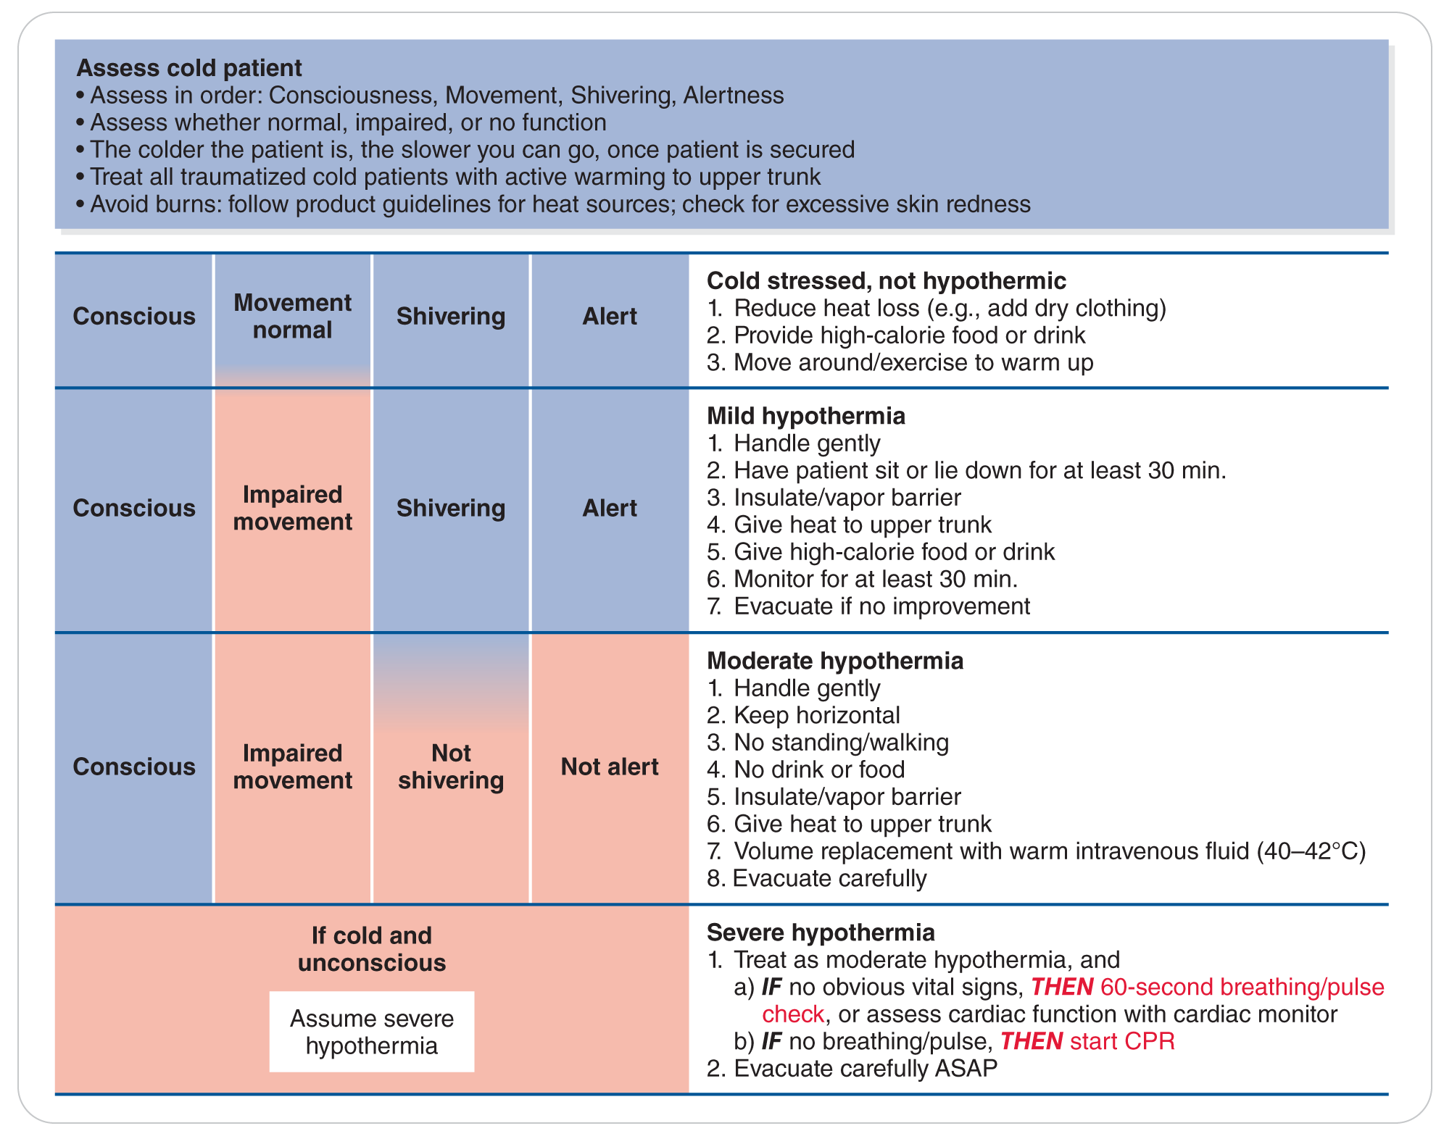
Management: Moderate to Severe Hypothermia
25-7
Multiple case reports indicate survival from accidental hypothermia can still occur, even with prolonged CPR and downtimes.
Patients with severe accidental hypothermia and cardiac arrest may benefit from resuscitation even in cases of prolonged downtime and prolonged CPR.
Should not be considered dead before warming has been provided

Slide 52
Management: Moderate to Severe Hypothermia
25-7
Use of an AED may be beneficial, although the protocols concerning its use in this situation may vary.
Temperature at which defibrillation should first be attempted in the severely hypothermic patient has not been established by AHA as of 2018.
Up to three shocks if recommended by the AED in a patient with severe hypothermia and core temperature less than 30°C (86°F) as transport or rewarming is ongoing
Continue chest compressions in accordance with BLS protocol.
Local medical director should provide input for your local protocol.

Slide 53
Management: Moderate to Severe Hypothermia
25-7
Attach an AED to patient as soon as it is available.
If the AED says shock advised defibrillation should be attempted
According to the AHA (2018) “It may be reasonable to perform further defibrillation attempts according to the standard BLS algorithm concurrent with rewarming strategies.”
A patient with mild hypothermia who has been adequately warmed and has returned to normal mental status need not be emergently evacuated.
Take care to prevent a recurrence of cold injury and monitor patient to ensure resolution.

Slide 54
Management: Moderate to Severe Hypothermia
25-7
Any patient who does not respond to warming, who has moderate to severe hypothermia, or has severe frostbite must be evacuated as soon as possible and transported to a definitive-care facility.
Evacuation must be as gentle as possible to prevent ventricular fibrillation or additional tissue damage/injury.
During transport, continue to monitor patient’s vital signs, the skin underneath any applied heat sources, and distal circulation.
Reexamine patient frequently unless doing so could increase heat loss or cause tissues to refreeze.
If this potential exists, limit patient’s exposure to the best of your ability.

Slide 55
Management: Frostnip
25-7
Frostnip is usually easily treated by seeking shelter and warming the affected area by simply placing a warm hand or applying a warm chemical heat pack covered in cloth (so that it’s not too hot).
Do not rub the affected body part. Various skin lotions may help itching and promote healing.

Slide 56
Management: Frostbite
25-7
The treatment for frostbite is rapid warming.
Slow, gradual warming should be avoided because it is associated with greater tissue injury.
Warming causes pain, sometimes severe pain, and this should be explained to patient.
Among the many factors to consider when rewarming frostbitten tissues are when, where, and how warming efforts should be performed.

Slide 57
Management: When to Treat Frostbite
25-7
Tissues should be warmed as soon as possible following initial discovery and in some instances prior to transport to a medical facility.
May avoid further injury
Circumstances or the lack of proper resources may prevent prompt warming.
Judgment is required when deciding when to warm frozen tissue.
Warmed tissues must not be allowed to refreeze because in that case, frostbitten tissue will become gangrenous.
If shelter and equipment are not available for thawing the part, then do not attempt to warm the tissue.

Slide 58
Management: When to Treat Frostbite
25-7
If you are in the backcountry and shelter and proper equipment are available, and if rapid warming is possible and there is no possibility of refreezing, then thaw the body part.
If the decision is made not to warm frozen tissue in the field, great care must be taken to protect the area from additional injury.
For patients who must self-evacuate, it is best to leave a foot frozen, because after it has thawed it will be too painful for walking.

Slide 59
Management: When to Treat Frostbite
25-7
Warming should be performed in a sheltered area.
Proper equipment should be available to warm patient adequately and prevent refreezing.
Best done in a medical facility
If you are in the backcountry and a shelter such as a cabin is available, you can build a fire to heat water, and if refreezing will not occur, a frostbitten body part may be thawed.

Slide 60
Management: Warming Frostbite
25-7
Remove constrictive clothes, rings, or watches.
Using a vessel large enough to accommodate the limb, prepare a warm water bath that is heated to 38.9–40°C (102–104°F).
Use a thermometer to check the water temperature.
If one is not available, you should be able to comfortably place your hand in the water.
Suspend the frostbitten part in the center of the warm water bath, using caution to not contact the sides or bottom.

Slide 61
Management: Warming Frostbite
25-7
Keep the affected area in the bath for 20 to 30 minutes.
Stir the water to keep it at a constant temperature, adding warm/hot water as needed.
Allow the affected part to air dry if further heat loss is preventable.
Do not rub the tissues because this can cause sloughing and additional tissue damage.

Slide 62
Management: Warming Frostbite
25-7
Once the area is warmed, aloe vera ointment and dry dressings may be applied.
Patient may self-administer ibuprofen or aspirin.
Warming a frostbitten body part can cause severe pain that requires advanced life support (ALS) for narcotic pain management.
Be sure to gently place dressings between the digits.
Elevate the affected area to the level of the heart to reduce swelling.

Slide 63
Management: Avalanche Victim
25-8
Rescue is a race against time with asphyxiation being the major cause of death during avalanche burial, but hypothermia is the primary medical concern.
The potential for serious trauma also is present in avalanche burial survivors.
Such trauma may impair thermoregulation and accelerate the development of hypothermia.

Slide 64
Management: Avalanche Victim
25-8
Death from asphyxiation is time dependent.
If the person can breathe, toxic levels of carbon dioxide build up around the face.
Avalanche burial victims who are extricated within 15 minutes have a greater than 90% chance of survival.
Potential for survival is minimal when avalanche victims are buried for more than 35 minutes and have an obstructed airway and are in cardiac arrest on extrication.
Survival beyond 35 minutes is usually dependent on whether patient had an air pocket and could expand the chest for breathing.

Slide 65
Management: Avalanche Victim
25-8
Initial priorities in the emergency management of an extricated avalanche burial victim are the same as for other patients:
Open the airway.
Ensure adequate ventilation.
Control external bleeding.
Provide supplemental oxygen while maintaining spinal motion restriction as defined by local protocol.
Patient may have severe hypothermia, so follow the treatment for severe hypothermia, checking pulse and respirations for up to 1 minute.

Slide 66
Management: Avalanche Victim
25-8
Severity of hypothermia in an avalanche burial victim may be assessed by the level of responsiveness and the duration of burial.
If the avalanche victim is responsive and the duration of burial is less than 1 hour:
Mild hypothermia is most likely.
Treatment consists of providing warm, dry insulation and warm sugar-containing liquids.
Warming will occur through shivering.

Slide 67
Management: Avalanche Victim
25-8
Development of hypothermia during avalanche burial does not occur as quickly as during cold-water immersion.
Generally takes more than 35 minutes of burial in an avalanche to cause moderate to severe hypothermia
Moderate or severe hypothermia may occur in avalanche burial victims after extrication because of accelerated development of hypothermia during exposure to a cold, windy environment.
Important to handle them gently
Package quickly using warming wraps in order to minimize additional heat loss

Slide 68
Management: Avalanche Victim
25-8
Avalanche burial victims who have a depressed level of responsiveness and are not shivering because they have progressed to moderate or severe hypothermia will require medical transport to a hospital for definitive warming.
Unresponsive avalanche burial victims who are breathing are likely moderately to be severely hypothermic.

Slide 69
Management of an Avalanche Victim
25-8
Avalanche burial victims extricated after burials of 35 minutes or less who are pulseless have most likely died from asphyxiation.
Although it is unlikely that resuscitation efforts will be successful, begin CPR.
If CPR is unsuccessful after 30 minutes, usually patient was already dead.
You should continue CPR until higher-level medical personnel assume care.
If burial time is greater than 35 minutes and core body temperature is less than 32°C (90°F), the victim may be severely hypothermic, and resuscitation efforts may be continued during transport to a medical facility.

Slide 70
Case Study

Slide 71
CASE PRESENTATION
It is a beautiful spring day, with temperatures in the low 40s. A healthy 45-year-old woman and her 18-year-old son set out for a day of skiing. Two hours later, she falls through some soft snow into a shallow creek. Uninjured, she is easily able to extricate herself from the water but not before getting wet up to her chest. The two skiers continue skiing. Riding the lift, she begins shaking uncontrollably. They decide to stop outside and drink what is left in their Thermos: hot chocolate and schnapps. They can make it to the gondola to ride to the base area. Halfway through the 20-minute ride, she is no longer shaking, appears sleepy, and closes her eyes. At the base area, her son is unable to wake her up. You are standing at the off-load ramp when the son yells out that he needs your help. He quickly briefs you while you conduct an initial assessment.
What should you do?

Slide 72
CASE UPDATE
You and another patroller move patient from the gondola and into the aid room at the base building. Her clothes are wet, and she appears to be dead. Her skin is pale and cold to the touch, and she is unresponsive. You immediately check her carotid pulse for 10 seconds, and you identify that it is very slow. There are no signs of trauma.
What should you do now?

Slide 73
CASE OUTCOME
You decide from her clinical picture that patient is severely hypothermic. You arrange for transport with ALS. You ensure an open airway, insert an OPA, and use a bag-valve mask for rescue breathing. Others help patient gently remove her wet clothes. You then place her in a warm electric blanket.
The paramedics arrive, intubate patient, and place her on a cardiac monitor, which shows that her heart has an organized rhythm with a very slow pulse. Additionally, the paramedics start intravenous lines and administer warm saline. They gently transfer her to the ambulance and take her to the hospital.

Slide 74
CASE OUTCOME
At the hospital, her core body temperature initially is 26°C (79°F). Patient goes into ventricular fibrillation, an AED is used, and CPR is started. Patient has no response to initial defibrillation, or the drugs given. In the emergency department, patient is aggressively warmed, and eventually her heart regains a normal rhythm. Patient remains in the intensive care unit for a few days and later is discharged from the hospital.

