Slide 1
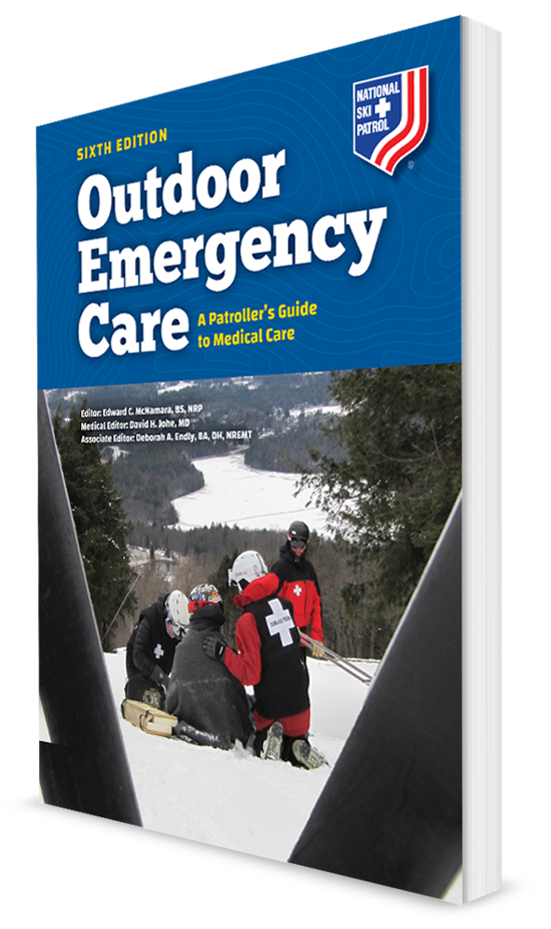
Heat-Related Emergencies
CHAPTER 26

Slide 2
The following presentation will utilize two symbols to identify material necessary for an OEC Technician to comprehend:
key term
Meets a Chapter Objective.
This symbol will have the corresponding Objective Number denoted within.
Identifies a Key Term.
The Key Term will be underlined for easy identification.

Slide 3
Objectives
26-1 Explain how to prevent heat-related illness.
26-2 Explain how the body adjusts to a hot environment.
26-3 List the signs and symptoms of a patient with the four types of heat-related illness.
26-4 Describe and demonstrate the assessment and management of a patient suffering from each of the four types of heat-related illness.

Slide 4
Key Terms
Ambient temperature
Core body temperature
Heat acclimatization
Heat index
Humidity
Hyperthermia
Thermoregulation

Slide 5
Overview

Slide 6
Chapter Overview
Being active in hot environments requires advance preparation and daily precautions to prevent heat-related illnesses.
Insufficient preparation under hot conditions can lead to heat-related illness.
Acute heat-related medical problems can be deadly.
This chapter discusses:
How to prevent heat-related illness
How the body regulates its core temperature in hot environments
The various forms of heat emergencies
How to assess and treat these conditions

Slide 7
Anatomy and Physiology

Slide 8
Thermoregulation
26-2
Normal core body temperature is 98.6°F (37°C).
Regulatory mechanisms keep this internal temperature relatively constant, regardless of the temperature of the surrounding environment (ambient temperature).
When these regulatory systems are no longer able to cool the body, heat-related illness occurs.
In hot environments or during vigorous physical activity (which causes excess heat production), the body discharges excess heat by sweating (evaporative heat loss) and dilation of the blood vessels in the skin (radiant heat loss).
Thermoregulation is known as the process of maintaining normal body temperature.

Slide 9
Sweating
26-2
Sweating is the body’s most important cooling mechanism.
One must be adequately hydrated before sweating occurs.
When sweat on the skin evaporates, heat is lost.
In environments with high humidity, sweating is less effective.
Sweat on the skin evaporates slower.
Humidity is the amount of water as a gas, called water vapor, in the air.

Slide 10
Physiology of Heat Loss
26-2
Dilation of blood vessels in the skin brings warm blood to the skin surface, allowing heat to radiate directly into the environment.
Heat transfers to cold.
When ambient temperature exceeds body temperature, loss of body heat by radiation from the skin is not effective for cooling, and sweating becomes the major mechanism for heat loss.
Body can lose heat through four mechanisms:
Conduction
Convection
Evaporation
Radiation

Slide 11
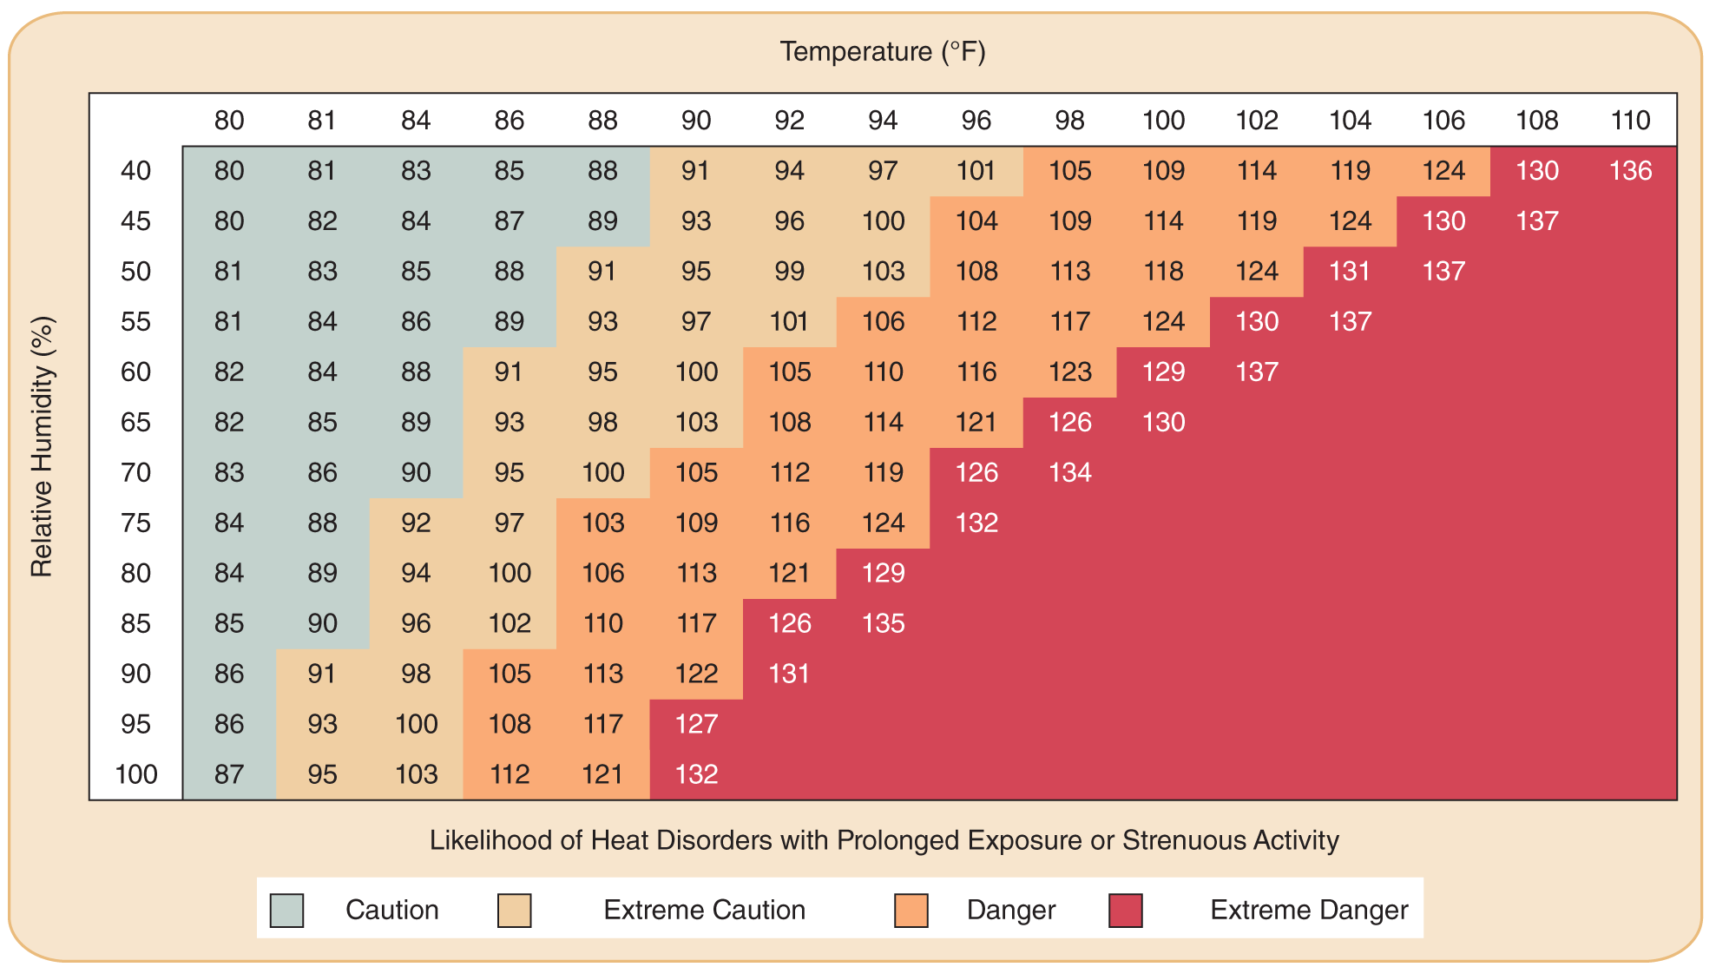
The Heat Index
26-2
The heat index is a measure of the risk for heat illness.
The higher the temperature and the higher the humidity, the greater the risk of heat illness.

Slide 12
Hydration
26-2
Adequate hydration is required for adequate heat loss from sweating.
During exercise in hot environments, up to a liter of sweat can be lost each hour.
Maintaining adequate hydration is essential to preventing heat illness.
Individual must match hydration needs to the level of activity and the temperature of the environment.

Slide 13
Heat-Related Illness Prevention
26-1
Adequate preparation is required to ensure that the body’s heat-regulating mechanisms maintain normal body temperature in hot environments.
Heat acclimatization is the body’s ability to adapt to a hot environment over a period of time.
Improve heat acclimatization before taking a trip to a hot environment by exercising daily in the heat for limited periods of at least 1 hour for at least several days, preferably for 1 week.
If this is not possible before a trip, individuals should then limit periods of exercise during the warmest parts of the day for the first week of the trip.

Slide 14
Heat-Related Illness Prevention
26-1
During periods of exercise lasting several hours or more, salty snacks and adequate water intake are necessary.
Urine that is a light-yellow color is a good indicator of adequate hydration status, whereas darker urine indicates dehydration.
In addition to the physiological mechanisms of heat loss—sweating and blood vessel dilation—behavior is important for maintaining normal body temperature in hot environments.
Wearing loose-fitting, lightweight, sun-blocking, light-colored clothing and a wide-brimmed hat, avoiding exercise during the hottest part of the day, and resting frequently in the shade are all important measures for preventing heat illness.

Slide 15
Common Heat-Related Emergencies

Slide 16
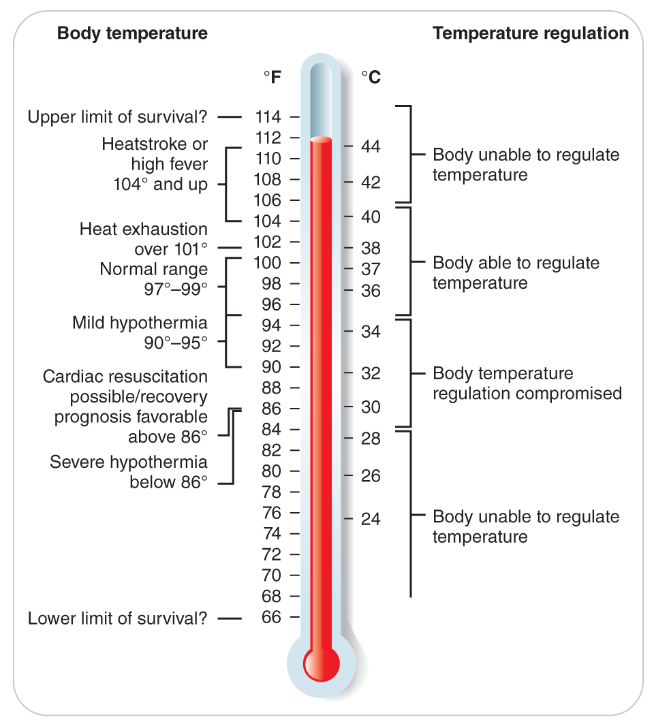
Hyperthermia
Hyperthermia is a heat illness that includes a broad spectrum of injuries caused by exposure to a hot environment and failure of the body’s normal mechanisms for regulating body temperature, electrolyte levels, and body fluid status.
Hyperthermia is characterized by a high core temperature, usually 101°F (38.3°C) or more.

Slide 17
Hyperthermia
Extreme or untreated hyperthermia can rapidly become life threatening.
Newborns, infants, the elderly, and the obese exhibit poor thermoregulation and are at greatest risk for heat illness.
Patients with chronic medical conditions like heart disease, lung disease, and diabetes are at increased risk of heat illness.
Alcohol and drugs, which dehydrate the body or decrease the body’s ability to sweat, make a person more susceptible to heat illnesses.
Illicit drugs such as amphetamines or cocaine and some prescribed medications may cause dehydration or the loss of thermoregulation.

Slide 18
Heat Illnesses
When the body’s mechanisms for transferring heat to the environment are overwhelmed and the body is unable to tolerate the excessive heat, illness from heat exposure can ensue.
Often categorized into four major phases:
Heat-related syncope
Heat cramps
Heat exhaustion
Heatstroke
Heat-related syncope and heat cramps usually precede the more serious conditions of heat exhaustion and heatstroke.

Slide 19
Heat Syncope
26-3
Heat Syncope is a condition that originates primarily in the cardiovascular system.
Clinically defined as a temporary loss of responsiveness or fainting due to a temporary loss of effective blood flow
Occurs when the body is heat stressed and blood is diverted into the peripheral circulation to allow heat to be lost at the body’s surface
Blood does not return from the surface to the heart rapidly enough, which decreases brain perfusion and results in fainting.
Often preceded by feelings of nausea or lightheadedness
May occur without warning while patient is standing

Slide 20
Heat Cramps
Heat cramps occur in large muscle groups after exercise in a hot environment.
Caused by electrolyte disturbances and dehydration
Can be quite painful during the contraction (spasm) of the muscles
Stretching can alleviate the cramp(s), and rest, rehydration, and electrolyte replacement will prevent recurrence.

Slide 21
Heat Exhaustion
26-3
Heat exhaustion is characterized by:
Exhaustion
Dizziness
Nausea
Headache
Leg cramps
Excessive sweating
Decreased urine output
A core body temperature that is greater than 101°F (38.3°C), but less than 104°F (40°C)
A level of responsiveness that is normal

Slide 22
Heat Exhaustion
26-3
When the body loses too much water and too many electrolytes through heavy sweating, the result is dehydration.
As a result of this severe dehydration, the low body fluid volume (hypovolemia) causes the signs and symptoms of Heat Exhaustion.
Body responds rapidly to treatment, and changes in mental status do not persist or worsen.

Slide 23
Heatstroke
26-3
Heatstroke is a life-threatening emergency identified by:
1) A decreased level of responsiveness
2) A core body temperature greater than 104°F (40°C)
Associated with an elevated heart rate, a high respiratory rate, decreased sweating, and eventually a severe drop in blood pressure
The defining characteristic of heatstroke that differentiates it from heat exhaustion is altered mental status.
A decreased level of responsiveness that persists or gets worse, which should prompt immediate treatment and evacuation

Slide 24
Heatstroke
26-3
Heatstroke is the most serious heat illness and can occur from either exposure to heat without exertion (classical heatstroke) or exertion in a hot environment (exertional heatstroke).
The body’s normal mechanisms for shedding excess heat are overwhelmed.
If untreated, shock follows.
It will cause damage to the brain, the heart and blood vessels, the liver, and the kidneys.
If the shock is left untreated, heatstroke results in death.

Slide 25
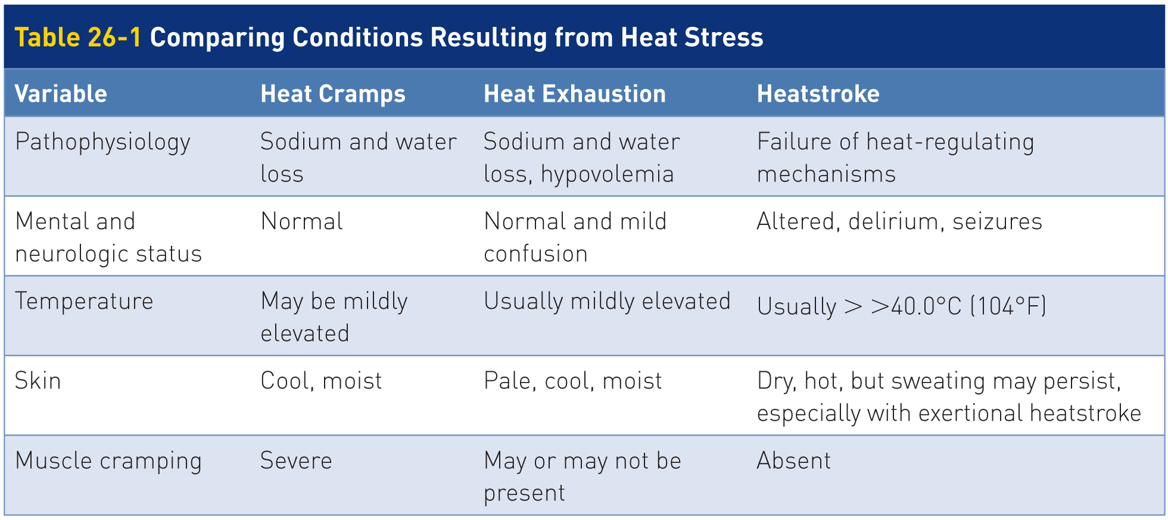
Heat Emergencies: Signs and Symptoms
26-3
Table 26-1 illustrates the signs and symptoms of serious heat emergencies.

Slide 26
Patient Assessment

Slide 27
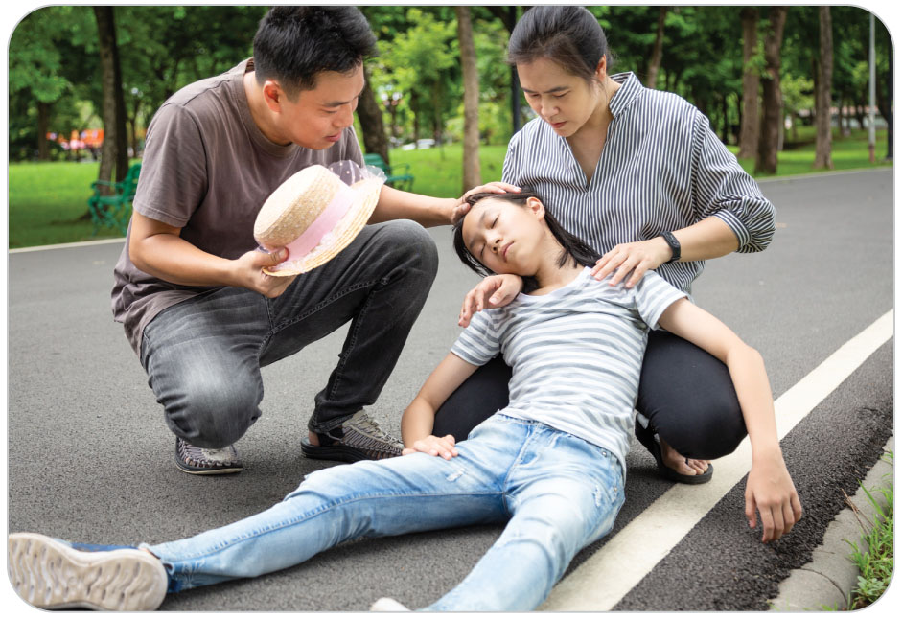
Patient Assessment
For any heat emergency:
Address any threats to life.
Provide adequate protection from direct exposure to the sun for both patients and rescuers.

Slide 28
Patient Assessment: Heat Syncope
26-4
Patients are warm to the touch, may be lightheaded and have tachycardia, and may be hypotensive initially.
Look for traumatic injuries especially significant bleeding resulting from falling after fainting.
Open their airway and simultaneously check for breathing while checking for a carotid pulse.
If there is no pulse or breathing, follow current CPR standards.
If patient has a pulse and is breathing, maintain the airway while conducting the secondary assessment.
Patients receiving prompt care usually rapidly regain responsiveness.

Slide 29
Patient Assessment: Heat Cramps
26-4
Hallmarks of heat cramps are intense, painful muscle spasm and painful cramping in affected extremities.
Abdominal cramping also may occur and can be quite severe.
Most cramps are self-limiting and resolve after a minute or two.

Slide 30
Patient Assessment: Heat Exhaustion
26-4
Depending on the severity of their condition, patients experiencing Heat Exhaustion exhibit a variety of signs and symptoms that include the following:
Weakness
Inability to work or participate in an activity
Headache
Anxiety
Nausea
Faintness, lightheadedness
Decreased appetite
Tachycardia
Normal or slightly elevated body temperature
Warm skin
Sweating (moderate to heavy)

Slide 31
Patient Assessment: Heatstroke
26-4
Heatstroke is a life-threatening emergency characterized by an altered level of consciousness and organ dysfunction.
Signs and symptoms of heat exhaustion but ALSO have significant altered mental status
Can be fatal
Classically, patients have hot, dry, flushed skin because the body’s sweating mechanisms have been exhausted.

Slide 32
Management

Slide 33
Management of Heat-Related Emergencies
Move patients to a cooler location as soon as possible and/or shade patients from direct exposure to the sun.
Nature of further care is based on the cause of the suspected heat-related illness.
If you suspect heatstroke, attend to any threats to life identified in your primary assessment.
Provide appropriate hydration and any needed supportive measures.
If patient’s oxygen saturation is less than 94%, provide oxygen.

Slide 34
Management: Heat Syncope
26-4
Remove the person from the heat source.
Place patient into a supine position with legs elevated 10 to 12 inches, which allows blood to flow to vital organs such as the brain.
Provide supportive measures.
Give cool nonalcoholic liquids.

Slide 35
Management: Heat Cramps
26-4
Heat cramps generally respond favorably to oral electrolyte solutions such as commercial sports beverages.
Sports drinks may need to be diluted to 50% water and 50% sport drink.
Mix 1/4 to 1/2 teaspoon of table salt into a quart of cool water and add some pleasant flavoring.
Consumed slowly to prevent vomiting
Gentle stretching or massage of the cramped muscles is usually beneficial and can provide some relief.

Slide 36
Management: Heat Exhaustion
26-4
Treat heat exhaustion promptly to prevent it from developing into heatstroke by taking the following actions:
Immediately move to a location that provides shade and a cooler temperature.
Place in a position of comfort, usually supine with the legs elevated 10 to 12 inches.
Remove clothing and cool patient by fanning.
Provide patient high-flow oxygen if oxygen saturation is less than 94%.
If patient can swallow, rehydrate patient with cool water, a cool electrolyte-containing solution, or 1/4 to 1/2 teaspoon of table salt added to a quart of cool water.
Never force oral fluids for patients who are not fully responsive.

Slide 37
Management: Heat Exhaustion
26-4
In most cases, these measures will improve patient’s condition rapidly.
Lack of improvement or a worsening of symptoms may be indications of heatstroke.
Because the distinction between heat exhaustion and heatstroke is not always clear, transport to a hospital for further evaluation and treatment any patient for whom any of the following conditions applies:
Symptoms that do not clear up promptly
Decreasing level of responsiveness
Body temperature that remains elevated
Patient is very young, elderly, or has an underlying medical condition such as diabetes or cardiovascular disease

Slide 38
Management: Heatstroke
26-4
Heatstroke is a true emergency that requires immediate attention.
Recovery from heatstroke depends on the duration of the hyperthermia and the speed with which treatment is administered.
Emergency treatment should begin immediately in the field and has one objective: lower patient’s body temperature by any means available.

Slide 39
Management: Heatstroke
26-4
Take the following steps when treating a patient with heatstroke:
Notify EMS as quickly as possible for advanced life support (ALS) transport to a hospital.
Move patient promptly from the hot environment to a cool, shaded environment.
Remove patient’s clothing.

Slide 40
Management: Heatstroke
26-4
Provide supplemental oxygen only if oxygen saturation is less than 94%, and then monitor to ensure it remains between 94-99%.
The most effective cooling mechanisms are convection and evaporation, which are accomplished by keeping exposed skin wet and having a continuous flow of air across the skin.
Conductive cooling can also be effective, particularly if ice packs are applied to areas of high blood flow, such as the armpits and groin.
Immersion of patients in cold water is the most effective treatment but is best done under direct medical supervision.

Slide 41
Management: Heatstroke
26-4
If possible, check patient’s temperature frequently to determine if core body temperature is cooling.
Although a rectal temperature is best, an oral thermometer can be used.
Forehead and tympanic “ear” thermometers are not accurate.
When the body temperature reaches approximately 101°F (38.3°C), taper off the cooling efforts.
Rapid cooling below this point may lead to shivering (which will generate unwanted heat).
Do not give medications such as aspirin, ibuprofen, or acetaminophen.
Rapid evacuation is indicated.
Monitor patients carefully for a rebound increase in body temperature.

Slide 42
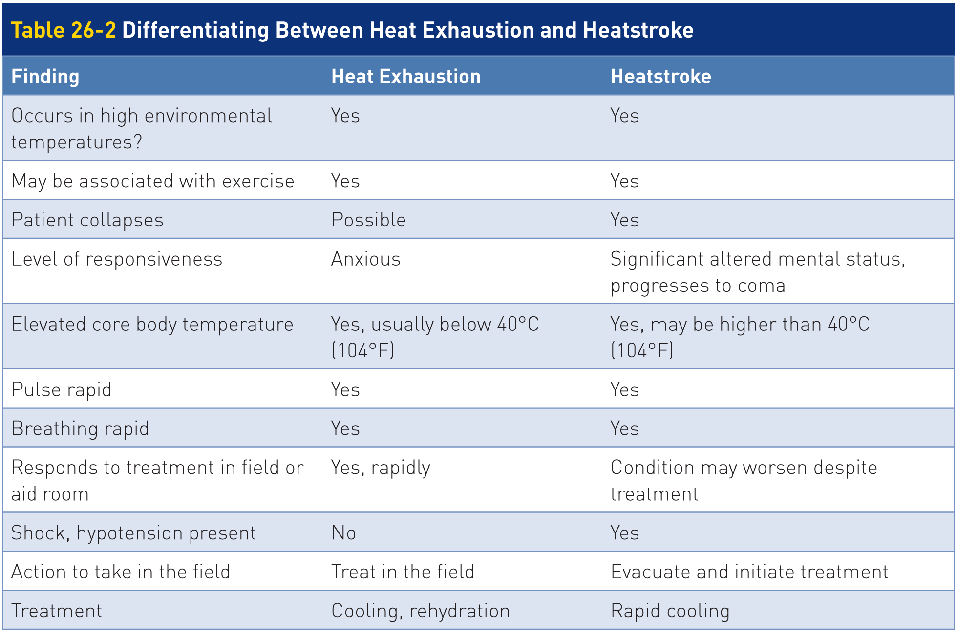
Differentiating Between Heat Exhaustion and Heatstroke
26-4
Table 26-2 lists the criteria that help differentiate between heat exhaustion and heatstroke.

Slide 43
Case Study

Slide 44
CASE PRESENTATION
You are asked to patrol at a summer off-road bicycle race at your resort. The race starts at 10 AM and takes 3 hours. Morning temperatures are tolerable, but midday temperatures reach 90°F. You are stationed near the finish line. As one of the last bikers comes to the finish line, she collapses after getting off her bike. She stands, staggers over to you, and bends over panting. She asks for water and states she is hot and exhausted. Her face is flushed.
What should you do?

Slide 45
CASE UPDATE
You help patient into the shade of the first-aid tent. Vital signs reveal her pulse is 120 beats per minute, her blood pressure is 100/60 mm Hg, and her oral temperature is 39°C (103°F).
What steps do you take now?

Slide 46
CASE OUTCOME
Now that the patient is in the medical tent, you loosen her clothing and have her lie down with her legs elevated about 10 inches. Now her respirations are 20 breaths per minute, and her pulse is 100 beats per minute. She is responding appropriately to questions. She drinks a diluted sports drink containing electrolytes, and once she lies down, she begins to look more comfortable.

Slide 47
CASE OUTCOME
As you spray water on her, you fan her with a piece of cardboard. She continues to rest and sip liquids over the next 30 minutes, her breathing slows, and she becomes more talkative. Her pulse is now 80 beats per minute. Your findings suggest that she was suffering from heat exhaustion. Even though she has improved, the EMS personnel start an IV and recommend she go to the hospital for further evaluation.

