Slide 1
Water-Related Emergencies
CHAPTER 29

Slide 2
The following presentation will utilize two symbols to identify material necessary for an OEC Technician to comprehend:
key term
Meets a Chapter Objective.
This symbol will have the corresponding Objective Number denoted within.
Identifies a Key Term.
The Key Term will be underlined for easy identification.

Slide 3
Objectives
29-1 Define drowning.
29-2 Explain the following water-related emergencies:
Arterial gas embolism (AGE)
Decompression sickness (DCS)
29-3 Discuss spinal injuries in submersion incidents.
29-4 Explain swimmer’s ear, including assessment and care.

Slide 4
Objectives
29-5 Explain how to assess a patient with one of the following water-related emergencies:
Drowning
Descent emergencies
Ascent emergencies
29-6 Describe how to manage a patient who has suffered one of the following water-related emergencies:
Drowning
Descent emergency
Ascent emergency
29-7 List multiple ways in which a water-based emergency may be prevented.

Slide 5
Key Terms
Arterial gas embolism (AGE)
Barotrauma
Decompression sickness (DCS)
Drowning
Laryngospasm
Mammalian diving reflex
Squeeze

Slide 6
Chapter Overview

Slide 7
Chapter Overview
Water-related injuries occur at any time and nearly anywhere.
When people think of a water emergency, the image that usually comes to mind is of someone drowning in a recreational body of water, such as a swimming pool, a lake, or the ocean.

Slide 8
Chapter Overview
Drowning can also occur in a bathtub, a well, or a creek.
Drowning can occur in as little as 2 inches of standing water, in a bucket, or in a puddle like those found in any ski resort’s parking lot.

Slide 9
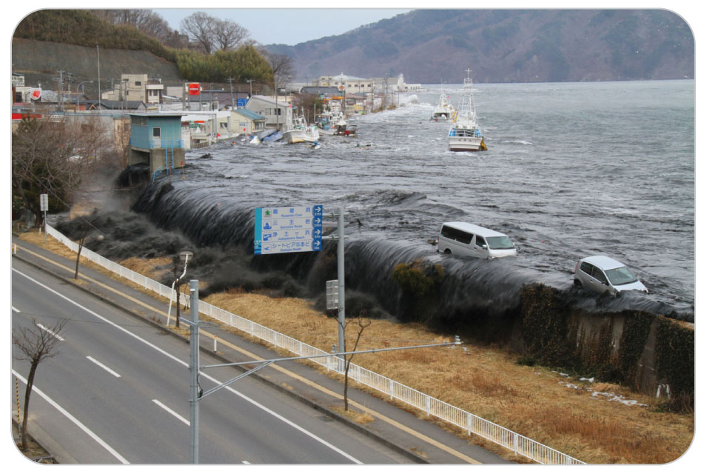
Chapter Overview
According to the Centers for Disease Control and Prevention, an average of 10 people die in the United States from accidental drowning each day.
An estimated 500 drowning victims survive but are injured.
Drowning ranks second only to driving as a cause of accidental death.
Leading cause of death for infants and toddlers

Slide 10
Anatomy and Physiology

Slide 11
Anatomy and Physiology
Water temperature plays a significant role in morbidity and mortality of drowning victims.
The survival rate is slightly higher for cold-water submersions.
When submerged in extremely cold water, the mammalian diving reflex helps to temporarily protect the heart and brain.
Warm blood gets shunt to the heart and brain.
Body metabolic and heart rates slow significantly, reducing oxygen demand and conserving oxygen.

Slide 12
Preventing Water Emergencies

Slide 13
Prevention Recommendations
29-7
Many of the inherent risks associated with water-based activities can be mitigated or prevented altogether by heeding the following recommendations:
Avoid alcohol and other drugs when around water.
Use proper safety equipment, including approved personal flotation devices (PFDs).
Place fencing and self-closing gates around swimming pools.
Never swim alone.

Slide 14
Prevention Recommendations
29-7
Monitor the activities of anyone who is in or near the water.
Never enter swiftly moving water.
Confirm water depth before diving; never dive into water that is not deep enough.
Check the thickness of the ice before traversing it.
Scuba dive conservatively; ascend slowly while breathing normally.
Watch for rip currents.

Slide 15
Common Water Emergencies

Slide 16
Drowning
29-1
Drowning is defined as the process of respiratory impairment caused by submersion or immersion in a liquid.
Suffocation by submersion in water
Drowning typically progresses in the following sequence:
Panic, struggle with breath-holding, and submersion
Gasp, swallowing of water with or without laryngospasm
Hyperventilation, then hypoventilation
Unresponsiveness, then apnea
Relaxation of laryngospasm
Cardiopulmonary arrest

Slide 17
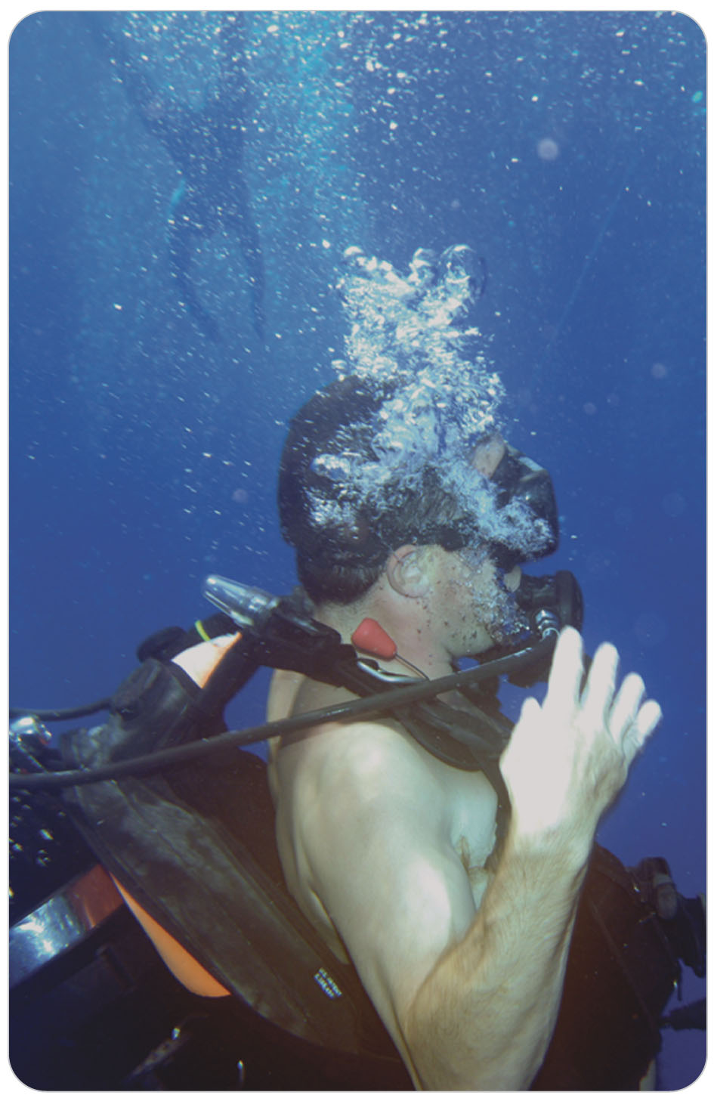
SCUBA Diving Emergency
29-5
SCUBA Injuries are separated into the three phases of the dive:
Descent
Bottom
Ascent

Slide 18
Descent Emergency: Barotrauma
29-5
Barotrauma:
A form of trauma that is caused by the difference in the pressure within air-filled structures of the body and the pressure of the external environment
Such pressure differences result in the expansion or compression of the gas within those body structures.
If the external pressure becomes too low, the unbalanced internal pressure within the structure can cause the structure to rupture.
If the external pressure becomes too high, the internal pressure does not balance it and the organ is compressed.

Slide 19
Descent Emergency: Barotrauma
29-5
There is severe pain as the pressure inside the organ or body cavity cannot adjust to the increased external pressure when diving to a depth.
Resulting pressure is relieved by returning to the surface, thus equalizing the pressure, similar to how your ears “pop” when you rise in an airplane.
Squeeze is a generic term used to describe the effects of too much external pressure on various parts of the body.

Slide 20
Descent Emergency: Barotrauma
29-5
Most commonly manifested in the ears
Can affect the ear if the canal between the middle ear and the nasopharynx (eustachian tube) is obstructed when descending to depth
Obstruction prevents the pressure in the middle ear from increasing to equalize with the pressure outside the eardrum.
This is a more extreme version of the ear pain many people experience during descent in an airplane.

Slide 21
Emergencies at the Bottom
29-5
When scuba diving, the diver breathes air, not oxygen.
Faulty equipment can cause poor mixing of oxygen and carbon dioxide, or other problems with breathing apparatus can cause drowning or problems when one rapidly ascends.
Problems are rare but usually very serious.
Equipment failures occurring during the deepest part of a dive can result in reduction or loss of air delivery to the diver.
Depending on the depth, the diver may not have enough time to surface, even with rapid ascent, before the onset of anoxia and drowning.

Slide 22
Ascent Emergencies: Arterial Gas Embolism
29-5
Arterial gas embolism (AGE):
A serious, often life-threatening, medical problem caused by a rapid ascent during which a diver holds his or her breath and does not breathe (exhale) properly
When this occurs, the gas within the lungs expands too much and the alveoli rupture.
The air from the ruptured portions of the lung then enters the bloodstream, resulting in air emboli.
Air can get into the pleural space or mediastinum (the space in the middle of the chest between the lungs), resulting in a pneumothorax or pneumomediastinum.
Approximately 6% of all diving problems involve AGE.

Slide 23
Ascent Emergencies: Decompression Sickness
29-2
Decompression Sickness (DCS)
Also known as “the bends”
A condition in which nitrogen bubbles develop within the blood vessels, obstructing blood flow
Small bubbles combine, forming larger bubbles within the tissues, causing blood vessel blockage, severe pain, and major complications.
Occurs in scuba divers who stay at depth too long, ascend too rapidly, or do repeated dives without allowing enough time for the body to recover
May also occur if a diver travels to high altitude (by either plane or car) too quickly after diving

Slide 24
Ascent Emergencies: Decompression Sickness
29-2
DCS Signs and Symptoms:
The patient doubles up from joint and abdominal pain.
Presents like air embolism
However, generally air embolism occurs immediately on return to the surface.
DCS may not occur for several hours.

Slide 25
Ascent Emergencies: Decompression Sickness
29-2
To illustrate this process:
Consider a bottle of carbonated soda.
Dissolved within the liquid soda is carbon dioxide, a gas that gives the liquid its characteristic “fizz.”
Once the bottle is opened, however, the pressure within the bottle is rapidly released, causing carbon dioxide bubbles to form.
In a diver who has ascended from a depth, dissolved nitrogen in the blood forms bubbles as the pressure of the water is reduced by ascent.
Bubbles then migrate from the bloodstream into the tissues, causing severe muscle and joint pain.
Sometimes, large nitrogen bubbles can become emboli and block blood flow to critical organs.

Slide 26
Ascent Emergencies: Decompression Sickness
29-2
DCS can be exacerbated by several factors, including, but not limited to:
Insufficient hydration
Increased respiratory rate at depth
Carbon dioxide retention
Colder temperatures
Cigarette and/or alcohol consumption
Exertion during the dive

Slide 27
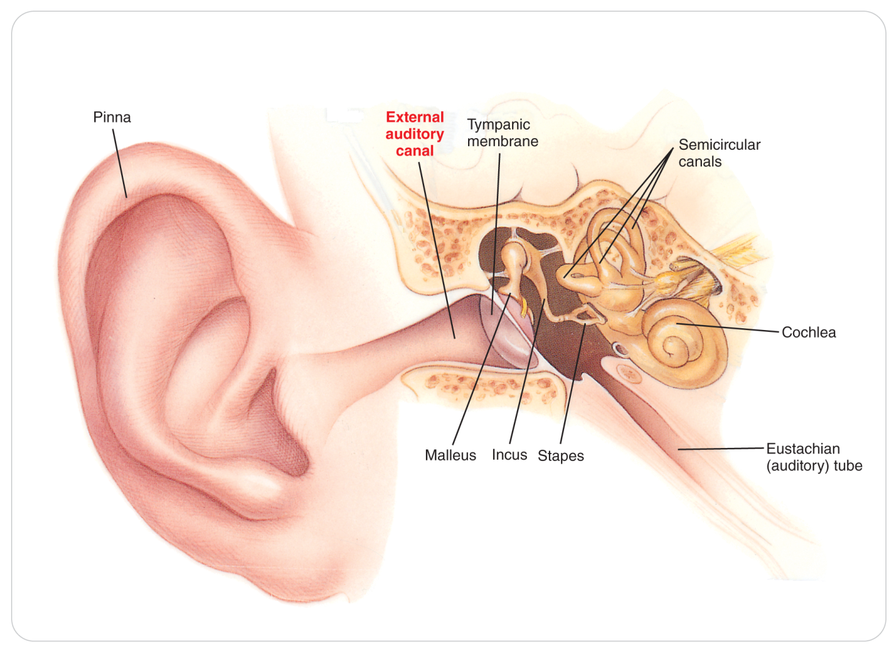
Swimmer’s Ear
29-2
An acute bacterial infection of the external auditory (ear) canal that occurs when the skin of the external canal remains wet for a prolonged period

Slide 28
Swimmer’s Ear
29-2
Patients usually present with:
Severe ear pain
A yellowish discharge from the ear
Tenderness upon pushing on the tragus (the anatomic bump in front of the ear canal)
Those susceptible:
Children and teenagers
Individuals with diabetes and immune system disorders
Preventative treatments:
Mildly acidic or alcohol-based solutions that make the ear canal dry and inhospitable to bacteria

Slide 29
Patient Assessment

Slide 30
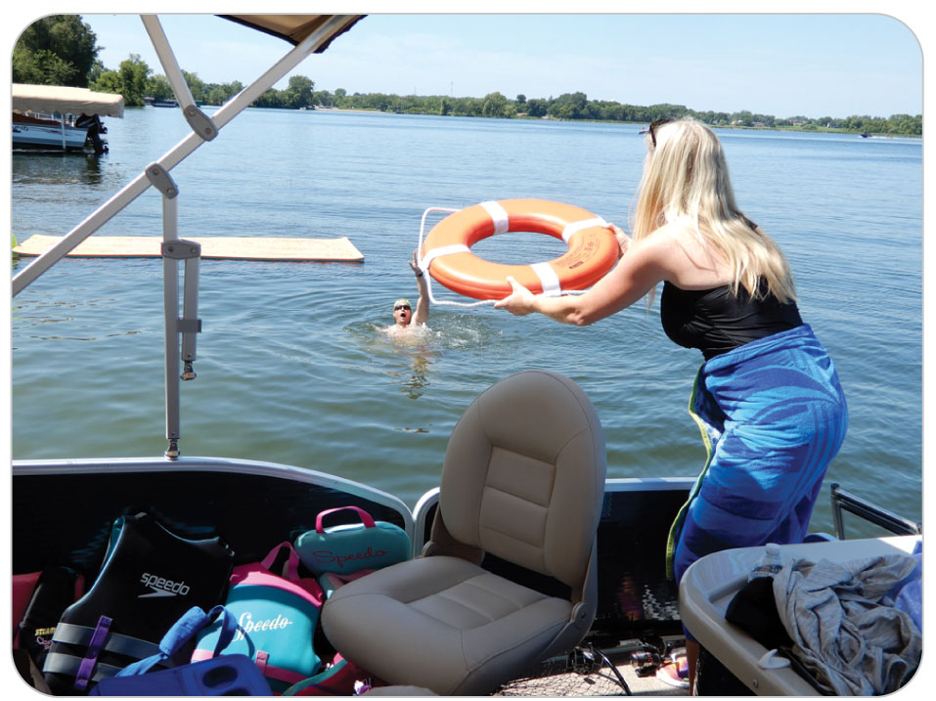
Patient Assessment: Scene Safety
29-5
The assessment of patients with a water-related emergency starts with ensuring the safety of yourself and others.
Safety measures may include putting on a PFD, a helmet, and other safety equipment as the situation requires.
Use standard precautions.
If not trained in water rescue techniques or do not have the proper equipment, wait for the arrival of specialized water rescuers.

Slide 31
Patient Assessment: Primary Survey
29-5
Once the scene is safe:
Quickly assess the patient’s ABCDs (airway, breathing, circulation, and disability).
Correct all potential threats to life, including excessive bleeding before proceeding to a secondary assessment.
Perform CPR if needed.
Remember that patients are not dead until they are warm and dead, especially in cold-water drowning.

Slide 32
Patient Assessment: Spinal Considerations
29-3
29-5
In any submersion injury, if necessary, carefully assess and protect the spine to prevent additional neurologic injury.
Should be initiated before the person is removed from the water
It may be easier to apply a cervical collar and place the patient onto a backboard in shallow water than to perform these procedures after you have removed the person from the water.
Spinal fractures and spinal cord injuries in submersion injuries may complicate the drowning.
Spinal motion restriction may be needed.

Slide 33
Patient Assessment: Spinal Considerations
29-3
29-5
Spine trauma may be present if the following has occurred:
Submersion injury is associated with a diving mishap or fall from a height.
Patient is unresponsive, and there is no witness to the drowning, particularly in the ocean surf.
Weakness, paralysis, or numbness in the arms or legs

Slide 34
Patient Assessment: Secondary Assessment
29-5
Unless the patient has serious or life-threatening injuries, perform a complete secondary assessment using the DCAP-BTLS mnemonic (deformity, contusions, abrasions/avulsions, punctures/penetrations, burns/bleeding/bruises, tenderness, lacerations, swelling).
Additionally, perform a complete neurologic exam on all noncritical patients.

Slide 35
Patient Assessment: Secondary Assessment
29-5
Assess the vital signs, level of responsiveness, skin condition, and capillary refill frequently because each may provide early indications of the presence of a serious underlying injury.
As part of the history, attempt to obtain as much information as possible about what has occurred:
How long the person was submerged
Water temperature and salinity
The person’s appearance immediately after being removed from the water
Determine if the patient has any preexisting medical conditions or is taking any medications.

Slide 36
Patient Assessment: Arterial Gas Emboli
29-2
29-4
Signs and Symptoms of AGE:
Blotching or mottling of the skin
Frothy (sometimes pink) sputum
Severe pain in the muscles, joints, and abdomen
Shortness of breath and/or chest pain
Dizziness, nausea, and vomiting
Cough
Cyanosis
Vision problems
Paralysis or coma
Irregular pulse or cardiac arrest

Slide 37
Patient Assessment: Decompression Sickness
29-2
29-4
Signs and Symptoms of DCS:
Pain, particularly near the joints
Numbness or paresthesia
Headache, lightheadedness
Unexplained fatigue, malaise
Nausea and/or vomiting, or anorexia
Dizziness or vertigo
Muscle weakness and discomfort
Cutaneous, or skin, problems—such as an itch, rash, or mottling

Slide 38
Patient Assessment: Decompression Sickness
29-2
29-4
Signs and Symptoms of DCS (cont’d)
Impaired mental status
Breathing difficulties (“the chokes”)
Impaired coordination
Reduced level of consciousness
Hearing problems, such as hearing sounds that are not there or having a hard time hearing
Swelling
Retention of urine
Compromised cardiovascular function

Slide 39
Patient Assessment: Swimmer’s Ear
29-2
29-4
Signs and Symptoms of Swimmer’s Ear:
Foul-smelling purulent material in ear canal
Pain in the ear
Redness in the external ear canal
Difficulty hearing in that ear

Slide 40
Management

Slide 41
Management: Water-Related Injury
29-3
29-6
The treatment of a patient who has suffered a water-related injury depends on the nature of the injury and the severity of the patient’s symptoms.
Remove all patients from the water as quickly as possible, protecting the spine if needed.
Victims with obvious clinical signs of injury, alcohol intoxication, or a history of diving into shallow water are at a higher risk of spinal cord injury.
OEC technicians may consider spinal motion restriction for these victims.

Slide 42
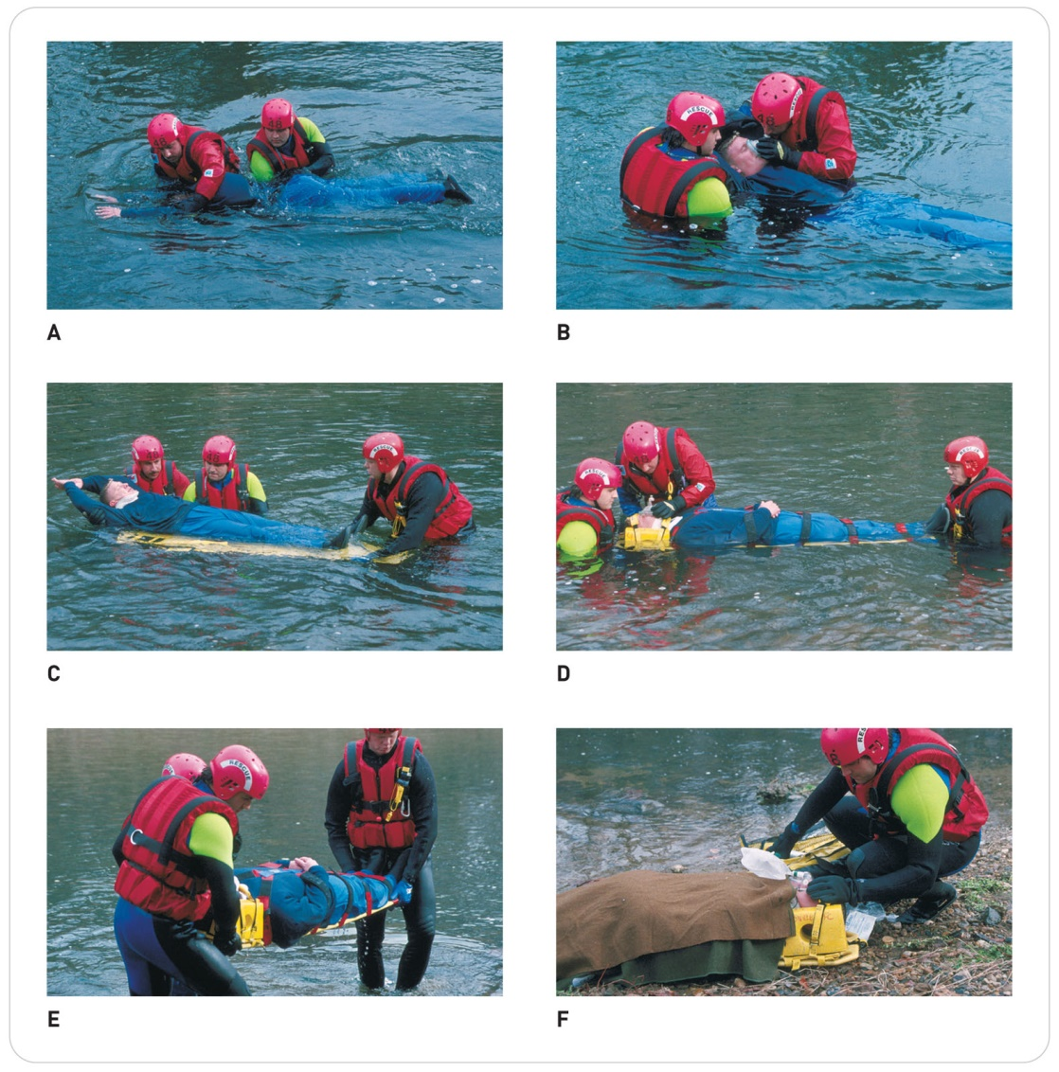
Management: Precautions for Spinal Injury
29-3
29-6
Initiate spinal motion restriction, preferably while the patient is still in the water.

Slide 43
Management: CPR Variations for Submersion Injuries
29-3
29-6
Rescue breaths may be given in the water; however, chest compressions are not practical in the water.
After removal from the water, open the airway and simultaneously check for breathing and a carotid pulse.
If no breathing or pulse, begin CPR, but start the cycle with 2 breaths.

Slide 44
Management: CPR Variations for Submersion Injuries
29-3
29-6
If the patient has a pulse but is not breathing, immediately begin rescue breathing.
There is no evidence that water in the respiratory system acts as an obstructive foreign body, so do not attempt to remove it.
Maneuvers to relieve foreign-body airway obstruction are not recommended for drowning victims because such maneuvers are not necessary and can cause injury, vomiting, aspiration, and delay of CPR.

Slide 45
Management: Transportation
29-3
29-6
Call for advanced medical providers and transportation as soon as possible.
When rescuing a drowning victim of any age, it is reasonable for the lone OEC technician to give 5 cycles of CPR before leaving the victim to activate the EMS system.
All patient who have suffered a submersion injury should be transported to a nearest hospital for further evaluation and treatment, even if they seem to fully recover following appropriate field care.

Slide 46
Management: Transportation to Definitive Care
29-3
29-4
29-6
Patients with suspected Ascent Emergencies (AGE or DCS) require specialized care.
Should be transported by ground to a facility with a hyperbaric chamber
Re-pressurization and the administration of supplemental oxygen are required to treat these disorders definitively.
All patients who appear to be dead after removal from cold water should receive CPR and be transported to the hospital.
Severe bradycardia induced by submersion in cold water can make the person appear pulseless.
These patients can often be successfully resuscitated, even after an extended time under water.

Slide 47
Management: Swimmer’s Ear
29-3
29-4
29-6
Swimmer’s Ear is treated by keeping the external ear and eardrum dry.
Antibiotics are needed when infection occurs.

Slide 48
Case Study

Slide 49
CASE PRESENTATION
You and several friends are at the ski resort’s heated outdoor swimming pool when you hear shouts for help. As you near the scene in street clothes, you come upon bystanders who tell you someone is drowning. You see a teen-aged girl floating facedown in the water just under the diving board. You have someone stop people from using the diving board. There is a cervical collar and spine board nearby. You enter the water and with help quickly remove the girl from the water, protecting her neck. She is unresponsive and cyanotic. You notice that she has a large gash on the top of her head.
What should you do?

Slide 50
CASE UPDATE
You direct one of your friends to call 9-1-1 to get EMS help. The gash on the head and the shallow water suggest a cervical spine injury, so you protect the spine as you assess and correct the ABCDs. Using a jaw thrust, you open the airway, assess the carotid pulse, and look for breaths. She is not breathing. She has a weak carotid pulse, at 60 beats per minute, and her skin is cool to the touch. A cervical collar is applied to the patient’s neck. A bystander says she knows CPR, so she begins rescue breathing with the pocket mask you have with you. You are holding the patient’s neck in alignment.
What should you do now?

Slide 51
CASE OUTCOME
Rescue breathing continues while others dry the patient off and cover her with towels. The head and neck are kept aligned. Within a few minutes, she starts to breathe on her own. Oxygen is provided, and full spinal motion restriction is applied. Vital signs improve. The patient is transferred to a trauma center, where she is diagnosed with a cervical spine fracture. Although her road to recovery will be long, she is expected to regain full neurologic function after spinal surgery.

