Slide 1
Adaptive Athletes
CHAPTER 32

Slide 2
The following presentation will utilize two symbols to identify material necessary for an OEC Technician to comprehend:
key term
Meets a Chapter Objective.
This symbol will have the corresponding Objective Number denoted within.
Identifies a Key Term.
The Key Term will be underlined for easy identification.

Slide 3
Objectives
32-1 Define the following terms:
Disability
Handicap
Impairment
32-2 List two disorders that cause physical disabilities.
32-3 List two disorders that cause intellectual disabilities.
32-4 List two disorders that cause sensory impairment.

Slide 4
Objectives
32-5 Describe and demonstrate how to assess an adaptive athlete.
32-6 Describe and demonstrate how to care for an adaptive athlete who is injured or ill.
32-7 Describe some special considerations that should be followed for extrication, transport, and evacuation of disabled athletes.
32-8 Describe various special equipment that may be used by adaptive athletes to participate in outdoor recreation.

Slide 5
Objectives
32-9 Describe how to effectively communicate with a person who has an intellectual disability.
32-10 Describe three ways to communicate with a deaf person.
32-11 List the signs and symptoms of autonomic dysreflexia.
32-12 Describe and demonstrate how to manage an above-the-knee amputee with a femur fracture of the same leg.
32-13 State the phone number to dial to allow you to talk to a deaf person.

Slide 6
Key Terms
Adaptive athlete
Attention-deficit/hyperactivity disorder (ADHD)
Autonomic dysreflexia
Bi-ski
Bucket
Cochlear implant
Cognitive disabilities
Dyslexia
Expressive aphasia
Four-track adaptive skier
Guide
Mono-ski
Ostomy bag
Outrigger
Paraplegics
Prosthetic
Quadriplegics
Sit-ski
Ski bra
Ski spreader
Ski stander

Slide 7
Chapter Overview

Slide 8
Chapter Overview
Many athletes have an impairment but can participate and compete in sports events.
However, the physical and social barriers these athletes may face while participating in outdoor sports can be profound.

Slide 9
Chapter Overview
Certain factors determine whether an impaired person can participate in a sport.
Active participation usually requires mental ability equivalent to performing activities of daily living.
e.g., dressing oneself, brushing one’s teeth
Passive participation requires less physical and mental ability.
e.g., sitting in a sit-ski
Physical participation depends on the person’s balance, muscle strength, coordination, and neurologic processes.
Impairment of one or more of these functions can make active participation difficult.

Slide 10
Chapter Overview
32-1
A person can have an intellectual impairment, a physical impairment, or both.
Intellectual impairments:
Involve a learning disability, or psychological and personality problems
Inability to see, hear, or become aware of something using the senses makes life more challenging.

Slide 11
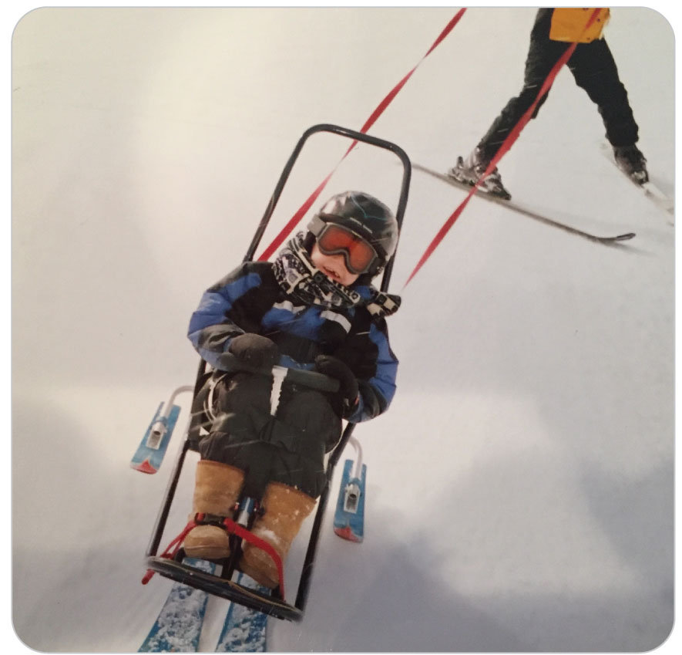
Chapter Overview
Participation in outdoor sports has become more popular for adaptive athletes due to improved access, trained helpers, and innovative equipment.
In 1990, the US Congress passed the Americans with Disabilities Act (ADA).

Slide 12
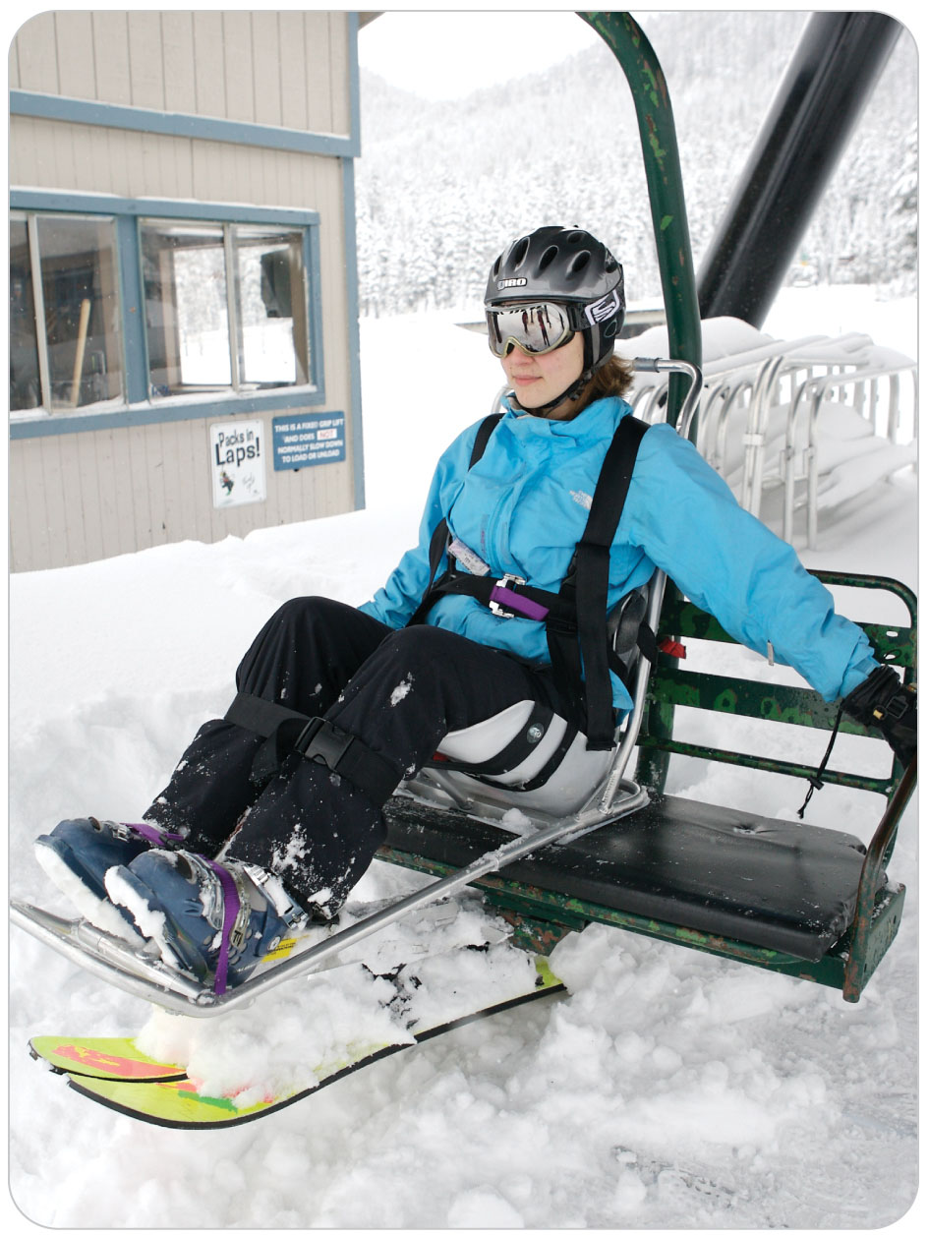
Chapter Overview
Incorporating new materials that are less expensive, stronger, and lighter into adaptive equipment has meant more independence for impaired athletes.
Many young US military veterans with traumatic physical problems and/or brain injuries want to continue to be active in recreational sports.
Outdated thinking regarding recreational opportunities appropriate for athletes with impairments has changed.

Slide 13
Chapter Overview
OEC technicians must be prepared to care for sick or injured adaptive athletes.
Patients with impairments may present unique challenges for assessment and management by OEC technicians.
Specialized equipment may be required to evacuate these athletes from the scene.
A guide, instructor, coach, or companion accompanying a disabled athlete may be required to assist during a rescue.

Slide 14
Chapter Overview
32-1
The terms used to describe a person with a limitation are important.
Impairment
A loss of a specific physical, physiological, or psychological ability
Disability
Any physical or mental condition that prevents a normal function or daily activity
An individual can have an impairment and not have a disability.
Many people with impairments are not disabled from many activities.

Slide 15
Chapter Overview
32-1
A handicap is a condition that markedly restricts a person’s ability to function physically, mentally, or socially.
Individuals with disabilities, whether genetically inherited or acquired through trauma or illness, prefer the term disability to the term handicap.
Adaptive athlete
Describes any individual with an impairment who participates in a sport or an outdoor activity
National Ski Patrol adopted term

Slide 16
Chapter Overview
The following terms are no longer acceptable and should be avoided:
Deaf
Dumb
Mute
Retarded
Crippled
Lame

Slide 17
Impairment Categories

Slide 18
Impairment Categories: Autonomic Dysreflexia
32-2
Autonomic Dysreflexia is an abnormal function of the nervous system that can lead to dangerously high blood pressure.
Potentially life-threatening emergency in a patient with a previous Spinal Cord Injury (SCI) due to a new problem below the level of the preexisting midthoracic or higher SCI
May be triggered by a variety of causes, including:
Pinching of skin
Sunburn
Distended bladder or bowel
Sexual arousal
Constipation

Slide 19
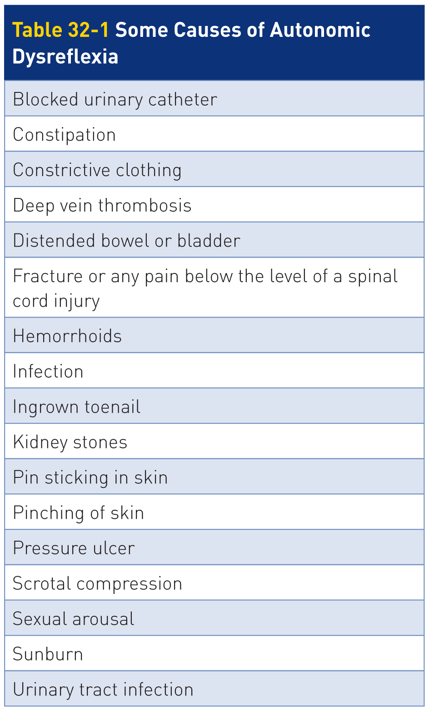
Impairment Categories: Autonomic Dysreflexia
32-2

Slide 20
Impairment Categories: Autonomic Dysreflexia
32-2
32-11
May initially present with feelings of panic or anxiety
Can cause a rapid increase in blood pressure to dangerously high levels
Possibly resulting in a stroke
Seizures and cardiac arrest may also occur.
Symptoms may include:
A pounding headache
Dizziness
Nausea
Altered mental status
Blurry vision

Slide 21
Impairment Categories: Autonomic Dysreflexia
32-2
32-11
32-2
Physical findings:
Skin changes such as sweating or flushing
Dilated pupils
Fluctuations in body temperature
A slow pulse below 60 beats per minute
Severe high blood pressure

Slide 22
Impairment Categories: Autonomic Dysreflexia
32-2
32-11
32-2
Look for a cause and correct it.
Take off tight clothes, unblock the urinary catheter, or look for other irritants.
Have the patient urinate to relieve a full bladder.
When autonomic dysreflexia occurs, have the patient sit up.
Sitting upright helps move blood to the lower body and eases the high blood pressure.
Arrange transport with ALS as soon as possible.
Even if you find the problem and correct it, allowing the patient to regain normal vital signs, you should still transfer the patient for further medical care.

Slide 23
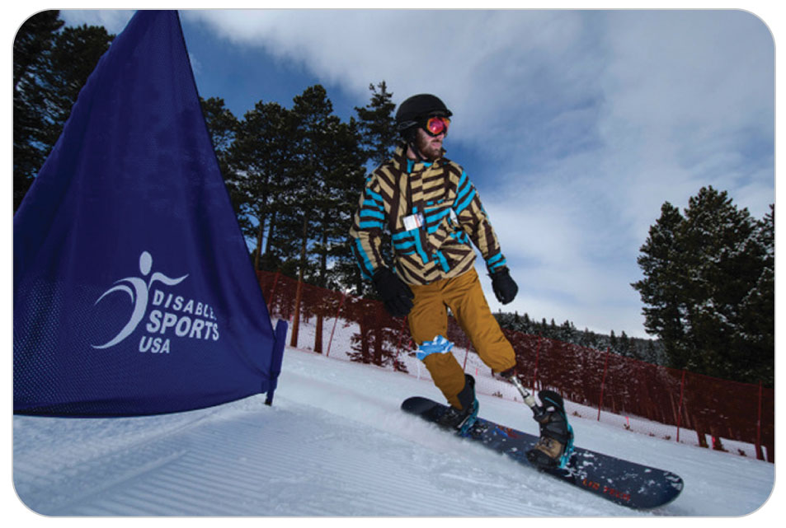
Impairment Categories: Amputations
32-2
Individuals with amputations are one of the largest groups of adaptive athletes.
Can be congenital, traumatic, or surgical in origin
Some people have more than one amputated extremity.
B/K amputation: below-the-knee amputation
A/K amputation: above-the-knee amputation
Relative impairment depends on:
Whether arm or a leg
How much of the extremity was lost

Slide 24
Impairment Categories: Amputations
32-2
People who have a limb missing from birth adapt early in life to the loss of the limb.
These individuals use a wide variety of adaptive equipment and prosthetics to overcome physical impairments.
Prosthetic is defined as an artificial part that substitutes for a missing or impaired body part.

Slide 25
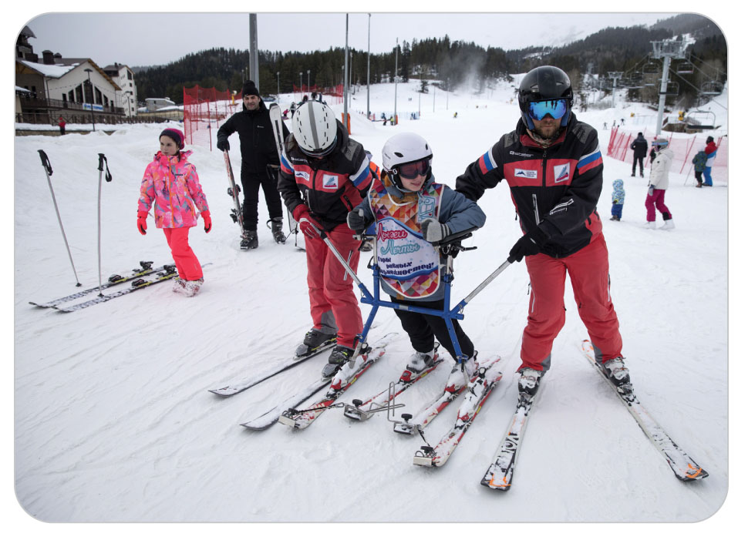
Impairment Categories: Combined Disability
Combined Physical and Intellectual/Cognitive Disability
People who have both physical and intellectual/cognitive impairments are usually a challenge when caring for them.
Use knowledge for both the physical and intellectual impairments.

Slide 26
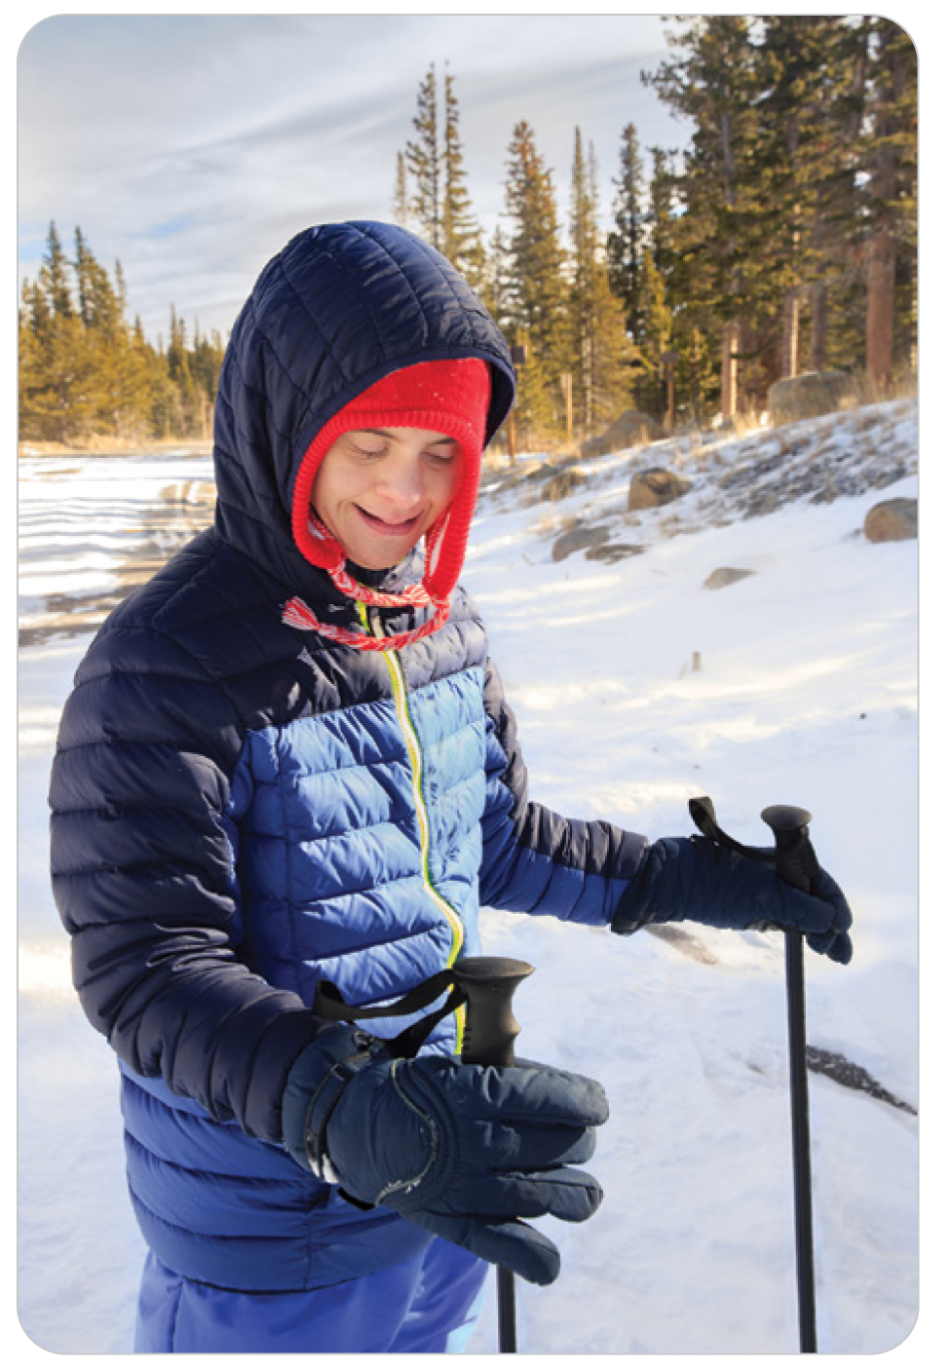
Impairment Categories: Down Syndrome
32-3
Caused by the presence of an extra chromosome.
Results in physical and intellectual disabilities that vary widely from one individual to another.
Degree of intellectual impairment cannot be predicted by:
Characteristic facial features
Short stature
Pleasant nature

Slide 27
Impairment Categories: Down Syndrome
32-3
Adaptive athletes with Down syndrome should be carefully evaluated to avoid dismissing a potentially serious injury.
Increased risk of musculoskeletal injuries due to general hypotonia (an abnormally low level of muscle tone) and lax ligaments.
In the neck, the ligament that stabilizes C1 to C2 can be torn, causing instability of the upper cervical spine.

Slide 28
Impairment Categories: Traumatic Brain Injury
32-3
Usually results from a violent blow to the head or body, an object that penetrates brain tissue, or the brain tissue being deprived of oxygen following trauma, allowing brain cells die
Long-term symptoms of traumatic brain injury can be divided into several categories, including:
Physical changes
Cognitive effects
Sensory effects
Perceptual effects
Social-emotional changes
Combination

Slide 29
Impairment Categories: Sensory Impairment
32-4
Visual or Hearing Impairment
Outdoor enthusiasts who are visually or hearing impaired represent a large percentage of adaptive athletes.
Age of onset and the severity of their impairment will affect the level of their disability.

Slide 30
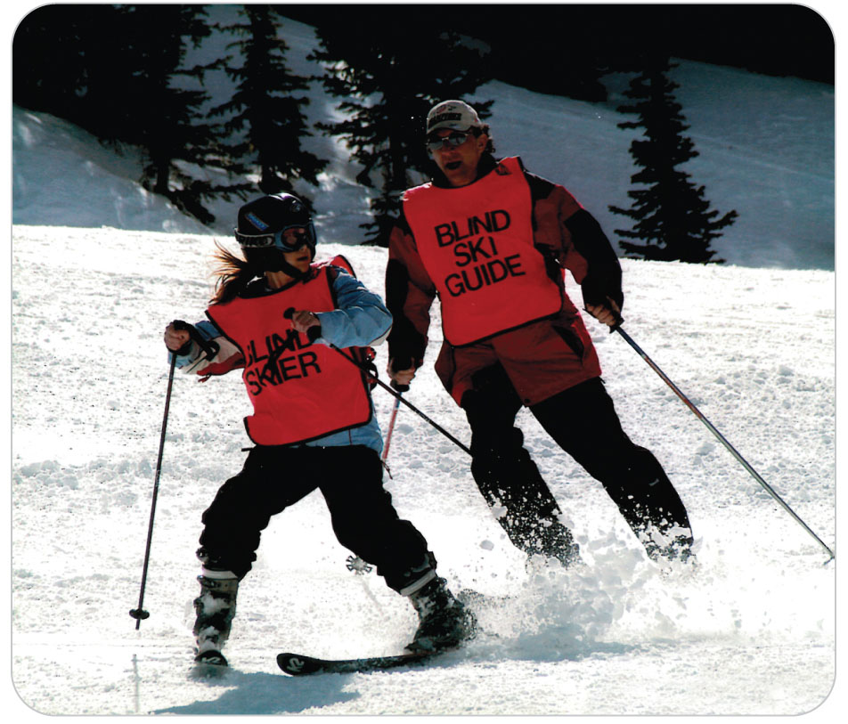
Impairment Categories: Visual Impairment
32-4
Blindness
Seen often on gentle slopes with guides acting as their “eyes.”
Blind skiers in the Para Olympics regularly exceed speeds of 50 mph in downhill racing.
Pattern of injuries seen in blind participants in snow sports is the same as participants with normal vision.

Slide 31
Impairment Categories: Visual Impairment
32-4
Different terms of visually impairment:
Blind: The word blind generally refers to the total absence of vision or to the ability to determine only the existence (not the source) of light.
Visual Impairment: A visual impairment is any vision problem that is severe enough to affect an individual’s ability to carry out the tasks of everyday living.
Low Vision: People are said to have low vision if they have a severe visual impairment even after the best possible correction (with eyeglasses, contact lenses, or surgery) but still have some usable vision.
Legally Blind: People with vision acuity that is worse than 20/200 with glasses or contact lenses are considered “legally blind” in the United States.

Slide 32
Impairment Categories: Visual Impairment
32-4
Visual impairments take many forms and exist in varying degrees.
Visual acuity (sharpness of vision) alone is not a good predictor of a person’s vision problems.
There are levels of visual impairment based on visual field loss (loss of central or peripheral vision).
Person who has no peripheral vision may be able to read with accommodations but not be able to drive.

Slide 33
Impairment Categories: Visual Impairment
32-4
Common causes of blindness in children include congenital cataract, retinopathy of prematurity, vitamin A deficiency, measles, and albinism.
Other causes include uncorrected strabismus (crossed eyes) and uncorrected amblyopia (lazy eye).
Around 60% of children born with vision impairments have other impairments and are classified as multiply disabled.
Older adaptive athletes may be visually impaired due to glaucoma, head or eye injuries, diabetic retinopathy, cataracts, corneal disease, macular degeneration, optic nerve disease, retinal damage, or multiple sclerosis.

Slide 34
Impairment Categories: Hearing Impaired
32-4
Individuals with hearing impairments can generally participate in any outdoor activity without too much difficulty.
Many can read lips, but they must be able to clearly see your mouth.
Most have some speech problems, and many choose not to communicate verbally.
Some deaf individuals use sign language communicating fluently with other users.
Often, an adaptive athlete’s companions will know sign language and assist and act as “translator” for the OEC technician.

Slide 35
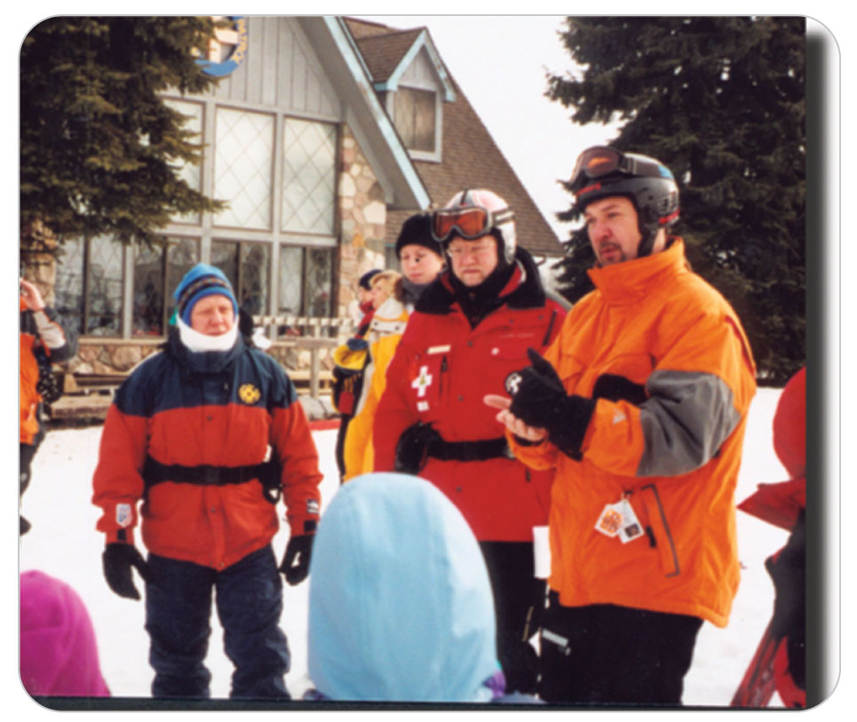
Impairment Categories: Hearing Impaired
32-4
American Sign Language (ASL) and British Sign Language (BSL) are two distinct languages with their own unique alphabets, sounds, and grammar.

Slide 36
Impairment Categories: Hearing Impaired
32-4
People who are hearing impaired may be able to hear some of the speech and sounds around them.
If they can barely hear any sound at all, they are “profoundly” deaf.
Deaf people may be able to hear a few environmental sounds but can’t understand speech, even with assistive technology.
Hearing problems at birth (congenital hearing loss) are rare.
Fewer than 3 out of 1,000 newborns have a moderate or severe hearing problem.
Can be caused by inherited neurologic disorders, premature birth, or birth trauma
Can also develop in childhood following an illness, such as meningitis, tumors, medical reactions, consequences of medications, or repeated or severe middle ear infections

Slide 37
Impairment Categories: Hearing Impaired
32-4
Problems are particularly common in older people due to age or accumulated lifetime environmental noise exposure (loud machinery or rock music).
The use of hearing aids and/or a cochlear implant can assist many hearing-impaired people, although they may not always wear these devices while participating in outdoor sports.

Slide 38
Impairment Categories: Intellectual/Cognitive
Cognitive ability refers to conscious mental activity: thinking, reasoning, or remembering.
They might be:
Learning disorders
Attention-Deficit/Hyperactive Disorder
Dyslexia
Autism
Mental Illness
Post-traumatic Stress Disorder
Cognitive disabilities results from any loss of brain function that limits the ability to process information.

Slide 39
Medical Equipment and Aids

Slide 40
Medical Equipment and Aids
32-8
The medical equipment used by adaptive athletes with physical impairment can be generic or custom.
Many have generic devices such as catheters, collection bags, and special clothes.
Catheter inserted into the urethra or lower abdomen just above the pubic area connected to an outside bag may be used to collect urine
Patients may have an ostomy bag, a clear plastic bag that enables the collection of feces through a surgically created port (stoma) in the abdominal wall.
Urostomy: a surgically created port in the anterior abdomen or near the kidneys that drains the urinary system.
Compression stockings may help with swelling in the legs.
Some athletes have stool and urinary incontinence and wear diapers.

Slide 41
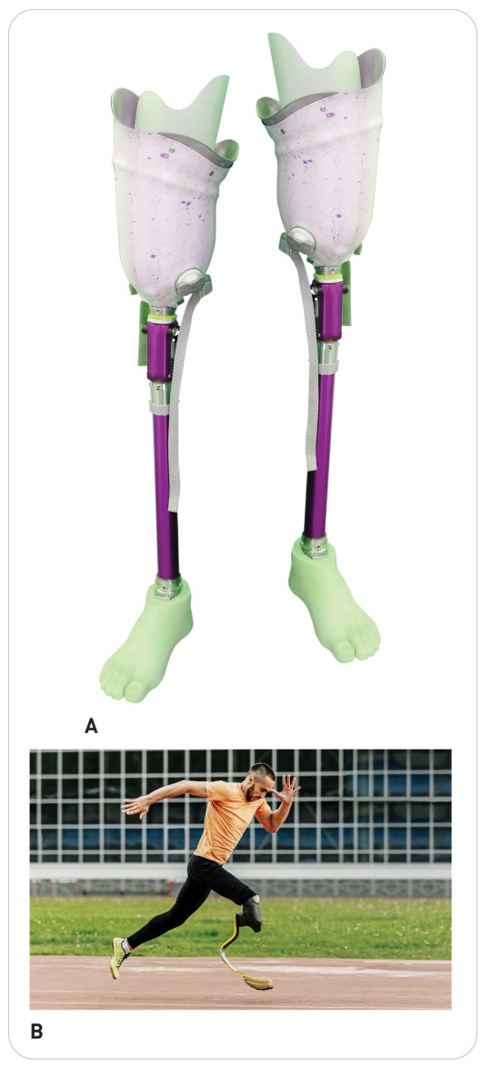
Medical Equipment and Aids: Customized Devices
32-8
Some have custom equipment, from specialized wheelchairs to custom tricycles.
An artificial part that substitutes for a missing or impaired body part is a prosthetic.
Devices can be functional, cosmetic, or both.

Slide 42
Medical Equipment and Aids: Prosthetics
32-8
Prosthetic legs come in many designs.
Only an ankle joint
Both a knee joint and an ankle joint
Depends on where the limb was amputated
Many have electronic components today.
Some prosthetic legs are designed for a specific sport.
Amputee skiers that ski on one leg (with two outriggers) may wear a brace on their “good” leg to decrease the risk of strain and injury.

Slide 43
Medical Equipment and Aids: Prosthetics
32-8
Prosthetic arms have a hook-shaped pinching device that enables objects to be grasped and manipulated.
A strictly cosmetic nonfunctioning hand can replace the hook on some prosthetic arms.
Newer prosthetic arms may have a hand controlled by computer chips that can open and close and look and function very much like a real hand.

Slide 44
Medical Equipment and Aids: Cane
32-8
Some people use a cane while walking, either to help with balance or to partially unload one leg.
By acting as an extension of one arm, a cane aids balance by giving its user a third point of contact with the ground.
A cane can be used on the same side as the affected leg to allow some weight to be transferred from the leg to the cane.

Slide 45
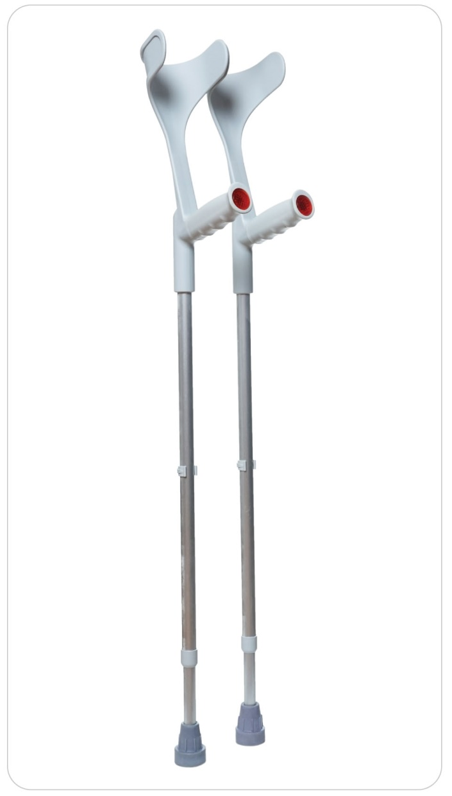
Medical Equipment and Aids: Crutches
32-8
Standard crutches:
Most of the body’s weight is borne by the hands and wrists and transferred through the arms to the shoulders.
Some to the armpits
To use crutches effectively, a person must have good upper body strength.
Most adaptive sport crutches, such as ski outriggers, are modifications of these crutches.
Outriggers aid mostly with balance and some weight transfer.

Slide 46
Medical Equipment and Aids: Wheelchair
32-8
The primary alternative mode of transportation for those who cannot walk is a wheelchair.
May be self-propelled, battery assisted, pushed by another person, or completely powered by an onboard battery/motor system
May allow for movement across severe terrain, up and down stairs, and allow patients to move to a standing position

Slide 47
Medical Equipment and Aids: Wheelchair
32-8
Features:
Many come with removable sides or leg extensions that ease transfers to and from the chair.
Some come with a padded seat, whereas others have a bucket seat to aid upper body posture.
Wheelchairs designed especially for sports are smaller, more lightweight, and have specialized wheels.
Modern wheelchairs fold up for easy transport in a vehicle, except motorized wheelchairs and some specialty sport wheelchairs.

Slide 48
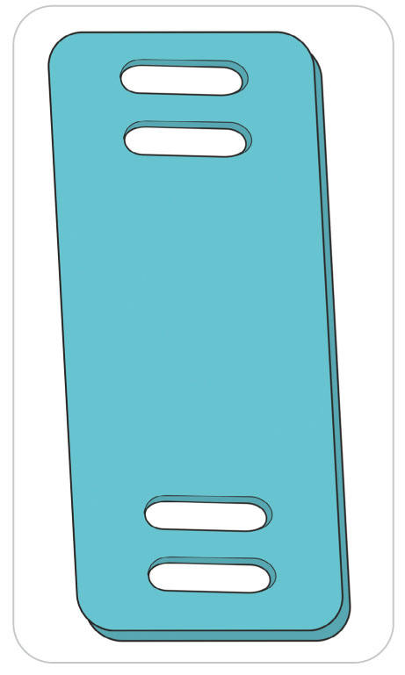
Medical Equipment and Aids: Sliding Board
32-8
Sliding Board:
A smooth, flat board approximately 12 inches wide and 3 feet long
Used to assist the transfer of an individual to and from a wheelchair
Sliding board may be used by the disabled person alone.
Others may use one to slide the person after performing a “total lift” onto the board.
Those with little to no leg muscle function may additionally use a sling device to move leg while sitting.
Use their arms to move the leg to the desired position

Slide 49
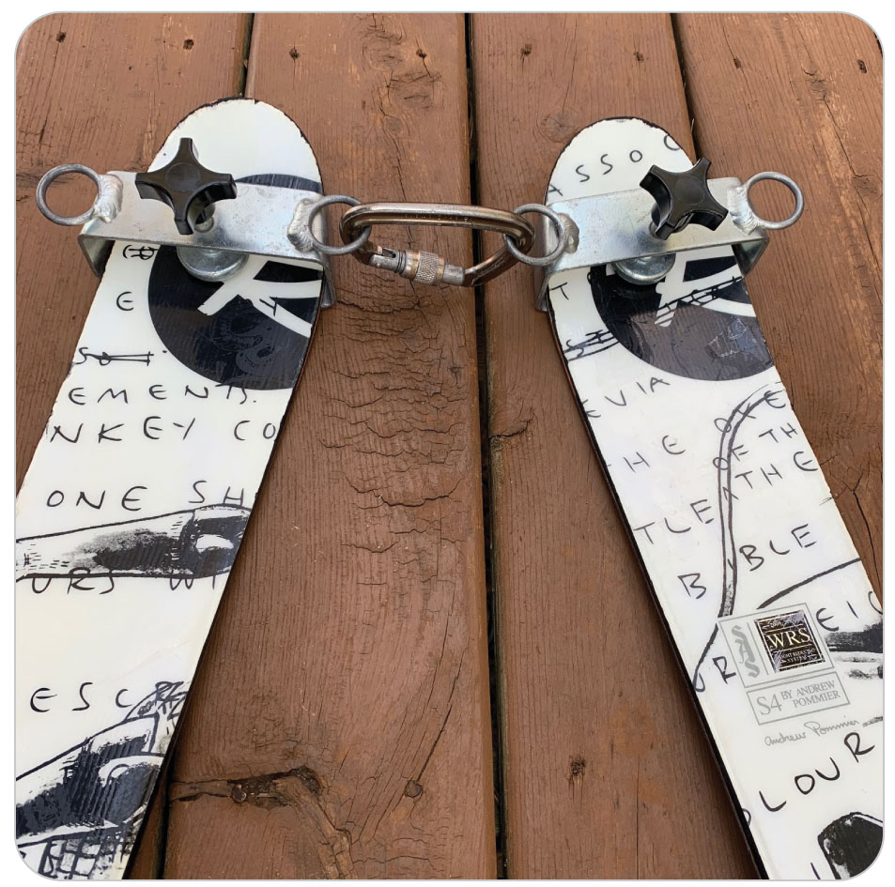
Medical Equipment and Aides: Additional Equipment
Ski-bra
A device that attaches to the front of each ski and holds the skis a fixed distance apart so that the tips do not cross or spread apart

Slide 50
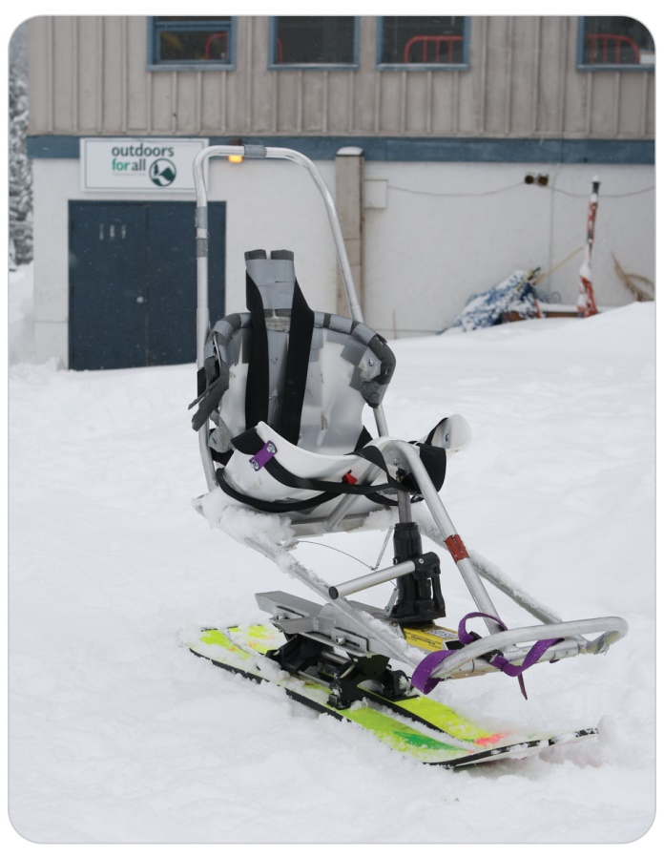
Medical Equipment and Aides: Additional Equipment
Sit-ski
A device consisting of a bucket or seat in which the adaptive skier sits
Has one or two skis attached to the bucket

Slide 51
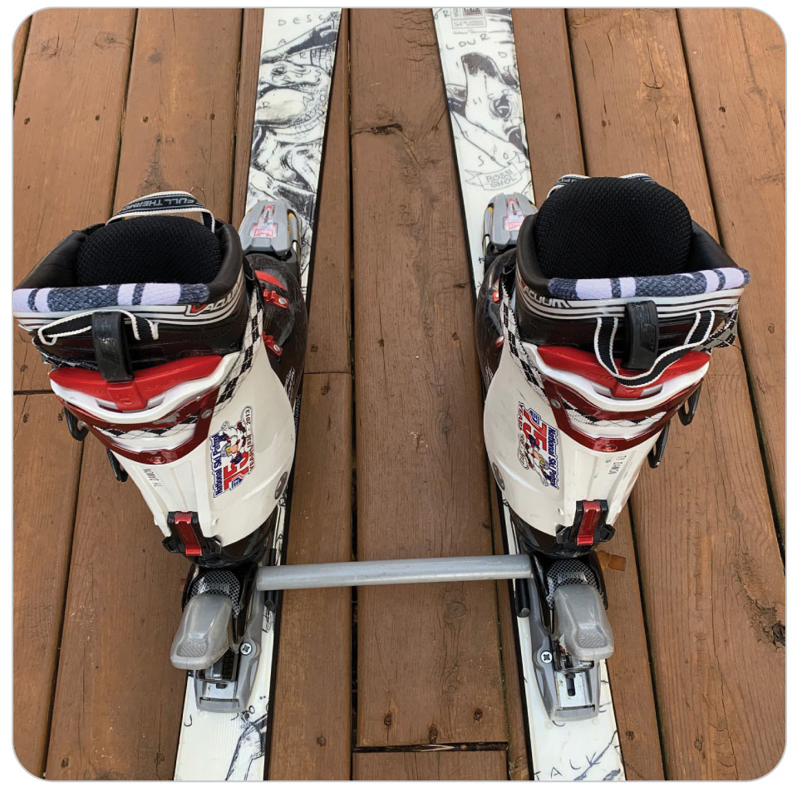
Medical Equipment and Aides: Additional Equipment
Ski spreader
A bar placed under the heels of adaptive skiers to keep the rear of the skis separated and fixed
Often use in conjunction with ski tip tethers to facilitate a stable wedge ski position

Slide 52
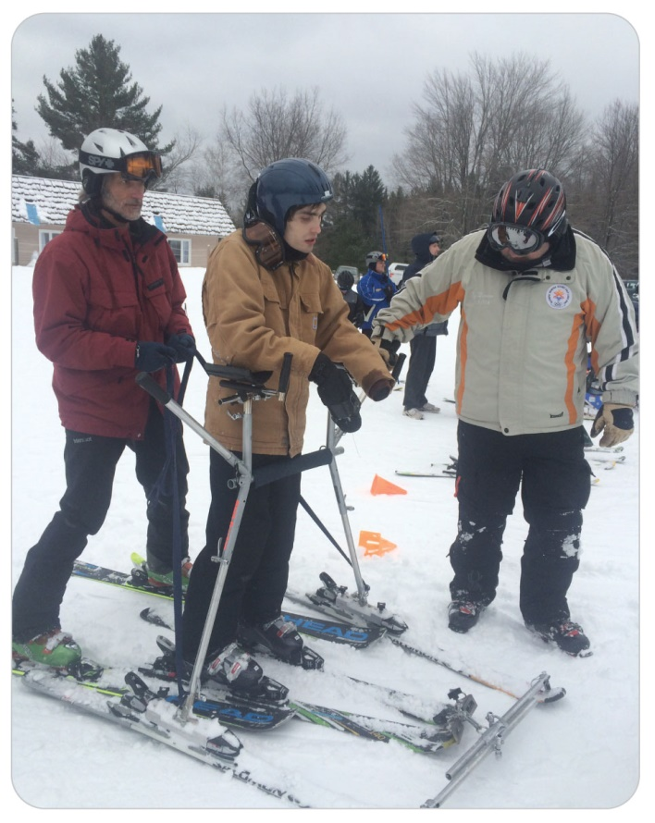
Medical Equipment and Aides: Additional Equipment
Ski stander
A device that attaches to skis and utilizes a waist harness and arm rest to help support the adaptive skier in a standing position

Slide 53
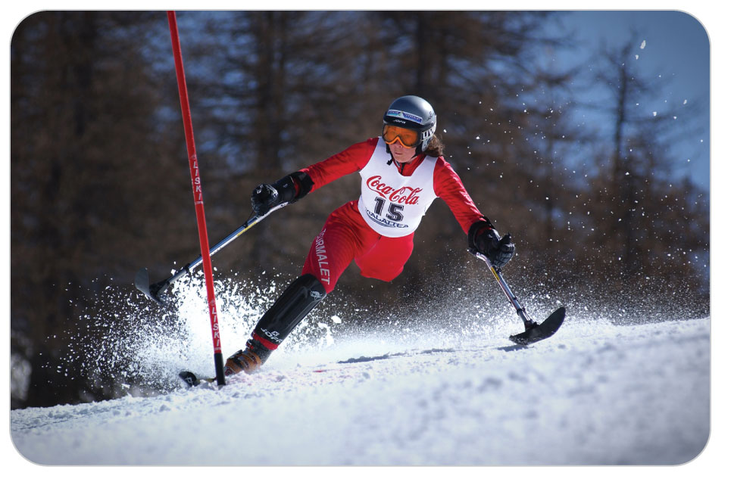
Medical Equipment and Aids: Terminology
32-8
Three-Track Adaptive Skier: uses two outriggers plus one ski or snowboard
Four-Track Adaptive Skier: uses two outriggers plus two skis

Slide 54
Medical Equipment and Aids: Considerations
32-8
The equipment and prosthetic devices adaptive athletes use in all these activities are typically very expensive.
Take special care in handling and transporting the equipment of ill or injured adaptive athletes.
Keep equipment nearby and ensure that it is transported safely with the athlete.

Slide 55
Communication Strategies

Slide 56
Communication Strategies: Physical Impairment
Adaptive athletes with physical impairments generally communicate as any other individual would, but their level of anxiety may be higher.
Good communication provides the basis for understanding and is one of the hallmarks of a highly trained rescuer.
Addressing the patient at an appropriate level for eye contact
Consider sitting or kneeling to speak with a wheelchair or sit-ski athlete.
OEC technicians can gain the confidence of injured or ill adaptive athletes if they ask how they can help, and how best to care for them and their equipment.
Communicate with the patient’s companion, relative, or caregiver because they may have important information that guides your care.

Slide 57
Communication Strategies: Intellectual Disability
32-9
Intellectual disabilities are likely to affect communication.
Always attempt to talk to the adaptive athlete first.
Severe disability: may need to rely on the athlete’s companion to answer history-related questions, provide valuable information regarding assessment findings and to get complete SAMPLE information

Slide 58
Communication Strategies: Intellectual Disability
32-9
Intellectual disabilities may slow an adaptive athlete’s ability to:
Understand or respond to questions
Appreciate the importance of scene safety
Use clear and concise communication.
Use simple, direct, polite sentences.
Present one question, instruction, or statement at a time.
Avoid using phrases that have more than one meaning or include difficult medical words.
Open-ended questions may be too difficult.

Slide 59
Communication Strategies: Intellectual Disability
32-9
Avoid frightening patients by making sudden movements or by speaking in a loud voice.
On-scene stimuli, such as noise from snowmaking equipment, may distract patients.
Direct other rescue team members to manage any distractions in and around the scene.
These adaptive athletes may be extra anxious that your treatment will cause further pain, so be gentle.
Establishing personal space boundaries or understanding the need for a physical exam may be very difficult.
Be honest.

Slide 60
Communication Strategies: Intellectual Disability
32-9
Adaptive athletes with learning disorders or cognitive disabilities may not be able to process questions normally or understand what you are doing without explanation.
Mental illness may cause a personality or behavior change that impairs an adaptive athlete’s ability to follow instructions.
Try to address the patient directly, even if his or her cognitive capacity is diminished.
Gain the person’s respect and attention.

Slide 61
Communication Strategies: Intellectual Disability
32-9
Sit in front of and at the same level as him or her and maintain eye contact.
First demonstrating what you need to do next is a good way to communicate your intentions and may relieve anxiety and build confidence in your care.
Rescuers should expect that some athletes will have unpredictable reactions to treatment.
A patient with an intellectual disability, for example, may panic when wrapped in the weatherproof tarp of a toboggan.
One of the most difficult situations could be strapping an intellectually impaired patient to a spine board during a “load and go.”
Due to a critical injury, the explanation may need to be cut short, creating severe anxiety for the patient.

Slide 62
Communication Strategies: Intellectual Disability
32-9
It may be difficult to establish whether a patient with an intellectual impairment has a preexisting condition versus and new injury.
Example: Is the expressive aphasia (inability to express speech normally) normal for the patient or due to altered mental status as a result of a new injury?
Ask a relative or caretaker.

Slide 63
Communication Strategies: Vision Impaired
With a blind adaptive athlete:
Greet as you would any other person.
Be sure to reassure them that the scene is safe.
Always ask their permission before touching them.
Avoid having multiple rescuers touching them at the same time.
Explain the scene for them:
Who is there: Introduce all patrollers and others who are present at the scene.
What their role is.
What equipment may have been brought to the scene.
Also explain the source of any distracting noises nearby.

Slide 64
Communication Strategies: Vision Impaired
Speak directly to the blind person, not through the person’s guide.
The patient is blind, not deaf, and should not have any trouble understanding you.
When inside:
Verbally close a conversation by announcing if you are leaving the room.
Explain who is in the room.
What their role is
Announce when others arrive or leave the room.
Your voice substitutes for their eyes.

Slide 65
Communication Strategies: Hearing Impaired
32-10
Depending on the severity of hearing loss and age of onset, a hearing-impaired person may not be able to communicate verbally.
Few congenitally profoundly deaf individuals have fully intelligible speech.
Individuals may read lips.
When talking, you should always face the patient directly and remove any clothing covering your mouth.
It is perfectly acceptable to write notes, passing a paper and pencil back and forth.
This is a very good way to obtain SAMPLE information, especially medications.
Another method is to text back and forth on smartphones.
If a companion is present who knows sign language, have the person be a translator.

Slide 66
Communication Strategies: Hearing Impaired
32-13
You may need to talk to a deaf relative of a patient on the phone.
Call 7-1-1 for the Relay System.
Using any phone, you can access this service anytime.
You will talk to an operator, who will type your words for display to the deaf person’s visual receiver on the other end of the call.
The deaf person will type back to the operator, who will give you a voice response.
Relay services also may be available communicating with American Sign Language by Internet video conference software.

Slide 67
Patient Assessment

Slide 68
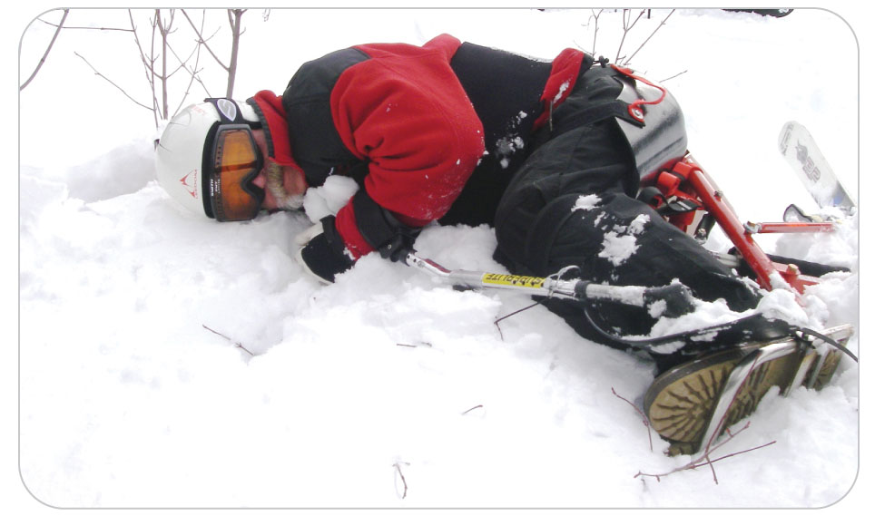
Patient Assessment of Adaptive Athletes
32-5
The evaluation of trauma or illness in adaptive athletes will present OEC technicians with unique challenges.

Slide 69
Patient Assessment: Basic Concepts
32-5
Respect for the patient, patience, and common sense are an OEC technician’s best tools for performing a useful and accurate evaluation.
Physical exam might require modification or special considerations for unique injuries.
Principles of a good assessment, however, apply to all adaptive athletes, whether their disability is physical, intellectual, or sensory.
Always use body substance isolation (BSI), as many adaptive athletes have body fluids in bags attached to their bodies.

Slide 70
Patient Assessment: Primary Assessment
32-5
After the scene is safe, begin with a scene size-up, followed by a primary assessment, and the correction of significant bleeding and ABCD-related problems.
Here, D represents NEW disability problems.
Take particular care to check for medic alert tags.
Always use latex-free disposable gloves and equipment.

Slide 71
Patient Assessment: Introduction
32-5
Start by introducing yourself using your first name.
Speak directly to adaptive athletes, not through their guides or companions, using a clear voice and calm demeanor.
Do not assume that the patient knows your role or can read your name badge.
Ask if you can help.
Quickly reassure patients that the scene is safe and they are there to help them.
Remaining calm is essential.
If the adaptive athlete is unable to provide this information, ask the athlete’s guide or companion how you can help.
Consider the level of stress that injured or ill adaptive athletes are experiencing.
Pain from an injury or anxiety caused by being separated from a companion or guide may reduce their ability to communicate with you.

Slide 72
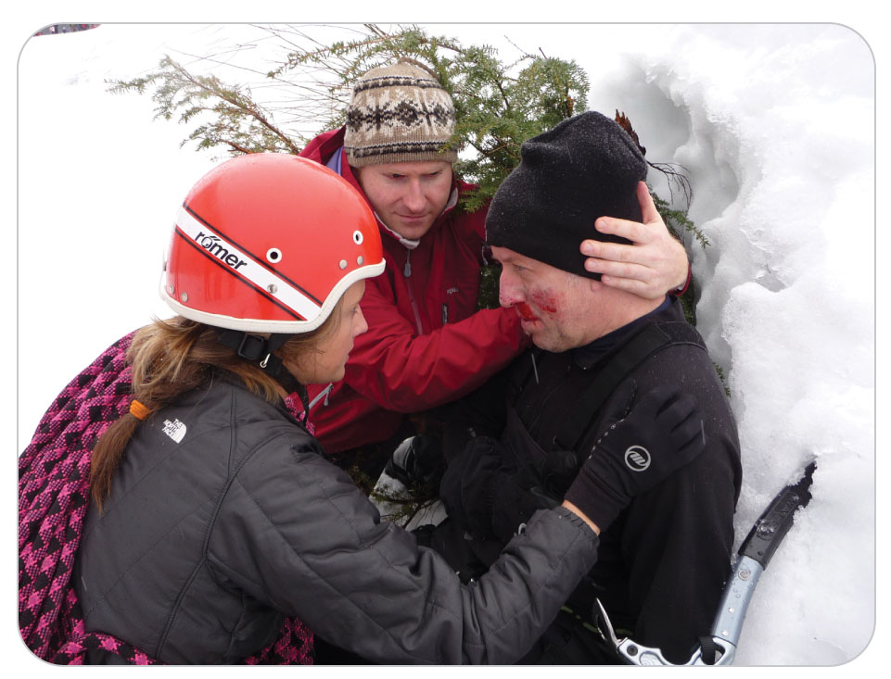
Patient Assessment
32-5
Be an especially good listener.
Use the responses of the adaptive athlete and the companion to guide your assessment and management.
Refer to the person by name, not by condition.
Do not say, “Please take vitals on the paralyzed man.”
Appreciate that you may not be familiar with the impairments or the equipment.
Be willing to ask the patient and companions about their condition and equipment.
Usually, they will be happy to help you.

Slide 73
Patient Assessment
32-5
Calling for additional assistance when starting an encounter with an adaptive athlete is often indicated.
Rescuer may need additional help with crowd or traffic control, a patient’s equipment, or lifting in preparation for transport.
Calling ahead alerts the aid room staff that a patient with special needs is en route and may allow time for notification of chaperones, staff interpreters, or family members who can assist in caring for the adaptive athlete.

Slide 74
Patient Assessment: Secondary Assessment
32-5
Obtain a medical history using SAMPLE and OPQRST if available.
Ask the patient’s guide or companion for information such as the individual’s “baseline” mental status and ability to communicate.
New headache or a change in responsiveness should alert a rescuer to the possibilities of a closed head injury or the development of autonomic dysreflexia.
Some adaptive athletes take multiple medications, and medical conditions such as seizure disorders are associated with certain physical disabilities.

Slide 75
Patient Assessment: Physical Exam
32-5
Perform a complete physical exam using DCAP-BTLS.
Be sure to explain in detail what you are doing.
Abnormal blood pressure, muscle wasting, spasticity, loose joints, and skeletal deformities may be preexisting.
Patients may:
Have decreased sensitivity or no pain at injury sight
Not realize they have a broken bone
Have thermoregulation problems so watch for hypothermia, frostbite, and poor circulation in limbs

Slide 76
Patient Assessment: Physical Exam
32-5
Neuromuscular irregularities such as hypertonia (an abnormally high level of muscle tone), hypotonia, and rigidity can facilitate injury.
Sit-skiers’ legs may be partially protected within the ski frame in a fall or collision, but lower extremity injuries can happen due to the osteoporotic nature of their leg bones.
Osteoporosis is a condition where bones can weaken, in this case by lack of exercise.
A thorough physical exam is a crucial part of the assessment, but it should not outweigh the risks of prolonging the patient’s exposure to cold or hot temperatures when outside.
Obtain a complete set of vital signs, repeating at regular intervals as needed.

Slide 77
Patient Assessment: Injury Involving Equipment
32-5
The MOI may involve the patient’s adaptive equipment:
Three-track skiing puts all the force and weight on the skier’s one good leg
Be sure to check for knee injuries.
Falls while using tall outriggers or sit-skis and short outriggers tend to cause more injuries to the upper extremities of sit-skiers.
Extremities can also be injured at the site of amputation by the pressure and twisting of a prosthetic limb.

Slide 78
Patient Assessment: Injury Involving Prosthesis
32-5
If there is pain or swelling at the site where the prosthesis attaches, check for trauma.
Unless there is bleeding, wait to remove prostheses.
Only remove in the aid room, and never without asking permission.
Treat these carefully as they are custom made and very expensive.
If they become removed by a fall, they should be transported (usually in the toboggan) with the patient.

Slide 79
Patient Assessment: Ostomy Equipment
32-5
Ostomy bags and tubing should be examined for damage or associated bleeding from the stoma site.
The adhesive tape securing the bag to the stoma site can be pulled loose.
Tubing can become blocked during extrication or when packaging the patient for transport.
Do not put pressure on an ostomy or bladder bag while securing the patient on a litter or in the toboggan.
Always observe standard precautions when inspecting or handling a collection bag or inspecting an ostomy site.

Slide 80
Patient Assessment
32-5
Abnormal communication, emotions, and movements may be part of the patient’s preexisting condition.
Ask the patient’s caregivers or companions what is considered “normal” functioning for the athlete.
If not available, assume that any deficit in mental status could be the result of a new injury or illness, or that an established intellectual disability may mask an emergent condition.

Slide 81
Patient Assessment: Down Syndrome
32-5
Treating Down syndrome athletes can be deceiving.
May have a serious injury that could be overlooked
Typical Manner:
Calm, easy-going
Tend to minimize pain or complaints
Associated Physiological Abnormalities:
Loose ligaments in the upper cervical spine
Joint instability
Thorough physical exam is important.

Slide 82
Patient Assessment: Autism Spectrum Disorder
32-5
Adaptive athletes with Autism Spectrum Disorder also tend to minimize complaints of pain.
Because ASD is a disability of communication, these patients may appear to ignore questions or repeat what you have said.
May avoid eye contact or attempt to move away from you
Using simple, concrete phrases can help direct the assessment.

Slide 83
Management

Slide 84
Management
32-6
Most medical or trauma problems are treated the same as other patients.
Splinting may require adaptation, and certain preexisting problems may need to be addressed.
If time permits, it may be necessary to demonstrate how to put a splint on another patroller before putting it on the patient.
When managing adaptive athletes’ injuries, how you communicate with the patient is key.

Slide 85
Management: Modified Splinting
32-6
32-12
32-6
Stabilization of injuries in amputees often means splinting in a position of comfort.
Modify splints and strapping if needed, but never force an injured extremity into a rigid splint.
Examples of modified splinting techniques based on impairment:
Using traction for a midshaft femur fracture in a below-the-knee amputee is not practical in outdoor environments.
Immobilize this fracture above and below the fracture, using a quick splint.
Use extra padding to avoid pressure on areas without sensation, whether those areas are close to the injury or not.
For patients with muscle spasticity as in Cerebral Palsy, traction splints used for a femur fracture may aggravate muscle spasticity, so use a quick splint or other immobilization technique if necessary.

Slide 86
Management: Spinal Cord Injury Patients
32-6
32-13
32-6
Paraplegics: no use of their legs
Quadriplegics: lost function in all four extremities
In patients with preexisting spinal cord problems, be alert for potential causes of autonomic dysreflexia.
A true medical emergency
Simply unblocking an obstructed catheter or loosening restrictive clothing may prevent or relieve autonomic dysreflexia.
An injury below the level of the previous spinal cord problem may cause autonomic dysreflexia.
Spinal Cord Injury (SCI) patients can assist you in determining the cause.
Patients can tell you their normal blood pressure and pulse rate.
Normal systolic blood pressure levels in SCI patients typically range from 90 to 110 mm Hg at rest.

Slide 87
Management
32-6
Many syndromes or traumas causing cognitive impairment may also include other neurologic conditions.
Be prepared to treat for seizures if necessary.
Disabilities from stroke or traumatic brain injury often cause specific motor and/or sensory deficits.
Signs such as muscle wasting (the weakening, shrinking, or loss of muscle mass) or flexor tendon contractures (which can cause permanent contortion of a joint or limb) may be evident in patients with preexisting brain injuries.
Can make assessment and immobilization more difficult

Slide 88
Management: Removing Specialized Equipment
32-6
32-7
Getting a physically disabled athlete out of their specialized equipment and caring for the injury requires gentle care, planning, coordination, common sense, a lot of help, and ingenuity.
Evaluate the situation and do what is easiest and safest for the patient.
Injured adaptive skiers need to have their adaptive equipment removed.
Never attempt to assist an injured patient down the hill in the patient’s sit-ski or ski stander.
Never keep injured patient in their sit-ski when placing them into a toboggan or on a litter.

Slide 89
Management: Removing Specialized Equipment
32-6
32-7
Ask the adaptive athlete and/or their guide how the various buckles and straps on their equipment operate.
Will take several patrollers to extricate a skier from a sit-ski for loading into a toboggan or litter, so the OEC technician should plan accordingly.
When removing a sit-skier from their sit-ski, make sure that all straps have been loosened.
The same principles apply to other adaptive equipment such as a bucket seat tricycle.

Slide 90
Management and Transport
32-6
Sit-skiers with a Spinal Cord Injury (SCI), spina bifida, or other neurologic disorders may have a high pain tolerance.
Also, serious injuries may be below the level of the spinal cord problem.
A thorough patient assessment is mandatory before moving these patients.
Based on the MOI, be sure to check for deformities, swelling, or bleeding before moving.
Osteoporosis in these patients can sometimes lead to fractures and dislocations from relatively minor falls or collisions.

Slide 91
Transport: Equipment
32-6
32-7
Be sure to fully support these patients when transferring.
Will need extra patrollers to help move since some may be stiff, floppy, and/or “dead weight”
Adaptive equipment and prosthetic limbs often cost thousands of dollars.
Needs to be transported along with the patient to the aid room
During “clean-up” of a rescue, make sure all items are accounted for.
Reassure adaptive athletes.
For injured adaptive athletes, make their equipment, such as a wheelchair, available to them when they leave an aid station or clinic.

Slide 92
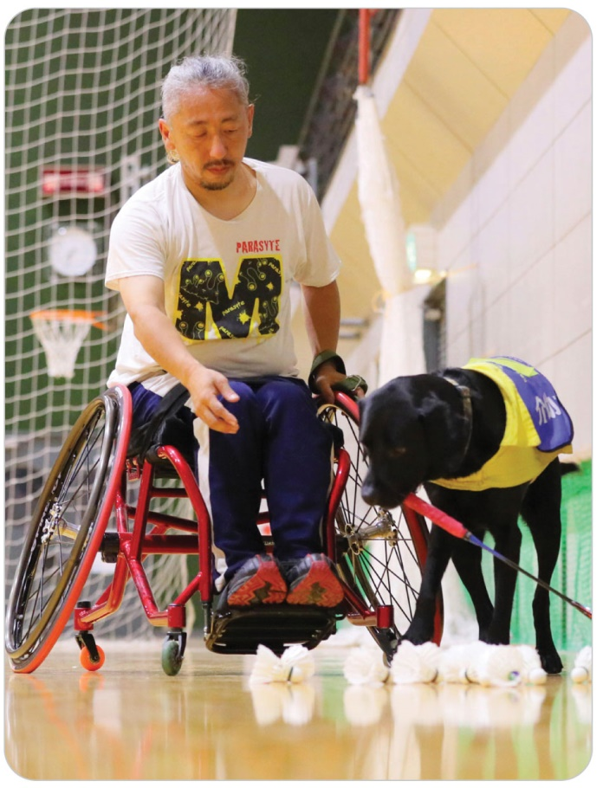
Management: Service Animals
32-6
Adaptive athletes may be accompanied by service animals, especially at base areas.
Maintain the normal relationship between injured adaptive athletes and their service animals, including proximity.
A service dog is not a pet.
Make sure the animals are not petted or distracted by bystanders in the aid room.

Slide 93
Transport: Cognitively Impaired
32-6
32-7
When lifting, transferring, or transporting a cognitively impaired adaptive athlete, be sure to show them in advance the steps that will be taken and the equipment that will be used.
Explain the role of all the assisting persons.
Explain the procedure.
Explain the need for the restraints to safely secure them in the toboggan for transport.
Demonstrate how restraints will work in advance.

Slide 94
Transport: Visually and Hearing Impaired
32-6
32-7
Transporting a Visually Impaired patient:
Explain in advance the process of loading and transporting in the toboggan.
Communicate clearly.
Explain to them the scene, the persons who are there assisting, and the procedure to be followed.
Speak directly to them and not through their guide.
If a blind person is mobile and needs to be guided while walking, offer your upper arm to hold on to and walk to the side.
Come to a complete stop before steps, curbs, and other such objects.
When lifting, transferring, or transporting a Hearing Impaired adaptive athlete, be sure to show them in advance what you are going to do and the equipment that will be used.

Slide 95
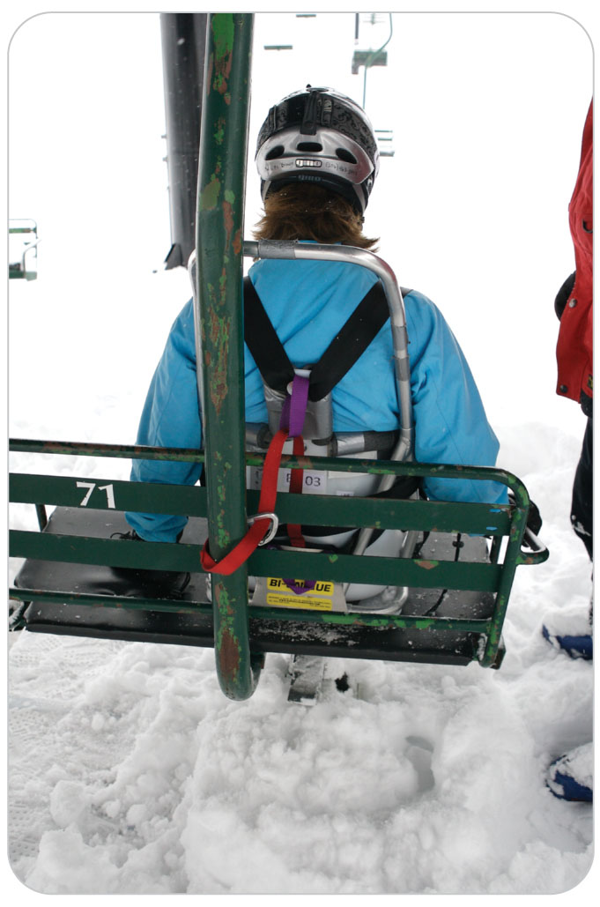
Management: Lift Evacuation
32-7
Every time an adaptive athlete in a sit-ski gets onto a chairlift, a safety strap should be attached to the back of the chair.
The strap is necessary because the safety bar may not fully close due to the size of the seat or the sit-ski’s bucket.

Slide 96
Management: Lift Evacuation
32-7
Adaptive athletes should always be given priority when evacuating chairlifts.
Athletes with mobility problems have an increased risk of cold exposure injuries.
Athletes with intellectual disabilities may have difficulty tolerating chairlift evacuation delays.
Evacuating early is standard practice.
Sit-skis typically have factory-built attachments to an evacuation line.

Slide 97
Management: Lift Evacuation
32-7
Before riding a lift, adaptive athletes should:
Inspect all webbing on their bi-ski or mono-ski to be sure it is in operating condition.
Know how the straps on their ski are designed to operate.
Carry a properly rated locking carabiner, to be used to secure their evacuation straps to the area’s evacuation equipment.
Evacuation straps are generally placed between the person’s legs and on either side of the bucket.
Each ski area must develop its own plan for evacuating skiers from all nonsurface ski lifts.

Slide 98
Management: Lift Evacuation
32-7
Blind athletes or those who have cognitive impairments will need additional oral coaching and reassurance during an evacuation, even if they have a guide with them in the same chair.
The evacuation process may be difficult to understand and could cause anxiety.
It is important to clearly demonstrate all the steps to be taken.

Slide 99
Management: Lift Evacuation
32-7
Always evacuate a cognitively impaired skier or rider before the person’s companion.
Have someone remain with the adaptive athlete and talk so that they can feel safe until their companion is evacuated.
If three or more individuals are on the lift, it may be helpful to evacuate one of them first so that the cognitively impaired athlete can witness the procedure.

Slide 100
Management: Lift Evacuation
32-7
Hearing Impaired skiers and snowboarders may not be able to hear verbal directions.
May be skiing or riding with a hearing friend, who can act as a translator
You could communicate with the adaptive athlete with a cell phone using text on your phone.
Clearly visually demonstrate how the evacuation will work.
If three or more people are on the lift, let another off the lift first to demonstrate the process.

Slide 101
Case Study

Slide 102
CASE PRESENTATION
You are stationed at your ski resort’s recreational racecourse during a special event for disabled athletes when an adult coach calls you to her group. As you approach, you notice an adaptive competitor using skis and outriggers (a four-track adaptive skier) sitting on the snow, wearing a helmet. Before reaching the skier, you talk with the coach. The coach explains that the 14-year-old girl has cerebral palsy and has not been acting normally since she finished racing about 10 minutes ago. The coach explains the athlete is usually much more interactive, and even though the skier just negotiated the racecourse without mishap, she had “a few falls” earlier that day.
Kneeling next to the girl, you begin your visual assessment and address her at eye level.
She stares off in one direction, not making eye contact with you. She does not respond to your questions and is unable to follow verbal instructions. The coach repeats, “This is not her normal personality.” Concerned that the patient’s mental status has changed, you radio dispatch for equipment and assistance.
What should you do while you are waiting for assistance?

Slide 103
CASE UPDATE
The adaptive athlete remains sitting on the snow as you establish that airway, breathing, and circulation (of ABCD) appear to be intact. There is no excessive bleeding. However, you are concerned that D for disability may not be her baseline response. You introduce yourself and ask if you can help. During your assessment of the patient, the coach lists the patient’s medications and describes her known seizure disorder. Two other patrollers arrive with a fully loaded toboggan. The patient begins to have a tonic-clonic (grand mal) seizure.
You direct one of the other patrollers to maintain the airway. You consider the possibility that she has sustained a head injury. The patient’s seizure activity stops spontaneously after about a minute, and she becomes postictal.
What should you do now?

Slide 104
CASE OUTCOME
Because the patient has remained confused and unresponsive to questioning, you are not sure of her mental status. You explain in detail to her and the coach that you are going to apply a cervical collar while the patient is still on the ski slope. You transport her using spinal motion restriction with the cervical collar in place. During transport in the toboggan down the slope, one patroller skis beside the toboggan, reassuring the patient and watching to make sure she does not vomit. You’ve radioed ahead to the patrol room, and EMS will be waiting for your arrival to transport the patient to further medical care. A family member and the coach meet the patient in the patrol room. The ambulance takes her away. X-ray imaging at the hospital of the patient’s cervical spine shows no evidence of injury, but a computed tomography scan of her brain shows a new small subdural hematoma. Even though the patient had a history of seizures, you made the correct decision to have her evaluated for a new condition, which probably saved her life.

