Slide 1
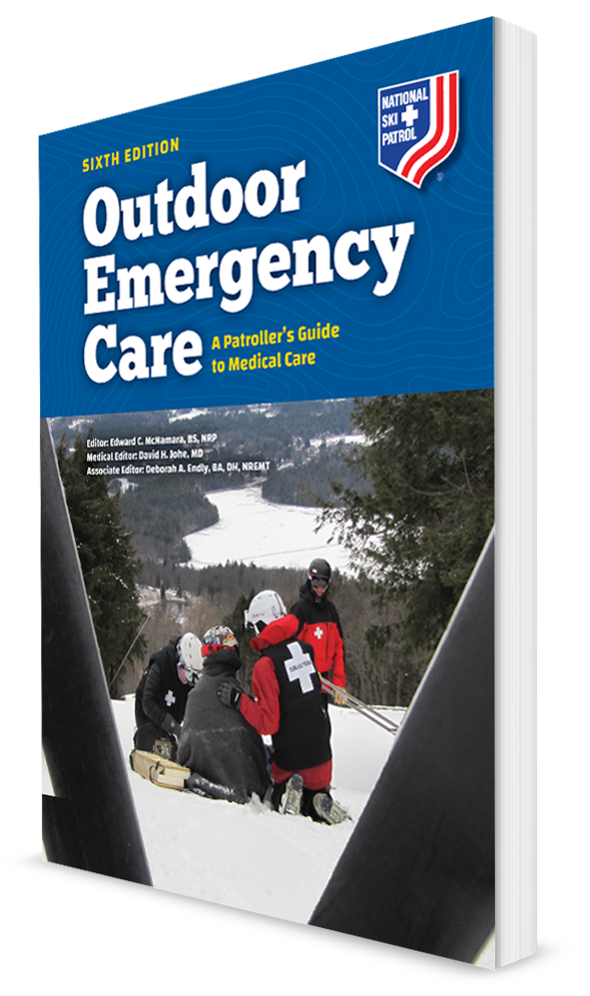
Rescue Basics
CHAPTER 3

Slide 2
The following presentation will utilize two symbols to identify material necessary for an OEC Technician to comprehend:
key term
Meets a Chapter Objective.
This symbol will have the corresponding Objective Number denoted within.
Identifies a Key Term.
The Key Term will be underlined for easy identification.

Slide 3
Objectives
3-1 Describe the steps an OEC technician can take to be prepared when responding to a request for assistance.
3-2 Describe how layering clothing can help preserve body heat.
3-3 Describe the five modes of disease transmission.
3-4 Define the following terms:
Pathogen
Standard precautions
Body substance isolation
Hazardous material

Slide 4
Objectives
3-5 List common personal protective equipment used by OEC technicians.
3-6 Demonstrate how to safely remove contaminated medical gloves.
3-7 Describe chain of custody.
Occupational exposure
Pathogen
Personal protective equipment (PPE)
Safety data sheet (MSDS)
Standard precautions
Ultraviolet radiation (UVR)

Slide 5
Key Terms
Body substance isolation (BSI)
Contamination
Decontamination
Disease transmission
Hazardous materials
Metabolism
Nutrition
Occupational exposure
Pathogen
Personal protective equipment (PPE)
Safety data sheet (MSDS)
Standard precautions
Ultraviolet radiation (UVR)

Slide 6
Chapter Overview

Slide 7
Chapter Overview
OEC technicians must be prepared to respond to a wide variety of situations.
Some situations will involve assessment and basic treatment of a single patient in mild weather.
Can be complicated by such factors as darkness, rain, snow, and steep terrain
It’s essential to have an awareness of overall well-being, can adapt to environmental changes, and are conscious of scene dynamics.
Must have a basic understanding of infectious diseases and hazardous materials
One of the most important skills is taking care of yourself.

Slide 8
Chapter Overview
Contagious disease is another hazard.
Learn how communicable diseases are transmitted and how to protect yourself from becoming infected.
Adopting a standardized approach to all patients by wearing appropriate protective equipment and properly decontaminating equipment after each patient encounter will reduce the risk of occupational exposures.
This chapter emphasizes the importance of scene safety.
Always make the scene safe before approaching the patient.
Protect yourself and others when approaching each patient.

Slide 9
Preparing to Work Outdoors

Slide 10
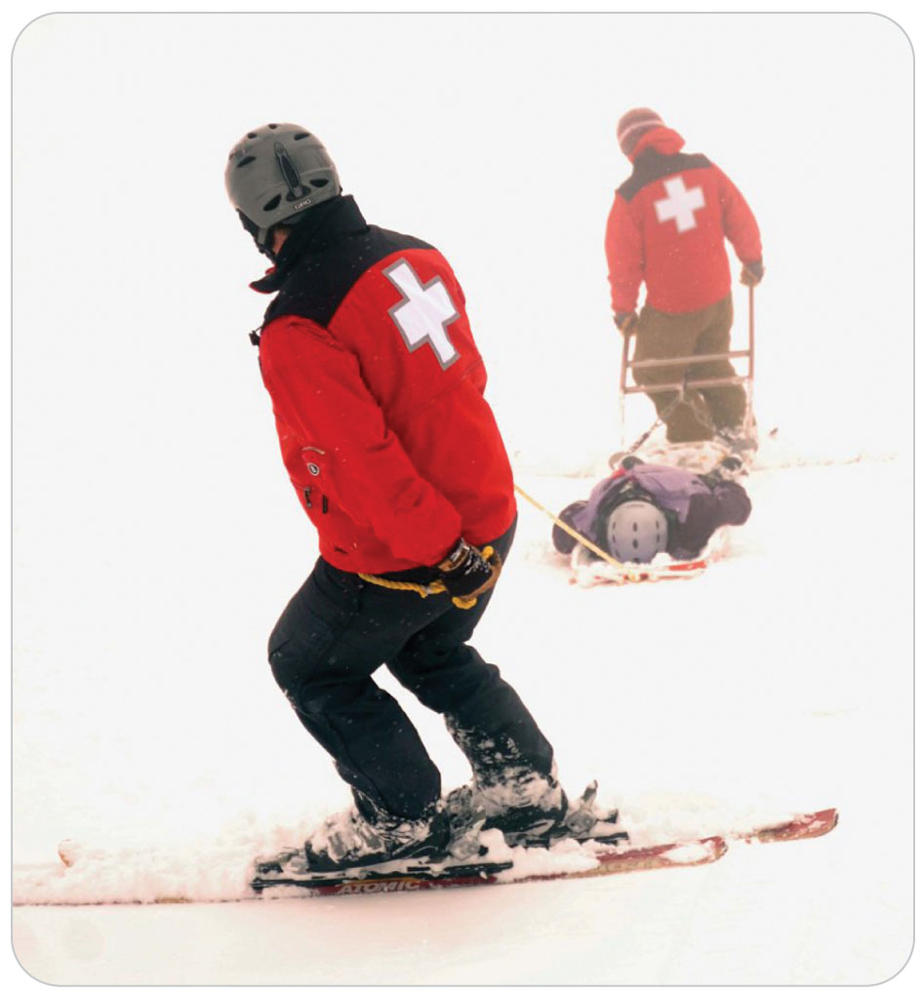
Preparing to Work Outdoors
3-2
Environmental Considerations
OEC technicians frequently work outdoors.
Exposed to all types of conditions
Essential to continually monitor the weather

Slide 11
Preparing to Work Outdoors
3-2
Mental Preparedness
Important to maintain well-being
Begins by having a positive attitude
Always be prepared to encounter the worst-case scenario, including:
Inclement weather
Interference by bystanders
Equipment failure
Emotionally disturbing situations
Must be able to recognize abnormal reactions to stress in themselves and in coworkers so that medical help can be obtained

Slide 12
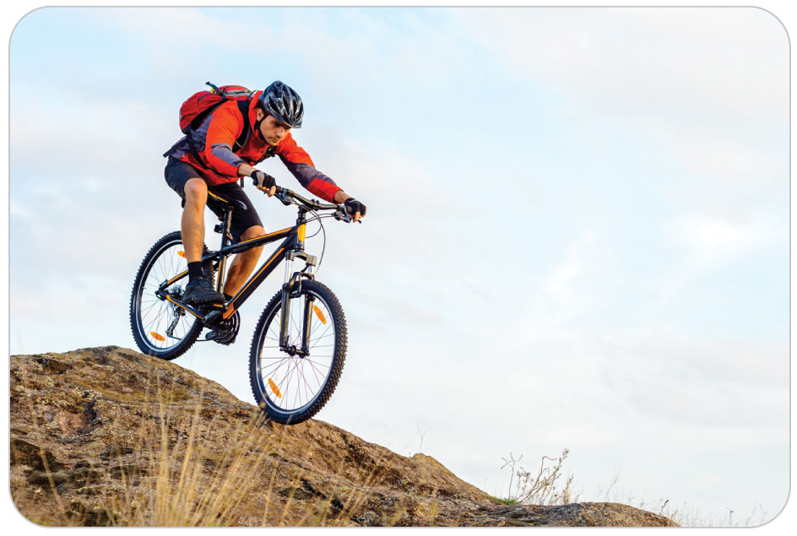
Preparing to Work Outdoors
3-2
Physical Fitness
Being physically fit will improve performance during a rescue.
Develop an exercise routine.

Slide 13
Preparing to Work Outdoors
3-2
Sleep and Fatigue
A lack of proper rest can cause a host of health-related problems.
Sleep deprivation and fatigue will reduce both mental and physical capability.
Maintain a regular sleep schedule of 7 to 9 hours of uninterrupted sleep each night.
Fatigue can:
Affect mood
Reduce the ability to adjust to new environments
Impair judgment
Leads to errors

Slide 14
Preparing to Work Outdoors
3-2
Food and Nutrition
The body must have energy to function.
Being well nourished makes a significant difference in your ability to participate in strenuous outdoor activities and rescue operations.
OEC technicians should try to eat healthful, nutritious foods whenever possible.
Good nutrition is recommended for overall fitness, optimal body function, and recovery from stress.
On very strenuous rescues, eating something every hour will provide the extra calories your body needs.

Slide 15
Preparing to Work Outdoors
3-2
Hydration
Dehydration is a major concern in any outdoor activity, not only in survival situations.
Remain properly hydrated.
Drink enough non-alcoholic fluids.
When on extended rescues, carry replacement fluids.
Carry more water than you think you will need.
Monitor your urine.
Should remain a mild yellow color
If it becomes dark in color, you are dehydrated.

Slide 16
Preparing to Work Outdoors
3-2
Alcohol and Substance Abuse
Avoid any substance that may compromise your ability to think clearly.
Resulting errors can place you, the patient, and others in immediate danger.
Providing care while under the influence of any substance is unethical, dangerous, and fraught with medical and legal risks.

Slide 17
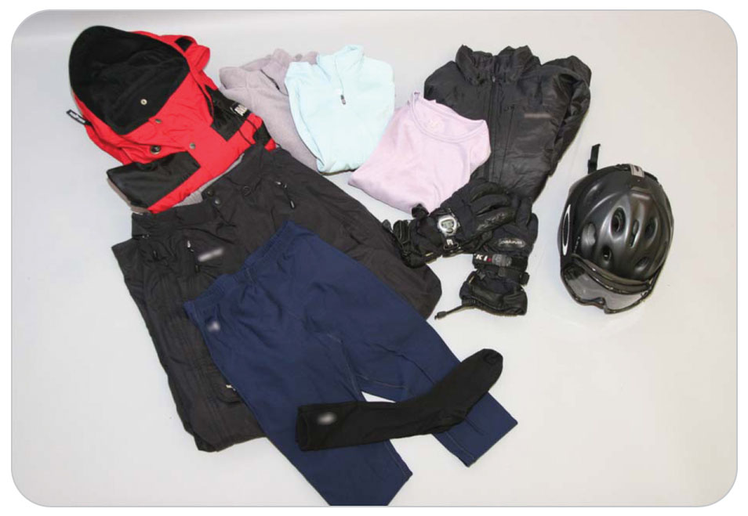
Preparing to Work Outdoors
3-2
Clothing
Select proper clothing for the work you will be performing, taking into account:
Temperature
Possible weather changes
Precipitation

Slide 18
Preparing to Work Outdoors
3-2
Base layer
Usually lies tight against the skin, helping to retain heat while allowing moisture to be transferred toward the exterior, a process known as wicking
Ideally should be made of silk or a synthetic material such as polyester
Middle layer
Serves as the insulating layer by trapping warm air
Common insulating materials are fleece, wool, and down.
Outer layer
Designed to be water repellant and wind repellant and should provide protection from sharp objects such as sticks or thorns

Slide 19
Preparing to Work Outdoors
3-2
Skin Protection
Too much sun exposure puts your skin and eyes at risk from ultraviolet radiation (UVR).
You can take measures to protect your eyes and skin.
A variety of products are available for protecting the skin from the sun’s harmful rays.
Sunscreen comes as a lotion, spray, gel, or paste that absorbs or reflects UVR.
Most products include an SPF rating; higher numbers provide greater protection.
Consider using a sunscreen with a minimum SPF of 50.

Slide 20
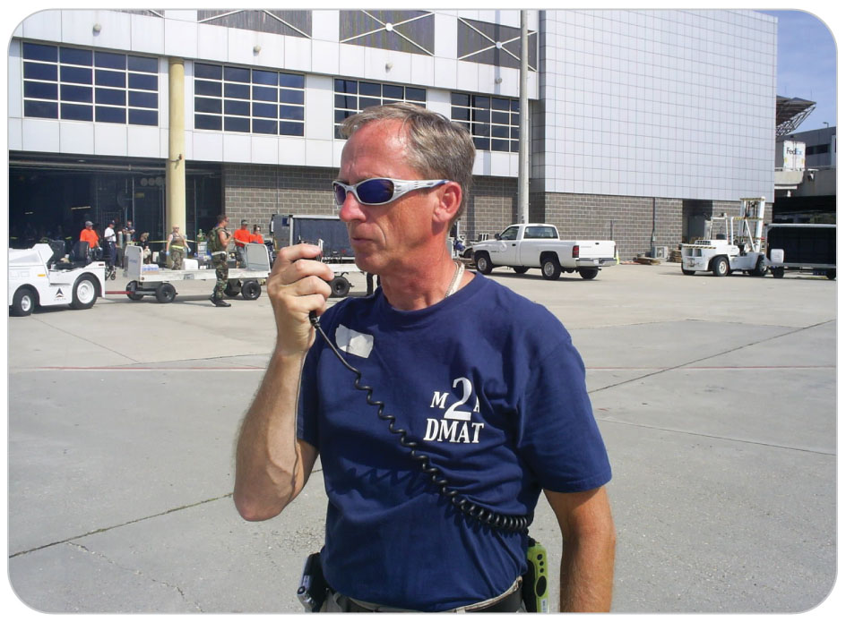
Preparing to Work Outdoors
3-2
Eye Protection
Proper eye protection is easily overlooked, but it is essential.
Long-term exposure to sunlight can:
Cause cataracts
Damage your retinas and corneas
Reducing the amount of UVR that reaches the eyes helps prevent ocular damage.
Wearing sunglasses or goggles with UVR protection
“Wraparound” style of sunglasses or those with side panels are best.

Slide 21
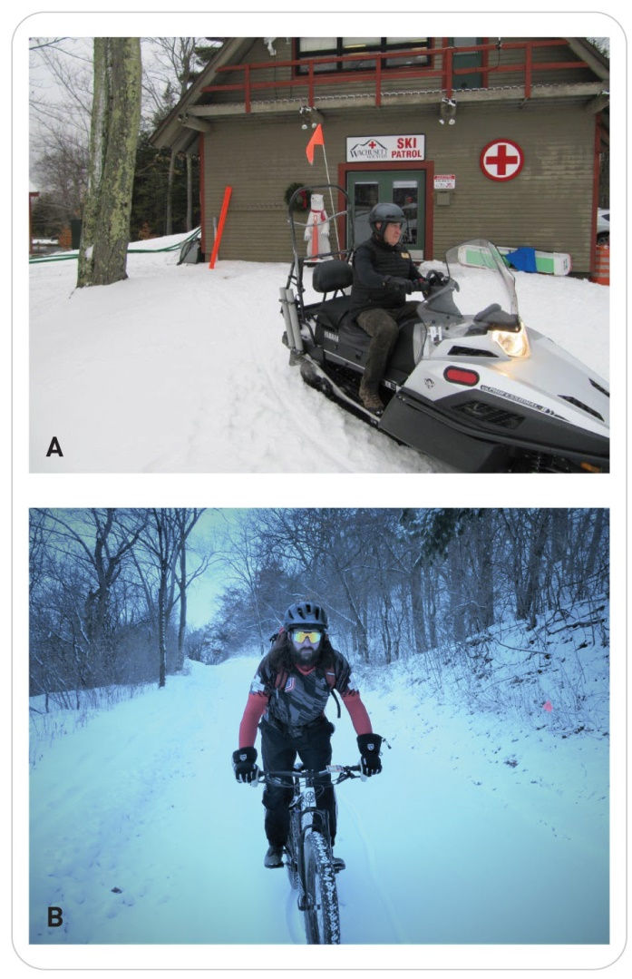
Preparing to Work Outdoors
3-2
Helmets
The NSP strongly recommends helmets.
Wearing a helmet sends a strong safety message to members of the public.
The public often adopts the equipment and philosophies of professional rescuers.
Advances in technology have enabled helmets to offer the combination of protection, comfort, and ventilation.

Slide 22
Preparing to Work Outdoors
3-2
Backcountry Equipment
In outdoor rescue work, need to carry gear in a first-aid pack for:
Providing patient care
Personal gear for maintaining your own well-being

Slide 23
Preparing to Work Outdoors
3-2
Pack a small survival kit that includes items to help with fire starting, navigation, and signaling.
Take a flashlight, a carabineer, a high-quality multipurpose tool, and sunblock.
Although GPS units are popular, these devices can fail.
A map, a compass, and good navigation skills are still necessary.
Carrying water and compact nutritious packaged food is important.
Your kit should also include a high-quality whistle.
Three short blasts are the international sign of distress.

Slide 24
Protecting Yourself from Disease

Slide 25
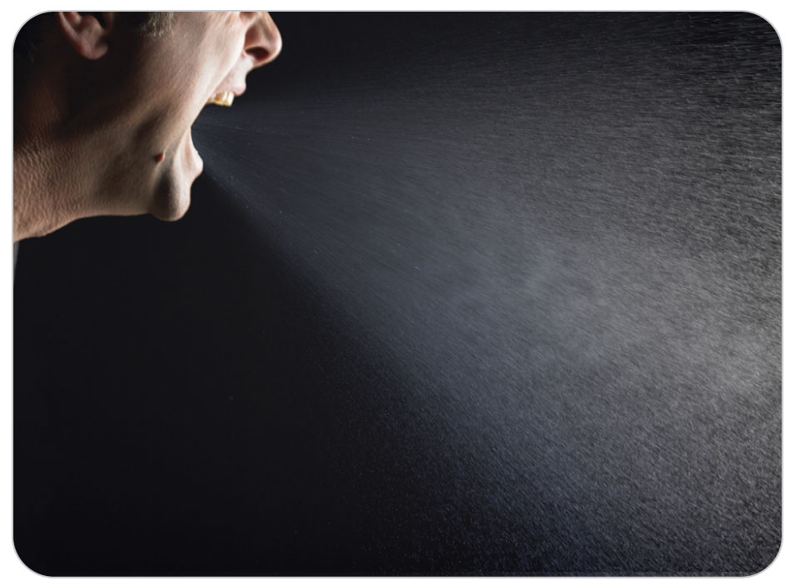
Protecting Yourself from Disease
3-3
3-4
Pathogens are microorganisms that can invade the body and cause disease or illness.
Disease Transmission
Transfer of illness from an infected individual to a healthy individual
Through direct, indirect, airborne, injection and vector borne transmissions

Slide 26
Protecting Yourself from Disease
3-3
3-4
Direct contact
Involves close person to person contact
Indirect contact
Involves physical contact with an object contaminated with pathogen
Airborne transmission
Occurs from inhaling droplets containing infections pathogens propelled into the air by coughing, sneezing, or acts of bioterrorism
Ingestion
Consumption of food or water that is contaminated with pathogen
Vector-borne transmission
Transmission from pathogens to humans by other animals such as ticks or mosquitoes

Slide 27
Protecting Yourself from Disease
Contamination
Soiling of an object, water, or air by foreign material such as dirt, debris, bodily fluids, or radiation
Occurs once an individual comes in contact with enough organisms to cause symptoms

Slide 28
Protecting Yourself from Disease
3-4
Standard Precautions and Body Substance Isolation
To reduce the number of health care workers acquiring illness from patients, the CDC has developed guidelines called standard precautions.
Health care workers treat every patient as potentially infectious.
Body substance isolation (BSI):
Measures taken to prevent the patient’s bodily fluids from contacting any unprotected portions of the rescuer’s person
Standard precautions and BSI are designed to prevent the transmission of pathogens.

Slide 29
Protecting Yourself from Disease
3-4
It is essential that OEC technicians be protected from patients’ bodily fluids.

Slide 30
Protecting Yourself from Disease
3-4
Be wary of any objects that may be contaminated with bodily fluids.
Including bandages, equipment, towels, blankets, clothing, paper products, and a patient’s other belongings
Practice standard precautions on every patient.
Do not succumb to the temptation of assuming the patient is “safe.”

Slide 31
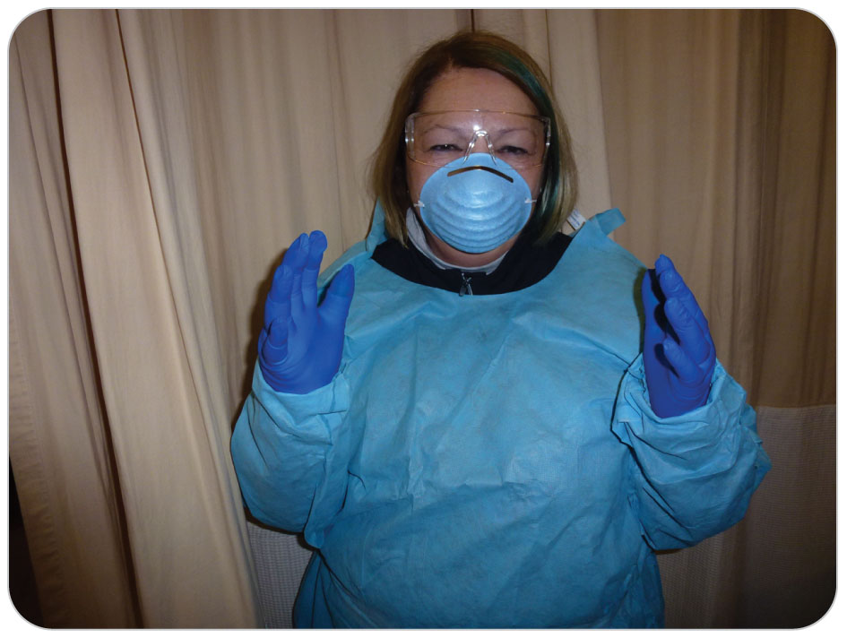
Protecting Yourself from Disease: PPE
3-5
3-6
OBJ
Personal Protective Equipment
Ensures that all patients are treated as though they harbor potentially contagious pathogens
It is important that a protective barrier be placed between you and each patient.
Prevent the transmission of disease using specialized protective medical equipment known as personal protective equipment (PPE).
PPE is designed to safeguard rescuers from exposure to infectious agents in the patient’s bodily fluids.

Slide 32
Protecting Yourself from Disease: PPE
3-5
Disposable Medical Gloves
Before touching any patient, always first put on a pair of disposable gloves.
Always carry several pairs of gloves.
To prevent self-contamination, remove your gloves properly and dispose of them with other contaminated waste.
Do not place contaminated gloves into your pocket or medical kit!
Time-tested key to removing gloves is “dirty to dirty and clean to clean.”
A contaminated surface should only touch another contaminated surface, whereas a clean surface should only touch another clean surface

Slide 33
Protecting Yourself from Disease: PPE
3-5
Eye Protection
Eye protection should be worn during every encounter with a patient.
Especially when there is a risk of bodily fluids getting splashed or splattered into your eyes
Ski goggles may serve as an emergency substitute for safety glasses.
More difficult to clean if they become contaminated
Sunglasses and prescription glasses also offer some protection.
Provide a less effective barrier than safety glasses
Should have attached side shields

Slide 34
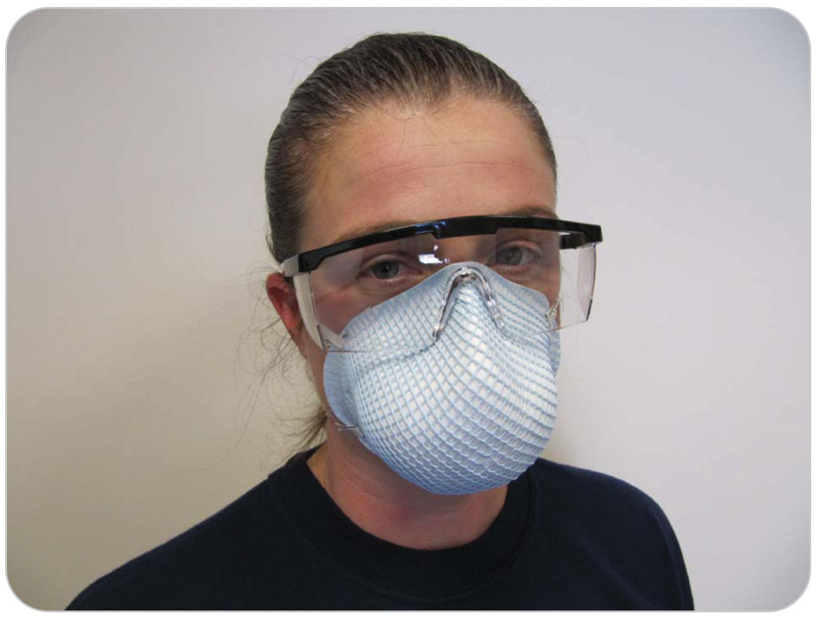
Protecting Yourself from Disease: PPE
3-5
Surgical masks provide an effective barrier to airborne droplets and protect your nose and mouth from exposure to bodily fluids.
Some have attached eye shields.
Masks also protect the patient from any pathogens that you may have.
Use of a mask is especially important if you are suffering from a cold, influenza, or other airborne-transmitted disease.
Place a mask on any patient who has, or is suspected of having, an airborne-transmitted disease, especially influenza.

Slide 35
Protecting Yourself from Disease: PPE
3-5
Medical Gown
Consider wearing a medical gown.
If there is a risk of bodily fluids being splashed or sprayed
For ski patrollers, most ski parkas and pants are waterproof and should suffice in protecting you while on patrol.
If exposed, should thoroughly decontaminate it

Slide 36
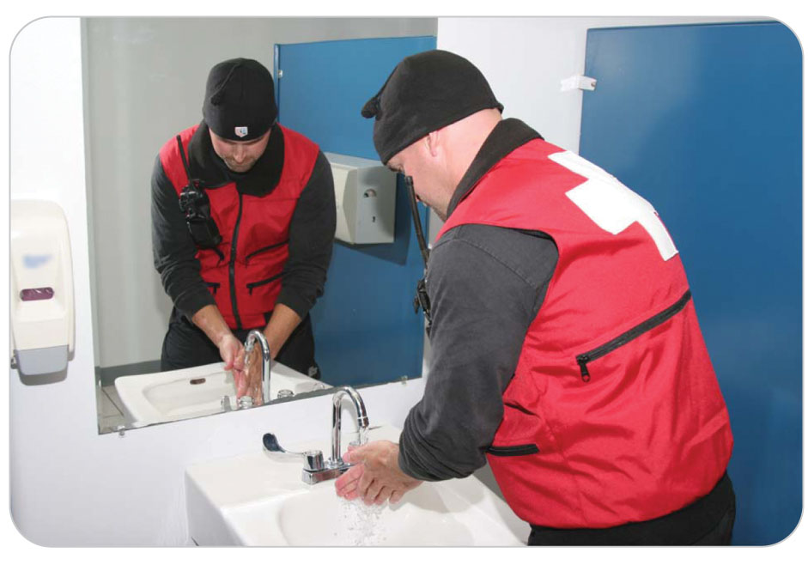
Protecting Yourself from Disease: Hand Washing
3-5
Hand Washing
Hand washing is one of the most effective methods for preventing the spread of disease.
Wash your hands before and after every contact with a patient.
Use soap and water or a waterless alcohol-based antimicrobial product.

Slide 37
Protecting Yourself from Disease
Occupational Exposure
An event in which a worker comes into contact with a bodily fluid or hazardous material while on the job
After an exposure:
Rinse the affected area with water.
If exposure site is your eyes, flush with copious water.
If site is skin, use soap and water.
Local protocols should be in place to assist any rescuer who has sustained an exposure.

Slide 38
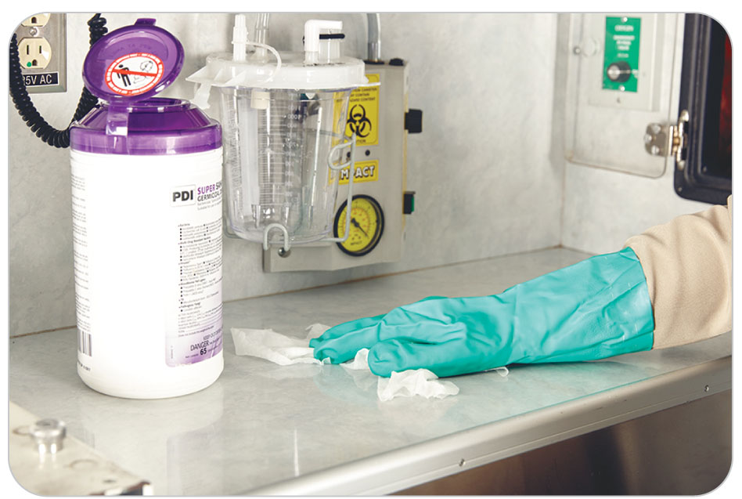
Protecting Yourself from Disease
After patient care, equipment must be processed before it can be used again.
Decontamination:
The process of removing disease-producing organisms, such as bacteria, and other harmful substances, such as poison, gas, and radiation.
When cleaning or disinfecting equipment, use appropriate PPE.

Slide 39
Dealing with Hazardous Materials

Slide 40
Dealing with Hazardous Materials
3-4
As part of the scene size-up and assessment for dangers, you may encounter hazardous materials.
A hazardous material is any solid, liquid, or gas that has the potential to cause harm to humans, animals, or the environment, either by itself or through interaction with other factors.
Hazardous materials include materials that are:
Radioactive
Flammable
Explosive
Corrosive
Pathogens, allergens, and other biohazardous substances

Slide 41
Dealing with Hazardous Materials
3-4
Examples of hazardous materials are avalanche explosives, chlorine, cleaning chemicals, gasoline, and propane.
Some can cause health problems if ingested or inhaled.
Others by contact with intact skin or the eyes
Many chemicals cause immediate health problems.
Respiratory distress and loss of vision
Others are more insidious and may take years to manifest.
Asbestos, which poses a long-term risk of lung cancer
It is your job to recognize any material that may be hazardous.

Slide 42
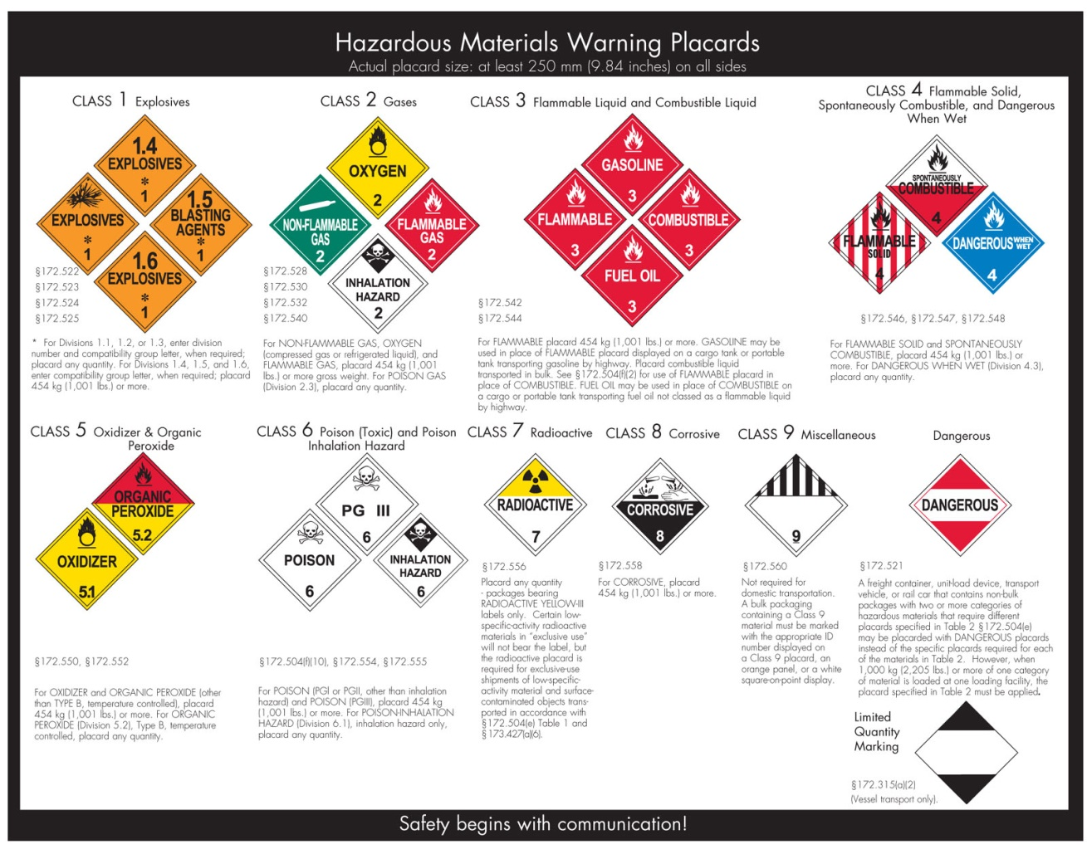
Dealing with Hazardous Materials
Safety data sheet (MSDS)
A form that contains relevant information pertaining to a specific substance, with a focus on the hazards it poses to workers

Slide 43
Crime Scene Management

Slide 44
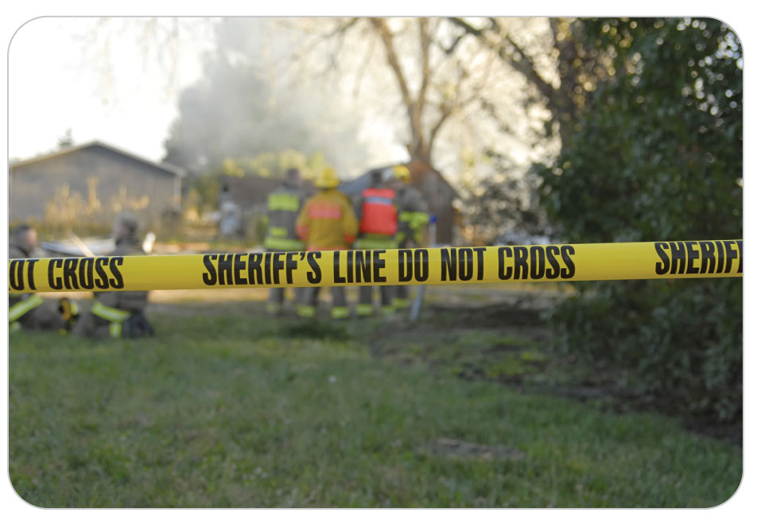
Crime Scene Management
3-7
OEC technicians may occasionally encounter crime scenes.
If you discover a potential crime scene, notify law enforcement immediately.
Take precautions not to remove, move, or otherwise disturb anything in the environment, except as is absolutely necessary to provide critical care to patients.
Any mishandling of evidence can make it inadmissible in court.

Slide 45
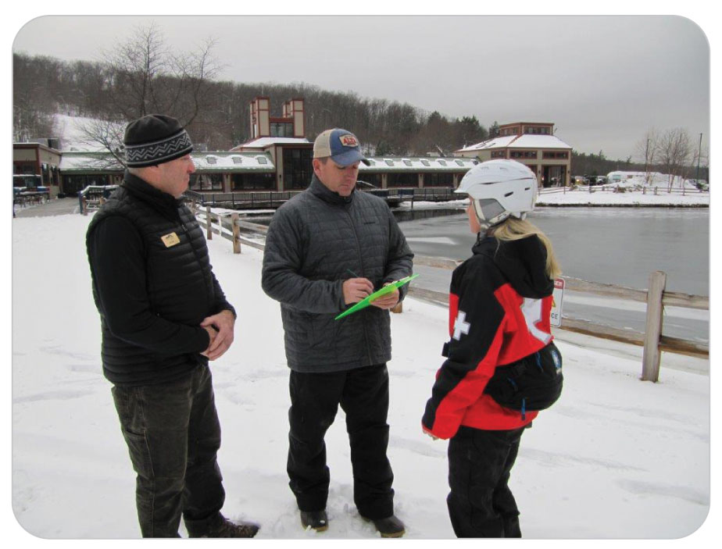
Crime Scene Management
3-7
To avoid this problem, create an accurate “paper trail,” or “chain of custody.”
Accounting for the location of the evidence at each step, from the time of its discovery to its presentation in court
Let law enforcement personnel handle any materials that could be used as evidence.

Slide 46
Case Study

Slide 47
CASE PRESENTATION
It is a chilly afternoon with moderate cloud cover. You have just entered the mid-mountain lodge and are looking forward to a well-earned bowl of hot soup when you are called to respond to a skier who has fallen approximately 30 feet from a chairlift. The skier reportedly landed on a rock pile and is responsive. You notify dispatch that you are responding. Upon arrival, you see that the patient has fallen into a ravine and that extrication will require specialized equipment and other rescuers. Two other OEC technicians are already on scene and have initiated care of the patient. One of the technicians is Peter, the newest member of your patrol, who has been assigned to you for mentoring. He is at the patient’s head while the other technician is assessing the patient for injuries. You note that Peter is wearing only a sweater and a lightweight outer shell. As you approach, Peter, who is shivering, looks up, smiles nervously, and then gives you a brief report on the patient’s condition. Peter is not wearing a hat, and his gloves appear to be soaked. A light, freezing rain begins to fall.
Do you have one patient to address, or two?

Slide 48
CASE UPDATE
Reaching into your pack, you hand Peter your spare wool hat and a dry set of waterproof gloves. You then assist the other technician in attending to the injured patient. Still other rescuers arrive to help with the rescue. As you continue to work, the weather becomes more severe as a mixture of rain and snow begins to fall. The temperature starts to drop, and the wind increases. Peter’s coat is not waterproof, and within minutes, he is soaked. His fingertips are becoming numb, and he repeatedly takes off his gloves to blow on his hands. You are about to say something to him when his stomach growls loudly. Embarrassed, he looks at you and says, “It was a late night last night, and I skipped breakfast.”
What is the best way to help Peter?

Slide 49
CASE OUTCOME
Pulling Peter aside, you instruct him to remove his wet jacket, and you give him your backup waterproof jacket. You also hand him two of your energy bars. As the rescue efforts continue, Peter realizes that he was not prepared for the scene. You instruct another rescuer to take Peter back to the ski area first-aid station so that he can be checked and warmed up. A few minutes later, Peter is heading to the first-aid room on the back of a snowmobile, covered with a wool blanket. Although Peter survived this event without any major complications, he learned some valuable lessons about being appropriately prepared, both physically and mentally.

Slide 50
OEC Skill Activities

Slide 51
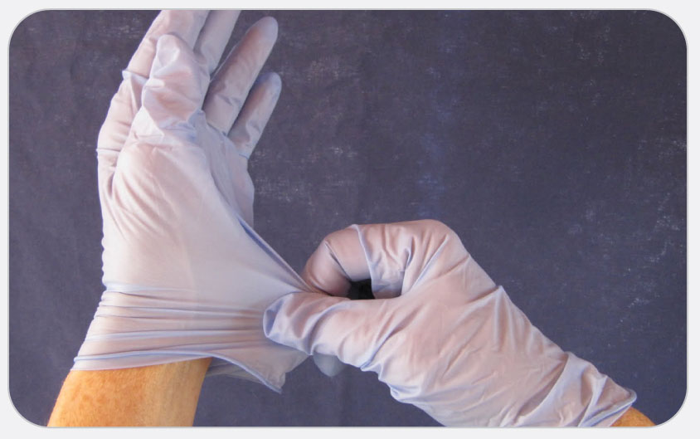
OEC Skill 3-1: Removing Contaminated Gloves
1. Using your dominant hand, grasp the exterior of the opposite glove at the wrist.

Slide 52
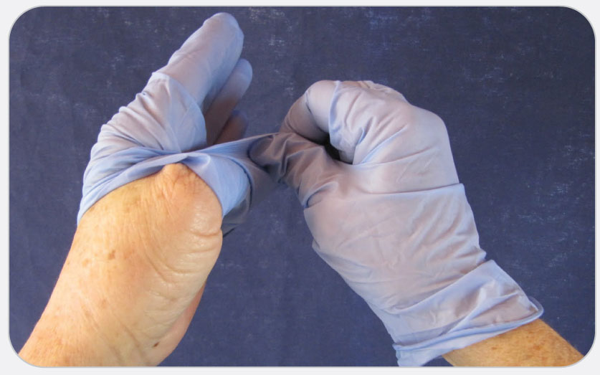
OEC Skill 3-1: Removing Contaminated Gloves
2. Carefully fold the glove over and peel it back, turning it inside out.

Slide 53
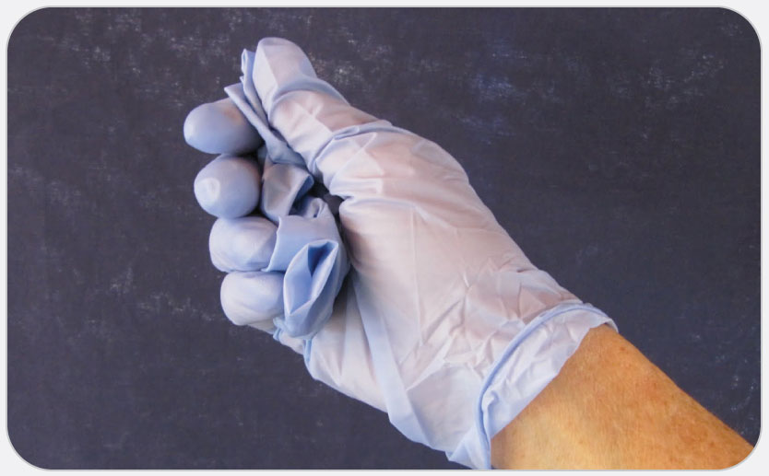
OEC Skill 3-1: Removing Contaminated Gloves
3. Once removed, hold the glove in your gloved dominant hand.

Slide 54
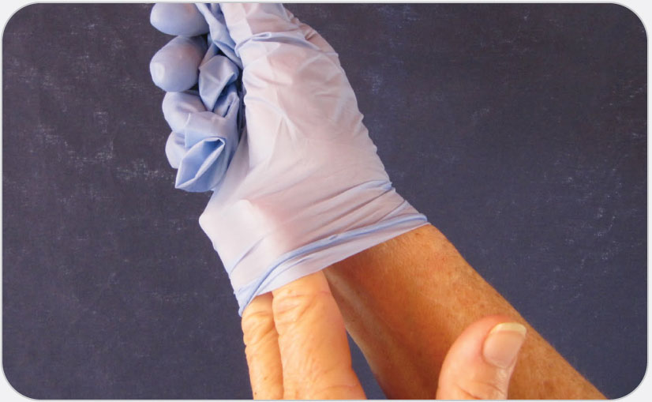
OEC Skill 3-1: Removing Contaminated Gloves
4. Place your ungloved fingers inside the cuff of the glove on your dominant hand, being careful not to touch the exterior.

Slide 55
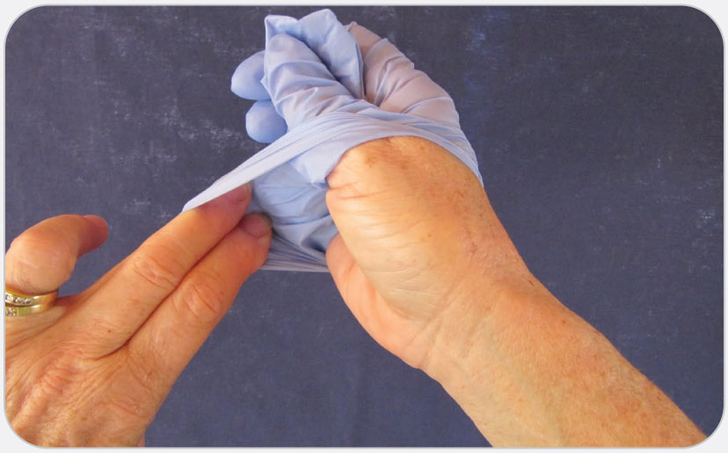
OEC Skill 3-1: Removing Contaminated Gloves
5. Carefully peel the glove off the hand, turning the glove inside out as you remove it. When finished, both gloves should be turned inside out, with the second glove serving as a container for the first glove.

