Slide 1
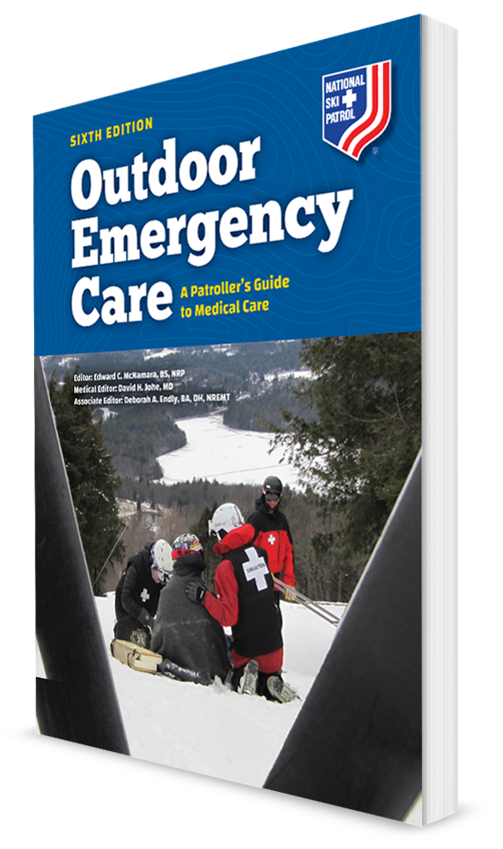
Moving, Lifting, and Transporting Patients
CHAPTER 5

Slide 2
The following presentation will utilize two symbols to identify material necessary for an OEC Technician to comprehend:
key term
Meets a Chapter Objective.
This symbol will have the corresponding Objective Number denoted within.
Identifies a Key Term.
The Key Term will be underlined for easy identification.

Slide 3
Objectives
5-1 Explain how to use good body mechanics.
5-2 Demonstrate the following:
Power grip
Power lift
5-3 Demonstrate the moves that can be used when there is not a spinal injury:
Extremity lift
Direct ground lift
BEAN/bridge lift

Slide 4
Objectives
OBJ
5-4 Demonstrate the moves that can be used when you suspect a spinal injury:
Draw-sheet, plastic slider, or flat transfer lift
Logroll
5-5 Demonstrate the following urgent moves:
Shoulder drag
Feet drag
Blanket drag
Underarm-wrist drag

Slide 5
Objectives
OBJ
5-6 Demonstrate the following nonurgent moves:
Human crutch
Two-person assist
Chair carry
Fore-and-aft carry
5-7 Describe and demonstrate the use of the following devices for lifting and moving patients:
Backboard
Portable stretcher
Scoop stretcher
Basket/Stokes stretcher
Sitting lifting device

Slide 6
Objectives
OBJ
5-8 Discuss how you place a patient in a toboggan while protecting the injury.
5-9 Explain the purpose and correct steps of packaging a patient.
5-10 Explain a landing zone and proper helicopter safety.

Slide 7
Key Terms
Body mechanics
Carry
Drag
Landing zone (LZ)
Lift
Move
Spinal motion restriction

Slide 8
Course Overview

Slide 9
Chapter Overview
As an OEC technician, you will care for backcountry, bike path, ski slope, and indoor patients who need to be lifted, moved, or positioned for care.
Sometimes, you will perform these tasks under difficult conditions, often with limited resources.
May need to carry, lift, or transport a patient package weighing more than 300 pounds
Can be extremely difficult on ice, snow, or uneven terrain

Slide 10
Chapter Overview
Transporting a patient is a role an OEC technician performs on a regular basis.
On foot with the patient walking with assistance
By skiing down a slope with the patient in a toboggan
By carrying the patient strapped to a backboard or litter
By using motorized ground vehicles
Can be a complex task
Rapid packaging and transport of a patient to definitive care are important.

Slide 11
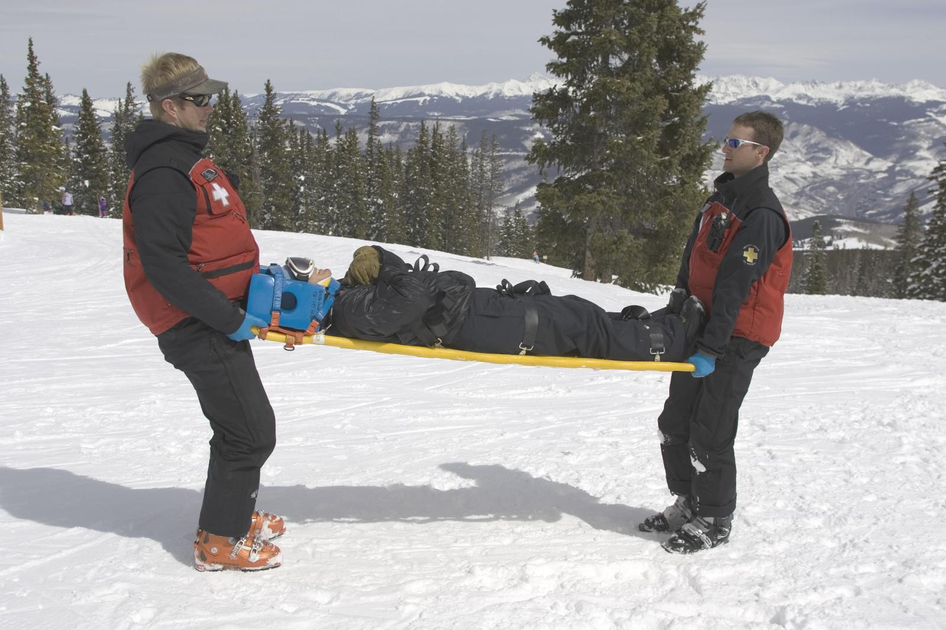
Chapter Overview
This chapter will help OEC technicians learn how to lift, move, and transport a patient in a safe and efficient manner.
Describes body mechanics and proper lifting techniques

Slide 12
Body Mechanics

Slide 13
Body Mechanics
5-1
When moving or transporting a patient, the top priority is your own safety.
Prevent injuries by understanding body mechanics.
Defined as the relationship between the body’s anatomic structures and the physical forces associated with lifting, moving, and carrying

Slide 14
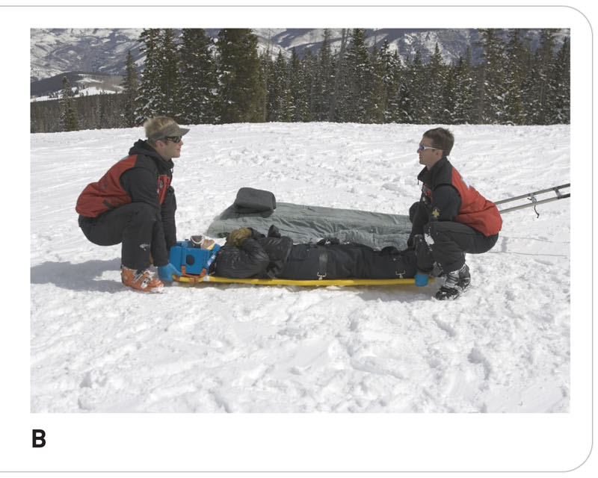
Body Mechanics
5-1
When lifting a heavy patient, use your strong leg muscles.
Do NOT use your back muscles.
Upper thigh leg muscles are well suited for lifting.
Among the strongest muscles in the body

Slide 15
Body Mechanics
5-1
The use of good body mechanics distributes the weight evenly down the entire spinal column, through the pelvis, and to the bones of the legs.
Shoulders need to be aligned over the spine.
When a person exhibits poor body mechanics and lifts improperly, the vertebrae are misaligned.
Causes the load to be unevenly distributed
The resulting force can damage discs, spinal nerves, and/or adjacent muscles and ligaments.
In some cases, this damage can be long-term or even permanent.
Stay as close to the patient as possible, keeping your back straight.

Slide 16
Back Smart Tips
5-1
Know your physical limitations.
Plan the move and/or lift.
Get help!
Keep your feet at shoulders’ width.
Keep your back straight.
Get a good grip on the object being lifted.
Bend your knees.
Lift with your legs, not with your back.
Keep your shoulders centered.
Keep the object close to your body.
Keep your head up as you lift.
Turn moving your feet, not your hips or back.
Communicate clearly with other people lifting.

Slide 17
Moving a Patient

Slide 18
Moving a Patient
A move is the transport of a patient from one location to another.
May be just a few inches or many feet
Some patients require minimal assistance in moving, whereas others cannot move at all on their own.
A patient requiring an urgent move using one or two rescuers
A more controlled move might require using multiple rescuers.

Slide 19
Moving a Patient
A lift is a way of moving the patient by raising the person from a lower position to a higher one.
A drag is a method of pulling a patient on the ground to another location.
Urgent moves generally involve some type of drag or pulling a patient on the ground to another location.
Most drags protect the head, but they may allow the spine to flex or move, which can aggravate any spinal injury that is present.
A carry is the act of lifting and moving the patient, usually a short distance.

Slide 20
Lifting or Sliding the Patient
5-2
Power Grip
The power grip maximizes the force of the hands and enables you to firmly grip and hold on to an object.
Can be used with the power lift (described next) when lifting or moving a patient
Provides the tightest grip possible by ensuring that the palms and fingers are in constant contact with the object

Slide 21
Lifting or Sliding the Patient
5-2
Power Lift
Weight lifters have long known the importance of proper form, enabling them to lift heavy weight without becoming injured.
Uses good body mechanics and the power of the leg muscles
A good method of lifting because it aligns the spine and evenly distributes the weight to be lifted

Slide 22
Lifting or Sliding the Patient
5-3
Patient Moves WITHOUT Spinal Protection:
Extremity Lift
Direct Ground Lift
BEAN/Bridge Lift

Slide 23
Lifting or Sliding the Patient
5-3
The Extremity Lift
Commonly used lift in rescue operations
Responsive patient may be lying at ground level or sitting.
Places pressure on the patient’s chest and thus may not be tolerated by all patients
Elderly patients and patients with breathing disorders
It is specifically indicated for any patient who does not have a spine injury and must be moved quickly from one location to another.
This lift is often used to move a patient onto a transport device.
It is not recommended for patients who are very heavy or obese.

Slide 24
Lifting or Sliding the Patient
5-3
Direct Ground Lift
Used to raise a patient lying on his or her back and place the patient onto a flat surface such as a stretcher, bed, or backboard used as a litter.
Only for patients who do not have a suspected spinal injury
It may be performed with as few as two rescuers, but ideally it is performed using four rescuers.
Patient is placed supine (on the back) and then is lifted with all rescuers maintaining a safe back position.

Slide 25
Lifting or Sliding the Patient
5-3
BEAN/Bridge Lift
Used to raise a patient who is lying on his or her back
There should be no suspicion of spinal injury.
Acronym for body elevation and non-movement
Uses four to six rescuers and involves keeping the patient in proper anatomic alignment and raising the patient from the ground while a backboard is slid under the patient

Slide 26
Lifting or Sliding the Patient
5-4
Patient Moves WITH Spinal Motion Restriction/Protection:
Draw-Sheet, Plastic Slider, or Flat Transfer Lift
Logrolling a patient

Slide 27
Lifting or Sliding the Patient
5-4
Draw-Sheet, Plastic Slider, or Flat Transfer Lift
Can lift a patient a few inches or can be used to transfer a patient a very short distance
A draw-sheet lift, or flat transfer, is accomplished with a sheet of plastic or fabric that is placed under a patient and then used to slightly raise the patient or slide him or her from one surface to another.
A draw sheet may be improvised using a standard bed sheet or blanket, or it may be commercially produced.
Great caution must be used when transferring a large or heavy patient using a sheet because the fabric can rip.

Slide 28
Lifting or Sliding the Patient
5-4
Logrolling a Patient
One way of placing a patient onto a backboard or assessing the patient’s spine is by using a logroll.
When properly done, the spine is kept in alignment.
This method can be used when you suspect a spinal injury.

Slide 29
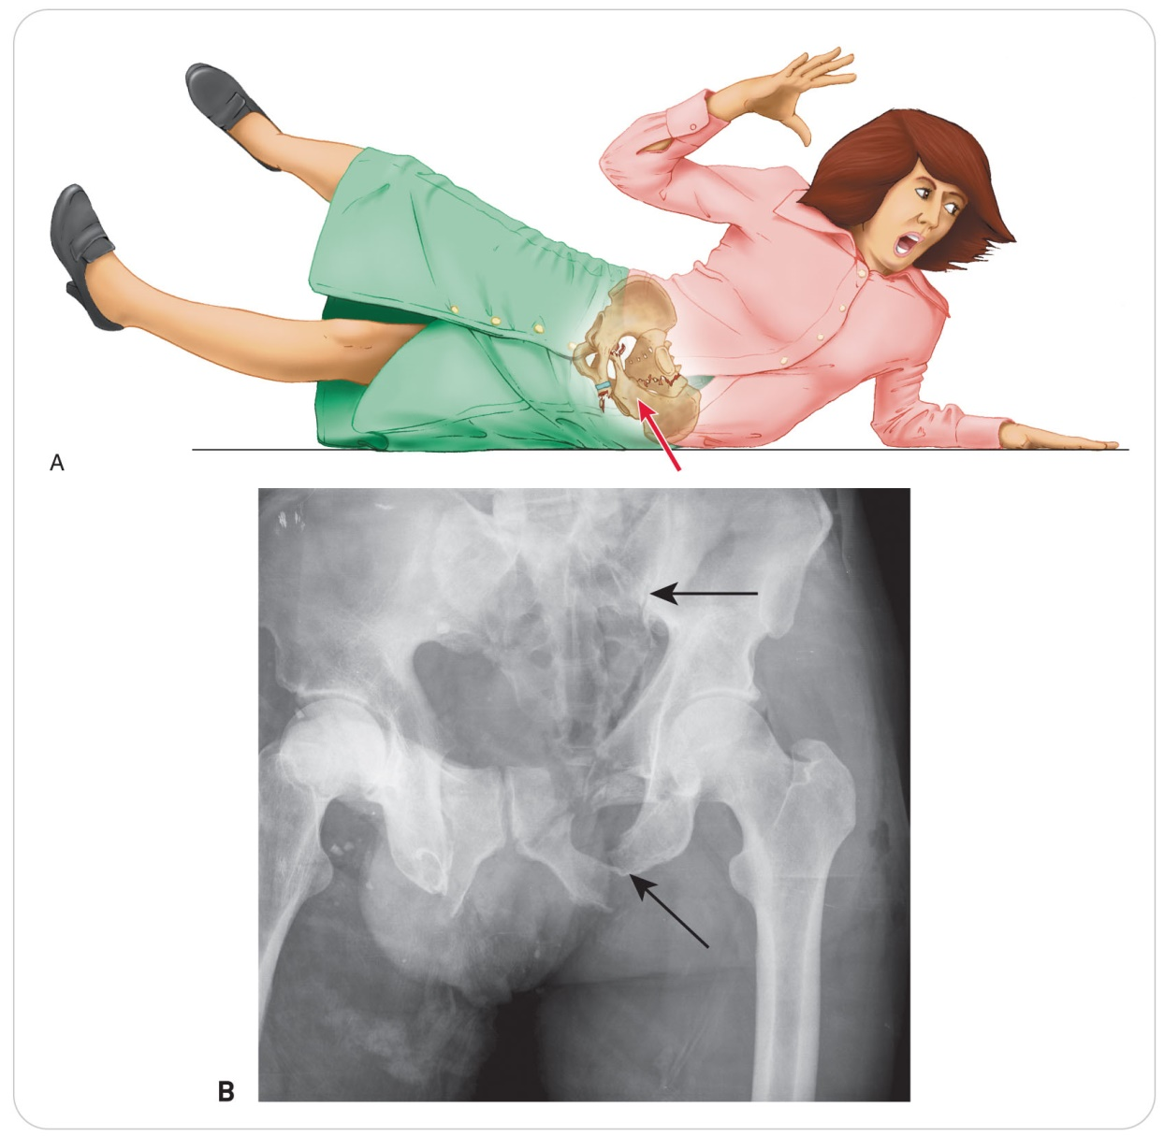
Lifting or Sliding the Patient: Special Case
Special Case: Pelvic Fractures
Using a lift is the preferred method.
Do NOT log roll unless absolutely necessary.
Pelvic fractures are unstable, and the blood clotted around each fracture site can become disturbed by logrolling.
Increased internal bleeding and possibly shock

Slide 30
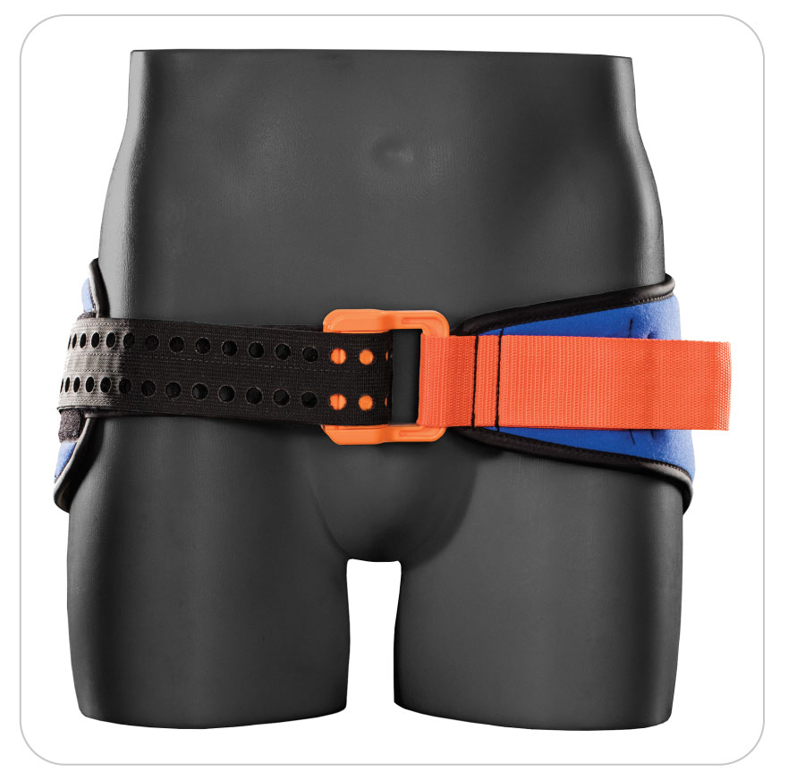
Lifting or Sliding the Patient: Special Case
After the application of a pelvic binder, gently use the BEAN lift.
Suspected spinal column injury:
Protect the spine by keeping it straight as you minimally lift, and be gentle with the pelvis.
If not enough manpower for a lift, considered including sliding the patient onto the board lengthwise.

Slide 31
Urgent and Non-Urgent Moves
5-5
5-6
Two types of moves:
Urgent moves
Non-urgent moves
One principle MUST be observed: the patient cannot be dropped or allowed to fall.
First principle of medicine is “Do no harm.”
If during your assessment a spinal injury is suspected, protect the patient’s spine.

Slide 32
Urgent Moves
5-5
Urgent Moves
Reserved for situations in which:
The patient and/or rescuer must move quickly to safety
The patient’s medical condition is life threatening and requires immediate transport
Primary indication for an urgent move is the presence of a hazard that could prove life threatening to the patient, the rescuer, or both.
Urgent moves do NOT incorporate spinal protection.

Slide 33
Urgent Moves: Long-Axis Drags
5-5
Long-axis drags are commonly used for urgent moves.
There are four types of long-axis drags:
Shoulder (or Clothes) Drag
Feet Drag
Blanket Drag
Underarm-Wrist Drag

Slide 34
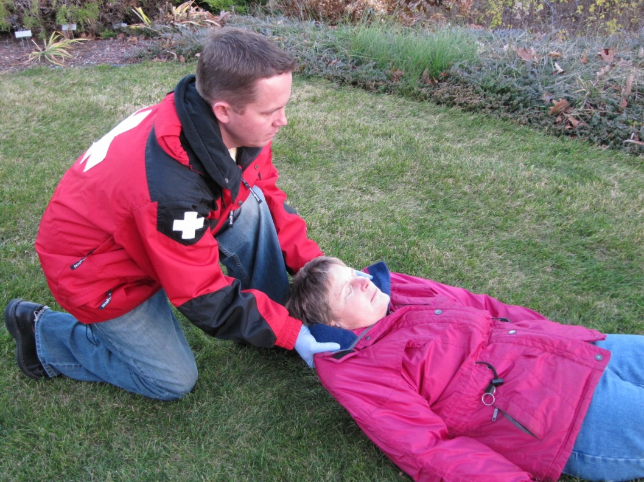
Urgent Moves: Shoulder (or Clothes) Drag
5-5
Shoulder (or clothes) Drag
Bend down on one knee and grab the patient’s clothing at the shoulders.
Support the patient’s head with both of your forearms.
Raise your head while moving from kneeling to standing.
Drag the patient to the desired location.

Slide 35
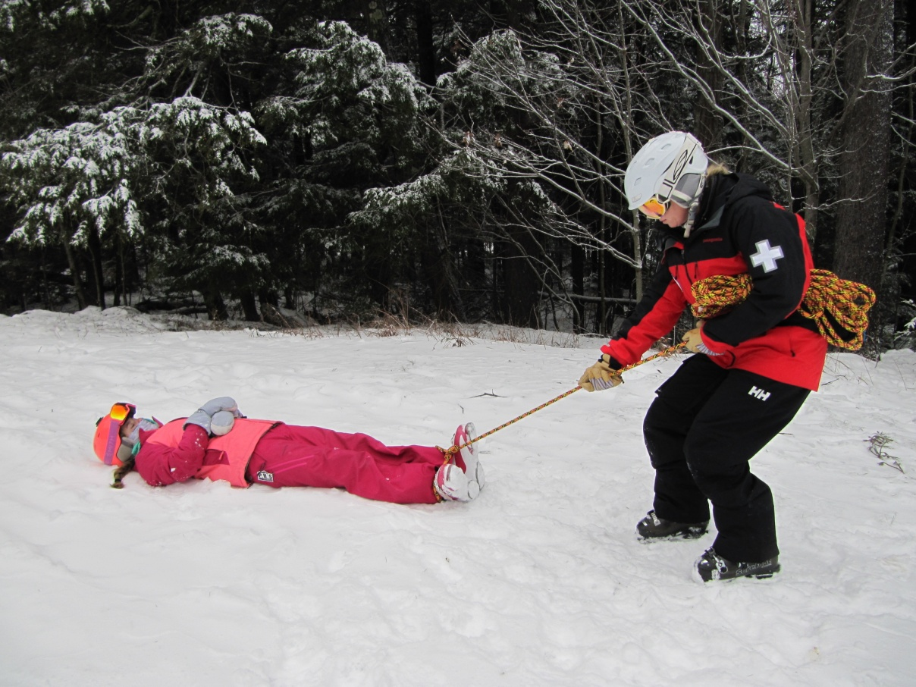
Urgent Moves: Feet Drag
5-5
Feet drag
Bend down on one knee and grasp the patient’s feet/ankles.
Raise your head while moving from kneeling to standing.
Drag the patient to the desired location.
An alternative method is to pull on a rope or sheet that is tied around the ankles.
This method should be used only if you cannot get to the patient’s head and shoulders.

Slide 36
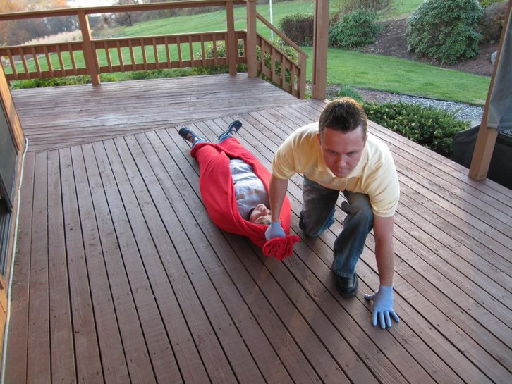
Urgent Moves: Blanket Drag
5-5
Blanket drag
Move the patient onto a blanket.
Bend down on one knee and firmly grasp the blanket either with one or both hands.
Raise your head while moving from kneeling to standing.
Drag the patient, pulling the blanket to the desired location.

Slide 37
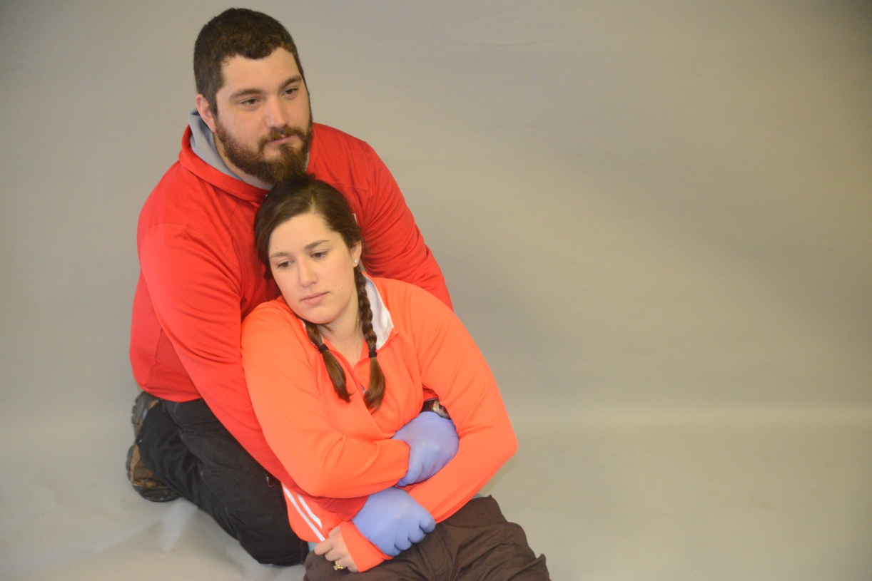
Urgent Moves: Underarm-Wrist Drag
5-5
Underarm-Wrist drag
Place the patient in seated position.
Bend down on one knee, reach under the patient’s armpits, and grasp the wrists.
Raise your head while moving from kneeling to standing.
Drag the patient to the desired location.

Slide 38
Non-Urgent Moves
5-6
Non-Urgent Moves
When a patient is moved in a controlled fashion, it is a non-urgent move.
Human Crutch
Also known as a one-person assist
One of the most common methods used for moving a patient
When performing this technique, the rescuer acts as a crutch.
Taking the weight off an injured leg
Thereby helping the patient walk with assistance

Slide 39
Non-Urgent Moves: Two-Person Assist
5-6
Two-Person Assist
Similar to the human crutch except two rescuers are available
One on each side of the patient
Preferable to the human crutch
Provides greater stability
Lessening the risk of falling

Slide 40
Non-Urgent Moves: Chair Carry
5-6
Chair Carry
A chair carry may be used to move a patient who is able to sit up unassisted.
This technique requires two rescuers.
Technique is effective for carrying a person over short-to-moderate distances, depending on:
The strength of the rescuers
The size of the patient

Slide 41
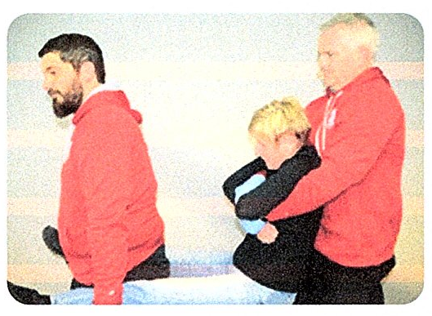
Non-Urgent Moves: Fore-and-Aft Carry
5-6
The Fore-and-Aft Carry
Used in conjunction with the extremity lift
Performed by two rescuers to carry a patient over a short-to-moderate distance

Slide 42
Transport Equipment

Slide 43
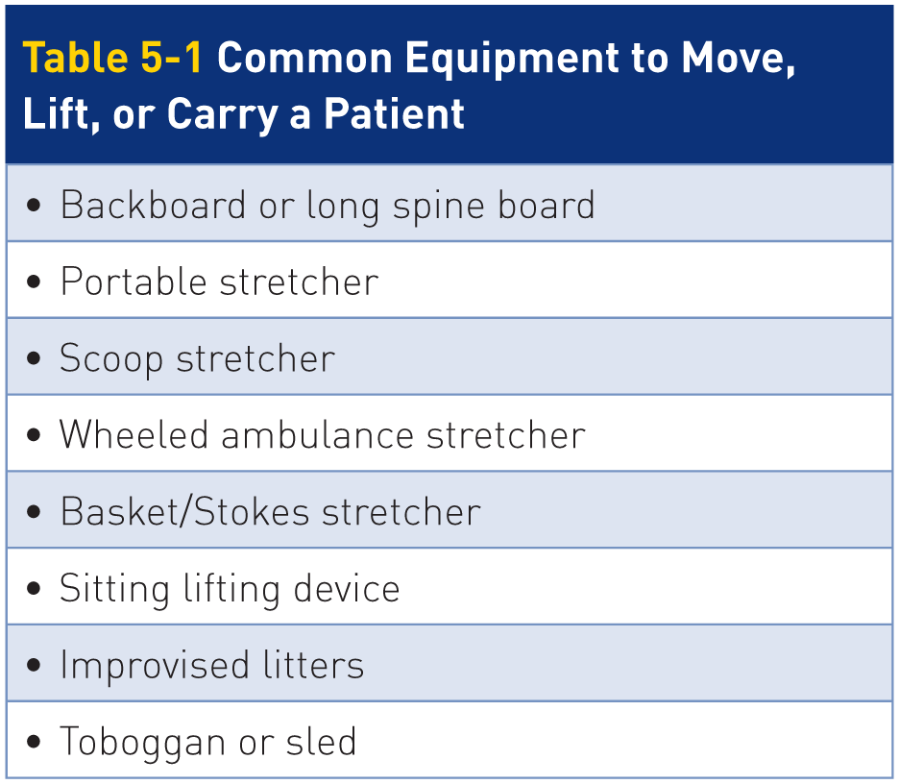
Transport Equipment
5-7
Many commercial devices are available to aid in moving, lifting, or carrying a patient.
Used properly, this equipment facilitates good body mechanics and lessens one’s risk of injury.

Slide 44
Transport Equipment: Backboard
5-7
Backboard
Also known as a long spine board
Usually readily available
Can be used to transport patients effectively
For spinal motion restriction
As a litter for transport from a difficult location
Manufactured from specially coated marine-grade plywood or lightweight plastic
Blood, bodily fluids, water, and snow resistant

Slide 45
Transport Equipment: Backboard
5-7
Used for a variety of purposes
Immobilization of suspected fractures of the spine, hip, pelvis, or femur
Carrying a patient over short distances outside
Transferring a patient between a bed and transport device
Extrication tool
Place the patient onto a backboard using proper lifting methods or with a logroll with a suspected spine injury.
For extrication or spinal protection, strap the patient on the backboard so they do not slip off.

Slide 46
Transport Equipment
5-7
Prolonged contact with any hard surface can cause back pain and increase risk of skin ulcers/pressure sores within a few hours.
Important in backcountry due to an extended time
Pad the backboard with closed cell foam pad or blanket, if available.
Any gaps should be filled with towels, shirts, or other padding to reduce the incidence of pressure sores.

Slide 47
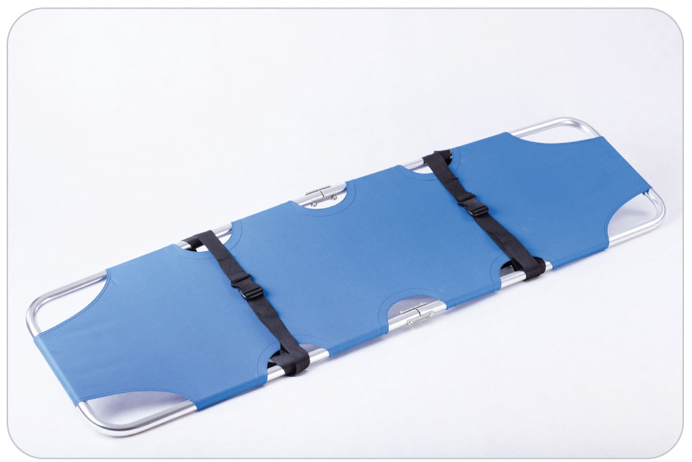
Transport Equipment: Portable Stretcher
5-7
Portable Stretcher
Consists of an aluminum frame and a vinyl-coated platform
Slightly wider than a standard backboard
Available as either a one-piece stretcher or as a folding stretcher
Lightweight and resistant to blood, bodily fluids, and water

Slide 48
Transport Equipment
5-7
Scoop Stretcher
A two-piece aluminum or high-density thermoplastic device that is slightly concave and has an open center section
Conforms to the patient’s body
Wide end of the device is used to support the head and torso, whereas the narrow end is used to support the lower legs and feet.
Can be adjusted to match the patient’s height

Slide 49
Transport Equipment: Wheeled Ambulance Stretcher
5-7
Wheeled Ambulance Stretcher
Also called a cot
The most commonly used stretchers in EMS ambulances
Have levers and controls for raising and lowering the bed parts and can raise or lower the patient’s head or feet
Make transport of patients much easier, especially when loading or unloading a patient into an ambulance

Slide 50
Transport Equipment: Wheeled Ambulance Stretcher
5-7
Ambulance personnel now use this device for spinal motion restriction.
SMR is defined as restricting the entire spine to limit spinal motion, protecting the spinal cord from injury.
This stretcher can be modified for use in an aid room, so a toboggan can be placed on it.
Toboggan can then be raised, allowing easier transfer of a patient to fixed exam table.

Slide 51
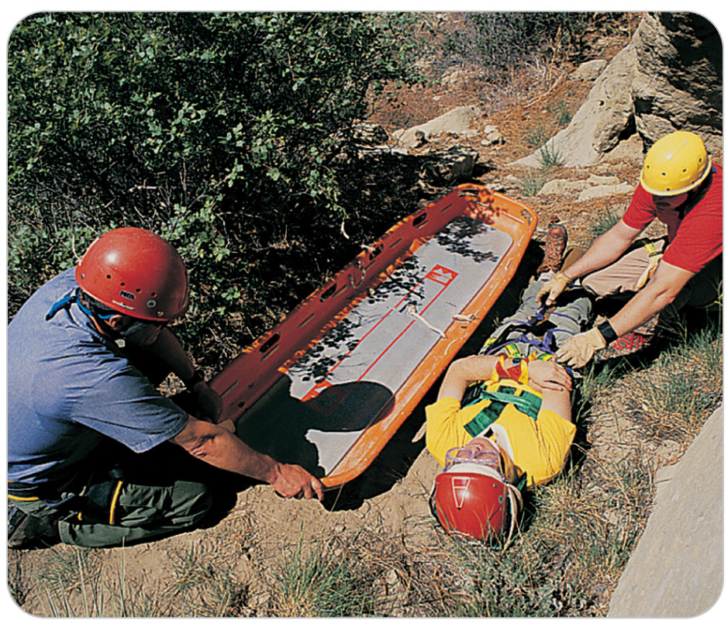
Transport Equipment: Basket Stretcher
5-7
Basket Stretcher
Also known as a Stokes stretcher
Initially used by the military for transferring patients between ships
Now constructed from high-impact plastics and ultra-light materials
Some can even be disassembled into two parts, making them easy to carry and reassemble at the point of use.
Great for backcountry operations or rescues requiring a great distance of travel

Slide 52
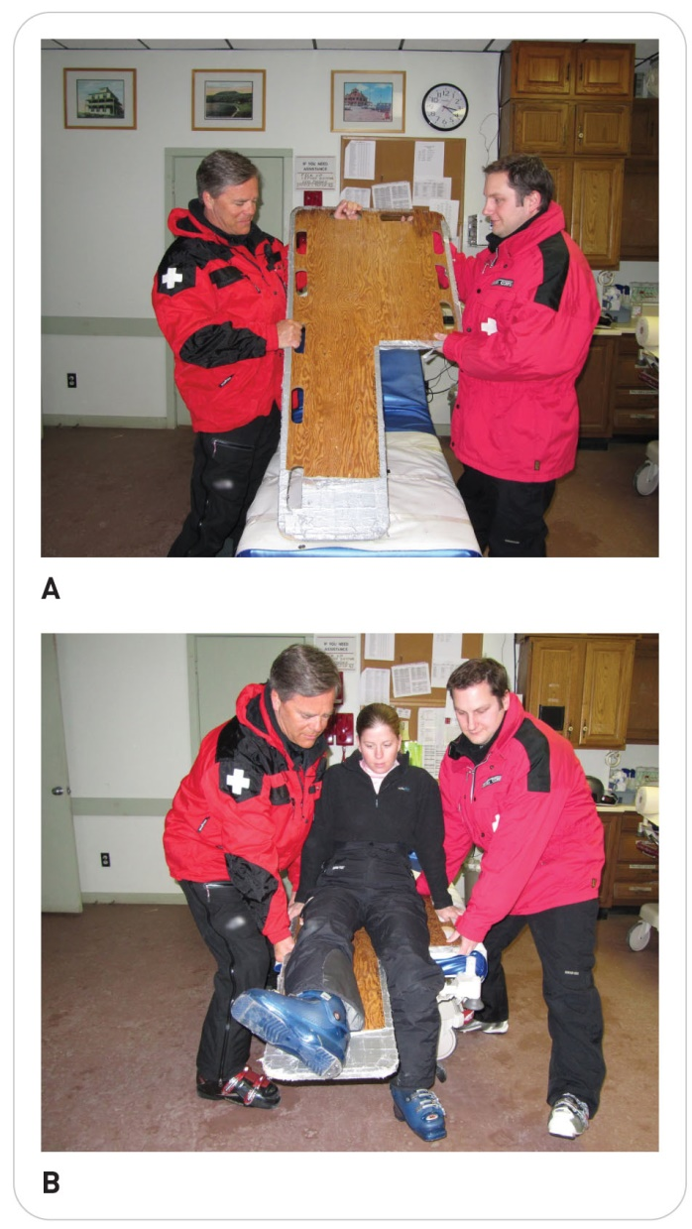
Transport Equipment: Sitting Lifting Device
5-7
Sitting Lifting Device
Made from plywood
A sitting lifting device allows a patient to sit on a board with an injured leg extended.
Handholds cut into the wood enable two rescuers to carry the patient for a short distance.
Third rescuer may be needed to hold the leg on the board.
Especially useful for leg injuries that have been immobilized in a splint
Not used for spinal motion restriction

Slide 53
Transport Equipment: Toboggan
Toboggan
Used as the primary device for transporting patients by ski patrollers
Reinforced fiberglass, aluminum, and steel
The patient is placed into the toboggan using lifting technique that best suits the injury or illness involved.
A toboggan can be used as a spinal protection device.
Proper loading of the patient into the toboggan is important, keeping the spine straight to avoid further injury.

Slide 54
Packaging a Patient

Slide 55
Packaging a Patient
5-9
Packaging is a process in which the patient is adequately prepared for transport, reducing the risk of further injury or worsening of symptoms.
In general, proper patient packaging consists of four steps:
Patient is properly positioned on the transport device, usually a toboggan or litter.
Patient is made as comfortable as possible.
Patient is securely fastened on the transport device.
All necessary medical equipment is transported with the patient.

Slide 56
Packaging a Patient
5-8
Positioning a Patient in a Toboggan
Judgment is always needed when placing a patient in a toboggan.
The first step is deciding whether the patient’s head should be positioned uphill or downhill.
Based on:
The patient’s injuries or illness
The care that has been rendered
The most comfortable way: Injury uphill
On steep terrain, gravity will cause increased weight on the injured part, possibly causing problems.

Slide 57
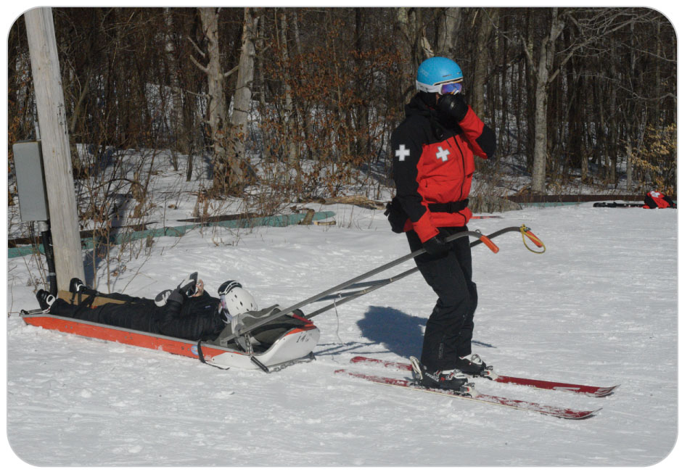
Packaging a Patient: Injury Specific Considerations
5-8
Traction splint:
Ideally, lower-extremity injuries are placed in a head-downhill position.
Head-uphill position harder to maintain traction
Gravity is working against maintaining traction.
The patient will tend to slide downhill, toward the front of the toboggan.
Multiple injuries:
Prioritize and place the more significant injury uphill.

Slide 58
Packaging a Patient: Injury Specific Considerations
5-8
Breathing difficulty:
Head-uphill position
Makes breathing easier because there is less pressure from the abdominal contents pushing upward on the chest cavity
Propping the chest up with a pack or blanket behind the patient’s back may be helpful.
Putting a second person in the sled to hold the patient’s upper body up is difficult and can be extremely dangerous.
Serious head injury:
Generally transported in a head-uphill position

Slide 59
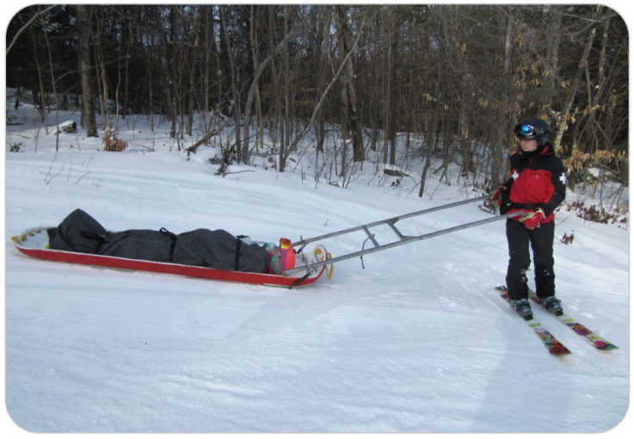
Packaging a Patient: Injury Specific Considerations
5-8
In nearly all injury situations, it is best to place patients on their back (supine).
Exception: Anterior dislocated hip, as the injured leg may be sticking out backwards
Placing patients on their stomach (prone) should be avoided.
May create breathing or airway problems
Typically uncomfortable especially over long transports

Slide 60
Packaging a Patient: Injury Specific Considerations
5-8
Some patients should be put on their side.
A pregnant woman should be placed on her left side.
The vena cava is not compressed by the baby, allowing blood to return to the heart.
For a patient who cannot stop vomiting, use the recovery position, which involves placing the patient on his or her side.
Consider placing the patient on his or her “good” uninjured side in the toboggan.
When the patient needs spinal protection with a backboard, place the patient supine with a collar.

Slide 61
Packaging a Patient: General Considerations
5-8
Make the patient as comfortable as possible.
In freezing conditions, it is important to insulate the patient from the elements.
Cover the patient completely, except for the face.
Conversely, in warm or hot climates, it may be necessary to provide some shade for the patient.
Use padding to lessen the effects of the inevitable bumps that occur during transport.
If spinal injuries are not suspected, a pillow may be placed under the patient’s head and/or knees to provide additional comfort for the ride down the mountain.

Slide 62
Packaging a Patient: General Considerations
5-8
Use the attached straps to secure the patient to the transport device.
Keep the patient from falling out
Extremities that are splinted must remain securely in place.
Must not be allowed to move around
Straps across the chest should be snug.
But not so tight as to restrict the patient’s breathing
Avoid placing straps directly over known injuries.
Doing so may cause pain.
Package essential medical equipment with the patient.

Slide 63
Final Transport of Patients

Slide 64
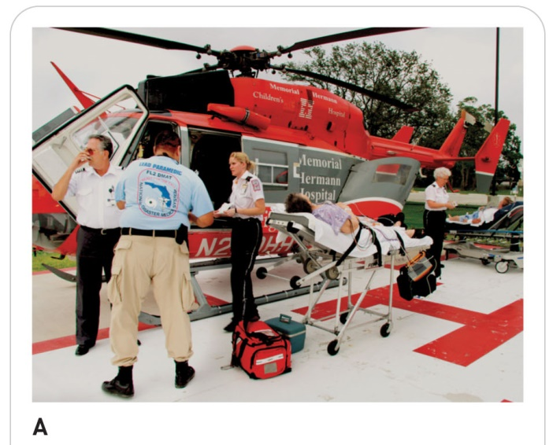
Air Transport
5-10
Patients can be transported by air in two ways: helicopter or airplane.
Helicopters have revolutionized mountain rescue operations.
Ability to land in tight spaces makes them logical rescue and transport vehicles.
Helicopters have limitations regarding their use, including factors relating to:
Weather
Altitude
Weight
Time of day
Need of a flat unobstructed area for landing

Slide 65
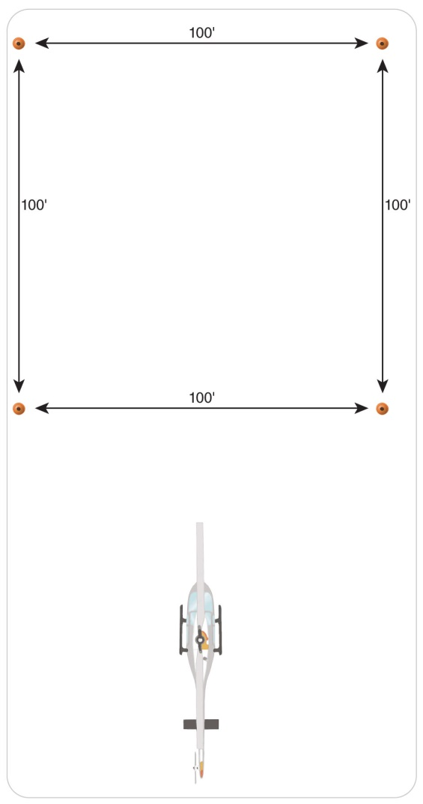
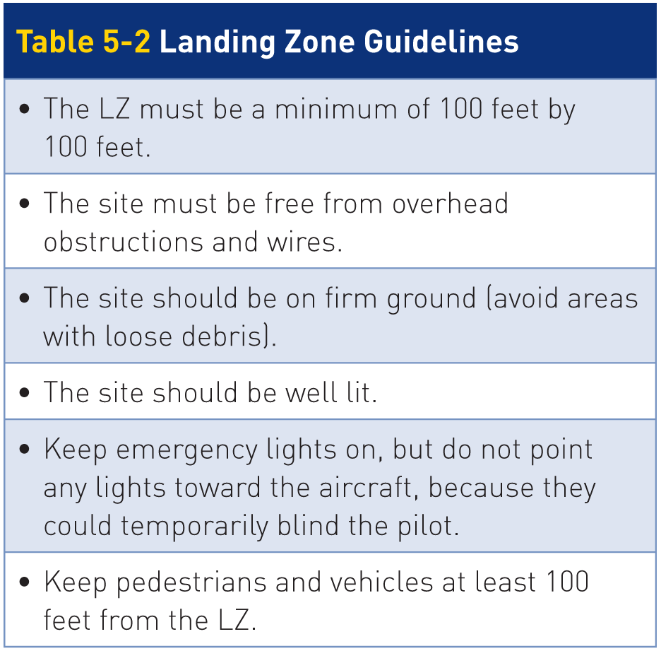
Landing Zone Selection
5-10
Landing zone (LZ): an area picked for the landing of aircraft that meets specific size and safety requirements

Slide 66
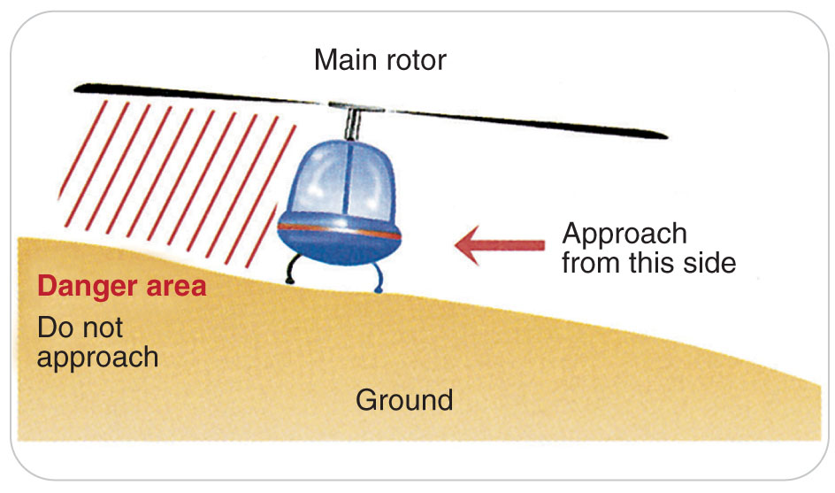
Ground Operations
5-10
Never approach a helicopter from the rear, and approach from the downhill side:

Slide 67
Case Study

Slide 68
CASE PRESENTATION
Having arrived at the bottom of a chairlift that has malfunctioned and stopped, you make sure the chairlift is “locked” and will not move. You find the patient unresponsive on the ground with a chair still hanging above him at the loading area. Helping this person is very difficult, because the chair is obstructing your ability to perform a patient assessment.
What are the first steps you should take?

Slide 69
CASE UPDATE
Because the patient needs a rapid primary assessment and the lift chair is in the way, you perform an urgent shoulder drag, protecting the patient’s head and neck. You firmly grab the unresponsive patient’s jacket on top of the shoulders with both hands, cradle the head between your forearms, and drag him 10 feet from the chair on flat ground, where you immediately perform a primary assessment.
What are the next steps you should take?

Slide 70
CASE OUTCOME
The patient becomes responsive. He is now fully alert and complains of arm pain. Following your full evaluation, you find the patient has had a concussion and a possible broken forearm. Since he is now alert, you take a history. There is no evidence of spinal injury, either by history or exam. You splint the arm, place him securely in a toboggan, and transport him to the aid room. Because of his previous unresponsiveness, you recommend transport to the hospital. Later, you learn he had a mild concussion that resolved and was placed in a cast for a forearm fracture.

Slide 71
OEC Skill Activities

Slide 72
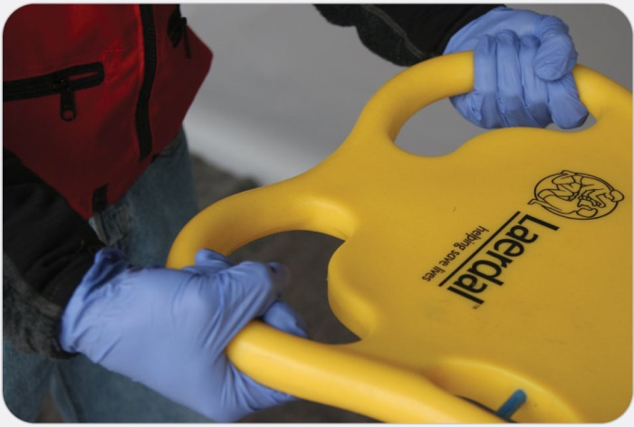
OEC Skill 5-1: Performing the Power Grip
1. Place your hands, palms up, approximately 10 inches apart.

Slide 73
OEC Skill 5-1: Performing the Power Grip
2. Reach underneath the object that is being lifted and firmly grasp the object, closing your hands.

Slide 74
OEC Skill 5-1: Performing the Power Grip
3. If possible, loop your thumb over your index and middle fingers.

Slide 75
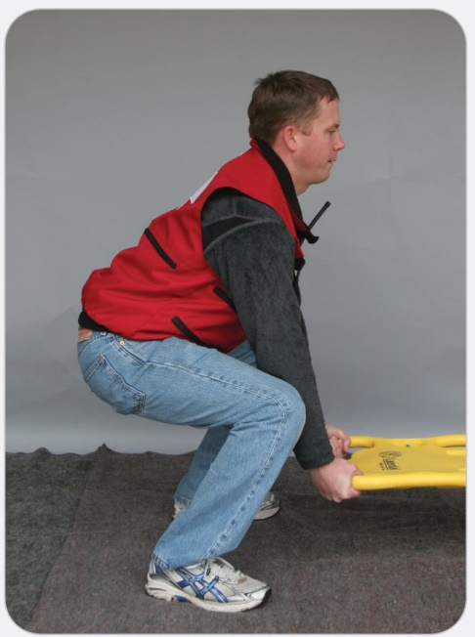
OEC Skill 5-2: Performing the Power Lift
1. Place your hands, palms up, approximately 10 inches apart. Maintain a wide stance by placing your feet shoulder-width apart (approximately 15 inches apart). Bend your knees and squat, keeping your back straight and your shoulders over the spine. Firmly grasp the item to be lifted with your palms up (power grip).

Slide 76
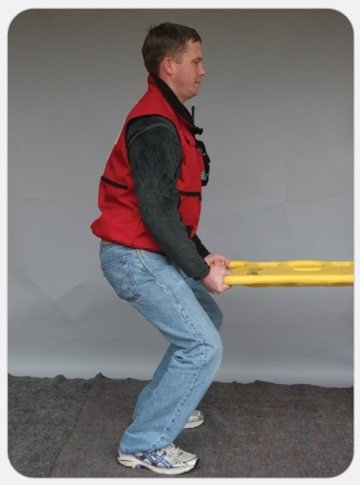
OEC Skill 5-2: Performing the Power Lift
2. Keep your back straight and your head up.

Slide 77
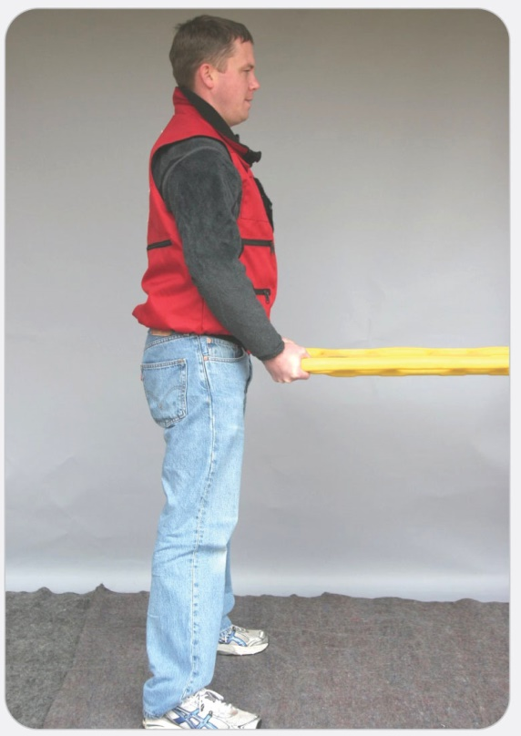
OEC Skill 5-2: Performing the Power Lift
3. Straighten your legs to lift the object.

Slide 78
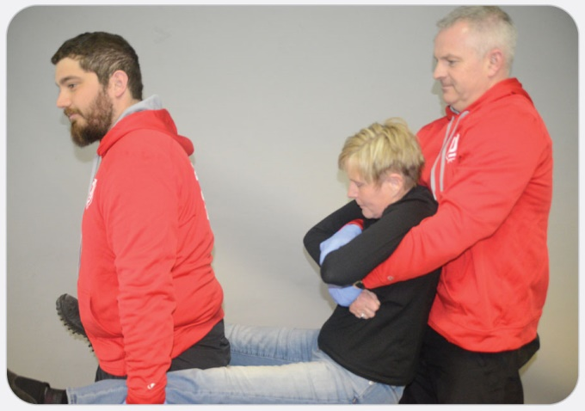
OEC Skill 5-3: Performing the Extremity Lift
1. The rescuers place the patient in a sitting position with the arms crossed on the chest. Rescuer 1 reaches under the armpits, grabbing the patient’s wrists.

Slide 79
OEC Skill 5-3: Performing the Extremity Lift
2. Rescuer 2 holds and supports the patient’s legs at the knees.

Slide 80
OEC Skill 5-3: Performing the Extremity Lift
3. When a command is given, both rescuers move into a crouching position, keeping their spines straight and heads up, and then lift the patient at the same time.

Slide 81
OEC Skill 5-3: Performing the Extremity Lift
4. Once both rescuers are standing, they may carry the patient.

Slide 82
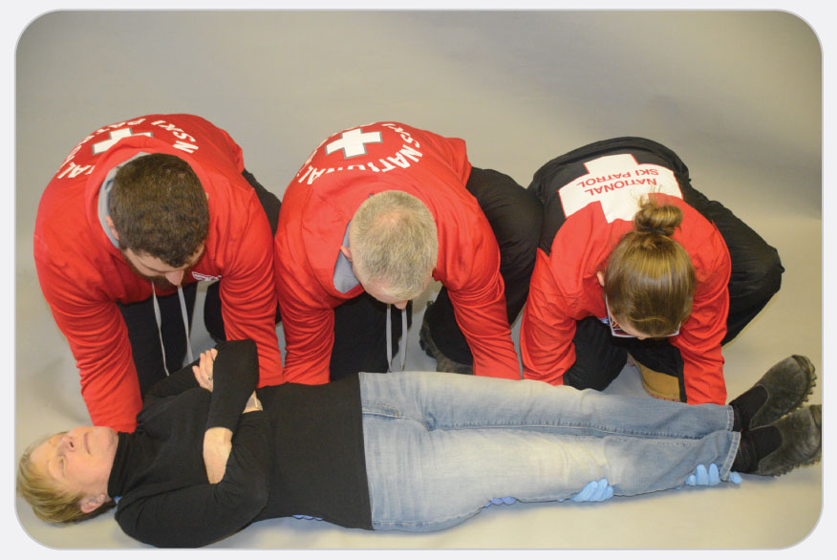
OEC Skill 5-4: Performing the Direct Ground Lift
1. All the rescuers kneel along the same side of the patient.
If there are two rescuers, one should be at the patient’s head and chest, and the other should be at the patient’s pelvis and knees.
If there are three rescuers, they should be at the patient’s head, chest/waist, and buttocks/knees.
If there are four rescuers, they should be at the patient’s head, chest, waist, and knees.

Slide 83
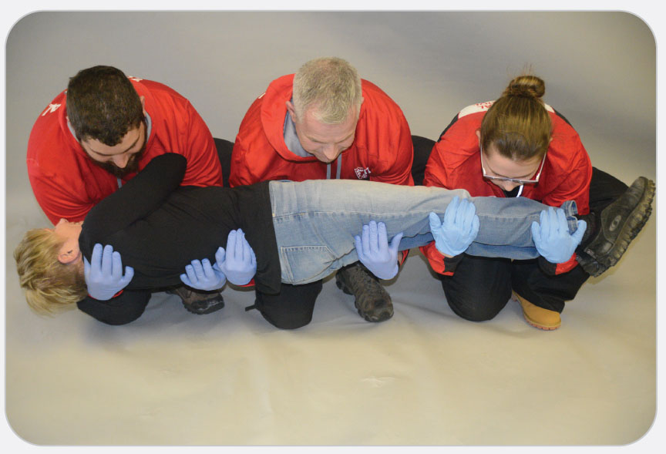
OEC Skill 5-4: Performing the Direct Ground Lift
2. The rescuers place their arms under the patient, with one rescuer holding the head. The rescuer at the patient’s head usually directs the lift. When the person in charge gives the command, the rescuers roll the patient toward their chests.

Slide 84
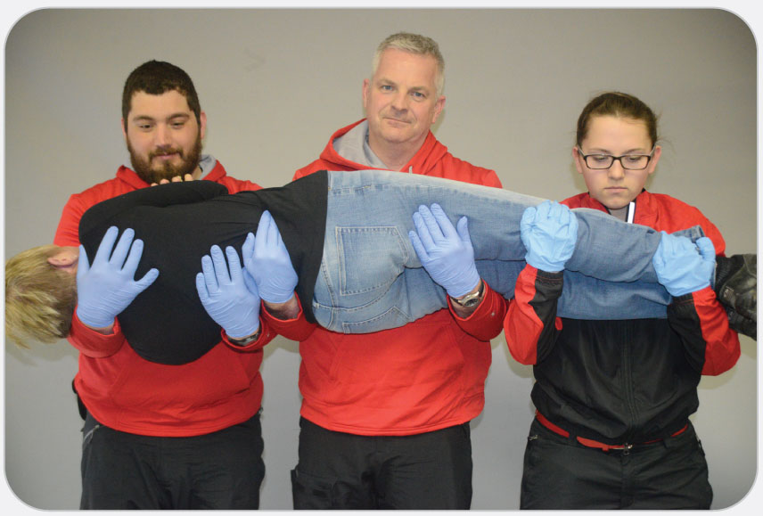
OEC Skill 5-4: Performing the Direct Ground Lift
3. On command, the rescuers all stand in unison. On command, the rescuers lower the patient onto the equipment in unison.

Slide 85
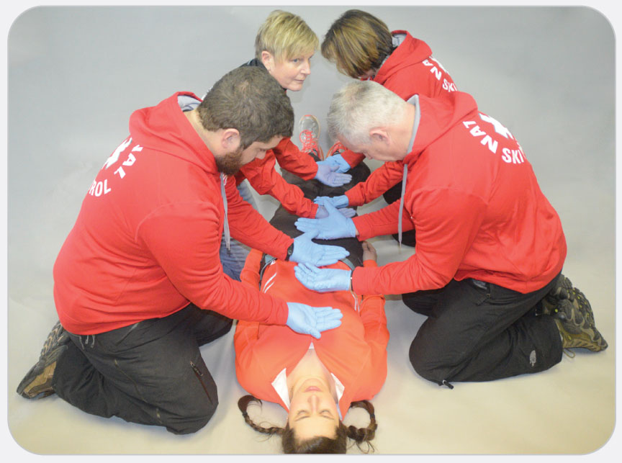
OEC Skill 5-5: Performing the BEAN/Bridge Lift
1. Two or three rescuers kneel on either side of the patient, staggering their positions. An additional rescuer or bystander will be required to move the backboard into position at the appropriate time.
If there are four rescuers, they should be at the patient’s head, chest, waist, and knees. An additional rescuer or bystander will be required to move the backboard into position at the appropriate time.
If there are five rescuers, they should be at the patient’s head, chest, waist, thighs, and knees. An additional rescuer or bystander will be required to move the backboard into position at the appropriate time.
It is recommended that rescuers rehearse the lift by placing their hands on top of the patient to determine where their hands will be placed under the patient. The hands are alternately sequenced to ensure sufficient coverage.

Slide 86
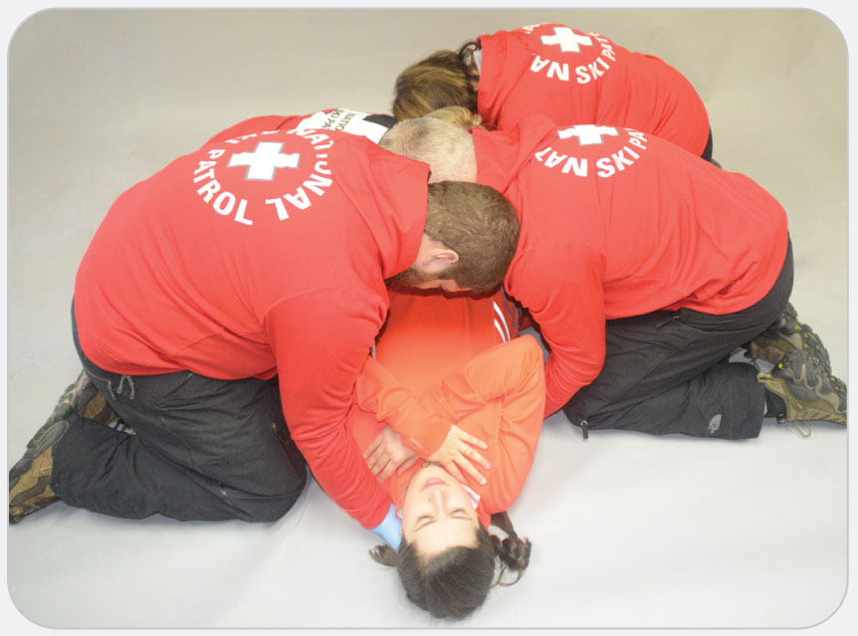
OEC Skill 5-5: Performing the BEAN/Bridge Lift
2. Rescuers then place their arms under the patient, following the same pattern as rehearsed. Ideally, the rescuers’ arms should be nearly touching.

Slide 87
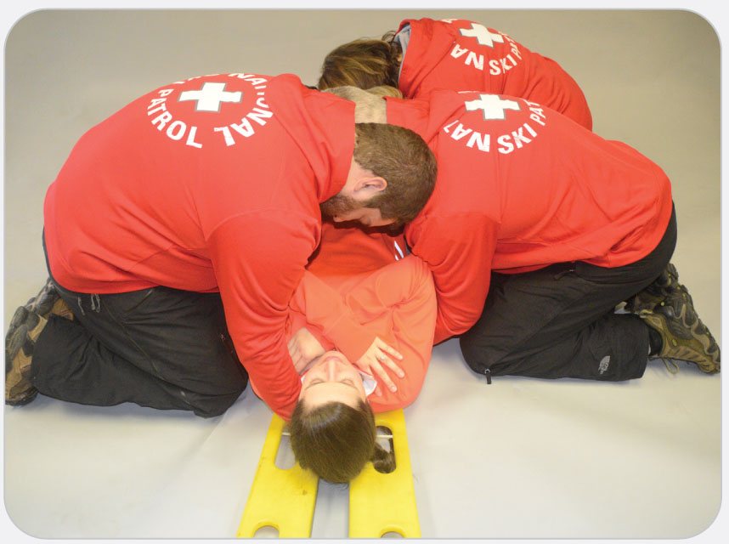
OEC Skill 5-5: Performing the BEAN/Bridge Lift
3. One rescuer prepares the backboard or other device. The rescuer closest to the patient’s head directs the lift. On command, rescuers raise the patient about 5 to 6 inches.

Slide 88
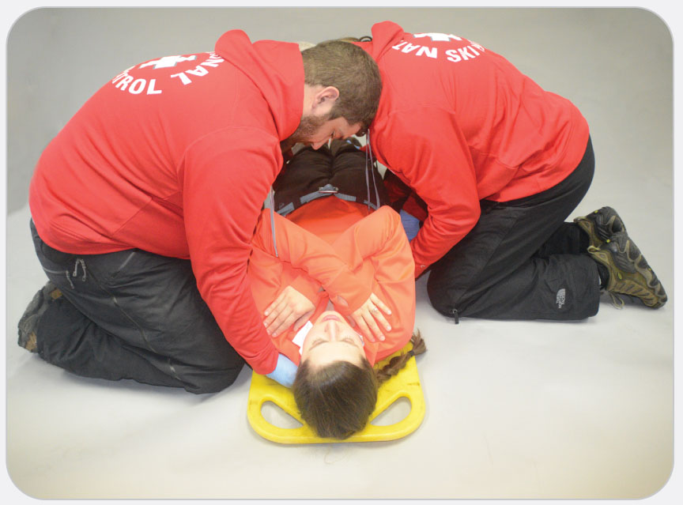
OEC Skill 5-5: Performing the BEAN/Bridge Lift
4. The backboard is positioned under the patient, sliding it up from the patient’s feet. To lower the patient, the steps are reversed.

Slide 89
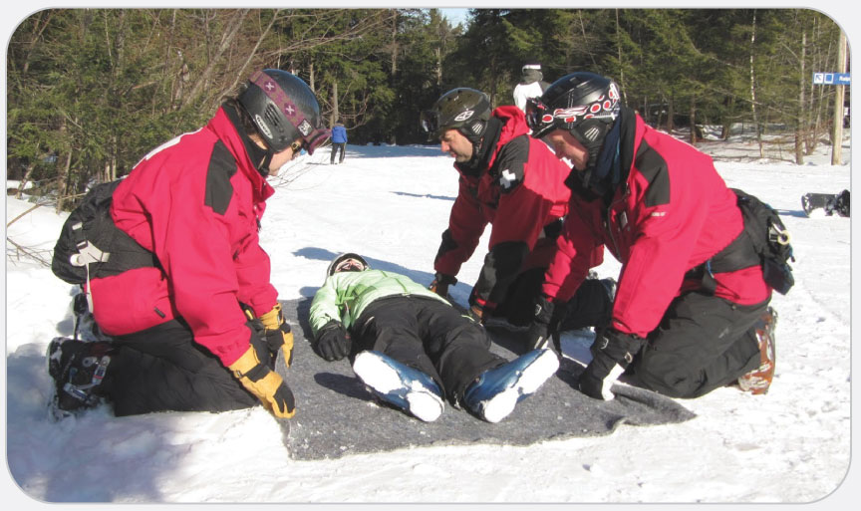
OEC Skill 5-6: Performing the Draw-Sheet, Plastic Slider, or Flat Transfer Lift
1. The rescuers place a sheet, blanket, or plastic device under the patient, using a logroll in both directions to protect the spine if necessary.

Slide 90
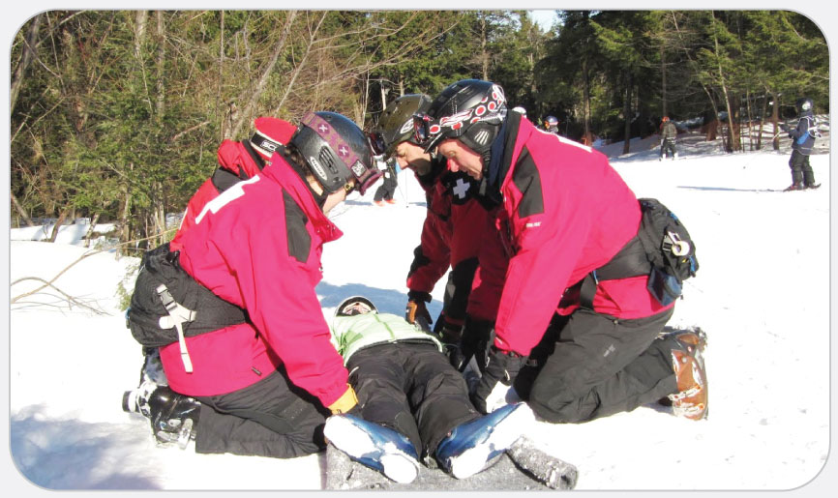
OEC Skill 5-6: Performing the Draw-Sheet, Plastic Slider, or Flat Transfer Lift
2. One to three rescuers should position themselves on each side of the patient and should roll the edges of the sheet up to the patient’s sides.

Slide 91
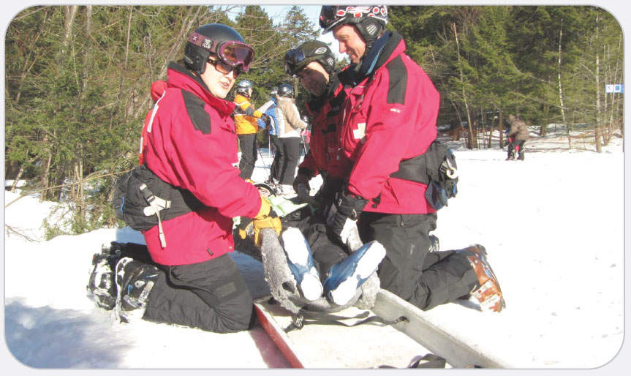
OEC Skill 5-6: Performing the Draw-Sheet, Plastic Slider, or Flat Transfer Lift
3. When the command is given, the rescuers gently lift while sliding the patient to the destination bed, table, or other flat surface. They must keep the patient’s body in alignment when transferring.

Slide 92
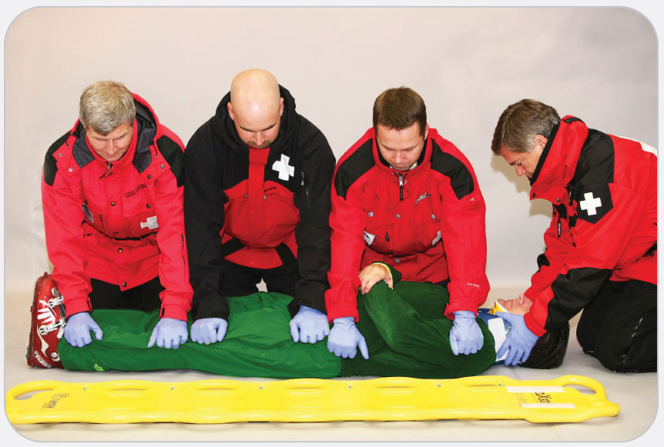
OEC Skill 5-7: Logrolling a Supine Patient onto a Backboard
1. Three or four rescuers kneel on the side of the patient away from the backboard, staggering their positions. These rescuers have their knees up against the patient. An additional rescuer needs to maintain proper head and neck position of the patient.
If the patient is unresponsive, it may help to tie the patient’s ankles and feet together with a cravat first.
If there are three rescuers, they should be at the patient’s head, chest, and thighs. If there are four rescuers, they should be at the patient’s head, chest, waist, and knees.
It is recommended that rescuers first place their hands on the top of the patient to determine where their hands will be placed under the patient. The hands are alternately sequenced (crisscrossed) to ensure sufficient coverage.

Slide 93
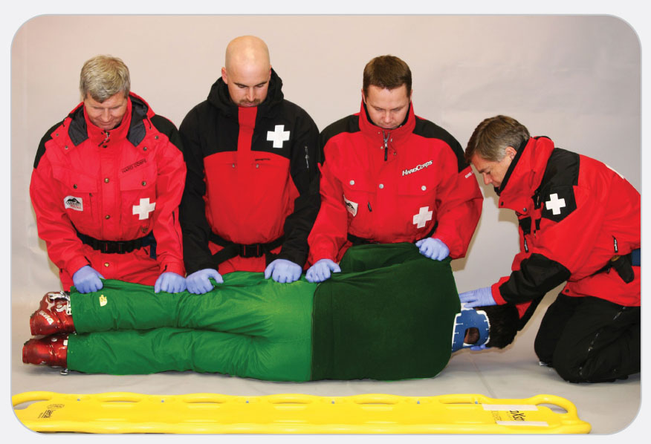
OEC Skill 5-7: Logrolling a Supine Patient onto a Backboard
2. Usually the rescuer at the head is the lead. While maintaining the head in axial alignment, the lead calls the roll. Rescuers reach across the patient and grab the clothing firmly, following the same pattern as rehearsed. Ideally, the rescuers’ arms should be nearly touching. When the lead rescuer gives the command, the rescuers roll the patient onto the side, toward themselves and up against their thighs, keeping the spine straight. The rescuer at the head keeps the head and neck in alignment with the rest of the spine.

Slide 94
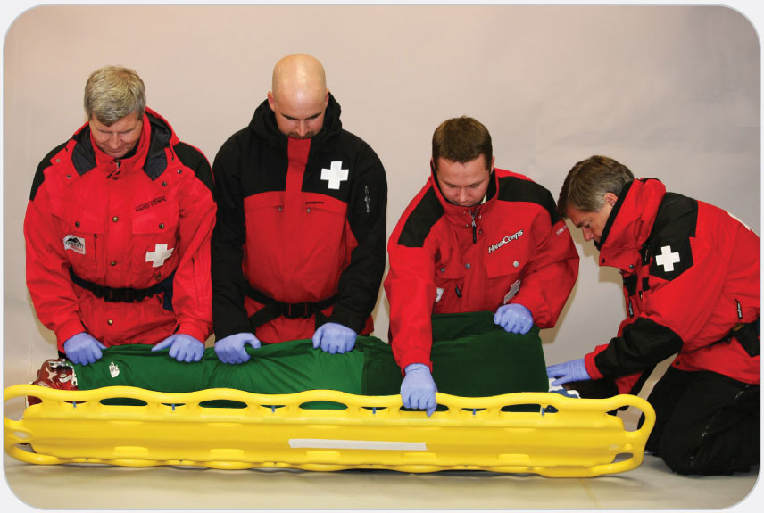
OEC Skill 5-7: Logrolling a Supine Patient onto a Backboard
3. On another command, rescuers roll the patient back onto the backboard or stretcher, keeping the spine straight.

Slide 95
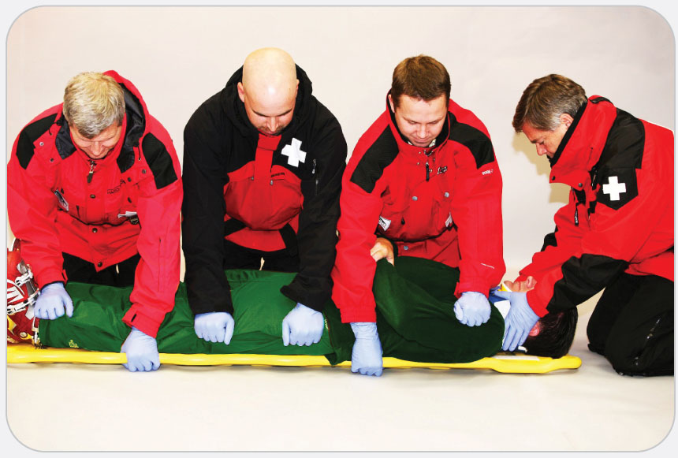
OEC Skill 5-7: Logrolling a Supine Patient onto a Backboard
4. If the patient is not centered on the backboard, long-axis drags (described later), keeping the spine straight and pulling under the patient’s shoulders and then on the feet, are then used to center the patient. A side slide, moving the patient in a coordinated fashion so that the spine remains in alignment, is acceptable.

Slide 96
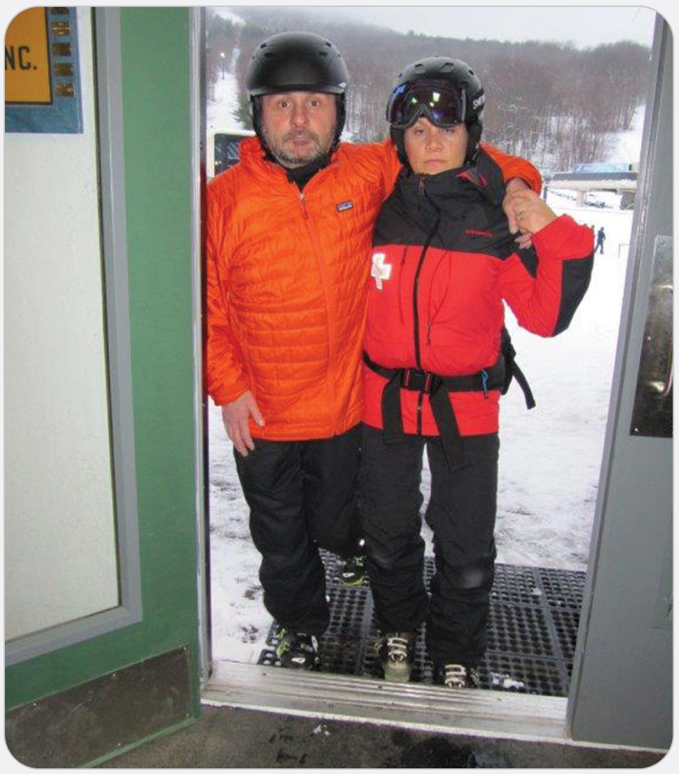
OEC Skill 5-8: Performing the Human Crutch
1. The rescuer assists the patient to stand on the good leg.

Slide 97
OEC Skill 5-8: Performing the Human Crutch
2. The patient places an arm over the rescuer’s shoulder on the same side as the injured leg.

Slide 98
OEC Skill 5-8: Performing the Human Crutch
3. The rescuer grasps the patient’s wrist with one hand while simultaneously wrapping the opposite hand around the patient’s waist, providing support. The rescuer also may hold on to the patient’s belt or pants.

Slide 99
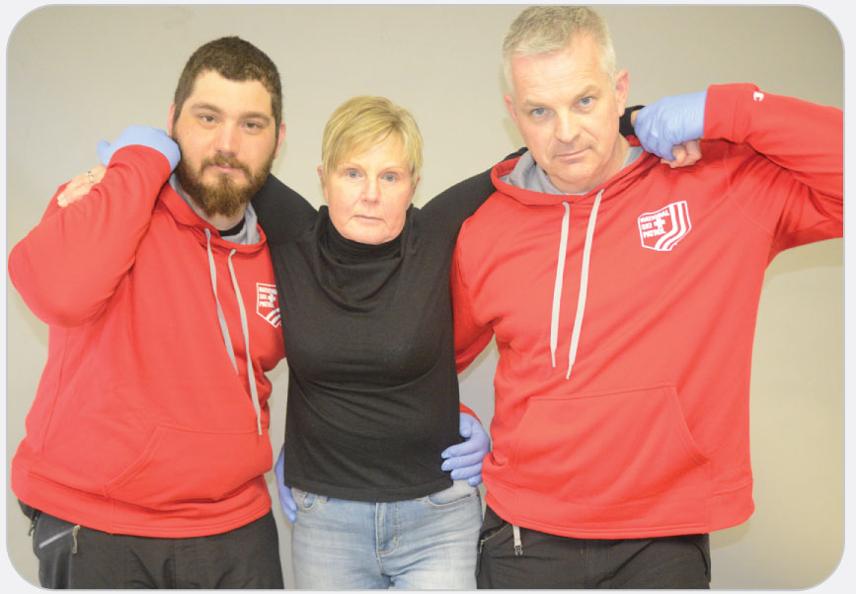
OEC Skill 5-9: Performing the Two-Person Assist
1. The rescuers assist the patient to stand on the good leg.

Slide 100
OEC Skill 5-9: Performing the Two-Person Assist
2. The rescuers stand on either side of the patient. The patient places an arm over each rescuer’s shoulder.

Slide 101
OEC Skill 5-9: Performing the Two-Person Assist
3. Each rescuer grasps the patient’s wrist on their side. The rescuers then wrap their opposite hand around the patient’s waist, or the two rescuers can hold on to the patient’s belt or pants on each side.

Slide 102
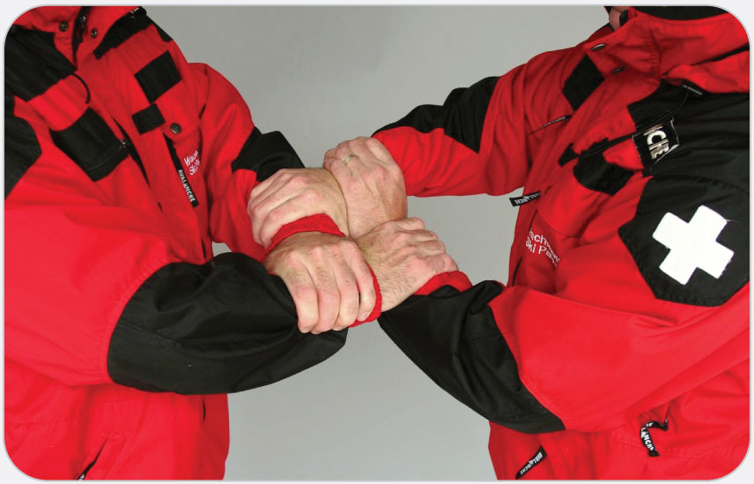
OEC Skill 5-10: Performing the Chair Carry
1. Two rescuers stand to either side of the patient; they should be facing each other. This carry is easier if both rescuers are close to same height.

Slide 103
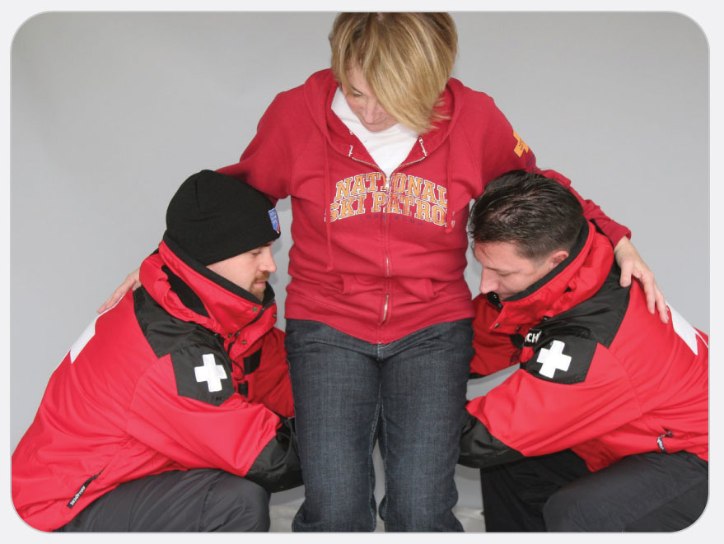
OEC Skill 5-10: Performing the Chair Carry
2. The rescuers squat down next to the patient, using good body mechanics, and the patient places his or her arms around the rescuers’ shoulders and necks.

Slide 104
OEC Skill 5-10: Performing the Chair Carry
3. The rescuers extend their dominant arm out in front of their body. They grasp their extended arm just below the elbow with their other hand then slowly bring the “chair” under the patient. The rescuers lift the patient off the ground.

Slide 105
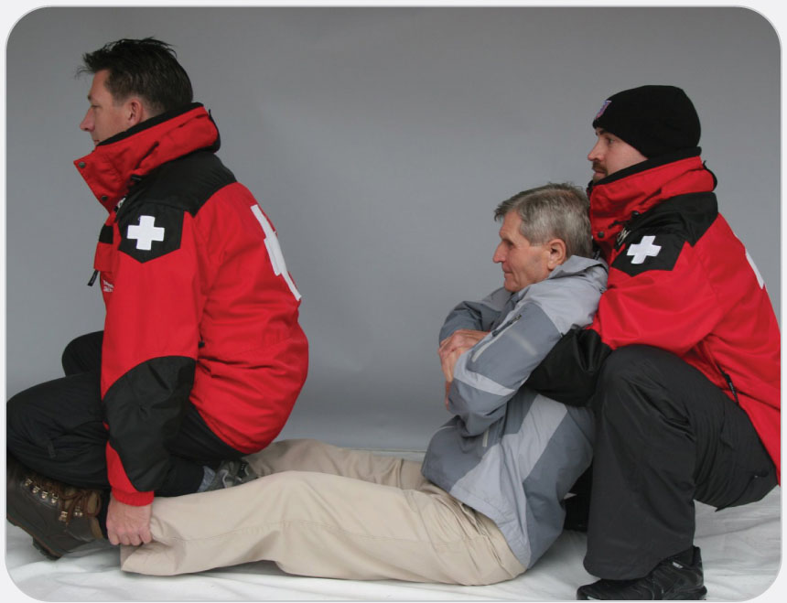
OEC Skill 5-11: Performing the Fore-and-Aft Carry
1. The rescuers place the patient in a sitting position.

Slide 106
OEC Skill 5-11: Performing the Fore-and-Aft Carry
2. Rescuer 1 (the taller of the two rescuers, located at the patient’s head) folds the patient’s arms across the patient’s chest, reaches under the armpits, and grabs the wrists.

Slide 107
OEC Skill 5-11: Performing the Fore-and-Aft Carry
3. Facing away from the patient, Rescuer 2 kneels between the patient’s legs and either grasps behind the patient’s knees or grasps the patient’s lower legs.

Slide 108
OEC Skill 5-11: Performing the Fore-and-Aft Carry
4. On a command, both rescuers crouch, keeping their backs straight, and then stand, lifting the patient in unison.

Slide 109
OEC Skill 5-11: Performing the Fore-and-Aft Carry
5. Once both rescuers are standing, they may carry the patient.

Slide 110
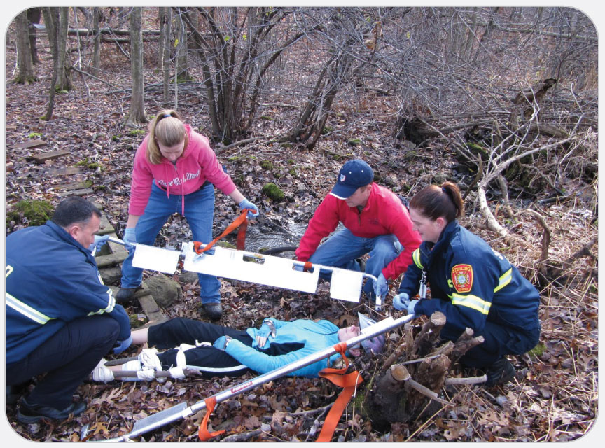
OEC Skill 5-12: Using a Scoop Stretcher
1. Disconnect the two sides of the stretcher. Place the two parts of the stretcher beside the patient and adjust for length, 1 to 3 inches longer than the patient.

Slide 111
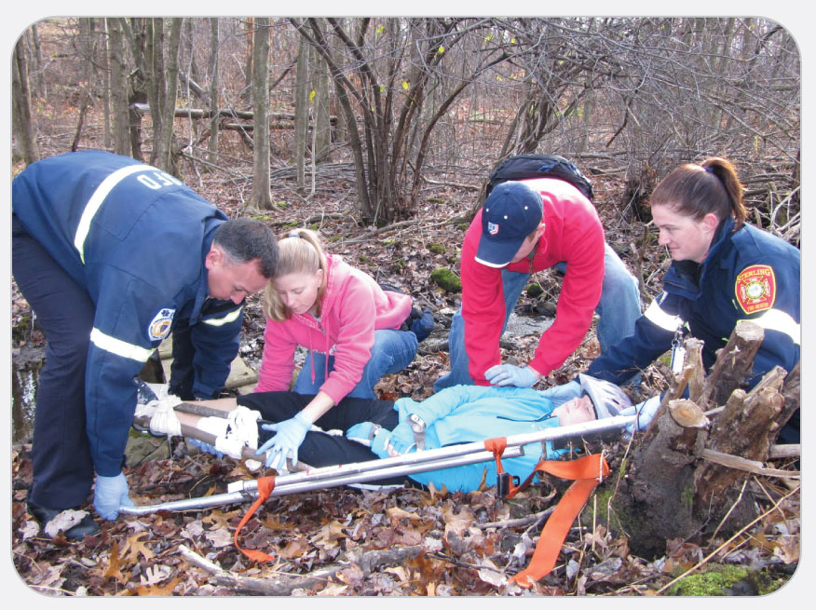
OEC Skill 5-12: Using a Scoop Stretcher
2. Ensure that both sides are the same length by checking that the number of exposed holes in the tubing is the same on both sides. Slide both parts of the stretcher beneath the patient until the mechanical fittings at each end touch. Slightly lift the patient to avoid pinching the patient’s backside or your fingers.

Slide 112
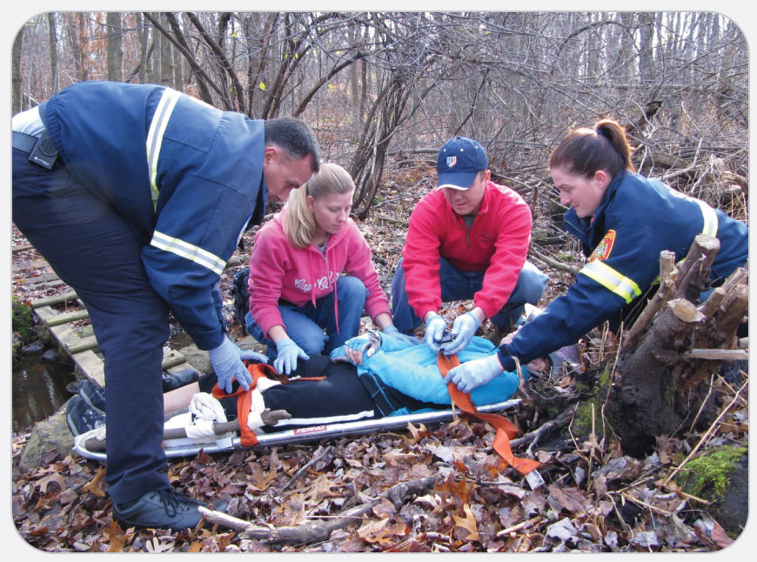
OEC Skill 5-12: Using a Scoop Stretcher
3. Connect the two sides of the stretcher by firmly pressing the two ends back together until you hear a loud “click” at each end. Secure the patient to the device using straps or a commercial device. To remove the stretcher, reverse the procedure.

