Slide 1
Communications and Documentation
CHAPTER 8

Slide 2
The following presentation will utilize two symbols to identify material necessary for an OEC Technician to comprehend:
key term
Meets a Chapter Objective.
This symbol will have the corresponding Objective Number denoted within.
Identifies a Key Term.
The Key Term will be underlined for easy identification.

Slide 3
Objectives
8-1 Define patient privacy.
8-2 Explain the types of medical communication and how they are used.
8-3 List the content that should be included in all verbal communications using the acronym SAILER.
8-4 Explain what a handoff report is used for and what information it contains.
8-5 Explain what field care notes are for and what information would be placed in them.

Slide 4
Objectives
8-6 Explain the parts of an incident report form.
8-7 Explain the parts of a patient care report.
8-8 Define the purpose of an incident investigation team.
8-9 Describe how to correct a written report.
8-10 Define the parts of a “clinical picture.”

Slide 5
Key Terms
Communication
Field care notes
Handoff report
Incident investigation (II) team
Incident report form
Patient care report (PCR)
Patient Privacy

Slide 6
Chapter Overview

Slide 7
Chapter Overview
OEC technicians evaluate patients whose injuries or illnesses range from a scratch on the arm to a life-threatening ruptured spleen.
After assessing and collecting information about the patient, you will communicate both orally and in written form your findings and interventions to other medical personnel.

Slide 8
Chapter Overview
During “handoff” of a patient, you must tell the next prehospital provider the:
Information you have gathered
Care rendered
Patient’s response
Medical communication needs to be consistent.
Information passed along the chain may be:
Critical in patient’s diagnosis and treatment at the definitive care center
Used in the future to determine the outcome of any legal case related to patient’s situation

Slide 9
Chapter Overview
Important for all medical professionals to use the same “language” when discussing a patient’s condition.
Must first learn the vocabulary used by medical personnel
Communication is a process whereby information is transmitted from one person to another.
Miscommunication can adversely affect patient’s outcome.

Slide 10
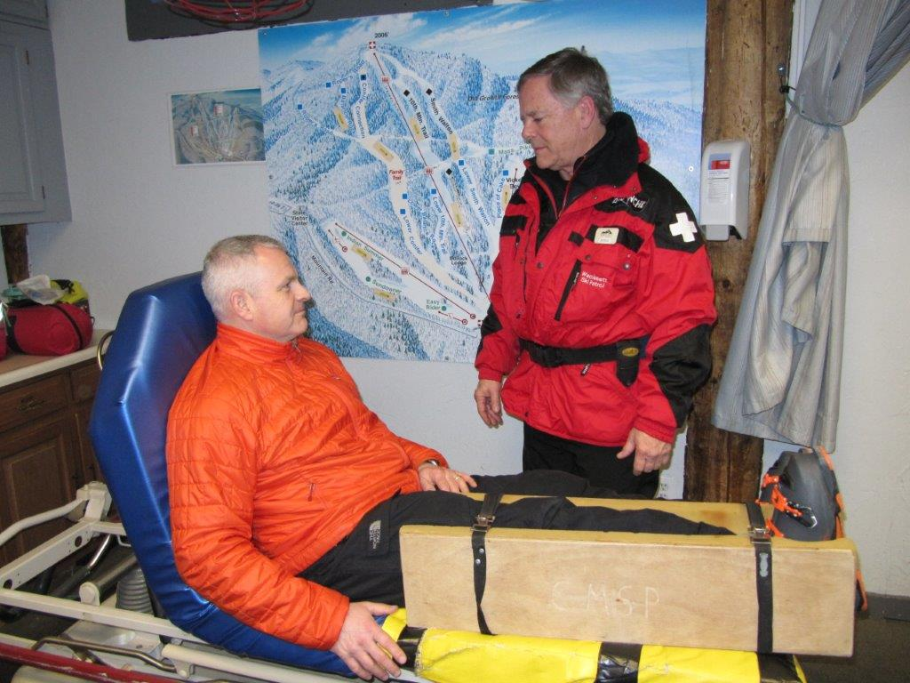
Chapter Overview
Communication and proper documentation are essential skills every OEC technician must possess.

Slide 11
Medical Communication

Slide 12
Medical Communication
8-1
Medical communication is a specialized form of communication used to transmit health care information.
OEC technicians primarily transmit information about an incident and a patient from one person to another.
Medical communications are generally considered “privileged communications” as it contains personal protected information.
Patient privacy is the practice of maintaining the security and confidentiality of patient records.
All medical personnel need to respect patient’s confidentiality at all times.
Patient information should be shared only with authorized personnel who have a direct need for the information.
Safeguard medical communications and prevent unauthorized access to these sensitive data.

Slide 13
Medical Communication
8-2
Must be proficient in two types of medical communication:
Oral communication
Written documentation
During assessment, nonverbal communications are also important.
You can pick up clues by watching the other person’s actions.
Nonverbal communication includes behaviors such as:
Facial expressions
Eye movements
Hand gestures
Touch
Vocal tone
Body posture
Positioning
Movement

Slide 14
Oral Communication

Slide 15
Medical Communication: Oral
8-2
Oral Communication
Oral communication is the transmission of information verbally.
Whether by phone, by radio, or in person
Rescuer-to-patient communication begins when you first talk to a patient on scene.
Use clear, concise sentences a patient can understand.
Children or those with a disability may need a simpler explanation of what you intend to do.
Someone with a disability may require a different communication method, adaptive to the situation.

Slide 16
Medical Communication: Oral
8-2
Talking to another prehospital provider:
Speak in simple, well-organized, short sentences.
Use appropriate medical terminology.
Plain English, not codes
Use oral communication to convey information to other health care providers.
Such as when transferring the care of a patient to an EMT or paramedic

Slide 17
Medical Communication: Oral
8-2
Communication with Dispatch/Aid Room:
After a general dispatch call has gone out to all rescuers that there is a possible accident, you respond.
It is best to radio back to dispatch that you are on scene:
“This is Paul, on scene at Fiddler’s Elbow. Standby for further information.”
Lets the dispatcher know someone has arrived to patient, is conducting a patient assessment, and will be assisting the patient shortly
In many cases, management wants dispatchers to record the time when a call is dispatched and the first rescuer arrives on scene.

Slide 18
Medical Communication: Oral
8-2
After performing the primary patient assessment, you need to tell dispatch:
What your patient’s condition is
What equipment or assistance you need

Slide 19
Medical Communication: Oral
8-3
Easy way to remember the important pieces of information that dispatch needs is to use the acronym SAILER:
S Sex of the patient
A Age of the patient
I Incident, chief complaint
L Location of incident/patient
E Equipment needed (e.g., splints, backboards, toboggans)
R Resources needed (e.g., extra help, security personnel, management, BLS or ALS ambulance)

Slide 20
Medical Communication: Oral
8-2
With few exceptions, you should be able to convey the information in 30 seconds or less.
Always make sure dispatch acknowledges your message.
Dispatcher should repeat the key portion of your message back to you so that miscommunication is less likely.
Local protocols will dictate the actual process to be followed.

Slide 21
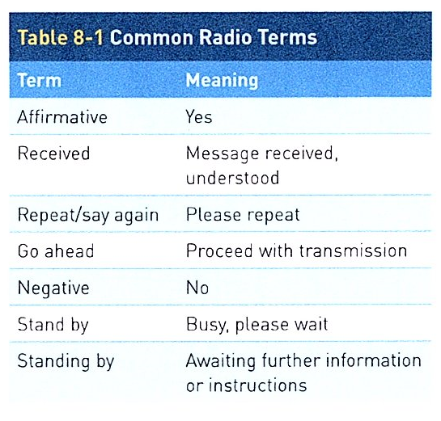
Medical Communication: Radio Terminology
8-2
The use of common language and terms is especially critical when communicating via radio.
Is a key factor in improving mutual understanding among rescue personnel

Slide 22
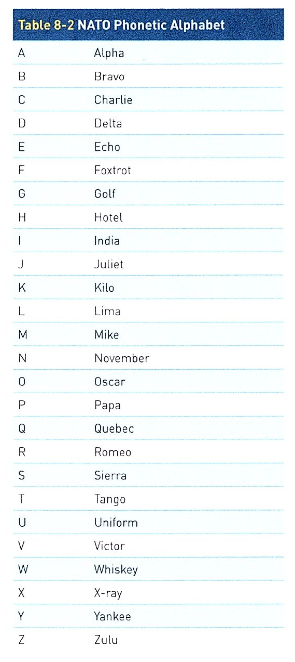
Medical Communication: NATO Phonetic Alphabet
8-2
NATO Phonetic Alphabet
Occasionally, unusual words, acronyms, or critical combinations of letters must be spelled out to others via radio.
Easily accomplished by using the NATO phonetic alphabet
For example: to communicate “Ben” as a lost child’s name, say “B as in Bravo, E as in Echo, N as in November.”

Slide 23
Medical Communication: On Scene
8-2
Communication with Other Pre-hospital Responders
As other rescuers arrive on scene, you should give each of them a concise oral report.
Includes a brief description of patient’s problems and instructions about how these rescuers can help you
Direct your assistants in a clear, calm, and professional manner, making sure they understand you.
As the “lead patroller” at the scene, continue to provide directions and communicate with all on-scene assistants as care is given and preparation for transport occurs.
If there is more than one patient, direct other rescuers to help other patients.

Slide 24
Medical Communication: On Scene
8-2
Listen to your helpers’ suggestions.
Use their ideas while maintaining overall management of the incident.
Never openly criticize another responder on scene.
Better to listen to their ideas and congenially come to a meeting of the minds
Effective communication increases the efficiency of rescue operations.
Decreases on-scene problems
Especially during incidents involving multiple patients

Slide 25
Medical Communication: On Scene
8-2
If you are alone on scene, a bystander may be willing and able to help.
Unless the person identifies himself or herself as a qualified medical provider, become a teacher.
Use simple words and giving the untrained person step-by-step instructions.
Talk at the level of a layperson, not medically.

Slide 26
Medical Communication: Oral Handoff
8-4
After the patient has arrived in the first-aid station or medical facility:
Provide a concise oral handoff report to the person now caring for the patient.
The handoff report contains more detailed information about the patient than that provided to dispatch.
Should emphasize patient’s current condition, treatment, and possible requirements

Slide 27
Medical Communication: Oral Handoff
8-4
May include additional information, such as:
Patient’s name
Age
Chief complaint
Nature of illness or mechanism of injury
Assessment findings (positives and negatives)
All treatments given
Response to treatment
Serial sets of vital signs (including current)
Any immediate patient care requirements
After delivering your handoff report, ask the personnel assuming patient’s care if they have any questions.
A clear and concise handoff report should take 30 to 60 seconds to complete.

Slide 28
Written Communication

Slide 29
Medical Communication: Written Communication
8-2
Written Communication
Field care notes and patient care reports are written communications used to document patient encounters.
Usually are a part of patient’s permanent medical record
Information may be given to the EMT or paramedic who transfers the patient by ambulance as part of a written “handoff report.”
May be used for research purposes, to identify or document trends, for quality-improvement reasons, and to assist in risk management
Used as medical-legal records
In most ski areas, these written incident reports become the cornerstone of incident risk management.

Slide 30
Medical Communication: Written Communication
8-2
Learning to properly document and preserve what happened during a patient encounter is vital for OEC technicians and the ski area alike.
You may encounter the following three types of written communication:
Field care notes
Incident report forms
Patient care reports

Slide 31
Written Communication: Field Care Notes
8-5
Field Care Notes
It is common for OEC technicians and other rescue personnel to take notes while they are involved with rescue operations.
Generally include essential information about the incident, including the:
Person’s name, level of consciousness, serial vital signs, medications, and other relevant data
Witnesses’ names and contact information may need to be recorded.
Often, information such as vital signs is documented along a timeline and is later transferred to, or becomes a part of, a patient care report, depending on your area’s local protocol.

Slide 32
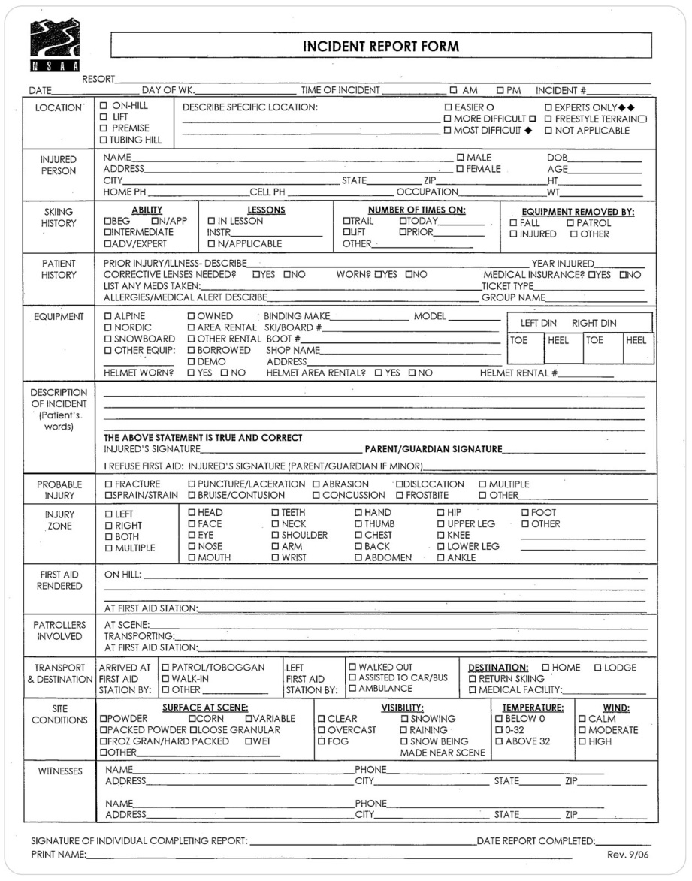
Medical Communication: Incident Report Form
8-6
Incident Report Form
Most OEC technicians use an incident report form published by the National Ski Areas Association or a ski area’s insurance company.
Contains all the fundamental information needed to document an incident
Properly completing this form is a skill OEC technicians MUST learn.
One part of this form asks the patient to describe what happened.
Always document and preserve any patient statements, such as, “I knew I was going too fast” or “I should not have been skiing that slope.”

Slide 33
Medical Communication: Incident Report Form
8-6
The information collected in an Incident Report Form are:
Patient identification information
Cause of the injury (MOI/NOI)
Names of individuals at the incident, including OEC technicians and witnesses
Patient’s statement concerning what caused the incident (must be in the patient’s own words)
Patrollers on scene and in the aide room and what they did to assist
Emergency care given in the aid room
Further comments about the incident
Witness information

Slide 34
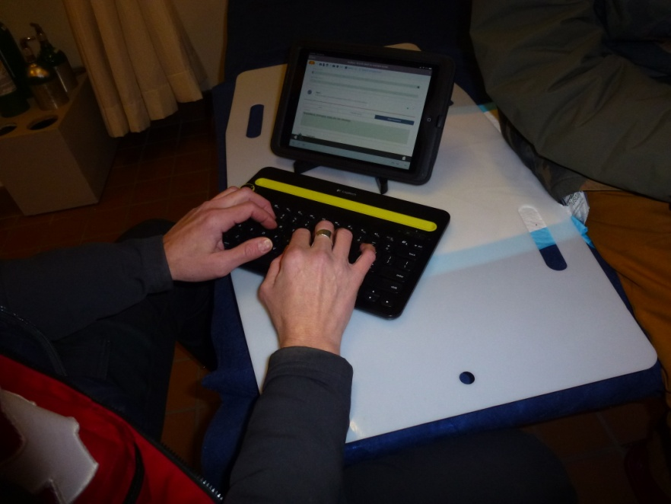
Medical Communication: Patient Care Reports
8-7
Patient Care Reports
When a patient needs additional medical documentation because of significant injury or illness, a patient care report (PCR) form is used.
A PCR is used to record specific information about the medical care provided to the patient.
This report becomes part of patient’s permanent medical record.
Your resort’s risk manager and local medical adviser should approve any PCR used.

Slide 35
Medical Communication: Patient Care Reports
8-7
Based on local protocol, a copy of the PCR might be a part of the handoff report to the EMS provider and accompany the patient to a definitive care facility.
PCRs have several formats:
Closed
Open
Mixed
A closed-format PCR has a series of check boxes or limited fill-in-the-blank sections, allowing the PCR to be completed quickly.
Favored by members of a multitiered emergency care system in which the field care of the patient is routinely transferred to other providers
Many ambulance carriers use this form.

Slide 36
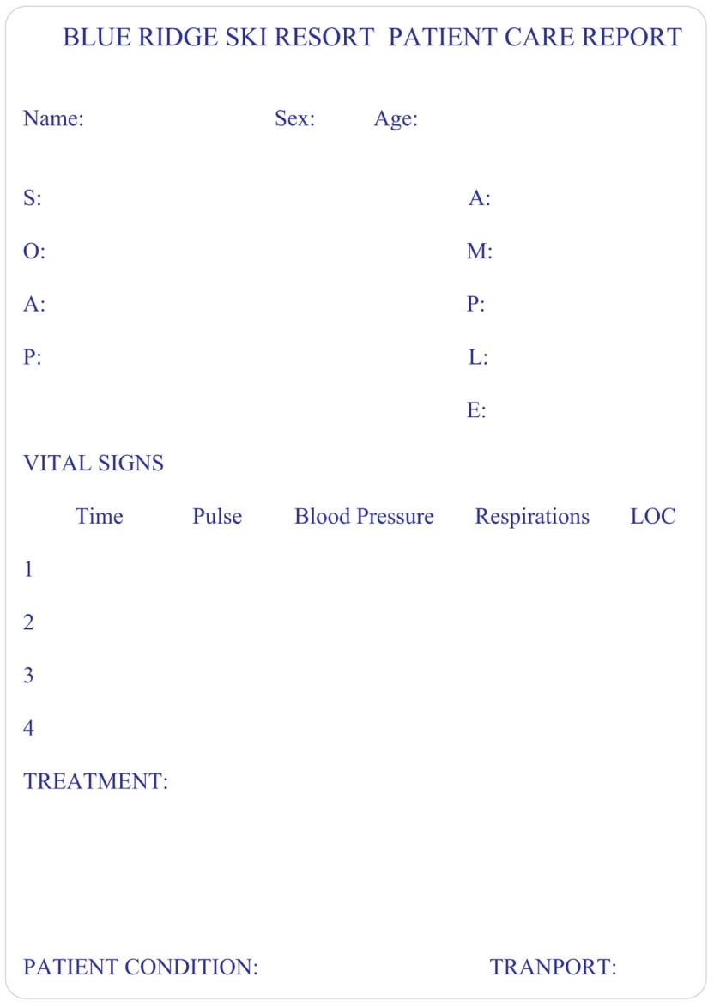
Medical Communication: Patient Care Reports
8-7
In contrast, in an open-format PCR, information is organized under broad headings such as Patient Information, SOAP or CHEATED notes.
SAMPLE
Vital Signs
Patient Condition
Treatment
Transport
Open-format PCRs generally take more time to complete than either closed or mixed-format PCRs.

Slide 37
Medical Communication: SOAP
8-7
SOAP is an acronym that represents four report components:
S Subjective: Symptoms or qualitative information the patient describes, including the chief complaint, the history of the present illness, and pertinent past medical history
O Objective: Signs, or observable, quantitative findings discovered during the scene size-up and physical exam, including vital signs
A Assessment: The general impression of the medical problem
P Plan: The treatment planned for the patient

Slide 38
Medical Communication: CHEATED
8-7
CHEATED acronym for medical documentation represents the primary components of the patient assessment and management process:
C Chief complaint: Patient’s primary problem
H History: SAMPLE history of the present illness and past medical history
E Examination: Physical exam
A Assessment: General impression of the patient
T Treatment: All aspects of treatment rendered, including that provided by bystanders
E Evaluation: Changes in patient’s condition over time; patient’s response to treatment
D Disposition: Information indicating whether the patient refused treatment, was treated and released, or was taken to a higher level of care such as a hospital

Slide 39
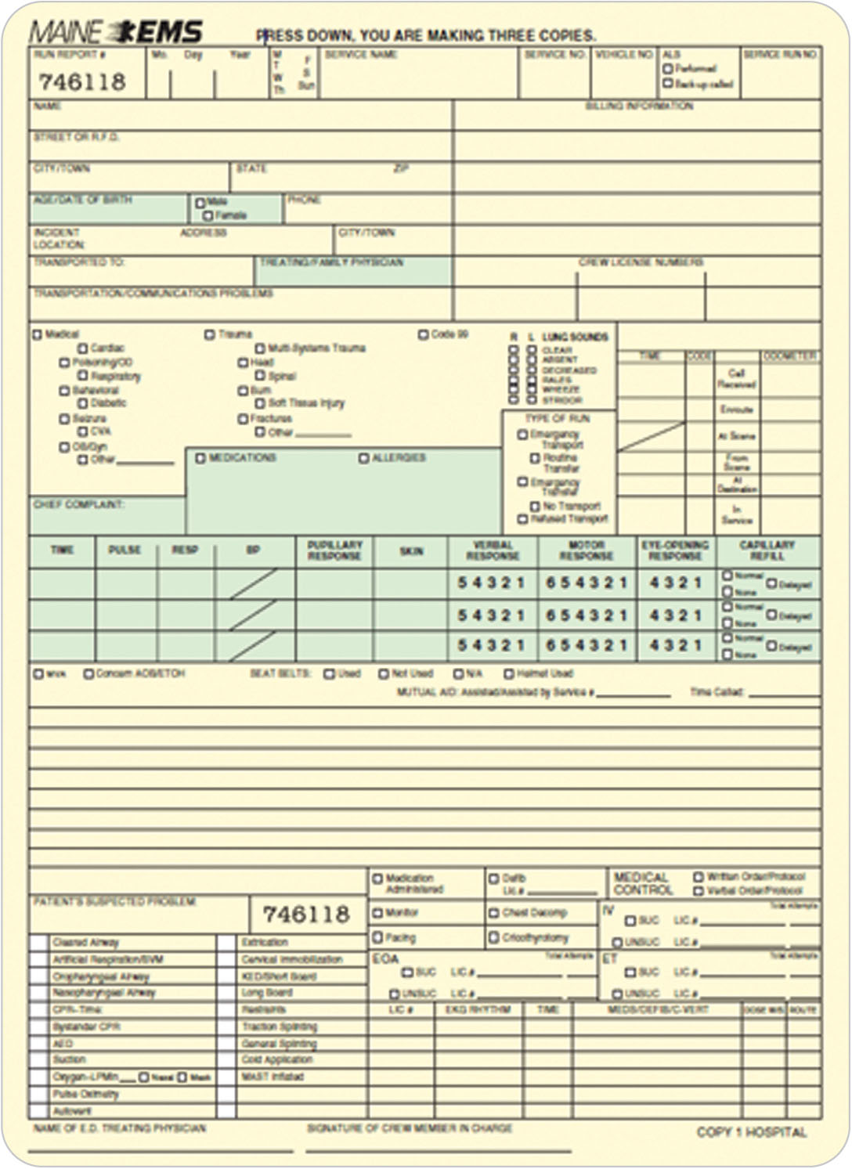
Medical Communication: Patient Care Report
8-7
A mixed-format PCR includes both check boxes for common types of data and blanks for specific comments.
Many computer-generated PCRs use this method, allowing space for typed comments.

Slide 40
Medical Communication: Patient Care Report
8-7
Nearly all PCRs for seriously ill or injured patients include a section for recording vital signs taken throughout patient’s care.
Spaces are provided to record serial sets of vital signs, including:
Pulse
Blood pressure
Respirations
Temperature (when appropriate)
Oxygen saturation
Level of consciousness
SAMPLE acronym is found on many of these forms.

Slide 41
Medical Communication
8-7
Remember: “If it isn’t documented, it didn’t happen.”
Fully document all the medical facts associated with the incident.
All the scene facts
The names of all the patrollers and witnesses involved
Include:
The statements of the patient
The mechanism of injury
Vital signs
Anything else that will enable you to review the documents
Include taking photographs or making diagrams if appropriate.
Years later, if legal consequences occur, you may need to accurately reconstruct what happened at the incident.

Slide 42
Incident Investigation Team

Slide 43
Incident Investigation Team
8-8
Your area may have an incident investigation (II) team.
Based on local protocols
The II team will often investigate any incident involving:
A life-threatening condition
A death
An accident in which liability is suspected
Lift-related accident
An injury involving a motorized vehicle or other human-made object

Slide 44
Incident Investigation Team
8-8
II team members gather maps, photos, witness statements, accident reports, PCRs, and other information.
Cooperate and assist the team as directed by your area management.
If you have questions regarding your role when helping with an accident investigation, talk to the II leader, your area management, or local patrol representative.

Slide 45
Incident Investigation Team
8-8
It is also important to document the incident scene and take pictures of a serious incident scene as soon as possible to preserve an accurate record of events.
Any delay in documenting important information can result in the loss of that information.
This would be a loss of potentially crucial information.

Slide 46
Good Report Writing

Slide 47
Good Report Writing
8-9
Well-written communication does not simply happen.
Result of determined professionalism and attention to detail
Because both the PCR and incident report form are considered medical and legal documents, you must exercise care when filling out these forms.

Slide 48
Good Report Writing: FACTUAL-OEC
F Facts: Include only information that is true and can be documented.
A Accurate: Describe what you saw, heard, and did correctly.
C Complete: Include all relevant information regarding the incident and the patient.
T Terms: Use only accepted medical terms and abbreviations.
U Unbiased: Information should be objective; avoid opinions.
A Avoid slang: Do not use informal words or words that have multiple meanings, unless quoting the patient.
L Legible/legal: Written reports should be written in clear, easy-to-read language, with black or blue ink.
O Organized: Present information in a logical manner; this is important when using an open-format PCR.
E Error-free: Ensure that all words are spelled correctly and that proper grammar is used.
C Checked: Proofread the document before submitting it.

Slide 49
Correcting Error and Creating Addendums

Slide 50
Correcting Errors and Creating Addendums
8-9
Occasionally, a written error may need correction.
To correct a written mistake, draw a single line through the error.
Never scratch out, erase, or otherwise obliterate the error.
Write in the correct information, either above or next to the error.
Place your initials and, ideally, the current date and time next to the corrected error.

Slide 51
Correcting Errors and Creating Addendums
8-9
Occasionally, important information may be inadvertently omitted in your written report.
To add information to a previously completed report or form, follow your local area’s protocol.
Standard procedure is to complete and sign the additional written information and then attach it to the original form.
Complete as soon as the need for additional information is identified.
Any delay in its submission reduces its credibility and potential usefulness.
The date and time this is done should be noted on the document.
Always sign the addendum and tell your risk manager you added information.

Slide 52
Essential Content of Medical Communication to Higher Medical Personnel

Slide 53
Essential Content to Higher Medical Personnel
8-10
It is important that you provide an accurate clinical picture.
Medical information should be presented clearly and succinctly in an organized manner, whether presented orally or in writing.
Although medical communications and documents vary, the information contained in these communications is standard.
A report to EMS personnel should take less than 60 seconds.

Slide 54
Essential Content to Higher Medical Personnel
8-10
When transferring a patient, you should communicate a clinical picture that includes these basic points:
Age and sex
Chief complaint
History of present illness
Past medical history
Physical exam
General impression
Treatment
Response to treatment

Slide 55
Essential Content to Higher Medical Personnel
8-10
Age and Sex
Report patient’s sex and actual or approximate age.
Chief Complaint
The chief complaint is what the patient tells you is wrong.
Should be recorded in patient’s own words
“My chest hurts,” or “I ran into a tree.”
If a patient is found unresponsive, use that as the chief complaint.

Slide 56
Essential Content to Higher Medical Personnel
8-10
History of Present Illness
Should provide a description of the circumstances surrounding the events of the incident and include all subjective descriptions presented by the patient
For an illness, this includes the symptoms the patient had before asking for help.
For trauma, it is a description of the circumstances before the injury.

Slide 57
Essential Content to Higher Medical Personnel
8-10
Past Medical History
Includes medical problems related to the chief complaint and any other pertinent medical history
Also includes present medications, allergies, and last oral intake

Slide 58
Essential Content to Higher Medical Personnel
8-10
Physical Exam
Includes all the objective findings obtained during the primary and secondary patient assessments
Both positive and negative findings may be important.
These findings include the level of responsiveness and all vital signs.

Slide 59
Essential Content to Higher Medical Personnel
8-10
General Impression
What you think the medical problem is based on the information that you gathered during the whole patient evaluation
Even though a general impression is not a final “diagnosis,” you should formulate a medical impression because this information may be used to make treatment decisions.
An example of a general medical impression is “possible right femur fracture.”

Slide 60
Essential Content to Higher Medical Personnel
8-10
Treatment
The treatment is a description of everything you have done in caring for the patient.
May include nothing more than “transported in the position of comfort” or may include the various treatments provided during a full resuscitation
If you administered oxygen, applied a splint, or immobilized the spine, report those actions in the treatment section.

Slide 61
Essential Content to Higher Medical Personnel
8-10
Response to Treatment
One of the most frequently overlooked aspects of medical communications is describing how the patient responded to the treatment rendered.
After you have done something for a patient, observe patient’s response.
Report whether the patient got better, got worse, or stayed the same.
For example, if you took care of a patient with a breathing problem who improved when given oxygen, you might state, “Oxygen was supplied at 15 liters per minute via nonrebreather mask and the patient responded by having a slower respiratory rate and was able to talk in full sentences.”

Slide 62
Case Study

Slide 63
CASE PRESENTATION
You are directed to respond to a snowboarder who fell while attempting a large jump. Upon arrival, you find a teenage male complaining of right thigh pain. The scene is safe. After introducing yourself and obtaining permission to care for him, you quickly do a primary patient assessment, finding no life-threatening problems. You next obtain a SAMPLE medical history, perform a secondary patient assessment with physical exam, and check vital signs. Only mid-thigh pain is found.
What should you do now?

Slide 64
CASE UPDATE
You notify dispatch of the incident:
You: “Ski Patrol to base.”
Dispatch: “Go ahead, Patrol.”
You: “I have a 19-year-old male, who fell on the back side of a jump midway down Fiddler’s Elbow. Patient has mid-thigh pain on his right leg. Vital signs are stable. He is fully responsive. Send a toboggan with backboard and traction splint, and extra help. I need an ALS ambulance. Notify management.”
At this point, dispatch would radio back the same information to the patroller, confirming that the communication was clear:

Slide 65
CASE UPDATE
Dispatch: “Received, Patrol. You are on scene with a 19-year-old male on Fiddler’s Elbow. Requesting toboggan, backboard with traction splint, additional manpower, ALS ambulance, and management.”
Ski Patrol would then acknowledge:
You: “That is correct.”
Other patrollers arrive to assist you. One patroller helps you care for the injured teenager.
You ask another patroller to provide scene safety. Another patroller interviews patient’s friend and witnesses to the incident, recording their names, brief statements, and phone numbers. These field care notes will be added to the patient care report. The bystanders are asked to come to the patrol aid room to continue the interview.

Slide 66
CASE UPDATE
On a small preprinted field-incident form, you record patient’s information. Following care and packaging, which includes a femoral traction splint, you help load the patient into a toboggan, take and record his vital signs again, and transport him to the aid room. Once inside, you help move the patient to a stretcher.
With the assistance of your field care notes, you give an OEC technician or the medical provider on duty in the aid room an oral report about the patient. This report includes a complete description of your initial general impression of the patient, the nature of patient’s injury, patient’s level of responsiveness, vital signs, results from the primary and secondary patient assessments, and the basic care you provided.
What should you and the aid room medical provider do now?

Slide 67
CASE UPDATE
The OEC technician in the aid room continues care with you as the ambulance arrives. The aid room OEC technician gives the following handoff report to the paramedic who is transferring the patient to the hospital:
“The patient is Adam Lee, a 19-year-old male who went off a large jump, landing on his right leg. He was wearing a helmet. His friends state that he never lost consciousness. When we arrived on scene, the patient was A on the AVPU scale, and this has not changed. He complained of right thigh pain and had tenderness in that location. The thigh was exposed, and there was no bleeding or bone penetration. There was no other obvious trauma. He denies drinking alcohol or taking drugs today. He has no medical problems and no allergies. He had lunch at noon. Vitals have been stable. He was put in the traction splint on the hill, helping the pain, and distal sensation, circulation, and motor remains intact. He appears to have a right midshaft femur fracture. Here is a copy of the PCR, which includes our care and patient information. Do you have any questions?”

Slide 68
CASE UPDATE
Lastly, you complete the incident report form documenting the case and place it in the patrol director’s box. You are later informed that the patient was admitted to the hospital with a fractured femur.

