Slide 1
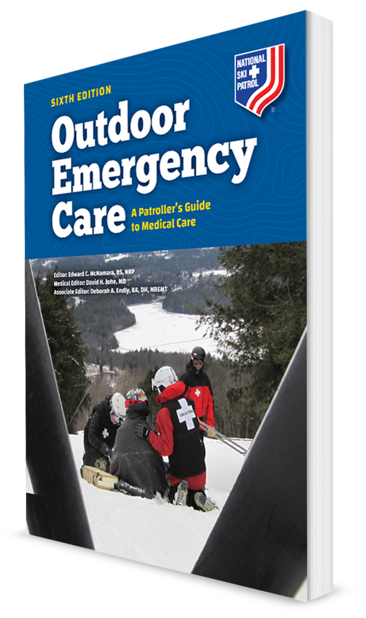
Airway Management
CHAPTER 9

Slide 2
The following presentation will utilize two symbols to identify material necessary for an OEC Technician to comprehend:
key term
Meets a Chapter Objective.
This symbol will have the corresponding Objective Number denoted within.
Identifies a Key Term.
The Key Term will be underlined for easy identification.

Slide 3
Objectives
9-1 Describe the function of the epiglottis.
9-2 Describe the mechanism of breathing.
9-3 Describe and demonstrate how to manually open the airway or mouth using the following techniques:
Cross-finger technique
Head tilt–chin lift maneuver
Jaw-thrust maneuver
9-4 Describe and demonstrate the proper way to clear an airway using the methods of finger sweep, suctioning, gravity and positioning, and abdominal thrusts.

Slide 4
Objectives
9-5 Explain and demonstrate the recovery position.
9-6 Describe the function of the oropharyngeal and nasopharyngeal airway, and demonstrate the sizing and placement of these devices.
9-7 Demonstrate the use of a face shield and a pocket mask.
9-8 Explain the tips for safely using oxygen.
9-9 Explain the indications for and administration of oxygen.
9-10 Demonstrate how to place an oxygen cylinder into service.
9-11 Describe the various devices used for delivering oxygen to a patient.
9-12 Explain what a pulse oximeter is and demonstrate how it is used.
9-13 Explain gastric distention and how to avoid it.

Slide 5
Key Terms
Airway
Bag-valve mask (BVM)
Barrier device
Epiglottis
Exhalation
Face shield
Finger sweep
Flowmeter
Gastric distention
Head tilt–chin lift maneuver
Inhalation
Jaw-thrust maneuver
Nasal cannula
Nasopharyngeal airway (NPA)
Nonrebreather mask
Oropharyngeal airway (OPA)
Patent
Pocket mask
Pulse oximeter
Suctioning

Slide 6
Chapter Overview

Slide 7
Chapter Overview
Having an open airway and adequate breathing are crucial factors for maintaining homeostasis.
Every cell in the body depends on a constant supply of oxygen.
Under normal conditions, the airway is “open and clear,” which permits breathing and the exchange of gas between the environment and the lungs.
Without a continuous source of oxygen, death occurs rapidly.

Slide 8
Chapter Overview
OEC technicians need to assess a patient’s airway quickly, immediately correcting any airway problems.
Be prepared to:
Open, clear, and maintain the airway using a variety of methods.
Deliver supplemental oxygen whenever it is indicated.
Provide artificial ventilations if either spontaneous breathing is not observed or the patient’s breathing efforts are ineffective.

Slide 9
Anatomy and Physiology

Slide 10
Anatomy: The Airway
The airway is the passageway that allows air to enter and exit the lungs.
It is divided into upper and lower components.
The upper airway begins at the mouth and nose and ends at the larynx next to the epiglottis.

Slide 11
Anatomy: The Upper Airway
Nasopharynx
Known as the nasal cavity
Warms and humidifies air as it enters the body
The hairs in it remove dust particles.
Oropharynx
Known as the oral cavity
Also helps to warm inhaled air
If either the nose or the mouth is blocked off, air can still get into the lower airway.
If both are blocked, air cannot get into the lungs.

Slide 12
Anatomy: The Upper Airway
9-1
The epiglottis is a leaf-shaped structure.
Allows air into the trachea and lungs when open
When swallowing, it closes and prevents food or liquids from entering the lower airway by covering the top of the airway.
Below the epiglottis and at the top of the trachea is the larynx.
Also known as the voice box
Has two cords that vibrate, making sound when we speak

Slide 13
Anatomy: The Lower Airway
The lower airway includes the trachea, bronchi, and lungs, containing the bronchioles and alveoli.
The trachea is a tube made of cartilage that splits into two mainstem bronchi, one to each lung.
Bronchi continue to branch into many smaller bronchioles.
The bronchioles end in tiny alveoli, where gases are exchanged in the lung.

Slide 14
Physiology: Respiration
9-2
Respiration
The act of breathing
Air enters the body through the airway passage and then is expelled back into the environment.
Oxygen in the air enters the lungs.
Carbon dioxide, a waste product, leaves the lungs.
Breathing is a mechanical process, both active and passive in nature, consisting of two phases: inhalation and exhalation.

Slide 15
Physiology: Respiration
9-2
Inhalation
Also known as inspiration
An active process
The respiratory muscles contract, creating negative internal pressure in the chest cavity.
Causing air to flow into the lungs
The diaphragm between the chest and the abdominal cavities is the main breathing muscle.

Slide 16
Physiology: Respiration
9-2
Exhalation
Also known as expiration
The passive phase of respiration
During this phase, the respiratory muscles relax:
Decreasing pressure within the chest
Expelling any unused air and gaseous waste products from the lungs and out of the body

Slide 17
Airway Management

Slide 18
Opening the Mouth: Cross-Finger Technique
9-3
9-3
Cross-finger technique
One way to open an unresponsive patient’s mouth
Follow standard precautions; use PPE.
Using your dominant hand, cross your index finger under your thumb.
Place your thumb and index finger against the patient’s upper and lower teeth. (Be careful not to insert either finger between the patient’s teeth.)
Spread your thumb and finger apart to open the patient’s mouth.
Do NOT use the cross-finger technique if someone is responsive, as the person may bite down.

Slide 19
Opening the Airway
9-3
Opening the Airway
Normal breathing requires the airway to be patent (open).
In an unresponsive patient, the tongue can fall back and occlude the airway.
When the head is unnaturally positioned, the misaligned airway becomes compressed or blocked.
The first step to effective airway management is to ensure the airway is aligned and open.

Slide 20
Opening the Airway: Head Tilt-Chin Lift
9-3
Head tilt-chin lift maneuver:
The head tilt–chin lift maneuver is the primary technique OEC technicians use to open a patient’s airway.
Kneel beside the patient’s head.
Place one hand on the patient’s forehead.
Place two or three fingers of your other hand under the patient’s chin.
Gently pull the chin up while simultaneously pushing down on the forehead. Do not compress the soft tissue under the chin.
Maintain the position to ensure the airway remains open.

Slide 21
Opening the Airway: Jaw-Thrust Maneuver
9-3
Jaw-thrust maneuver
If concerned about a potential head/cervical spine injury, open the airway using the jaw-thrust maneuver.
This method allows only minimal movement of the cervical spine.
It is essential that the neck is not moved and remains in an anatomically neutral position.
Can also be used in someone who does NOT have a neck injury

Slide 22
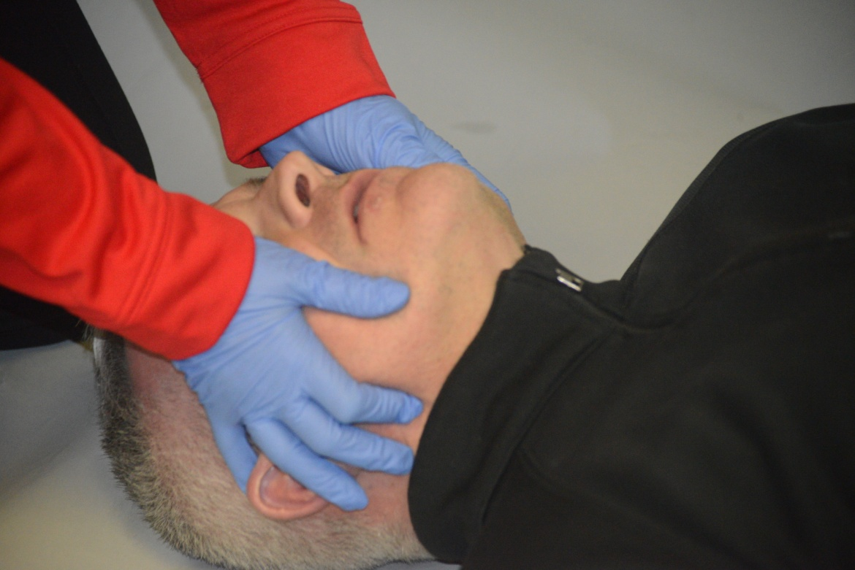
Opening the Airway: Jaw-Thrust Maneuver
9-3
To perform the jaw-thrust maneuver:
Kneel above the patient’s head, with your knees straddling the head.
You can use your knees to gently stabilize the head and cervical spine.
Using the fingers of both hands, grasp the angle of the mandible on each side of the jaw.
Place your thumbs on the maxilla.
Use the thumbs as a lever to lift the mandible upward.

Slide 23
Clearing the Airway

Slide 24
Clearing the Airway
9-4
Clearing the Airway
Foreign material such as blood, mucus, fluids, broken teeth, foreign bodies, dirt, and food can obstruct the airway.
Debris must be cleared quickly to ensure adequate oxygen flow and prevent aspiration of fluid or solids into the lungs, using the following techniques:
Finger sweep
Suction
Gravity and positioning
Abdominal thrust

Slide 25
Clearing the Airway: Finger Sweep
9-4
Finger Sweep
Indicated ONLY for patients who are unresponsive when a foreign body is seen in the mouth
Placing a finger into the mouth of a responsive person:
Could stimulate the gag reflex, inducing vomiting
Could cause the person to bite down, injuring the rescuer’s finger
Do NOT do a “blind finger sweep” by inserting your finger farther than you can see.
Might push the object inward, further compromising patient’s airway

Slide 26
Clearing the Airway: Suctioning
9-4
Suctioning
Works well whenever repeated vomiting or active oral bleeding occurs.
Two basic types of suction devices used in the outdoor emergency care field:
Manually operated devices
Mechanical, battery-powered devices

Slide 27
Clearing the Airway: Manual Suction
9-4
Manually operated suction devices:
Are lightweight and compact
Can provide adequate suction for short periods of time
Require a continuous manual pumping action by the rescuer
Usually have a small container for collecting fluids and debris
Container fills quickly.
Do not work well when there is a lot of material to suction.

Slide 28
Clearing the Airway: Battery-Powered Suction
9-4
Battery-powered suction devices provide excellent suctioning capabilities.
Some suction devices may be powered by an electric motor using alternating current (AC).
Others operate off a vacuum source from a vehicle engine (i.e., the ambulance).
Portable motorized units use rechargeable batteries.
Usually very reliable, providing suction for extended periods of time

Slide 29
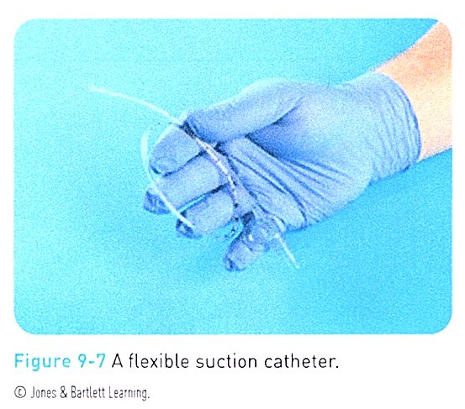
Clearing the Airway: Suctioning
9-4
Regardless of type, all suction devices must be capable of generating a strong vacuum.
Suctioning can be done on either a responsive patient or an unresponsive patient.
Can be performed using either a rigid or a flexible suction catheter

Slide 30
Clearing the Airway: Suctioning
9-4
A rigid suction catheter
Also known as a tonsil tip or Yankauer catheter
Has a wide-diameter tip
Made of clear plastic
Is curved or angled
Should have a port (hole) in the handle
Enables control of the flow of suction

Slide 31
Clearing the Airway: Suctioning
9-4
When the hole is covered with the thumb, suction is applied.
Little or no suction occurs when the hole is left uncovered.
Catheter has a connector to which suction tubing is attached.
Other end of the catheter has one or more holes through which fluid and solid matter are remove.
Rigid suction catheters are primarily used to suction the oropharynx but also can be used to suction around the external nasal passages.

Slide 32
Clearing the Airway: Suctioning
9-4
A flexible suction catheter is a tube constructed of clear silicone or soft plastic.
Its pliable design allows it to enter narrow passageways.
Used to suction the nasopharynx
Also may be used for oropharyngeal suctioning

Slide 33
Clearing the Airway: Suctioning
9-4
Can also suction a stoma
Surgical hole in the front of the neck
Also has an adapter on one end that connects to a suction tube
The other end is open.
Both types of suction catheters are connected to a collection container through a clear, flexible suction tube.

Slide 34
Clearing the Airway: Suctioning
9-4
Rigid suction catheters are used more often.
These are less affected by temperature and other environmental conditions.
Can remove large volumes of debris rapidly
Manually powered suction devices usually have an integrated suction catheter directly connected to a disposable collection container, which is replaced following use.

Slide 35
Principles of Suctioning
9-4
If possible, pre-oxygenate the patient before suctioning by giving high-flow oxygen by mask.
Open the patient’s mouth and look in the oropharynx to locate the fluid or object you need to remove.
Insert the tip of the suction catheter into the pharynx before applying suction.
Be careful not to insert the catheter farther than you can see because doing so may:
Result in trauma to the soft oral tissues
Initiate the gag reflex in a responsive or semi-responsive patient
Force a foreign body farther into the airway

Slide 36
Principles of Suctioning
9-4
Using either a side-to-side or circular motion, suction the airway as you slowly pull the catheter out from the airway.
Always protect the cervical spine if you suspect any spinal trauma.
Pre-oxygenation is not always possible.
Goal of suctioning is to clear the airway as quickly as possible to avoid aspiration of blood, vomit, or other material.

Slide 37
Principles of Suctioning
9-4
Besides removing fluid and debris, suctioning also removes oxygen.
Adult patient
Apply suction for no more than 10 to 15 seconds at a time.
Child
Suction the airway for only 5 to 10 seconds.
Repeat the procedure as needed until the airway is clear.

Slide 38
Principles of Suctioning
9-4
If there are large pieces of debris, the holes in the tip of the catheter may be too small to get this material sucked into the tubing, so the catheter tip can be inserted repetitively.
Material sticking to the end can be wiped off each time.
Each time you put the catheter in, uncover the thumb hole.
With active oral bleeding or repeated vomiting, it may be necessary to use gravity and suction concurrently to clear the airway.
Roll the patient onto the side.
Report to ambulance personnel what material was suctioned out, especially if it included blood.

Slide 39
Principles of Suctioning
9-4
After each incident, the suction unit must be thoroughly cleaned and disinfected before being placed back into service.
All disposable equipment, such as the suction catheter, suction tubing, and collection bag, must be replace.
If the suction unit is battery operated, replace or recharge the batteries as necessary.
If the suction unit is manually powered, replace the catheter collection assembly.
Put disposable medical equipment in a biohazard container to dispose of it properly.

Slide 40
Clearing the Airway: Gravity and Positioning
9-4
Gravity and Positioning
Gravity is a time-honored method for quickly removing fluid and solids from the airway.
It requires no special equipment.
Can be effective regardless of whether the patient is responsive or unresponsive
If the patient is responsive and can follow simple commands:
Instruct the person to lean forward with the head down (in a dependent position) to allow vomit, blood, and any solids to flow or fall out of the mouth or nose.

Slide 41
Clearing the Airway: Gravity and Positioning
9-4
If the patient is unresponsive:
Roll the person into the recovery position, discussed in the next section.
In the presence of a suspected spinal injury:
Patient may be rolled onto the side while another rescuer maintains the patient’s head and neck in a neutral position.
If foreign material is wedged in the pharynx, gravity may not work.

Slide 42
Clearing the Airway: Abdominal Thrusts
9-4
Abdominal Thrusts
A maneuver to dislodge a foreign body immediately after someone begins choking
Can be used in any patient older than 1 year
Back blows are given to infants.
Suspect if you encounter a person grasping his or her throat or trying to speak but unable to do so.
If the person can speak, the airway is not obstructed.
Hard candy, a piece of meat, or a small part of a toy can block the airway.

Slide 43
Clearing the Airway: Abdominal Thrusts
9-4
This procedure, originally described by Heimlich, is used if the patient is responsive.
Stand behind the standing or sitting patient.
Reach around and put one fist, thumb toward the patient, between the xiphoid process and the navel.
Grasp your fist with the other hand.
Begin firm upward thrusts, not hugs.
Repeat these thrusts until the foreign object is expelled or the patient becomes unresponsive.

Slide 44
Clearing the Airway: Alternatives
If the patient is unresponsive:
Begin chest compressions as you would with CPR.
Same effect as the abdominal trusts
For infants with an obstructed airway:
Deliver five back blows, followed by five chest thrusts.
Repeat as necessary.

Slide 45
Keeping the Airway Open and Clear

Slide 46
Recovery Position
9-5
Recovery Position
Airway must remain open and clear to ensure adequate breathing.
Place the patient in the recovery (left lateral recumbent) position.
Can be used for any unresponsive patient where a spine injury is NOT suspected
May be used for responsive patients or any patients with an altered level of responsiveness who cannot manage their airway
When alone, rescuers should use this technique to allow them to do other care-related tasks.

Slide 47
Recovery Position
9-5
To place the patient in the recovery position:
Kneel at the patient’s left side, preferably with your knees near the patient’s hips or chest.
Extend the patient’s left arm so it extends over the person’s head.
Gently roll the patient toward you onto the left side so the patient’s head rests on his or her straightened arm.
Patient’s head should be tilted at a slight downward angle, with the mouth open, to allow secretions to flow out of the mouth.
Flex the patient’s right knee at a right angle to anchor the patient into this position.
Position the patient’s right arm so it is in front of the patient and does not block the rescuer’s access to the patient’s airway.
Always make sure the airway remains open.

Slide 48
Airway Devices
9-6
Airway Devices
Sometimes it is necessary to insert an airway device to keep the airway open.
The OEC technician has two options:
Nasopharyngeal airway
Oropharyngeal airway
The device used depends on the patient’s level of responsiveness.
Always place an airway device in an unresponsive patient.

Slide 49
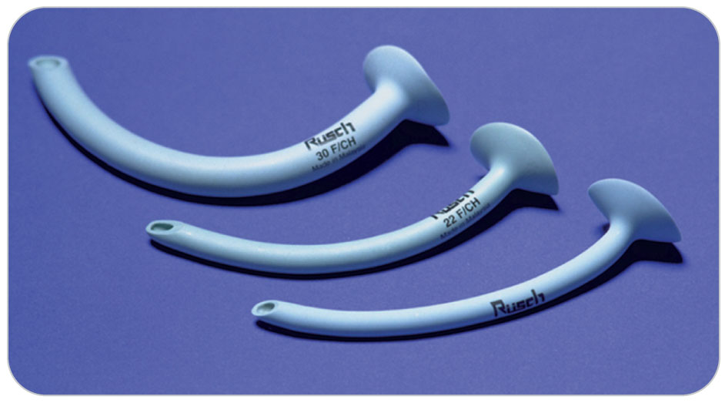
Airway Devices: Nasopharyngeal Airway
9-6
Nasopharyngeal airway
A nasopharyngeal airway (NPA) is a flexible tube inserted into the nasopharynx (nose).
Made of soft, latex-free plastic
Also known as a nasal trumpet
This mechanical airway provides an unobstructed pathway from one of the nostrils to the posterior nasopharynx.
Keeps passageway open for air exchange

Slide 50
Airway Devices: Nasopharyngeal Airway
9-6
When properly sized:
The adjunct is well tolerated, even in responsive patients.
It does not stimulate the gag reflex.
NPAs come in a variety of sizes.
Can be used in all patients, from small children to large adults
Do NOT use this airway in patients with massive head or facial injuries due to possible injury pushing the tube into the brain.

Slide 51
Airway Devices: Nasopharyngeal Airways
9-6
Steps to insert an NPA can be remembered using the acronym SLIC.
S Size the device
L Lubricate the adjunct
I Insert the device
C Check the device
If the patient’s level of responsiveness improves, you may need to remove the NPA.
Grasp the NPA by the flange and withdraw the adjunct using a steady downward motion that follows the device’s curvature.

Slide 52
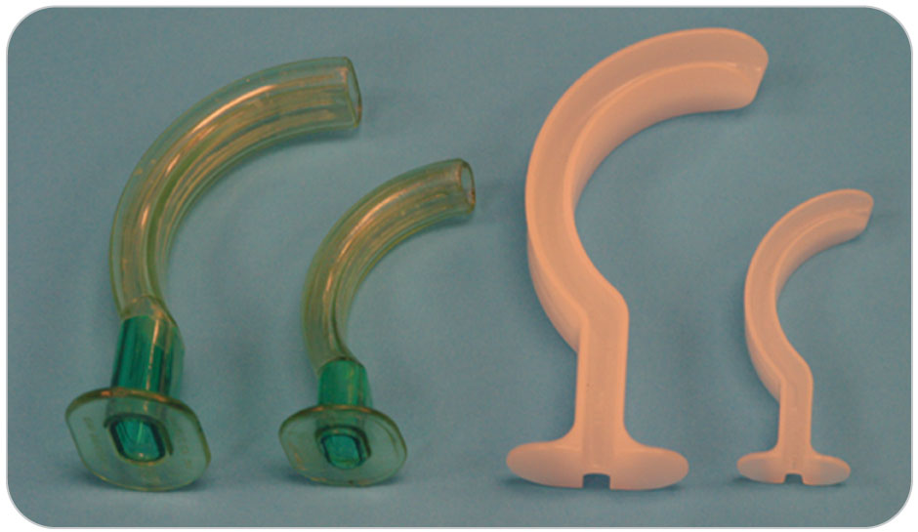
Airway Devices: Oropharyngeal Airway
9-6
Oropharyngeal airway
A hard plastic device inserted into the oropharynx (mouth) to help keep the airway open
Displaces the relaxed tongue
Prevents it from lying across the epiglottis and occluding the airway
When the OPA is in place, the tongue rests within the curvature of the device.
OPA is indicated only for unresponsive patients who do not have a gag reflex and are unable to protect the airway.
Frequently used when assisting ventilations with a bag-valve mask

Slide 53
Airway Devices: Oropharyngeal Airway
9-6
OPAs come in several sizes.
Range from #0 for infants to #6 for large adults
Must be properly sized to be effective.
Too small: will force the tongue downward and block the oropharynx
Too large: can enter the esophagus or damage the epiglottis or vocal cords
The steps to insert an OPA can be remembered using the acronym SIC.
S Size the airway
I Insert the airway
C Check the airway for proper placement

Slide 54
Airway Devices: Oropharyngeal Airway
9-6
Attempting to place an OPA into a patient who is either fully or partially responsive will stimulate the gag reflex.
May result in vomiting and possible aspiration of gastric contents
If the soft palate is touched by the OPA and the person gags, remove the OPA and do not reinsert it.

Slide 55
Airway Devices: Oropharyngeal Airway
9-6
Confirm proper placement by:
Listening for breaths
Watching the chest rise and fall
Feeling air moving in and out of the OPA
Air should be able to move freely in and out of the airway.
If air does not move freely, the tongue may have been pushed farther back into the posterior pharynx and may be blocking the airway.
Remove the OPA, confirm it is properly sized, and then reinsert.

Slide 56
Airway Devices: Oropharyngeal Airways
9-6
An OPA should be left in place until one of two conditions arises:
The patient begins to gag
A more advanced airway device is inserted by an ALS provider.
If you need to remove an OPA, grasp the adjunct by the flanges and pull it both outward and slightly downward, following the natural contour of the tongue.
Removal should be performed in one swift motion to reduce the incidence of vomiting and other complications.
Have a suction device ready in case the patient vomits.

Slide 57
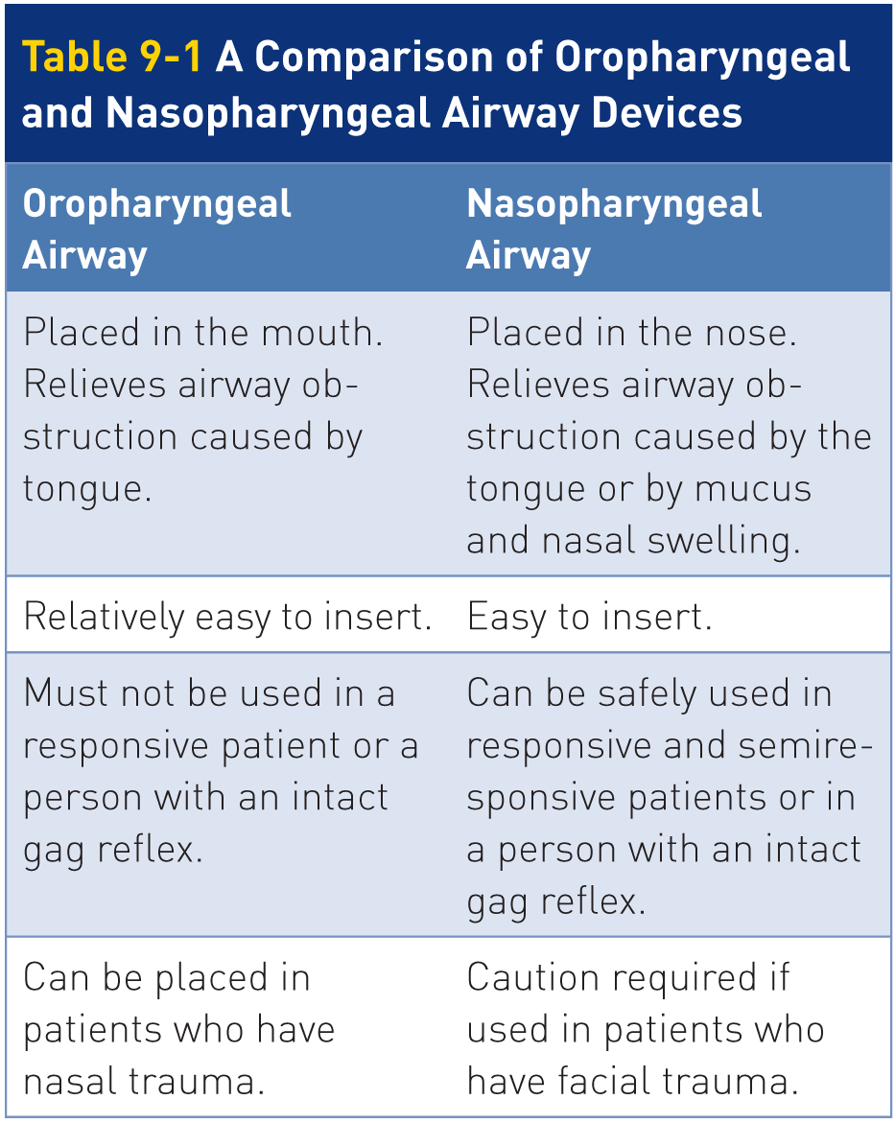
Airway Devices: A Comparison of OPAs and NPAs
9-6

Slide 58
Airway Devices: Barrier Devices
9-7
Barrier Devices
A personal protective device that provides a nonporous layer between you and the patient to prevent the transmission of communicable diseases
If the patient is not breathing, use a barrier device to provide rescue breaths.
An effective way to ventilate a patient until more sophisticated airway equipment and oxygen become available

Slide 59
Airway Devices: Barrier Devices
9-7
Barrier devices permit OEC technicians to provide rescue breaths using the residual oxygen in the rescuer’s lungs.
The mixture of gases in exhaled air contains approximately 15% to 16% oxygen.
Enough to provide initial oxygenation to a patient who is not breathing
Room air is 21% oxygen.
The most common barrier devices used for this purpose are face shields and a pocket masks.

Slide 60
Airway Devices: Face Shield
9-7
Face Shield
A clear, usually rectangular, plastic sheet that includes a mouthpiece through which rescue breaths are administered.
Some also have an integrated one-way valve/bite block.
Directs airflow into the patient’s airway while preventing the rescuer from becoming contaminated

Slide 61
Airway Devices: Face Shield
9-7
To use a face shield, perform the following procedure:
Kneel at either side of the patient’s head.
Remove the face shield from its protective package and place the shield over the patient’s mouth and nose.
If the device contains an integrated one-way valve/bite block, place the valve into the patient’s mouth, between the teeth.
Pinch the patient’s nose and seal your lips on the shield around the valve and provide rescue breaths.
Should see the chest rise and fall with each breath

Slide 62
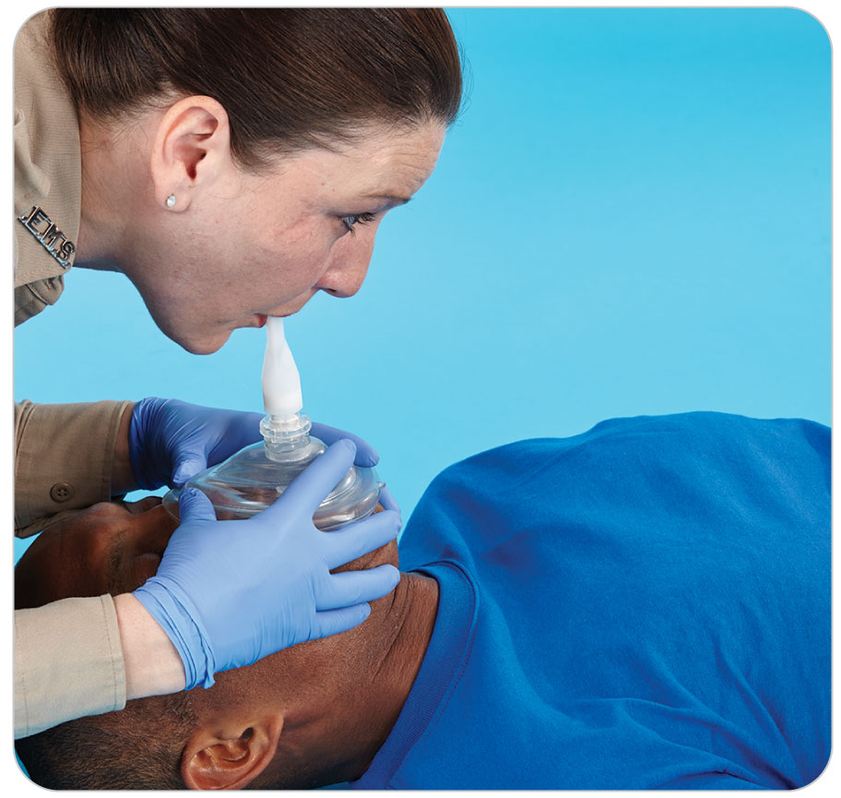
Airway Devices: Pocket Mask
9-7
Pocket Mask
A triangular or pear-shaped mechanical breathing device
Some older styles are circular, or donut shape.
Made from clear, soft plastic or silicone
Used to deliver mouth-to-mask rescue breathing
Apex of the mask fits over the bridge of the patient’s nose.

Slide 63
Airway Devices: Pocket Mask
9-7
Some include a built-in oxygen port that allows the device to be connected to supplemental oxygen.
Used correctly, a pocket mask provides an excellent seal on the patient’s face.
Offers better protection from blood and secretions than a face shield
Creating an adequate seal and delivering appropriate rescue breaths with a pocket mask is an important skill in emergency airway and respiration care.
Practice this skill until you are very comfortable with it.

Slide 64
Oxygen

Slide 65
Oxygen
9-8
Oxygen
Oxygen is an odorless, colorless, and tasteless gas essential to human survival.
Air consists of 78% nitrogen, 21% oxygen, and 1% other gases.
If the body does not receive enough oxygen, the following can occur:
Cellular or tissue damage
Organ failure
Shock
Death

Slide 66
Oxygen
9-8
Many OEC technicians give supplemental oxygen as part of their regular care.
In some areas, OEC technicians are not legally permitted to administer oxygen.
Depending on where care is given, a doctor’s order to give oxygen may be needed.
Patrol’s medical advisor may provide this authorization as either an indirect or direct order, or it may be obtained through the local emergency care system’s medical control.
To determine if you are permitted to provide oxygen therapy in your state, province, or area, check with your patrol director, area management, or state EMS office.
Best to develop a local protocol

Slide 67
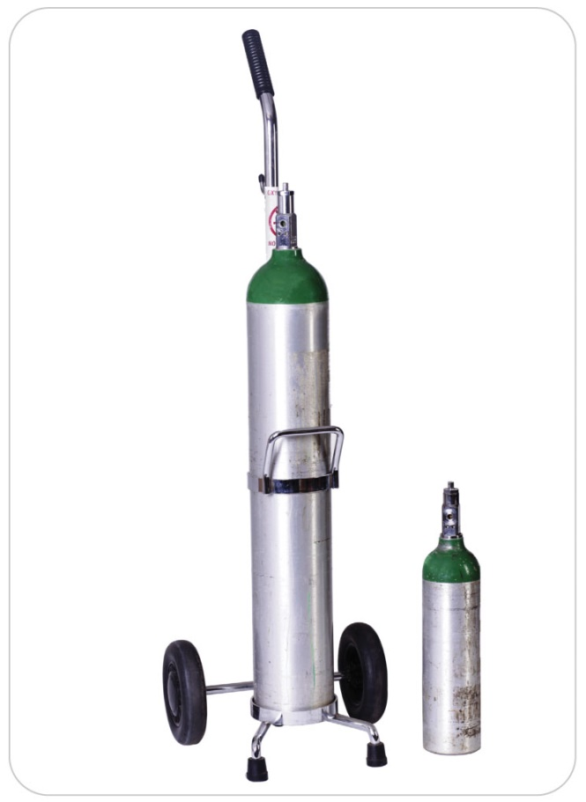
Oxygen
9-8
Oxygen administered to patients is 100% pure medical oxygen.
Unlike industrial oxygen, which should not be administered to patients, medical oxygen contains no impurities.
Stored as a compressed gas in specially marked cylinders that either are solid green or have a large green stripe on top.
Medical-grade oxygen may require a doctor’s prescription.

Slide 68
Oxygen Equipment
9-11
Oxygen Equipment
Several pieces of equipment are required to administer supplemental oxygen, including:
An oxygen cylinder
A pressure regulator/flowmeter
A nasal cannula or face mask

Slide 69
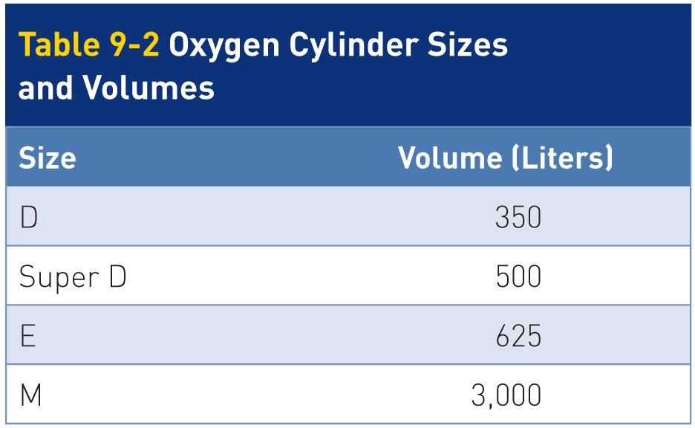
Oxygen Equipment: Oxygen Cylinders
9-11
Oxygen Cylinders
Oxygen is compressed to 2,000 pounds per square inch (psi) and stored in portable cylinders.
Many oxygen cylinders are constructed of lightweight aluminum, although older or larger cylinders are made of steel.
Oxygen cylinders come in a variety of sizes.
Portable oxygen cylinders used by most ski patrol systems are either size D or E.

Slide 70
Oxygen Equipment: Oxygen Cylinders
9-11
When full, these cylinders contain 350 to 625 liters of oxygen.
At 4 liters per minute (LPM), a full D cylinder lasts about 70 minutes.
At 15 LPM, it lasts about 20 minutes.
These numbers give a good idea of how much oxygen is available based on the rate given.

Slide 71
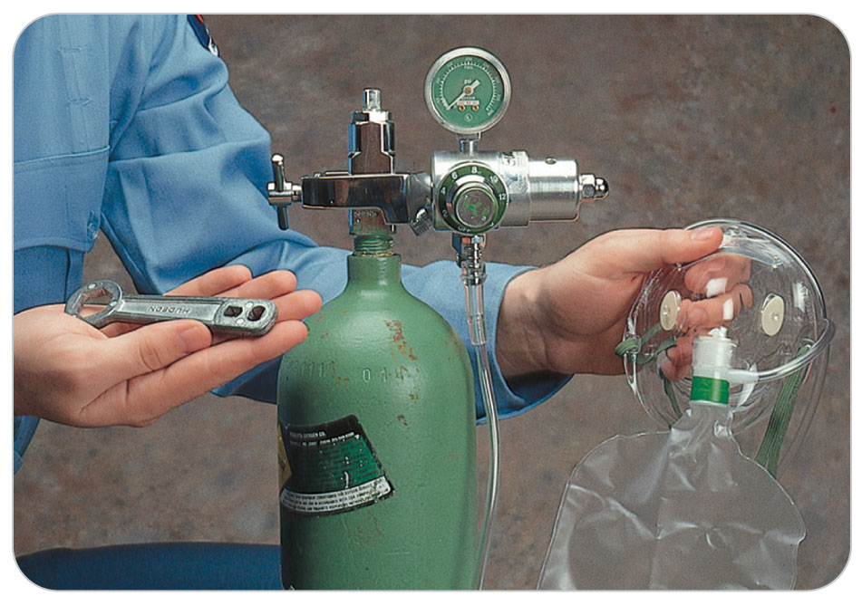
Oxygen Equipment: Oxygen Cylinders
9-11
Oxygen cylinders must be marked:
With a green color
Be labeled as medical oxygen
A valve at the top of the oxygen cylinder allows you to control the flow of oxygen from the cylinder.

Slide 72
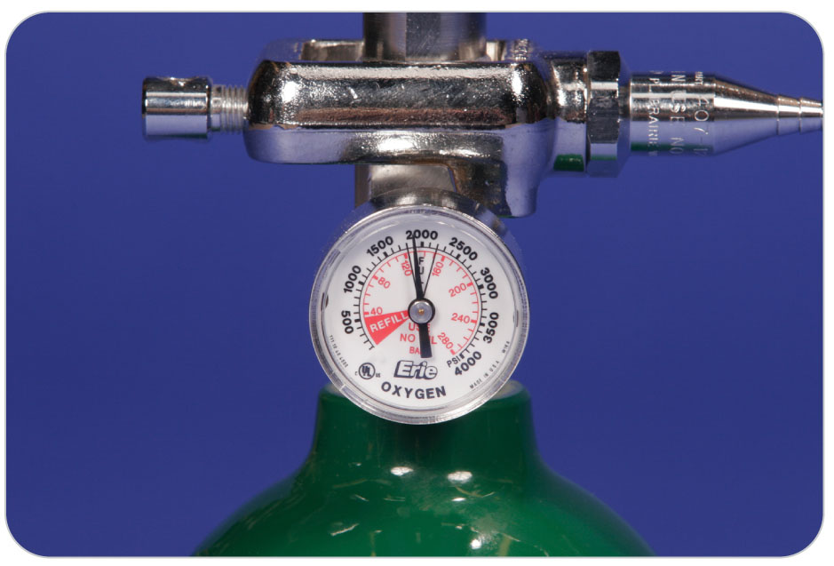
Oxygen Equipment: Pressure Regulator/Flowmeter
9-11
Pressure Regulator/Flowmeter
Oxygen can be used only when the pressure is regulated down to about 50 psi.
Done by using a pressure regulator
The pressure regulator and the flowmeter are a single unit.
Attached to the outlet of the oxygen cylinder
You can adjust the flowmeter to deliver oxygen at a rate of 2 to 15 LPM.

Slide 73
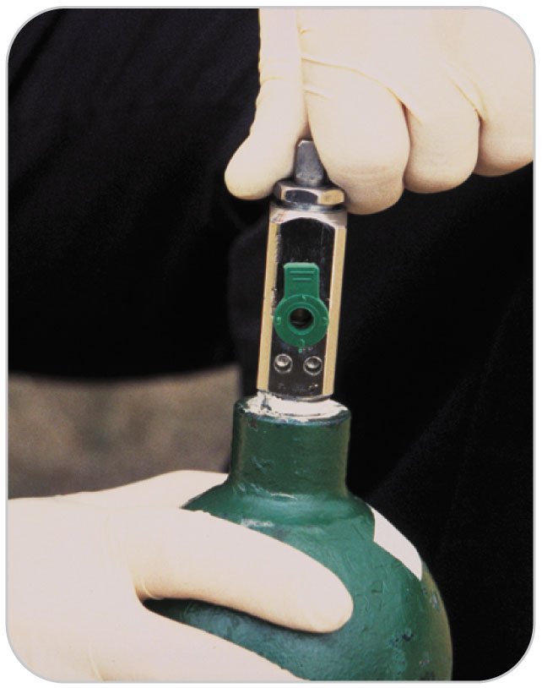
Oxygen Equipment: Pressure Regulator/Flowmeter
9-11
Different medical conditions require different amounts of oxygen.
The flowmeter lets you select the proper amount of oxygen to administer.
A gasket between the cylinder and the pressure regulator/flowmeter ensures a tight seal and maintains the high pressure inside the cylinder.
Always check for this gasket before attaching the regulator.

Slide 74
Oxygen Equipment: Nasal Cannulas
9-11
The third part of an oxygen-delivery system is a device that ensures the oxygen is delivered to the patient and is not lost in the air.
A nasal cannula:
Has two small holes, which fit into the patient’s nostrils
Delivers 2 to 6 LPM
Delivers between 35% and 50% oxygen

Slide 75
Oxygen Equipment: Nasal Cannulas
9-11
A face mask:
Is placed over the patient’s nose and mouth to deliver oxygen through the patient’s mouth and nostrils
Nonrebreather face masks deliver higher concentrations of oxygen (up to 90%) than standard oxygen face masks.
OEC technicians will use non-rebreather face masks.

Slide 76
Oxygen Safety

Slide 77
Oxygen Safety
9-8
Oxygen Safety
Oxygen actively supports combustion and can quickly turn a small spark or flame into a serious fire.
Never use oxygen near a spark or flame such as candles, a campfire, a stove, or a heater.
Do not allow a patient or others to smoke when oxygen is being used.
Keep oil, grease, or other petroleum-based or combustible materials away from oxygen cylinders and oxygen regulators.

Slide 78
Oxygen Safety
9-8
Oxygen cylinders are vessels containing highly compressed gas.
Should be laid on their side, kept in a protective carrier, or firmly secured to a wall to prevent them from falling
Turn the oxygen cylinder off when it is not in use.
If the valve stem at the top of the cylinder is damaged, the cylinder can take off like a rocket.
Oxygen cylinders should be kept inside sturdy carrying cases that protect the cylinder and regulator/flowmeter.

Slide 79
Oxygen Therapy

Slide 80
Indications for Oxygen Therapy
9-9
Oxygen should be administered to:
Anyone who is short of breath
Patients with:
Suspected cardiac or respiratory arrest
Cardiac-related chest pain
Stroke
Significant blood loss
Shock
Decreased level of responsiveness
Significant head injury

Slide 81
Indications for Oxygen Therapy
9-9
By administering supplemental oxygen:
The oxygen saturation of hemoglobin in the blood increases.
Provides more oxygen to the body’s tissues
Insufficient oxygen to the body’s tissues results in hypoxia.
Patients at risk for hypoxia and need oxygen if injured include:
Those who have chronic lung disease (usually from smoking)
Those whose respiratory rate has been decreased by an overdose of depressant drugs
Those who have a failing heart

Slide 82
Administering Supplemental Oxygen
9-9
9-10
To administer supplemental oxygen:
Place the regulator/flowmeter over the stem of the oxygen cylinder.
Line up the pins on the pin-indexing system correctly.
Check for the mandatory gasket and make sure it is not damaged.
Tighten the securing screw firmly by hand.
With the special key or wrench provided, turn the cylinder valve two turns counterclockwise.
Allows oxygen from the cylinder to enter the regulator/flowmeter.

Slide 83
Administering Supplemental Oxygen
9-9
9-10
Check the gauge on the pressure regulator/flowmeter to see how much oxygen pressure remains in the cylinder.
If the cylinder contains less than 500 psi, the amount of oxygen in the cylinder is too low for emergency use.
Should be re-placed with a full cylinder (2,000 psi)

Slide 84
Administering Supplemental Oxygen
9-9
9-10
To administer oxygen, you will need to adjust the flowmeter to deliver the desired liter-per minute flow of oxygen.
The patient’s condition and the type of oxygen delivery device you use (a face mask or a nasal cannula) dictate the proper flow.
When the oxygen flow begins, place the face mask or nasal cannula onto the patient’s face.

Slide 85
Oxygen Delivery/Ventilation Devices

Slide 86
Oxygen Delivery/Ventilation Devices
9-11
Different devices are available for giving oxygen to a patient.
Delivery method chosen should meet the patient’s needs.
Nasal cannula and nonrebreather mask are used only if the patient is breathing.
Bag-valve mask is used to assist breathing.

Slide 87
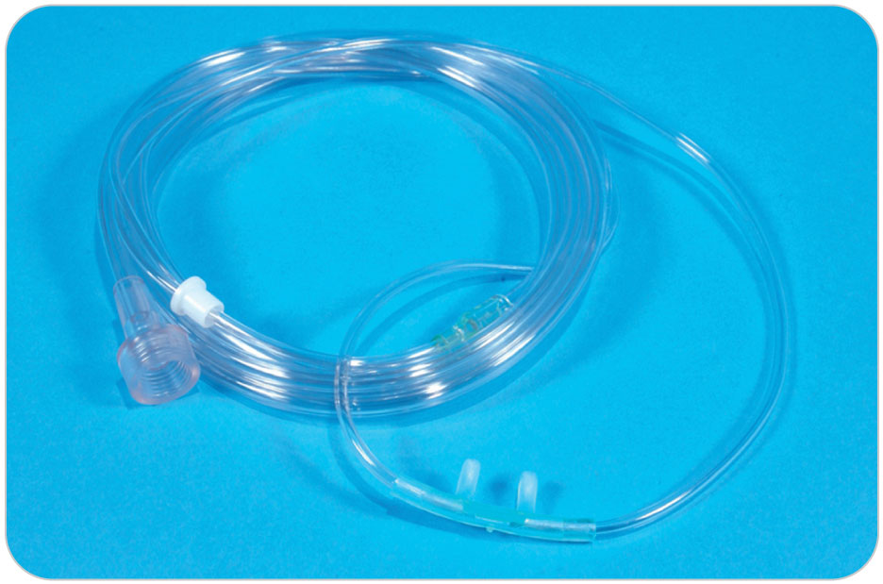
Oxygen Delivery Devices: Nasal Cannula
9-11
Nasal Cannula
A flexible, circular tube attached to an oxygen source by a long clear hose
Two short, pliable hollow prongs inserted (concave down) into the patient’s nostrils
Passively delivering smaller amounts of oxygen, or low-flow oxygen

Slide 88
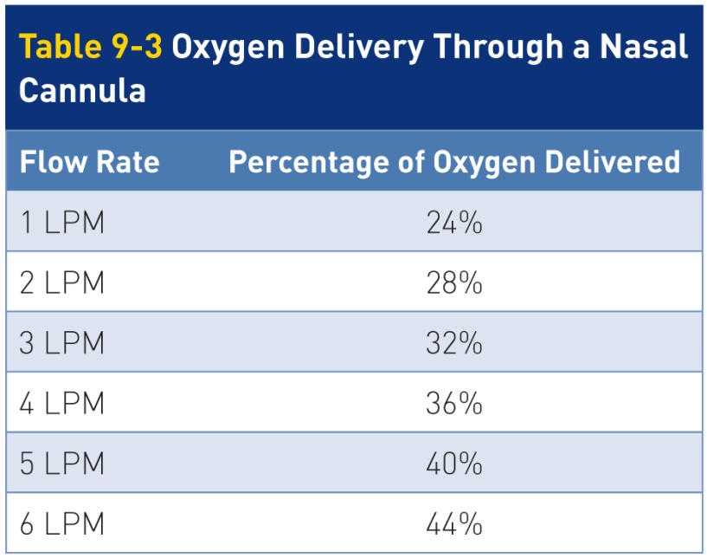
Oxygen Delivery Devices: Nasal Cannula
9-11
Administration flow rates vary from 1 to 6 LPM.
2 to 4 LPM being the typical rate
Used for fairly stable patients
Such as those with mild shortness of breath
Delivers an oxygen concentration of 24% to 44%
Actual percentage varies whether the patient breathes exclusively through the nose or also through the mouth.

Slide 89
Oxygen Delivery Devices: Nasal Cannula
9-11
Nasal cannulas do have several drawbacks.
Prolonged use is associated with drying of the nasal passages.
Blowing oxygen into the nose can be irritating.
Only low flow rates can be delivered.
Not recommended for use on patients who have signs of respiratory distress, shock, or severe chest pain

Slide 90
Oxygen Delivery Devices: Nasal Cannula
9-11
For patients who refuse to wear a mask, the use of a nasal cannula at 2 to 4 LPM is better than providing no supplemental oxygen at all.
To use a nasal cannula, connect the end of the tubing to the regulator and set the oxygen regulator to the desired flow rate in LPM.
Put the tubing on the patient’s head, usually behind each ear, and tighten it with the prongs upward in the nose.
Loosen or tighten for comfort.

Slide 91
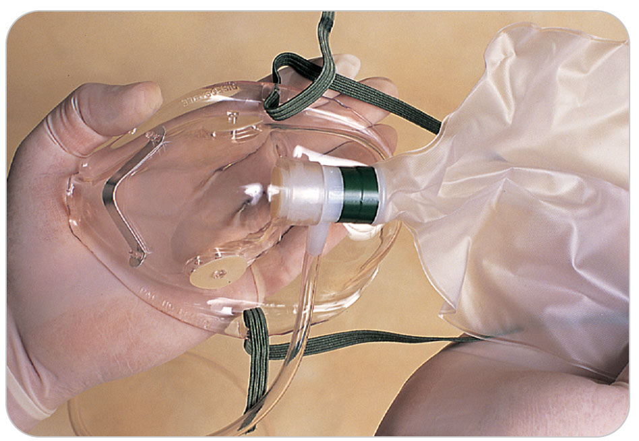
Oxygen Delivery Devices: Nonrebreather Face Mask
9-11
Nonrebreather Face Mask
A face mask that covers both the nose and the mouth
Attaches with the use of an elastic cord around the patient’s head
An attached collapsible reservoir bag, typically 1 liter, connects to an oxygen source.

Slide 92
Oxygen Delivery Devices: Nonrebreather Face Mask
9-11
First, the reservoir bag is inflated with oxygen.
Before placing the mask on a patient
Approximately one-third of the air from the reservoir is depleted each time the patient inhales.
It is then replaced by the flow from the oxygen supply.
If the bag becomes completely deflated, the patient will no longer have a source of air to breathe.
Exhaled air is directed through a one-way valve in the mask.
Prevents the inhalation of room air and the reinhalation of exhaled air
The valve, along with a sufficient seal around the patient’s nose and mouth, allows for the administration of high concentrations of up to 90% oxygen.

Slide 93
Oxygen Delivery Devices: Nonrebreather Face Mask
9-11
Use nonrebreather masks for patients who require a high flow of oxygen, including patients experiencing:
Serious shortness of breath
Severe chest pain
Carbon monoxide poisoning
Congestive heart failure

Slide 94
Oxygen Delivery Devices: Nonrebreather Face Mask
9-11
There are disadvantages of a nonrebreather mask.
Mask covers both the nose and the mouth, possibly causing anxiety.
Reassurance may relieve the patient’s anxiety.
Communication with the patient may be difficult due to the mask’s position over the mouth and the noise of oxygen flow.

Slide 95
Oxygen Delivery Devices: Nonrebreather Face Mask
9-11
To prepare a nonrebreather mask for use:
Remove the mask from its protective wrapper.
Connect the attached connecting tubing to the regulator.
Set the regulator at the desired flow rate, usually 15 LPM while simultaneously holding down the flap valve located inside the nose piece of the mask until the reservoir completely inflates.
After the bag inflates, place the mask on the patient’s face, placing the elastic strap behind the patient’s head to hold the mask in place.
Gently squeeze the aluminum nose piece to help ensure a good seal.

Slide 96
Oxygen Delivery Devices: Nonrebreather Face Mask
9-11
Observe while the patient breathes.
Upon each inspiration, the reservoir bag should deflate by about one-third of its total volume.
Adjust the flow from the initial 15 LPM downward so oxygen is not wasted, provided the bag stays partially inflated during inspiration.
Very important during a prolonged rescue
A fully deflated bag results in less oxygen for the patient.

Slide 97
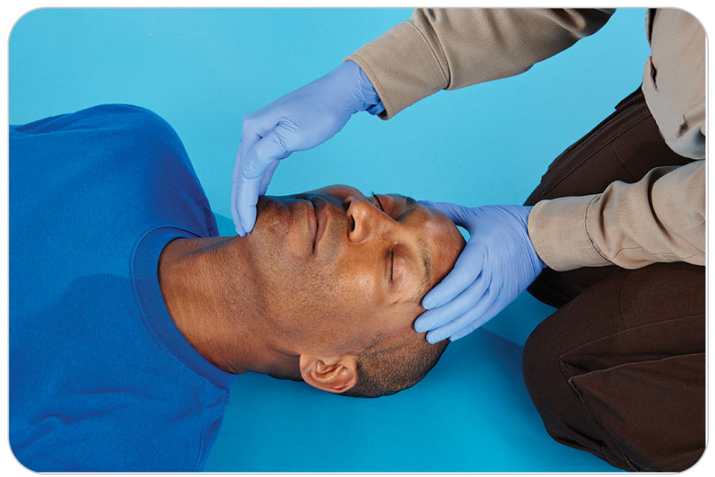
Oxygen Delivery Devices: Bag-Valve Mask
9-11
Bag-Valve Mask (BVM)
A BVM is a ventilation device OEC technicians use for patients who are:
Not breathing
Need assisted ventilation
Are critical
The system consists of:
An oxygen reservoir
A self-expanding squeezable bag (about the size of a football)
A one-way valve
A universal adaptor
A clear flexible face mask

Slide 98
Oxygen Delivery Devices: Bag-Valve Mask
9-11
Mask is typically constructed from silicone.
The reservoir and universal adapter are generally fashioned from plastic.
With the mask in place on the patient, when you squeeze the bag, oxygen (when connected) or just air is delivered to the patient.
BVMs come in three basic sizes: adult, child, and infant.
When the appropriately sized bag is used, the device should automatically deliver the correct volume of oxygen per breath.
The unit should be latex-free.

Slide 99
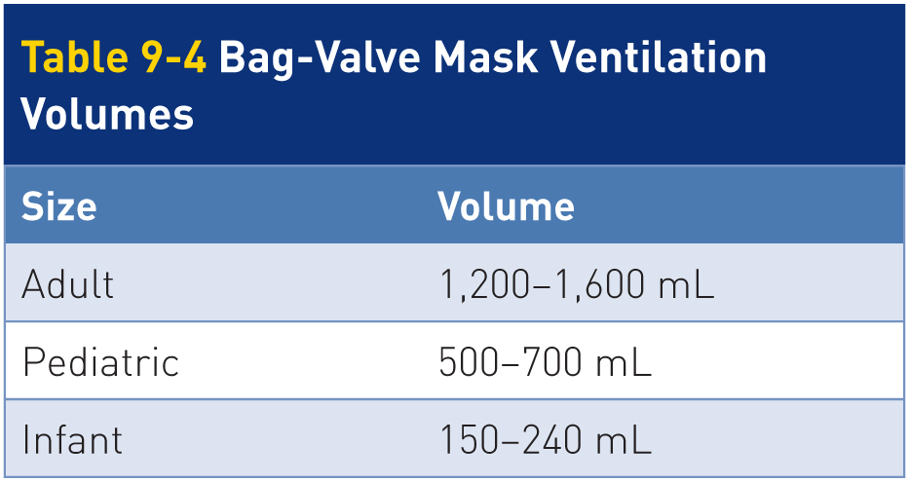
Oxygen Delivery Devices: Bag-Valve Mask
9-11
With an oxygen flow rate of 15 LPM and an adequate mask-to-face seal, a BVM with an oxygen reservoir can deliver nearly 100% oxygen.
The volume delivered also can vary, depending on bag size and depth of ventilation.

Slide 100
Oxygen Delivery Devices: Bag-Valve Ventilations
9-11
One-Person BVM Ventilation
The one-person BVM technique should be used only when other rescuers are not available to assist.
If two rescuers are available, use the two-rescuer method.
Properly sized oral or nasal airway should be inserted into the unresponsive patient before using a BVM.
Help keep the airway open when assisting with ventilation

Slide 101
Oxygen Delivery Devices: Bag-Valve Mask
9-11
First assemble the system.
Fully expand the bag.
Connect the reservoir.
If available, connect oxygen and set the flow rate to 15 LPM.
The reservoir should begin to fill immediately.
Attach the universal, L-shaped adapter to the other end of the bag.
Connect the face mask to the universal adapter.

Slide 102
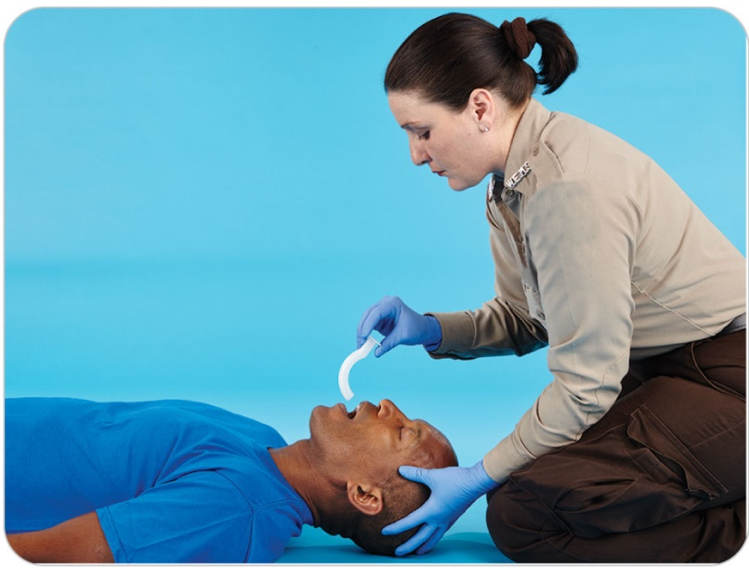
Oxygen Delivery Devices: Bag-Valve Mask
9-11
To perform one-rescuer BVM ventilation, follow these steps:
Kneel next to the top of the patient’s head.
Open the patient’s mouth (head tilt–chin lift or jaw-thrust maneuver).
Suction as necessary to clear secretions.
Insert an oral or nasal airway.

Slide 103
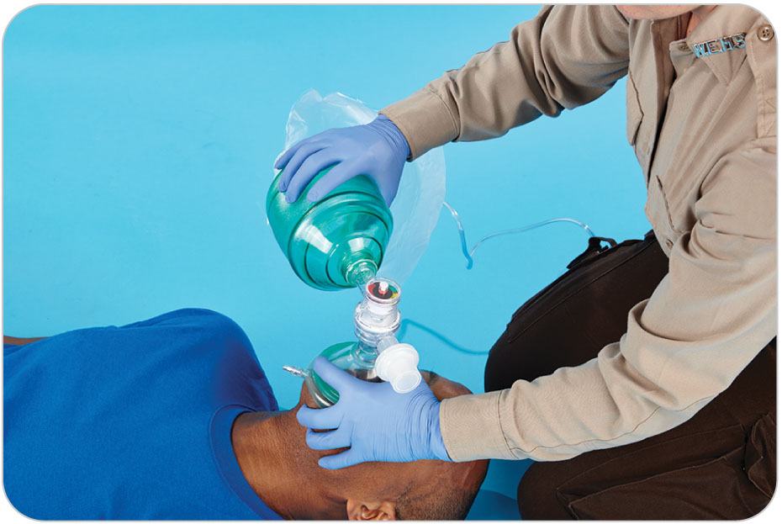
Oxygen Delivery Devices: Bag-Valve Mask
9-11
Select the appropriate mask and position it properly on the patient’s face.
Place the mask on the patient’s face with the apex (top) over the bridge of the patient’s nose.
The base fits in the groove between the patient’s lower lip and chin.
With your nondominant hand, place your thumb on the mask over the bridge of the patient’s nose and your index finger on the mask over the patient’s lower lip.
Forming a “C” shape around the mask-valve opening

Slide 104
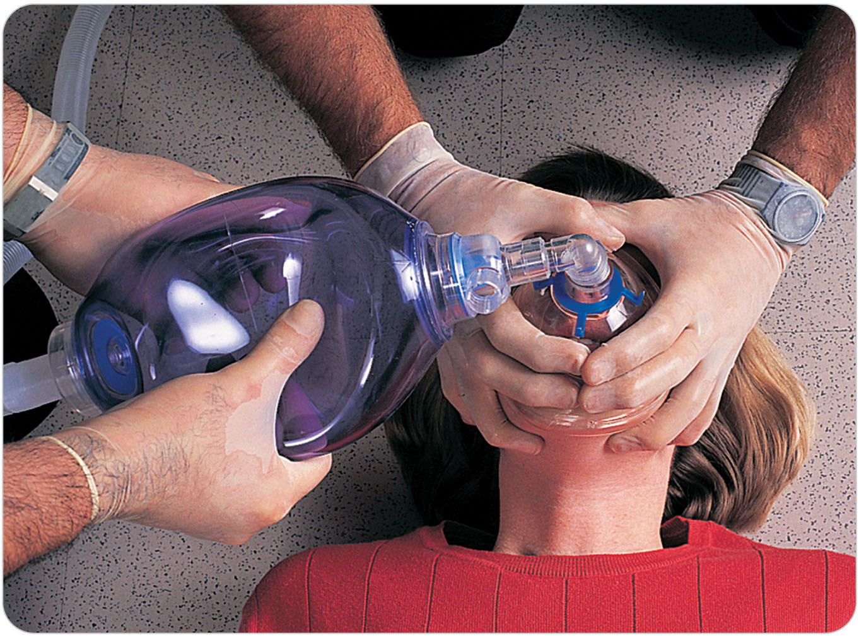
Oxygen Delivery Devices: Bag-Valve Mask
9-11
With your little, ring, and middle fingers, grasp the underside of the patient’s mandible.
Pull upward with your fingers on the jaw, opening the airway.
To form a tight seal, the mandible should be pulled up toward the mask rather than the mask being pushed onto the patient’s face.
With your dominant hand, compress the bag, watching for chest rise to deliver a breath.
If you become tired, reverse your hands.

Slide 105
Oxygen Delivery Devices: Bag-Valve Mask
9-11
Two-Person BVM Ventilation
To perform two-person BVM ventilations, follow these steps:
Rescuer 1 (holds the mask):
Kneel to the side of the patient’s head.
Place the mask onto the patient’s face as described previously in the one-person BVM technique.
Place your thumbs alongside the edges of the mask. The thumbs and the padded portions of the palm at the base of each thumb should be in contact with the mask.
Using the middle, ring, and little fingers of each hand, grasp the underside of the mandible and pull upward, opening the airway.
As before, the mandible should be pulled up toward the mask.

Slide 106
Oxygen Delivery Devices: Bag-Valve Mask
9-11
Rescuer 2 (bagger):
Kneel beside Rescuer 1, near the top of the patient’s head.
Squeeze the bag with both hands while watching for chest rise.

Slide 107
Pulse Oximetry

Slide 108
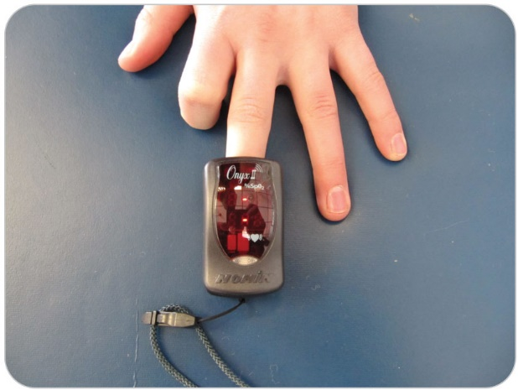
Pulse Oximetry
9-12
A pulse oximeter is a noninvasive device that evaluates oxygenation at the tissue level.
By measuring oxygen saturation of hemoglobin in red blood cells
Has a photoelectric sensing probe and a monitor
Probe is clipped onto a finger, toe, or earlobe, measuring the oxygenation of the blood in the capillaries.

Slide 109
Pulse Oximetry
9-12
The “pulse ox” gives a reading of % O2 saturation, or O2 sat.
Normal oxygen saturation is between 94% and 99%, when a person is breathing room air normally at sea level.
Patients with an oxygen saturation less than 94% generally require treatment.
Unless they have a chronic condition that causes perpetually low oxygen saturations
Some people with chronic lung disease may have lower normal levels than this.
After placing a patient on high-flow oxygen (15 LPM), adjust the flow, keeping the patient’s oxygen saturation between 94% and 99%.

Slide 110
Pulse Oximetry
9-12
Like other diagnostic instruments, not foolproof
Should not be used as the sole method of assessing oxygenation
False readings can occur.
Factors that can cause false readings include:
Nail polish
Cold weather
Shock
Carbon monoxide poisoning
A low red blood cell count
Device malfunction
Clinical assessment of the patient generally is more reliable than a pulse oximeter.

Slide 111
Gastric Distention

Slide 112
Gastric Distention
9-13
Whenever artificial ventilations are provided, the patient’s stomach can fill with air.
Causing abdominal bloating known as gastric distention
Occurs when the amount of pressure pushing air or oxygen into the upper airway exceeds the pressure keeping the opening of the esophagus closed
Causing gas to be directed down the esophagus and into the stomach
Partial or total obstruction of the upper airway can also cause gastric distention to occur.

Slide 113
Gastric Distention
9-13
Condition is more common in children than in adults.
Can be prevented by administering slow, gentle breaths
Do not overventilate the patient by squeezing the bag too fast.
CPR teaches to ventilate at a controlled rate.
Chest should rise and fall as if the patient were breathing in a normal fashion.

Slide 114
Gastric Distention
9-13
If the stomach becomes distended, make sure the airway is open.
Do not push on a distended stomach.
The result is nearly always vomiting, which can lead to aspiration of the vomit.
If the patient does vomit, place the patient on his or her side in the recovery position, suction the airway, and then resume rescue breathing.

Slide 115
Case Study

Slide 116
CASE PRESENTATION
While bike patrolling, you and your partner find a middle-aged bicyclist with a pulse who is not breathing and is unresponsive to painful stimuli. It appears that he fell over a cliff approximately 20 feet from a mountain bike path, striking his head and neck on a rocky outcrop. You note minor bleeding coming from the patient’s mouth as well as a deep cut on his chin.
His pulse is rapid at 108 beats per minute. The cyclist’s left arm appears bent at an unnatural angle. You radio for help, equipment, oxygen, and ALS transport.
What should you do?

Slide 117
CASE UPDATE
Your partner immediately performs a jaw-thrust maneuver to open the unresponsive patient’s airway. The patient begins breathing. As your partner protects the patient’s spine, you carefully roll the patient onto his left side in the recovery position to allow blood to flow out of the airway. Noting several broken teeth in the patient’s airway, you perform a finger sweep to remove the debris. Upon arrival of a suction device, you suction out the airway. Although the patient’s pulse is strong, his respirations are becoming increasingly shallow and erratic. His lips are cyanotic.
What should you do now?

Slide 118
CASE OUTCOME
As other providers and equipment arrive, you request another OEC technician to assist you in two-person ventilation using a BVM attached to oxygen, and you suction the patient as needed. The patient’s arm is splinted. Continuing to immobilize the patient’s head and spine, you and the other providers place the patient onto a stretcher and transport him to a waiting ambulance. Later you learn the patient had a severe head injury. The doctor who treated the patient credits your team for effective airway management.

Slide 119
OEC Skill Activities

Slide 120
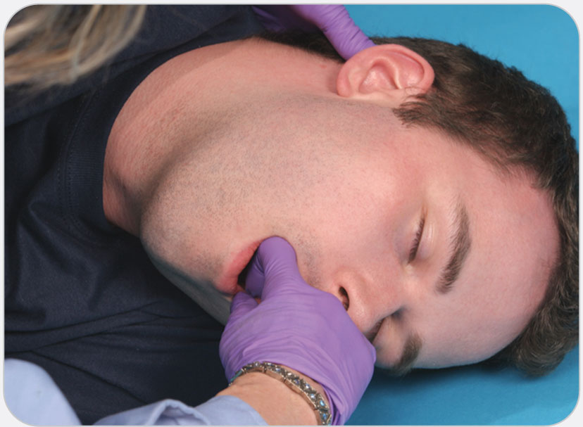
OEC Skill 9-1: Performing the Finger Sweep
1. Follow standard precautions.

Slide 121
OEC Skill 9-1: Performing the Finger Sweep
2. Open the unresponsive patient’s mouth using the cross-finger technique.

Slide 122
OEC Skill 9-1: Performing the Finger Sweep
3. Insert your gloved index finger into the patient’s mouth so the tip of your finger is behind or beneath the foreign object. (Be careful not to push the foreign object farther into the airway.)

Slide 123
OEC Skill 9-1: Performing the Finger Sweep
4. Curve your finger into a hook and remove the object. (You may need to repeat this technique more than once to completely clear the airway.)

Slide 124
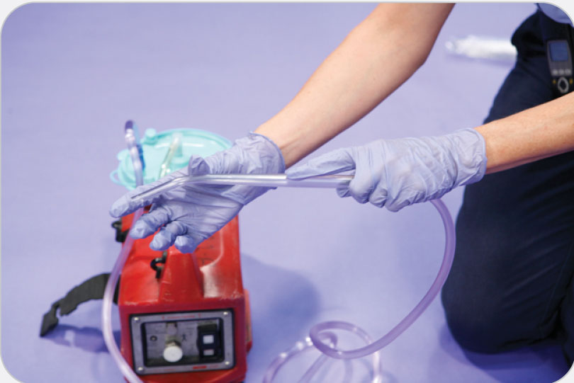
OEC Skill 9-2: Suctioning a Patient’s Airway
1. Make sure the suctioning unit is properly assembled and turned on. Clamp the tubing, and make sure the unit generates a vacuum of more than 300 mm Hg.

Slide 125
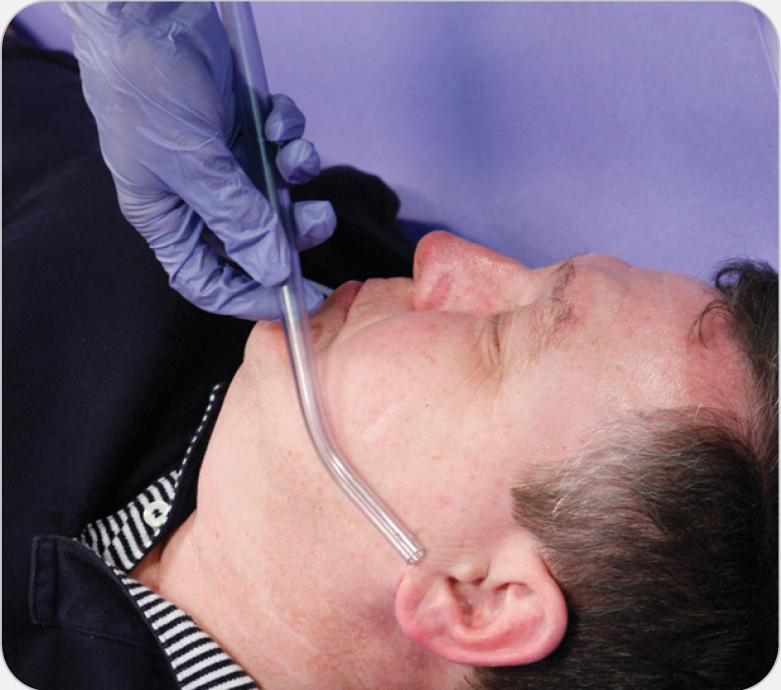
OEC Skill 9-2: Suctioning a Patient’s Airway
2. Measure the catheter from the corner of the mouth to the earlobe or angle of the jaw.

Slide 126
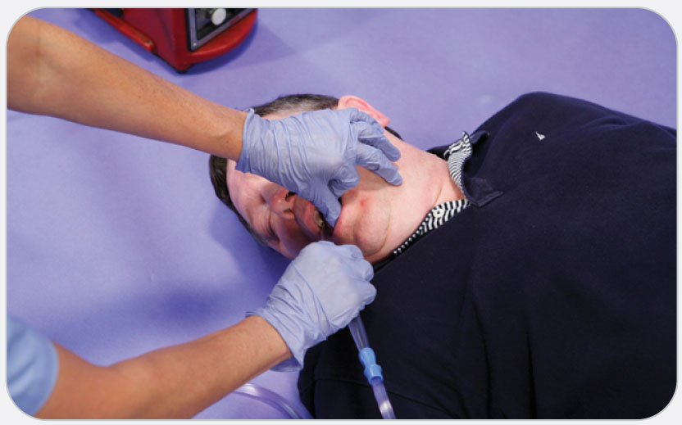
OEC Skill 9-2: Suctioning a Patient’s Airway
3. Turn the patient’s head to the side (unless you suspect cervical spine injury), open the mouth using the cross-finger technique, and insert the catheter to the predetermined depth without suctioning.

Slide 127
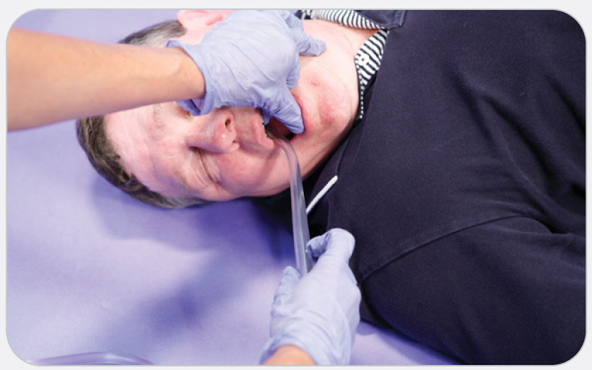
OEC Skill 9-2: Suctioning a Patient’s Airway
4. Apply suction in a circular motion as you withdraw the catheter. Do not suction an adult for more than 15 sections, a child for more than 10 seconds, and an infant for more than 5 seconds.

Slide 128
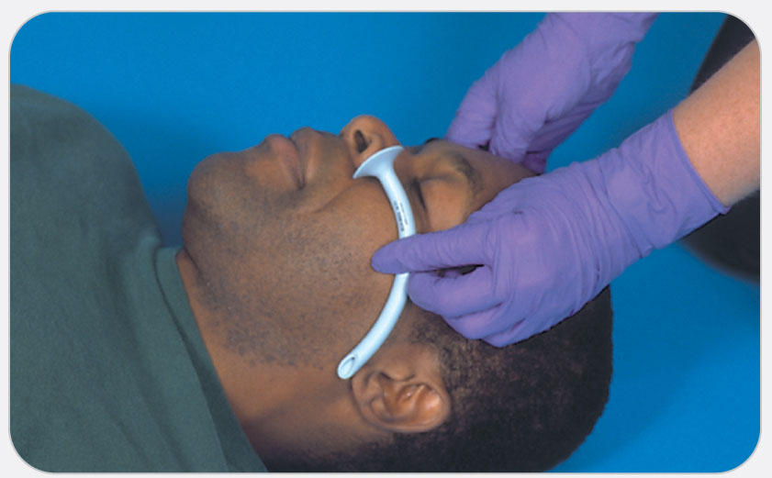
OEC Skill 9-3: Inserting a Nasopharyngeal Airway
1. S Size the device. NPAs come in a variety of sizes. To be effective, the device must be sized appropriately. A tube that is too small may become blocked by the tongue, whereas a tube that is too large may enter the esophagus or stimulate the patient’s gag reflex. To size an NPA, hold the tube against the side of the patient’s face. The flange should rest against the nostril, the end should just touch the patient’s lower earlobe on the same side of the face, and the outside of the tube should be slightly smaller than the nostril into which it will be placed.

Slide 129
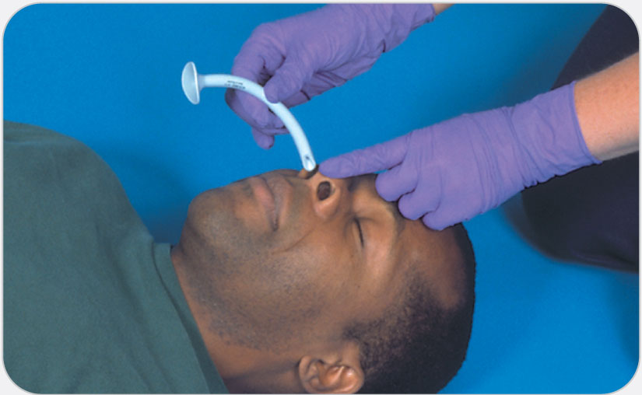
OEC Skill 9-3: Inserting a Nasopharyngeal Airway
2. L Lubricate the adjunct. Apply a small amount of water-based lubricant along the entire length of the NPA tube. Be careful not to apply too much lubricant, which could aggravate an existing airway problem. The goal is to provide a slippery surface so the tube can slide gently into position as shown.

Slide 130
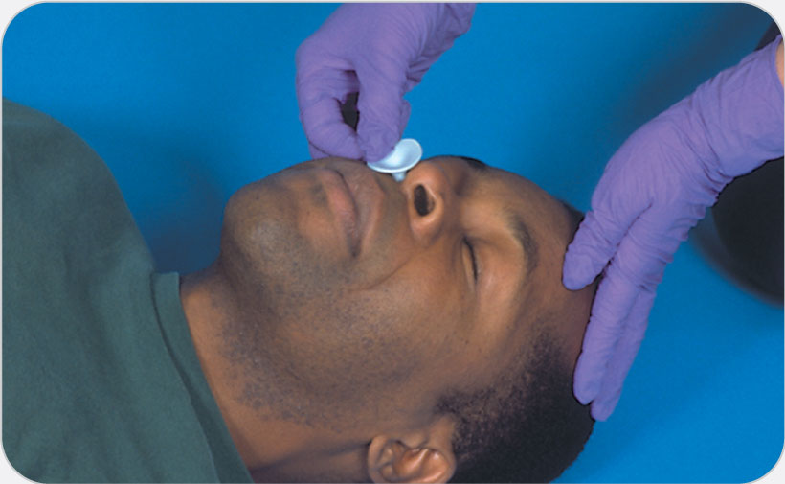
OEC Skill 9-3: Inserting a Nasopharyngeal Airway
3. I Insert the device. Hold the tube between your thumb and first two fingers. Place the bevel side of the tube toward the nasal septum. Gently insert the tube into the nostril while following the curvature of the tube until the flange is flush with the nostril. Do not force the tube into position; doing so can cause a nosebleed, an obstruction, or other injuries. If an obstruction is met, pull the tube back slightly and reinsert, again while rotating the tube between your fingers. Properly placed, the curvature of the tube will follow the natural curve of the nasal passage and lie in the distal portion of the nasopharynx directly above the larynx.

Slide 131
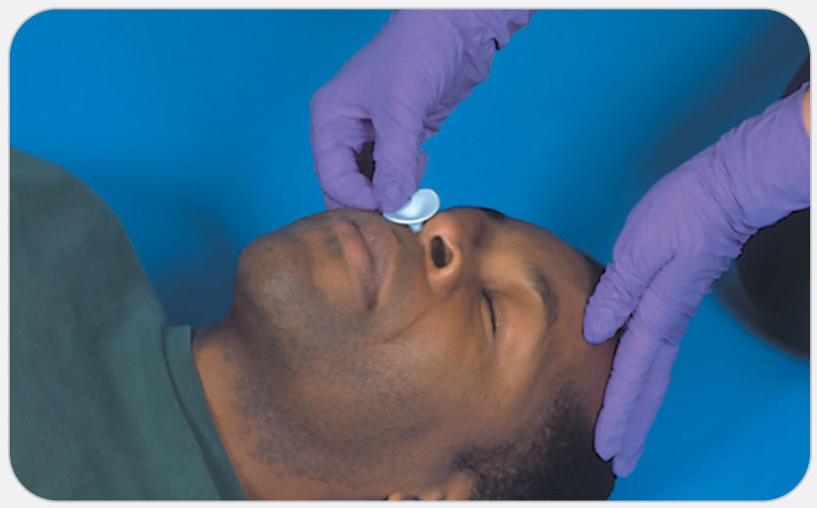
OEC Skill 9-3: Inserting a Nasopharyngeal Airway
4. C Check the device. Confirm proper placement of the tube by listening to the patient breathe. You should be able to hear or feel air movement through the tube. If no air is detected, check to see if the patient is still breathing. If the patient is not, assist the patient’s ventilations. If the patient is breathing, the tube may be obstructed, may need to be repositioned, or may need to be removed and resized. Rarely, foreign material inside the nose can obstruct the opening of the NPA.

Slide 132
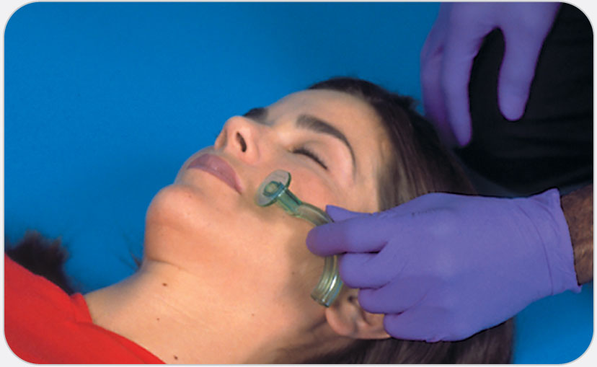
OEC Skill 9-4: Inserting an Oropharyngeal Airway
1. To properly size an OPA, hold the adjunct against the side of the patient’s face with the flange adjacent to the corner of the patient’s mouth. The tip of the adjunct should touch the angle of the jaw on the same side of the face; alternatively, measure from the corner of the mouth to the earlobe on the same side of the face.

Slide 133
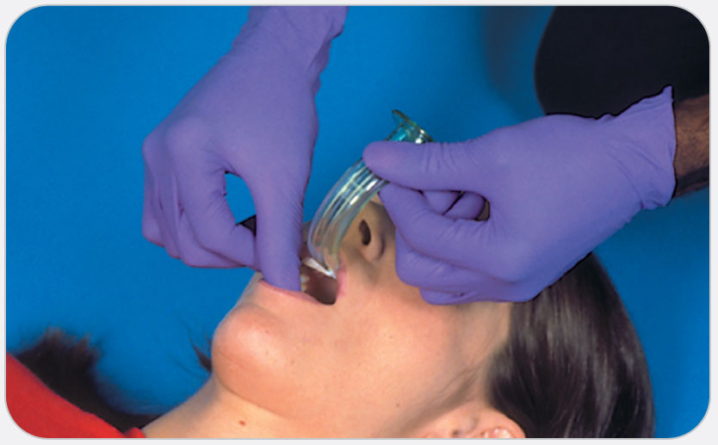
OEC Skill 9-4: Inserting an Oropharyngeal Airway
2. To insert an OPA, open the patient’s mouth using the cross-finger technique or push down on the chin. Insert the OPA, with the tip pointed up toward the roof of the mouth, until it is halfway into the mouth.

Slide 134
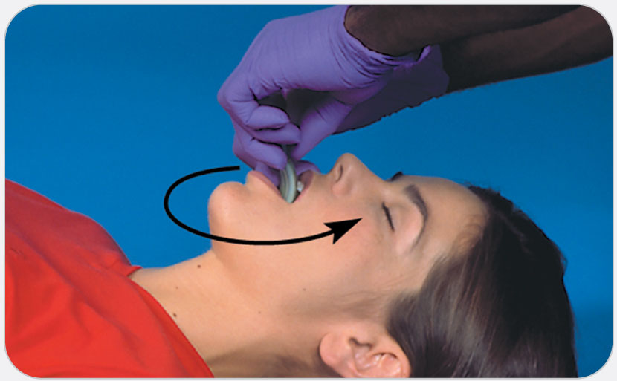
OEC Skill 9-4: Inserting an Oropharyngeal Airway
3. Rotate the adjunct 180 degrees so the tip faces toward the patient’s tongue. The tongue should now lie along the curve of the OPA, and the external flange should rest against the patient’s lips. In children, the device is not rotated 180 degrees before insertion. The tip is pointed toward the tongue, not the roof of the mouth when inserted.

Slide 135
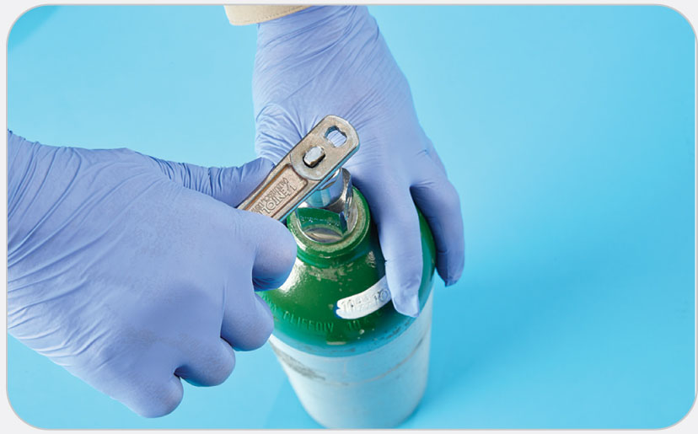
OEC Skill 9-5: Placing an Oxygen Cylinder into Service
1. Using an oxygen wrench, turn the valve counterclockwise to slowly “crack” the cylinder.

Slide 136
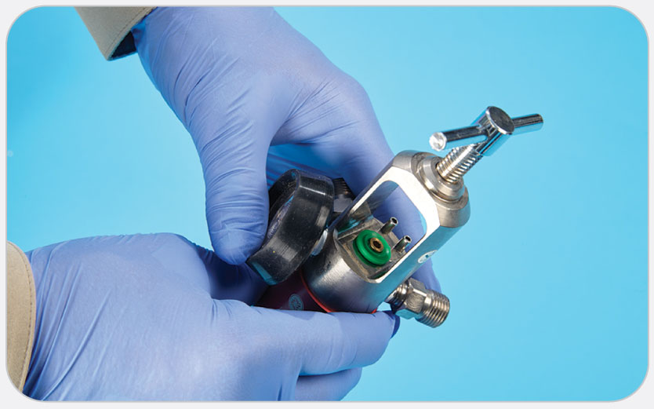
OEC Skill 9-5: Placing an Oxygen Cylinder into Service
2. Attach the regulator/flowmeter to the valve stem using the two pin-indexing holes and make sure that the washer is in place over the larger hole.

Slide 137
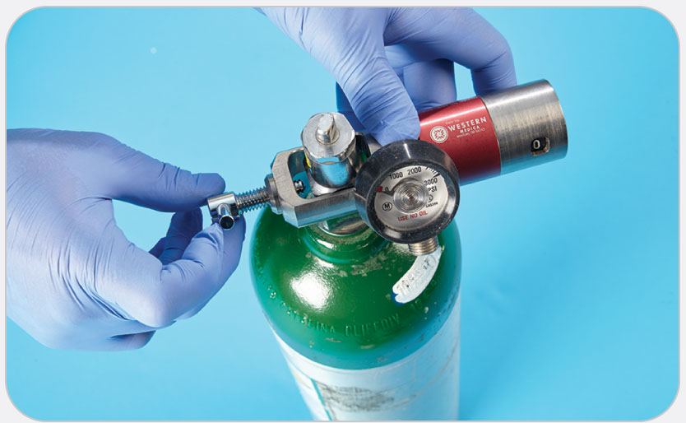
OEC Skill 9-5: Placing an Oxygen Cylinder into Service
3. Align the regulator so that the pins fit snugly into the correct holes on the valve stem, and hand tighten the regulator.

Slide 138
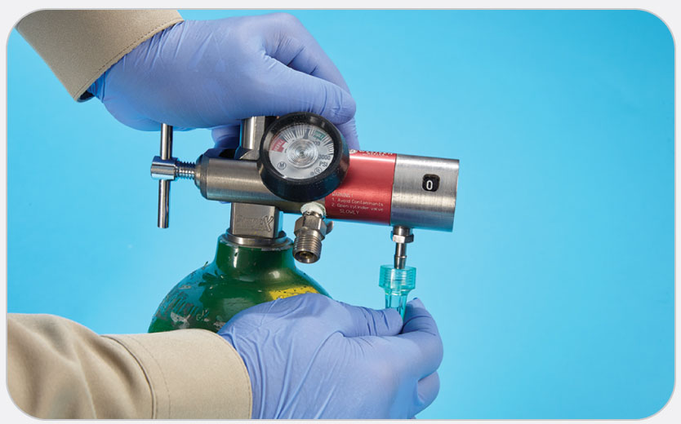
OEC Skill 9-5: Placing an Oxygen Cylinder into Service
4. Attach the oxygen connective tubing to the flowmeter.

